Slide 1
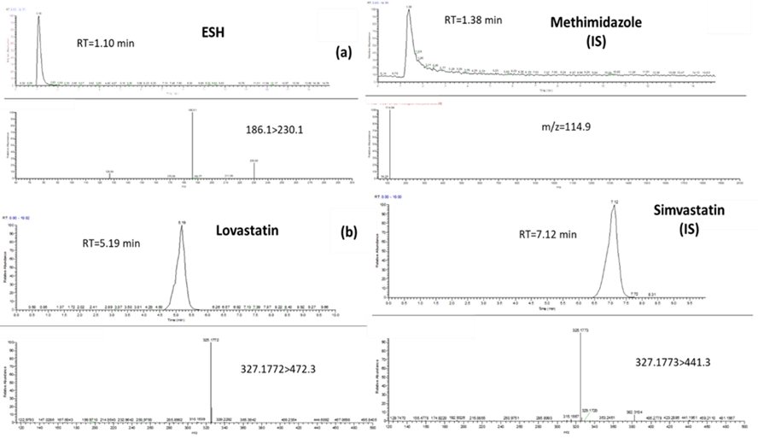

On the identification and quantification of ergothioneine and lovastatin in mushroom species: A comparison between different analytical approaches
Konstantinos Tsiantas¹, Thalia Tsiaka¹, Georgios Koutrotsios², Panagiotis Zoumpoulakis^{3*}, Georgios I. Zervakis^{2*}
¹Institute of Chemical Biology, National Hellenic Research Foundation, 48, Vas. Constantinou Ave., 11635 Athens, Greece; kostastsiant@Hotmail.gr; thtsiaka@eie.gr ²Laboratory of General and Agricultural Microbiology, Department of Crop Science, Agricultural University of Athens, 11855 Athens, Greece; georgioskoutrotsios@gmail.gr, ³Laboratory of Chemistry, Analysis & Design of Food Processes, Department of Food Science and Technology, University of West Attica, Ag. Spyridonos, 12243 Egaleo, Greece; *Correspondence: pzoump@uniwa.gr, zervakis@aua.gr
1. Introduction
Mushrooms are considered to be one of the main sources of health promoting bioactive compounds, such as ergothioneine (ESH) and lovastatin (LOV). In the present project we aim to evaluate the content of ergothioneine and lovastatin in different types of mushrooms (A. Bisporus, P. Ostreatus, P. Citrinopileatus) as well as that of Pleurotus Citrinopileatus cultivated in substrates from winery (Grape Marc, GM) and olive oil (OL) by – products using liquid chromatography mass spectrometry (LC-MS) and Ultraviolent- Visible Spectroscopy (UV-Vis).
2. Materials and Methods
ESH
100mg mushroom powder
+ 10mL meOH:$H_{2}O$
Vigorous Shaking (20 min)
Centrifugation
(20min for ESH/30min for Lov at 3650 rcf, 25ºC)
+
Solvent removal
(Nitrogen pump/Freeze drying)
Extraction
4:1 (% v/v)
LOV
400mg mushroom powder
+ 4mL ACN
Hard Shaking
(2hours)
UV-Vis analysis
Dual Beam UV-1900 spectrophotometer (Shimadzu)
Ergothioneine Lovastatin
LC-MS Analysis
3 D quadrupole
Ion trap LCQ FLEET
Analysis
1
2
3. Results
LTQ Orbitrap
Velos
Table 1: Validation parameters of the two LC-MS methods
Table 2: ESH-LOV content in conventional cultivated mushrooms (Wheat Straw, Control) using UV-Vis and LC-MS
Analytical figures of merit | ESH | LOV
Concentration range (μg mL⁻¹) | 0.05 – 45 | 0.001 – 1
Slope (a) (±sa) | 0.0307 (±0.00023) | 35.47 (±0.18)
Intercept (b) (±sb) | 0.0012 (±0.0051) | 0.090 (±0.065)
R² | 0.9993 | 0.9998
LOD (μg mL⁻¹) | 0.02 | 0.00039
LOQ (μg mL⁻¹) | 0.06 | 0.0012
Accuracy (%) | 102,95 | 105.17
Intra-Day Precision (n=3, % RSD) | 2.0 | 4.91
Inter-Day Precision (N=3) | 1.9 | 3.21
Extraction Recoveries (%) | 80% | 75%
Method | Ergothioneine Content (mg/ kg dry sample)ª (n=3)
 | Agaricus | Ostreatus | P. Citrinopileatus – WS
UV – Vis | 7100 (±300)B | 9200 (± 800)A | 8300 (±1100)A
LC – MS | 521.2 (±14.7)C | 607.3 (±11.2)B | 822.1 (±20.6)A
Method | Lovastatin Content (mg/ g dry sample)ª (n=3)
UV – VIS | 1050 (±80)A | 930 (±100)A | 840 (±250)A
LC-MS | 1.39 (±0.014)A | 1.11 (±0.042)B | 0.158 (±0.05)C
¹ N: The number of consecutive days required for inter – day precision determination; ² n: the number of QC replicates
ª Each value is expressed as mean ± standard error (n=3). Means with different letters within a line are significantly different (P < 0.05)
Table 3: ESH-LOV content in alternative cultivated mushrooms (Grape Marcs, GM and olive oil by-products, OL) using UV-Vis and LC-MS
Method | Ergothioneine Content (mg/ kg dry sample)ª (n=3)
 | WS | GM | OL
UV – Vis | 8300 (±1100)A | 11800 (±1400)A | 6700 (±1100)A
LC – MS | 822.1 (±20.6)A | 637.2 (±24.5)B | 884.5 (±20.0)A
Method | Lovastatin Content (mg/ g dry sample)ª (n=3)
UV – Vis | 840 (±250)A | 860 (±180)A | 904 (±0.241)A
LC-MS | 0.158 (±0.05)B | 0.218 (±0.014)A | 0.161 (±0.009)B
ª Each value is expressed as mean ± standard error (n=3). Means with different letters within a line are significantly different (P < 0.05)
Figure 1. Representative chromatographs and mass spectra of (a) ergothioneine – methimidazole and (b) lovastatin – simvastatin standard solutions.
4. Conclusion
The use of UV – Vis method was hindered due to co-absorbance of different constituents.
LC – MS/MS methodologies were developed, optimized and validated having (a) shorter analysis time and (b) higher resolution
Pleurotus genus and especially, P. Citrinopileatus contained higher amounts of ergothioneine than A. Bisporus.
Agaricus Bisporus contained higher amounts of lovastatin than P. Ostreatus and especially from P. Citrinopileatus.
Olive oil (OL) and grape marcs (GM) contained the highest amount ergothioneine and lovastatin respectively.
Since by products can affect ergothioneine and lovastatin biosynthetic pathways, a colleration between their bioactive compounds would be an area of investigation.
5. Acknowledgement
This research has been co-financed by the European Union and Greek national funds (European Social Fund—ESF) through the Operational Program Competitiveness, Entrepreneurship and Innovation, under the call RESEARCH-CREATE-INNOVATE (project code: T1EDK-02560).

