Slide 1
Hedwigia ciliata (Hedw.) P. Beauv. moss extracts - Chemical characterization and in vitro testing of immunomodulatory potential
Marija R. Mandić¹, Mariana M. Oalđe², Tanja M. Lunić¹, Aneta D. Sabovljević², Marko S. Sabovljević², Uroš M. Gašić³, Sonja N. Duletić-Laušević², Bojan Dj. Božić^{1*¶}, Biljana Dj. Božić Nedeljković^{1*¶}
¹Institute of Physiology and Biochemistry “Ivan Djaja”, Faculty of Biology, University of Belgrade,Belgrade, Serbia
²Institute of Botany and Botanical Garden "Jevremovac", Faculty of Biology, University of Belgrade, Belgrade, Serbia
³Department of Plant Physiology, Institute for Biological Research “Sinisa Stankovic”, National Institute of Republic of Serbia, University of Belgrade, Belgrade, Serbia
* Corresponding authors
E-mail: bbozic@bio.bg.ac.rs ; biljana@bio.bg.ac.rs
¶These authors contributed equally to this study.

Slide 2
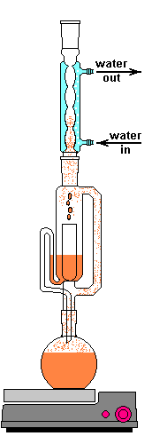
Hedwigia ciliata (Hedw.) P. Beauv. moss extracts - Chemical characterization and in vitro testing of immunomodulatory potential
Samples collection
Serbia
Soxhlet extraction
Chemical characterization
Spectrophotometry
Biological assays
Antitumor activity
Biochemical assays
LC/MS analysis
Antioxidant activity
Antidiabetic activity
Antineurodegenerative activity
Anti-neuroinflammatory activity

Slide 3
Abstract: Owing to structural diversity and potental pharmacological activity, bioactive compounds derived from natural sources are in the focus of intensive exploration. In this study, the chemical composition of moss Hedwigia ciliata P. Beauv. extracts was examined, and further tested for antioxidant, antineurodegenerative, antidiabetic, and antiproliferative activity. The extracts were prepared by Soxhlet extractor using solvents of different polarity. Chemical analysis revealed the presence of phenolics, flavonoids, and triterpenoids. Antioxidant activity of extracts was assessed using DPPH (2,2-diphenyl-1-picrylhydrazyl), total reducing power, and β-carotene/linoleic acid assay. To evaluate the enzyme-inhibitory activity, extracts were screened for α-amylase, α-glucosidase, acetylcholinesterase, and tyrosinase inhibitory effects. The H. ciliata extracts displayed significant antiproliferative activity (~ 50% inhibition) against the MDA-MB-231 (human breast adenocarcinoma) cells. The potential anti-neuroinflammatory activity was observed due to significant reduction of the NO production by LPS-stimulated BV2 (normal murine microglia cell line), being in line with previously recognized antineurodegenerative potential, as measured by the inhibition of acetylcholinesterase and tyrosinase activity. Furthermore, the extracts displayed significant antidiabetic effect via α-glucosidase inhibition. In general, the obtained results suggest the potential immunomodulatory activity of the moss H. ciliata extracts, remaining to be characterized in more detail in search for mechanisms underlying the immunomodulation processes.
Keywords: antidiabetic, antineurodegenerative, antiproliferative, moss extracts

Slide 4
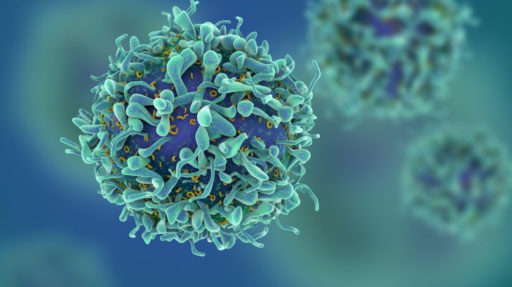
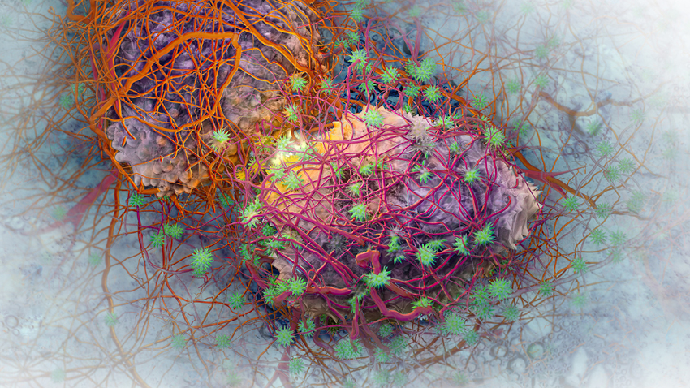
Introduction
As a result of an excessive inflammatory response, various acute and chronic diseases can occur, as well as tumors
The increased rate of tumor diseases has led to an expanding number of studies aimed at prevention, diagnosis, prognosis and therapy
Bioactive compounds act as immunomodulators

Slide 5
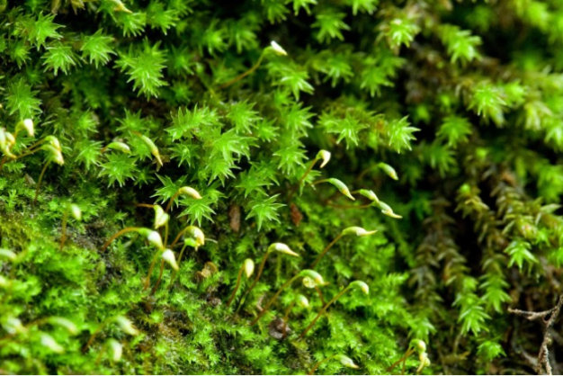
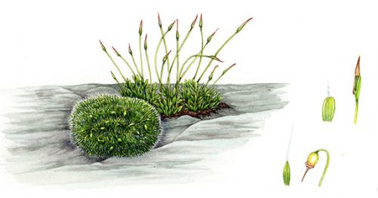
Immunomodulators are present in various plant extracts
Bioactive compounds from natural sources are of great importance because of their potential pharmacological activities and tremendous structural diversity
Some of the currently identified moss secondary metabolites belong to phenolics, flavonoids and terpenoids which are considered to have antioxidative, antiproliferative and anti-inflammatory properties

Slide 6
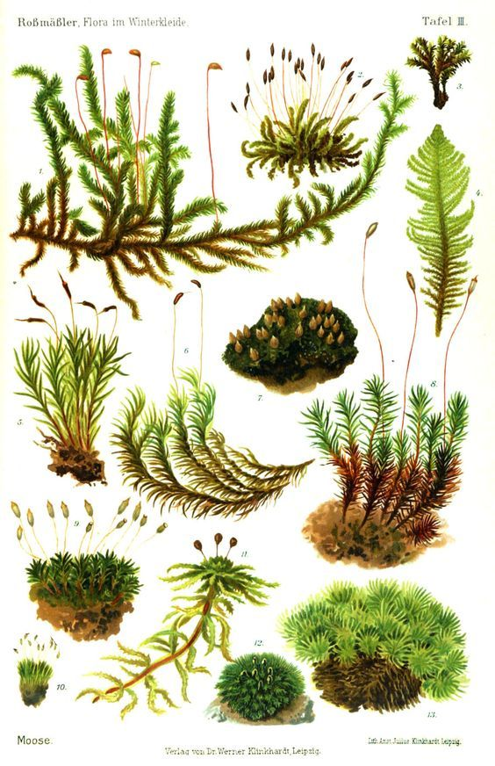
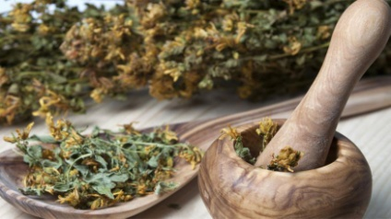
Mosses represent a large group of plants that are widespread in almost every part of the world
one of the oldest plants on the planet
there are about 20,000 species which include:
Anthocerotophyta (hornworts, ~ 300)
Marchantiophyta (liverworts , ~ 6,000)
Briophyta (mosses ~ 14,000)
mosses have been used in traditional medicine since ancient times for the treatment of various pathological conditions

Slide 7
Results and discussion
Chemical characterization of selected secondary metabolite content in extracts of Hedwigia ciliata
Extract | Solvent | Phenols (mg GAE/g extract) | Phenolic acids (mg CAE/g extract) | Flavonols (mg QE/g extract) | Flavonoids (mg QE/g extract) | Triterpenoids (mg UAE/g extract)
E1 | ethanol | 11.46 | 56.33 | <5 | 28.75 | 134.80
E2 | water:ethanol | 16.04 | 57.56 | <5 | 20.60 | 94.38
E3 | ethyl acetate | 14.04 | 151.14 | 15.50 | 49.54 | 79.37

Slide 8
Liquid Chromatography – Mass Spectrometry analysis of moss extracts
 | Ethanol [mg per 100 g weight] | water:ethanol [mg per 100 g weight] | ethyl acetate [mg per 100 g weight]
Gallic acid | 1.48 | 1.16 | 0.49
Protocatechuic acid | 8.11 | 4.01 | 0.83
5-O-Caffeoylquinic acid | 0.12 | 0.08 | 0.02
p-Hydroxybenzoic acid | 6.97 | 9.21 | 0.60
Caffeic acid | 1.04 | 0.51 | 0.08
Quercetin 3-O-rutinoside | 0.87 | 1.29 | 0.03
p-Coumaric acid | 0.99 | 0.42 | 0.26
Quercetin 3-O-glucoside | 0.69 | 0.23 | 0.14
Isorhamnetin 3-O-glucoside | 0.37 | 0.16 | 0.23
Eriodictyol | 0.46 | 0.38 | 0.07
Apigenin | 1.83 | 0.86 | 0.15
Naringenin | 2.42 | 1.09 | 0.07
Kaempferol | 2.45 | 1.00 | 0.10
Acacetin | 0.23 | 0.08 | 0.04

Slide 9
Antioxidant activity - the capacity of the extracts to inhibit lipid peroxidation by measuring the inhibition rate of ß-carotene bleaching (%).
Significant activity was measured for water:ethanol (E2) extracts
p<0.05; different concentrations of extracts vs. * BHT (3,5-di-tert-butyl-4-hydroxytoluene);
# BHA (2-tert-butyl-4-hydroxyanisole);
+ AA (ascorbic acid)

Slide 10
Antidiabetic activity - the effects of extracts against α-glucosidase
All of the tested extracts exhibited inhibitory effect against α-glucosidase with the highest inhibition detected in ethyl acetate extract
* p<0.05 ; different concentrations of extracts vs. acarbose

Slide 11
Antineurodegenerative activity - the effects of extracts towards acetylcholinesterase and tyrosinase
The extracts exhibited inhibitory effects against acetylcholinesterase and tyrosinase, enzymes associated with the development of Alzheimer’s and Parkinson’s disease
* p<0.05; ** p<0.01 different concentrations of extracts vs. standard galantamine / kojic acid

Slide 12
Anti-neuroinflammatory activity towards LPS-stimulated BV2 (microglia) cell line – the effect of extracts on the cell viability in vitro after 24 h of exposure
Cell viability - MTT assay
Extracts increased the viability of LPS-stimulated BV2 cells
** p<0.01 extract vs. LPS-treated cells

Slide 13
Anti-neuroinflammatory activity – the effect of extracts on the reactive oxygen species (ROS) production in vitro after 24 h of exposure
ROS production - NBT assay
The extracts exhibited low antioxidant potential according to their inability to decrease the concentration of ROS
** p<0.01 extract vs. LPS-treated cells

Slide 14
Anti-neuroinflammatory activity – the effect of extracts on the NO production (measured by nitrite level) in vitro after 24 h of exposure
NO production - Griess assay
The extracts reduced the production of NO
** p<0.01 extract vs. LPS-treated cells

Slide 15
Antitumor activity towards MDA-MB-231 (breast cancer) cell line in vitro after 24 h of exposure
Cell viability - MTT assay
This study showed for the first time that extracts of moss H. ciliata exhibited antitumor activity against the MDA-MB-231 cells
All three extracts showed antiproliferative activity, among which water:ethanol and ethyl acetate extracts exhibited the highest activity, inhibiting up to 50% of tumor cells
** p<0.01 extract vs. non-treated control cells

Slide 16
Antitumor activity towards MDA-MB-231 - the effect of investigated extracts on ROS and NO production
ROS production - NBT assay
NO production - Griess assay
**
**
**
All extracts increased ROS and NO production
Potential antitumor agents in the prevention/treatment of breast cancer
** p<0.01 extract vs. non-treated control cells

Slide 17
Conclusions
The chemical characterization of the extracts revealed a wide range of phenolic, flavonoid and triterpenoid compounds as secondary metabolites of high biological activity
The extracts showed biocompatibility towards the normal MRC -5 cell line
The extracts demonstrated the antioxidant activity via β-carotene/linoleic acid assay, as well as an inhibitory effect against α-glucosidase, acetylcholinesterase, and tyrosinase
In this paper is reported for the first time that Hedwigia ciliata moss extracts shows significant antiproliferative activity against MDA-MB-231 cells (~ 50% inhibition)
Anti-inflammatory potential - extracts reduced the production of NO by LPS-stimulated BV2 cells
Different moss extracts could provide entirely new avenues for developing more efficient natural supplements for preventing and treating different inflammatory/degenerative and malignant processes

Slide 18
Acknowledgments
This work was supported by the grant of the Ministry of Education and Science of the Republic of Serbia (Contract numbers: 451-03-68/2020-14/200178 and 451-03-68/2020-14/200007).

