Slide 1
Chemical characterization and immunomodulatory potential of the moss Hypnum cupressiforme Hedw. extracts
Tanja M. Lunić¹, Mariana M. Oalđe², Marija R. Mandić¹, Aneta D. Sabovljević², Marko S. Sabovljević², Uroš M. Gašić³, Sonja N. Duletić-Laušević², Bojan Dj. Božić^{1*#}, Biljana Dj. Božić Nedeljković^{1*#}
¹ Institute of Physiology and Biochemistry “Ivan Djaja”, Faculty of Biology, University of Belgrade, 11000 Belgrade, Serbia;
² Institute of Botany and Botanical Garden “Jevremovac”, Faculty of Biology, University of Belgrade, 11000 Belgrade, Serbia.
³ Department of Plant Physiology, Institute for Biological Research “Sinisa Stankovic”, National Institute of Republic of Serbia, University of Belgrade, 11060 Belgrade, Serbia
*Corresponding authors: bbozic@bio.bg.ac.rs; biljana@bio.bg.ac.rs
#These authors contributed equally to this study

Slide 2
Chemical characterization and immunomodulatory potential of the moss Hypnum cupressiforme Hedw. extracts
Graphical abstract

Slide 3
Abstract:
This study aimed to examine the chemical composition and immunomodulatory potential of the moss Hypnum cupressiforme Hedw. extracts. The corresponding extracts were obtained utilizing Soxhlet extractor and further characterized by spectrophotometric assays and liquid chromatography coupled to mass spectrometry (LC-MS). The antioxidant activity was determined by 2,2-diphenyl-1-picrylhydrazyl (DPPH), total reduction power, and β-carotene bleaching assays. The inhibitory activities on α-glucosidase, α-amylase, acetylcholinesterase, and tyrosinase were tested for potential antidiabetic and antineurodegenerative activity. Additionally, biocompatibility, antitumor, and anti-inflammatory potential were tested on MRC-5, HCT-116, MDA-MB-231, and BV2 cells, respectively.
Major compounds identified by LC-MS in H. cupressiforme extracts were kaempferol and five phenolic acids: p-hydroxybenzoic, protocatechuic, p-coumaric, gallic, and caffeic acid. Biochemical assays revealed the significant immunomodulatory potential of examined extracts. Moreover, significant antiproliferative potential against human breast cancer cells – MDA-MB-231 (inhibitory rate up to 50%) and acceptable biocompatibility were observed. Also, a significant decrease in NO production, observed in lipopolysaccharide-stimulated BV2 cells, implies potential anti-neuroinflammatory application. Obtained results qualify the moss H. cupressiforme as a highly promising candidate for more detailed examination and also putative therapeutical application.
Keywords: Hypnum cupressiforme; antioxidant; antidiabetic; anti-neuroinflammatory/antineurodegenerative; antitumor activity

Slide 4
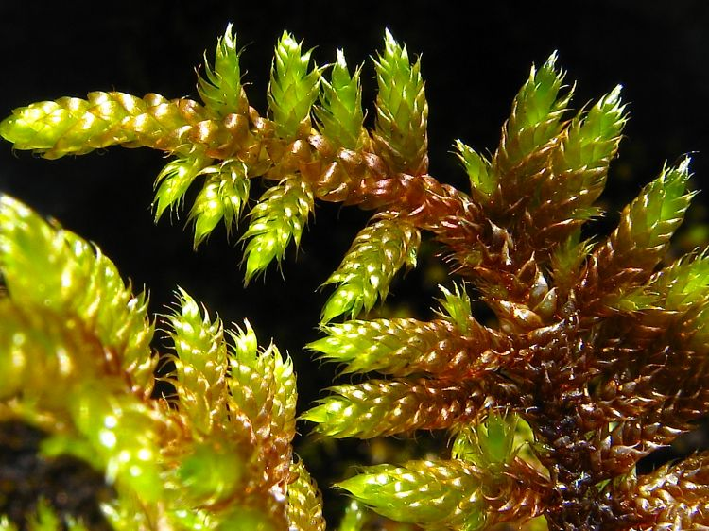
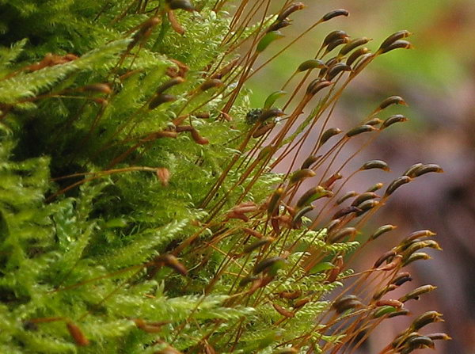
Introduction – Hypnum cupressiforme
Mosses belong to the second largest group of higher plants – bryophytes
These plants are recognized as promising sources of novel biologically active compounds
Hypnum cupressiforme Hedw. is a common moss species found in a variety of habitats
Studies have reported good antimicrobial, antioxidant, and antiproliferative potential of this moss

Slide 5
Chemical composition of mosses
Moss phytochemistry has been overlooked in the past
Secondary metabolites found in bryophytes can be divided into two main groups – polyphenols and lipids
The majority of secondary metabolites from mosses belong to flavonoids, terpenoids, and bibenzyls
Diverse biological activities of these metabolites: cytotoxicity, antimicrobial, antifungal, antitumor, antioxidant, anti-inflammatory, antidiabetic, and many other

Slide 6
The aim of this study
1. Extraction of biologically active compounds from H. cupressiforme
2. Chemical characterization of the obtained moss extracts
3. Evaluation of potential biological activities of the extracts
Antioxidant activity
Antitumor activity
Antidiabetic activity
Antineurodegenerative/
anti-neuroinflammatory
activity

Slide 7
Extracts chemical characterization
Extraction yield for Hypnum cupressiforme moss extracts
 | Solvent | Moss weight (g) | Extract weight (g) | Yield (%)
E1 | Ethanol (96%) | 10 | 0.42 | 4.2
E2 | Water-ethanol (1:1, vol%) | 10 | 0.80 | 8.0
E3 | Ethyl-acetate | 10 | 0.06 | 0.6
E4 | Water | 7.6 | 2.00 | 26.3
Chemical characterization of moss Hypnum cupressiforme extracts
 | TPC (mg GAE/g extract) | TPAC (mg CAE/g extract) | TFC (mg QE/g extract) | TFlC (mg QE/g extract) | TTC (mg UAE/g extract)
E1 (Ethanol) | 6.25 ± 0.48 | 67.41 ± 6.97 | 35.00 ± 1.34 | ND¹ | 88.37 ± 1.55
E2 (Water–ethanol) | 7.38 ± 0.34 | 7.08 ± 2.36 | 12.43 ± 0.49 | ND | 75.93 ± 2.97
E3 (Ethyl-acetate) | 15.33 ± 0.95 | 339.93 ± 14.03 | 58.86 ± 2.82 | 14.11 ± 1.33 | 235.95 ± 4.09
E4 (Water) | 18.21 ± 0.73 | 8.31 ± 3.48 | 2.04 ± 0.29 | ND | 43.33 ± 0.86
CAE – caffeic acid equivalents; GAE – gallic acid equivalents; ND – not detected; QE – quercetin equivalents; TPAC – total phenolic acid content; TFC – total flavonoid content; TFlC – total flavonol content; TPC – total phenolic content; TTC – total triterpenoid content; UAE – ursolic acid equivalents

Slide 8
Extracts chemical characterization
LC-MS analysis of the investigated Hypnum cupressiforme extracts
mg/100 g extract | E1 (Ethanol) | E2 (Water-ethanol) | E3 (Ethyl-acetate) | E4 (Water)
Gallic acid | 0.62 | 0.70 | 0.50 | 1.21
Protocatechuic acid | 3.75 | 2.89 | 2.39 | 3.91
5-O-Caffeoylquinic acid | 0.14 | 0.07 | 0.02 | 0.04
p-Hydroxybenzoic acid | 4.56 | 3.17 | 5.78 | 4.62
Caffeic acid | 0.65 | 0.42 | 0.13 | 1.10
Quercetin 3-O-rutinoside | 0.09 | 0.06 | 0.01 | 0.03
p-Coumaric acid | 2.60 | 2.33 | 0.46 | 4.40
Quercetin 3-O-glucoside | 0.27 | 0.21 | 0.02 | 0.04
Isorhamnetin 3-O-glucoside | 0.12 | 0.06 | 0.02 | 0.04
Eriodictyol | 0.13 | 0.11 | 0.05 | 0.07
Apigenin | 0.51 | 0.47 | 0.11 | 0.11
Naringenin | 0.57 | 0.62 | 0.12 | 0.08
Kaempferol | 7.35 | 6.60 | 0.21 | 0.47
Acacetin | 0.21 | 0.15 | 0.09 | 0.02

Slide 9
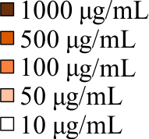
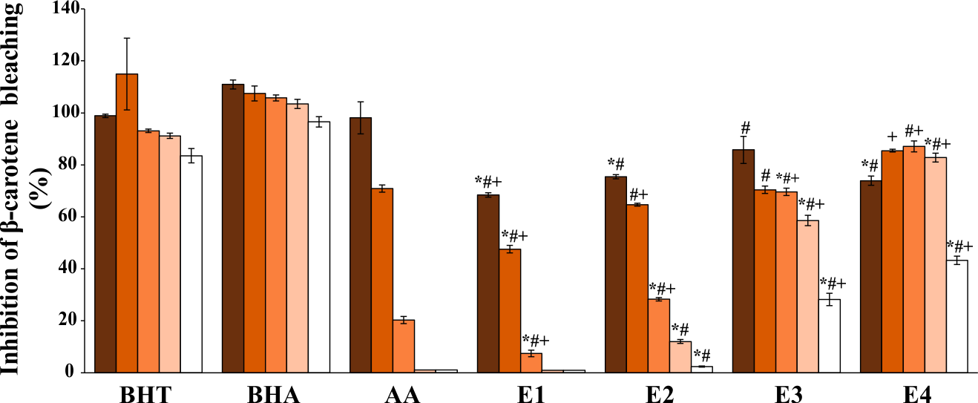
Antioxidant activity
#,+,*p<0.05 different moss extracts vs. different standard substances.
Symbols *, #, + were used for standards BHT, BHA, and AA (ascorbic acid), respectively
Significant antioxidant activity obtained for ethyl-acetate and aqueous extracts (E3 and E4) in the β-carotene bleaching test

Slide 10
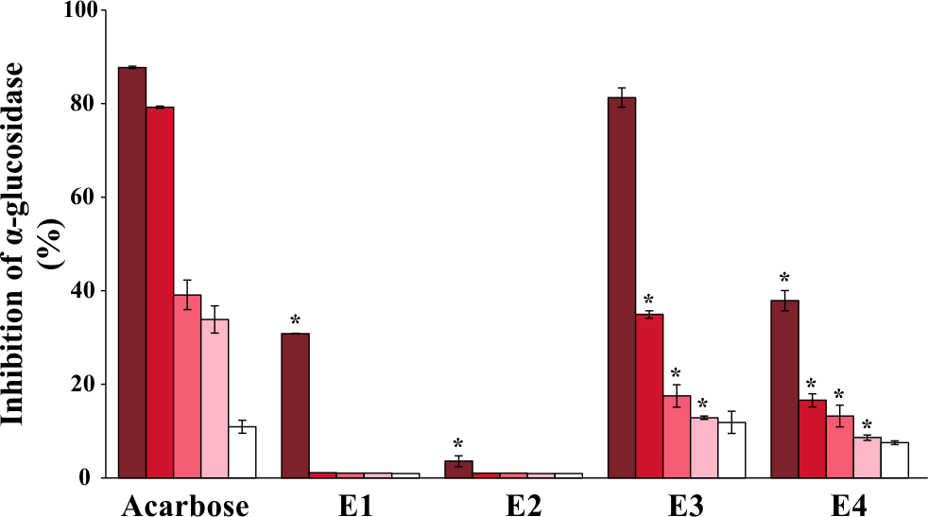
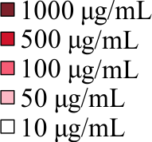
Antidiabetic activity
*p<0.05 standard vs. different moss extracts
Significant inhibitory effect of ethyl-acetate and aqueous extracts (E3 and E4) on carbohydrate hydrolyzing enzyme α-glucosidase
Potential adjuvant therapy to delay postprandial hyperglycemia

Slide 11
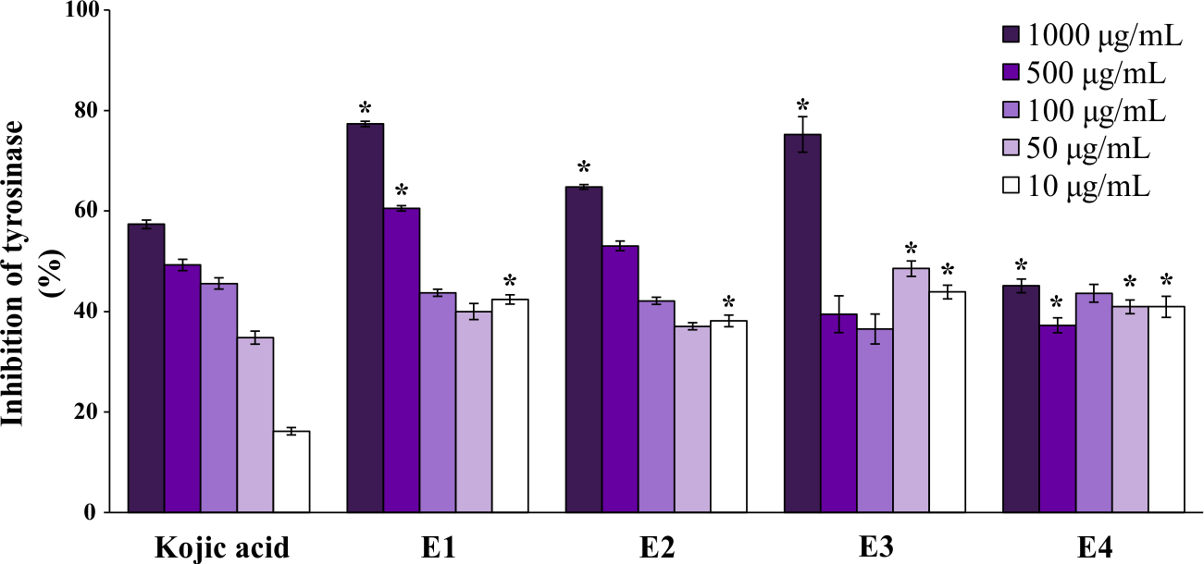
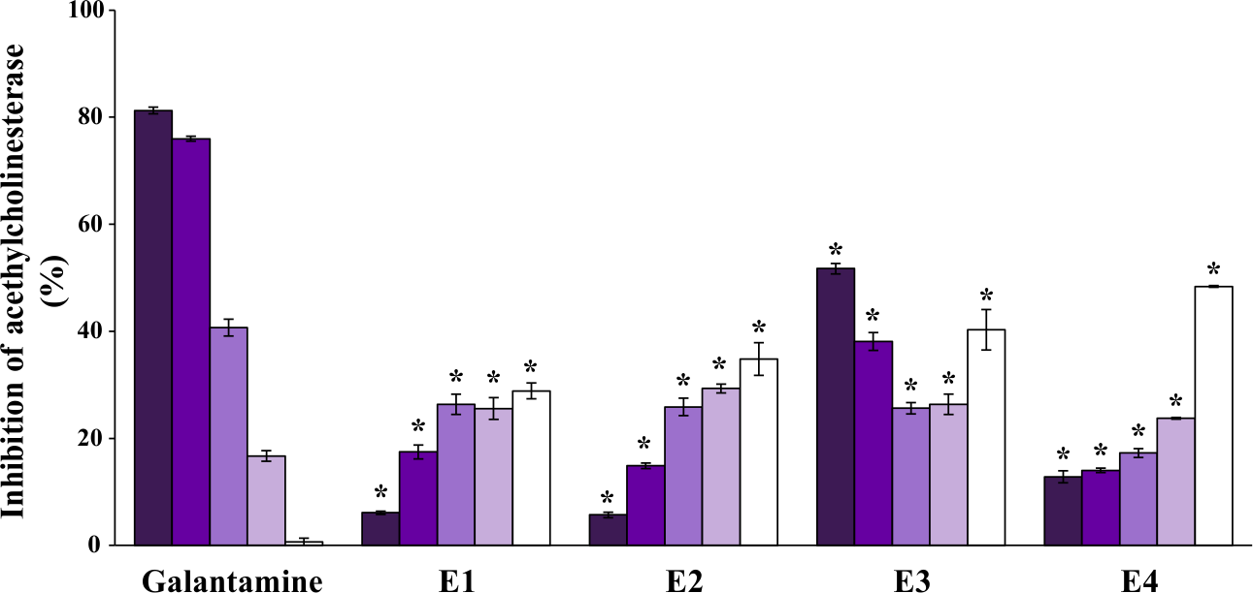
Antineurodegenerative activity
Significant inhibition of tyrosinase and acethylcholinesterase
Enzymes associated with the development of Alzheimer’s and Parkinson’s disease
Potential therapeutic application in the prevention/treatment of neurodegenerative diseases
*p<0.05 standard vs. different moss extracts

Slide 12
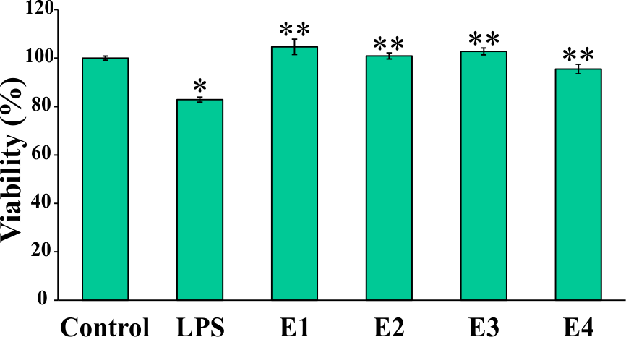
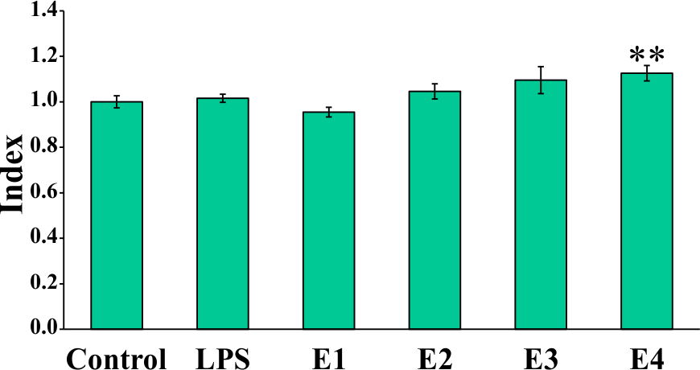
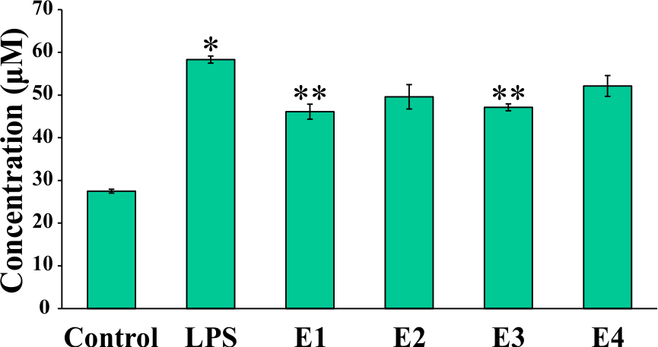
Anti-neuroinflammatory activity – BV2 cells
Cell viability – MTT assay
ROS production – NBT assay
NO production – Griess assay
Extracts increased the viability of LPS-stimulated BV2 cells
The production of NO by activated microglia is diminished
Another evidence for extracts anti-neuroinflammatory potential
*p<0.05 LPS-stimulated control cells vs. non-stimulated control cells;
**p<0.05 extracts vs. only LPS-stimulated control cells

Slide 13
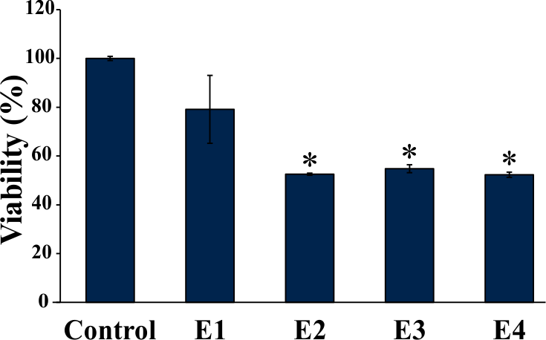
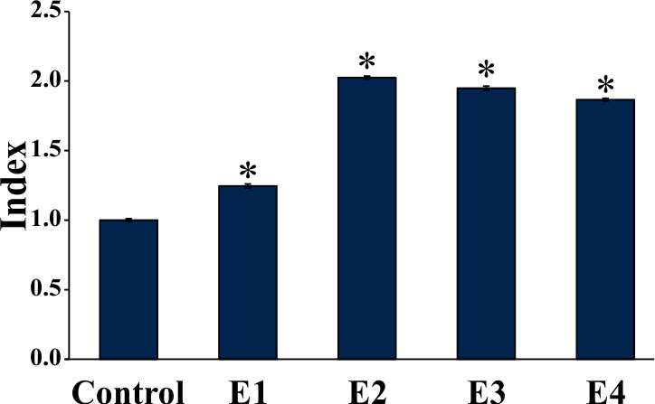
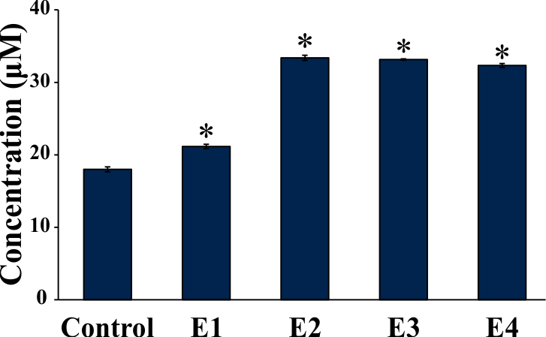
Antitumor activity – MDA-MB-231 cells
Cell proliferation – MTT assay
ROS production – NBT assay
NO production – Griess assay
Significant antiproliferative activity against MDA-MB-231 cells
All extracts increased ROS and NO production
Potential antitumor agents in the prevention/adjuvant treatment of breast cancer
*p<0.05 control cells vs. different moss extracts

Slide 14
Conclusions
Flavonoids, phenolic acids, and triterpenoids – important classes of secondary metabolites discovered in H. Cupressiforme extracts
Extracts exhibited good antioxidant activity regarding the prevention of β-carotene bleaching
High tyrosinase and acethylcholinesterase inhibition potential
High α-glucosidase inhibition activity
Promising anti-inflammatory potential (reducing the production of NO by LPS-stimulated BV2 cells)
Significant antiproliferative effects against MDA-MB-231 cancer cells
Altogether, H. cupressiforme is a highly promising source of novel biologically active compounds

Slide 15
Acknowledgments
This work was supported by the grant of the Ministry of Education and Science of the Republic of Serbia (Contract numbers: 451-03-68/2020-14/200178 and 451-03-68/2020-14/200007).

