Slide 1
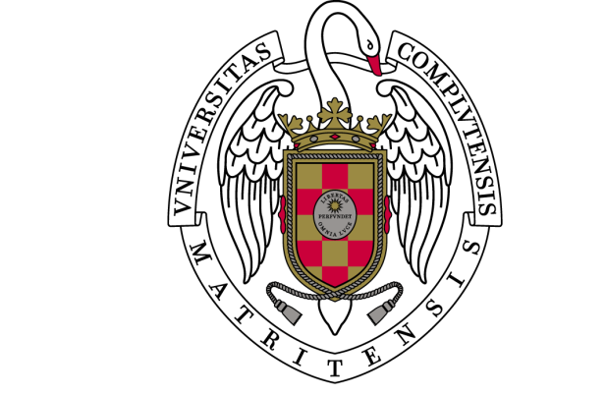
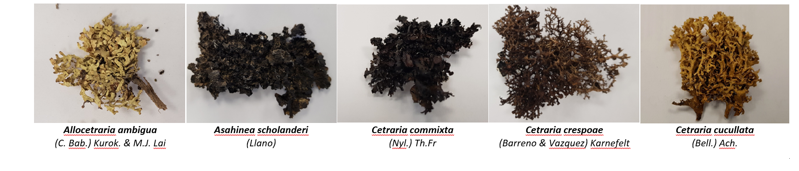
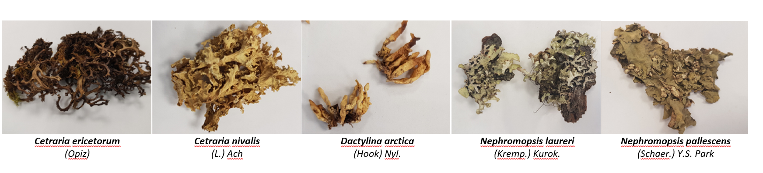
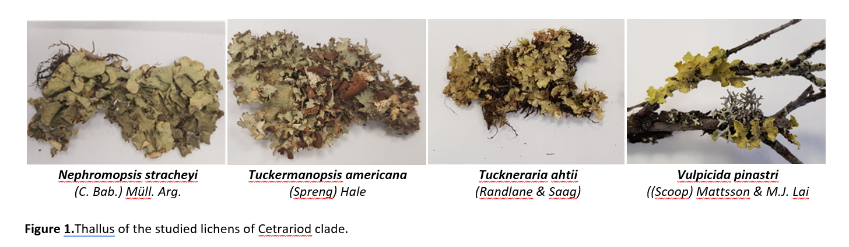

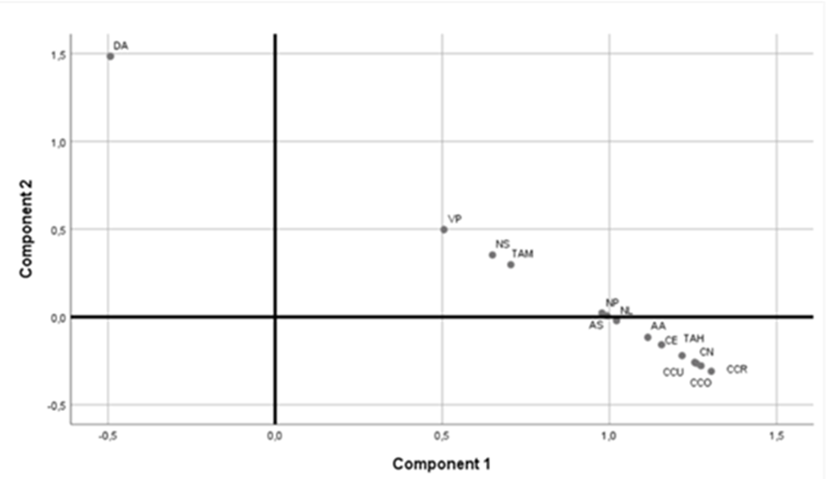
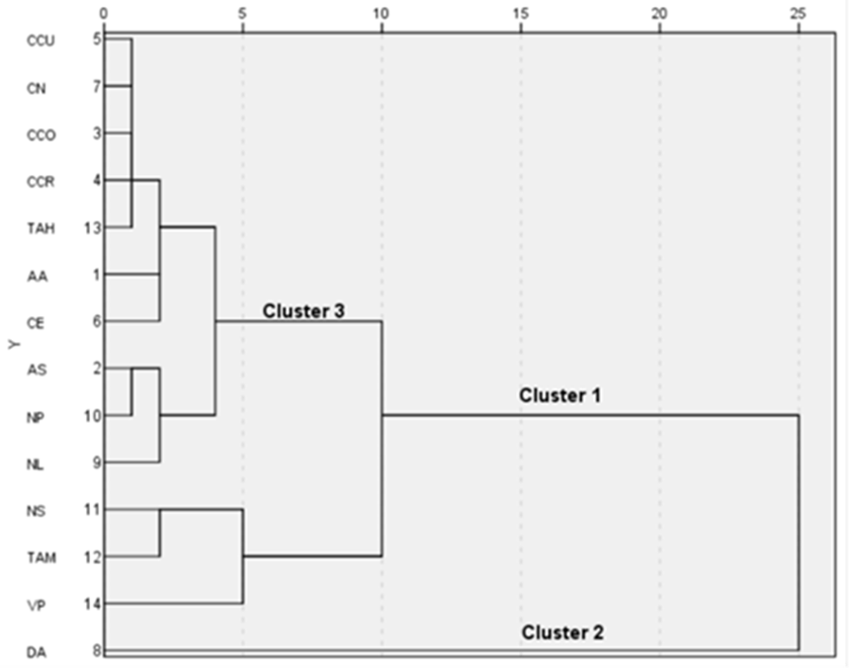
Analysis on in vitro antioxidant capacities and phenolic composition of lichens extracts of Cetrarioid clade based on multivariate statistical analysis
Ureña-Vacas, I.M. ª, González-Burgos, E. ª, Gómez-Serranillos, M.P. ª
ªDepartment of Pharmacology, Pharmacognosy and Botanical, Faculty of Pharmacy, Universidad Complutense de Madrid, Plaza Ramon y Cajal s/n,
Ciudad Universitaria, 28040, Madrid, Spain
Introduction
Lichens (fungus and unicellular algae/cyanobacteria symbiosis) are one of the least studied organisms from a pharmacological point of view. They contain own secondary metabolites with phenol groups to which an important antioxidant potential has been attributed. The Cetrarioid clade is one of the most numerous within the Parmeliaceae family.
There are several techniques that allow evaluating in vitro antioxidant activity.
H
Antioxidant
Antioxidant
.
.
.
.
.
.
DPPH assay
ORAC assay
Folin-Ciocalteu Reagent
( W⁶⁺, Mo⁶⁺)
Fe³⁺ -TPTZ + reducing antioxidant -> Fe²⁺ - TPTZ ( intense blue at 595 nm
Reduced Folin-Ciocalteu Reagent
( W⁶⁺, Mo⁶⁺)
FRAP assay
Total phenol content assay
Objectives
Material and methods
Evaluation of the antioxidant properties of 14 samples of lichen extracts from Cetrarioid clade.
Classification of lichen species by multivariate analysis.
Principal component analysis (PCA) and Hierarchical Cluster Analysis (HCA) using IBM SPSS statistics version 25.
Variables were autoscaled (transformation into z-scores).
Results
A)
PCA
Cluster 1: lichen species with moderate phenolic content and antioxidant capacity.
Cluster 2 is composed of a single specie Dactylina arctica (DA). (strongest antioxidant activity and the highest total phenolic content). Cluster 3 characterized by the lowest antioxidant properties and the lowest phenolic content values. It can be divided in two subclusters 3A and 3B.
Differences and similarities in antioxidant activity and phenolic content.
Dactylina arctica was placed on left half up of the plot (first quadrant). Nephromopsis stracheyi, Tuckermannopsis americana and Vulpicida pinastri were in the second quadrant (right half up of the plot) and finally, the other lichen species from Cetrarioid clade were placed on right half down of the plot (third quadrant).
B)
 | Cluster 1 | Cluster 2 | Cluster 3A | Cluster 3B | p-value* | p-value**
DPPH (IC₅₀ µg/mL) | 441.7±127.2 | 346.3±0.2 | 1445.6^{ab}± 506.83 | 853.2^{ab}± 196.64 | 0.001 | <0.01
FRAP (µmol of Fe2+ eq/g sample) | 25.9ª±0.9 | 29.6±0.2 | 12.1^{a,b}±4.2 | 15^{a,b}±2.4 | 0.007 | <0.01
ORAC (µmol TE/mg dry extract) | 2.5ª±0.9 | 8.2±0.1 | 1.4ª±1.1 | 1.6ª±0.9 | 0.142 | <0.01
Total Phenolic content (µg GA/mg) | 64.3ª±14.8 | 113.5±0.2 | 47,9^{a,b}±7.9 | 66.1^{a,c}± 15.7 | 0.008 | <0.01
Figure 2. A. Principal component analysis (PCA). B. Dendogram for lichen extracts obtained from HCA.
Abbreviations: AA (Allocetraria ambigua), AS (Asahinea scholanderi), CCO (Cetraria commixta), CCR (Cetraria crespoae), CCU (Cetraria cucullata), CE (Cetraria ericetorum), CN (Cetraria nivalis), DA (Dactylina arctica), NL (Nephromopsis laureri), NP (Nephromopsis pallescens), NS (Nephromopsis stracheyi), TAH (Tuckneraria ahtii), TAM (Tuckermanopsis americana), VP (Vulpicida pinastri).
Table 1. In vitro antioxidant activity and total phenolic content of clusters of lichen species obtained by Hierarchical cluster analysis (HCA). Results were expressed as mean ± SD. *The Levene's F Test for Equality of Variances. **One-way ANOVA or the Krustal-Wallis test. Statistical significance (p<0.05) is presented in letters superscripts a: versus cluster 1; b: versus cluster 2; c: versus cluster 3A, d: versus cluster 3B.
Conclusions
Bibliography
The antioxidant profiles were different between Dactylina arctica (Richardson) Nyl species and the rest of the studied species of the Cetrarioid clade. Dactylina arctica showed the highest total phenolic content and the highest antioxidant capacity.
HCA grouped lichen species into three clusters. Cluster 1 and 2 stand out due to their antioxidant activity and total phenolic content higher than the other species from Cluster 3.
González-Burgos E, Fernández-Moriano C, Gómez-Serranillos MP. Current knowledge on Parmelia genus: Ecological interest, phytochemistry, biological activities and therapeutic potential. Phytochemistry. Sep 2019;165:112051.
Liguori I, Russo G, Curcio F, et al. Oxidative stress, aging, and diseases. Clin Interv Aging. 2018;13:757-772.

