Slide 1
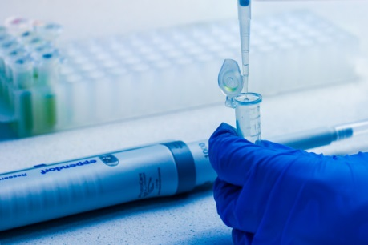
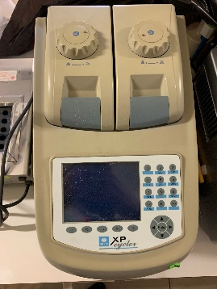
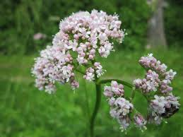
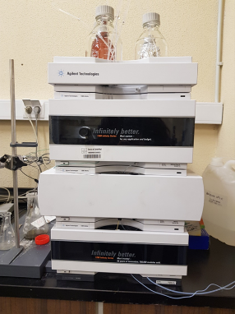
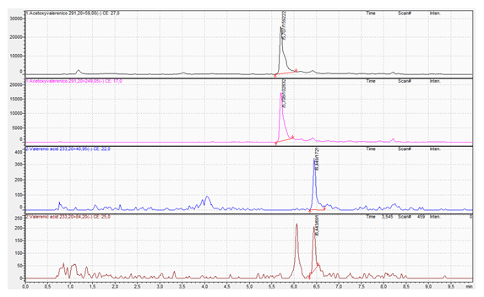
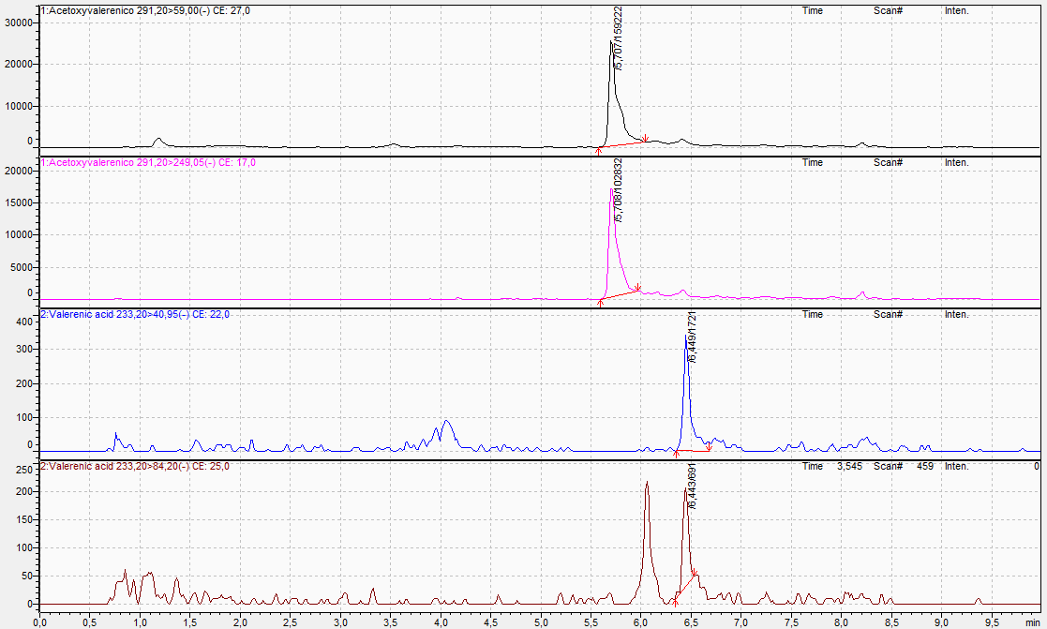
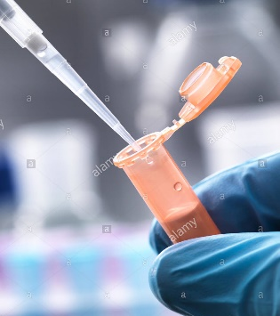
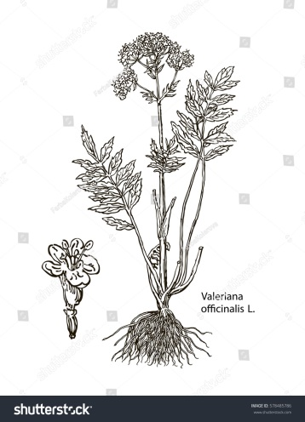
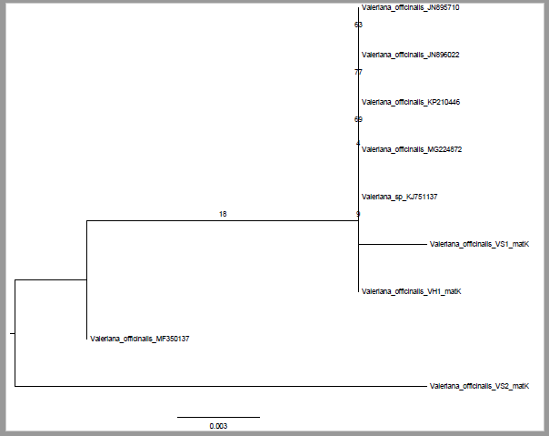
Identification and quality assessment of commercial valerian samples using DNA barcoding and UHPLC-MS
Marta Sánchez, Elena González-Burgos, M. Pilar Gómez-Serranillos
Department of Pharmacology, Pharmacognosy and Botany, Faculty of Pharmacy, Universidad Complutense de Madrid, Plaza Ramon y Cajal s/n, Ciudad Universitaria, 28040, Madrid, Spain
Introduction
Material and Methods
The root of V. officinalis L. has been widely used for sleep troubles, anxiety and states of nervousness. The main compound responsible for these activities is the sesquiterpene valerenic acid which acts by modulating GABA receptors (Felgentreff et al., 2012). Apart from valerenic acid, there have been identified a great diversity of bioactive compounds in Valeriana officinalis including iridoids such as valepotriate and isovalepotriate, flavonoids such as luteolin and quercetin, lignanoids such as 8’-hydroxypinoresinol, alkaloids such as valerine and valerianine and other terpenes such as isovaleric acid, valeric acid and acetoxyvalerenic (Patpcka & Jakl, 2010; Wang et al., 2010; Chen et al., 2013; Wang et al., 2013; Chen et al., 2015).
Over the past two decades, there have been an increase in medicinal plants consumption for the treatment of minor syndromes (Shaw et al., 2012). Medicinal plants must comply with quality, safety and efficacy standards. DNA barcoding is an effective tool to ensure correct identification and authentication of medicinal plants. This technique consists of using short DNA sequences from standardized genetic regions (rbcL, matK and ITS2) (Group CPW, 2009; Pawar et al., 2017). Moreover, Ultra High Performance Liquid Chromatography coupled with Mass Spectrometry (UHPLC-MS) is a very useful technique to identify and quantify bioactive compounds presented in medicinal plants.
Plant material
Seven commercial samples of valerian obtained from pharmacies, herbal shops and supermarkets were analyzed. They were preserved in conditions of humidity and environmental temperature.
DNA Extraction
DNA extraction - Speed Tools Biotools Biotechnological & Medical Laboratories. As a previous step to DNA extraction, secondary metabolites were eliminated by treatment with methanol.
Sequencing and PCR
The matK gene was chosen in this study because it is one of the universal DNA barcode markers for terrestrial plants. The primers used were MatK-1RKIM-f and MatK-3FKIM-r . PCR amplifications were performed in a Techne R TC-3000 thermal cycler.
UHPLC-MS Analysis
The HPLC standards were prepared at a concentration of 20 mg/L in the HPLC grade of methanol. Dilutions were prepared in the range of 0.05 to 1 mg/L in 70%/30% (v/v) ethanol/water. A Phenomenex Gemini 5u C18 110A, 150x2mm column (Phenomenex, Alcobendas, Spain) was used for the HPLC analysis. The gradient mode was 7 min 5%-95% Phase B; 8 min 95% Phase B; 8.5 min 5% Phase B using acetonitrile and in phase A 0.1% formic acid in water. The flow rate was 0.5 mL/min and the infection volume was 10 µl for all samples.
Objectives
To apply the DNA-Barcoding technique and the UHPLC-MS methodology as tools to evaluate the quality of commercial samples of Valeriana officinalis L.
Results and discusion
DNA-BARCODING ANALYSIS
Sequencing
The DNA sequences were manually assembled and adjusted through the BioEdit sequence alignment editor software (v 7.2). A second edition and assembly of the sequence fragments was done with the SeqMan v.7 program (Lasergene R, DNASTAR, Madison, Wisconsin, USA). The sequence identity was evaluated using the mega-BLAST search function in GenBank. Each data set was aligned using MAFFT v.7 implementing the G-INS-I alignment algorithm, score matrix '1PAM/K = 2' with a compensation value of 0.0, and the rest of the parameters set to default values. The identification of the samples was evaluated using the Life Barcode Data System (BOLD Systems v3).
UHPLC-MS
The compounds valerenic acid and acetoxy valerenic acid were identified in all study samples.
Sample | Acetoxyvalerenic acid (%) | Valerenic acid (%)
VH1 | 0.026 | 0.109
VH2 | 0.024 | 0.115
VH3 | 0.024 | 0.101
VF1 | 0.020 | 0.048
VF2 | 0.029 | 0.078
VF3 | 0.053 | 0.167
VS1 | 0.025 | 0.084
PCR
Table 1. Bioactive compounds identified and quantified in valerian by UHPLC-MS
Figure 3. Representative UHPLC-ESI-QqQ-MS/MS chromatograms
Conclusions
DNA was extracted from 3 of the 7 analyzed samples of Valeriana officinalis
These 3 valerian samples were labelled as Valeriana officinalis but they were identified as Valeriana hirtella Kunth
DNA-barcoding is an effective method to guarantee the quality control of plant species.
UHPL-MS revealed that acetoxy valerenic acid concentration was from 0.020% to 0.053% whereas valerenic acid content was from 0.048% to 0.167%.
Figure 1. DNA-barcoding analysis.
References
Chen, H.W., Chen, L., Li, B., Yin, H.L., Tian, Y., Wang, Q., Xiao, Y.H. & Dong, J.X. 2013. Three new germacrane-type sesquiterpenes with NGF-potentiating activity from Valeriana officinalis var. latiofolia. Molecules. 18(11): 14138-14147
Chen, H.W., Wei, B.J., He, X.H., Liu, Y. & Wang, J. 2015. Chemical Components and Cardiovascular Activities of Valeriana spp. Evid. Based. Complement. Alternat. Med.. 2015: 947619.
CBOL Plant Working Group (2009) A DNA barcode for land plants. Proc Natl Acad Sci U S A 106: 12794–7. doi: 10.1073/pnas.0905845106 PMID: 19666622
Felgentreff, F., Becker, A., Meier, B. & Brattström, A. 2012. Valerian extract characterized by high valerenic acid and low acetoxy valerenic acid contents demonstrates anxiolytic activity. Phytomedicine.19(13): 1216-1222.
Patocka, J. & Jakl, J. 2010. Biomedically relevant chemical constituents of Valeriana officinalis. J. Appl. Biomed. 8: 11–18.
Pawar RS, Handy SM, Cheng R, Shyong N, Grundel E. Assessment of the Authenticity of Herbal Dietary Supplements: Comparison of Chemical and DNA Barcoding Methods. Planta Med. 2017;83(11):921-936. doi:10.1055/s-0043-107881
Shaw D. , GraemeL. , PierreD. , W. Elizabeth., and C. Kelvin. “Pharmacovigilance of herbal medicine,” Journal of Ethnopharmacology, vol. 140, pp. 513–518, 2012.
Wang, P.C., Ran, X.H., Chen, R, Lou, H.R., Liu, Y.Q., Zhou, J. & Zhao, Y.X. 2010. Germacrane-type sesquiterpenoids from the roots of Valeriana officinalis var. latifolia. J. Nat.Prod. 73(9): 1563-1567
Wang, P.C., Ran, X.H., Luo, H.R., Ma, Q.Y., Liu, Y.Q., Zhou, J. & Zhao, Y.X. 2013. Phenolic compounds from the roots of Valeriana officinalis var. latifolia. J. Braz. Chem. Soc. 24: 1544-1548.
Figure 2. DNA sequence based identification of valerian marked samples.

