Slide 1
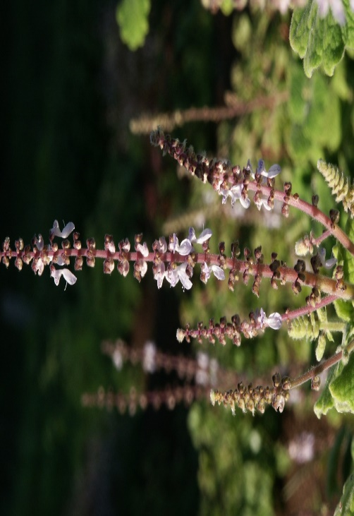
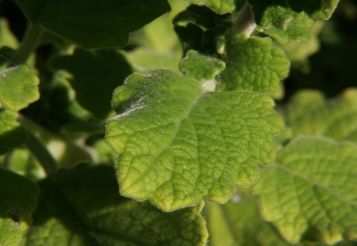
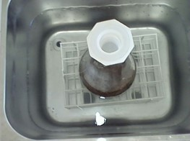

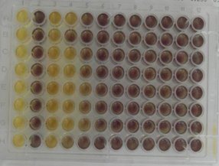
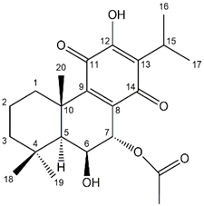




Self-assembly nanoparticles of
7α-acetoxy-6β-hydroxyroyleanone isolated from Plectranthus hadiensis
Eva María Domínguez-Martín^{a, b}, Epole Ntungwe ^{a, b}, Vera Isca ^{b, c}, Eleonora Colombo^{d}, Tatiana Pinto^{b}, Catarina Pacheco^{b}, Jaime A.S. Coelho ^{b}, Gabrielle Bangay ^{b}, Ana María Díaz-Lanza ª, Daniele Passarella^{d}, Patrícia Rijo^{b, c}
ª Department of Biomedical Sciences, Faculty of Pharmacy, University of Alcalá de Henares, Ctra. A2, Km 33.100 – Campus Universitario, 28805. Alcalá de Henares, Madrid, Spain
^{b} CBIOS-Center for Research in Biosciences & Health Technologies, Universidade Lusófona de Humanidades e Tecnologías, Campo Grande 376, 1749-024 Lisbon, Portugal
^{c} iMed.ULisboa - Research Institute for Medicines, Faculty of Pharmacy, Universidade de Lisboa, Av. Prof. Gama Pinto, 1649-003 Lisbon, Portugal
^{d} Dipartimento di Chimica, Università degli Studi di Milano, Via Golgi 19, 20133 Milano, Italy
E-mail: p1609@ulusofona.pt
1. Introduction
Plectranthus genus belongs to the Lamiaceae family and consists of around 300 species distributed from Africa to Asia and Australia. Plectranthus spp. has been reported to be rich in diterpenoids, such as different types of royleanones. One of Plectranthus medicinal plants species is P. hadiensis (Forssk.) Schweinf. ex Sprenger, which contains diverse metabolites such as phenolic and diterpenoid compounds. Furthermore, this plant is widely used in an array of traditional and Ayurvedic recipes for the treatment of diverse range of ailments like cancer¹⁻³.
P. hadiensis aerial parts
2. Objectives
3. Methodology
❶ Isolation and employment of the cytotoxic diterpene 7α-acetoxy-6β-hydroxyroyleanone (Roy)⁴⁻⁶ to hemi-synthetize 7α-acetoxy-6β-hydroxyl-6-benzoyloxyroyleanone (Roy-6-Bz).
Reaction:
❷ Synthesis of self-assembled nanoparticles using Roy and Roy-6-Bz as starting materials and squalene linker following the procedures described in literature ⁷⁻⁸.
Nanoparticles properties characterization and study of their cytotoxicity and biological properties.
Acetonic extracts were prepared using ultrasounds-assisted method.
Roy caracterization by NMR, MS, Crystal X-ray diffraction…
 Extraction &
Isolation
 Synthesis and chemical characterization
Using a squalene linker
● Self-assembly Nanoparticles characterization
LDS, SEM, FTIR, SEM, etc
❍ Cytotoxicity & biological studies
In different cancer cell lines
4.Results
Roy was characterized by spectroscopic methods, mainly 1D- and 2D-NMR techniques.
Hemi-synthesis of drug-linker conjugate using Roy-6-Bz was isolated and confirmed by ¹H-NMR.
Production of self-assembly Nanoparticles.
H-15
H-15
¹H-RMN spectra and structure of 7α-acetoxy-6β-hydroxyroyleanone (Roy)
5. Conclusions
In this study, it was explored the cytotoxic Roy and Roy-6-Bz as lead molecules for the hemi-synthesis of drug-linker conjugates.
Production of self-assembly nanoparticles of Roy-6-Bz for chemical characterization is on going.
Finally, the ability to release the drug unit from the self-assembly nanoparticles and the evaluation of their biological activity in different cell lines will be also tested.
[1] Ladeiras D, Monteiro CM, Pereira F, Reis CP, Afonso CA, Rijo P (2016) Curr Pharm Des 22:1682-714. [2] Matias D, Nicolai M, Saraiva L, Pinheiro R, Faustino C, Diaz Lanza A, et al. (2019) ACS Omega 4: 8094–103. [3] Garcia C, Teodosio C, Oliveira C, Oliveira C, Diaz-Lanza A, Reis C, et al. (2018) Curr Pharm Des 24:4207-36. [4] Bernardes CES, Garcia C, Pereira F, Mota J, Pereira P, Cebola MJ, et al. (2018) Mol Pharm 15:1412-9. [5] Sitarek P, Toma M, Ntungwe E, Kowalczyk T, Skała E, Wieczfinska J, et al. (2020) Biomolecules 10: 194. [6] Śliwiński T, Sitarek P, Skała E, Isca VMS, Synowiec E, Kowalczyk T. et al. (2020) Pharmaceuticals 13(6): 123. [7] Fumagalli G, Christodoulou MS, Riva B, et al. (2017) Org Biomol Chem 15:1106–9. [8] Borrelli S, Christodoulou MS, Ficarra I, Silvani A, Cappelletti G, Cartelli D, et al. (2014) Eur J Med Chem. 2014;85:179–90.
7. Acknowledgements
6. Bibliografía
This project was funded by the Fundação para a Ciência e a Tecnologia (FCT, Portugal), through projects UIDP/04567/2020 and UIDB/04567/2020. E.M.D-M gratefully acknowledges had been the recipient of the grant UID/DTP/O4567/2019-CBIOS/BI1 and have, currently, a predoctoral FPU 2019 fellowship from the University of Alcalá de Henares.

