Slide 1

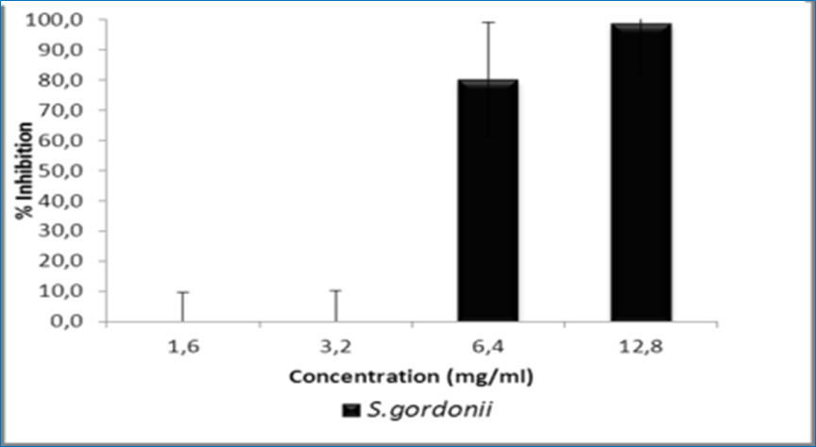
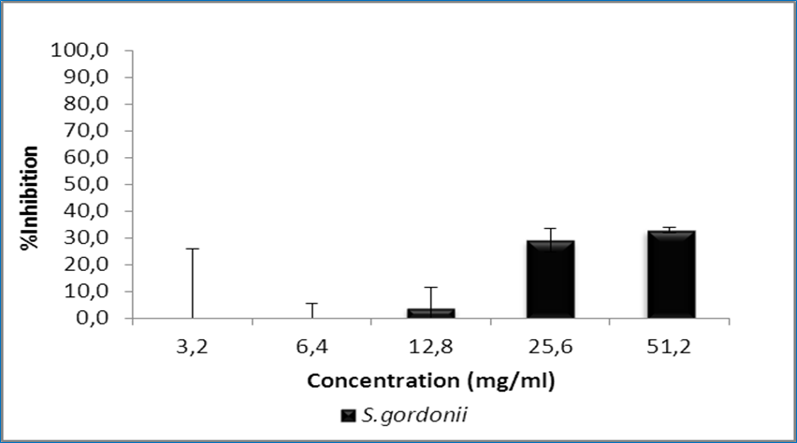
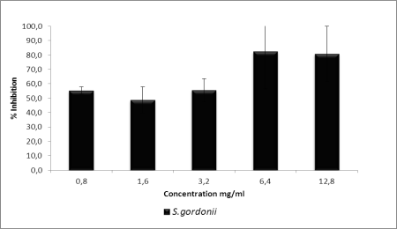
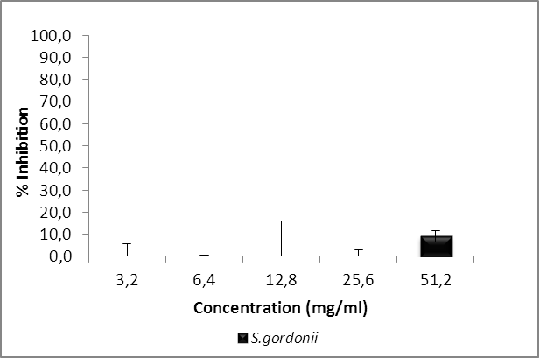
In vitro antibiofilm activity of Algerian Salvadora persica and Juglans regia extracts against oral Streptococcus gordonii
Wafae Didi¹, Hafida Hassaine¹, Sarah Gaouar¹
1. Laboratory of Applied Microbiology in Food, Biomedical and Environment LAMAABE. University of Tlemcen. Algeria
Introduction
The internal surface of removable dentures has many irregularities and microporosities which promote colonization and penetration of bacteria and yeasts into the base of the acrylic resin (1). Denture biofilm is a real microbial reservoir which can be responsible for prosthetic stomatitis or aspiration pneumonia, a potentially fatal infection, especially in geriatric patients (2). Chewing sticks may play a role in the promotion of oral hygiene, and further evaluation of their effectiveness is warranted, as stated in the Consensus Report on Oral Hygiene (3). Thus, this study aimed at investigating the antibacterial activity of extracts from the two chewing sticks on the growth of oral bacteria, in their planktonic forms and in denture biofilms.
Materials and methods
Results
 Antibacterial activity
Bacterial cells were grown in brain heart infusion broth and the two methanolic plant extract materials were formulated in dimethyl sulfoxide and taken into different concentrations.
Minimum inhibitory concentrations (MIC) were determined by the microtiter broth method in sterile 96‑well plates. Serial dilution techniques were used to determine the MIC50 and MIC90 of extracts.
Optical density of each well was measured at 490nm and the mean % inhibition of replicate tests was used to determine the final MIC values.
A microtiter plate test was used to test the effect of plant extracts on biofilms already established in sterile 96‑well plates.
 Bacterial attachment on resin
Uniformly sized sterile acrylic resin plates were incubated in bacterial suspension for 48h at 37°C under aerobic condition.
Plates were treated for 4h with the two plant extracts.
Electronic microscopy was carried out to observe the effect of extract on Streptococcus gordonii adhesion to resin using an environmental scanning electron microscope (XL 30 ESEM Philips, Netherlands).
Planktonic form
Biofilm form
Figure 1. The percent inhibition of Salvadora persica extract
Planktonic form
Biofilm form
Figure 2. The percent inhibition of Juglans regia extract
A
B
C
Figure 3. Environmental scanning electron microscope (ESEM) images showing the effect of extracts on Streptococcus gordonii biofilm formed on acrylic resin (scale bars = 10 µm). (A) S. gordonii biofilm formed on resin before antimicrobial treatment. (B) Salvadora persica extract effect. (C) Juglans regia extract effect
Conclusion
The S. persica and J. regia extracts are highly potent as antibacterial and biofilm removal agents. These findings highlighted that the bioactive components of the two plants showed useful alternatives to improve denture hygiene and oral health.
References
1. Sesma Newton, Laganá Dalva Cruz, Morimoto, Susana, & Gil Carlos. (2005). Effect of denture surface glazing on denture plaque formation. Brazilian Dental Journal, 16(2): 129-134.
2. Murata Hiroshi, Chimori Hironori, Hong Guang, Hamada Taizo, Nikawa Hiroki. (2010). Compatibility of tissue conditioners and denture cleansers: Influence on surface conditions . Dental Materials Journal, 29(4):446-453.
3. World Health Organization. Consensus statement on oral hygiene. (2000). Int Dent J,50:139.

