Slide 1
Evaluation of Aryl amidines/benzimidazoles
as Potential Anti-COVID-19 Agents: A computational study
Osvaldo A. Santos-Filho¹, Jean J. Vanden Eynde^{2 *}, Annie Mayence³, Tien L. Huang^{4*}
¹Laboratório de Modelagem Molecular e Biologia Estrutural Computacional, Instituto de Pesquisas de Produtos Naturais Walter Mors, Federal University of Rio de Janeiro, 21941-902, Rio de Janeiro, RJ, Brazil;
²University of Mons-UMons, Department of organic chemistry, B-7000 Mons, Belgium;
³Haute Ecole Provinciale de Hainaut Condorcet, B-7730 Saint-Ghislain, Belgium;
⁴Xavier University of Louisiana, College of Pharmacy, New Orleans, Louisiana, USA.
* Corresponding authors: jean-Jacques.vandeneynde@ex.umons.ac.be; tlhuang2002@yahoo.com

Slide 2
Evaluation of Aryl amidines/benzimidazoles
as Potential Anti-COVID-19 Agents: A computational study
Graphical Abstract
Binding Energy (Kcal/mol) 3CLpro GRP78 TMPRSS2
1228 | -9.3 | -10.5 | -6.3
523 | -7.6 | - | -7.4

Slide 3
Abstract
In silico drug design techniques were used to identify several small molecules as potential therapeutics against the coronavirus SARS-CoV-2 which causes COVID-19. A group of 12 approved and experimental drugs containing benzamidine or/and benzimidazoles moieties as key structural motifs were found to have good binding affinity to the viral protease 3CLpro, and the host proteins GRP78 and TMPRSS2. The targeted proteins are attractive drug targets since they are essential to the entry and replication of the virus in host cells. Two of the experimental compounds, bearing the benzimidazole moiety, were found to have stronger binding to the three targeted proteins than the approved drugs (dabigatran, nafomostat, pentamidine). The stronger binding of the compounds is attributed to greater hydrogen bonding, hydrophobic, and pi-pi interactions with the respective targeted proteins.
Keywords: 3-Chymotrpsin like protease (3CLpro); Glucose Regulated Protein 78 (GRP78); Transmembrane protease serine 2 (TMPRSS2); benzamidine; benzimidazole; molecular docking

Slide 4
Introduction
COVID-19 is a highly contagious viral disease for which no specific approved drugs or vaccines are currently available. Consequently, there is an urgent global effort to develop effective therapeutics. Biochemical pathways that are crucial in the life cycle of the coronavirus, SARS-CoV-2, represent attractive targets for drug development. We have identified three proteins as potential drug targets, based on the observations that several clinically used drugs, namely, dabigatran and nafamostat, may modulate the activity of these proteins.
3CLpro is the main viral protease that plays a crucial role in facilitating viral replication and transcription. GRP78 has recently been suggested to be a host receptor for the virus spike protein, which, upon binding, facilitates initial infection of host cell. TMPRSS2 is a host protease, which primes the spike protein for entry and fusion into the host cells.
Three approved drugs and nine experimental molecules, all of which contain the benzamidine and/or benzimidazole moiety, were selected for this in silico study.

Slide 5
Approved Drugs (structures shown in Table 1):
Nafamostat is an anticoagulant used for acute pancreatitis. It inhibits SARS-CoV-2 infection of human lung cell line calu-3 with EC50 ~ 10nM (1). It is an inhibitor of TMPRSS2.
Dabigatran is an anticoagulant used for strokes and systemic embolism. It has been suggested to inhibit 3CLpro (2)
Pentamidine is used in the treatment of African trypanosomiasis, leishmaniasis, and pneumocystis pneumonia.
Experimental Compounds (structures shown in Tables 2 and 3)
Nine representative bisbenzamidines (Table 2) and bisbenzimidazoles (Table 3) were selected for this study. The synthesis, antifungal and antiparasitic properties of these compounds have been reported (3-5).
References:
(1) Yamamota, M. et al., BioRviv preprint:http://doi.0rg/10.1101/2020.04.22.054981
(2) Eleftheriou, P. et al., Molecules, 2020, 25, 2529
(3) Mayence, A. et al., Eur. J. Med. Chem., 2004, 39, 547
(4) Mayence, A. et al., J. Med. Chem., 2004, 47, 2700
(5) Mayence A., et al., Bioorg. Med. Chem., 2011, 19, 7493

Slide 6
In silico drug design techniques
The crystallographic structures of both SARS-CoV-2 3CLpro (PDB ID: 6LU7) (6) and GRP78 (PDB ID: 5E84) (7), as well as a homology model for TMPRSS2 (8) were used as the biomacromolecular receptors in molecular docking simulations.
The structures of the ligands were energy minimized using the Universal Force Field Molecular Mechanics method (9).
The docking simulations were performed with AutoDock Vina 1.1.2 software (10).
Molecular graphic representations were performed with PoseView 1.1.2 (11) softwares.
References:
(6) Jin, Z. et al., Nature, 2020, 582, 289
(7) Yang, J. et al., Structure, 2015, 23, 2191
(8) Rahman, N. et al., Molecules, 2020, 25, 2271
(9) Rappe, A. et al., J. Am. Chem. Soc., 1992, 114, 10024
(10) Trott, O. et al., J. Comput. Chem., 2010, 31, 455
(11) Stierand, K. et al., Med. Chem. Lett., 2010, 1, 540

Slide 7
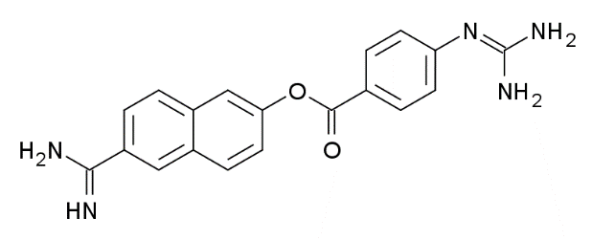
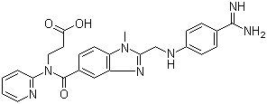
Results and discussion
Table 1. Structure and binding energy of approved drugs toward targeted proteins
Names/Structures Binding Energy (Kcal/mol) 3CLpro GRP78 TMPRSS2
Nafamostat | -8.6 | -10.0 | -7.1
Dabigatran | -7.8 | -9.8 | -7.1
Pentamidine | -6.8 | -8.8 | -

Slide 8
Table 2. Structure and binding energy of bisbenzamidines toward targeted proteins
Names/Structures Binding Energy (Kcal/mol) of bisbenzamidines 3CLpro GRP78 TMPRSS2
322 | -7.8 | -9.5 | -7.3
508 | -7.4 | -10.1 | -7.3
701 | -7.3 | -9.2 | -6.8
103 | -7.1 | -6.1 | -
1131 | -6.8 | -9.2 | -6.1

Slide 9
Table 3. Structure and binding energy of bisbenzimidazoles toward targeted proteins
Names/Structures Binding Energy (Kcal/mol) of bisbenzimidazoles 3CLpro GRP78 TMPRSS2
1228 | -9.3 | -10.5 | -6.3
523 | -7.6 | - | -7.4
1203 | -6.1 | -9.5 | -7.2
115 | - | - | -7.3

Slide 10
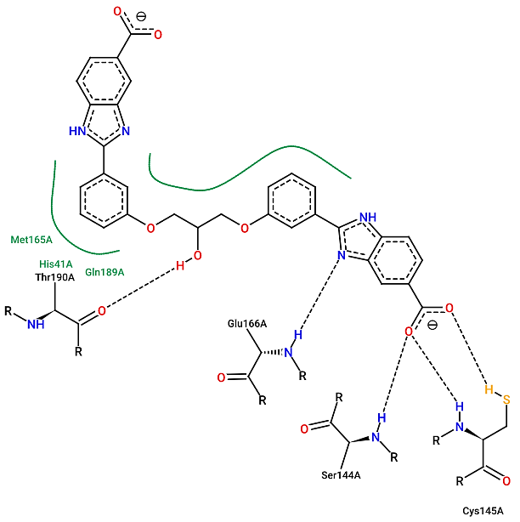
Figure 1. 2D-binding interactions of 1228 with 3CLpro
Strong binding affinity (-9.3 Kcal/mol)
of 1228 to 3CLpro is due to:
Hydrogen bonds with
Ser144, Glu166, Cys145, Thr190
Hydrophobic interactions with
His41, Met165, Gln189

Slide 11
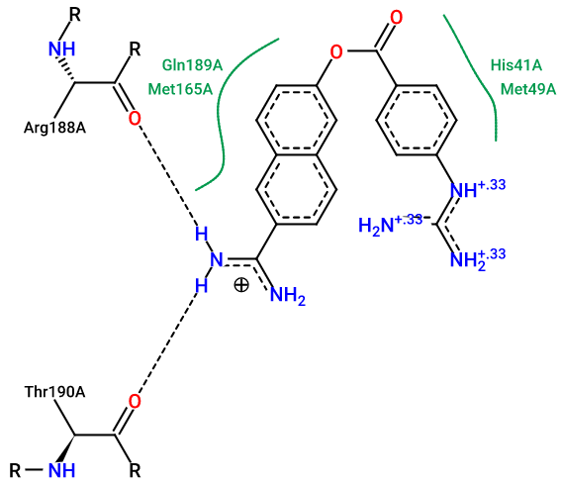
Figure 2. 2D-binding interactions of Nafamostat with 3CLpro
Strong binding affinity (-8.6 Kcal/mol)
of Nafamostat to 3CLpro is due to:
Hydrogen bonds with
Arg188, Thr190
Hydrophobic interactions wit
His41, Met165, Gln189

Slide 12
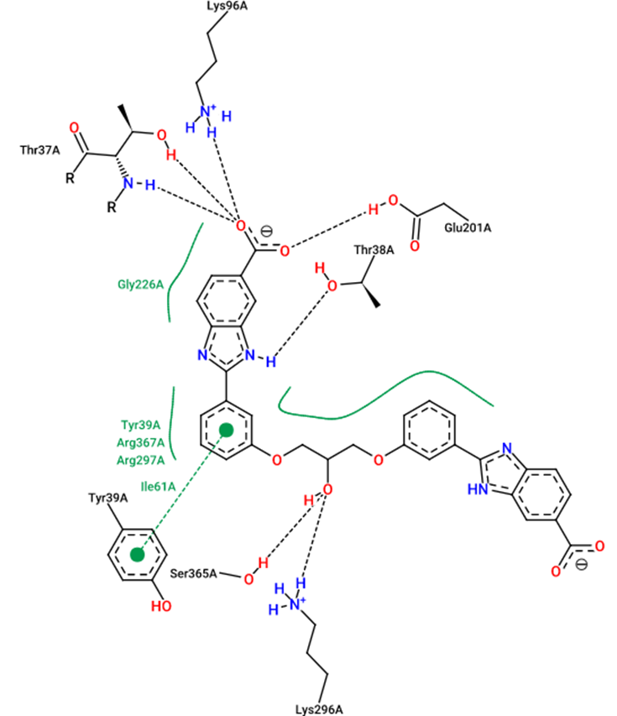
Figure 3. 2D-binding interactions of 1228 with GRP78
Strong binding affinity (-10.5 Kcal/mol)
of 1228 to GRP78 is due to:
Hydrogen bonds with
Thr37, Thr38, Lys96, Glu201, Lys296
Hydrophobic interactions with
Tyr39, Ile61, Gly226, Arg297, Arg 367
Pi interactions with
Tyr39

Slide 13
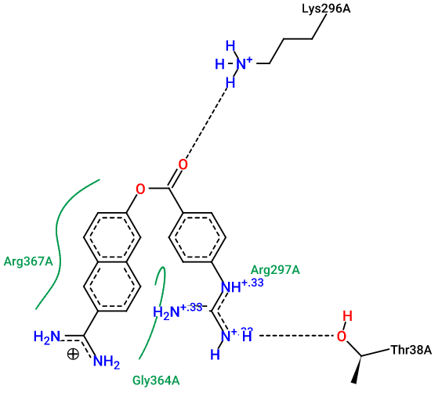
Figure 4. 2D-binding interactions of Nafamostat with GRP78
Strong binding affinity (-10.0 Kcal/mol)
of Nafamostat to GRP78 is due to:
Hydrogen bonds with
Thr38, Lys296
Hydrophobic interactions with
Arg297, Gly364, Arg367

Slide 14
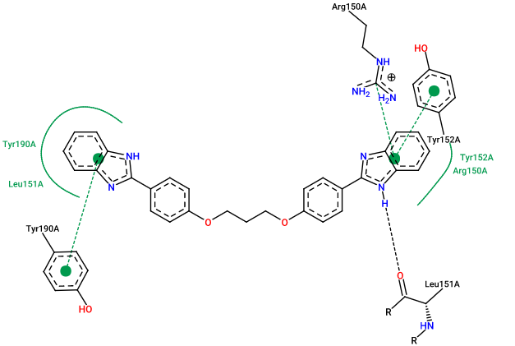
Figure 5. 2D-binding interactions of 523 with TMPRSS2
Strong binding affinity (-7.4 Kcal/mol)
of 523 to TMPRSS2 is due to:
Hydrogen bonds
with Leu151
Hydrophobic interactions with
Arg150, Leu151, Tyr152, Tyr190
Pi interactions with
Arg150, Tyr152, Tyr190

Slide 15
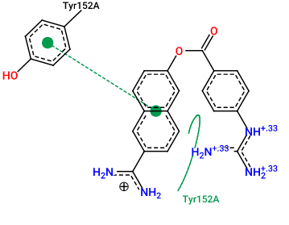
Figure 6. 2D-binding interactions of Nafamostat with TMPRSS2
Strong binding affinity (-7.1 Kcal/mol)
of nafamostat to TMPRSS2 is due to:
Hydrophobic interactions with
Tyr152
Pi interactions with
Tyr152

Slide 16
Conclusions
In silico results indicate that two experimental bisbenzimidazoles have stronger binding affinity to targeted proteins than approved drugs Nafamostat, Dabigatran, or Pentamidine
1228 showed the lowest binding energy of -9.3 Kcal/mol with 3CLpro and -10.5 Kcal/mol with GRP 78.
523 showed the lowest binding energy of -7.4 Kcal/mol with TMPRSS2.
Strong binding affinity of above compounds is due to greater hydrogen bonding, hydrophobic interactions, and/or pi interactions with targeted proteins.

Slide 17
Acknowledgments
The authors are grateful to Dr. Luca Rastrelli (Dipartimento di Farmacia, University of Salerno, Italy), and Dr. Haroom Khan (Department of Pharmacy, Abdul Wali Khan University, Pakistan) for kindly providing their homology model of TMPRSS2.
OAS-F is grateful to the Minitries of Education and of Science, Technology and Innovation of Brazil.

