Slide 1
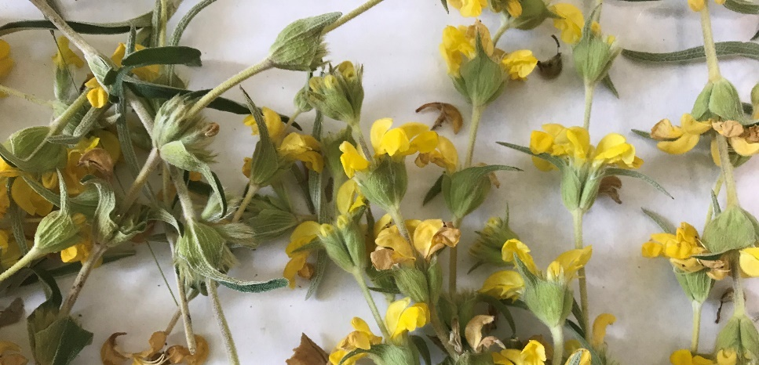
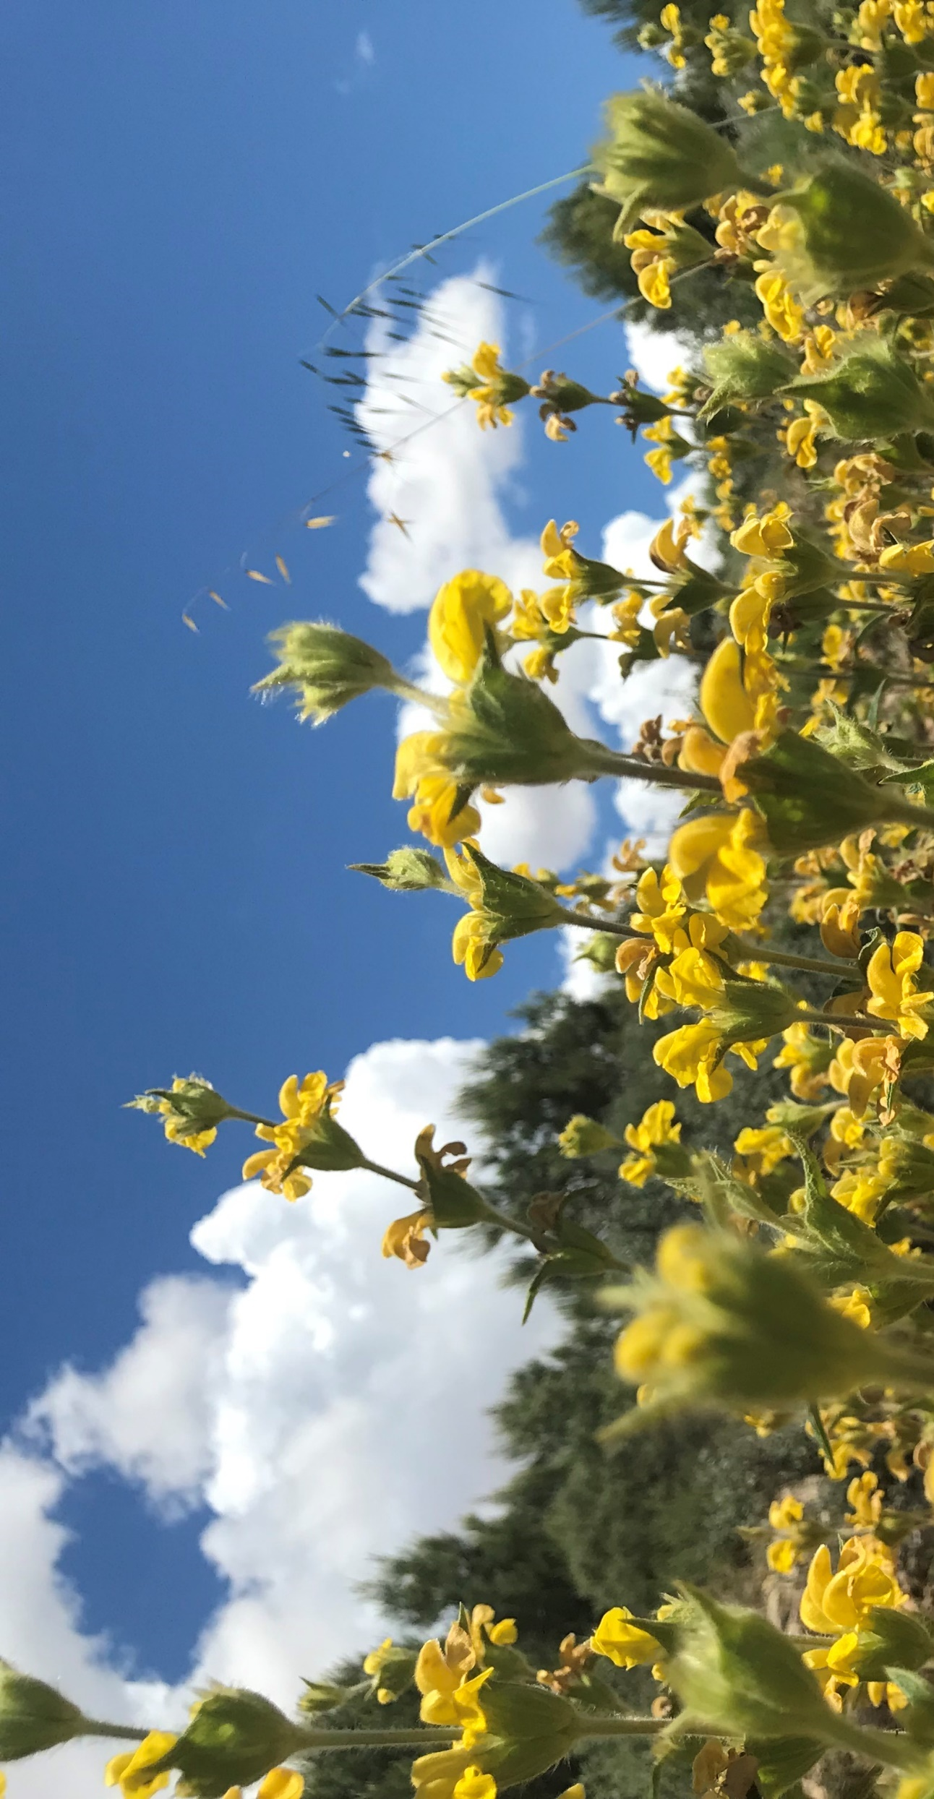
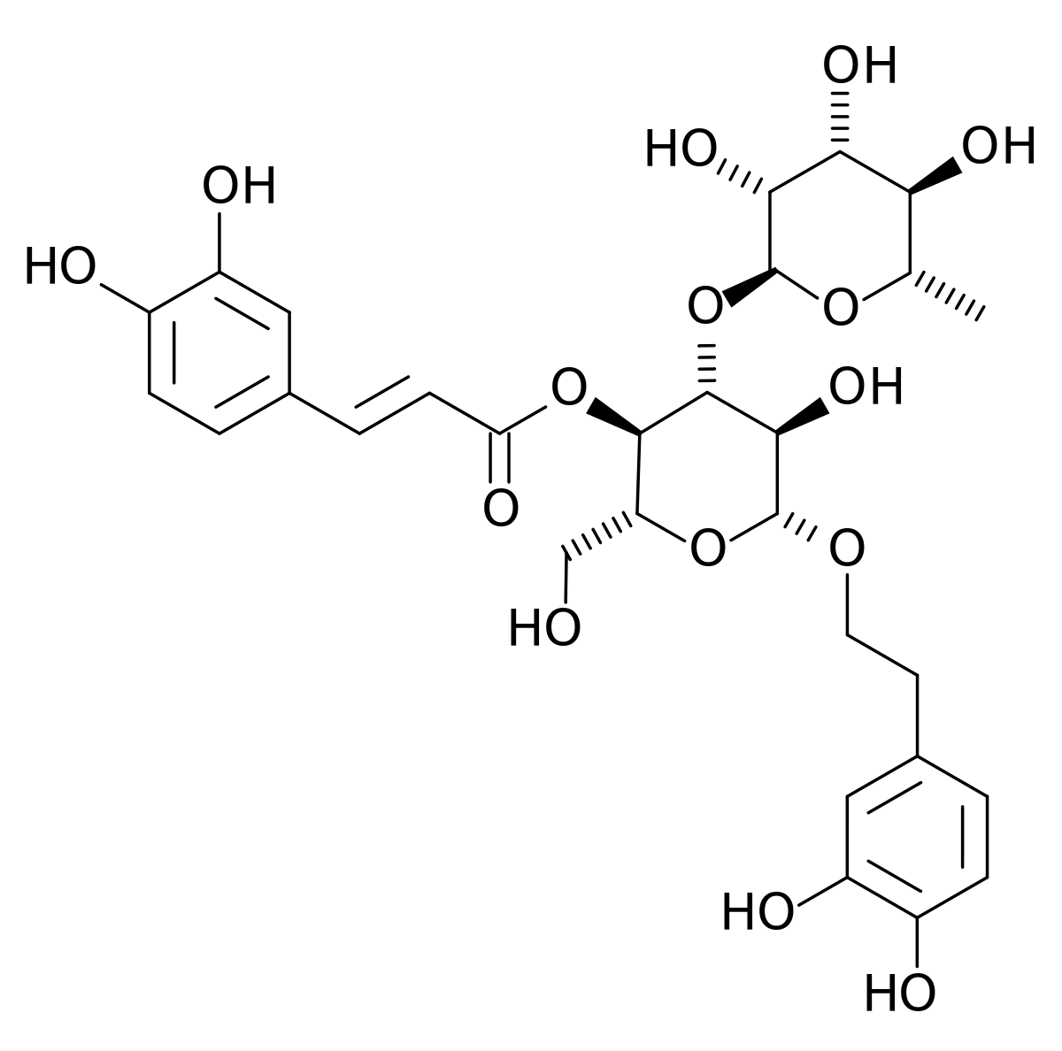
Phlomis lychnitis L. (Lamiaceae) as a source of bioactive compounds with functional properties
Francisco Les, Guillermo Cásedas and Víctor López Department of Pharmacy, Faculty of Health Science, Universidad San Jorge, Zaragoza
INTRODUCTION:
Phlomis lychnitis L. (Lamiaceae) is a shrub found in the Iberian Peninsula and in other Mediterranean countries. P. lychnitis, also known as "candilera" in Spain, has been used in traditional medicine to treat illnesses such as colds and gastrointestinal problems. Due to the presence of different metabolites in the composition of this plant, it could be a source of bioactive principles for the development of possible new treatments.
OBJECTIVE:
To determine the bioactive properties (total polyphenols, antioxidant properties and capacity to inhibit digestive enzymes) of a methanolic extract of P. lychnitis L.
MATERIAL & METHODS:
Maceration in methanol and subsequent rotary evaporation
Reducing capacity:
Total Polyphenols→ Folin-Ciocalteu method
Antioxidant Screening :
→ DPPH· radical scavenging
→ Superoxide radical scavenging
Enzymatic inhibition Screening :
→α-Glucosidase
→ Xanthine oxidase
→ Lipase
It does not inhibit lipase
RESULTS:
The extract contains
75,4 $±$ 18,4 μg GAE equivalents /mg extract.
Verbascoside
CONCLUSION:
The extract showed antioxidant-reducing capacity with ability to inhibit the α-glucosidase and xanthine oxidase enzymes

