Slide 1





Chemical Composition and Biological Activity of Diterpenoids from Plectranthus mutabilis codd.
Epole Ntungwe^{1,2}, Máté Vágvölgyie⁴, Jaime A. S. Coelho¹, Vera Isca^{1,3}, Lucilia Saraiva⁵, Ana María Díaz-Lanza², Attila Hunyadi⁴, Noélia Duarte³, Milica Pesic⁶, Patrícia Rijo^{1,3}*
¹ CBIOS – Center Research for Biosciences & Health Technologies, Lisbon, Portugal
² Department of Biomedical Sciences, Faculty of Pharmacy, University of Alcalá, Spain
³ iMed.ULisboa, Faculdade de Farmácia da Universidade de Lisboa, Portugal
⁴ Institute of Pharmacognosy, University of Szeged, Eötvös str. 6. 6720 Szeged, Hungary
⁵ LAQV - Faculty of Pharmacy of University of Porto, Portugal
⁶ Institute for Biological Research ‘Siniˇsa Stankovi´ c’, University of Belgrade, Serbia
* Corresponding author: patricia.rijo@ulusofona.pt

Slide 2
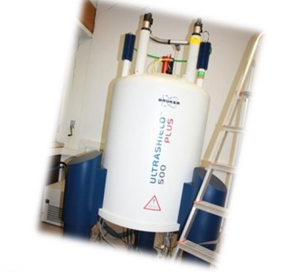
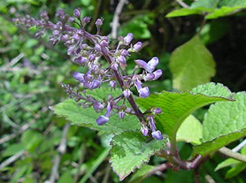

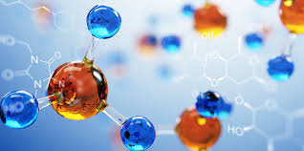
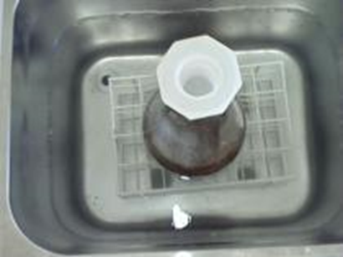

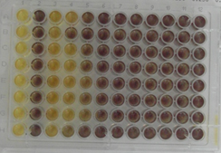
Cytotoxic Activity of Coleon Diterpenoids from Plectranthus mutabilis Codd.
1D- and 2D-NMR
Graphical Abstract
Plectranthus mutabilis Codd.
Structure elucidated
LC/MS
Bio-guided isolation of the most active extract:
P. mutabilis Codd.
HRMS
Ultrasound-assisted Extraction method
Cytotoxicity Study
Toxicity study:
General toxicity (Artemia salina)
Cytotoxicty (Cancer and normal Human cell lines)

Slide 3
Abstract:
Despite the great development in Human medicine, cancer is still a serious threat to public health and consequently, research on new anticancer agents should be continued. Natural products from medicinal plants (e.g., Plectranthus species) continue to be a substantial resource to treat different diseases, particularly in developing countries [1, 2]. Plectranthus species are rich in diterpenoids, which are reported to be responsible for various pharmacological activities such as cytotoxic activity [1]. P. mutabilis Codd. is a perennial succulent herb containing Nepetoidins A and Nepetoidins B in its essential oils and have limited information available in the literature [3].
In this study, we performed an ultrasound-assisted acetone extraction of air-dried P. mutabilis whole plant followed by a bio-guided fractionation using the Artemia salina general toxicity assay that resulted in the identification of four compounds: Coleon U quinone (1), 8α,9α-Epoxycoleon U quinone (2), Coleon U (3) and 7-hydro,14-deoxycoleon U (4) [4]. The cytotoxicity of the isolated compounds and P. mutabilis extract was evaluated using a model system of sensitive (NCI-H460) and MDR (NCI-H460/R) cells, along with normal human embryonal bronchial epithelial cells (MRC-5). Studies of modulation of P-gp activity are ongoing to unveil the interaction of these compounds and extract with P-gp.
Keywords: Plectranthus, Coleon, Cytotoxicity, P-gP

Slide 4
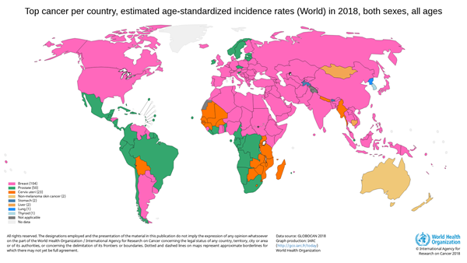
Introduction
Cancer is still a serious threat to public health
Cancer –2nd leading cause of death worldwide
18.1 million new cases and
1 in 6 deaths is due to cancer in 2018

Slide 5
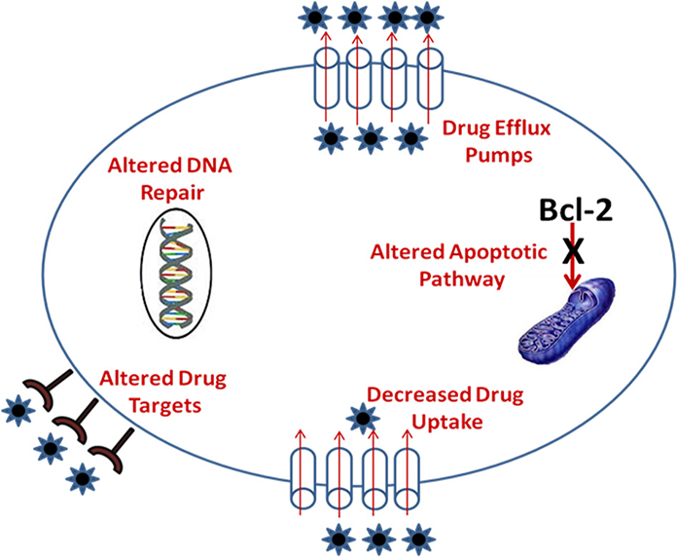
Introduction
Multidrug-resistant (MDR)
Major challenge to cancer therapy
Need to develop new reversal MDR agents

Slide 6







Introduction
Plectranthus genus
Natural products: source of bioactive compounds
Plectranthus genus (Lamiaceae) uses:
Treatment of different types of cancer
Source of bioactive compounds:
abietane-type diterpenoids
antibacterial, antifungal and antitumoral

Slide 7
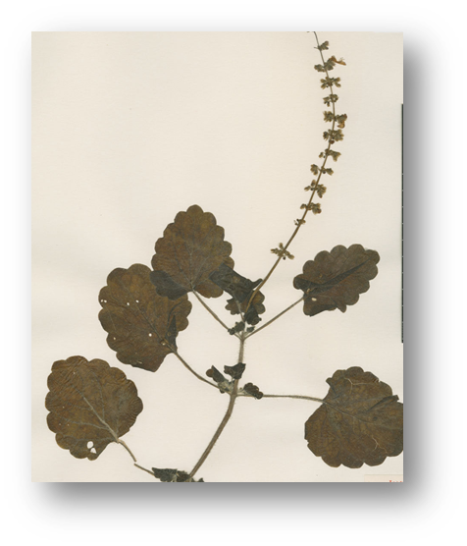
Introduction
Plectranthus mutabilis
Limited phytochemical literature information
Chemical constituents in essential oils only reveals:
Nepetoidins A and Nepetoidins B
 | R₁ | R₂
Nepetoidins B | H | OH
Nepetoidins A | OH | H
Grayer et al, Phytochemistry ,(2003), 519–528

Slide 8
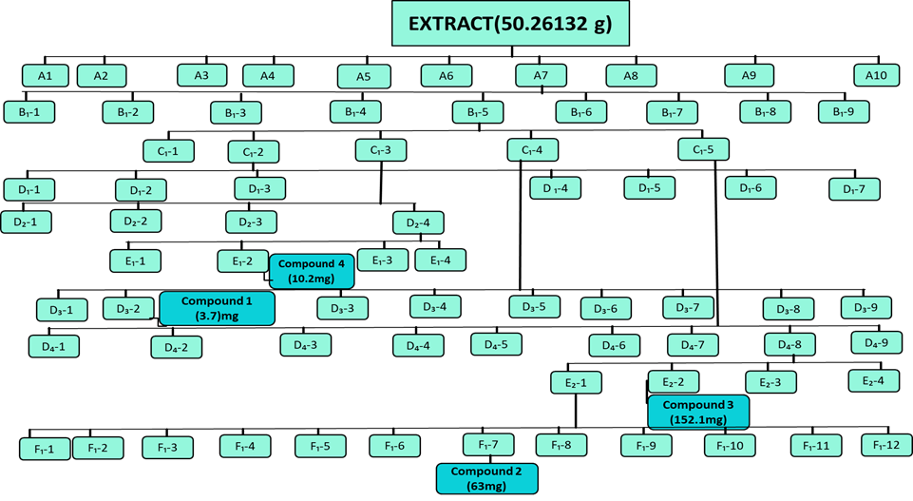
Bio-guided Isolation of Four Abietane diterpenoids from P. mutabilis
Flash chromatography
Stationary Phase: Silica and Polyamid, 100g
Eluent: increasing polarity
Semi-preparative HPLC
C18 column (kinetex 5u XB-C18 100A, 250 x 21.2mm)
53% aqueous acetonitrile

Slide 9
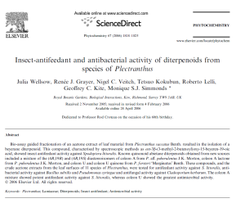
Characterization of isolated compounds
Structure elucidated
1D- and 2D-NMR
¹H, ¹³C, HMBC, HSQC, COSY, NOESY
LC/MS
HRMS
Available Literature
Coleon U quinone (1)
HMBC
Available literature
8α,9α-Epoxycoleon U quinone (2)

Slide 10
Results and discussion
Diterpenoids from isolated P. mutabilis
Coleon U quinone
MM=344
[M+H]⁺ m/z = 345
HRMS m/z 345.1711 [M]⁺ (calcd. for C₂₀H₂₄O₅, 345.1697
8α,9α-Epoxycoleon U quinone
MM=360
[M+H]⁺ m/z = 361
[M-H]⁻ m/z = 359
HRMS m/z 361.1658 [M]⁺ (calcd. for C₂₀H₂₄O₆, 359.1502)
Coleon U
MM=346
[M-H]⁻ m/z = 345
HRMS m/z 345.1708 [M]⁻ (calcd. C₂₀H₂₄O₅, 345.1707).
7-hydroxy,14-deoxycoleon U
MM=332
[M-H]⁻ m/z = 331

Slide 11
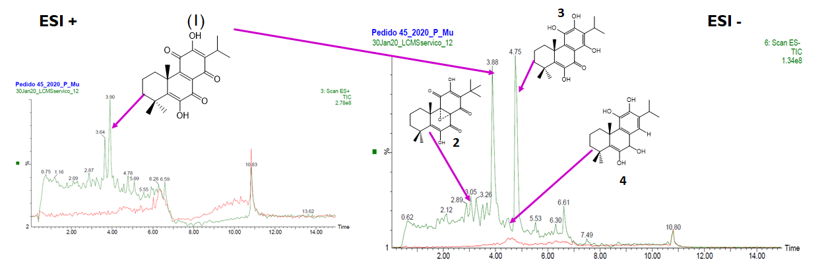
LC/MS analysis of 4 compounds from P. mutabilis
Chromatographic profiles of P. mutabilis extract and identification of 4 isolated compounds
All the compounds were found to be present in the extract
Coleon U quinone (1) and Coleon U (3) seem to be the major compounds in extract

Slide 12
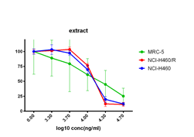
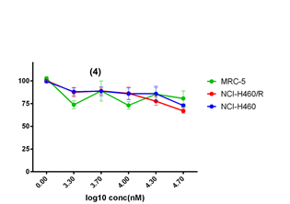
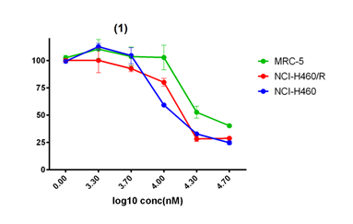
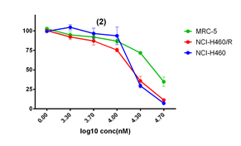
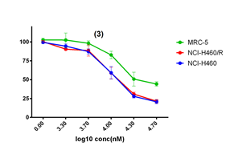
Cytotoxicity study: MTT assay, IC₅₀ values in μM
Compounds | NCI-H460 | NCI-H460/R | MRC-5
Coleon U Quinone (1) | 22.96±0.56 | 20.37±0.43 | 44.13±1.19
8α,9α-Epoxycoleon U quinone (2) | 20.23±0.59 | 17.26±0.26 | 40.22±0.44
Coleon U (3) | 14.11±0.19 | 14.50±0.18 | 35.47±0.56
Mutabilol (4) | 112.58±2.05 | 81.14±1.13 | 120.25±4.69
P. mutabilis extract | 15.30±0.37 | 15.66±0.47 | 16.68±0.69
Compounds 1, 2 and 3 are selective towards cancer cells
Compound 4 is not cytotoxic in a given range of concentrations (2 to 50 µM)
All compounds are not substrates for P-gp

Slide 13

Conclusions
P. mutabilis extract contains: Coleon U quinone, 8α,9α-Epoxycoleon U quinone, Coleon U and 7-hydro,14-deoxycoleon U.
Coleon U quinone is one of the major compounds in extract
Compounds 1, 2 and 3 are selective towards cancer cells due to lower IC₅₀ in cancer cells than in normal bronchial fibroblasts
Compound 4 is not cytotoxic in a given range of concentrations (2 to 50 µM).
All compounds are not substrates for P-gp

Slide 14





Acknowledgments
This project is funded by the
-UIDB/04567/2020, UIDP/04567/2020
-PADDIC 2019 (ALIES-COFAC)
-Short Term Scientific Mission (STSM) of the COST ACTION: CA17104

