Slide 1
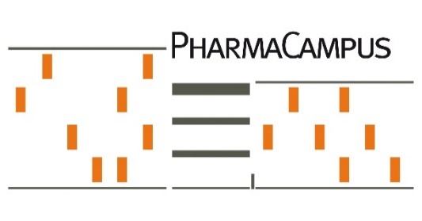
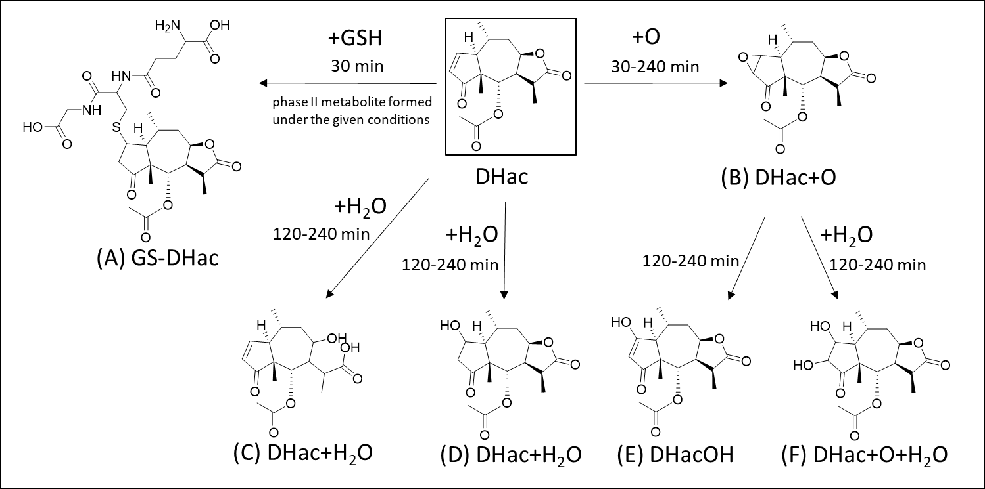
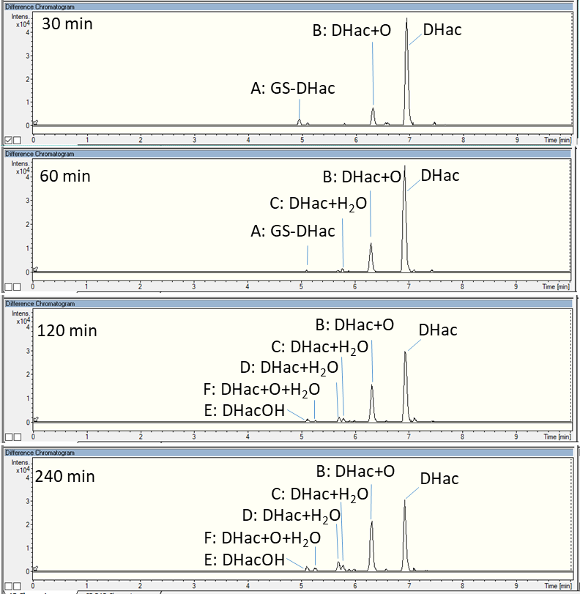
In vitro metabolism of 11α, 13-dihydrohelenalin acetate, a sesquiterpene lactone from Arnica
Franziska M. Jürgens¹, Matthias Behrens² and Thomas J. Schmidt¹
¹ Institute of Pharmaceutical Biology and Phytochemistry (IPBP), University of Münster, Corrensstraße 48, D-48149 Münster, Germany
² Institute of Food Chemistry, University of Münster, Corrensstraße 45, D-48149 Münster, Germany
Correspondence: franziska.juergens@uni-muenster.de and thomschm@uni-muenster.de
Introduction
Arnica montana preparations are used for the topical treatment of injuries and inflammations, as well as rheumatic muscle and joint complaints [1]. Ester derivatives of the sesquiterpene lactones (STL) helenalin as well as 11α,13-dihydrohelenalin are known to be the active compounds in Arnica preparations [2]. Leishmaniasis is one of the 20 communicable diseases currently classified by WHO as neglected tropical diseases. In recent studies an ethanolic tincture of A. montana flowers effectively cured cutaneous leishmaniasis (CL) in a golden hamster model [3]. To use Arnica preparations on open wounds such as CL lesions, absorption, distribution, metabolism and excretion of Arnica constituents have to be analysed.
Experiments
Experiments on phase I in vitro metabolism were carried out with pig liver microsomes (PLM) and an NADPH regenerating system following the protocol of Sohl et al. [4]. Incubation of 11α,13-dihydrohelenalin acetate (DHac) with PLM was quenched after 30, 60, 120 and 240 min, respectively and metabolites were detected and identified with UHPLC-Qq-TOF MS/MS analysis (cf. Fig. 1). Difference chromatograms of the samples and matrix control samples were calculated with MetaboliteDetect 2.0 (Bruker Daltonics). Fig. 2 shows a schematic overview of the detected metabolites.
Results
Fig 2. Proposed chemical structures of detected metabolites of 11α,13-dihydrohelenalin acetate (DHac).
Glutathione was added to the cyclopentenone moiety of DHac, which is a strong Michael acceptor (metabolite A). Furthermore, we found hints for the formation of an epoxide (B), and its rearrangement and hydrolytic opening after 120 min of incubation, leading to the metabolites F and E, respectively. Besides, two metabolites were formed by addition of water which is supposed to attach at the double bond of the cyclopentenone moiety (D) and to open the lactone ring (C).
Conclusions and Outlook
In vitro experiments with PLM indicate the formation of a glutathione adduct, an epoxide and hydroxides of DHac.
Analogous experiments with helenalin acetate as well as experiments including phase II reactions and with microsomes of other species (incl. human) are planned.
In vivo metabolism will be examined by rat urine, plasma and feces analysis for the unchanged STLs and their metabolites after dermal application of Arnica tincture.
Fig 1. UHPLC/+ESI-QqTOF MS difference chromatograms of 11α,13-dihydrohelenalin acetate (DHac) and its metabolites after incubation with PLM.
References
[1] EMA. (2014). EMA/HMPC/198793/2012.
[2] Lyss G, et al. (1998). J. Biol. Chem. 273(50): 33508-33516.
[3] Robledo SM, et al. (2018). Molecules 23(1): 150.
[4] Sohl DC, et al. (2009). Nat. Protoc. 4(9): 1252-1257.
Acknowledgements
We thank the Wilhelm Doerenkamp-Foundation, Chur, Switzerland, for financial support and Prof. Dr. H.-U. Humpf, WWU Münster, for the support concerning the in vitro metabolism studies.

