Slide 1
Gene expression profile in peripheral blood cells of patients with COVID-19
Nataliia Melnichuk *¹, Viktor Liashko ², Vladimir Kashuba ¹, Zenoviy Tkachuk ¹
¹ Institute of Molecular Biology and Genetics, National Academy of Sciences of Ukraine, Kyiv, Ukraine;
² Ministry of Health of Ukraine, Kyiv, Ukraine.

Slide 2
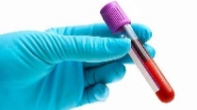
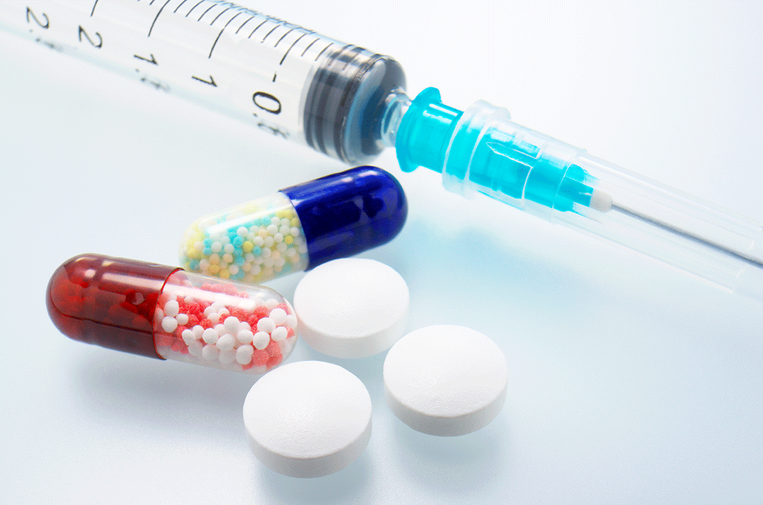
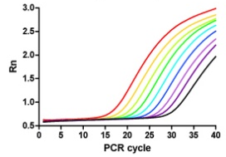
Title of the Presentation
2
2

Slide 3
Abstract:
The clinical course of coronavirus disease 2019 (COVID‐19) varies from mild symptoms to acute respiratory distress syndrome, hyperinflammation, and coagulation disorder. The hematopoietic system plays a critical role in the observed hyperinflammation, particularly in severely ill patients. Using peripheral blood cells (PBCs) for gene expression analysis is valuable to evaluate disease-associated and drug-response related genes. In this study, we aimed to explore the gene expression profile of PBCs in patients with COVID‐19. Whole blood samples were collected from 19 patients with acute COVID‐19 infection and 20 healthy volunteers. The gene expression of PBCs was determined by RT-qPCR. We investigated the expression of cytokines, chemokines, interferon-stimulated, pro-oxidation, and coagulation genes in PBCs of the infected and healthy samples. Up-regulated expression of some genes was found out in the blood of COVID‐19-infected patients compared to the healthy sample. We have identified some genes in whole blood that classifies COVID‐19-infected and healthy patients with good accuracy. These results suggested that the expression of cytokines, coagulation, and interferon-stimulated genes in PBCs can be used for early detection of hyperinflammation, coagulation disorders, and evaluation of efficiency treatment of this disease.
Keywords
coagulation, COVID‐19, gene expression, hyperinflammation, peripheral blood cells

Slide 4
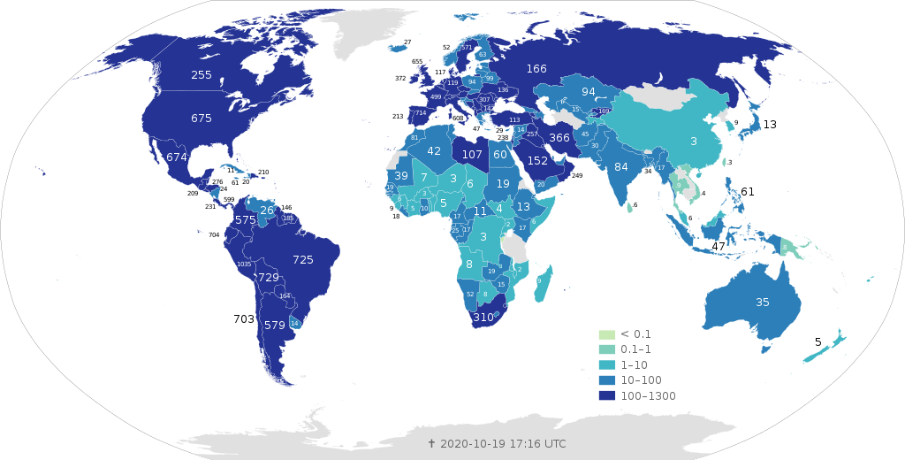
Introduction
Coronavirus SARS-CoV-2 is the etiologic agent for COVID-19, a disease from which over 1180,000 persons have died in the past 10 months. The clinical course of COVID‐19 varies from mild symptoms to acute respiratory distress syndrome, hyperinflammation, and coagulation disorder. Patients with COVID19 have a higher risk of developing blood clots (thrombosis) mainly in their lungs which is associated with higher death. In ~70% of COVID-19 patients, who died had disseminated intravascular coagulation. The blood clots can be in both venous and arterial circulations, clots in small blood vessels.
Total confirmed deaths per million
of COVID-19 by country and territory
https://en.wikipedia.org/wiki/COVID19_pandemic_by_country_and_territory

Slide 5
Introduction
Endothelium plays a key role in the pathogenesis of coagulation disorders in infectious diseases and is important for the initiation and regulation of haemostatic. Although direct interactions between the infectious agent and the endothelial cells occur, cytokines—also endothelial-derived—are believed to be important mediators in this process.
Vessel–lung tissue interface in normal state and in COVID-19 disease
Te uwen, L. et al. Nat Rev Immunol, 2020. https://doi.org/10.1038/s41577-020-0343-0

Slide 6
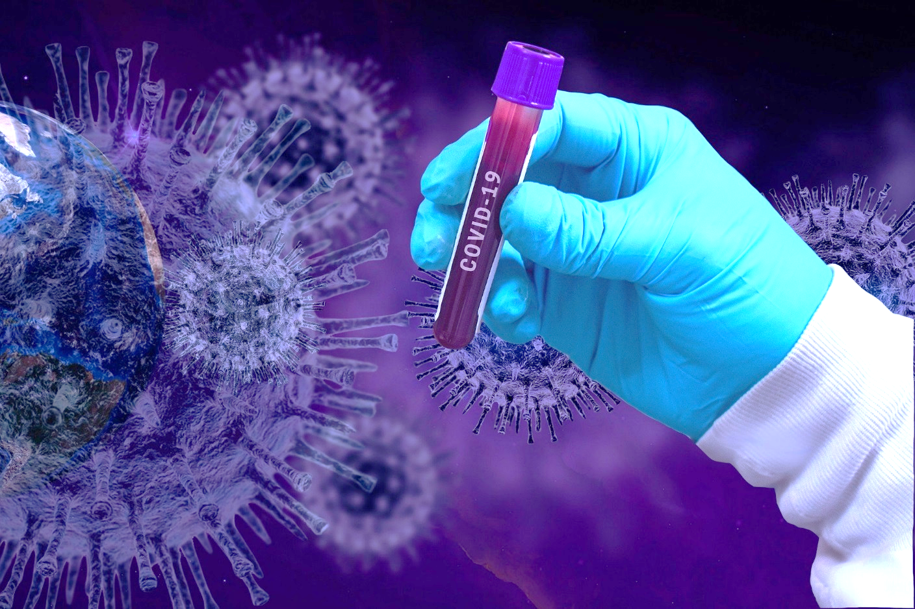
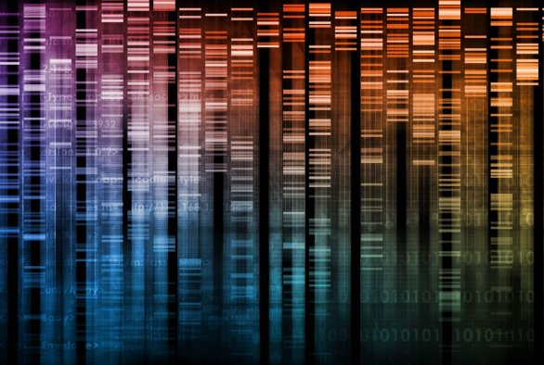
Introduction
.
The hematopoietic system plays a critical role in the observed hyperinflammation, particularly in severely ill patients. Using peripheral blood cells (PBCs) for gene expression analysis is valuable to evaluate disease-associated and drug-response related genes. Early detection of inflammation and coagulation markers can indicate the onset of a cytokine storm, coagulation disorder and assist clinicians with timely interventions. So the aim of our study was to explore the gene expression profile of PBCs in patients with COVID‐19 and to find out genetic markers that indicate the onset of a cytokine storm, coagulation disorder.

Slide 7
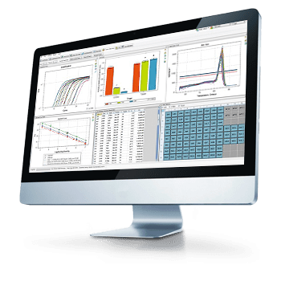
Results and discussion
Whole blood samples were collected from patients with acute COVID‐19 infection (n=19) and healthy volunteers (n=20). The gene expression of PBCs was determined by RT-qPCR.
We investigated the expression of cytokines (IL6, IL8, IL10, IL10R2, IL12, IL18, TNFα), chemokines (CCL, CXCL10), coreceptors (CD4, CD80) interferon-stimulated (OAS1, OAS3, RNASEL, MX1, EIF2AK2), pro-oxidation (ARG2, NOS2, XDH), and coagulation (F5, F10) genes in PBCs of the infected and healthy samples.
Sampling
RNA analysis
RT-qPCR
RNA isolation
cDNA synthesis
Data interpretation
Schematic representation of
the gene expression analysis
Samples were normalized to TBP as a reference control. The Mann–Whitney U test was used to assess statistical differences in gene mRNA level values.

Slide 8
Results and discussion
Up-expression of IL8 and TNFα
in PBCs of the COVID‐19-infected patients
ns
*
****
The mRNA level of cytokines in PBCs of the COVID‐19-infected patients. ****P˂0.0001 vs. Control; *P˂0.05 vs. Control; ns, non significant vs. Control.

Slide 9
Results and discussion
Hyperexpression of IL10 and IL12
in PBCs of the COVID‐19-infected patients
***
ns
****
ns
The mRNA level of cytokine genes in PBCs of the COVID‐19-infected patients. ****P˂0.0001 vs. Control; ***P˂0.001 vs. Control; ns, non significant vs. Control.

Slide 10
Results and discussion
Increased expression of CD80
in PBCs of the COVID‐19-infected patients
ns
ns
ns
*
The mRNA level of chemokines and coreceptors in PBCs of the COVID‐19-infected patients. ****P˂0.0001 vs. Control; ns, non significant vs. Control.

Slide 11
Results and discussion
High expression of F5 and F10
in PBCs of the COVID‐19-infected patients
***
**
The mRNA level of coagulation genes in PBCs of the COVID‐19-infected patients. ***P˂0.001 vs. Control; **P˂0.01 vs. Control.

Slide 12
Results and discussion
Up-expression of OAS1, OAS3, and RNASEL
in PBCs of the COVID‐19-infected patients
***
****
****
The mRNA level of interferon-stimulated genes in PBCs of the COVID‐19-infected patients. ****P˂0.0001 vs. Control; ***P˂0.001 vs. Control.

Slide 13
Results and discussion
Hiperexpression of MX1 and EIF2AK2
in PBCs of the COVID‐19-infected patients
****
***
The mRNA level of interferon-stimulated genes in PBCs of the COVID‐19-infected patients. ****P˂0.0001 vs. Control; ***P˂0.001 vs. Control.

Slide 14
Results and discussion
Increased expression of ARG2
in PBCs of the COVID‐19-infected patients
**
ns
ns
The mRNA level of pro-oxidation genes in PBCs of the COVID‐19-infected patients. **P˂0.01 vs. Control; ns, non significant vs. Control.

Slide 15
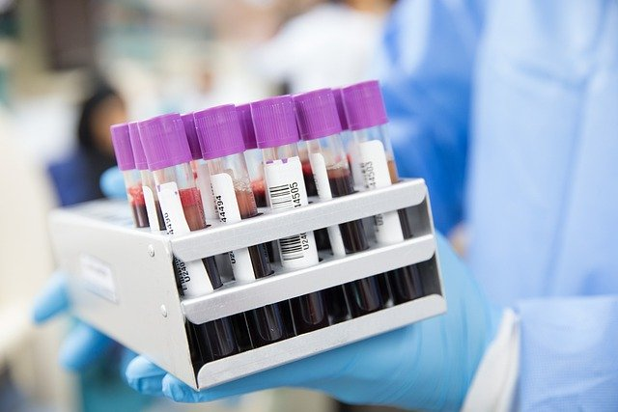
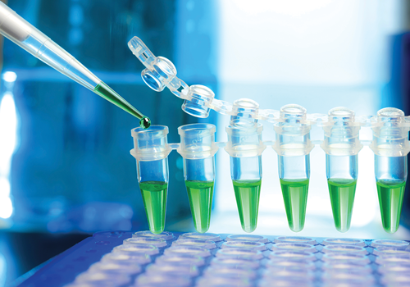
Results and discussion
Expression of the IL8, IL10, IL12, TNFα, CD80, OAS1, OAS3, RNASEL, MX1, EIF2AK2, F5, F10, ARG2 was increased in the PBCs of COVID‐19-infected patients compared to the healthy sample. These genes can be used as genetic markers for early detection of hyperinflammation and coagulation in patients with acute COVID‐19 and evaluation of efficiency treatment of this disease.

Slide 16
Conclusions
Up-regulated expression of IL8, IL10, IL12, TNFα, CD80, OAS1, OAS3, RNASEL, MX1, EIF2AK2, F5, F10, ARG2 genes was found out in the blood of COVID‐19-infected patients compared to the healthy sample;
mRNA expression of IL8, IL10, IL12, TNFα, CD80, OAS1, OAS3, RNASEL, MX1, EIF2AK2, F5, F10, ARG2 classifies COVID‐19-infected and healthy patients with good accuracy in whole blood;
Gene expression profile in PBCs can be used for early detection of hyperinflammation, coagulation disorders, and evaluation of efficiency treatment of this disease.

Slide 17
Acknowledgments

