Slide 1




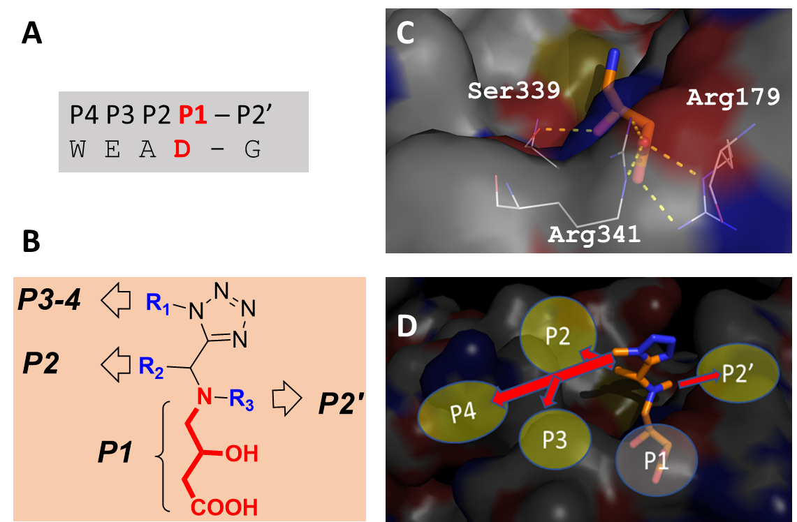
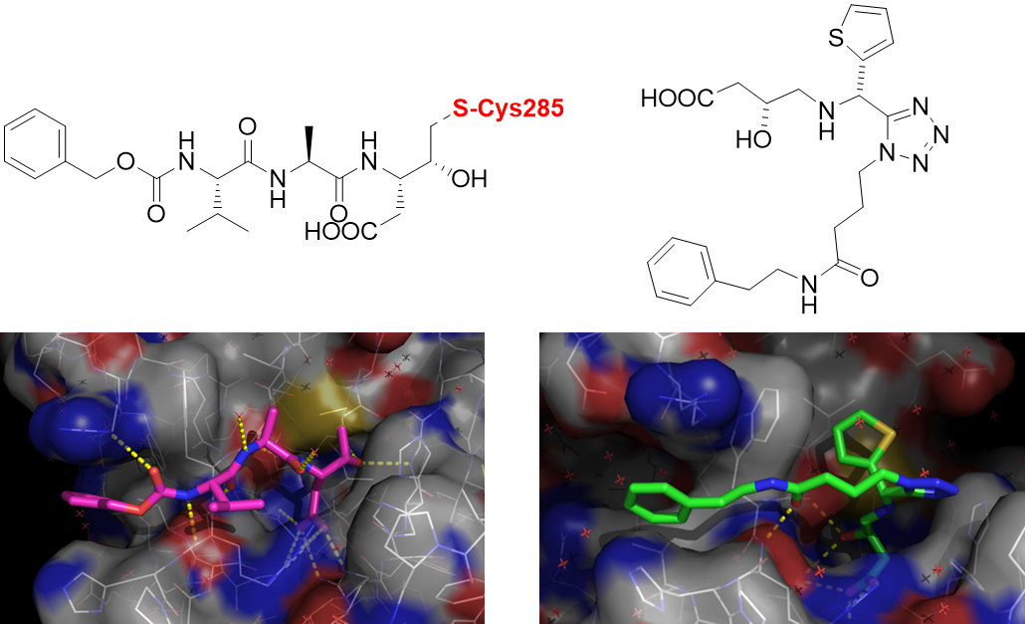

Non-covalent Inflammasome-Caspase-1 Complex Inhibitors:
New Molecules Targeting Immune and Inflammatory Disorders Including Covid-19
Fausta Ulgheri,*¹ Pietro Spanu,*¹ Francesco Deligia,¹ Giovanni Loriga,¹ Maria Pia Fuggetta,² Andrea Morra,¹ Iris de Haan,³ Ajay Chandgudge,³ Matthew R. Groves,³ Alexander Domling*³
¹ Istituto di Chimica Biomolecolare - CNR, Italy;; ² Istituto di Farmacologia Traslazionale - CNR, Italy;; ³Department of Drug Design, University of Groningen, Groningen, The Netherlands
fausta.ulgheri@cnr.it
INTRODUCTION
The release in the cytosol of potent pro-inflammatory mediators interleukin-1β and interleukin 18, triggered by activation of inflammasome-caspase 1 complex in response to danger signals, culminates in beneficial immune responses.^{1,2} However, there is a growing evidence of the relation between innate immunity, excessive release of pro-inflammatory IL-1β and various immune and inflammatory disorders, including CNS diseases such as Alzheimer's (AD), Parkinson’s (PD) and Huntington's (HD) diseases, amyotrophic lateral sclerosis (ALS), and multiple sclerosis (MS).³ Moreover there is also a growing evidence⁴ that the pathway inflammasome NLRP3/Caspase-1 is overactivated by the SARS-Cov-2 and may be responsible for the high mortality observed in the COVID-19 patients due to the inflammatory internal organs collapse driven by the cytokine storm induced by the virus. It is now quite clear that an effective pharmacological approach to Covid-19 must comprise an antiviral drug in combination with an inflammation modulator able to regulate the innate immunity system response preserving its regular activity but quenching its overactivation. For all of these reasons a new caspase-1 inhibitor drug could be a useful tool to treat inflammation driven diseases including Covid-19.
Compounds inhibiting the caspase-1 activity with covalent mode of action (MoA) have been proposed as promising new therapeutics by modulating immune and inflammatory response, but until now there are no caspase-1 inhibitor drugs approved for clinical use on the market (Figure 1). Novel, improved, compounds characterized by a different MoA are needed. We have designed a new class of non-covalent, non-peptidic, small molecule caspase-1 inhibitors by structure-based drug design in order to obtain a new class of stable and bioavailable inhibitors.
DESIGN
Our design of non-covalent caspase-1 inhibitors is based on a substrate mimicry approach (Figure 2). The WEAD (trp-glu-ala-asp) sequence is generally recognized by caspase-1 and target proteins are always aspartyl-cleaved (P1 = Asp). Thus, we aimed to design non cleavable aspartyl mimicking scaffolds which would allow for easy modification in further positions to address P2-P4 sites. Multicomponent reaction (MCR) chemistry was used to address a large drug-like scaffold space and in particular the Ugi tetrazole variation (UT-4CR). Our design includes a 4-amino-3-hydroxy butanoic acid, as amine component, mimicking the aspartyl P1 side chain with significative interaction to protein bonding sites. (Figure 3)
Figure 1. Caspase 1 inhibitors progressed in clinical trials
Figure 2. Caspase-1 inhibitor design.
Figure 3
SYNTHESIS OF TARGET COMPOUNDS 5
The multicomponent reaction (MCR) approach was used for the synthesis of desired compounds 5, because it offers a significant advantage over conventional linear step synthesis permitting the one pot assembly of very complex structures (Scheme 1). In order to meet the requirements established by the computational approach four component (1-4) were needed for the Ugi tetrazole variation (UT-4CR).
IC₅₀ ENZYMATIC TEST RESULTS
Scheme 1. Reagents and conditions: (a) CH₃OH, Na₂SO₄, Et₃N, rt; (b) NaOH, CH₃OH
REFERENCES
1) P. Broz, V. M. Dixit. Nat. Rev. Immunol. 2016, 16: 407–420.
2) a) S. M. Man, T.-D. Kanneganti. Immunol. Rev. 2015, 265: 6–21; b) E.-K. Jo et al. Cell. Mol. Immunol. 2016, 13: 148–159.
3) a) E. Ozaki et al. J. Inflamm. Res. 2015, 8: 15–27; b) L. Gao et al. Inflamm. Res. 2017, 66: 17-24; c) N. Khan et al. Inflammopharmacology 2018, 26: 77–86; d) J. P. de Rivero Vaccari et al. Transl. Res. 2016, 167: 35–45; e) C. Pellegrini et al. Front. Immunol. 2017, 8, article 36; f) Y.-S. Yi. Korean J. Physiol. Pharmacol. 2018, 22: 1-15; g) L. Song et al. Front. Cell. Neurosci. 2017, 11, article 63; h) J. G. Walsh et al. Nat. Rev. Neurosci. 2014, 15: 84–97.
4) a) V. Quagliariello et al. European Review for Medical and Pharmacological Sciences 2020, 24: 9169-9171; b) P. C. Lara et al., Aging&Disease 2020, 4; 756-762; c) A. Shah Front. Immunol. 2020, 11: article 1021; d) M. Z. Ratajczak, M. Kucia Leukemia 2020, 34: 1726–1729.
CONCLUSIONS
Through rational design and MCR based synthetic approach we obtained 1,5-disubstituted α-amino tetrazoles able to target the inflammasome NLRP3/caspase-1 pathway that could be of use for the treatment of dysregulated immune system diseases, including Covid-19. This new class of inhibitors showed an IC₅₀ in the low μM range. These compounds could be further optimized towards new inflammasome/caspase-1 pathway inhibitors, characterized by good potency and reduced toxicity. Further medicinal chemistry and pharmacological studies are in progress.
ACKNOWLEDGEMENT
Thanks to Dr. Maria Cristina Porcu for technical assistance and to Regione Sardegna for financial support

