Slide 1
In Silico Prediction of Biopharmaceutical Features of Remdesivir: A Serendipitous Drug for COVID-19
Anthony Allen Reeves, Subrata Deb*
Department of Pharmaceutical Sciences, College of Pharmacy, Larkin University, Miami, FL 33169, USA
* Corresponding author: Dr. Subrata Deb, E-mail: sdeb@alumni.ubc.ca / sdeb@ularkin.org

Slide 2
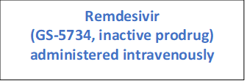
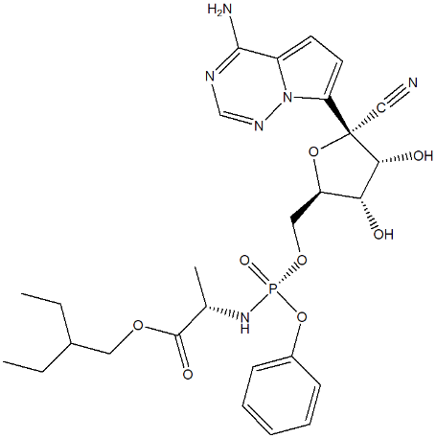
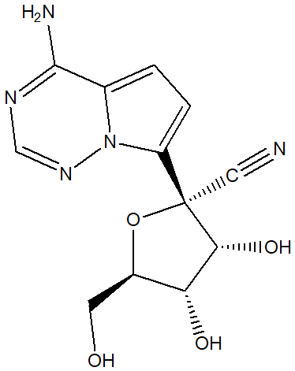
In Silico Prediction of Biopharmaceutical Features of Remdesivir: A Serendipitous Drug for COVID-19: Graphical Abstract
GastroPlus version 9.7
ADMET Predictor
PKPlus modules
Simulation

Slide 3
Abstract: Due to the novel nature of the Coronavirus Disease 2019 (COVID-19), there is limited or no standard treatment for it. Remdesivir is the only approved agent for COVID-19, however, there is limited information available about the physicochemical and pharmacokinetic (PK) properties of this drug. The objective of this in silico simulation work was to simulate the biopharmaceutical behavior of remdesivir. The Spatial Data File format structures of remdesivir prodrug and nucleoside core were obtained from the PubChem database to upload on the GastroPlus software 9.7 version. The Absorption, Distribution, Metabolism, Excretion and Toxicity (ADMET) Predictor and PKPlus modules were used to simulate physicochemical and PK properties, respectively, in healthy and predisposed patients. Remdesivir’s nucleoside core (GS-441524) was more hydrophilic than the inactive prodrug (GS-5734) with nucleoside core demonstrating better water solubility. Both had low blood brain barrier penetration while GS-5734 predicted to be 100% metabolized by CYP3A4. The bioavailability (Fa%, F%, Cmax, CmaxLiver) of GS-5734 was higher than GS-441524. In addition, there was limited effect of renal function, liver function, weight, or age on the PK profile of remdesivir. GS-5734 (inactive prodrug) appears to be a superior remdesivir derivative due to its hepatic stability, optimum hydrophilic/lipophilic nature, and disposition properties with limited effect of patient physiological conditions.
Keywords: Remdesivir, COVID-19, ADME, Pharmacokinetics, GastroPlus

Slide 4
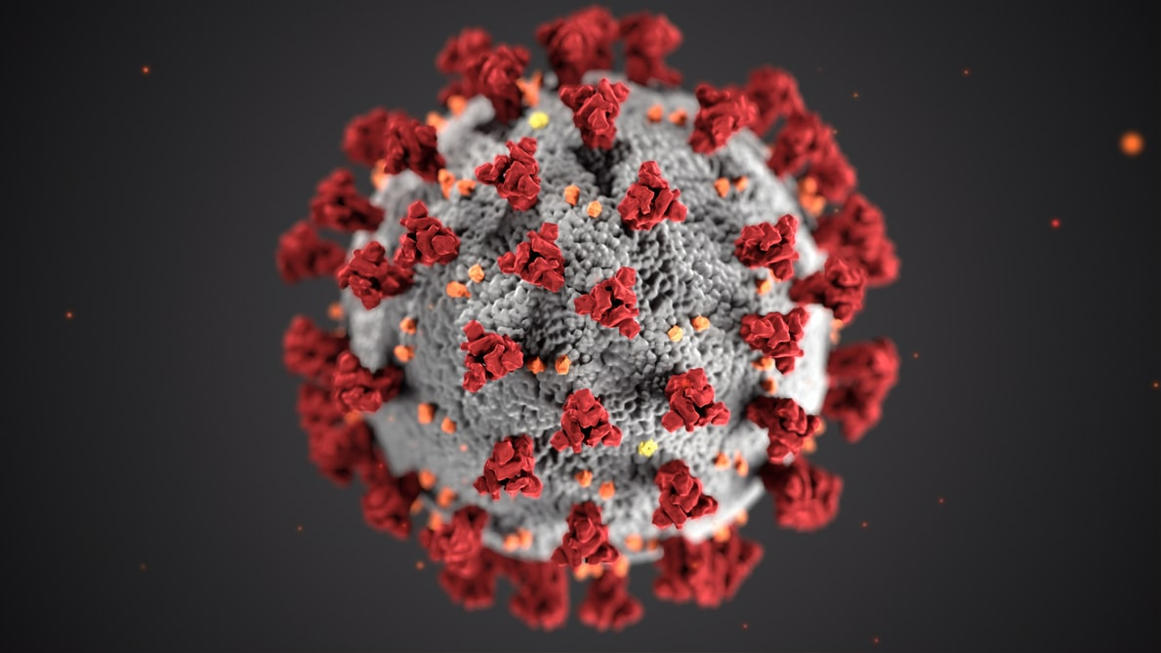
Introduction: Coronavirus
Coronavirus disease of 2019 (COVID-19) is caused by the novel beta coronavirus called severe acute respiratory syndrome coronavirus 2 (SARS-CoV-2)
Single-stranded, glycoprotein enveloped, positive-sense RNA viruses
It consists of four subgroups (alpha, beta, gamma, delta)
There are a total of seven coronaviruses that can infect humans
Alpha viruses: 229E, and NL63
Beta viruses: OC43, HKU1, MERS-CoV, SARS-CoV, and SARS-CoV-2

Slide 5
Introduction: Remdesivir Treatment of COVID-19
On October 22, 2020 the FDA made remdesivir as the only approved drug against COVID-19.
Remdesivir was originally developed against Ebola virus but has shown to be somewhat effective against COVID-19.
Although FDA has approved remdesivir for COVID-19, there is limited information available about its physicochemical and pharmacokinetic (PK) properties.
The objective of this in silico simulation work was to predict the biopharmaceutical properties of remdesivir.
Commissioner, Office of the. FDA Approves First Treatment for COVID-19, 22 Oct. 2020, www.fda.gov/news-events/press-announcements/fda-approves-first-treatment-covid-19.

Slide 6
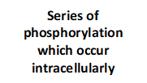
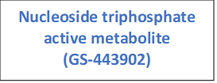
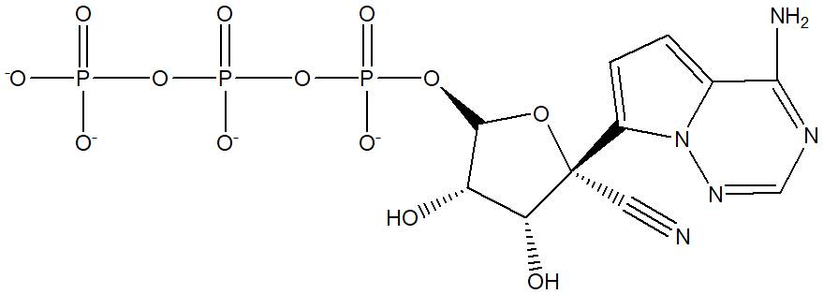
Introduction: Remdesivir Metabolism Pathway
Amirian ES, Levy JK. Current knowledge about the antivirals remdesivir (GS-5734) and GS-441524 as therapeutic options for coronaviruses. One Health. 2020;9:100128.
Kim S, Chen J, Cheng T, et al. PubChem 2019 update: improved access to chemical data. Nucleic Acids Res. 2019;47(D1):D1102–D1109.

Slide 7
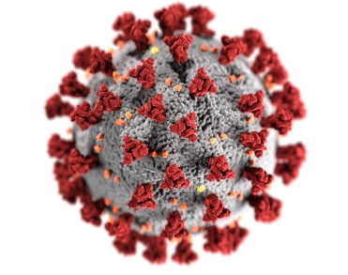
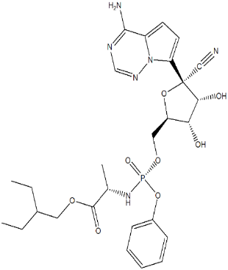
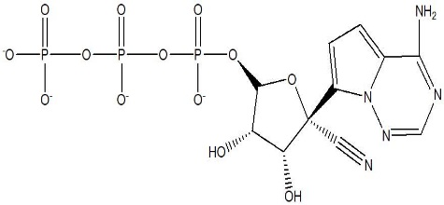
Introduction: Remdesivir Pharmacological Target
Remdesivir is an adenosine analog prodrug that converts metabolically to GS-441524. GS-441524 is then up taken by infected SARS-CoV-2 lung cells. Intracellularly GS-441524 becomes GS-443902 a nucleoside triphosphate metabolite after a series of phosphorylations. The active nucleoside triphosphate selectively inhibits its pharmacological target viral RNA-dependent RNA polymerase, preventing replication of SARS-CoV-2.
SARS-CoV-2
Endocytosis
RNA-dependent RNA
Polymerase (RDRP)
Replication of
SARS-CoV-2
ACE-2
Remdesivir Inhibits
viral RDRP
preventing SARS-CoV-2
replication
GS-441524
GS-5734
GS-443092
Yan VC, Muller FL. Advantages of the Parent Nucleoside GS-441524 over Remdesivir for Covid-19 Treatment. ACS Med Chem Lett. 2020;11(7):1361-1366.
SARS-CoV-2 image: Eckert, Alissa. “SARS-CoV-2.” CDC: Public Health Image Library (PHIL), 2020, phil.cdc.gov/Details.aspx?pid=23312.

Slide 8
Methods
The Spatial Data File format structures of remdesivir prodrug and nucleoside core were obtained from the PubChem database to upload on the GastroPlus software 9.7 version.
The Absorption, Distribution, Metabolism, Excretion and Toxicity (ADMET) Predictor and PKPlus modules were used to simulate physicochemical and PK properties, respectively, in healthy and predisposed patients.
PK models simulated include:
Compartmental
Age 30, 70 kg, healthy
Age 30, 70 kg, moderate kidney impairment
Age 30, 70 kg, Child-Pugh score B
Age 30, 85.53 kg, BMI 32 Obese
Age 40, 87.58 kg, BMI 28 Overweight
Age 75, 70 kg, healthy

Slide 9
Results and Discussion
Table 1. Preliminary estimation of physicochemical properties of remdesivir using GastroPlus software.
Compound | log P | MW (g/mol) | Solubility (µg/mL) | Diff. Coeff (cm²/s x 10⁻⁵) | P_{eff} (cm/s x 10⁻⁴) | pKa Microstates
GS-5734, inactive prodrug | 1.6 | 602.59 | 0.023 | 0.51 | 0.0841 | Acid: 10.93 Base: 3.68
GS-441524, nucleoside core | -1.09 | 291.27 | 2.6 | 0.84 | 0.3 | Base: 3.76

Slide 10
Results and discussion
Table 2. Preliminary CYP-mediated predicted metabolism and ability to cross blood brain barrier (BBB) of remdesivir determined by ADMET Predictor feature of the GastroPlus software.
Compound | BBB penetration | Predicated CYP fm | Mechanism of Clearance
GS-5734, inactive prodrug | Low | 3A4 = 100% | Metabolism
GS-441524, nucleoside core | Low | N/A | Renal excretion
Table 3. Preliminary predicted pharmacokinetic properties using compartmental PK models.
Compound | Dose (mg) | CL (L/h) | T_{1/2} (h)
GS-5734, inactive prodrug | 200 | 48.81 | 1.18
GS-441524, nucleoside core | 400 | N/A | N/A

Slide 11
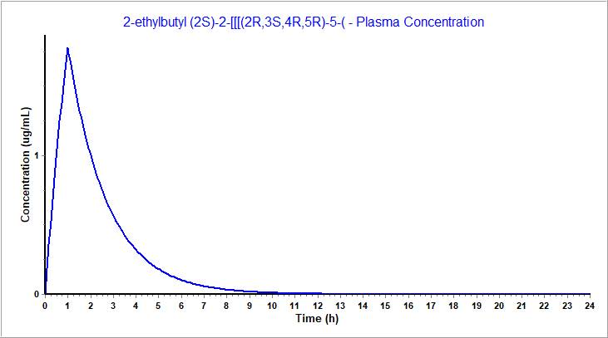
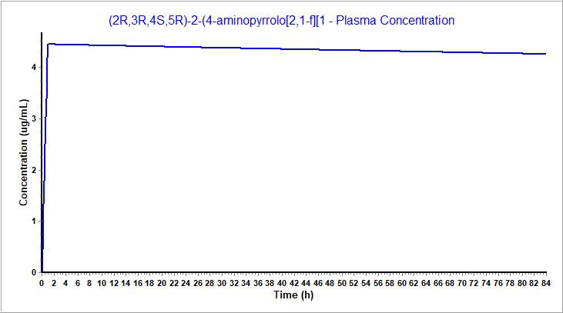
Results and discussion
Figure 1. Preliminary plasma concentration of 1-hour IV infusion of 200 mg remdesivir (GS-5734, inactive prodrug).
Figure 2. Preliminary plasma concentration of 1-hour IV infusion of 100 mg remdesivir (GS-441524, nucleoside core).
GS-5734, inactive prodrug (Plasma Concentration)
GS-441524, nucleoside core (Plasma Concentration)

Slide 12
Results and Discussion
Table 4. Preliminary predicted pharmacokinetic parameters of 1-hour IV infusion of 200 mg remdesivir (GS-5734, inactive prodrug) in different simulated populations. The PKPlus platform was used in a single compartment model.
Simulated populations (male) | Fa% | F% | C_{max} (µg/mL) | C_{max Liver} (µg/mL) | T_{max} (hr)(sim) | AUC _{0-∞} (µg -h/mL) | AUC ₀₋₂₄ (µg-h/mL)
Age 30, 70 kg, healthy | 99.67 | 99.50 | 9.46 | 3.95 | 1 | 5.74E+4 | 179.58
Age 30, 70 kg, moderate kidney impairment | 99.63 | 99.45 | 9.49 | 3.97 | 1 | 5.23E+4 | 181.38
Age 30, 70 kg, Child-Pugh score B | 99.56 | 99.34 | 8.77 | 3.68 | 1 | 4.32E+4 | 178.52
Age 30, 85.53 kg, BMI 32 Obese | 99.70 | 99.55 | 7.95 | 3.32 | 1 | 5.24E+4 | 147.82
Age 40, 87.58 kg, BMI 28 Overweight | 99.70 | 99.55 | 7.75 | 3.24 | 1 | 5.22E+4 | 145.16
Age 75, 70 kg, healthy | 99.67 | 99.50 | 9.74 | 4.05 | 1 | 5.72E+4 | 181.76

Slide 13
Results and discussion
Table 5. Preliminary predicted pharmacokinetic parameters of 1-hour IV infusion of 100 mg of GS-441524 (nucleoside core) in different simulated populations. The PKPlus platform was used in a single compartment model.
Simulated populations (male) | Fa% | F% | C_{max} (µg/mL) | C_{max Liver} (µg/mL) | T_{max} (hr)(sim) | AUC _{0-∞} (µg -h/mL) | AUC ₀₋₂₄ (µg-h/mL)
Age 30, 70 kg, healthy | 87.90 | 87.06 | 4.03 | 2.30 | 1 | 2175.10 | 263.72
Age 30, 70 kg, moderate kidney impairment | 87.70 | 86.85 | 3.98 | 2.27 | 1 | 2108.70 | 259.83
Age 30, 70 kg, Child-Pugh score B | 87.04 | 86.15 | 3.80 | 2.18 | 1 | 1995.50 | 259.02
Age 30, 85.53 kg, BMI 32 Obese | 88.12 | 87.29 | 3.60 | 2.05 | 1 | 1977.80 | 235.25
Age 40, 87.58 kg, BMI 28 Overweight | 88.39 | 87.57 | 3.40 | 1.94 | 1 | 1977.80 | 222.39
Age 75, 70 kg, healthy | 87.88 | 87.04 | 4.06 | 2.30 | 1 | 2175.10 | 264.07

Slide 14
Conclusions
GastroPlus software was useful in predicting physicochemical and pharmacokinetic properties remdesivir and its derivatives.
GS-5734, inactive prodrug was more lipophilic, and expressed a clearance via metabolism.
GS-441524, nucleoside core was more hydrophilic being eliminated via excretion.
GS-5734 (inactive prodrug) appears to be a superior remdesivir derivative due to its hepatic stability, optimum hydrophilic/lipophilic nature, and disposition properties with limited effect of patient physiological conditions.
Potential applications will require additional validation using further in vitro and in vivo studies.

Slide 15
Acknowledgments
GastroPlus software 9.7 version was provided to S.D. by Simulations Plus, Inc. (Lancaster, CA) as an in-kind research support.
For additional information and potential collaboration, please contact Dr. Subrata Deb at sdeb@alumni.ubc.ca / sdeb@ularkin.org

