Slide 1
Selection of RNA aptamers targeting the 3’ untranslated region of the West Nile Virus genome
Ana Hinckley Boned, Cristina Romero-López, and Alfredo Berzal-Herranz*
¹ Instituto de Parasitología y Biomedicina “López-Neyra”, IPBLN-CSIC
PTS Granada. Av del Conocimiento 17, 18016 Granada, Spain.
* Corresponding author: aberzalh@ipb.csic.es

Slide 2
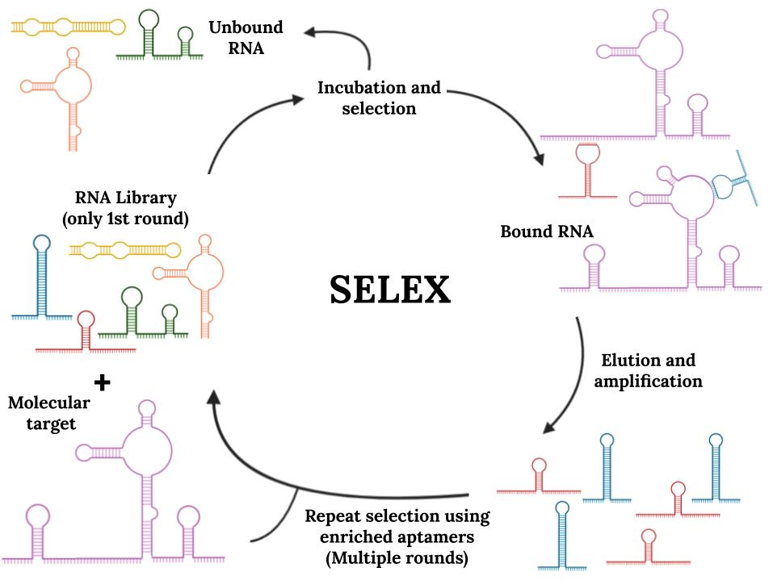
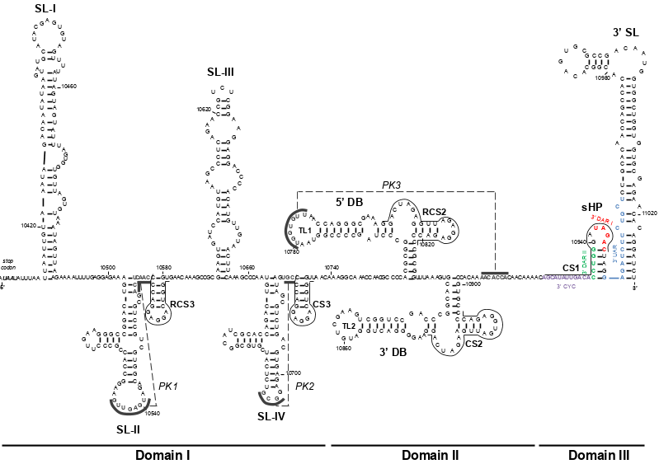
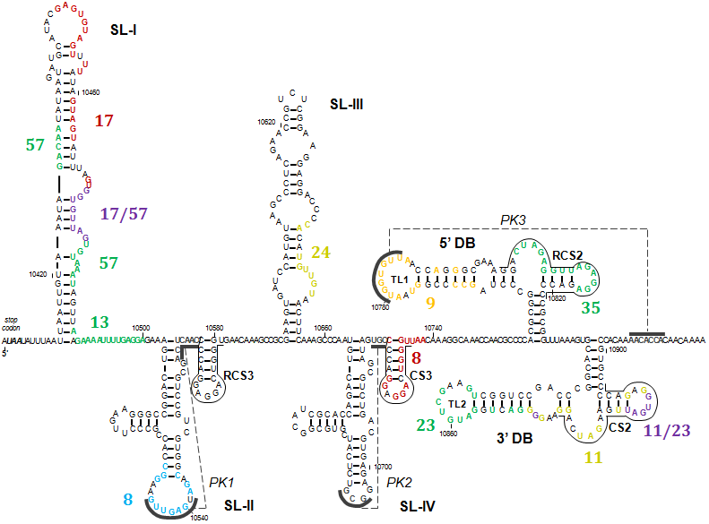
Selection of RNA aptamers targeting the 3’ untranslated region of the West Nile Virus genome
3’UTR region of WNV genome
3’WNV
In silico analysis of the aptamers from rounds 6 and 9 and their putative target sites

Slide 3
Abstract: West Nile Virus (WNV) is a positive polarity, single-stranded RNA virus that causes West Nile fever, for which no cure has been found to date. WNV, like other RNA viruses, needs to compact all the information to complete the viral cycle into a very small genome. Beyond the information that is stored in the primary structure, the genome of RNA viruses bear functional structural domains that perform multiple essential functions for the viral cycle. In WNV, several of these functional domains are found in the 3'UTR region. Based on the importance of these functional domains, in this work, RNA aptamers have been studied as a possible therapeutic agent. Aptamers are oligonucleotides with the ability to efficiently bind to a molecule, not taking into account only the sequence of the target but also its structural motifs. In this work, various aptamers directed against the 3'UTR region of WNV, which could potentially inhibit processes of the WNV viral cycle, have been analysed and selected by in silico analysis. We have also studied certain characteristics of the SL-I structural element of the WNV 3’UTR, which shows a high chance of interacting with host molecules. This work will lead further studies towards the generation of antiviral aptamers against WNV and a deeper understanding of WNV interaction with the host cell.
Keywords: aptamer, functional RNA domains, RNA genome, RNA structure, RNA-RNA interactions, West Nile Virus.

Slide 4
Introduction- WNV
Positive polarity single-stranded RNA virus
Disease
Vector
Genus
West Nile Fever
Culex mosquitoes
Flavivirus
-Outbreaks in 6 out of 7 continents.
-Symptoms: fever, neuroinvasive disease, death.
-No cure or vaccination.
Principal transmission cycle: bird-mosquito-bird.
Humans are accidental hosts.
Viruses causing: dengue, Zika, yellow fever, Japanese encephalitis ...

Slide 5
Introduction- Genome organization of WNV
Viral particles formation
Promoters, regulation of viral cycle
11 kb
Polyprotein processing
Host defenses antagonism
Replication
Assembling of viral particles

Slide 6
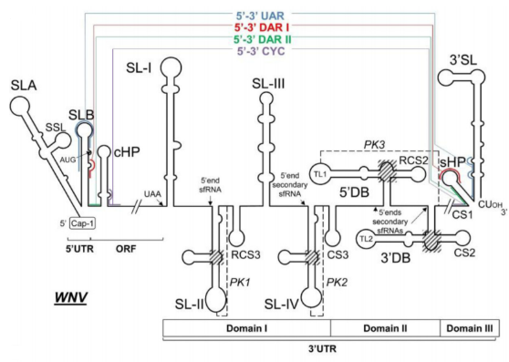
Introduction- Functional structural RNA elements of WNV genome
Conserved on the Flavivirus genus
Potential therapeutic targets
WNV → Small genome
+
Replication, translation, infectivity
Complex viral cycle
+
Need for coordination between replication and translation
Necessary compaction of information in elements superimposed on the sequence
Structural elements with fundamental functions for viral cycle regulation
Cycling control
Infectivity
Protein recruitment and RNA-RNA interactions
Schematic representation of the secondary structure of the 5’ and 3’ UTRs of the WNV RNA genome. The main structural motifs and proposed functions are depicted.

Slide 7
Introduction- Selection of Aptamers
Starting from a large synthetic single-stranded population of variable sequence oligonucleotides (DNA or RNA), typically ranging from 10¹² to 10¹⁶ variants, molecules able to efficiently bind to a target molecule with high specificity can be selected by a SELEX procedure. They are named Aptamers
They recognize both the primary structure and the three-dimensional conformation of the target
Schematic representation of the standard procedure for the selection of aptamers (SELEX). It consists of iterative cycles of binding, selection and amplification

Slide 8
Introduction- Aptamers against WNV genomic 3’UTR
Initial population of 66 nucleotides-long RNA molecule variants
Selection conditions | [RNA Pool] : [RNA Target] | Tº | Time | [MgCl2] | [NaCl]
Cycle 5-6 | 10:1 | 37ºC | 10’ | 1mM | 50mM
Cycle 7-9 | 100:1 | 37ºC | 10’ | 1mM | 50mM
fix PCR sequence
fix PCR sequence
25 nts randomly mutagenized
3’UTR region of WNV
genome
3’WNV

Slide 9
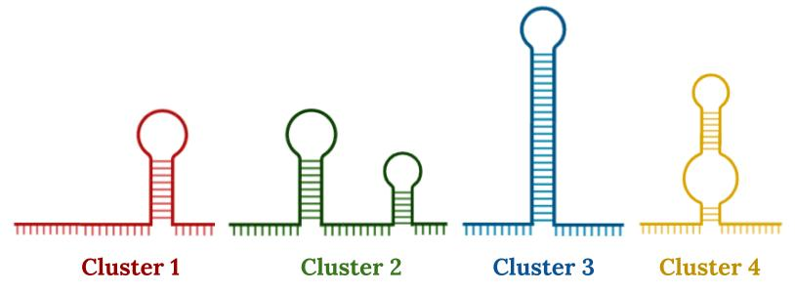
Results- Aptamers are structurally selected in for clusters
Aptamers secondary structure prediction by RNAStructure
Structural clustering by visual inspection
RNAstructure
Theoretical RNA aptamer secondary structure prediction
Cluster | P6-1 | P6-2 | P6-3 | Excluded | P9-1 | P9-2 | P9-3 | P9-4 | Excluded
Aptamers | 10 | 9 | 6 | 11 | 7 | 17 | 9 | 2 | 9
Table summarizes the number of aptamers classified in each cluster. Those representatives showing more than one theoretical structure prediction were excluded of the analysis.

Slide 10
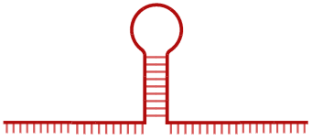
Results- Increase in the interaction affinity leads towards structurally complex aptamers
Increase in the number of aptamers included in more structurally complex clusters from round 6 to 9
Decrease of excluded aptamers
P6: 11/36 → P9: 9/44
10 → 7
9 → 17
6 → 9
0 → 2
Number of non excluded aptamers in round 6 and (→) 9 for each cluster
Fixation of secondary structures with the increase of affinity → higher structural complexity = higher affinity

Slide 11
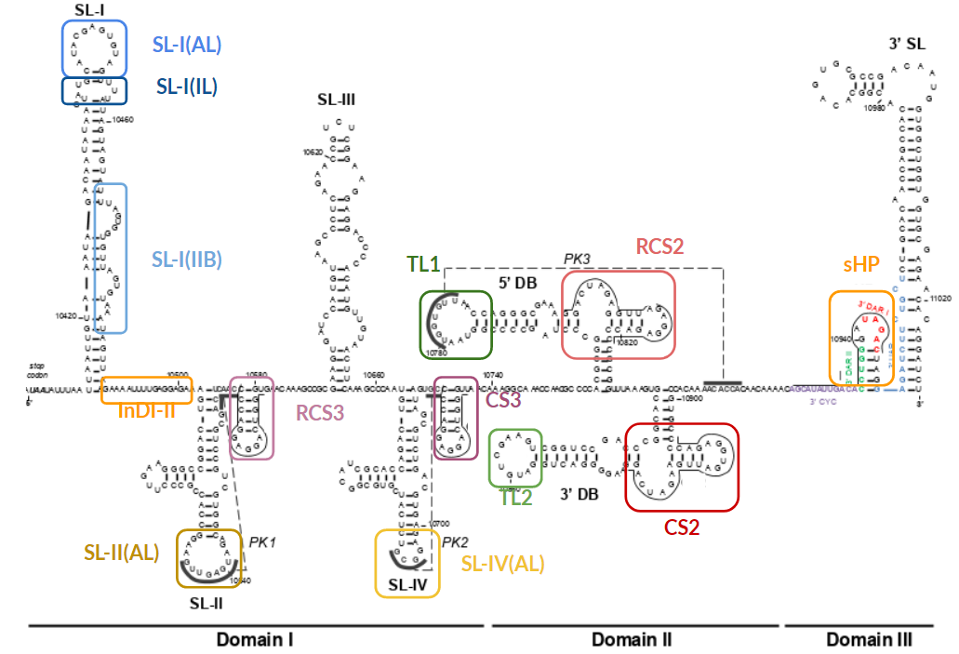
Results- Sequence motifs and structural elements of interest in the WNV 3’ UTR
AL: Apical Loop
IL: Internal Loop
IIB: Double Bulge
InDI-II: Inter Domain I-II
Structural elements and sequence motifs in the WNV 3’UTR with functional and biological interest presented as putative target sites for the selected aptamers

Slide 12
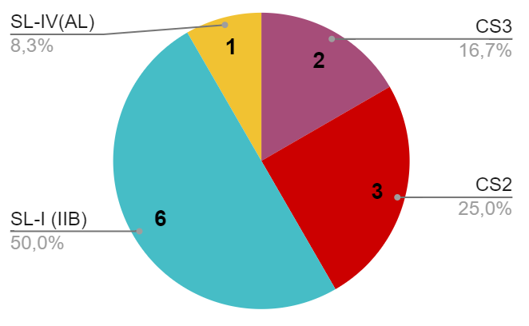
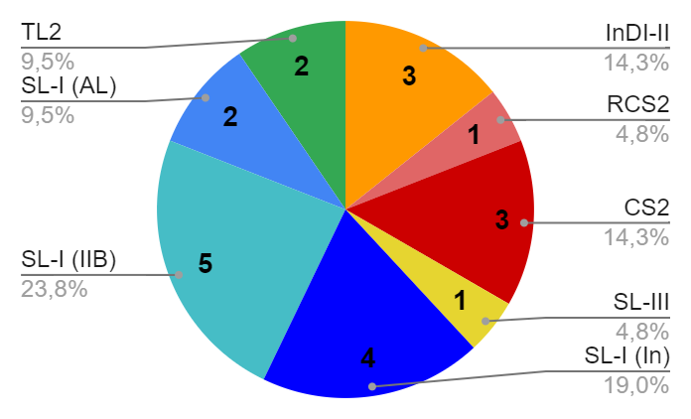
Results- In silico strategies based on sequence homology predict 10 different targets
Clustal Omega
P6
Two strategies aimed at searching for the targets of homologous sequences in the selected aptamers
Analysis through apical loop sequence homology
Analysis through complete aptamer sequence homology
P9
Multiple alignment of the apical loop sequences of each subgroup
Multiple alignment of the aptamers of each subgroup
Homologous sequences
Number of aptamers that interact with
each structural motif in each round
Multiple alignment of the complementary sequence from the homologous sequences with WNV 3‘ UTR
Long interactions and high number of targets
It does not take into account the target folding

Slide 13
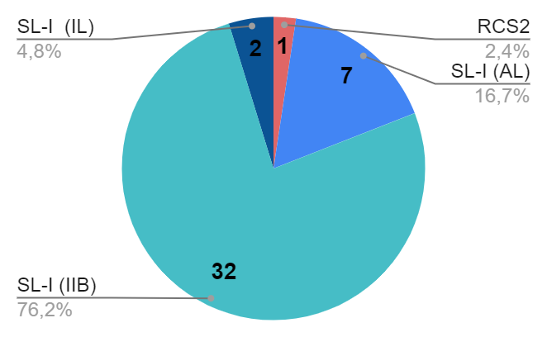
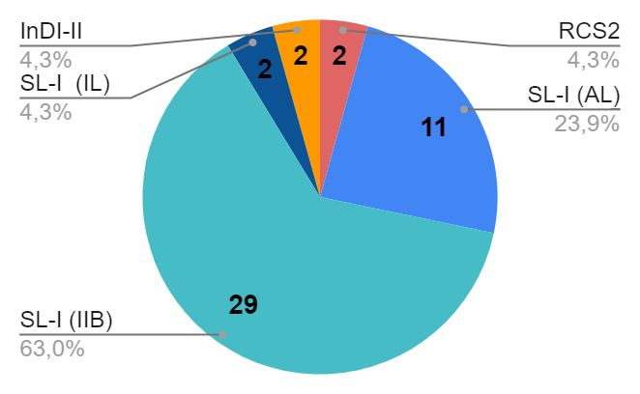
Results- RNAcofold predicts five different targets considering secondary structure
P6
RNAcofold
Target prediction considering the complete sequence and secondary structure of the interacting molecules
P9
Generation of partition matrixes
Visual inspection of the matrixes and obtainment of the interaction sequences in the aptamer and in WNV 3’UTR
Number of aptamers that interact with
each structural motif in each round
Target prediction for most of the selected aptamers
Smaller target diversity

Slide 14
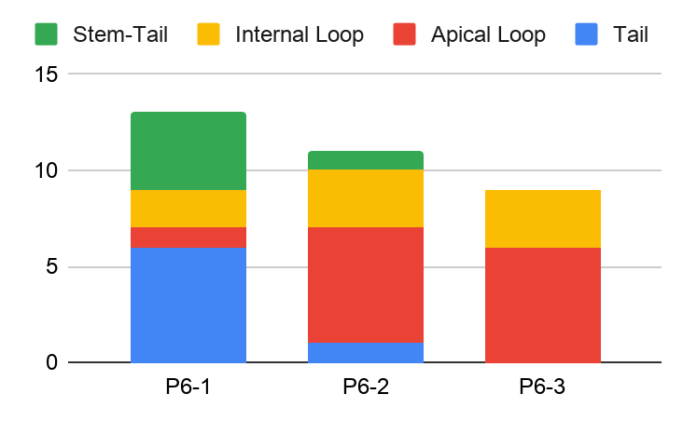
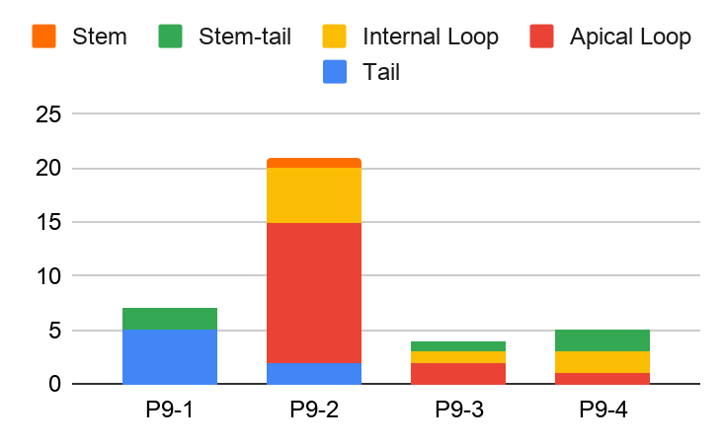
Results- The aptamer population presents a selection towards the interaction through apical and internal loops
P6
Visual analysis of the aptamer structural elements involved in the interaction with the target
Cluster 1, which interacts mostly through sequences at the tail of the structure, is reduced from round 6 to 9; while cluster 2, which interacts through the loops, increases significantly
Most interactive structure
P9
Selection towards more interactive clusters

Slide 15
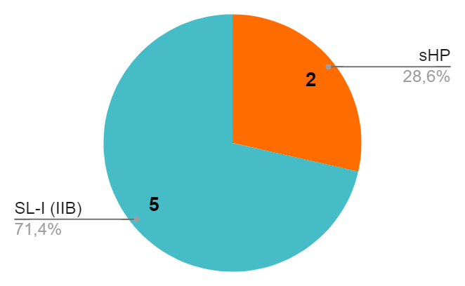
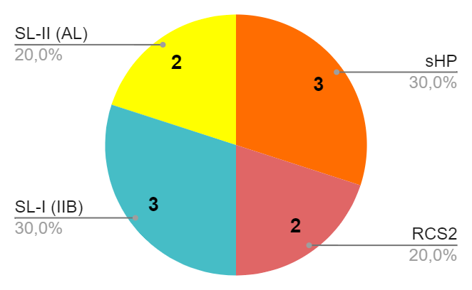
Results- SL-I(IIB) target dominance and round 9 target diversity
P6
P9
Apical loop analysis
Sequence homology
RNAcofold
Apical loop analysis
Sequence homology
RNAcofold
Dominance of the interaction with SL-I, specially SL-I (IIB) compared to the other targets
Higher prevalence of SL-I (IIB) with RNAcofold predictions, meaning that not only sequences but also structural motifs have been selected
Target diversification between rounds 6 and 9 ¿SL-I saturation?

Slide 16
Results- There is an increase in sequence conservation from round 6 to 9
Compseq
Increase in sequence conservation in round 9, represented as repeated sequences
It renders the number of repetitions of a given sequence motif in an aptamer
 | P6 | P9 | P9 without repseq*
Hexanucleotides repeated 6 times or more in the aptamer population | 10 | 29 | 15
Most repeated hexanucleotide | ACACUA (18 repeats) | CACUAA (16 repeats) | CACUAA (15 repeats)
*In round 9 there is one whole aptamer sequence repeated 5 times and 3 whole aptamer sequences repeated twice.
Notes:
Round 9: one sequence repeated 5 times and 3 repeated twice

Slide 17
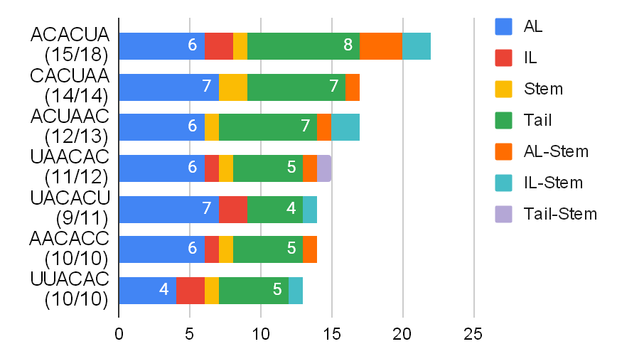
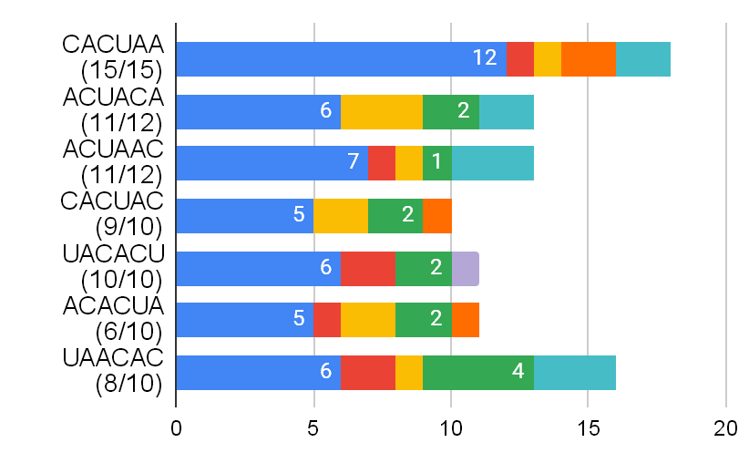
Results- Sequences are conserved because of their interaction with WNV 3’UTR
P6
P9
Visual analysis of the location of hexanucleotide motifs within the aptamer
Structural element
3’WNV interaction
Most repeated hexanucleotides and their hexanucleotide motif location. Between brackets, the amount of hexanucleotides from the total of repeats that are part of the sequence that interacts with WNV 3’UTR.
The conserved sequences interact, at least in part, with WNV 3’UTR
Notes:
3’WNV

Slide 18
Results- The putative target of the conserved sequences is preferently SL-I(IIB)
Clustal Omega
Analysis of the putative targets in WNV 3’UTR of the conserved hexanucleotide sequences
Analysis of the number of aptamers in each round that don’t have any conserved hexanucleotide
Multiple alignment software
Round | Target interactions | Apt without hexants
6 | SL-I(IIB) (7/7), CS2 (2), SL-I (LA) (1) | 7
9 | SL-I(IIB) (5/6), CS2(2), SL-I (LA) (2), no target (1) | 13
Supports the hypothesis of a general evolution of aptamers towards SL-I
Supports the hypothesis of target diversification between rounds 6 and 9

Slide 19
Results- The putative target of the conserved sequences is preferently SL-I(IIB)
Search for longer conserved sequences and their putative targets through analysis of the adjoining nucleotides of the conserved hexanucleotides
Clustal Omega
Repeat | Round 6 | Round 9 | Target
CACUAACACC | 6 repeats | 2 repeats | SL-I
UUACACUA | 7 repeats | 0 repeats | SL-I
CACUACAC | 3 repeats | 5 repeats | SL-I
ACUACACUCG | 1 repeats | 4 repeats | SL-I
Supports the hypothesis of a general evolution of aptamers towards SL-I
Through this process a new target was found: TL-1

Slide 20
Results- Most represented targets present high U% and low C%
Sequence | %GC | A | C | G | U | Sequence | %GC | A | C | G | U
3’UTR | 28,57 | 29,1 | 23,3 | 28,3 | 19,4 | Apt P9 (re) | 52,36 | 28 | 37,1 | 15,3 | 19,6
Apt P6 | 46,59 | 30,9 | 34,4 | 12,2 | 22,5 | Apt P9 | 51,48 | 27,4 | 39,7 | 12,3 | 20,6
Apt P6(-E) | 45,96 | 32 | 34,8 | 11,1 | 22,1 | Apt P9 (-E) | 52,22 | 27,3 | 39,9 | 12,3 | 20,5
SL-I (IIB) | 28,57 | 23,8 | 0 | 28,6 | 47,6 | SL-III | 51,61 | 27,4 | 27,4 | 24,2 | 21
SL-I (LA) | 46,15 | 30,8 | 15,4 | 30,8 | 23,1 | SL-IV | 58,82 | 19,6 | 27,4 | 31,4 | 21,6
SL-I (LI) | 11,1 | 22,2 | 0 | 11,1 | 67 | TL1 | 35,71 | 28,6 | 7,1 | 28,6 | 35,7
SL-I (total) | 25,97 | 35,8 | 3,7 | 21 | 39,5 | RCS2 | 56,52 | 30,4 | 17,4 | 39,1 | 13,1
InDI-II | 31,25 | 43,8 | 0 | 31,2 | 25 | TL2 | 45,45 | 27,3 | 9,1 | 36,3 | 27,3
SL-II (LA) | 46,67 | 33,3 | 6,7 | 40 | 20 | sHP | 56,25 | 25 | 18,7 | 37,5 | 18,7
RCS3 | 73,33 | 18,7 | 25 | 43,7 | 12,5 | 3’SL | 58,97 | 24,3 | 29,5 | 29,5 | 16,7
Compseq
%nts
Infoseq
%GC
Most interesting data presented in bold letters.
The targets with higher number of predictions present high U% and low C%, which concordates with the percentages in the aptamers if we consider the G-U pairs

Slide 21
Results- Higher GC content in the sequences that interact with SL-I compared to the adjoining nucleotides
GC pairs make structures more stable because of their triple hydrogen bond and their stacking
Analysis of the GC content in the sequences that interact with WNV 3’UTR putative targets
Comparison of the %GC of the aptamer interacting (int) sequence with the %GC of the whole aptamer
Comparison of the %GC of the target site with the %GC of the 10 adjoining nucleotides (a.n.)
Infoseq
Software | Target | Media % int | Media % a.n. | Higher %GC in int
RNAcofold | SL-I | 38,35 | 19,77 | 63/67
RNAcofold | Other targets | 47 | 47,24 | 2/5
RNAcofold | Aptamers | 34,79 | 49,03 | -
Clustal Omega | SL-I | 36,56 | 28,43 | 13/16
Clustal Omega | Other targets | 40,42 | 55,5 | 0/10
Clustal Omega | Aptamers | 35,18 | 49,03 | -

Slide 22
Results- G residues make SL-I domain the preferred target site for the selected aptamers
High G% and really low C% in SL-I → Analysis of the Gs in the SL-I structure reveal that they are not forming GC pairs because they are located in loops, bulges or G-U pairs
Guanine in loops and bulges
Exclusion of bases towards the solvent
Guanines size
Improved molecular intercalation
Guanine stacking
Minor groove size variation
Missing C and high frequency of G in loops, bulges or G-U pairs→ unique characteristics of SL-I = preferred putative target of the selected aptamers

Slide 23
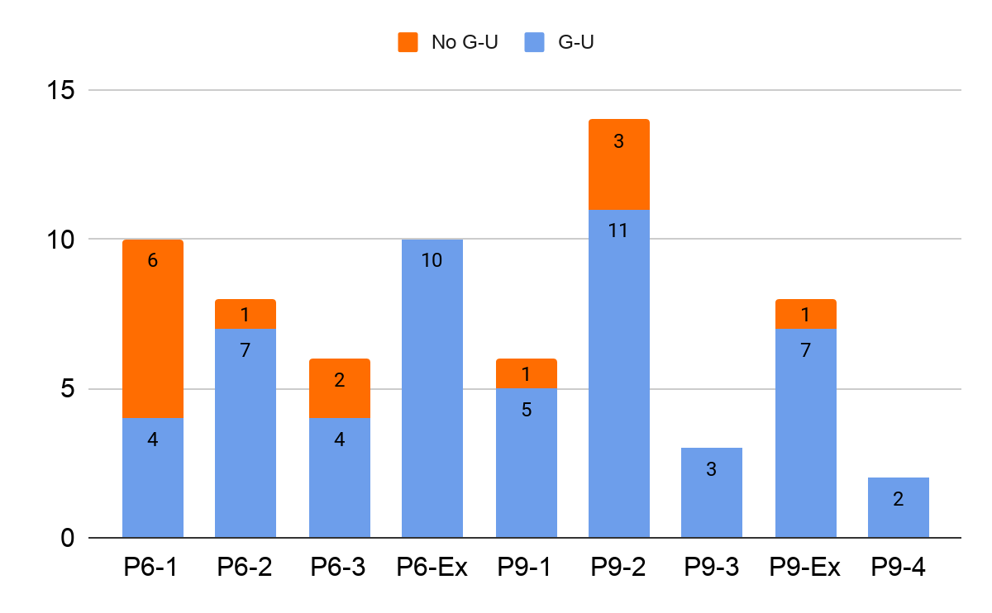
Results- G-U pairs are highly present in the interactions between aptamers and WNV 3’UTR
After observing several G-U pairs in the SL-I structure, we analysed the G-U pairs formed in the interactions between aptamers and WNV 3’UTR
High frequency of G-U pairs in interactions, especially for those aptamers derived from round 9

Slide 24
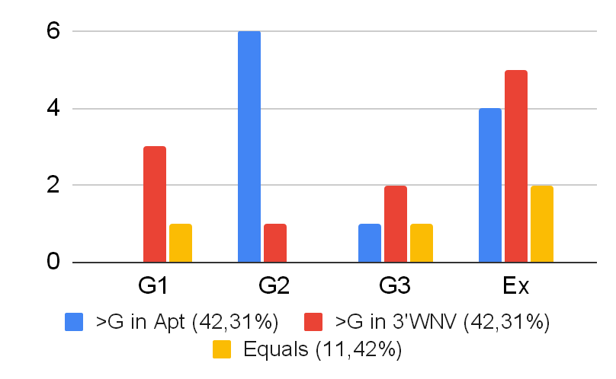
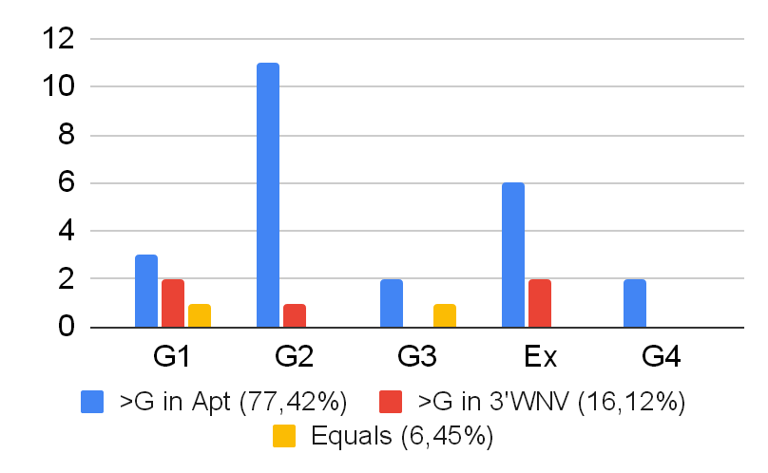
Results- G-U pair directionality facilitates target-aptamer interaction
G-U pairs are non isosteric to U-G pairs, they generate different torsions of the helix, yielding differences in the minor groove size
P6
P9
Analysis of the location of the G from the G-U pair in either the aptamer or the target
G nucleotide location from the G-U pair in aptamer or in WNV 3’UTR
The selection of a specific directionality of the G-U pair and consequent minor groove size variation seems to be facilitating target-aptamer interaction

Slide 25
Results- Criteria for the selection of aptamers for biochemical analysis
Selection criteria for the aptamers that would be further studied in vitro:
1-To obtain a group of aptamers that together, have the maximum number of WNV 3’UTR targets with biological interest predicted.
2-If there are several predictions for the same target, select those aptamers, which yields interactions with lower ΔG and / or greater number of interacting nucleotides.
3-If the data were similar between rounds, aptamers from round 9 were selected because of their theoretical higher affinity.
4- Conserved hexanucleotides have SL-I and CS2 as targets. Search for aptamers lacking these hexanucleotide sequence motifs.

Slide 26
Results- Selected aptamers for biochemical analysis
Round | Group | Apt | Apt struct | ΔG | Rep hexant | 3’WNV putative targets
6 | 1 | 17 | Tail | -17,87 | 2 | [SL-I (LA,IIB)(10)]
 | 1 | 8 | Tail | - | 0 | CS3 (8) [SL-I (IIB)(12)]
 | 2 | 57 | Apical loop | -19,05 | 7 | [SL-I (IIB)(15)]
9 | 2 | 35 | Stem, AL | -13,37 | 0 | [RCS2(15)]
 | 2 | 23 | Apical loop | - | 2 | TL2-CS2 (8) [SL-I (LA, IIB)(11)]
 | 2 | 13 | Apical loop | -9,8 | 0 | [InDI-II (14)]
 | 3 | 8[5] | Apical loop | - | 0 | SL-II(LA) (6)
 | 4 | 11 | IL, AL, Stem | - | 2 | CS2 (9) [SL-I (IIB)(14)]
 | 4 | 24 | Internal loop | - | 0 | SL-III (6) [SL-I (LA, IIB)(11)]
 | Ex | 9 | Stem-AL | - | 3 | TL-1 (11) [SL-1 (IIB)(12)]
Apt struct, structure of the aptamer that interacts with WNV 3’UTR; rep hexant, number of most repeated hexanucleotides in each aptamer. [] Structures predicted by RNAcofold, () number of nucleotides that interact.

Slide 27
Results- The selected aptamers cover most of the biologically interesting structural motifs of WNV 3’UTR
Location in WNV 3’UTR of the selected aptamers for biochemical and functional analysis
The selected aptamers interact with most of the biologically interesting structural motifs of WNV 3’UTR and may permit the generation of antiviral agents. They also have potential as molecular tools for studying the functions of different structural motifs for a deeper understanding of Flavivirus replication and infectious cycles

Slide 28
Conclusions
-The aptamer population shows an evolution throughout the SELEX process, both at the structural complexity level and at the chosen target. Thus, the application of restrictive conditions has promoted the isolation of aptamers against structural elements of the WNV 3’UTR distinct from the SL-I domain.
-The structural element SL-I presents some structural characteristics that make it a highly disposable domain to interact. This supports the interest of a further study of such structural features and their contribution to the completion of the viral cycle.
- 10 aptamers, which theoretically recognize 9 of the biologically relevant structural elements in WNV 3’UTR, have been selected for biochemical analysis.
-In silico analysis of the RNA structure and interaction has provided useful information that would reduce the cost of analysis of the whole aptamer population in vitro and also given interesting data about structural preferences for RNA-RNA interactions.

Slide 29
Acknowledgments
This work has been funded by the Spanish Agencia Estatal de Investigación:
PID2019-104018RB-100/ AEI /10.13039/501100011033

