Slide 1



Stability study, method for the quantitation of a new antifilovirus agent in biological fluids and a preliminary study of its pharmacokinetics
V. P. Putilova^{1,2,*}, O. I. Yarovaya^{1,2}, A. D. Rogachev^{1,2}, A. V. Zaykovskaya³,
N. F. Salakhutdinov^{1,2}
¹ N. N. Vorozhtsov Novosibirsk Institute of Organic Chemistry, acad. Lavrentiev ave., 9, Novosibirsk 630090, Russia.
² Novosibirsk State University, Pirogov str., 2, Novosibirsk 630090, Russia.
³ State Research Center of Virology and Biotechnology VECTOR, 630559, Russia, Koltsovo, Novosibirsk region.
* Corresponding author: valya1put1@gmail.com

Slide 2
Stability study, method for the quantitation of a new antifilovirus agent in biological fluids and a preliminary study of its pharmacokinetics
AS-358

Slide 3
Abstract:
The stability of the new antifiloviral agent AS-358 consisting of borneol and 3-(piperidin-1-yl)propanoic acid, was studied in the blood and blood plasma of rats in vitro. It was found that in both matrices stabilized by EDTA or heparin, the compound is rapidly hydrolyzed at the ester bond. When sodium fluoride was added, the decomposition of the compound was significantly slowed down. This made it possible to develop and validate a method for the quantitative determination of the agent in whole rat blood. Analysis was performed by HPLC-MS/MS method using reverse phase chromatography. The developed method was used for a preliminary study of the pharmacokinetics of the agent AS-358 after its oral administration to rats, and it was shown that the concentration of AS-358 in the blood of animals reached 550 ng/ml after 1 hour, despite its instability in blood. Analogues of the agent which contain ether linker have been synthesized and their metabolic stability has been shown.
Keywords: antifiloviral agent; rat blood; HPLC-MS/MS; pharmacokinetics

Slide 4
Introduction
Ebola virus
IC₅₀ = 9 µM, SI=30,8
Marburg virus
IC₅₀ = 9 µM, SI=35
AS-358
(1S,2R,4S)-1,7,7-trimethylbicyclo[2.2.1]heptan-2-yl 3-(piperidin-1-yl)propanoate
The compound showed high antifiloviral activity in in vitro experiments. (O. I. Yarovaya, A. S. Sokolova et al. Pat. RU 2 649 406, 2018
O.I. Yarovaya, A.S. Sokolova et al.; Patent RU 2697716, 2019)

Slide 5
Targets and goals
Study of the stability of the antifiloviral agent AS-358 in rat blood and plasma
Determination of the decomposition products of the AS-358 compound
Development and validation of a method for the quantitative determination of AS-358 in rat whole blood
Study of the pharmacokinetics of the compound AS-358 after oral administration to rats
Synthesis of stable analogues of AS-358 having ether as a linker
2-amino-adamantane hydrochloride
(internal standard)
AS-358

Slide 6

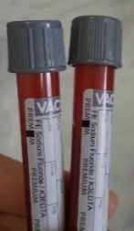
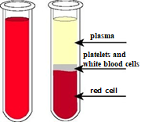

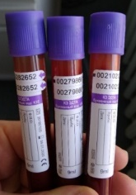
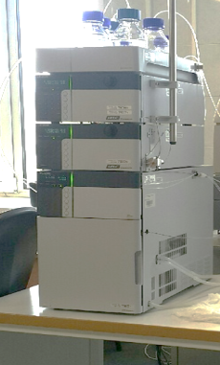
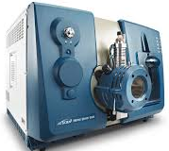

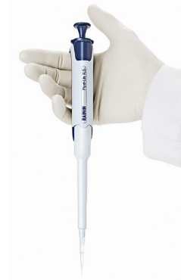

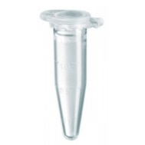
Materials, equipment, methods
Chromatograph
Shimadzu LC-20AD Prominence
Mass-spectrometer
ab sciex 6500

Slide 7

Stability of AS-358 in blood and plasma in vitro
Vacutainers with blood with anticoagulants:
а)
б)
а) EDTA б) EDTA with NaF
The use of NaF as an addition results in inhibition of the enzymes taking part in hydrolysis of AS-358.
AS-358

Slide 8
Search and establishment of the structure of the metabolite formed from AS-358 in blood and plasma in vitro
NaOH, MeOH, 48 ч.
HCl|Et₂O, pH~7, solvent stripping
Treatment of the mixture with hexane → borneol (2) (GC-MS)
Treatment CH₂Cl₂ → acid (1) + borneol (2) (GC-MS, HPLC-MS/MS)

Slide 9
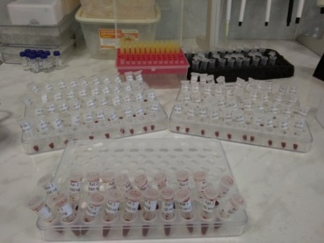
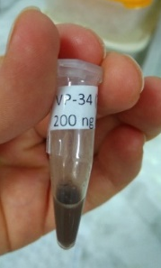
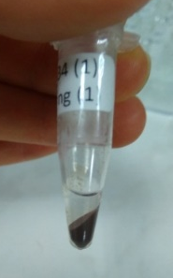


Sample preparation scheme
To prepare calibration solutions:
AS-358 (20 μl) | (10 ng/ml) | + blood with EDTA + NaF preservative (180 μl) = | spike (200 ml) | (1 ng/ml)
 | (20 ng/ml) |  |  | (2 ng/ml)
 | (30 ng/ml) |  |  | (3 ng/ml)
 | (50 ng/ml) |  |  | (5 ng/ml)
 | (100 ng/ml) |  |  | (10 ng/ml)
 | (200 ng/ml) |  |  | (20 ng/ml)
 | (500 ng/ml) |  |  | (50 ng/ml)
 | (1000 ng/ml) |  |  | (100 ng/ml)
 | (2000 ng/ml) |  |  | (200 ng/ml)
 | (4000 ng/ml) |  |  | (400 ng/ml)
 | (5000 ng/ml) |  |  | (500 ng/ml)

Slide 10
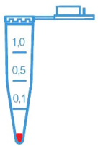
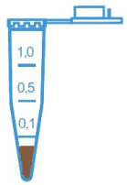
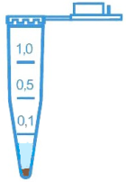
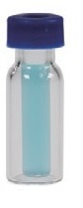
Sample preparation scheme
Sampling 20 μl
spike (200 ml)
50 μl 0.2M
ZnSO₄/MeOH
50 μl supernatant
+100 μl H₂O
centrifugation
Sampling 20 μl
20 μl sample
An animal that has been orally administered with AS-358

Slide 11
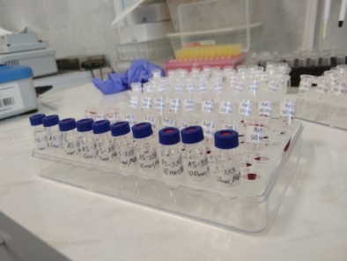
Quantitative determination procedure
Taking into account the stability data, a method for the quantitative determination of AS-358 in rat blood was developed and validated.
The bioanalytical method was validated in accordance with the FDA and EMA regulations in terms of selectivity, calibration curve, accuracy, recovey, carry over and stability of a prepared sample in autosampler.
2-amino-adamantane hydrochloride
(internal standard)
Calibration plot of the ratio of the AS-358 peak area to its concentration in the blood.
1-500 ng/ml.
Calibration solutions

Slide 12
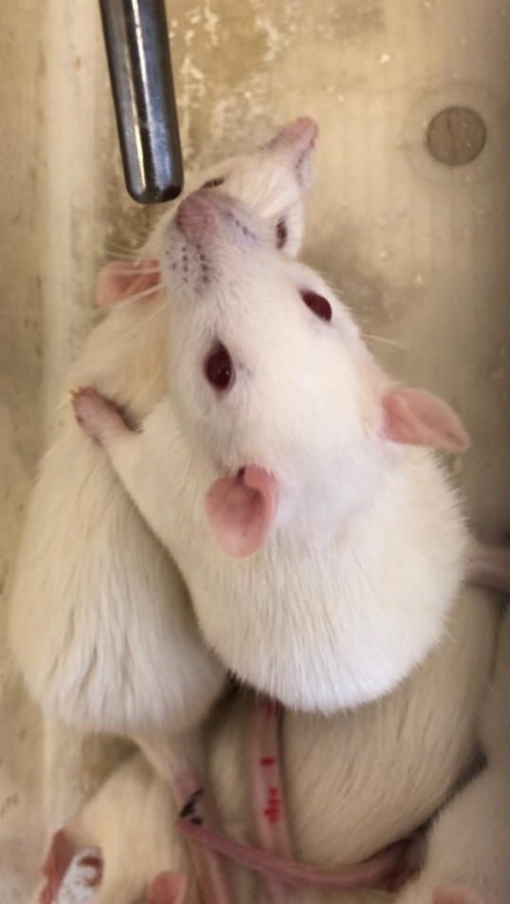
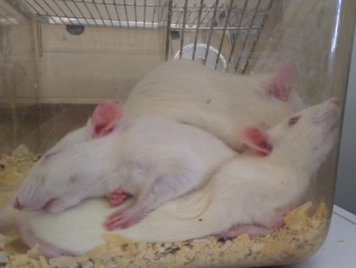
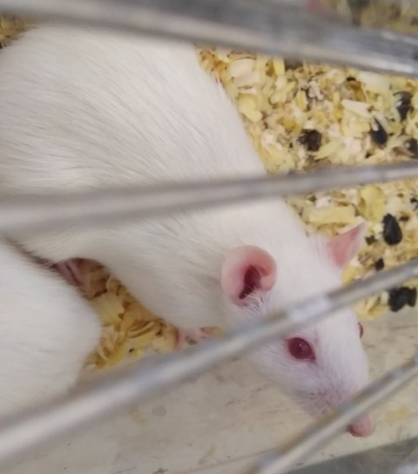
Preliminary study of pharmacokinetics
mixture AS-358 with chalk (1:10), suspended in saline
mixture of AS-358 with chalk (1:3), suspended in saline
AS-358 suspension in 1% aqueous starch
Dose 200 mg/kg, 3 animals
Blood was collected from the tail vein after 15 min, 30 min, 1 h,
2 h, 3 h, 4 h, 5 h, 6 h, 24 h.

Slide 13
Metabolite detection
a)
b)
Concentration-time profile: a) compounds AS-358; b) 3- (1-piperidinyl) -propanoic acid

Slide 14
Dependence "concentration - time" of AS-358 in the blood of animals after oral administration

Slide 15

Synthetic part
It is based on the previously developed two-stage method starting from camphene: at the first stage camphene reacts with 2-bromoethanol / 3-bromopropanol in the presence of K-10 cationoid clay producing a bromoether. This bromoether then subsequently alkylates a saturated nitrogen heterocycles leading to target compounds.
n = 1, 2; m = 0, 1, 2; X= CH₂, CH₂-CH₃, N-CH₃, O, N-CH₂-C₆H₅

Slide 16

Synthesis of target compounds
At the moment, all new substances are being tested at the State Research Center of Virology and Biotechnology VECTOR.

Slide 17
VP-11 stability check
In rat blood, after distribution of the substance VP-11 between blood cells and plasma, no hydrolysis or other transformations are observed.
Thus, it was shown that ethers based on borneol and 3-(piperidin-1-yl) -propane do not undergo enzymatic hydrolysis when introduced into rat blood.

Slide 18

Conclusions
The stability of the agent in rat whole blood and plasma was studied.
A method for the quantitative determination of the AS-358 agent in rat whole blood by HPLC-MS / MS was developed and validated.
A preliminary study of the pharmacokinetics of the agent AS-358 after oral administration to rats in the form of three different dosage forms at a dose of 200 mg / kg was carried out.
It has been shown that the use of a suitable dosage form can ensure the presence of the AS-358 agent in rat blood, despite its instability.
The synthesis of a set of camphene derivatives containing an ether linker of various lengths and a set of saturated N-heterocyclic fragments was carried out.
A method for the detection of agent VP-11 using HPLC-MS / MS was developed and the stability of the substance in rat whole blood was shown. The applicability of the method of sample preparation of rat blood samples using zinc sulfate precipitation for the analysis of the agent in the blood is shown, and a calibration dependence in the range of 1-1000 ng/ml is constructed.

