Slide 1
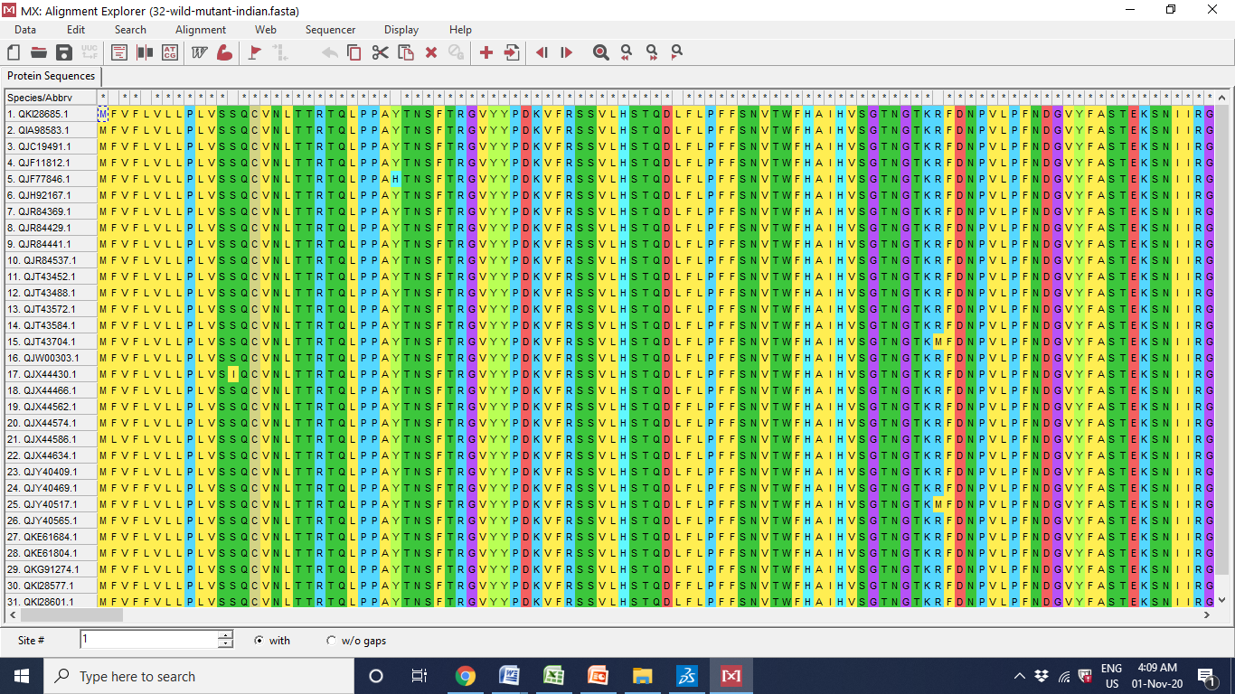
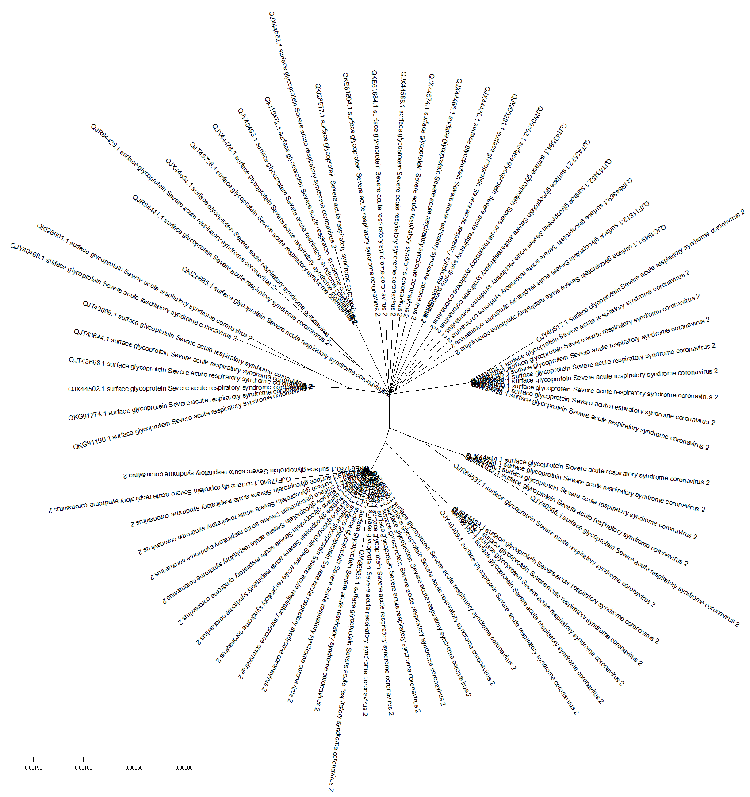
Sequence and Structure Analysis of Surface Glycoprotein of SARS-CoV-2 from India Variants
¹Pramodkumar P. Gupta, ²Virupaksha A. Bastikar, ³Alpana Bastikar, and ⁴Santosh S. Chhajed
¹School of Biotechnology and Bioinformatics, D. Y. Patil Deemed to be University, Navi -Mumbai, Maharashtra, India.,
²Amity Institute of Biotechnology (AIB), Amity University Maharashtra, Mumbai, Maharashtra India.,
³Department of Computer -Aided Drug Design, Navin Saxena Research and Technology Pvt. Ltd, Gandhidham, Gujarat, India.,
⁴Department of Pharmaceutical Chemistry, Bhujbal Knowledge City, MET's Institute of Pharmacy, Adgaon, Nashik, Maharashtra, India
Corresponding author: Pramodkumar P. Gupta, pramodkumar785@gmail.com
COVID19 is a pandemic across the world. It is caused by a novel coronavirus, severe acute respiratory syndrome coronavirus 2 (SARS-CoV-2). The Surface/Spike Glycoprotein of SARS-CoV-2, which plays a key role in the receptor recognition and cell membrane fusion process, is composed of two subunits, S1 and S2. In the present work we have searched for Surface/Spike glycoprotein in the NCBI protein database and origin from “India”, the search hit out 192 protein sequences as on 20 June 2020. Further, the sequences were aligned using Surface/Spike glycoprotein from Wuhan-China Origin and on the basis of the sequence length of 1273, the sequences were screened. Out of 192 input protein sequences, 177 sequences were complete in the length of 1273 amino-acids. Comparing all the sequences via sequence alignment mode in MEGA-X, exhibited a complex diversified outcome and reported 32 sequences. The protein sequence id QKI28685.1 was identified as a root and 31 protein sequences as a mutant/variant. QKI28685.1 was subjected to 3D protein structure modelling. As no full-length structural template was identified in the database. Automated homology modelling, Swiss-Model server and threading based I-Tasser were considered for the structure determination. Swiss-Model reported a partial structure from amino acid length 27 to 1146. A full-length structure is obtained from the I-Tasser server. The structures were analyzed using the ProSA and Ramachandran plot. 31 identified mutations were manually incorporated in the protein structure and a total of 31 mutants were created. Further, these proteins are in a process to study and understand the structural changes and their impact on the protein-protein interaction and protein-drug interaction.
Methodology
Protein sequences of surface glycoprotein of SARS-CoV-2 from India
Sequence analysis using MEGA
Phylogenetic guide tree
Mutation identification
Structure modelling
Results
Fig 1: Sequence alignment
Fig 2: Phylogeny of all the sequences
Fig 3: Phylogeny of all full length sequences
Table 1: Details about protein sequence, mutation and model
sr no | Protein Sequence Id | Mutation Position | Mutation Position | ProSA Score | Ramachandran Plot using Molprobity |  |  | Energy Minimization from Yasara
 |  |  |  |  | Favoured region | Allowed Region | Outlier | Initial Energy Kj/mol | Final Energy Kj/mol
1 | QKI28685.1 | 614G |  | -9.91 | 71.52% | 89.30% | 10.70% | -325057.3 | -503512
2 | QJF77846.1 | 28(Y/H) | 614(G/D) | -9.94 | 71.52% | 89.20% | 10.78% | -351536.1 | -504211
3 | QIA98583.1 | 614 (G/D) | 930 (A/V) | -9.9 | 71.50% | 89.20% | 10.78% | -348526.6 | -507212
4 | QKI28673.1 | 614(G/D) |  | -9.93 | 71.50% | 89.20% | 10.78% | -351888 | -504978
5 | QJY40409.1 | 614(G/D) | 677(Q/H) | -9.91 | 71.52% | 89.20% | 10.70% | 1066717883 | -504756
6 | QJH92167.1 | 677(Q/H) |  | -9.9 | 71.52% | 89.30% | 10.70% | 1066717927 | -504136
7 | QJR84537.1 | 583(E/D) | 614(G/D) | -9.9 | 71.52% | 89.20% | 10.78% | -351435.5 | -502811
8 | QJY40565.1 | 583(E/D) | 1083(H/Q) | -9.92 | 71.52% | 89.30% | 10.70% | -351579.1 | -503256
9 | QJT43488.1 | 583(E/D) |  | -9.92 | 71.52% | 89.30% | 10.70% | -351544.7 | -501305
10 | QJY40517.1 | 78(R/M) | 1083(H/Q) | -9.99 | 71.52% | 89.30% | 10.70% | -350279.6 | -504551
11 | QJT43704.1 | 78(R/M) |  | -9.96 | 71.52% | 89.30% | 10.70% | -350268.1 | -504040
12 | QKG91274.1 | 572(T/I) |  | -9.9 | 71.52% | 89.30% | 10.70% | -351653.7 | -504555
13 | QKI28601.1 | 5(L/F) | 572(T/I) | -9.91 | 71.52% | 89.30% | 10.70% | -351510.8 | -499995
14 | QJY40469.1 | 5(L/F) | 162(S/I) | -9.89 | 71.44% | 89.30% | 10.70% | -308769.4 | -505735
15 | QKE61684.1 | 148(N/Y) |  | -9.89 | 71.52% | 89.30% | 10.70% | -351390.5 | -499820
16 | QJX44574.1 | 1104(V/L) |  | -9.88 | 71.52% | 89.30% | 10.70% | -350126.3 | -503512
17 | QJX44430.1 | 13(S/I) |  | -9.92 | 71.52% | 89.30% | 10.70% | -350518.7 | -508495
18 | QJT43584.1 | 827(T/I) |  | -9.9 | 71.52% | 89.30% | 10.70% | -351167.8 | -503572
19 | QJR84369.1 | 1181(K/R) |  | -9.92 | 71.52% | 89.30% | 10.70% | -352072.2 | -504759
20 | QKI28577.1 | 54(L/F) |  | -9.91 | 71.52% | 89.30% | 10.70% | -351475.1 | -505910
21 | QJX44562.1 | 54(L/F) | 471(E/Q) | -9.89 | 71.52% | 89.30% | 10.70% | -350705 | -501060
22 | QJT43572.1 | 892(A/V) |  | -9.88 | 71.52% | 89.30% | 10.70% | -351914.4 | -502281
23 | QJF11812.1 | 1250(C/F) |  | -9.92 | 71.52% | 89.30% | 10.70% | 2.9702E+12 | -504405
24 | QJC19491.1 | 271(Q/R) |  | -9.93 | 71.52% | 89.30%` | 10.70% | -352094.1 | -501956
25 | QJT43452.1 | 156(E/D) |  | -9.92 | 71.52% | 89.30% | 10.70% | -351994.8 | 505783
26 | QJW00303.1 | 177(M/I) |  | -9.91 | 71.52% | 89.30% | 10.70% | -351189.1 | -504217
27 | QJX44466.1 | 879(A/S) |  | -9.92 | 71.52% | 89.30% | 10.70% | -351994.1 | -503085
28 | QJX44586.1 | 2(F/L) |  | -9.89 | 71.52% | 89.30% | 10.70% | -352043 | -503833
29 | QKE61804.1 | 255(S/F) |  | -9.9 | 71.52% | 89.30% | 10.70% | -350978.1 | -505004
30 | QJR84441.1 | 1243(C/F) |  | -9.89 | 71.52% | 89.30% | 10.70% | -346291.9 | -501549
31 | QJX44634.1 | 706(A/S) |  | -9.92 | 71.52% | 89.30% | 10.70% | -351990.6 | -503669
32 | QJR84429.1 | 706(A/S) | 1243(C/F) | -9.9 | 71.52% | 89.30% | 10.70% | -346248 | -505940
Fig 4: QKI28685.1
Fig 5: QJF77846.1
Fig 6: QIA98583.1
Fig 7: QKI28673.1
Fig 8: QJY40409.1
Fig 9: QJH92167.1
Fig 10: QJR84537.1
Fig 11: QJY40565.1
Fig 12: QJT43488.1
Fig 13: QJY40517.1
Fig 14: QJT43704.1
Fig 15: QKG91274.1
Fig 16: QKI28601.1
Fig 17: QJY40469.1
Fig 18: QKE61684.1
Fig 19: QJX44574.1
Fig 20: QJX44430.1
Fig 21: QJT43584.1
Fig 22: QJR84369.1
Fig 23: QKI28577.1
Fig 24: QJX44562.1
Fig 25: QJT43572.1
Fig 26: QJF11812.1
Fig 27: QJC19491.1
Fig 28: QJT43452.1
Fig 29: QJW00303.1
Fig 30: QJX44466.1
Fig 31: QJX44586.1
Fig 32: QKE61804.1
Fig 33: QJR84441.1
Conclusion : All the modelled structures were analyzed using ProSA and Ramchandran plot. Energy minimization is carried out using Yasara online server. Further these proteins are in a process to study and understand the structural changes and its impact on the protein-protein interaction and protein-drug interaction. All the modelled protein could be an initiating point to understand the impact of mutations on existing and future therapies.
Fig 33: QJX44634.1
Fig 35: QJR84429.1
Reference:
Improving physical realism, stereochemistry, and side-chain accuracy in homology modeling: Four approaches that performed well in CASP8. Krieger E, Joo K, Lee J, Lee J, Raman S, Thompson J, Tyka M, Baker D, Karplus K (2009) Proteins 77 Suppl 9, 114-122 PMID19768677'

