Slide 1
Understanding Knowledge and Behaviors Related to COVID–19 Epidemic in United Arab Emirates Undergraduate Pharmacy Students: A Cross-Sectional Study
Samir Haj Bloukh ¹, Zehra Edis ^{2,}*, Haya Yasin ², Nihal Abdalla Ibrahim ¹, Hamid Abu Sara ¹, Suaad Mahmood Barakat ³, Noran Sarmad Al-Jabari ³ and Asawer Husam Al-Shimmery ³
¹College of Pharmacy and Health Science, Department of Clinical Sciences, Ajman University, PO Box 346, Ajman, United Arab Emirates
²College of Pharmacy and Health Science, Department of Pharmaceutical Sciences, Ajman University, PO Box 346, Ajman, United Arab Emirates
Corresponding author: z.edis@ajman.ac.ae
sciforum-039534

Slide 2
Understanding Knowledge and Behaviors Related to COVID–19 Epidemic in United Arab Emirates Undergraduate Pharmacy Students: A Cross-Sectional Study

Slide 3
Abstract:
The coronavirus disease 2019 (COVID-19) claimed until now more than 730.000 lives globally. Prevention and infection control measures were implemented in many countries, including the United Arab Emirates (UAE). Frontline healthcare workers in health care settings and pharmacists are susceptible to be infected by the virus. During a pandemic, the knowledge, attitude and practice of these two groups play a major role in saving lives and reducing infection rate. The aim of this study was to assess COVID-19 related knowledge, self-reported preventive behaviors and risk perception. This cross-sectional study was conducted during the first two weeks of April, 2020. We assessed pharmacy students’ knowledge, preventive behaviors and risk perceptions of COVID-19 using an online questionnaire. Questions were based on the Centers of Disease Control (CDC) guidelines and the reliability of the questionnaire was shown to be satisfactory. The study revealed a good level of knowledge about the pandemic and its control. A positive relationship was observed between the knowledge and attitude of participants. We found a high level of COVID-19 related knowledge and self-reported preventive behaviors among pharmacy students in the UAE especially in students of senior levels. This study helps the authorities to develop strategies in future pandemics regarding healthcare system shortages.
Keywords: COVID-19; health behavior; knowledge; pharmacy students; prevention; control; risk; UAE

Slide 4
Introduction
Clinical pharmacists are frontline health workers and they are responsible for medication therapy of patients. Pharmacists are the first contacts sought for advice and OTC supplementation in the UAE. They manage and account for patient medication and therapy either by practicing independently or in collaboration with other health professionals. Pharmacists have crucial roles during pandemics and crisis management.
Our aim is to assess whether future pharmacists in the United Arab Emirates (UAE) have “Knowledge and Behaviors Related to COVID–19 Epidemic”. This study will help us assess the level of knowledge and perceptions of pharmacy students in the United Arab Emirates during this global health crisis. In addition, we aim to explore pharmacy students’ source of information of COVID-19 during this peak period.

Slide 5
Results and discussion
This is the first study aimed to examine the level of knowledge of United Arab Emirates undergraduates about COVID–19, to the best of our knowledge. Pharmacists are healthcare professionals at high risk and assessing their knowledge is crucial.
The important work of healthcare providers aims in controlling and providing the optimal actions to prevent further spreading of COVID-19. In the UAE, pharmacists are useful health care providers because they are directly interacting with the community. Patients usually visit the pharmacy for medications to stop mild symptoms with over the counter medications.

Slide 6
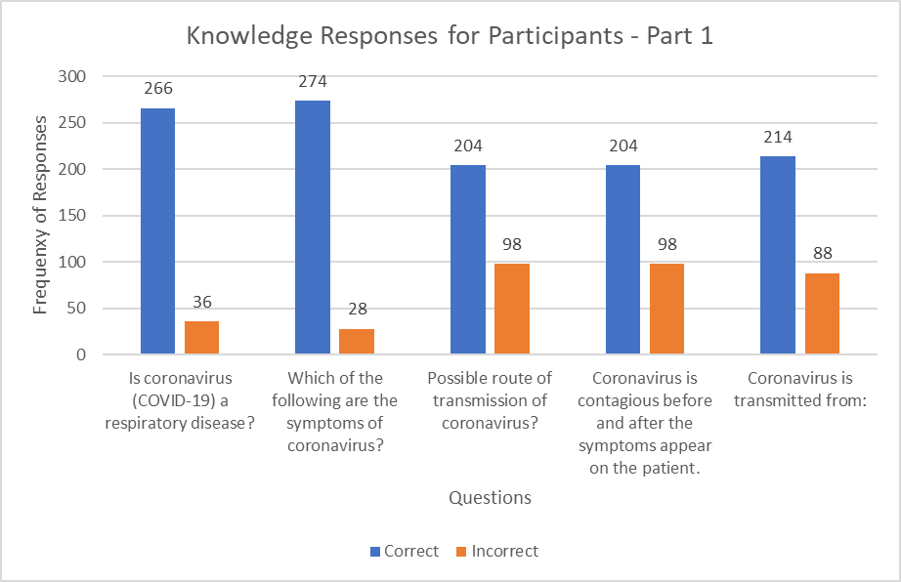
Results and discussion
Above 85% of students were aware that COVID–19, and the symptoms associated with COVID-19 like high fever, cough, sore throat, vomiting, shortness of breath, and diarrhea (Figure 1).
Figure 1. Frequency of responses towards knowledge by participants regarding pandemic COVID-19 virus

Slide 7
Results and discussion
Whilst only 67.55% of pharmacy students identified air as the main route of transmission, but this percentage was significantly higher among senior pharmacy students than in the other group (Figure 1). 57.95 % of pharmacy students recognized that Coronavirus is contagious before and after the symptoms appear on the patient; this percentage was significantly higher among senior pharmacy students than in the other group. Concerning the transmission of COVID-19 through animals, 70.86% students answered correct (Figure 1).

Slide 8
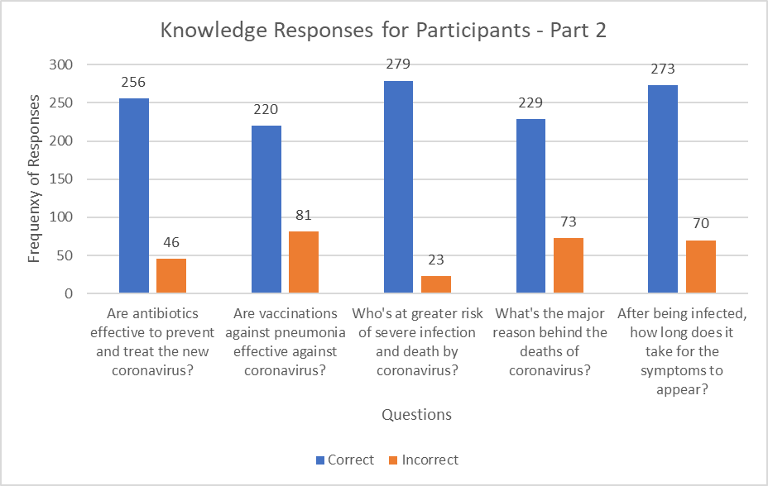
Results and discussion
Around 85% of pharmacy students recognized that antibiotics were not effective for treating COVID–19 (Figure 2).
Figure 2. Frequency of responses towards knowledge by participants regarding pandemic COVID-19 virus.

Slide 9
Results and discussion
While 73.18% of pharmacy students recognized that, there is no vaccine yet for the prevention of COVID–19, the majority of correct answers were from senior pharmacy students (Figure 2). A 92.38% of pharmacy students identified people with pre-existing medical conditions especially older people, were at greater risk of severe infection and death by coronavirus, while a lower percentage 75.83% identified that COVID-19 may affect all people independently by age. 90.4% of pharmacy students knew that symptoms appear in 2-14 days (Figure 2).

Slide 10
Conclusions
As shown in the previous responses, knowledge scores of senior year students were higher than freshman year students. These scores are expected since senior pharmacy students have more infectious diseases courses than freshman students, and students of senior years have retained more knowledge over the years. Knowledge alone is not enough to forecast that participants have good attitude, practice and behavior towards dealing with pandemics [31]. This is verified by the scores of both attitude and knowledge that has no significant variation among other categories. Upon that, using educational techniques that depend on modelling can help the participant to transform knowledge into something physical that can be used for attitude and practice improvement. In the UAE, the “Mohammad Bin Rashid University of Medicine and Healthcare Sciences” provided a free online course by the help of MBRU Community Immunity Ambassador Program, called “Let's Break the Chain of COVID-19 Infection” [32]. Protocols and precautions implemented during a pandemic crisis, teaching the public about attitudes to crush the curve of new cases of COVID-19 were explained in the course.

Slide 11
Conclusions
The findings of this investigation testify an acceptable level of undergraduate pharmacy students’ knowledge regarding the epidemic and the control measures adopted. 4th year students showed higher awareness than the others towards the infection mechanisms and the procedures to prevent its spread. The knowledge, attitude and practice of pharmacy and students regarding COVID-19 pandemic have a significant role in preventing further distribution, and providing acknowledgment and preventive precautions to the public. Pharmacy students are the future pharmacists and health care professionals. Their knowledge, attitude and behaviours will be crucial in future pandemics. Pharmacists are health care practitioners, which have high potential in shortcomings of medical personal during crisis.

Slide 12
Conclusions
Pharmacists are the front line medical workers facing patients and customers for advice, preventive measurements, supportive therapies, dispensing drugs, masks, disinfectants and further protective equipments. Pharmacist are the first ones to see patients and customers in pharmacies and have the crucial role of determining, if further hospitalization, follow-up or reporting to the authorities is needed. Future pharmacists should be ready to fulfill these requirements supported by their educational institutes, government and health care system. The preparedness of pharmacy students will have an impact on prevention, transmission rate and spread of further outbreaks.

Slide 13
Acknowledgements
The authors gratefully acknowledge Ajman University for supporting this research project.

