Slide 1
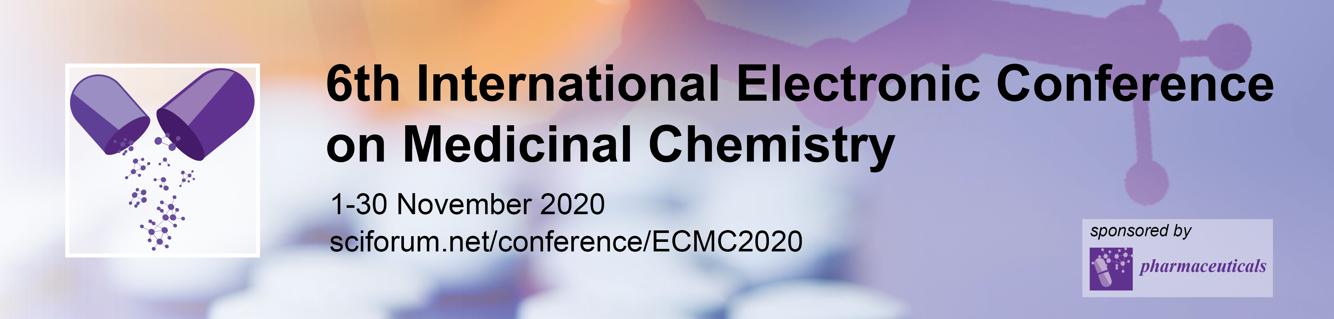


Potent antiviral activity against HSV-1 and SARS-CoV-2 by antimicrobial peptoids
Gill Diamond^{1,}*, Claudine Herlan², Natalia Molchanova², Erika Figgins¹, Lisa K. Ryan³, Donghoon Chung⁴, Robert Scott Adcock⁴, and Annelise Barron²
¹ Department of Oral Immunology and Infectious Diseases, University of Louisville School of Dentistry, Louisville, KY 40202 USA;
²Department of Bioengineering, Stanford University, Stanford, CA 94305;
³Division of Infectious Diseases and Global Medicine, Department of Medicine, University of Florida School of Medicine, Gainesville, FL 32601 USA
⁴Department of Microbiology, Center for Predictive Medicine, School
of Medicine, University of Louisiville, KY 40202
* Corresponding author: gill.diamond@Louisville.edu

Slide 2
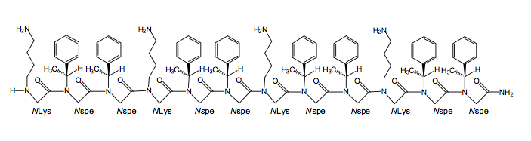

Potent antiviral activity against HSV-1 and SARS-CoV-2 by antimicrobial peptoids
cationic
Antimicrobial peptoid
hydrophobic
Disruption of viral envelope
envelope
HSV-1
capsid
SARS-CoV-2
Viral inactivation

Slide 3
Abstract: Most therapeutic strategies for the development of antiviral agents are designed based on targets specific to each virus. We examined the potential broad-spectrum activity of antimicrobial peptoids (AMPs) against two different viruses. AMPs are mimetics of antimicrobial peptides, which are sequence-specific N-substituted glycine oligomers, where their side chains are appended to the backbone amide nitrogens rather than α-carbons. As a result, peptoids are not proteolyzed, and have improved biostability and bioavailability and reduced immunogenicity relative to natural peptides. AMPs exhibit potent in vitro activity against a wide variety of bacteria and fungi via disruption of microbial membranes as well intracellular binding to nucleic acids. Thus, we hypothesized that they also exhibit activity against enveloped viruses. HSV-1 is an enveloped DNA virus that causes topical lesions. Incubation of HSV-1 with a panel of AMPs demonstrates variable inactivation of the virus prior to infection of cultured epithelial cells. Peptoids with the best activity exhibited dose- and time-dependent inactivation of HSV-1. Lead compounds inactivate the virus within 30 minutes at µg/ml concentrations. Transmission electron microscopy shows that these compounds remove the viral envelope, similar to what is seen with detergent treatment. We also tested the compound against SARS-CoV-2, an enveloped RNA virus that causes COVID-19. Our results show a dose-dependent inactivation of this virus prior to infection of target cells. Cytotoxicity assays show little toxic effects when applied to the apical surface of well-differentiated air-liquid interface cultures of airway epithelial cells. These results indicate that AMPs are strong candidates for broad-spectrum antiviral agents.
Keywords: 3 to 5 keywords separated by semi colons

Slide 4
Introduction
Traditional therapeutic strategies to treat pathogenic viruses involve designing drugs to target specific viral enzymes
  Acyclovir for Herpes Simplex Virus (HSV)-1
    Inactivates HSV-specific DNA polymerases
  Remdesivir for Ebola (and SARS-CoV-2)
    Inactivates RNA-dependent RNA polymerase
Problems with this approach
  Resistance
  Different drugs for each virus

Slide 5
Introduction
New approach for antiviral drug development
Design a drug that targets the overall structure
  No resistance development
  Can target multiple viruses

Slide 6
Introduction
Viral structures:
  Enveloped vs. non-enveloped
  RNA vs. DNA
Goal: Design an antiviral drug based on antimicrobial peptides to target the viral envelope

Slide 7
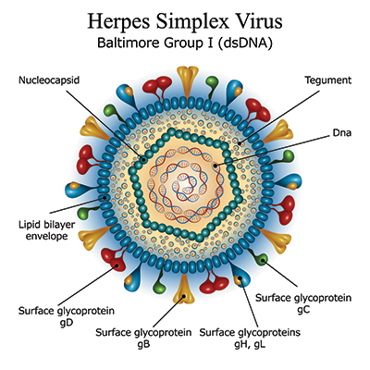
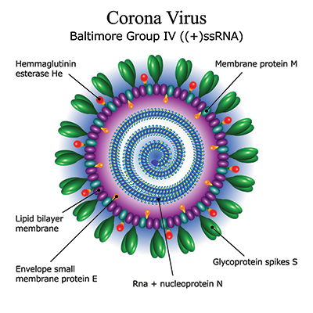
Introduction
HSV-1
  Enveloped DNA virus
SARS-CoV-2
  Enveloped RNA virus
DNA
RNA + nucleoprotein N

Slide 8
Introduction
Antimicrobial peptides
Broad-spectrum antimicrobial agents
Cationic, amphipathic peptides
Important components of innate immunity
Mechanism of action is through membrane disruption
Defensins, cathelicidins, protegrins, magainins

Slide 9
Human cathelicidin LL-37 inactivates KSVH by disrupting the viral envelope
Brice et al., Antiviral Res., 158:25, 2018

Slide 10
Can we use antimicrobial peptides as antiviral therapeutics?
Introduction
GOOD
BAD
Naturally occurring
Broad-spectrum antimicrobials
Little resistance
Low antigenicity
Protease sensitive
Expensive to produce and purify
Often are inactivated by other proteins

Slide 11
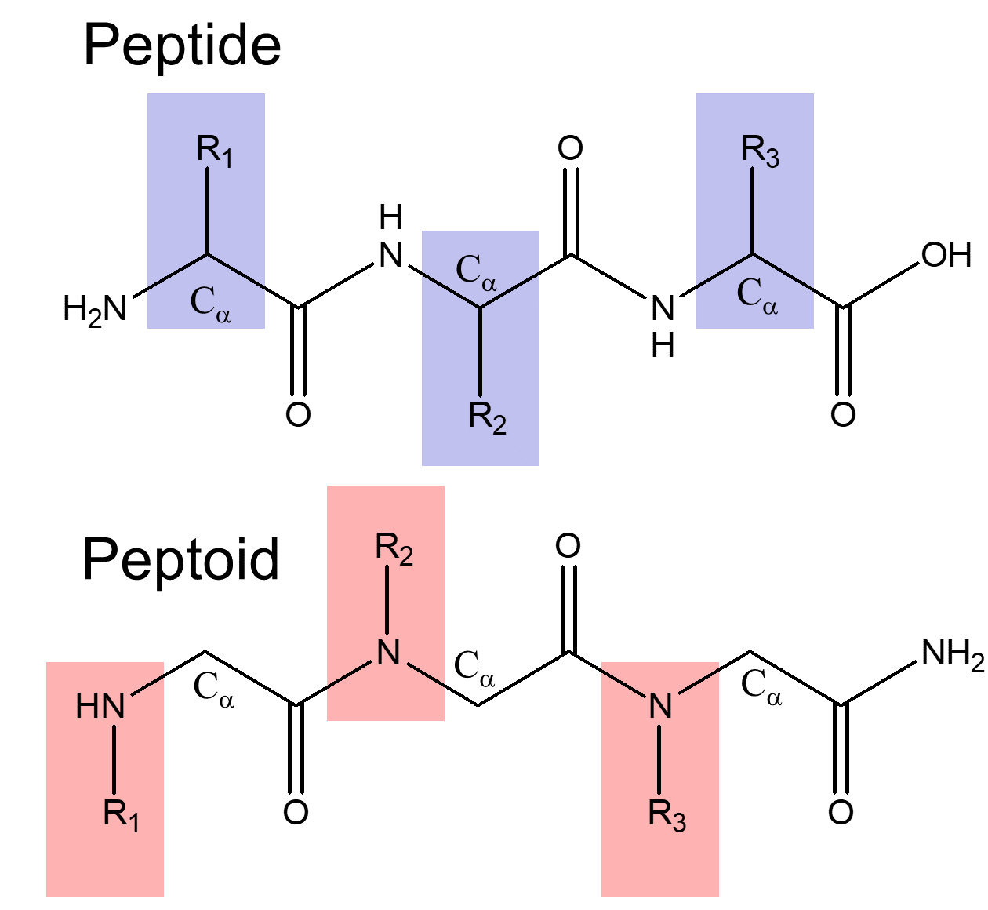
Design novel antiviral molecules based on antimicrobial peptides
Introduction
β-peptoids: N-substituted glycine polymers
Resistant to proteases
Inexpensive to synthesize
Peptoid helices: α-chiral side chains stabilize helical structures , ~ 3 residues per turn, a helical pitch of 6 - 6.7 Å²

Slide 12
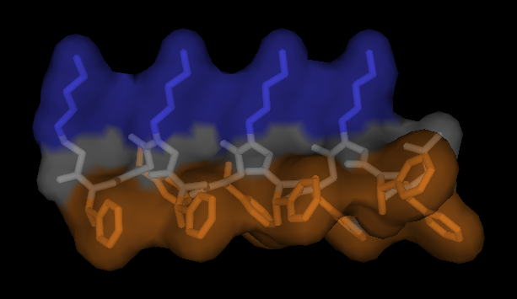
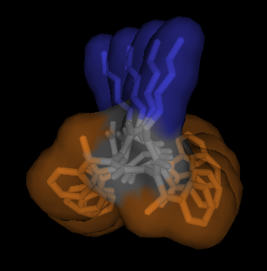
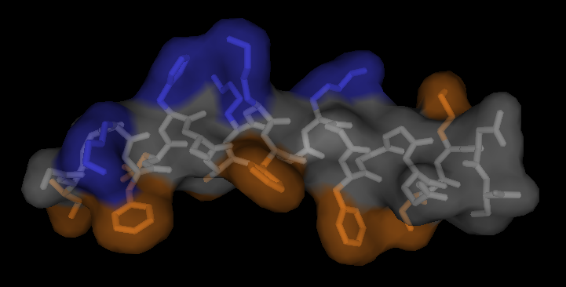
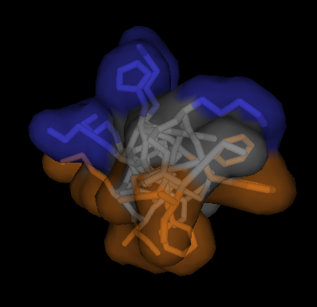
Synthetic, non-natural peptoid mimics of natural AMPs:
Short, sequence-specific, helical oligo-N-substituted glycines
Peptoid 1: H–(NLys–Nspe–Nspe)₄–NH₂
NLys
Nspe
(phenylethylgycine)
Magainin-2: GIGKFLHSAKKFGKAFVGEIMNS–NH₂
cationic
hydrophobic
(Pexiganan)
Chongsiriwatana, N.P. et al. PNAS, 2008, 105: 2794-2799.
Notes:
Mimicking magainin alpha helix with 3-sided peptoid helix mimicking only gross physiochemical property
Peptoid 1 is a 12 residue long with positively charged residues at every third position and intervening chiral hydrophobic residues. Magainin 2 is a 23 amino acid AMP with positively charged residues in the blue and hydrophobic residues in orange.
Pexiganan: an analog of magainin-2 developed for therapeutic applications
Peptoid 1 is comparable or more potent than pexiganan against these BSL2 pathogens

Slide 13
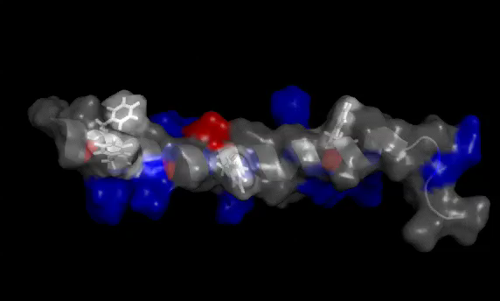
‘Cathelicidin’ peptide LL-37: Unique in the human proteome
Human innate immune peptide LL-37
LL-37 is the single human cathelicidin innate immune peptide, and exhibits potent antiviral activity against enveloped viruses
G. Wang, J. Biol. Chem. (2008)
Vol. 283, No. 47, pp. 32637-32643.

Slide 14
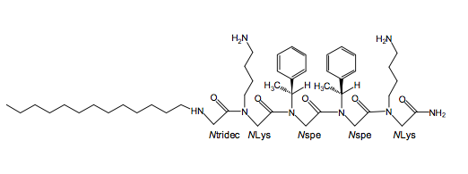
Designing an antimicrobial peptoid based on LL-37
Peptoid 1 (MW 1819)
(MXB1)
Peptoid 1-C13_{4mer}
(MW 835)
(MXB5)
Nspe Nssb Ntridec Npm NLys
Chongsiriwatana, N.P. et al. 2011, Antimicrob. Agents Chemother. 55: 417-420.
Notes:
Wide range of side chain diversity (greater than natural amino acids)

Slide 15
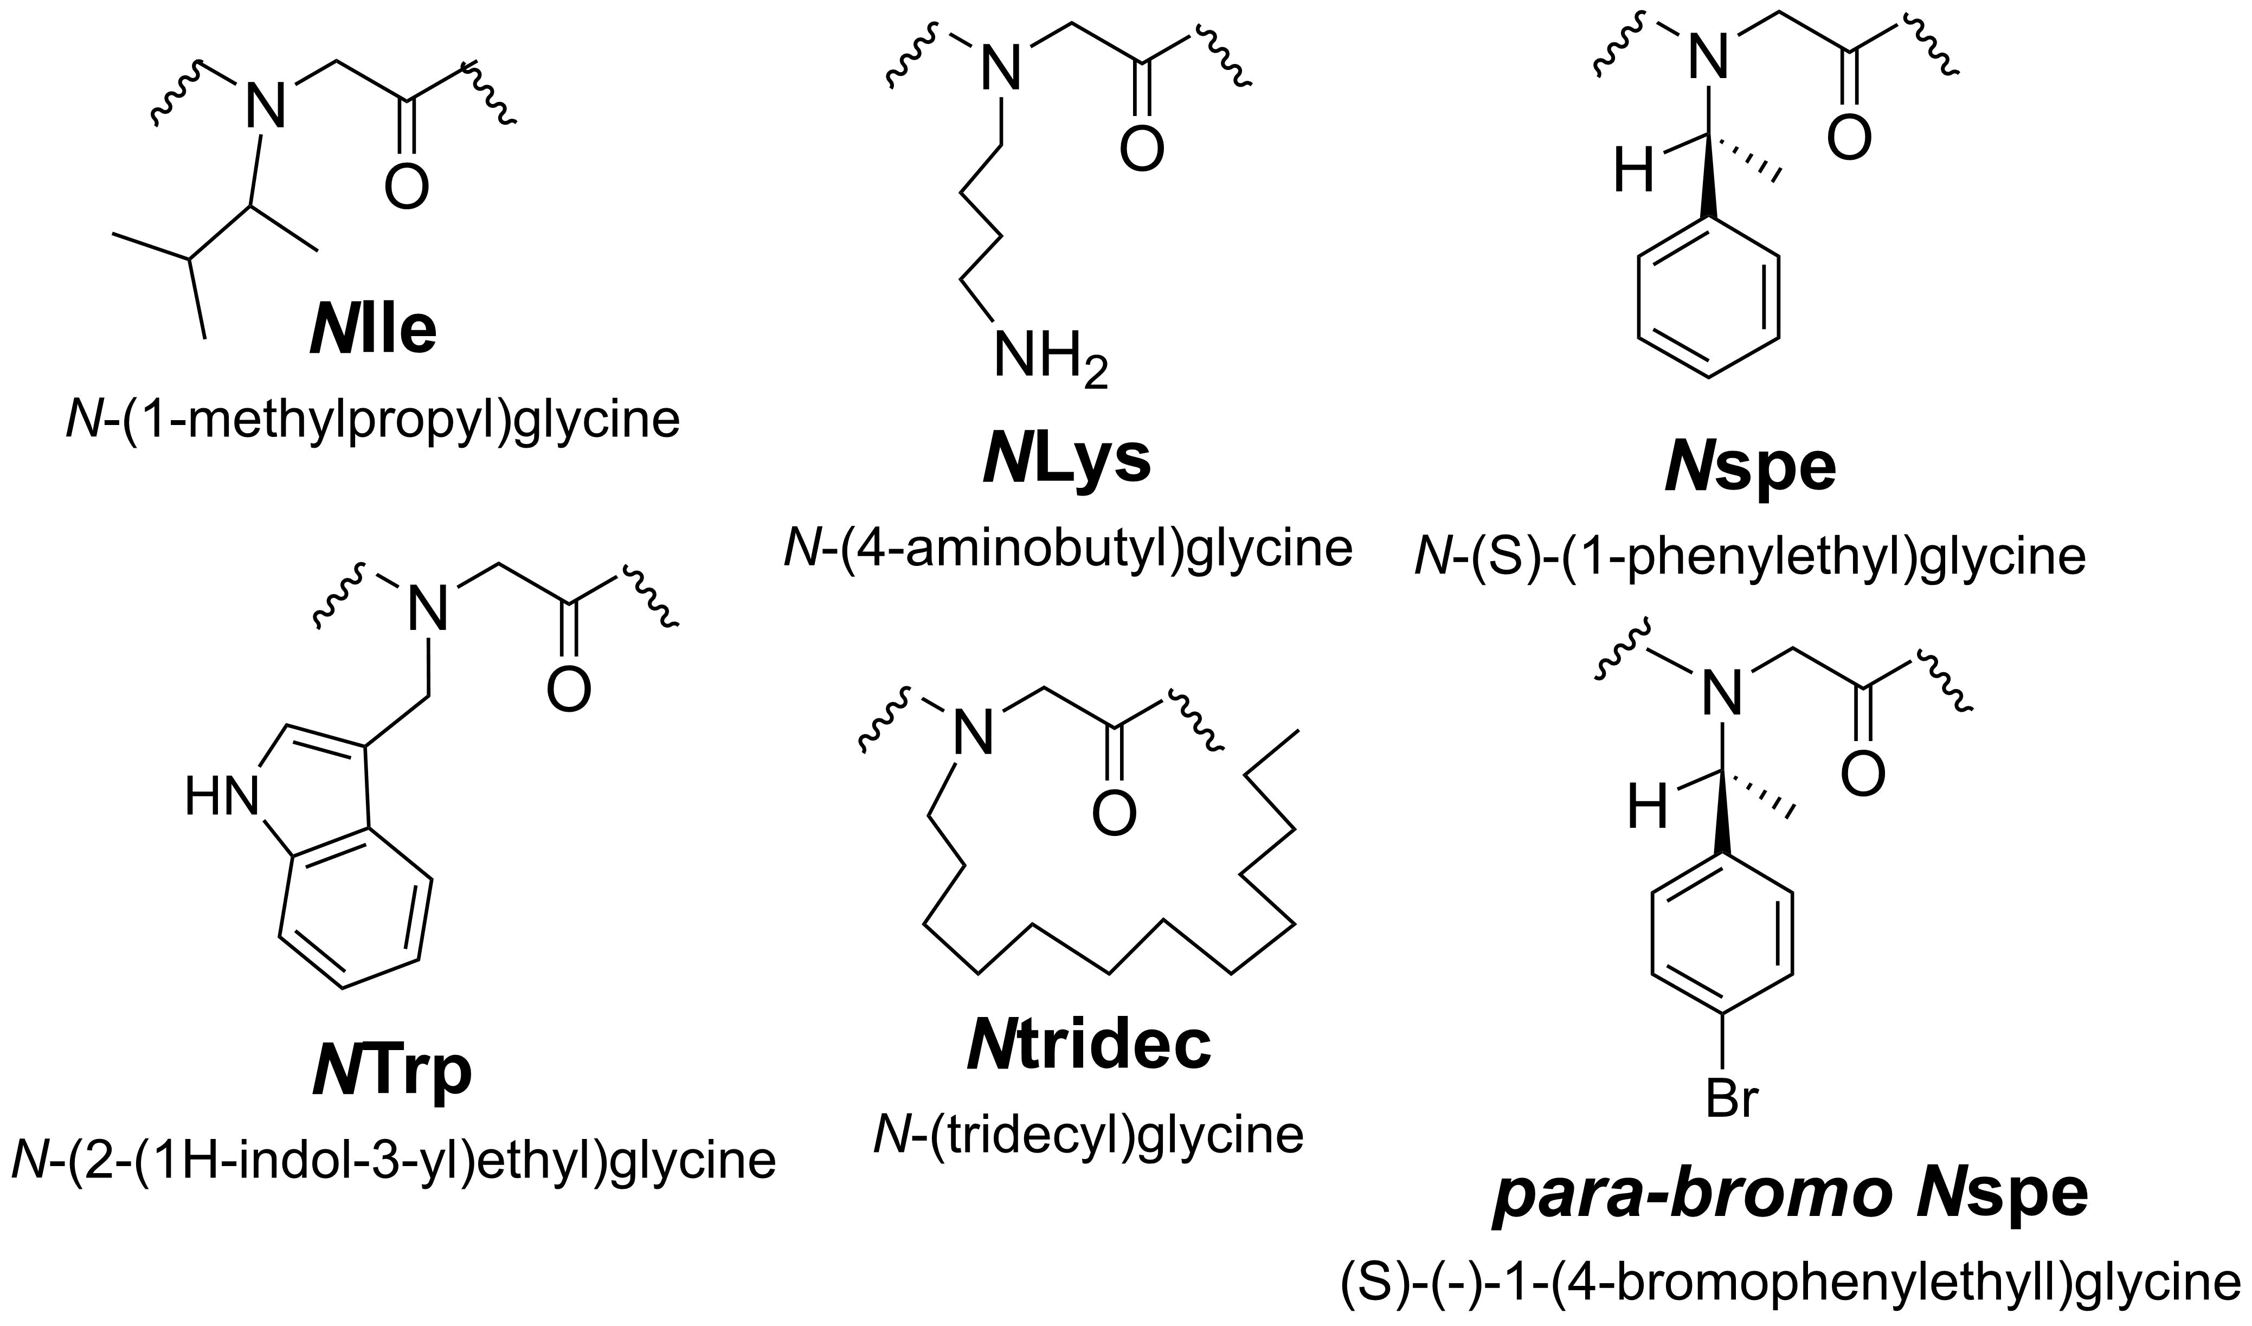
Variants with N-terminal alkylation, para-bromination of Nspe
Håvard Jenssen
LBNL Molecular Foundry

Slide 16
Variants with N-terminal alkylation or para-bromination of Nspe
Peptoid Sequences
MXB1 (Peptoid 1) | H-(NLys-Nspe-Nspe)₄-NH₂
MXB2 | H-(NLys-Nspe-Nspe(p-Br))₂-NH₂
MXB3 | H-NLys-Nspe-Nspe-NLys-Nspe-Nspe(p-Br)-NH₂
MXB4 | H-(NLys-Nspe(p-Br)-Nspe(p-Br))₂-NH₂
MXB5 (C13-4mer) | H-Ntridec-NLys-Nspe-Nspe-NLys-NH₂
MXB6 (1-11mer) | H-(NLys-Nspe-Nspe)₃-NLys-Nspe-NH₂
MXB7 | H-(NLys-Nspe-Nspe)₂-NH₂
MXB8 | H-Ndec-(NLys-Nspe-Nspe)₂-NH₂
MXB9 | H-Ndec-(NLys-Nspe-Nspe(p-Br))₂-NH₂
MXB10 | H-Ntridec-(NLys-Nspe-Nspe(p-Br))₂-NH₂
12mer
6mer
6mer
6mer
5mer
11mer
(neg. control)
6mer
7mer
7mer
7mer
Molchanova, N. et al., 2020 Sci. Rep. 10:14805

Slide 17
Quantify antiviral activity of antimicrobial peptoids
Results and discussion
Assay:
Incubate HSV-1 in the presence of peptoid
Infect oral keratinocyte cell line OKF6/TERT-1
Quantify HSV-1 genomic DNA after 24 hours

Slide 18
Antimicrobial peptoids exhibit potent antiviral activity against HSV-1
Results and discussion

Slide 19
Antimicrobial peptoids exhibit potent antiviral activity against HSV-1
Results and discussion

Slide 20
Antimicrobial peptoids disrupt the HSV-1 viral envelope
Results and discussion

Slide 21
Antimicrobial peptoids inactivate SARS-CoV-2
Results and discussion

Slide 22
Antimicrobial peptoids are not cytotoxic
Results and discussion

Slide 23
Conclusions
Antimicrobial peptoids exhibit potent in vitro activity against two different types of enveloped viruses
No in vitro cytotoxicity is observed in differentiated cell cultures
As with antimicrobial peptides, the activity appears to be through disruption of the viral envelope
Thus, these peptoids can be developed as broad-spectrum antiviral agents, to treat viral infections including COVID-19

Slide 24






Acknowledgments
Funding:
Thanks to Jillian Cramer, University of Kentucky Electron Microscopy Core

