Slide 1
Computational prediction and experimental confirmation of Solid Solution formation from different nitrobenzoic acid derivatives and their isomers
Kristaps Saršūns ¹, Agris Bērziņš ^{1,*}
¹ Faculty of Chemistry, University of Latvia, Jelgavas iela 1, Riga, LV-1004, Latvia; kristaps.sarsuns@lu.lv
* Correspondence: agris.berzins@lu.lv; Tel.: +371-67672576

Slide 2
Abstract
Crystallization experiments of mixtures of various substituted nitrobenzoic acid (NBA) derivatives and their isomers, were used to determine the experimental information about that the solid solutions (SS) can form between those substances. Crystalline phases that were obtained during the work, were characterized by combination of use of X-ray powder diffraction (XRPD) and thermal analysis (DSC/TG), also using the nuclear magnetic resonance spectroscopy (¹H-NMR), information about stoichiometric ratios, of mixtures of different nitrobenzoic acid derivatives and their isomers in crystallization products, were obtained.
Furthermore, using quantum chemical calculations for information about structural and energetic aspects were carried out to identify possible factors, which could be used in prediction of solid solutions in binary systems of chemically similar molecules.
Keywords: Solid solutions; quantum chemical calculations; two component phase diagram; Crystal lattice parameters; powder X-ray diffractometry

Slide 3
Introduction
Several nitrobenzoic acid (NBA) derivatives (-chloro, -methyl, -hydroxyl) and their isomers (Figure 1), such as 2-substituted 4-nitrobenzoic acid (24NBA, Figure 1a), 2-substituted 5-nitrobenzoic acid (25NBA, Figure 1b), 4-substituted 3-nitrobenzoic acid (43NBA, Figure 1c) and 5-substituted 2-nitrobenzoic acid (52NBA, Figure 1d), were selected as model compounds because of their availability and chemically similar structures*.
R = chlorine atom (-Cl), hydroxyl group (-OH) or methyl group (-CH₃)
Figure 1. Molecular structures of (a) 2-substituted 4-nitrobenzoic acid, (b) 2-substituted 5-nitrobenzoic acid, (c) 4-substituted 3-nitrobenzoic acid and (d) 5-substituted 2-nitrobenzoic acid.
* - All corresponding to polymorph I of the respective compound were used as received.
Notes:
In these compounds, the different group/atom (R) does not significantly affect the dominant intermolecular interactions – hydrogen bonds formed by the carboxylic group.

Slide 4
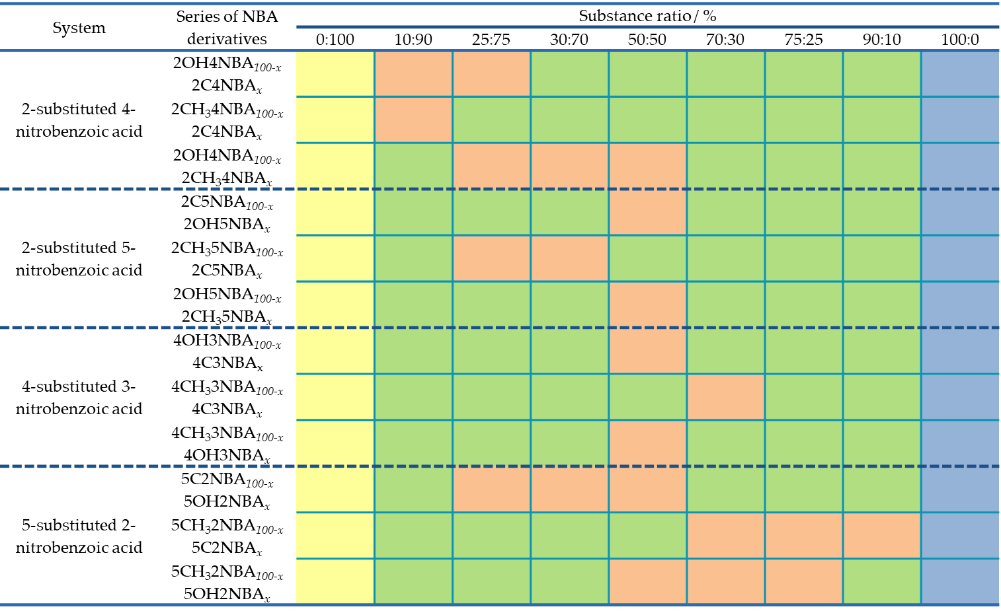
Crystallization results
Table 1.Experimentally obtained crystalilne phases from different nitrobenzoic acid mixtures*.
Solid solution (SS)
Mixture
Pure phase (polymorph I)
* - The preparation of the solid solutions of various nitrobenzoic acid derivatives and their isomers was based on crystallization from solvent (in this case from ethanol), in different proportions (%), from 100-x to x, where 0 ≤ x ≤ 100.
Notes:
Crystal forms of the studied compounds obtained in the crystallization experiments are given in the Table S1. All solid solutions from various nitrobenzoic acid derivatives ant their isomers are designated as SS^{NBA}I (where NBA = abbreviated name of the nitrobenzoic acid).
Crystallization experiments were performed for mixtures of different substituted nitrobenzoic acid derivatives and their isomers, in different substance ratios from 0:100 to 100:0 using ethanol as solvent (cooling crystallization), to determine the crystallization products obtained for each system (see Table 1).
As it was observed that in the cooling crystallization (substance ratios and solvent volumes see Table S2) usually, the solid solution of stable polymorph I was obtained for all experimentally used substituted nitrobenzoic acid derivatives and their isomers.

Slide 5
Results and Discussion
I. Identification of nitrobenzoic acid solid solutions*
Solid solution formation can be confirmed by means of melting phase diagram. It precisely demonstrate that the various substituted nitrobenzoic acid derivatives and their isomers form solid solutions between each other, for example, when solid solution forms in the whole range of substance ratios (a) and at both sides - limited substance ratios (b).
a)
b)
Figure 2. Melting points (DSC onset temperatures) and maximum points (DSC peak temperatures) vs. mass fraction of a) 2OH4NBA in 2OH4NBA_{100-x} 2C4NBA_{x} and b) 4C3NBA in 4C3NBA_{100-x} 4OH3NBA_{x} solid solutions.
* - Graphically depicting the melting of the crystallization products (onset temperature) depending on the weight fraction of the substituted nitrobenzoic acid derivative, as well as including the maximum temperature (peak temperature) a two-component phase diagram is formed (T_{melt.} – solidus and T_{max.} – liquidus).

Slide 6
II. Structural aspects of nitrobenzoic acid solid solutions*
In the case of non-solvated solid solutions, the crystalline lattice parameters were determined. This was done based on experimentally obtained powder X-ray diffraction image data taken from the products obtained during the crystallization process. The crystalline lattice parameters of pure crystalline phases (pure raw materials) were used as initial crystal lattice parameters. Using TOPAS v5.0, the profile was adjusted according to the Pauli method.
a)
b)
Figure 3 Crystalline lattice parameters (a, b and c) changes depending on the content of a) 2OH4NBA in 2OH4NBA_{100-x} 2C4NBA_{x} solid solutions.
* - In the case of non-solvated solid solutions, it can be observed that the crystal lattice parameters, depending on the content of substituted nitrobenzoic acid derivative, form a monotonous function, this means that the Vegard’s Law is fulfilled.

Slide 7
Molecular Modelling – Simulation of solid solutions
Simulation of solid solutions or construction of the crystal structures was performed using Mercury CSD 4.1.3. Virtual solid solutions were obtained as follows (Scheme 1)*.
Scheme 1. Construction of a simulated solid solution.
A lattice is constructed by reducing symmetry of the respective structure and setting it to P1 space group. One molecule in the unit cell is then replaced with another, for example, one 2CH₃4NBA molecule (called “native”) is removed and replaced by one of the derivatives (containing -OH functional group or -Cl atom).
* - Several ratios of native and derivative molecules have been investigated: ratios 1:0 (original structure, P2₁/c), 0:1 (isostructural structure, P2₁/c) and 3:1 (substituted structure, P1).

Slide 8
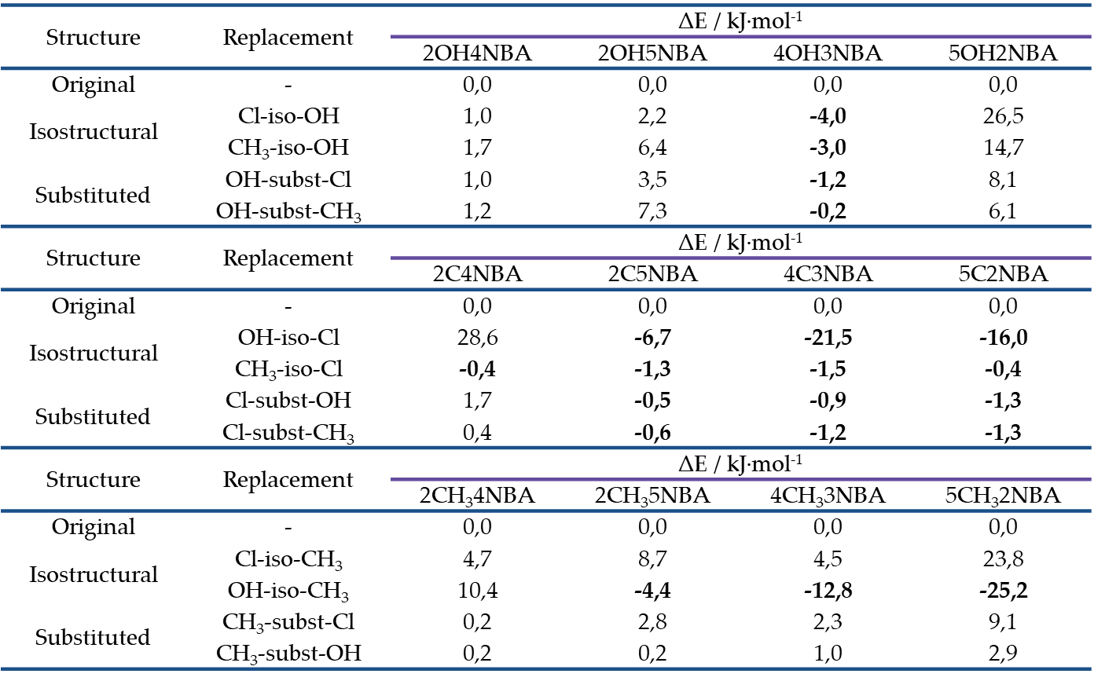
III. Quantum chemical calculations*
Table 2. Information about crystal lattice energy changes for different nitrobenzoic acid derivatives and their isomers (calculated according to VC-relax and SCF solution)*.
* - ∆E < 0 (colored in bold), it is likely that the two compounds will crystallize separately and will form solid solutions with each other in the given combination.

Slide 9
IV. Energetic aspects of nitrobenzoic acid solid solutions*
a)
b)
c)
d)
Figure 4. Energy change (ΔE) depending on the crystal lattice energy of a) 2-substituted 4-nitrobenzoic, b) 2-substituted 5-nitrobenzoic acid, c) 4-substituted 3-nitrobenzoic acid and d) 5-substituted 2-nitrobenzoic acid
* - By graphically interpreting the results, it can be clearly seen in which cases the isostructural and/or replaced structure is more energetically advantageous compared to the original structure (pure phase) energy (the frame is covered in black). Colors are marked by substitution of group/atom (R): green – chlorine atom, orange – hydroxyl group, red – methyl group).

Slide 10
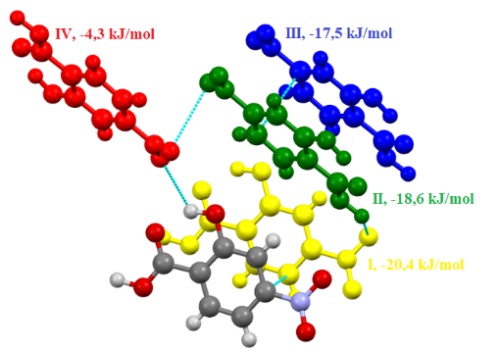
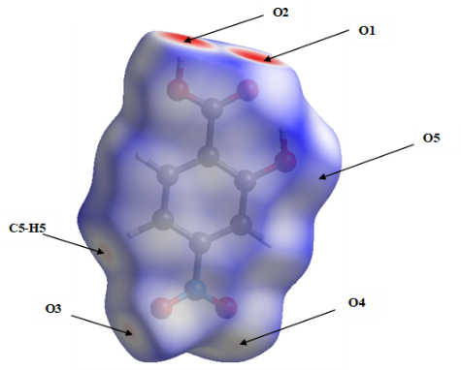
V. Structural characterization of ansolvates*
Intermolecular interactions
Hirschfield surface
b)
a)
Hirschfield surface 2D fingerprint graphs
Electrostatic potential maps
c)
d)
ESP (a.u.)
(δ⁺)
(δ⁻)
* - Analysis of the crystal structures of the non-solvated forms revealed that most of the non-solvated phases crystallize in P2₁/c (8/12) space group and 1 in P2₁/a space group, but 3 in P-1. In all cases Z’=1 except for 2CH₃5NBA, 4CH₃3NBA, 5C2NBA and 5OH2NBA (Z’=2). In all structures centrosymmetric hydrogen bonded $R_{2}^{2}\left(8\right)$ dimers O2-H∙∙∙O1 are present (although the hydrogen-bonded molecules have similar conformation.

Slide 11
Conclusions
The possibility of solid solution formation in a system which contains different substituted nitrobenzoic acid derivatives and their isomers was investigated using a simple molecular modeling procedure which consists of (I) replacement of a given amount of B molecules into the A structure by preparing a virtual solid solution as well as a fully replaced isostructural phase; (II) computation of the lattice and intermolecular interaction energy, furthermore comparison energy of these structures with the energy of the original structure (calculated for pure phases);
A prediction of different experimental phase behaviors observed in these systems was achieved. Computational studies can be used to predict the formation of solid solution in binary systems of various substituted nitrobenzoic acid derivatives and their isomers. The results show that the lattice and intermolecular interaction energy can be used to determine whether the respective solid solution will form, but do not allow prediction of specific maximum ratios of formed solid solutions;
As this modelling approach was successful, research will proceed with molecules that are more complex (for example, active pharmaceutical ingredients) in order to understand possible factors, both geometric and energetic, and systematize the factors responsible for the formation of solid solutions.

Slide 12
Funding
This work has been supported by the Latvian Council of Science, project “Crystal engineering of pharmaceutical multicomponent phases for more efficient crystalline phase design”, project No. lzp-2018/1-0312.
Acknowledgments
Author would like to Acknowledge the MSc. Chem. Rihards Klūga on ¹H-NMR spectra admission, MSc. Chem. Artis Kons on the determination of the structure of pure crystalline phases using powder X-ray diffraction results, as well as Dr. Chem. Toms Rēķis for consulting on the construction of two-component phase diagrams of solid solutions and the provided comments.

