Slide 1
Quantum chemical modeling of molecular crystal deformations
Yevhenii A. Vaksler ^{1,2,3,}*, Abdenacer Idrissi ², and Svitlana V. Shishkina ^{1,3}
¹ V.N. Karazin Kharkiv National University, 4 Svobody Sq., Kharkiv, 61022, Ukraine
² SSI “Institute for Single Crystals” NAS of Ukraine, 60 Nauky ave., Kharkiv, 61001, Ukraine
³ Laboratoire de Spectroscopie pour les Interactions, la Réactivité et L’environnement (UMR CNRS A8516), Université de Lille, 59655, Villeneuve d’Ascq Cedex, France.
* Corresponding author: vakslerea@gmail.com

Slide 2
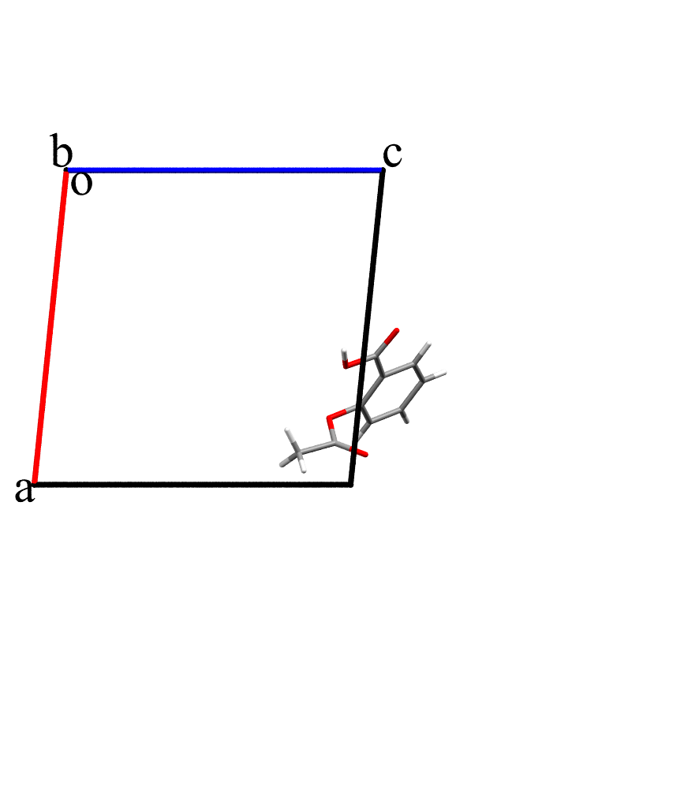
Energy-vector diagrams for visualization

Slide 3
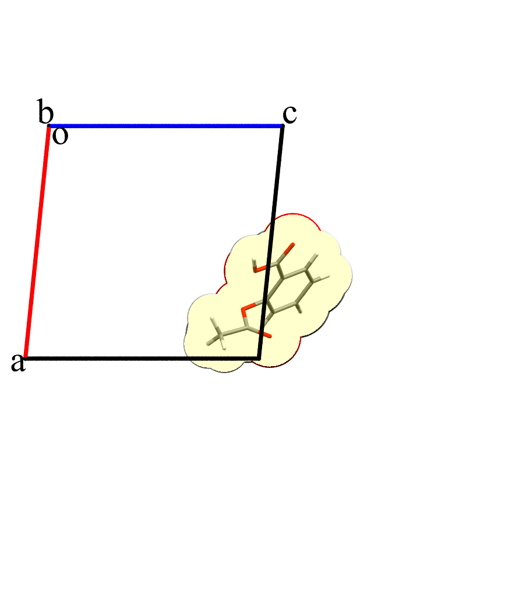
Energy-vector diagrams for visualization
Search for neighbors:
$$D_{ij}≤{VdW}_{i}^{im}+ ?$$
where D_{ij} – distance between the i and j atoms of the initial molecule and nth neighbor
${VdW}_{i}^{im}$ - van der Waals radius of the i atom of the initial molecule

Slide 4
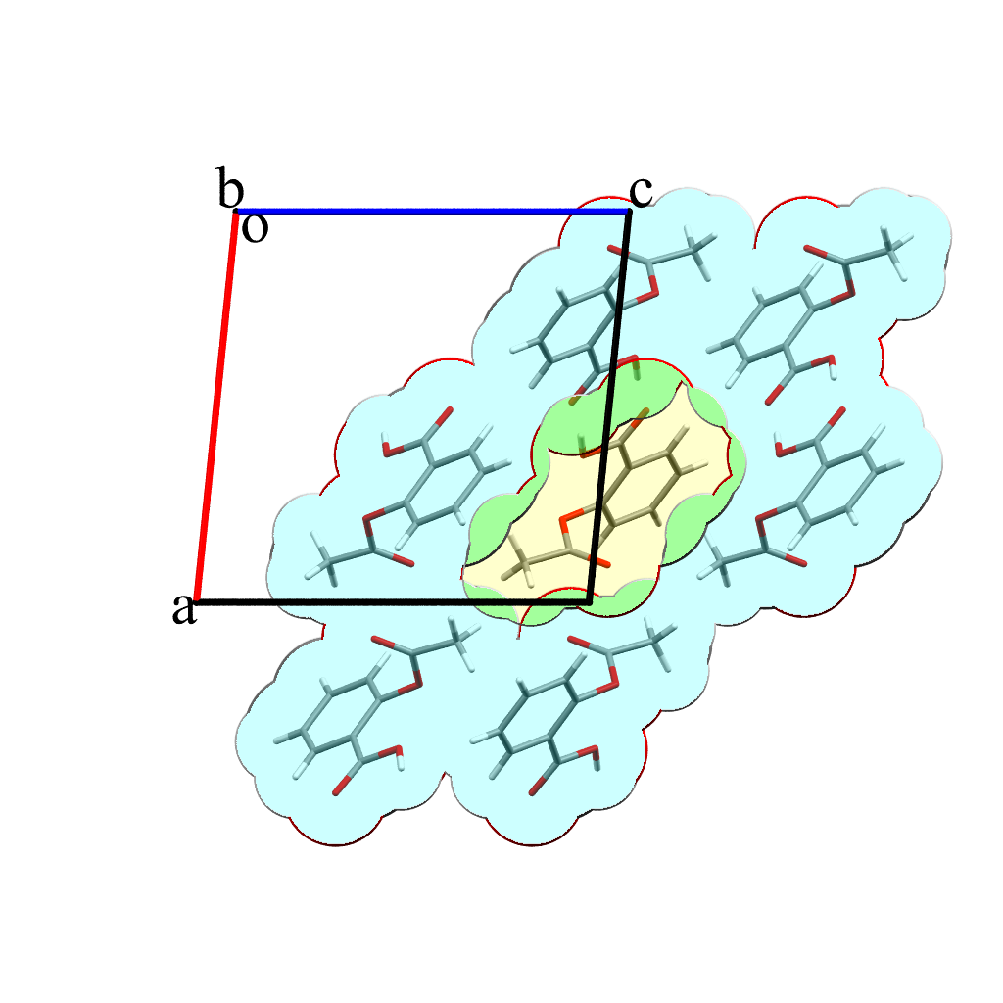
Energy-vector diagrams for visualization
Search for neighbors:
$$D_{ij}≤{VdW}_{i}^{im}+{VdW}_{j}^{nm}+1$$
where D_{ij} – distance between the i and j atoms of the initial molecule and nth neighbor
${VdW}_{i}^{im}$ - van der Waals radius of the i atom of the initial molecule
${VdW}_{j}^{nm}$ - van der Waals radius of the j atom of the neighboring molecule

Slide 5
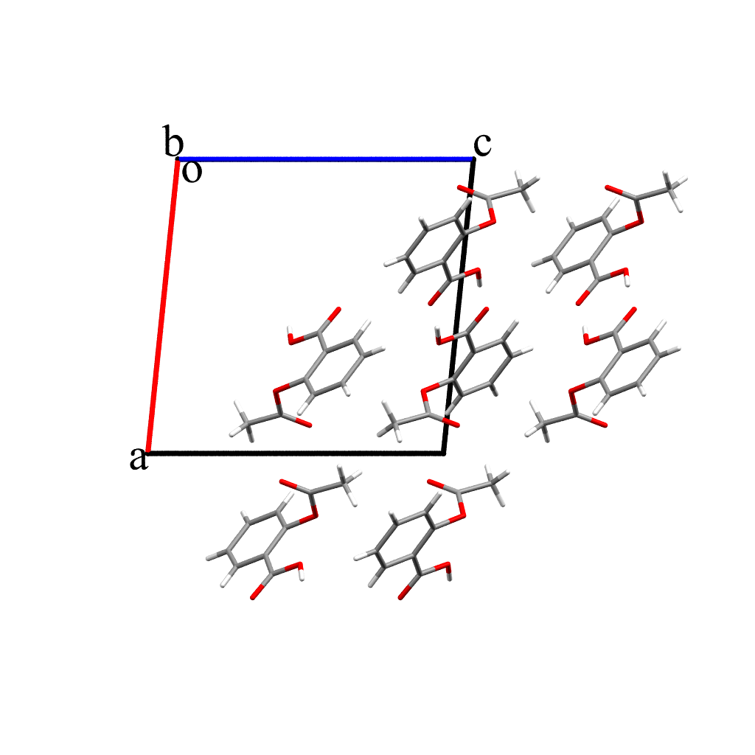
Energy-vector diagrams for visualization
Search for neighbors:
$$D_{ij}≤{VdW}_{i}^{im}+{VdW}_{j}^{nm}+1$$
where D_{ij} – distance between the i and j atoms of the initial molecule and nth neighbor
${VdW}_{i}^{im}$ - van der Waals radius of the i atom of the initial molecule
${VdW}_{j}^{nm}$ - van der Waals radius of the j atom of the neighboring molecule

Slide 6
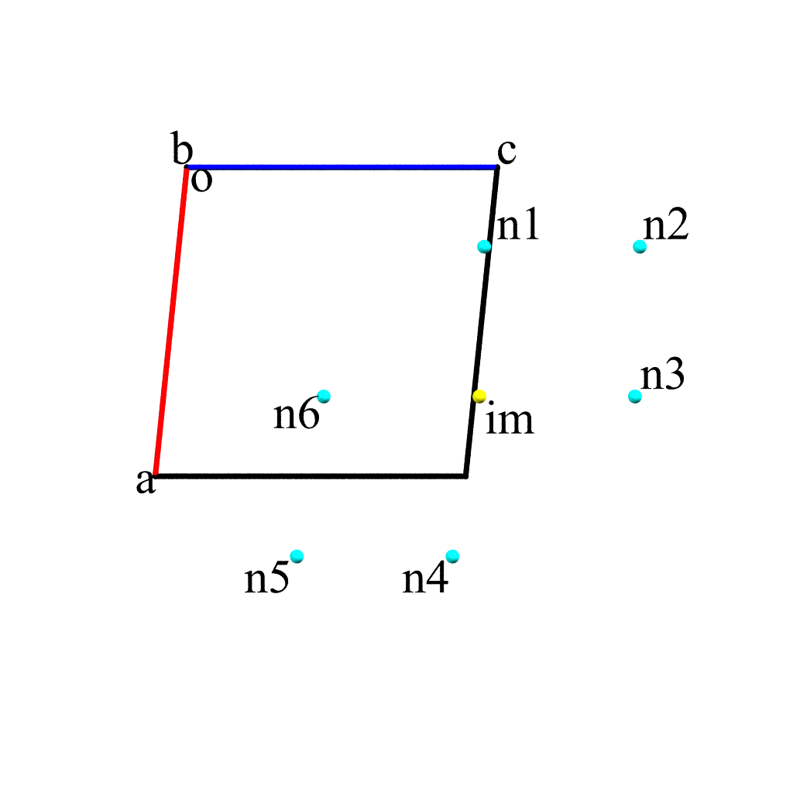
Energy-vector diagrams for visualization
Search for neighbors:
$$D_{ij}≤{VdW}_{i}^{im}+{VdW}_{j}^{nm}+1$$
where D_{ij} – distance between the i and j atoms of the initial molecule and nth neighbor
${VdW}_{i}^{im}$ - van der Waals radius of the i atom of the initial molecule
${VdW}_{j}^{nm}$ - van der Waals radius of the j atom of the neighboring molecule

Slide 7
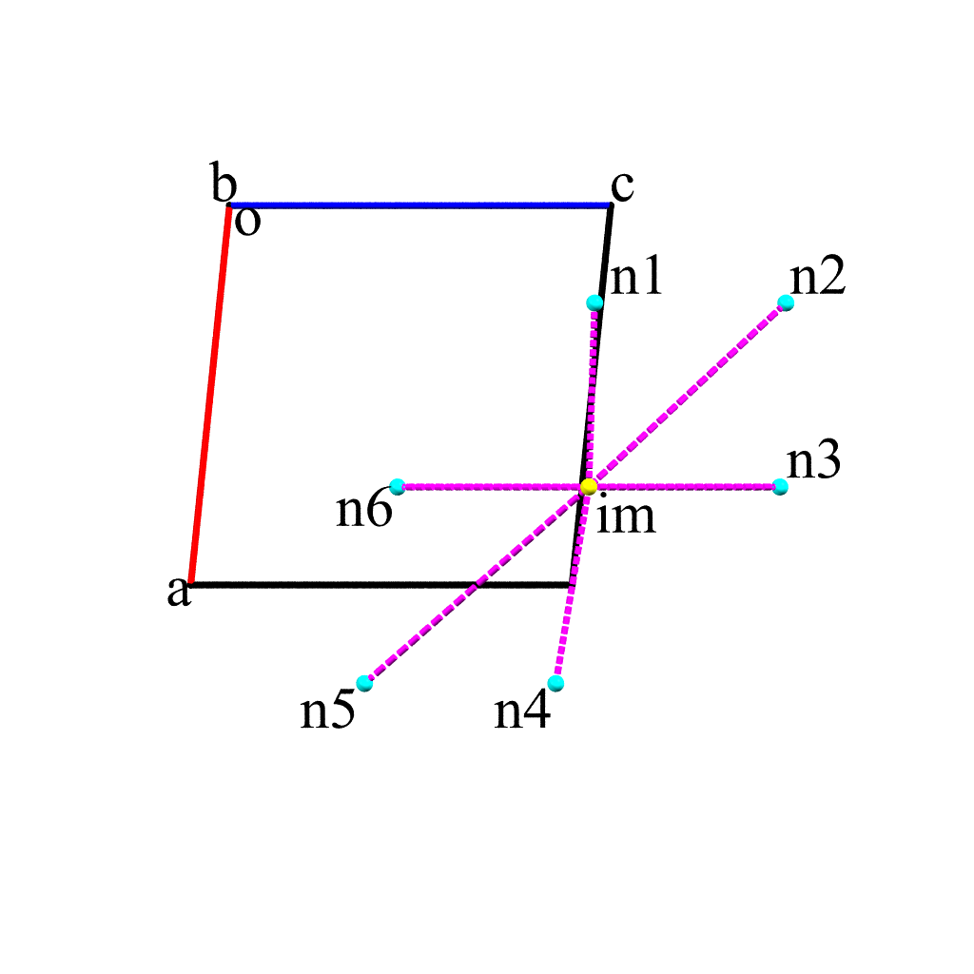
Energy-vector diagrams for visualization
Search for neighbors:
$$D_{ij}≤{VdW}_{i}^{im}+{VdW}_{j}^{nm}+1$$
where D_{ij} – distance between the i and j atoms of the initial molecule and nth neighbor
${VdW}_{i}^{im}$ - van der Waals radius of the i atom of the initial molecule
${VdW}_{j}^{nm}$ - van der Waals radius of the j atom of the neighboring molecule

Slide 8
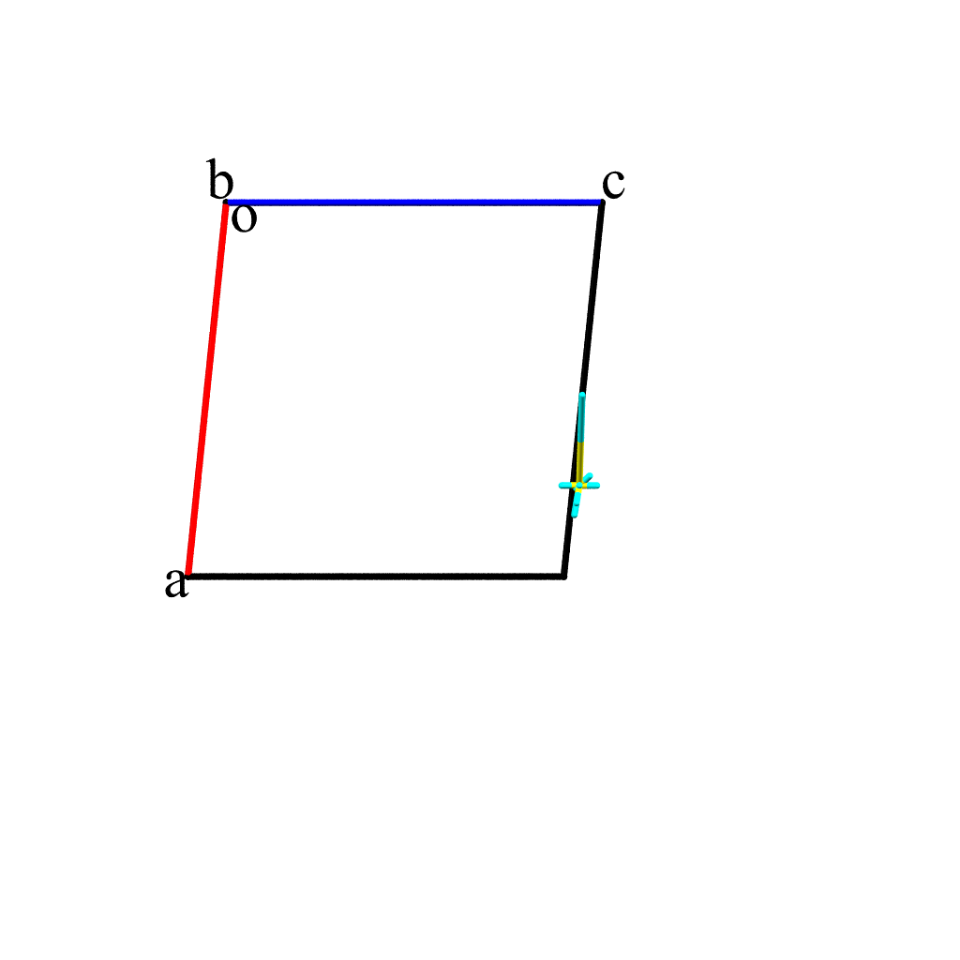
Energy-vector diagrams for visualization
Length of the vector:
$$L_{n}=R_{n}E_{n}/2E_{str}$$
where R_{n} – the distance between the geometric centers of nth neighbor and the initial molecule
E_{n} – interaction energy between between nth neighbor and the initial molecule
E_{str} – energy of the strongest pairwise interaction in crystal
Search for neighbors:
$$D_{ij}≤{VdW}_{i}^{im}+{VdW}_{j}^{nm}+1$$
where D_{ij} – distance between the i and j atoms of the initial molecule and nth neighbor
${VdW}_{i}^{im}$ - van der Waals radius of the i atom of the initial molecule
${VdW}_{j}^{nm}$ - van der Waals radius of the j atom of the neighboring molecule

Slide 9
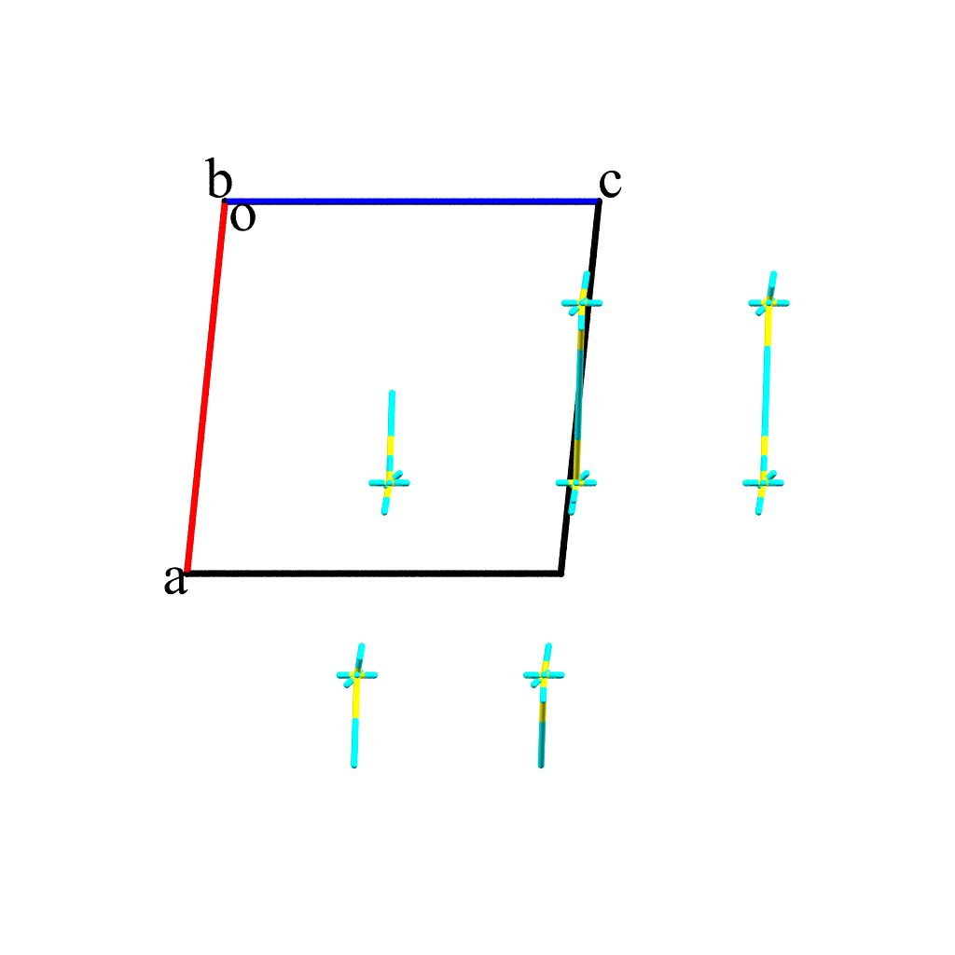
Energy-vector diagrams for visualization
Length of the vector:
$$L_{n}=R_{n}E_{n}/2E_{str}$$
where R_{n} – the distance between the geometric centers of nth neighbor and the initial molecule
E_{n} – interaction energy between between nth neighbor and the initial molecule
E_{str} – energy of the strongest pairwise interaction in crystal
Search for neighbors:
$$D_{ij}≤{VdW}_{i}^{im}+{VdW}_{j}^{nm}+1$$
where D_{ij} – distance between the i and j atoms of the initial molecule and nth neighbor
${VdW}_{i}^{im}$ - van der Waals radius of the i atom of the initial molecule
${VdW}_{j}^{nm}$ - van der Waals radius of the j atom of the neighboring molecule

Slide 10
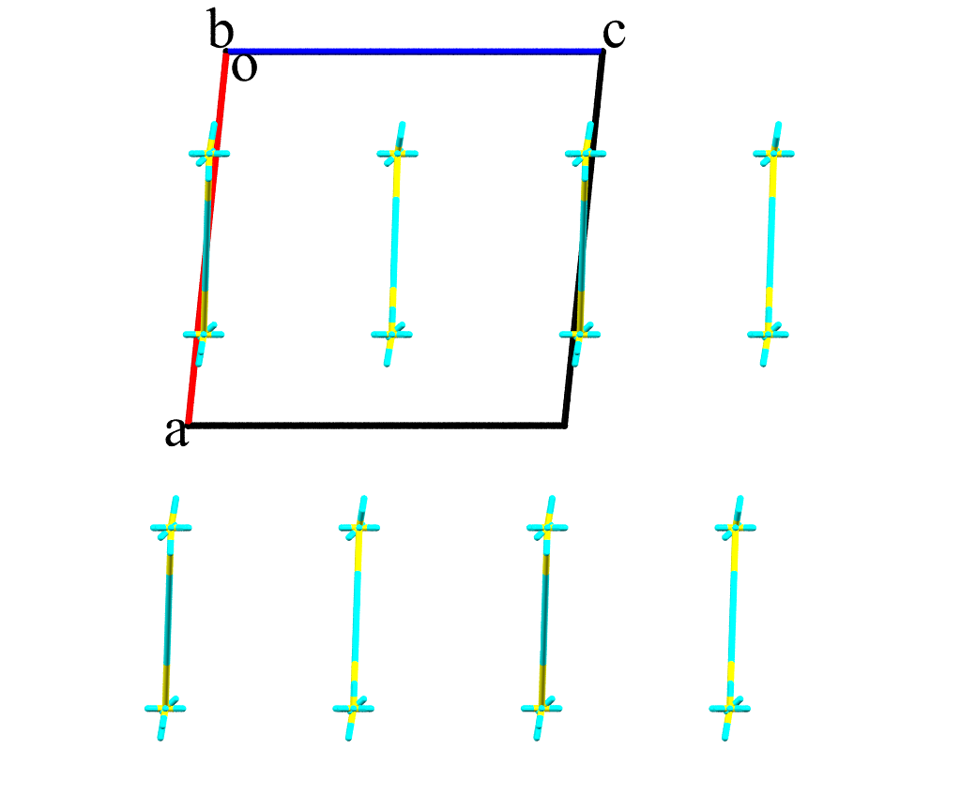
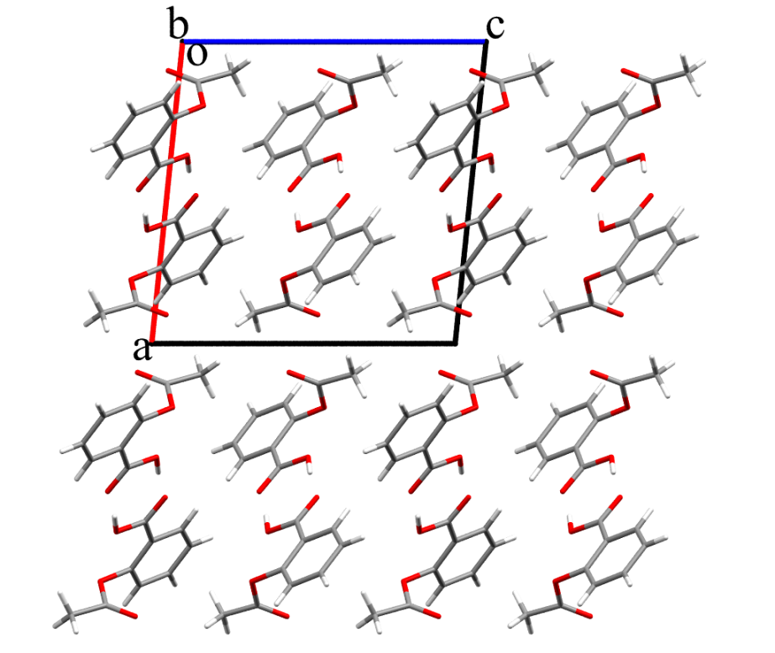
Energy-vector diagrams for visualization
Length of the vector:
$$L_{n}=R_{n}E_{n}/2E_{str}$$
where R_{n} – the distance between the geometric centers of nth neighbor and the initial molecule
E_{n} – interaction energy between between nth neighbor and the initial molecule
E_{str} – energy of the strongest pairwise interaction in crystal
Search for neighbors:
$$D_{ij}≤{VdW}_{i}^{im}+{VdW}_{j}^{nm}+1$$
where D_{ij} – distance between the i and j atoms of the initial molecule and nth neighbor
${VdW}_{i}^{im}$ - van der Waals radius of the i atom of the initial molecule
${VdW}_{j}^{nm}$ - van der Waals radius of the j atom of the neighboring molecule

Slide 11
Classification of molecular crystals
Isotropic
Columnar
Layered
Columnar-layered
Relationship between anisotropy of physical properties and anisotropy of crystal packing
Different properties of polymorphs due to different systems of intermolecular interactions
Shishkin O. V. , Zubatyuk R. I., Shishkina S. V., [et al.] (2014).
Phys. Chem. Chem. Phys., 16, 6773-6786.

Slide 12
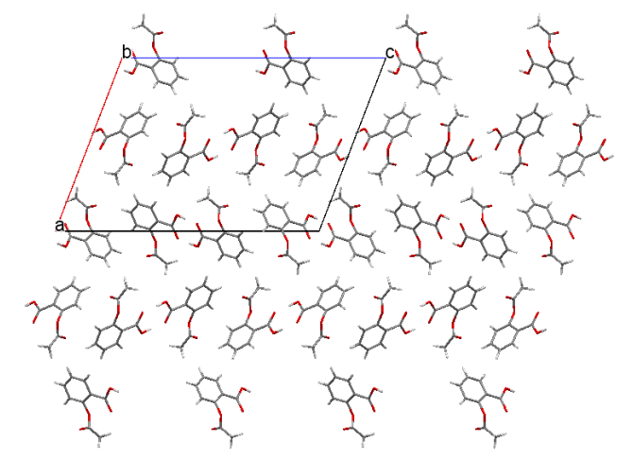
Aspirin’s polymorphic forms
P21/c: a= 11.2776, b= 6.5517, c= 11.2741 β= 95.837
2.0 GPa
I
III
Grinding*
Bond A., Boese R., Desiraju G. (2007).
Angew. Chem. Int. Ed., 46(4), 615-617
P21/c: a= 12.1515, b= 6.5064, c= 11.3677 β= 111.574
II
2.2 GPa
III
P21/c: a= 16.741, b= 4.795, c= 23.802 β= 111.08
Pressure
drop
III
Unknown form
Metastable
Shtukenberg A., Hu C., Zhu Q., [et al.] (2017).
Cryst. Growth Des., 17(6), 3562-3566
*Varughese S., Kiran M. S. R. N., Solanko K. A., [et al.] (2007).
Angew. Chem. Int. Ed., 46(4), 615-617
4

Slide 13
Analysis of energetic structure of aspirin’s polymorphs
Interaction energy, kcal/mol | I |  | II |  | III AA |  | III BB
 | (1 0 0) | (0 0 1) | (1 0 0) | (-1 0 2) | (1 0 0) | (0 0 1) | (1 0 0) | (0 0 1)
In chain | -26.8 |  | -26.9 |  | -35.3 |  | -32.9
Between chains in layer | -32.2 | -12.3 | -33.6 | -13.3 | -19.7 | -17.4 | -20.9 | -17.4
In layer | -59.9 | -39.0 | -60.5 | -40.1 | -55.0 | -52.8 | -53.8 | -50.3
Between layers | -15.4 | -36.3 | -14.8 | -35.2 | -24.6 | -26.9 | -24.6 | -28.1
Chain with all neighbors | -48.6 |  | -48.4 |  | -44.3 |  | -45.5
Total | -73.5 |  | -73.5 |  | -79.7 |  | -78.5
I
II
III
5

Slide 14
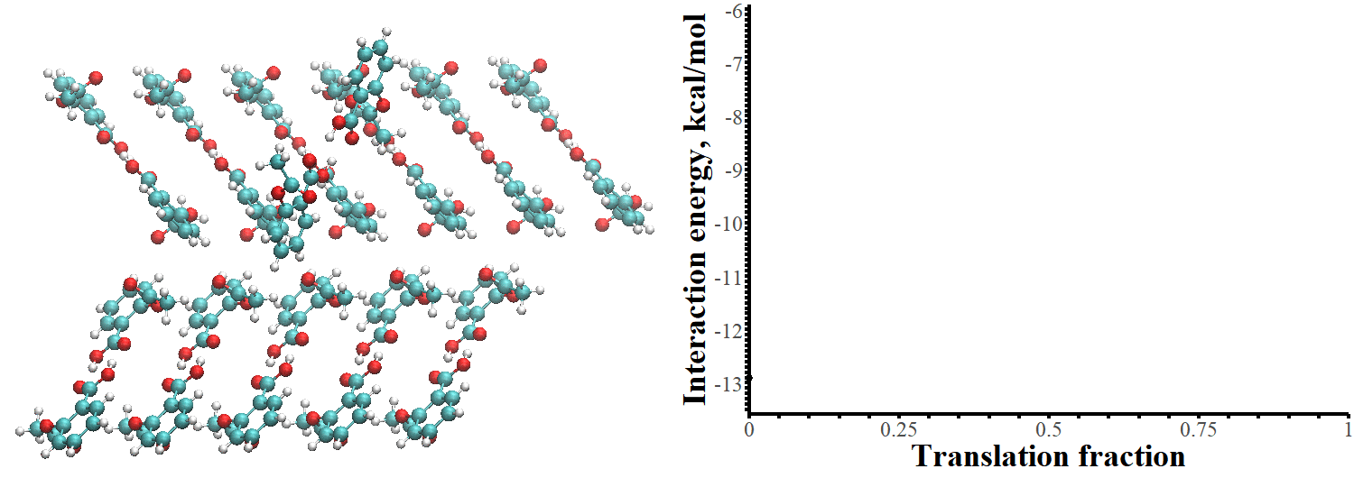
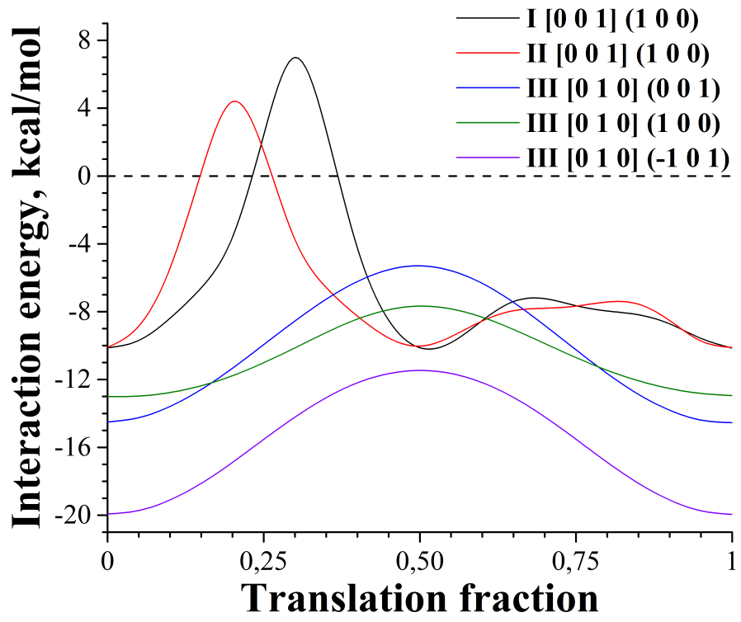
Modelling of shift in aspirin’s crystals
 | Shift energy barrier, kcal/mol | Minimal distance, Å
I [001] (100) | 17.1 | 1.19
II [001] (100) | 14.5 | 1.27
III [010] (001) | 9.2 | 1.73
III [010] (100) | 5.3 | 1.73
III [010] (-101) | 8.5 | 1.82
Crystal structure transformation under pressure
6

Slide 15
Transformation in piracetam under pressure
Pressure growth
?
Conversion
1 bar
0.45 GPa
0.70 GPa
0.90 GPa
2.50 GPa
4.00 GPa
Tableting
Form II, P-1: a= 6.321, b= 6.5597, c= 8.380
α= 79.82, β= 102.34, γ= 90.94
Form V, P-1: a= 6.442, b= 6.3530, c= 8.737
α= 81.43, β= 112.88, γ= 91.38
Fabbiani F. P. A., Allan D. R., David W. I. F., [et al.] (2007).
Cryst. Growth Des., 7(6), 1115-1124.
7

Slide 16
Changes in energetic structure of piracetam upon a transition
Interaction energy, kcal/mol | II at 0.45 GPa |  |  | V at 0.70 GPa
 | (001) | (010) | (0-11) | (001) | (010) | (0-11)
In chain | -35.9 |  |  | -34.6
Between chains in layer | ‑19.2 | ‑8.8 | ‑9.6 | ‑20.4 | ‑13.2 | ‑12.9
In layer | ‑74.3 | ‑53.4 | ‑55.2 | ‑75.4 | ‑60.9 | ‑60.3
Between layers | ‑18.4 | ‑28.8 | ‑27.9 | ‑26.0 | ‑33.2 | ‑33.5
Total | -111.0 |  |  | -127.4
8

Slide 17
Modelling of shift in piracetam’s crystals
[100] direction along (001) layer
Polymorph | Pressure, GPa | Shift energy barrier, kcal/mol | Minimal distance, Å
II | 1.00*10⁻⁴ | 5.3 | 1.72
 | 0.45 | 6.0 | 1.84
V | 0.70 | 7.2 | 2.01
 | 0.90 | 8.2 | 1.96
 | 2.50 | 9.4 | 1.88
 | 4.00 | 10.3 | 1.84
9

Slide 18
Cavities detection in piracetam
Shortening of the van der Waals radii sum at a point:
$SvdWR$-$MD=min⁡(D_{ij}−R_{i}^{FP}−R_{j}^{MP})$
where $D_{ij}$ – the distance between the atoms of fixed (i) and motile (j) parts
$R_{i}^{FP},R_{j}^{MP}$– van der Waals radii of the corresponding atoms in fixed (i) and motile (j) parts
10

Slide 19
Cavities detection in piracetam
Shortening of the van der Waals radii sum at a point:
$SvdWR$-$MD=min⁡(D_{ij}−R_{i}^{FP}−R_{j}^{MP})$
where $D_{ij}$ – the distance between the atoms of fixed (i) and motile (j) parts
$R_{i}^{FP},R_{j}^{MP}$– van der Waals radii of the corresponding atoms in fixed (i) and motile (j) parts
(0.78,0.97)
10

Slide 20
Comparison of structure and energy assessment of the transition in piracetam crystals
Polymorph II under the pressure of 0.45 GPa
Polymorph V under the pressure of 0.70 GPa
11

Slide 21
Comparison of structure and energy assessment of the transition in piracetam crystals
Polymorph II under the pressure of 0.45 GPa
Polymorph V under the pressure of 0.70 GPa
No repulsion!
(0,0): -16.4 kcal/mol
(0.78,0.97): -9.0 kcal/mol
11

Slide 22
Comparison of structure and energy assessment of the transition in piracetam crystals
Polymorph II under the pressure of 0.45 GPa
Polymorph V under the pressure of 0.70 GPa
No repulsion!
(0,0): -16.4 kcal/mol
(0.78,0.97): -9.0 kcal/mol
Compression
11

Slide 23
Consistency of ibuprofen’s structure
Compression up to 4 GPa
No conversion
under pressure!
Ostrowska K., Kropidłowska M., Katrusiak A. (2015)
Cryst. Growth Des., 15(3), 1512-1517.
12

Slide 24
Sustainability of ibuprofen’s energetic structure
Interaction energy, kcal/mol | 0.23 GPa
 | (100) | (001) | (102)
In chain | -21.6
Between chains in layer | ‑30.3 | ‑6.0 | ‑4.5
In layer | -82.2 | -33.6 | -30.5
Between layers | ‑10.5 | ‑34.8 | ‑36.3
Total | -103.2
Total energy
Energy in layer
13

Slide 25
Modelling of shift in ibuprofen’s crystals
[001] direction along (100) layer
9.1 kcal/mol
0.40
Pressure, GPa | Shift energy barrier, kcal/mol | Minimal distance, Å
0,23 | 13,6 | 1,46
0,60 | 24,9 | 1,30
0,80 | 34,8 | 1,18
0,88 | 34,7 | 1,20
2,65 | 104,6 | 0,86
4,00 | 190,7 | 0,70
14

Slide 26
Conclusions
On the base of a study of pairwise interactions energies in crystals the new quantum-chemical method able to describe shear-based transformations of crystal structures was proposed.
The new cheap express method for the 2d-detection of cavities in structure was offered and applied for the preliminary assessment of the molecular slips probability in crystals.
Testing with experimental results showed a good match within the simulated and real properties and transformations for three pharmaceutic compounds: aspirin, piracetam and ibuprofen.
15

