Slide 1
N-Donor Functionalized Acetylacetones for Heterobimetallic MOFs – The Next Episode: Trimethylpyrazoles
Steven van Terwingen^{1,}*, and Ulli Englert^{1,2}
¹ Institute of Inorganic Chemistry, RWTH Aachen University, Landoltweg 1, 52074 Aachen, Germany;
² Key Laboratory of Materials for Energy Conversion and Storage, Institute of Molecular Science, Shanxi University, Taiyuan, Shanxi 030006, People's Republic of China.
* Corresponding author: steven.vanterwingen@ac.rwth-aachen.de

Slide 2
Abstract: While metal-organic frameworks (MOFs) have been investigated intensively throughout the last decades, only a fraction of the published articles on MOFs feature heterobimetallic structures. Combining two metallic centers in a rigid framework could lead to interesting effects, such as magnetic coupling, collaborating fluorescence or catalytic properties; however, its synthesis is more sophisticated than for monometallic MOFs. We utilize ditopic ligands whose coordination sites differ in their Pearson hardness (HSAB). This enables a stepwise selective formation of heterobimetallic MOFs: first, a monometallic building block is synthesized. In a second step the framework can be constructed by crosslinking with a second metal ion.
In this work we present our most recent ligand candidate: 3-(1,3,5-trimethyl-1H-pyrazol-4-yl)acetylacetone. Its synthesis is straightforward and inexpensive. The O,O’ coordination was accomplished with a variety of hard cations like Fe^{III} or Ga^{III}. First crosslinking attempts with N coordination of the Fe^{III} building block to Ag^{I} leads to a one-dimensional coordination polymer with high porosity.
Keywords: MOFs; coordination chemistry; crystal engineering

Slide 3
Introduction
We aim for the stepwise and selective synthesis of heterobimetallic metal-organic frameworks (MOFs). For that purpose we utilize ditopic ligands which donor sites differ in Pearson hardness [1]. Here we present a trimethylpyrazolyl substituted acetylacetone to construct a heterobimetallic coordination polymer.
Cu^{I}, Ag^{I}, Hg^{II}
Soft
Hard
Fe^{III}, Ga^{III}, Yb^{III}

Slide 4
Motivation
Stepwise synthesis of a heterobimetallic MOF achieved with a ditopic ligand:
Ligand
building unit
heterobimetallic MOF

Slide 5
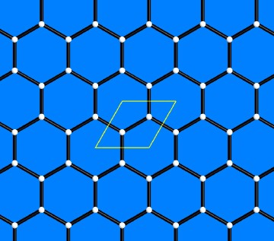
Motivation
There are various properties of these MOF’s which are worth investigating (bottom left). Post-modification and/or thermal decomposition can also lead to complex systems with interesting features, e.g. one example of our group shows catalytic properties for the N₂O conversion to the elements after thermal decomposition of an Yb^{III}/Ag^{I} MOF (bottom right) [3]:
Yb₂O₃
Ag⁰
Analysis of the MOF‘s:
topology[2]
catalytic properties[3]
luminescence
gas storage properties
magnetism
N₂O
N₂
O₂
N₂O
N₂
heterogeneous solid[3]

Slide 6
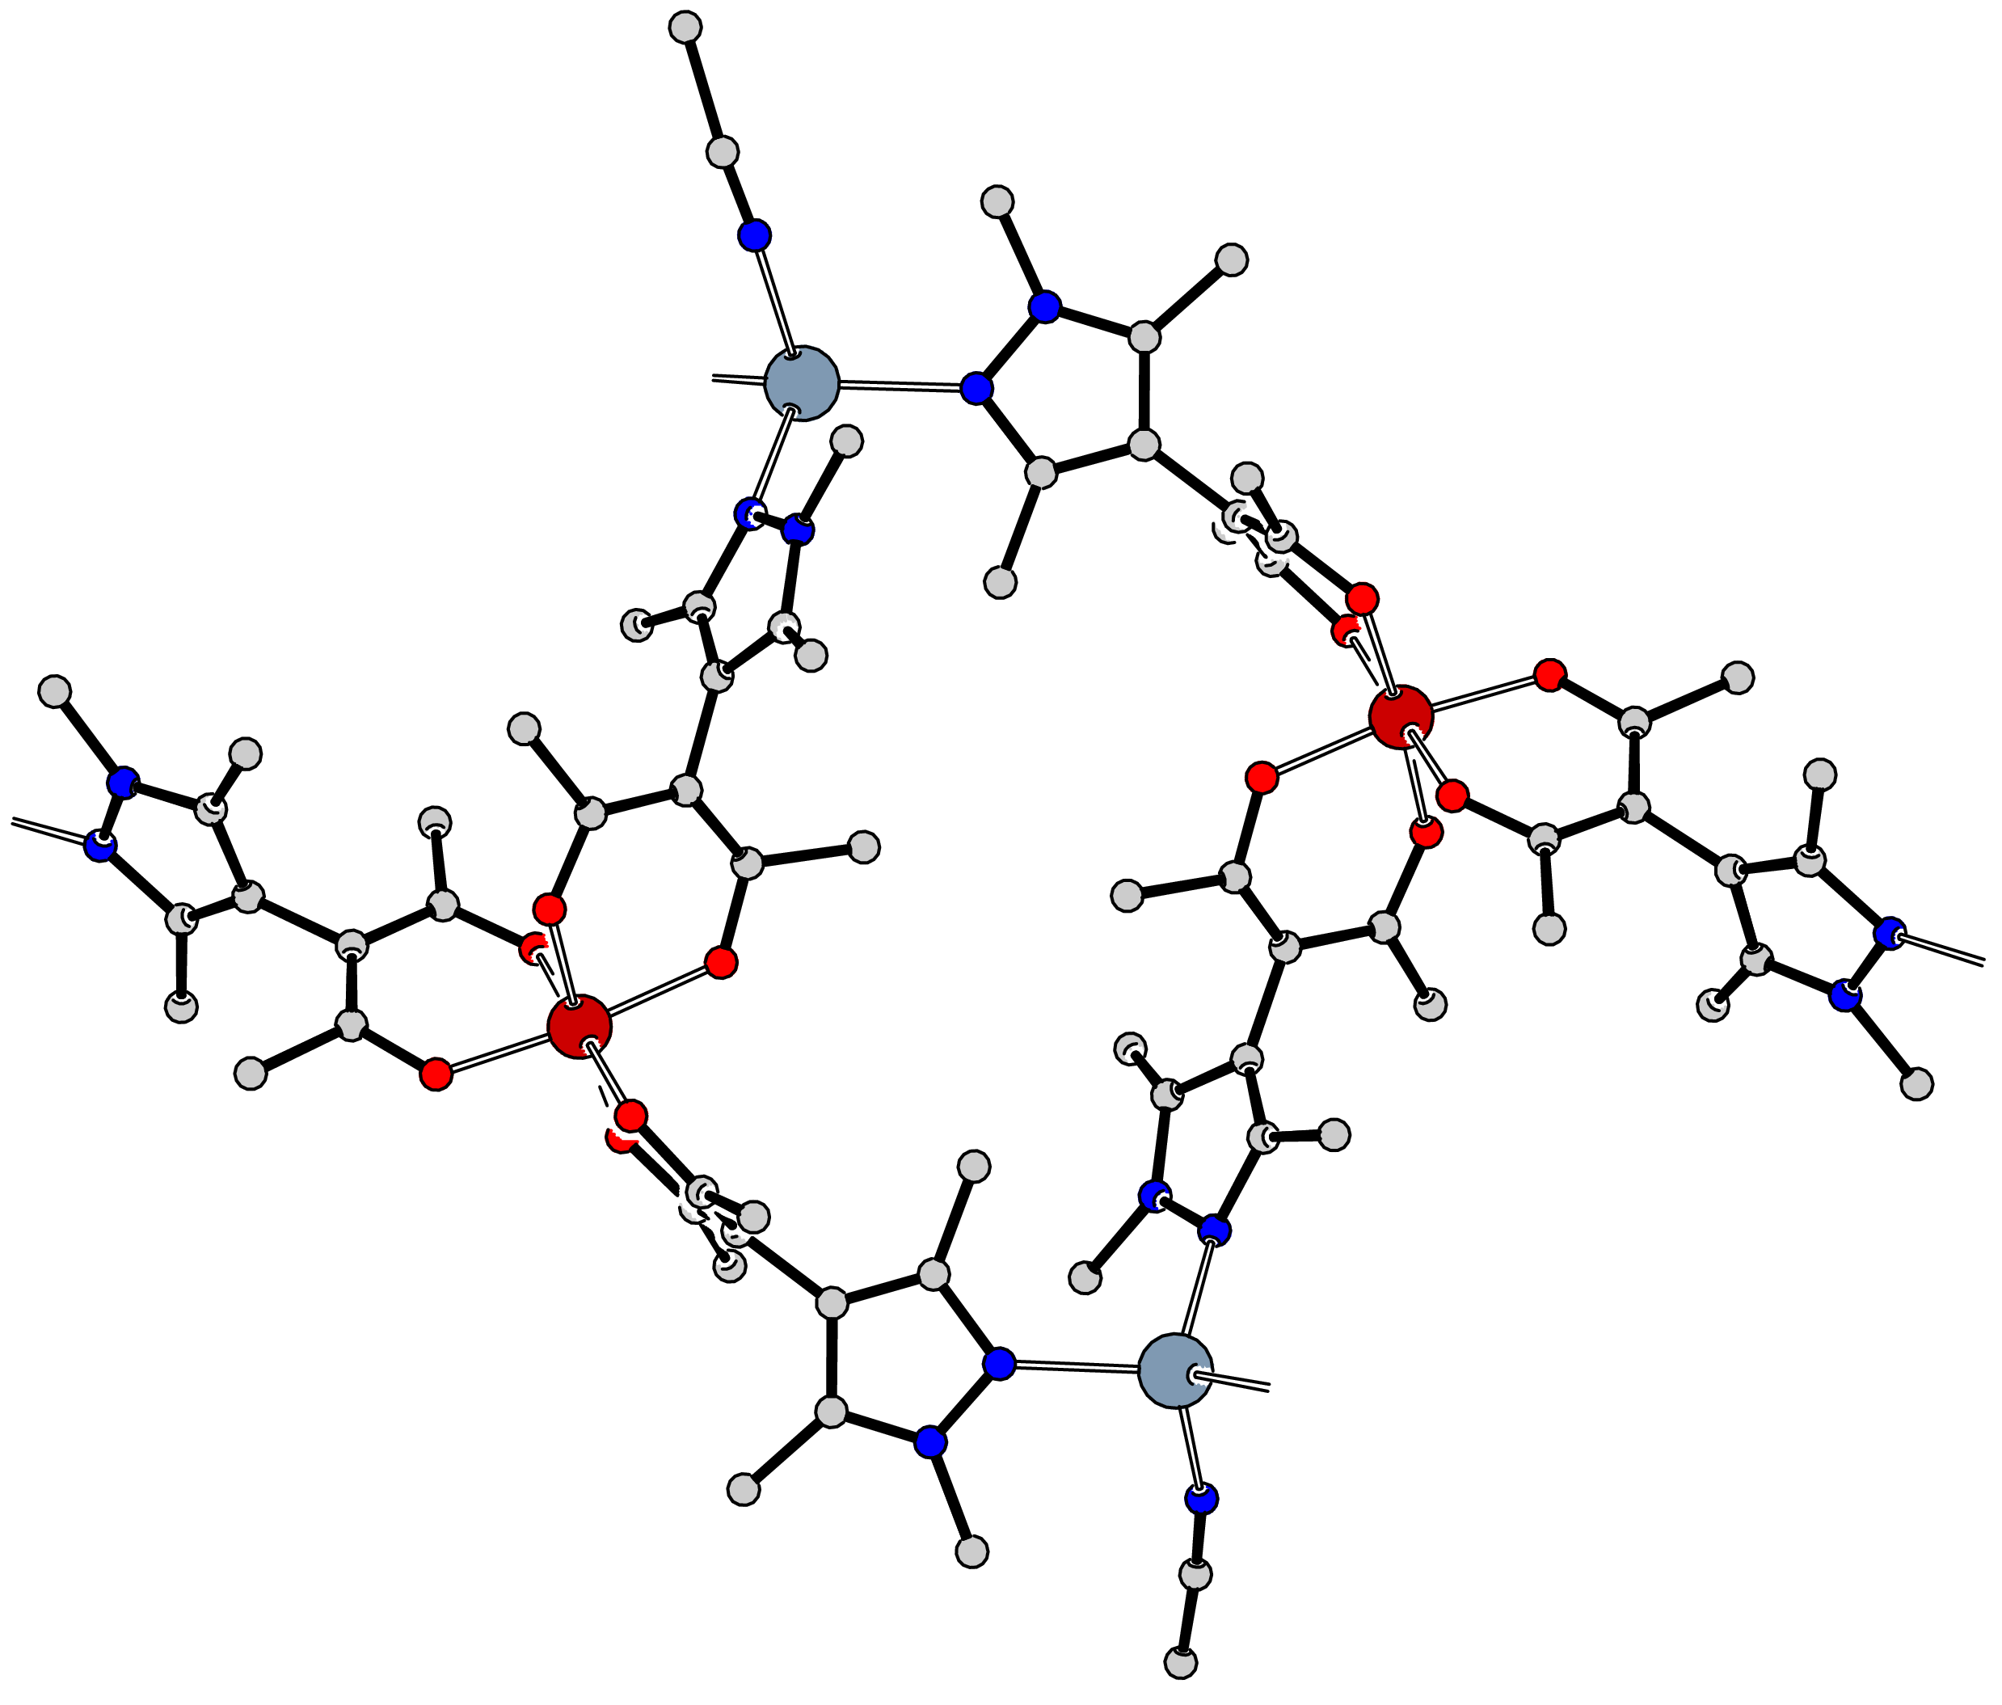
Results – Synthesis
Crosslinking with Fe^{III}/Ag^{I} leads to a 1D polymer 1:
1. Fe(NO₃)₃
Ag
2. AgClO₄
MeCN
Fe
Fe
composition | C₅₆₀H₇₆₈Ag₁₆Fe₁₆N₁₁₂O₉₆
Crystal system | orthorhombic
Space Group | Fdd2
a / Å | 53.3047(8)
b / Å | 70.5917(12)
c / Å | 15.1465(3)
V / Å | 56994.3(17)
Z | 2
θ_{min/max}(Cu-K_{α}) | 2.08/58.2
total/unique/observed refl. | 144676/19245/10675
R₁[I > 2σ(I)] | 12.92 %
wR₂[all data] | 22.75 %
S | 0.962
Ag
1

Slide 7
Results – Topology
The chain polymer propagates in a wave-like fashion:
View from the ab plane:
n
The chains exhibit ligands as crosslinkers between two strands, forming a ladder-like chain:
View from the ac plane:

Slide 8
Results – Topology
a
c
The polymer propagates in [1 0 1] direction. Three different strands are depicted on the right.
The point symbol for this coordination polymer is 4¹.4¹.6¹.

Slide 9
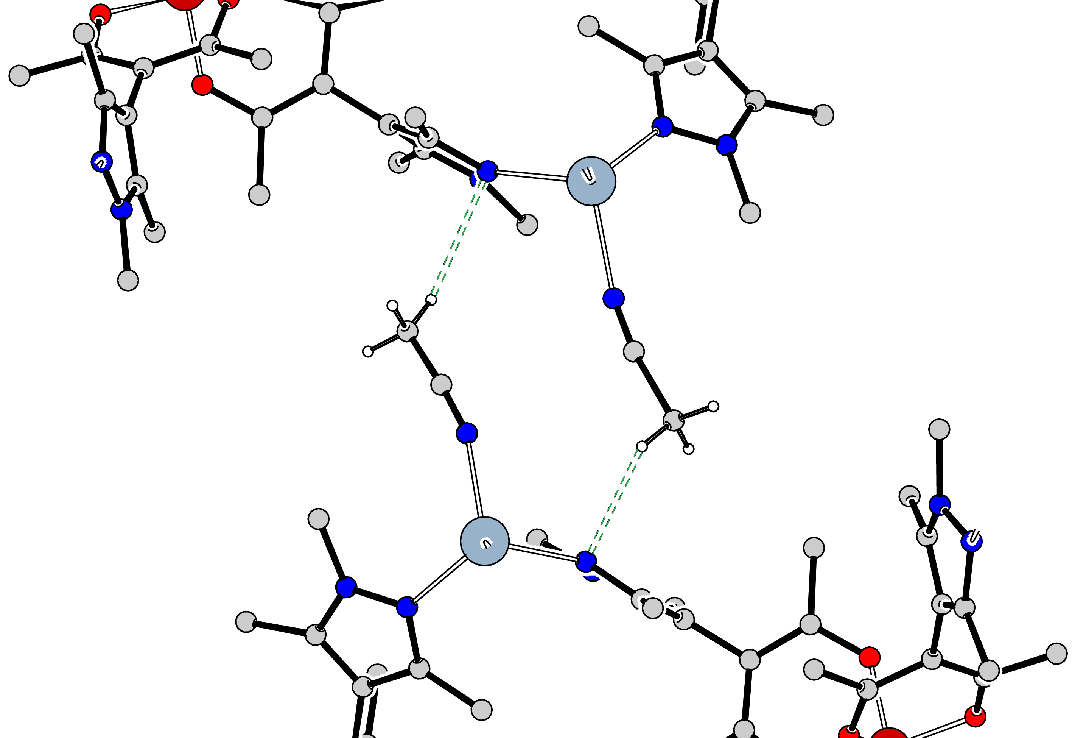
Results – Topology
simplified representation of the 1D polymer:
There are no meaningful interactions between two of the ladder-like chains. The shortest distance between them amounts to 2.7 Å:
=
2.7 Å

Slide 10
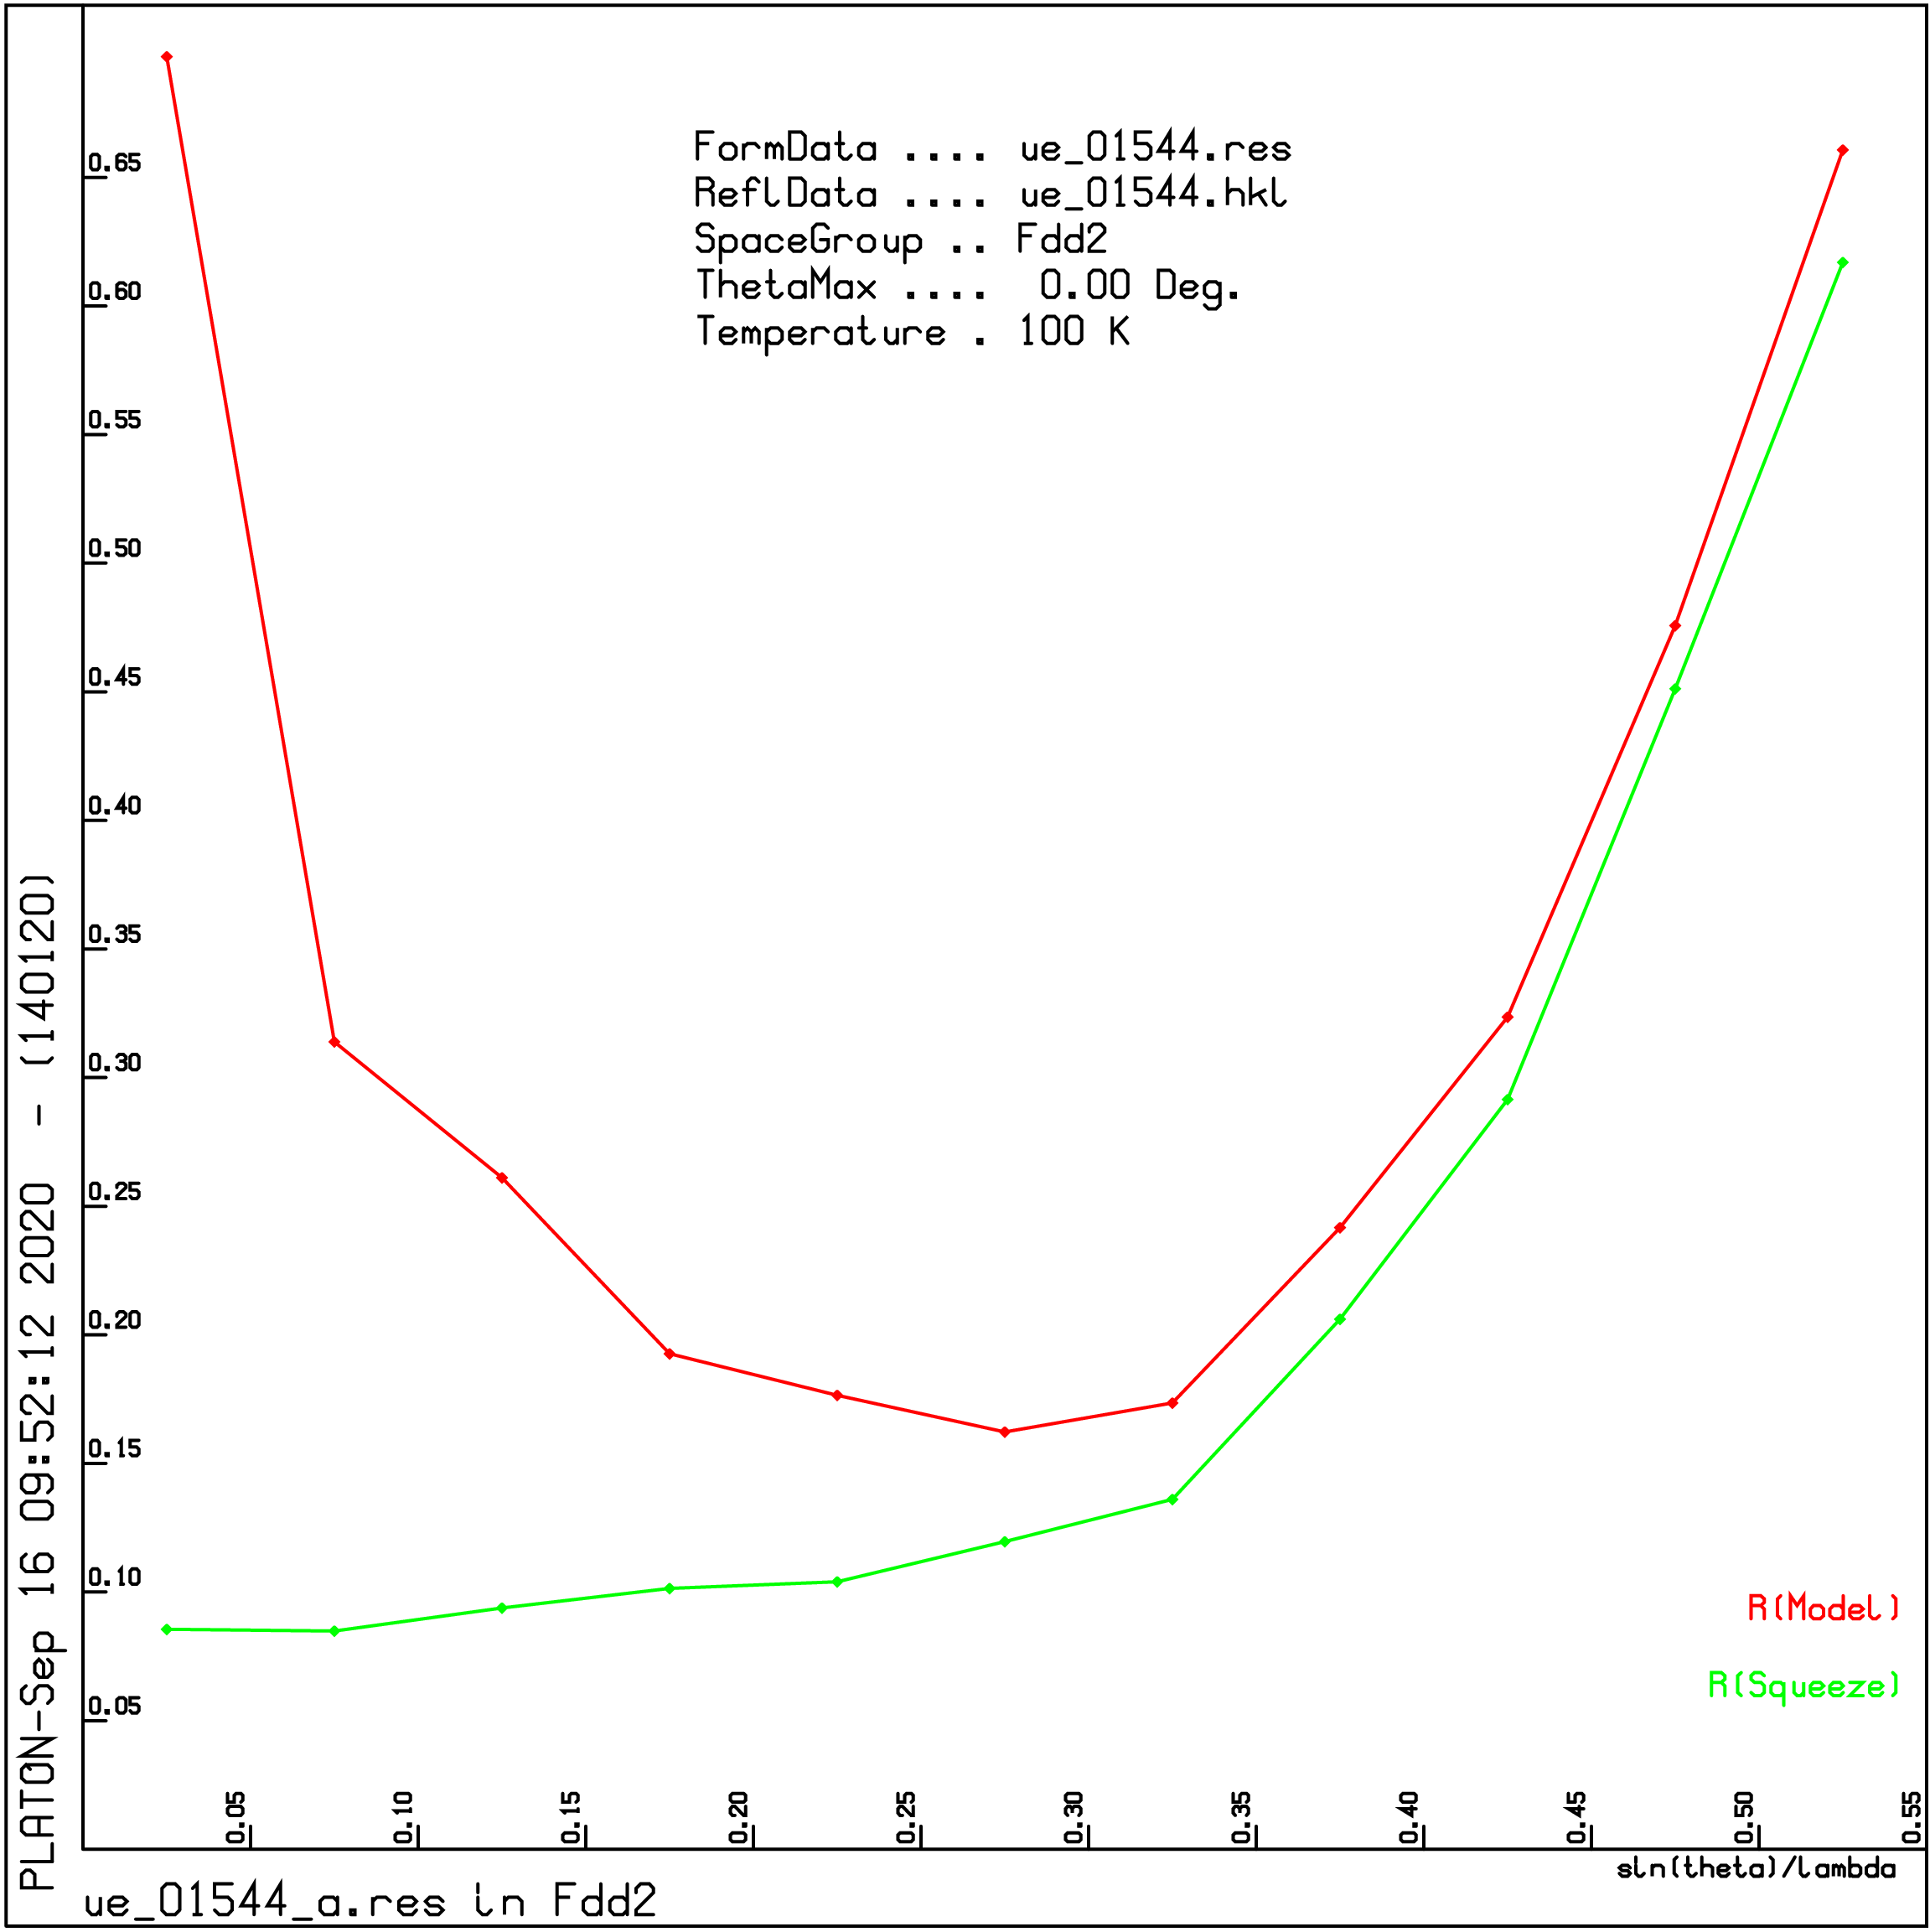
Results – Topology
There are huge solvent accessible voids in the structure. The PLATON SQUEEZE [4,5] procedure was used to determine size and electron count of the voids:
Cell volume / Å³ | 56994.3(17)
Void volume / Å³ | 30200
percent void of cell | 53.1 %
electron count | 9600
packing index | 67.4 %
electron count − 32 ClO₄⁻ | 8250
amount* of MeCN/H₂O | 260
Volume* per Atom / Å³ | 25
b
a

Slide 11
Conclusions
The potential of the novel ligand featuring a pyrazolyl group shows promising results for the stepwise synthesis of heterobimetallic MOFs. The coordination polymer with Fe^{III}/Ag^{I} shows large solvent-filled voids, created by the wave-like propagation of the one-dimensional chains in [1 0 1] direction.
Further investigation of the properties is planned. Thermal decomposition and, afterwards, screening for catalytic properties will be performed. The anion of the Ag^{I} salt will be altered, to investigate ist effects on the related structure. Also, the choice of different metals, e.g. Cu^{II}, could lead to interesting effects and different topologies.
If you have any questions please do not hesitate to write me an e-mail: steven.vanterwingen@ac.rwth-aachen.de

Slide 12
Acknowledgements
An RWTH fellowship to SvT is gratefully acknowledged. The help of all members of the AKS and the Institute of Inorganic Chemistry, RWTH Aachen University is greatly appreciated.

