Slide 1
Competition of the Donor Atoms – Coordination Chemistry of a O,P,N tritopic Ligand – Complexes, Supramolecules and Metal-Organic Frameworks
Hans Gildenast^{1,}*, Franziska Busse¹, and Ulli Englert^{1,2}
¹ RWTH Aachen University, Institute of Inorganic Chemistry, Landoltweg 1, 52074 Aachen, Germany;
² Key Laboratory of Materials for Energy Conversion and Storage, Institute of Molecular Science, Shanxi University, Taiyuan, Shanxi 030006, People's Republic of China.
* Corresponding author: hans.gildenast(at)ac.rwth-aachen.de

Slide 2
Abstract
In the rich field of metal-organic frameworks (MOFs) there is a vast number of results with O and N donor ligands, but little to no work on ligands containing P donors. A few reasons for this lack of research are obvious: the lower stability of P^{III}, the more elaborate syntheses, and the nonexistent availability of commercially suitable candidate molecules. Nevertheless, the usage of phosphorus can enable a much greater variety of structural possibilities for MOF synthesis, as it can stabilize metal cations in low oxidation states, among other advantages.
Thus, we intend to compare the abilities of the three donors by preparing the ligand 4-(3-(4-(diphenylphosphino)phenyl)-3-oxopropanoyl)benzonitrile. This multifunctional ligand contains a chelating beta-diketone and a nitrile group as O and N donors, as well as a triarylphosphine P donor group. The results show that its coordination behavior very much depends on reaction conditions. We have selectively prepared mononuclear complexes on both the O and P side, but no purely N coordinated complexes could be obtained. Furthermore, we have crystallized a bimetallic supramolecular cube in the rare cubic space group P$\overline{\text{4}}$3n. Finally, the formation of a porous bimetallic MOF with an interesting topology could be achieved by the simultaneous coordination of all three donors.
Keywords: metal-organic frameworks; coordination chemistry; supramolecular chemistry; phosphines

Slide 3
Introduction
Using heterofunctional polytopic ligands the different chemical properties of the donor atoms can be utilized to bind different metal cations selectively.
For example, the Pearson hardness^{[1]} of different donor elements can result in selective binding of metal cations that differ in their Pearson hardness as well.
For this ligand the beta diketo function represents the Pearson hard donor functionality. It additionally needs to be deprotonated for coordination. The other two donors, the nitrile and the triarylphosphine are both soft, whereas the phosphine should display a superior ligand strength.
Hard
Softer
Soft

Slide 4
Introduction
Depending on the metal cations and crystallization conditions supramolecules or coordination polymers can be formed. This heavily depends on both the chemical properties of the metal cations, as well as the geometry of the ligand.
Below two examples are shown in which the ligand and metal cations display the same connectivity, but the resulting structures are different.
ligand
metal cations
supramolecular cube
coordination polymer

Slide 5
Results and Discussion
The synthesis of bimetallic compounds proceeds via a monometallic building block with free donor functions for subsequent crosslinking – a metalloligand. Both the P and O donors can bind to metal cations selectively to form monometallic complexes.
O,O’-complexes – these octahedral complexes give two stereoisomers and yield no crystalline material. Identity was determined spectroscopically.
P-complexes – give only one isomer and yield crystalline materials.

Slide 6
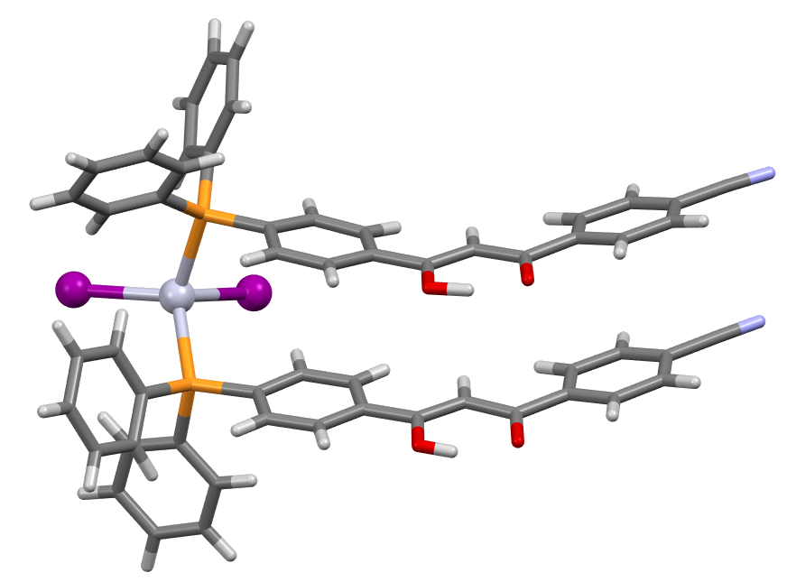
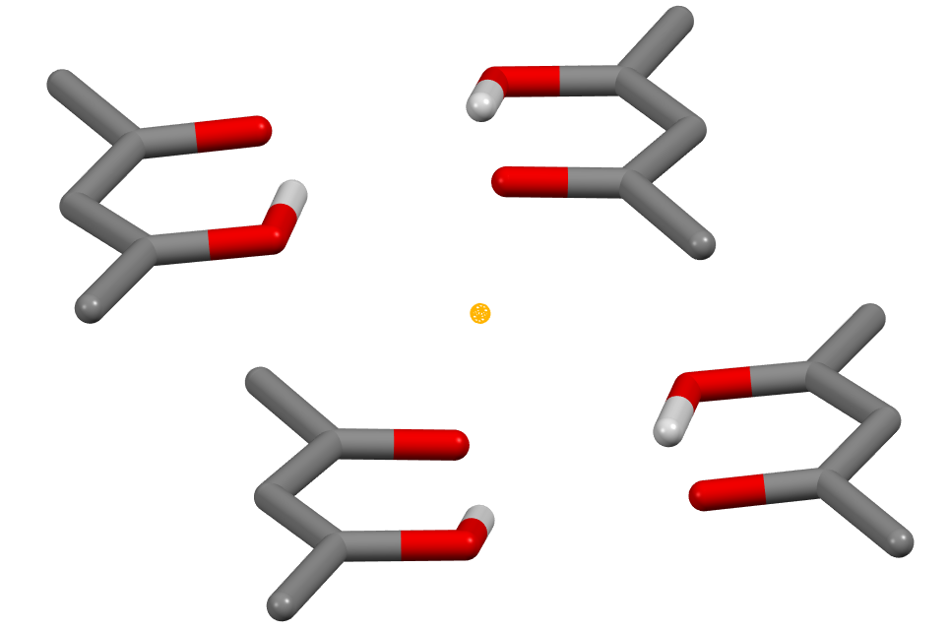
P-complexes
The tetrahedral HgI₂ complex was characterized with SCXRD.
Four beta diketo moieties are arranged in close proximity to each other. The opposing O atoms (O2, O4’) adopt a short distance that usually signals an H bond between them.
The close proximity may be enabled by H1 and H3’ whose positions may be fluctuant due to keto enol tautomerism.
This is unfortunately not visible with XRD.
Hg
I2
 | d / Å
O1···O4‘ | 2.971(8)
O2···O4‘ | 2.705(9)
O2···O3‘ | 3.015(8)
O4···O4‘ | 3.283(10)
I1
P2₁/c
a / Å | 10.471(4)
b / Å | 16.666(6)
c / Å | 32.251(11)
β / ° | 95.647(6)
V / Å³ | 5601(4)
R₁ | 0.0484
wR₂ | 0.1256
O3‘
O2
H3‘
H1
O4‘
O1
_
1
O1‘
O4
H1‘
H3
O2‘
O3

Slide 7
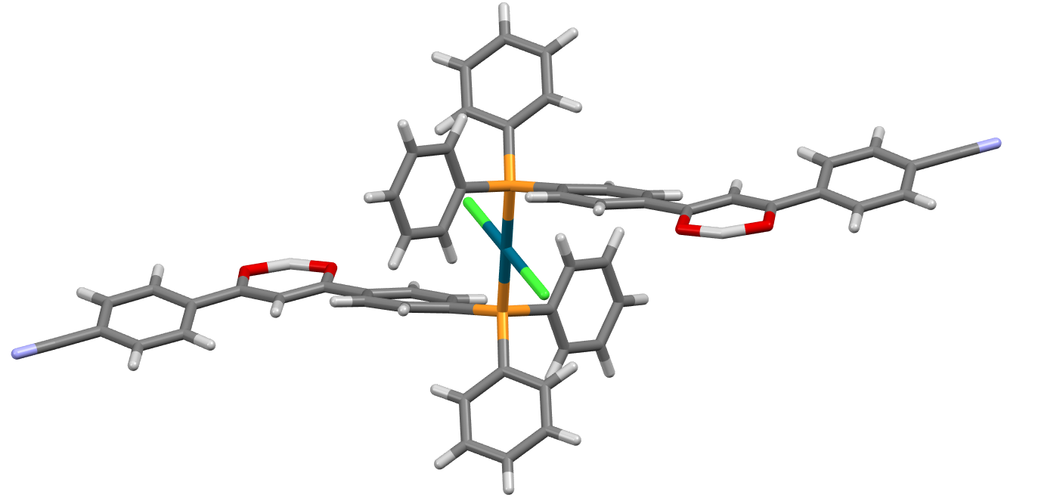
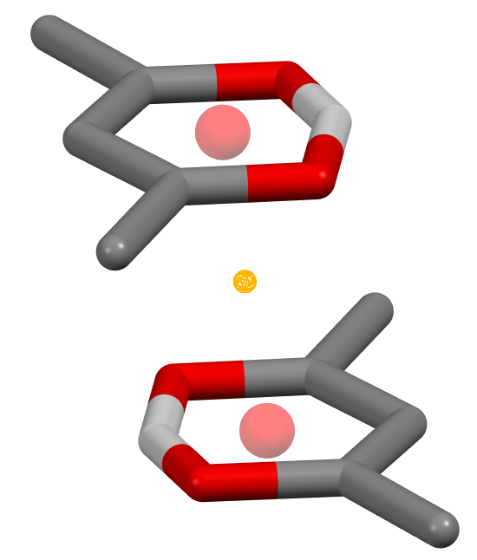
P-complexes
The square planar PdCl₂ complex was characterized with SCXRD.
C2/c
a / Å | 27.340(13)
b / Å | 7.494(4)
c / Å | 23.398(11)
β / ° | 95.012(9)
V / Å³ | 4776(4)
R₁ | 0.0525
wR₂ | 0.1415
Cl1’
Pd
Cl1
 | d / Å
O1···C3‘ | 3.334(6)
O2···C1‘ | 3.397(6)
centroids | 3.400
C1
O1
O2
The beta diketo moieties stack around an inversion center with a π-π stacking interaction. In both examples the P donor is superior to the N donor both in terms of Pearson softness and ligand strength.
C3
_
1
O2‘
C3‘
O1‘
C1‘

Slide 8
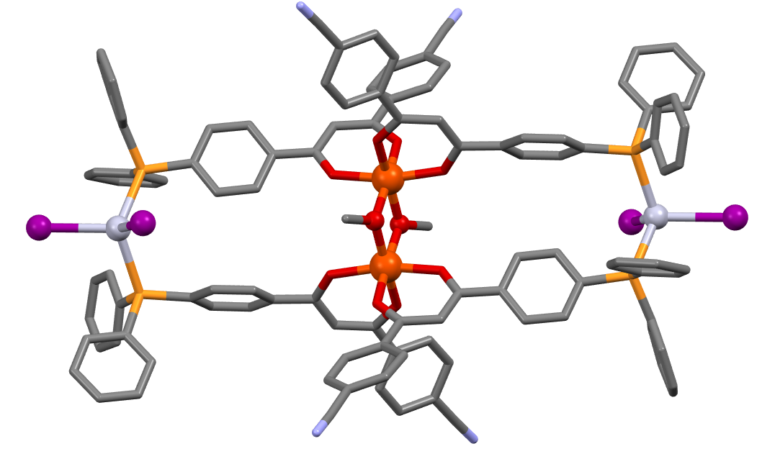
Bimetallic rectangle
Reacting the monometallic Fe^{III} complex with HgI₂ in methanol leads to the formation of a tetranuclear rectangle. The center is a dinuclear Fe^{III} complex with two bridging methanolates.
2 FeL₃ + 2 MeOH + 2 HgI₂
+ 2 HL
P$\overline{\text{1}}$
a / Å | 12.494(5) | α / ° | 74.125(6)
b / Å | 17.089(7) | β / ° | 77.095(6)
c / Å | 18.057(7) | γ / ° | 76.097(6)
V / Å³ |  | 3548(2)
R₁ | 0.0641 | wR₂ | 0.1415
Hg
Fe
Hg’
I1
I1’
I2
Fe’
I2’
The rectangle proves that the simultaneous coordination of two donors is possible with this ligand. Again, the P donor is the preferred option compared to the N donor.
 | d / Å
Fe···Fe‘ | 3.079(2)

Slide 9
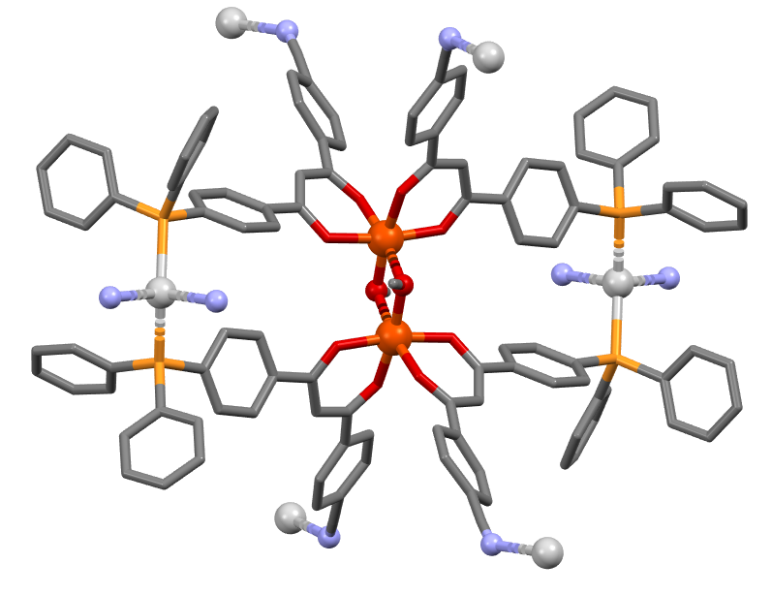
Bimetallic metal-organic framework
By using Ag⁺ as the soft metal cation with non coordinating anions instead of HgI₂ the same rectangle is obtained. But now, the N donors coordinate to the Ag⁺ resulting in a bimetallic MOF that uses all three donor atoms.
Ag^{b}
Ag^{c}
P2₁/c
a / Å | 16.3537(19)
b / Å | 18.213(3)
c / Å | 26.477(4)
β / ° | 94.678(2)
V / Å³ | 7860(2)
R₁ | 0.0747
wR₂ | 0.2317
Ag
Fe
Fe’
Agª
Ag^{d}
Ag^{e}
This results in a porous cationic 3D network with ClO₄⁻ cations and CHCl₃ inside the void.
 | d / Å
Fe···Fe‘ | 3.078(2)

Slide 10
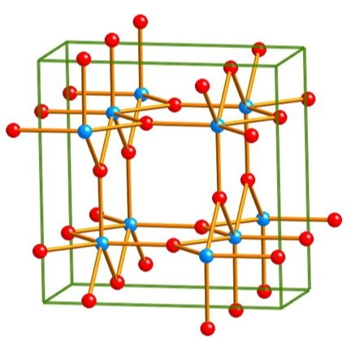
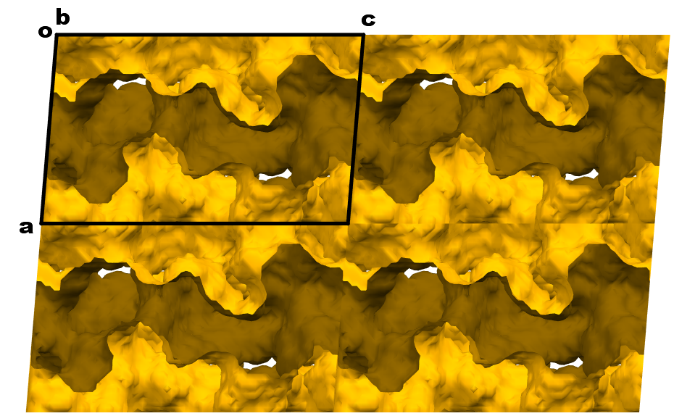
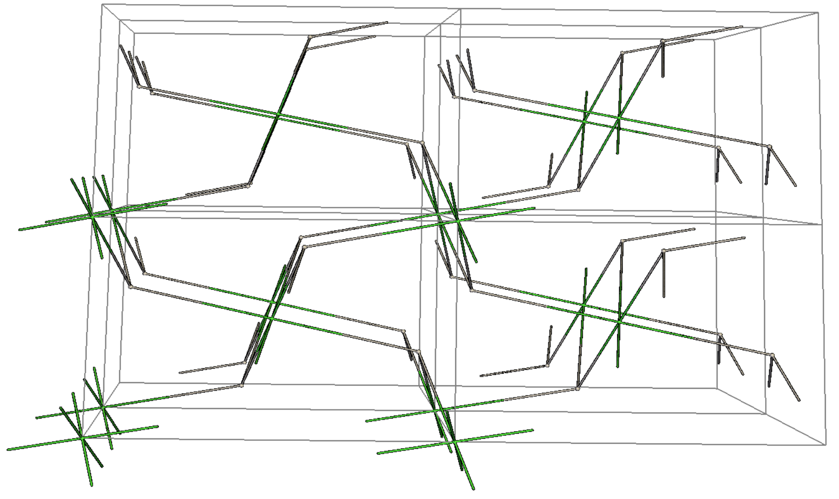
Bimetallic metal-organic framework
The material is highly porous with about 37% of the unit cell volume accessible to solvent molecules and anions. The pores are accessible in all 3 lattice directions with the largest pore along the a axis.
If the dinuclear iron center is treated as one node the topology is that of an hwx net.^{[2]}
hwx
3.1 Å
Mercury void plot of the network after deletion of all solvent molecules and anions. Calculated with a probe radius of 1.2 Å.
GTECS^{[3]} plot of the network to simplify the topology

Slide 11
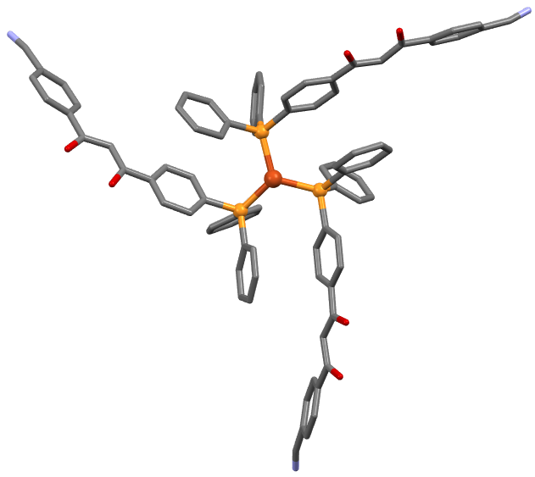
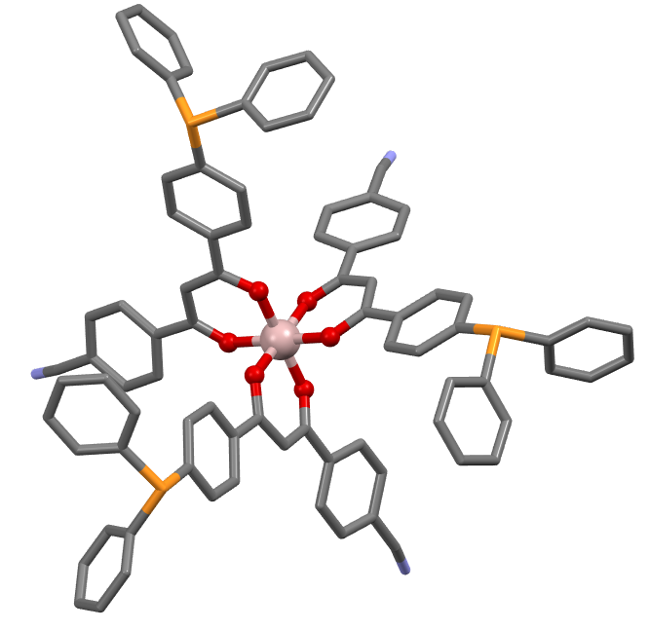
Bimetallic supramolecular cube
In presence of little methanol the Al^{III} and Fe^{III} octahedral building blocks form a tetrameric cube upon reaction with a soft metal cation. The octahedral M^{III} complex is the fac isomer and the M^{I} ion is coordinated by three phosphines forming a trigonal planar coordination sphere. Both metal cations are located on threefold rotation axes. The entire cube is generated by symmetry. The asymmetric unit only contains a single ligand molecule.
P$\overline{\text{4}}$3na
M^{III} | Al^{III}
M^{I} | Cu^{I}
a / Å | 28.7770 (15)
V / Å³ | 23831(4)
R₁ | 0.0771
wR₂ | 0.2210
Cu
Al
monometallic cutouts of the cube

Slide 12
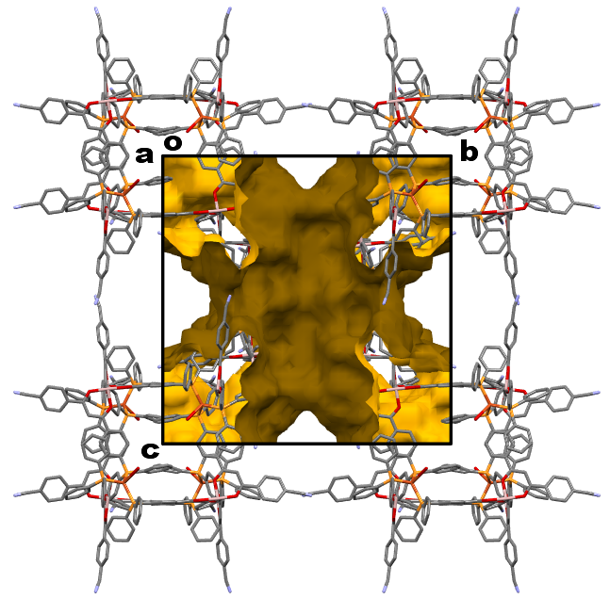
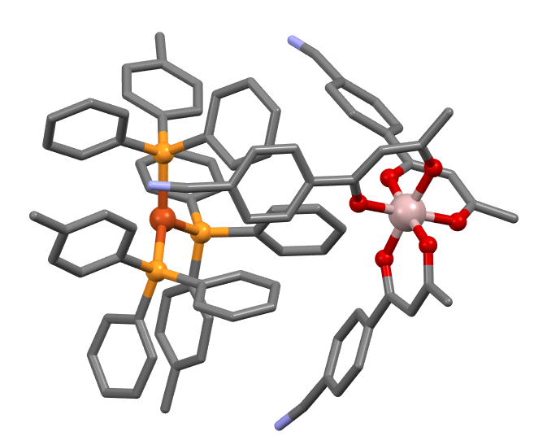
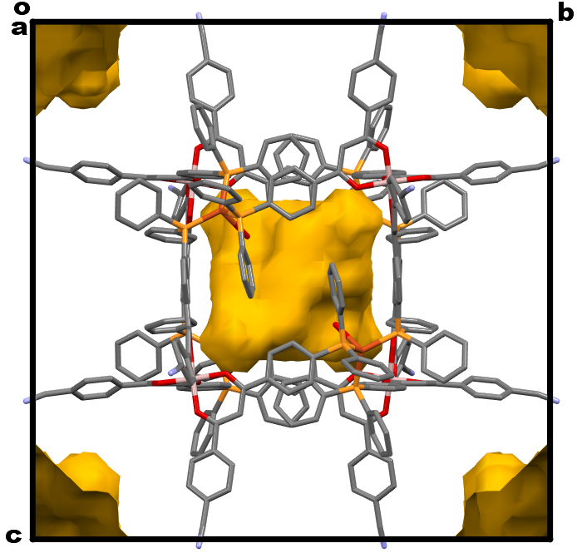
Bimetallic supramolecular cube
The packing is pseudo body centered with the center of each cube on the corners and the center of the unit cell. The inside of the cubes and the space between them is filled with solvent molecules and non coordinating anions that are heavily disordered. The two gaps are not connected but the outer pores are continuous in all three directions.
The cubes are connected via an intramolecular interlocking of phenyl rings at all corners:
6.1 Å
9.2 Å
void plots of the outer and inner void

Slide 13
Conclusion and Outlook
The results show that the ligand is capable of connecting two metal cations with a pronounced difference in Pearson hardness. As expected, the phosphine is a stronger donor than the nitrile and will, thus, dominate the coordination chemistry with soft metal cations. Nevertheless, under the right conditions the nitrile can act as a crosslinker and be the decisive donor atom in the formation of a porous MOF.
Both the MOF and the supramolecular cube are under further investigation for example with soaking experiments to exchange solvent molecules and luminescence measurements.
Furthermore, we are expanding the bandwidth of polytopic ligands containing phosphine donors to explore this new branch of MOF and supramolecular chemistry.
If you have any questions, remarks or suggestions, please do not hesitate to contact me: hans gildenast(at)ac.rwth-aachen.de

Slide 14
Acknowledgments
We gratefully acknowledge the scholarship of the german academic scholarship foundation. The help of all members of the Englert group and the Institute of Inorganic Chemistry, RWTH Aachen University is greatly appreciated.

