Slide 1
Stochastic dynamic mass spectrometric quantification of steroids in mixture
Bojidarka Ivanova *, and Michael Spiteller
Lehrstuhl für Analytische Chemie, Institut für Umweltforschung, Fakultät für Chemie und Chemische Biologie, Universität Dortmund; Otto-Hahn-Straße 6, 44221 Dortmund, Nordrhein-Westfalen, Deutschland
* Corresponding author: B.Ivanova@web.de; B.Ivanova@infu.uni-dortmund.de

Slide 2
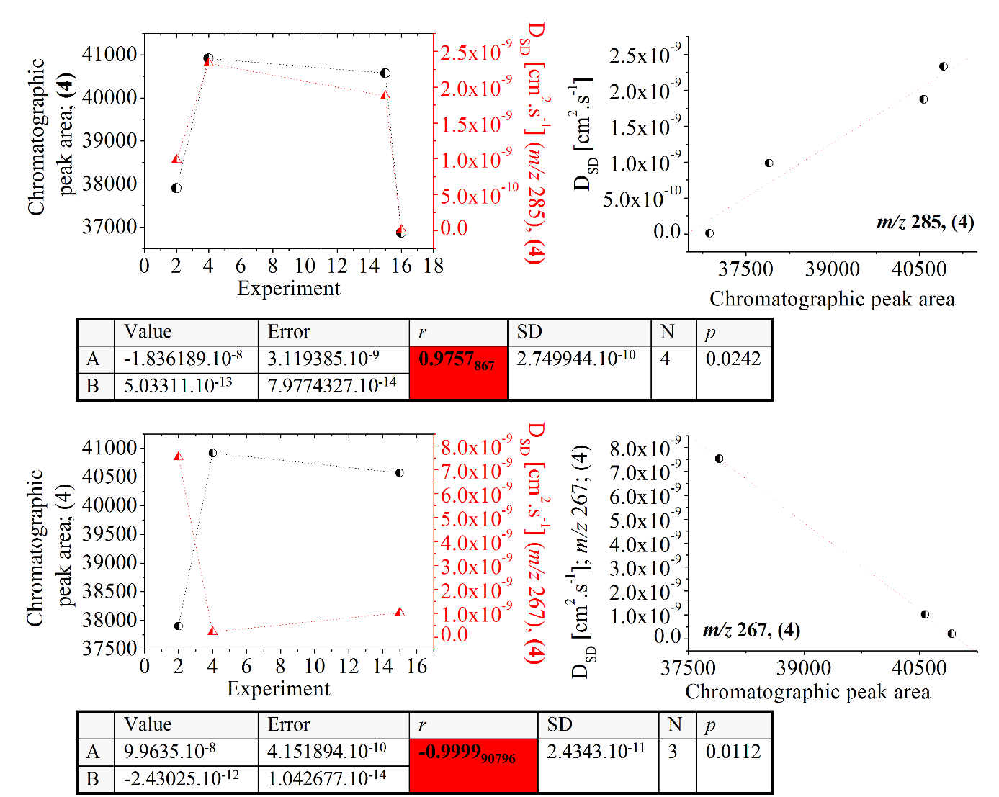
Title of the Presentation
Graphical Abstract

Slide 3
Abstract:
In this contribution we further explore our innovative stochastic dynamic (SD) concept and model formulas treating quantitatively experimental mass spectrometric (MS) variable intensity with respect to the analyte concentration in solution by introducing the so-called mass spectrometric stochatic dynamic diffusion parameter (D_{SD}.) It is directly connected with the measurable outcome. The steroids (STs) in mixture: hydrocortisone (1), deoxycorticosterone (2), progesterone (3) and methyltestosterone (4) at analyte concentration ng.(mL)⁻¹ are studied. The reader's attention is focused on our new more simplistic model formula: D”_{SD} = 2.6388.10⁻¹⁷.(<I²> – <I>²) connecting between D_{SD} data and the MS intensity values. Its experimental testability is discussed. A correlative analysis among the stochastic dynamic parameters derived, so far, is presented. The MS results are correlated independently with chromatographic data. Chemometrics is carried out. The excellent chemometric data obtained in this study show that it significantly contribute not only to the field of the quantitative analytical chemistry, but also to our understanding of the functional relationships among mass spectrometric measurable variables, experimental factors and parameters such as the analyte concentration in solution and the temperature as well as molecular parameters and properties, respectively.
Keywords: 3 to 5 keywords separated by semi colons

Slide 4
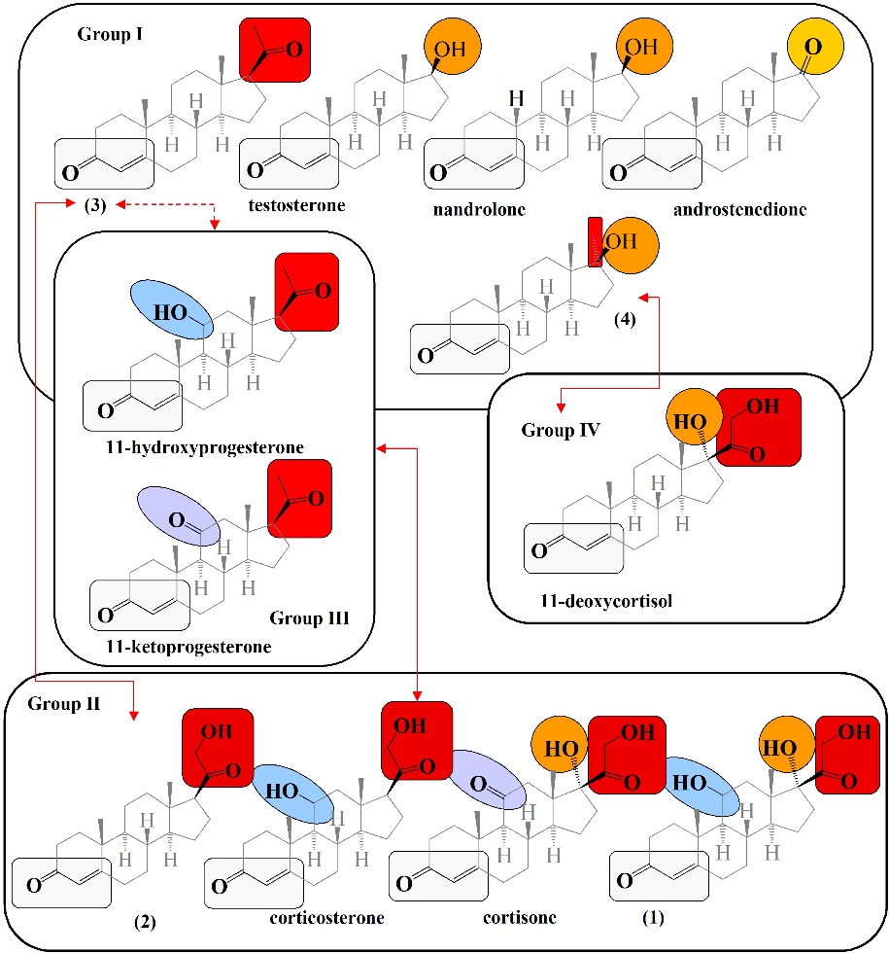
Introduction
The steroids (Figure 1) have a broad spectrum of biological activity. They influence widespread processes in the living systems such as the electrolyte-water balance; the metabolism of proteins, fatty acids, carbohydrates; the functions of cardiovascular and nervous systems; the coagulation/fibrinolysis system, causing for intra-cardiac and arterial embolism, pulmonary embolism, thrombosis; and more.
The biological role of STs in humans has been shown as: (i) Implementation into processes of reproduction and sexual differentiation; (ii) regulation of metabolism; (iii) affect on the nutrient supply; (iv) cell development and growth; and more. STs are used to treat diseases on the base on their anti-inflammatory activity, as well. However, due to adverse side effects many of STs are banned or prohibited.
For the aforementioned reasons, a significant amount of research effort, so far, has been concentrated on determining STs in biological human and animal samples, for instance, urine, human serum or hair. Such analysis is compulsory required by control authorities including doping control authority and health institutions.
Talking about analytical protocols for STs analysis, the hyphenated techniques such as gas-chromatography coupled with mass spectrometry remain methods of choice already routinely implemented into the analytical practice in doping control laboratories [2–5].
[1] Z. Zaretskii, J. Curtis, A. Brenton, J. Beynon, Org. Mass Spectrom. 23 (1988) 511–516.
[2] E. Prokudina, J. Prchalova, E. Vysatova et al. Int. J. Mass Spectrom. 392 (2015) 28–33.
[3] N. Deshmukha, I. Hussain, J. Barker et al. Steroids 75 (2010) 710–714.
[4] F. Buiarelli, L. Giannetti, R. Jasionowska et al. Rapid Commun. Mass Spectrom. 24 (2010) 1881–1894.
[5] R. Soares, A. de Araujo, J. de L. Castro et al. J. Braz. Chem. Soc. 23 (2012) 2065–2074.
Figure 1. Chemical diagrams of analytes (1)–(4) and other STs; the common structural fragments are highlighted; Groups I–IV are according to ref. [1]

Slide 5
The low concentrations of the analytes and the complexity of the biological samples often limit the sensitivity of the only chromatographic detectors. These facts have led to elaboration of protocols chiefly based on mass spectrometry. Despite, that the HPLC enable us to determine the Δ⁴-3-ketonic structure of STs by means of UV-detection, the Δ⁵-3-hydroxy structural unit in pregnenolone and dehydroepiandrosterone (Figure 1) can be determined only is means of HPLC with immobilized enzyme column [6], accounting for other fact that HPLC cannot identify unknown peaks. The frequently employed radio-immunoassay cannot be utilized to determine mixtures of STs despite its sensitivity. Further, the labeled with stable isotopes internal standards of STs are very frequently not commercially available [7,8]. This requires effort on development of free of isotope labeling protocols for determination of such analytes.
Also, the STs physiological activity depends on their stereo-chemistry, thus, the accurate MS determination of enantiomers of steroids is also required [9]. The latter phenomenon — the affect on stereoisomerism on fragment path of STs — has significant contribution to the analytical practice and the theory describing the connection among molecular 3D structure of steroids their thermodynamic stability and preferred fragment paths, respectively [10–17]. In this context, the collision induced dissociation (CID) mass spectrometry, amongst others, appears method of choice in developing protocols for STs’ analysis. Because of, it is known that the conventional atmospheric pressure chemical ionization (APCI) method – mainly used to quantify STs; due to their physico-chemical properties [18,19] – unable to differentiate between stereoisomers [20]. Despite, highly selective and sensitive MS based protocols for STs determination by means of laser desorption ionization mass spectrometry have been also developed [21].
Therefore, accurate protocols for determination of steroids depend on the superior instrumental characteristics of the MS methods.
[17] H. Ludwig, J. Reiner, G. Spiteller, Chem. Ber. 110 (1977) 217–227.
[18] D. Carroll, J. Nowlin, R. Stillwell, et al. Anal. Chem. 53 (1981) 2007–2013.
[19] D. Siegel, A. Meinema, H. Permentier, et al. Anal. Chem. 86 (2014) 5089–5100.
[20] P. Sjberg, K. Markides, J. Mass Spectrom. 33 (1998) 872–883.
[21] G. Guild, C. Lenehan, G. Walker, Int. J. Mass Spectrom. 294 (2010) 16–22.
[6] F. Komatsu, M. Morioka, Y. Fujita et al. J. Mass Spectrom. 30 (1995) 698–702.
[7] R. Hirano, A. Yokokaw, T. Furuta et al. J. Mass Spectrom. 53 (2018) 665–674.
[8] J. Fischer, P. Elsinghorst, M. Wuesta, J. Label Compd. Radiopharm 54 (2011) 591–596.
[9] P. Sjberg, K. Markides, J. Mass Spectrom. 33 (1998) 872–883.
[10] L. Tokes, B. Amos, J. Org. Chem. 37 (1972) 4421–4429.
[11] F. Brown, C. Djerassi, J. Am. Chem. Soc. 102 (1980) 807–817.
[12] J. Reiner, G. Spiteller, Monatsh. f. Chem. 106 (1975) 1415–1428.
[13] M. Spiteller-Friedmann, G. Spiteller, Org. Mass Spectrom. 1 (1968) 231–250
[14] E. Larka, I. Howe, J. Beynon, Z. Zaretskii, Tetrahedron 37 (1980) 2625–2632.
[15] H. Ohermunn, M. Spiteller-Friedinann, G. Spiteller, Chem. Ber. 103 (1970) 1497–1511.
[16] H. Ludwig, G. Spiteller, D. Maithaex, F. Scheler, J. Chromatogr, 146 (1978) 381–391.

Slide 6
Despite, enormous effort on establishment of MS protocols for STs quantification in biological samples, there are only few methods capable of simultaneous quantification of STs in serum [22,23]. Furthermore, there are included a time-consuming; large quantities of solvents requesting and expensive sample pretreatment procedures based on Solid phase extraction (SPE) [22,23]. In general, SPE is a routine approach to extract STs from environmental samples, as well [22–29].
Therefore, in addition to the lack of isotope labeled internal standards, the long sample pretreatment stages appear drawback to the currently implemented into the analytical practice MS protocols for analysis of STs, despite as mentioned above, superior MS instrumental characteristics. Moreover, the largest part of STs is chemically modified during the metabolism in humans, thus yielding to mainly glucuronides [30]. The determination of analytes of the former type by mass spectrometry, however, also appears a significant research challenge [31]. It is of paramount importance to develop, elaborate and validate simple, fast, easy, selective, sensitive, accurate, precise, and reproducible analytical procedure, respectively, method for a highly reliable quantification of steroids in complex samples Furthermore, it should be applicable to different MS methods and operating even without isotope labeling internal standards [32].
From the perspective of the analytical chemistry the pursuing of such goal represents a challenging research task. The method should ensure quality and comparability of the corresponding analytical results in accordance with the Council Directive 96/23/EC of 29 April 1996 and its implementation (2002/657/EC) concerning the analytical method performances and interpretation of the analytical results [33].
[22] M. Genangeli, G. Caprioli, M. Cortese, et al. J. Mass Spectrom. 52 (2017) 22–29.
[23] F. Guan, C. Uboh, L. Soma, et al. J. Chromatogr. B 829 (2005) 56.
[24] W. Backe, C. Ort, A. Brewer, et al. Anal. Chem. 83 (2011) 2622–2630.
[25] H. Piri-Moghadam, F. Ahmadi, G. Gymez-Ros, et al. Angew. Chem. Int. Ed. 55 (2016) 7510–7514.
[26] Y. Zhao, J. Yonghu, W. Jin, Environ. Sci. Technol. 42 (2008) 5277–5284.
[27] C. Li, Y. Wei, S. Zhang, et al. Environm. Chem. Lett. (2020) doi.org/10.1007/s10311-019-00961-2.
[28] S. Errico, T. Chioccarelli , M. Moggio, et al. Molecules 25 (2020) 48.
[29] B. Vanderford, R. Pearson, D. Rexing, et al. Anal. Chem. 75 (2003) 6265–6274.
[30] M. Polet, W. van Gansbeke, A. Albertsdóttir, et al. Drug Test Anal. 11 (2019) 1656–1665.
[31] B. Ivanova, M. Spiteller, Bioorg. Chem. 93 (2019) 103308.
[32] P. Herrero, N. Cortes-Francisco, F. Borrull, et al. J. Mass Spectrom. 49 (2014) 585–596.
[33] Commission decision of 12 August 2002 implementing Council Directive 96/23/EC concerning the performance of analytical methods and the interpretation of results, Official J. Eur. Commun. L 221/8, 17.8.2002.

Slide 7
As an effort to meet the analytical needs of highly precise, selective and sensitive mass spectrometric protocols, we have developed, more recently, an innovative stochastic dynamic approach and have written model formulas (See the next section Theory) connecting among MS measurable variable intensity; experimental factors such as temperature and analyte concentration in solution; as well as properties of the analytes [34–40]. Furthermore, the introduced stochastic dynamic diffusion parameters (D^{i}_{SD}) is linearly connected with the so-called quantum chemical diffusion parameter (D_{QC.}) (The latter parameter has been introduced within the framework of the Arrhenius’s theory.) Owing to the fact that D_{QC}-parameter reflect unique 3D molecular and electronic structures of a molecule; and the current methodological developments of the methods of quantum chemistry are capable of determining thermodynamic parameters with a superior accuracy, our theory and formulas extend crucially the capability of the method of mass spectrometry to determine exactly the 3D molecular and electronic structures of the analytes in condense phases, because of they connect the molecular properties with the 3D molecular structure of the analytes.
A particular advantage of the SD is that our equations are applicable to different ionization MS methods. They have been tested on ESI, APCI, CID and MALDI methods, respectively.
Further, the stereoisomers differ mainly with respect to the intensity of the MS peaks [10–17]. Therefore, an accurate quantification of the intensity values of MS peaks of such isomers by means of D_{SD} data provide a highly reliable information about the isomers in quantitative terms. The reader needs to be aware that the chemometrics studying native cyclodextrins at low m/z-values, where identical MS fragment species occur has shown coefficient of correlation between experiment and our theory r = 1 [31]. In the light of the result in [31] it seems obvious the great advantages of our quantitative concept studying STs stereoisomers. There should be accounted for subtle changes of the MS intensity depending on the STs’ molecular structures. (See MS spectra of 5a- and 5b-androstane [10–17].)
In order to, verify the great applicability of our formulas (1)–(4) to quantify STs in mixture achieving significantly improved method performances, in this study, we correlate quantitative data on D_{SD}-parameter with respect of analyte concentration in solution and chromatographic data on the analytes under the same experimental conditions. The experimental design involves chemometric analysis of the SD concept and independent physical method (chromatography) for quantitative analysis. As the section “Abstract” to this presentation has shown there are studied the steroids (1)–(4) in mixture. We also advanced the aforementioned view in the applicability of equation (1) to an exact 3D structural analysis, presenting results from correlation of D_{SD} and D_{QC} parameters of ions of steroids (1)–(4) (Figure 1) treated chemometrically.
[34] B.Ivanova, M.Spiteller, Experimental mass spectrometric and theoretical treatment of the effect of protonation on the 3D molecular and electronic structures of low molecular weight organics and metal–organics of silver(I) ion, In book: Protonation: Properties, Applications and Effects, A. Germogen (Ed.) (2019), Nova Science Publishers, N.Y., pp. 1–182, ISBN: 978-1-53614-886-2.
[35] B. Ivanova, M. Spiteller, J. Mol. Liquids, 282 (2019) 70–87.
[36] B. Ivanova, M.Spiteller, J. Mol. Struct. 1179 (2019) 192–204.
[37] B. Ivanova, M. Spiteller, Rev. Anal. Chem. 38 (2019) 20190003.
[38] B. Ivanova, M. Spiteller, On the temperature dependence on the stochastic dynamic mass spectrometric diffusion parameter, GRIN Verlag, Muenchen, 2019, ISBN: 9783668985803, pp. 1–18.
[39] B. Ivanova, M. Spiteller, J. Mol. Liq. 292 (2019) 111307.
[40] B. Ivanova, M.Spiteller, Quantitative Relations Among Temperature, Analyte Concentration in Solution, Stochastic Dynamic Diffusions and Mass Spectometric Variable Intensity, GRIN Verlag, Muenchen (2020), pp. 1–278.

Slide 8
Theory
The functional relationships among the D^{i}_{SD} parameter the absolute measurable MS variable intensity (I) of ions of analytes with respect to i^{th} span of the scan time of the experimental measurement; the experimental factor temperature (T;) and the concentration of the analyte in solution (C_{M},) can be written as equations (1)–(4) [41].
The review-article [37] discusses the application of equation (1) to exact 3D structural analysis. The chemometrics, so far, has shown excellent coefficients of correlation |r| = 0.9956–0.9833 between D_{SD} and D_{QC} data. The application of equation (3) to quantify the concentration of the analyte in solution has resulted to |r| = 0.9979–0.9995₄ studying steroids (1)–(3) in mixture at concentration levels of ng.(L)⁻¹. Conversely, the analysis of the total intensity value (I^{TOT}) with respect to the whole time of the measurement [33] — the classical quantitative concept for treatment of the MS outcome intensity — yields to a statistical significance of only |r| = 0.9896 [40]. Even more remarkable result has been obtained studying the MS intensity via parameter D_{SD} by means of equations (1)–(4) with respect to the analyte concentration in solution of drugs showing |r| > 0.9999 at a concentration level pg.(mL)⁻¹. There crucial results lead us to adopt the view that our formulas improve drastically the MS method performances. The latter facts arises important topic about the rethinking and debates in the applicability of the classical quantitative protocols based on assessment of the total mass spectrometric intensity (I^{TOT}) [33] value determined over the whole time of a measurement to the analytical practice. Because of, the chemometrics in our study according to these latter approaches has shown |r| < 0.99. 00
(1)
(2)
(3)
(4)
The k_{B} denotes the Boltzmann constant (k_{B} = 1.3806.10⁻²³ m².kg.s⁻².K⁻¹;) T is temperature [K]; Δt – short span of time [s] of the whole time of a MS measurement; m is the molecular weight of the analyte ion or the m/z-value when the charge is equal to one; D_{SD} denotes the stochastic dynamic diffusion parameter according to our theory [cm².s⁻¹] and C_{M} represents the concentration of the analyte in solution.
[41] B. Ivanova, M. Spiteller, SN Applied Sciences 2 (2020) 731.

Slide 9
Our theoretical concept behind the derivation of equations (1)–(4) is that the MS variable intensity is treated as a stochastic variable. Intensity-values of MS peak of an ion per different span of scan time of a measurement are treated as a set of possible values or as a probability distribution. This set of observable outcomes can be described as a discrete set of variables per short span of scan time, instead of over the whole time of a measurement. The values can be processed as continuous data over the whole time of the measurement or can be treated as partially continuous and partially discrete sets, respectively [42]. This appears one of the advantages of the stochastic methods, among many others, for mathematical processing of MS measurable outcomes. The set of stochastic variables can be multidimensional. The probability distribution is described as density distribution (P(x)) (equation (1A)) of all these ensembles of m/z- or intensity-values of i^{th} MS peaks of an analyte. The P(x) in our case is viewed as having thermal Maxwell-Boltzmann distribution. The population of themodynamically stable MS ions obtained under single MS operation mode is approximated to latter function [43]. It is agreed that under the low-field experimental conditions, the state of MS ion is approximated to thermal equilibrium. The standard Maxwell-Boltzmann distribution is normal Gaussian distribution of the kinetic energy.
We consider further the time-evolving of the intensity values with respect to different spans of scan time (Δt). Under temporal behavior of the MS intensity there is understood the dynamics of the ensemble of values per span of the scan time or over the whole time of a measurement. The probabilistically description of the temporal behavior of a random variable ⎯ in our case of MS intensity ⎯ within the framework of stochastic methods can be expressed mathematically by equation (1A) [44].
If we describe the behavior of the MS species as homogeneous Markov processes the characteristic functions A(x,t) (it is frequently called drift function) and D(x,t) in equation (1A) are given by equations (2A) and (3A) [45,46]. Any Markov process with functions A(x) = -k.x (k >0) and D(x) = D (D > 0) is called Ornstein-Uhlenbeck process. The functional forms of A(x,t) and D(x,t) define a process and are given by equations (2A) and (3A).
(1A)
[42] N. van Kampen, (2007) Stochatic Processes in physics and chemistry, Elsevier, Amsterdam, pp. 1–464.
[43] D. Goeringer, S. McLuckey, Rapid Commun. Mass Spectrom. 10 (1996) 328–334.
[44] D. Gillespie, The mathematics of Brownian motion and Johnson noise, American Journal of Physics 64 (1996) 225.
[45] D. Gillespie, (1992) Markov Processes, Academic Press, San Diego, CA, pp.1–565
[46] D. Gillespie, Physical Review E, 54 (1996) 2084–2091.

Slide 10
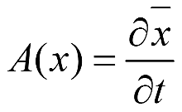
(2A)
(4A)
(3A).
(5A)
The Fokker-Planck equation and its approximation to Ornstein-Uhlenbeck process exactly determine the stochastic process or the time-evolution of a random variable. It is carried out by means of the average value of the variable per span of time and variance (s².) The experimental MS intensity-value reflects concentration of analyte. The concentration represents mass of analyte per volume. The examination of temporal behavior of MS intensity with respect to small spans of the scan time, essentially examines dynamics of mass over a small span of the scan time of the whole time of measurement. When ions are affected on low electric field, then their drift velocity along the direction of the field can be superimposed on stochastic thermal motion [44–46]. The upshot of the latter assumption is that, when the mass of the analyte ions is approximated directly to the observable values of the intensity; and the temporal behavior of the velocity of the MS ions is described as a stochastic variable, then the intensity-outcome is also described as random variable. According to our theory we examine the temporal behavior of the variable over spans of the whole time of a measurement. The theory accounts for fluctuations of the observable intensity and m/z-values of peaks of an analyte ion with respect to different spans of scan time of the measurements under MS continuum or environment. These fluctuations are due to ion/molecular interactions or, ion/continuum interactions. Under continuum we understand all other molecules and ions around analyte MS ions. In general, the issue of fluctuation phenomena in the natural processes leads back to fundamental works by Einstein, which crucially contributes to their mathematical and physical expression, and respectively, description. In Einstein’s works [47,47] we approximate the temporal behavior of the fluctuating path of solid particles in liquid to elementary diffusion equation. The latter equation represents precisely the forward Fokker-Planck equation (1A) [44–46]. The exact numerical solution of the Ornstein-Uhlenbeck process approximating the A(x,t) and D(x,t) in equation (1A) has been shown that express mathematically the fluctuating path of solid particles in liquid [44–46]. The characteristic function D(x,t) according to Einstein’s approximation is given by equation (4A).
In writing our innovative equations (2)–(4) we empirically modify equation (4A). The Einstein’s model does not fit our experimental data perfectly in chemometric terms [35,36]. Equation (4A) we have written as equation (5A), thus yielding to excellent coefficients of correlation (|r|) between theory and experiment.
[47] A. Einstein, Annalen der Physik 17 (1905) 549–560.
[48] A. Einstein, Annalen der Physik 19 (1906) 371–385.

Slide 11
The statistical parameter A^{i} is dimensionless. Because of, the Taylor row of ln(K_{B}.T/m) (lnx = 2.{((x-1)/(x+1)) + (1/3.((x-1)/(x+1))³)} + (1/5.((x-1)/(x+1))⁵)+...} leads to A^{i} [units] (kg.m².s⁻¹)/(K.s.m².kg.s⁻².K⁻¹) or it is dimensionless. Conversely, the D_{SD} parameter as can be expected shows D_{SD} [units] (K.s.m².s⁻².K⁻¹.kg)/(kg) or it has units [m².s⁻¹]. The units of D(x,t) according equation (5A) are [s⁻¹].
The analysis of the applicability of our SD concepts and formulas (1)–(3) is not limited only to these models.
More recently [49] we have shown that the statistical parameter A^{i} obtained by fitting of the theoretical model (1) with experimental data on the intensity presented as a functional relationship (I – < I >)² = f(t) is connected with the D^{i}_{SD} parameter via equation (4). In writing the latter equation we have explored our empirical modification of the characteristic function diffusion D(x,t) [39,40]. Its validity has been tested studying fragment ions of acetylated cyclodextris [49]. There have been obtained |r| = 0.998–9.996. Our claim is that the latter equation is applicable to quantify not only biologically active macromolecules, but also low molecular weigth analytes (LMWs) analytes such those reported to this work STs.
For the first time in the literature, this presentation applies equation (4) to LMWs studying analytes (1)–(4). By means of the latter equation we describe as well as the physical meaning of the statistical parameter “A^{i}” [41]. Its validity is tested in the latter reference, as well. Equation (4) is derived from equation (2) making an approximation that A^{i} = <(I – < I >)² >. If so, then equation (1) can be written as equation (5) making a substitution of the fitting parameter A^{i}. The units of the D_{SD} and A^{i} parameters have been discussed in [49].
(5)
[49] B. Ivanova, M. Spiteller, Mass spectrometric study of randomly acetylated cyclodextrins and their associates — a stochastic dynamic approach (2020) submitted.

Slide 12
Results and discussion
1. Mass spectrometric data
1.1. Assignment of fragment ions of steroids under atmospheric pressure chemical ionization mass spectrometric conditions
The common and different fragment characteristics of STs (1)–(4) with respect to the type of the substituents are shown in Figure 2. The STs belong to the Δ⁴-3-keto derivatives [11]. The nonsubstituted steroid 4-androsten-3-one exhibit fragment peaks at m/z 124 and 149 due to of the C⁶–C⁷ and C⁹–C¹⁰ bonds of the steroids’ ring B (Figures 3 and 4) [11]. Under the electron impact MS conditions there has been proposed a ion-radical mechanism of ion formation based on: (i) a fission of the C9-C10 bond leads to a steric compression of A/B rings of the steroid followed by a intramolecularrearrangement and stabilization of cation-radical; (ii) the next intramolecular proton transfer from C⁸ to C¹⁰ atoms leads to a diene structure which appear favorable energetically; (iii) the further fission of C⁶–C⁷ bond yields to cation-radical of 4-methyl-3-methylene-cyclohex-1-enol and neutral 3a-methyl-7-methylene-2,3,3a,4,7,7a-hexahydro-1H-indene in the case of non-substituted 4-androsten-3-one. A comparative analysis among these latter results from previous comprehensive analysis of the preferred fragment paths of D⁴–3-keto steroids and analytes (1)–(4) studied under APCI-MS conditions show that in cases (1)–(3) the observed MS peaks at m/z 239 (1), 209 (2) and 191/123 (3) can be assigned to products obtained on the base on reactions of cleavage of the same C⁶-C⁷ and C⁹-C¹⁰ bonds of the B-ring of the steroids.

Slide 13
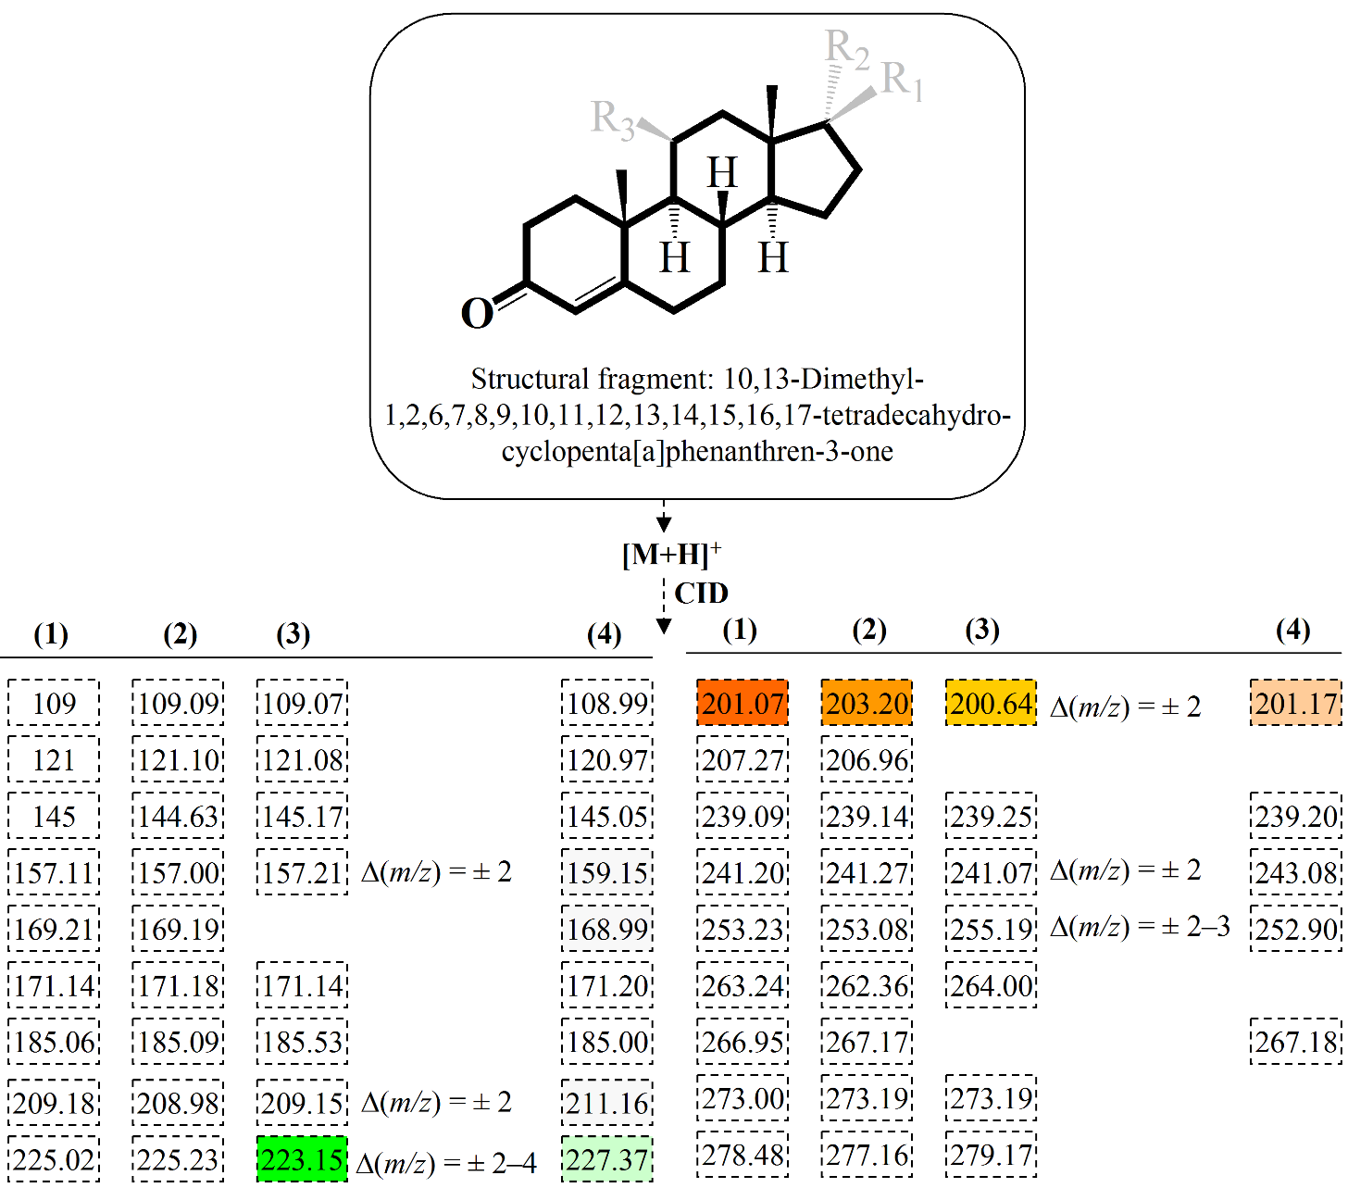
Figure 2. Chemical diagram of the common molecular skeleton of STs; fragment ions of steroids (1)–(4) under CID experimental conditions of the protonated analyte molecule [M+H]⁺; the different ion-products are highlighted

Slide 14
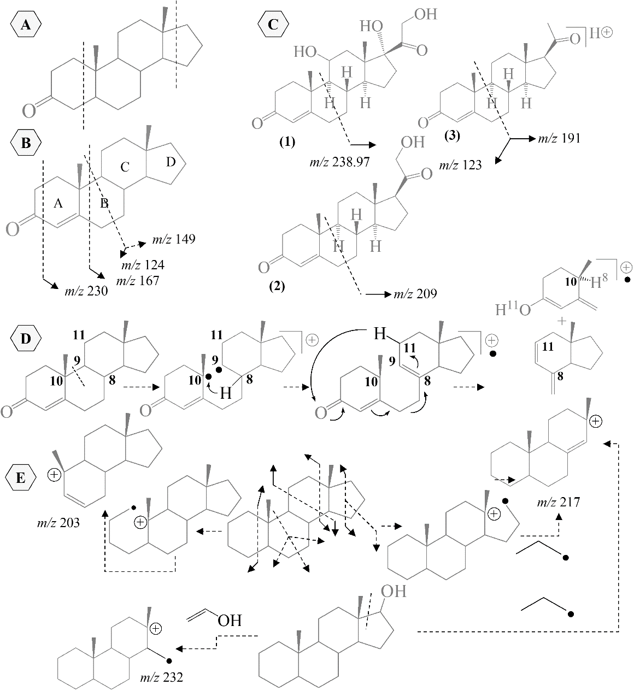
Figure 3. Fragment paths of androstan-3-one (A) and 4-androsten-3-one (B) according to [11] under electron impact experimental conditions; fragment paths of (1)–(3) according to the data on this paper under APCI-MS experimental conditions (C); ion-radical mechanism of cleavage of bonds of 4-androsten-3-one according to [11] (D); fragment paths of 5a- ad 5b-adrostae according to [12,13]; ion-radical mechanism of cleavage of C¹–C¹⁰ and C¹³–C¹⁷ bonds of 5a-androstane according to [12,13]; and fragment processes of 17b-hydrohy-5a- and 17b-hydrohy-5b-adrostans according to the latter reference (E).

Slide 15
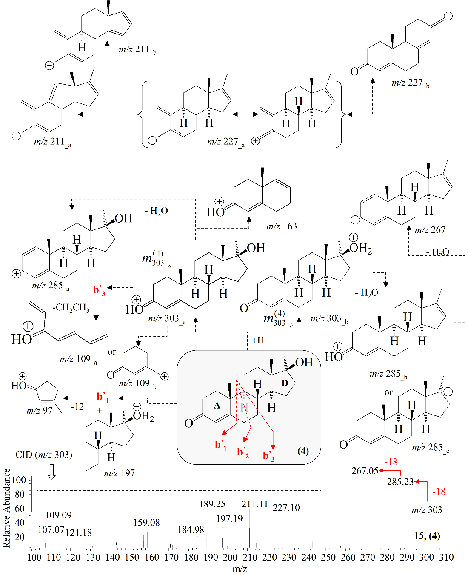
Figure 3. The assignment of MS peaks at m/z 109_{_a} and 97 is according to [50–52]; while the species m/z 227_{_b} – according to [53]; the assignment of peak m/z 109_{_b}, 163 and 285_{_c} is according to [54]; the m/z 97, 109 and 123 ions originated from [M+H]` ion.
[50] Z. Zaretskii, J. Curtis, D. Ghosh, et al. Int. J. Mass Spectrom. 86 (1988) 121–136.
[51] Z. Zaretskii, D. Ghosh, A. Brenton, et al. Rapid Commun. MassSpectrom. 3 (1989) 329–334.
[52] Z. Zaretskii, D. Ghosh, A. Brenton, et al. Rapid Commun. Mass Spectrom. 4 (1990) 44–51.
[53] S. Hammerus, C. Djerassi, Tetrahedron 31 (2004) 2391–2400.
[54]. Noh, C. Yoon, J. Lee, et al. Bull. Korean Chem. Soc. 37 (2016) 1029–1038.

Slide 16
Looking at the experimental data on androstan-3-one, 4-androsten-3-one and (1)–(3) toward reaction path of subsequent cleavable of C⁶–C⁷ and C⁹–C¹⁰ bonds, it is clear that despite the fact that APCI-MS conditions tolerate fragment ion-radical mechanisms in case of (1)–(3) the observed data cannot be associated with such mechanisms. Further question arises: why (4) does not exhibit those discussed lastly characteristic MS peaks? Because of, the data on (1)–(3) show that the discussed fragment path does not depend on the type of the substituent at the shown position. Moreover, the shown fragment path of androstan-3-one in Figure 3 is observed, as can be expected, in the case of the nonsubstituted 5a- or 5b-androstans [13]. Therefore, these fragment reactions which appear common and preferred reactions of STs are little affected on the type of the substituents in the molecular structure. The later statement is also confirmed looking at the experimental MS spectra of 17b-hydroxy-5a or 17b-hydroxy-5b-androstans [13], where, again, a peak at m/z 217 occurs like in the case of the nonsubstituted ST. In parallel, a new peak at m/z 232 is found. Owing to the fact that the two peaks are result from the initial cleavage of C¹³-C¹⁷ bond despite the type of the substituent at C¹⁷-position. Nevertheless, the further increasing in the complexity of the substitution of the main ST molecular skeleton – the 10,13-dimethyl-hexadecahydro-cyclopenta[a]phenanthrene one – such as the derivatives 5a-androstane-3-one-17b-ol, and 5b-androstane-3-17b-ol leads to a preferred cleavage of two solvent molecules H₂O yielding to most abundance MS peaks of the corresponding fragment ions. The latter reference has highlighted that the EI spectra of the epimeric diols are virtually indistinguishable; due to, the subtle difference in the MS intensity of the fragment species. Conversely, the there is a lack of cleavage of the second C–O bond in the case of testosterone 5a-androstane-3-one-17b-ol, and 5b-androstane-3-17b-ol, which is explained with the presence of the conjugated C=O group as a Δ⁴-3-keto derivative. However, the presence of double bond at C¹-position of Δ^{l,4}-androstadiene-3-one-17b-ol does not affect significantly on the MS patter of the compound, which appears almost identical with the spectrum of testosterone. Looking at the APCI-CID-MS spectra of (1)–(4) we may distinguish clearly a series of MS peaks which have been obtained due to cleavage of H₂O molecule (loss of 18 a.u.) depending on the number of OH-, respectively keto C=O groups in the molecules. These are the fragment processes: 363.30 → 345.18 → 327.21 → 309.18 (1); 331.30 → 313.16 → 295.24 → 277.18 (2); 315.30 → 297.22 → 279.26 (3); and 303.30 → 285.23 → 267.05 (4), respectively. It is important to pay attention to the molecular factors governing the subsequence of the loss of H₂O molecules of compounds (1)–(4) and to determine a rule, if any, defining the loss of solvent water molecules of STs with respect the position of the OH-, respectively, keto C=O-groups. In doing so, we conduct a series of computations of the thermodynamics of fragment reactions of steroids depending on the subsequence of the loss of the 18 atomic units. This is a very important issue of further study, because of previous work on this topic suggests, again, a ion-radical mechanism of loss of molecule H₂O, accompanied with an intramolecular proton transfer; furthermore, there is a regiospecific 1,3-elimination of species H- and OH-species leading to the so-called unsaturated effect; or an effect of obtaining of unsaturated steroids. Due to, an effect of intermolecular rearrangement there can be observed even loss of angular CH₃-groups of the analytes.

Slide 17
In the case of 5b-cholestan-3a-ol a detail study of mechanistic aspects of reaction of loss of H₂O molecule has shown that the process is accompanied with a preliminary chair-to-boat isomerization of the ring A of the steroid. Thus, within the framework of a subsequent series of loss of more than one solvent water molecules of (1)–(4) the correlation between molecular structure and thermodynamics of the processes is far from a straightforward one. We can simply suggest a variety of mechanisms accompanied weather with change of the 3D molecular conformation and electronic structures of STs depending of the subsequence of the cleavage of the H₂O molecule depending on the initial position of the OH-, respectively C=O groups in the analyte molecules.
The epimers testosterone and its derivative 11-epitestosterone can be distinguished quantitatively using the intensity ratio of the peaks of {[M-CH₂CO-H₂O]^{·+}} and {[M-CH₂CO]^{·+}} at m/z 228 and 246. There is a subsequent loss of CH₂CO fragment leading to cation radical of 2a,4a-dimethyl-2a,2b,3,4,4a,5,6,7,7a,7b,8,9-dodecahydro-2H-cyclobuta[a]cyclopenta[f]naphthalen-5-ol followed by loss of solvent water molecule from C¹⁷-position. Steroid (4) exhibits MS peaks at m/z 227 and 245, which we assign to product ions obtained within the framework of the same reactions as far as (4) represents a derivative of testosterone. Analogously, (4) also shows MS peak at m/z 203; or, there is, a competition between the reactions of loss of solvent water molecule from the D-ring and C¹-C¹⁰-C¹⁹ fragment unit from rings B and C.
The obtaining of cation of type m_{109_a} of (4) has been proposed by many authors. Mechanism of its formation has been detailed.
An in-depth study of the fragment pattern of progesterone or Δ⁴-pregnene-3,20-dione, (3) has been presented. The study of the loss of CH₃-groups has been detailed accounting for the favorable reaction. The loss of C¹⁸-CH₃ methyl-group appears comparable from the perspective of chemical kinetics and thermodynamics. Despite the fact that the loss of C¹⁹-CH₃ methyl-group , presumably, should dominate as a fragment process of (3) under APCI-MS experimental conditions, due to, the discussed above preferred cleavage of C¹⁰-C¹⁹ bond cases from cleavage of the C¹⁸-CH₃ methyl-group.

Slide 18
1.2. Quantitative mass spectrometric analysis
1.2.1. Method performances
Our SD formulas are derived per span of scan time of a measurement, instead of over the whole time of the measurement. This would mean that the method performances should be evaluated statistically per span of scan time. The descriptive statistic data are shown in Figures 4 and 5. To begin with, by asking do the datasets of random variables follow the normal distribution. This consideration is of importance for the evaluation of the method performances, because of many of the other statistical tests are applicable to normally distributed variables. We use Shapiro-Wilk test having the best power for evaluation of the type of the distribution of random variables. It introduces the W-statistics. The large values of the latter parameter mean normal distribution of the evaluated set of variables. Some data reveals that the datasets of the temporally variables corresponding to ions having m/z 285 and 267 of samples 04 and 05 do not come from normal distribution. Despite, that within the framework of the same experiments 04 and 05 the datasets corresponding to other m/z-values are normally distributed. Since, Shapiro-Wilk test has capability of rejecting the hypothesis about a normal distribution of a set of random variables, but it cannot confirm such distribution we apply the other statistical t- and F-tests assuming a normal distribution of the variables. Even if the distributions do not follow a normal distribution the latter tests will give relatively reliable results, because of the distributions of the datasets of m/z-values resemble a normal distribution. The latter figure illustrates the distribution of the number of times when given m/z-value fell into a bin or histogram and the ordered normal probability plot of the experimental values. If the later plot yields to straight line, then the variables come from normal distribution.
In order to test whether the difference among the means of the m/z-values per span of scan time of different measurements (analysis between samples) is so great that there is unable to be explained by a random error we use ANOVA test. Besides, analysis of values among different spans of scan time within the whole time of a measurement (analysis within a sample) is carried out. The relationship between the F- and P-values is that when the former parameter is large, then the latter parameter has small value. When the latter case is obtained small P-values, then the null hypothesis is rejected. In the studied cases of sets of m/z-values the decision rule states that the values are not significantly different. Via the F-test there are detected systematic errors. Besides, ANOVA test is used to account for the random-effect factor. The equality of the populations means is also tested by means of t-test. The results determine our justification in claiming that the sets of m/z-values obtained experimentally per span of the scan time, for instance the dataset of variables of ion at m/z 285 of (4) belong to the same molecular ion. Therefore, we describe the same ion within the framework of all measurements in multiplication and with respect to the different concentrations of the analyte.

Slide 19
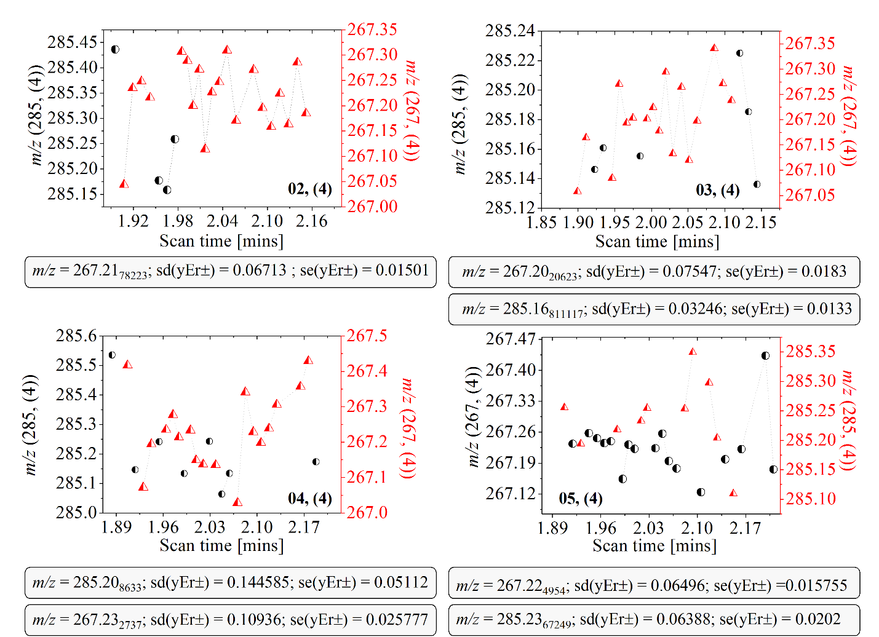
Figure 4. Temporal behavior of m/z-values of ions of (4) at concentration of the analyte in solution 02–05; descriptive statistics; sd(yEr±) – standard deviation; se(yEr±) – standard error

Slide 20
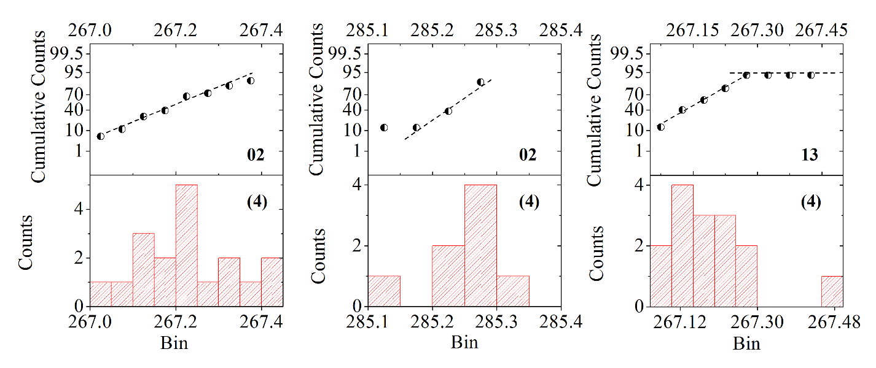
Figure 5 Histograms and probability distribution of m/z-values of MS ions of steroid (4) with respect to the concentration of the analyte in solution 02 and 13.

Slide 21
1.2.2. Determination of stochastic dynamic mass spectrometric diffusion parameters
The terms and the statistical parameters which we used to obtain the experimental D_{SD} values within the framework of our model formula (1) have been determined previously [31]. The latter reference details the calculation tasks, as well. Table 1 summarizes the temporal behavior of the absolute intensity value per analyte MS ions it is observed experimentally (Figure 6.) Table 2 show the statistical and experimental diffusion parameters according to our theory and functional relationships; besides, they illustrate the experimentally observable and curve-fitted relationships between the intensity-values and the scan time. Chemometric data are shown, as well.
Conversely, results reported so far from correlative analysis between experimental D_{SD} parameters and total intensity values (I^{TOT}) which have shown good-to-excellent chemometric correlation coefficients, the analysis of the data on steroid (4) indicates only |r| = 0.7551 and 0.6352 (Figure 7.) This point of the study should be carefully noted, because of it reflects one of the crucial advantages of our innovative formulas and SD theory ― the capability of the D_{SD} parameter to account exactly for the temporal behavior of the variable intensity per span of scan time, which improved crucially the method performances of the analytical protocols, comparing with quantification methods based on determination of the I^{TOT}-values.

Slide 22
Table 1
Temporal behavior of the intensity value [arb.units] per span of the scan time of ions of (4) with respect to the analyte concentration in solutions 02–04 and 13–16
Table 2
APCI(+)-MS and statistical data on ions of (4); σ² and σ^{’2} – variances; t – scan time [mins]
Experiment | 02 |  | Experiment | 03
t | m/z 267 | m/z 285 | t | m/z 267 | m/z 285
2.003 | 54966 | 28202 | 1.956 | 41339 | 57744
2.013 | 33958 | 31080 | 1.967 | 45604 | 35434
2.024 | 34246 | 22447 | 1.978 | 41995 | 45604
2.036 | 18130 | 15822 | 1.988 | 62665 | 38386
Experiment | 04 |  | Experiment | 13
t | m/z 267 | m/z 285 | t | m/z 267 | m/z 285
1.918 | 29334 | 38868 | 1.954 | 53342 | 34243
1.930 | 60502 | 30434 | 1.964 | 45292 | 48765
1.943 | 69669 | 28234 | 1.974 | 51922 | 32823
1.954 | 51335 | 47307
1.963 | 47668 | 53535
Experiment | 05
t | m/z 267 | m/z 285 | m/z 227 | m/z 211 | m/z 177 | t | m/z 109
1.916 | 30572 | 18485 | 20150 | 17780 | 2766 | 1.973 | 10431
1.936 | 58063 | 30572 | 16331 | 13434 | 8166 | 1.983 | 11401
1.948 | 53086 | 46450 | 27131 | 19755 | 15014 | 1.994 | 11401
1.959 | 46450 | 55219 | 31213 | 32530 | 18175
Experiment | 05
t | m/z 245 | m/z 227 | m/z 203 | t | m/z 303
1.900 | 7453 | 7995 | 1339 | 2.071 | 808
1.912 | 136 | 13551 | 437 | 2.083 | 1574
1.924 | 3930 | 20462 | 1994
Experiment | 14 |  | Experiment | 16
t | m/z 267 | m/z 285 | t | m/z 267 | m/z 285
1.939 | 45462 | 47666 | 1.969 | 48364 | 27765
1.950 | 81827 | 52074 | 1.979 | 39152 | 26699
1.960 | 38300 | 40504 | 1.991 | 30452 | 28062
1.972 | 44636 | 50972
 | m/z 267 | m/z 285 | m/z 267 | m/z 285
 | 02 | 02 | 03 | 03
t | 2.003–2.036 | 2.003–2.036 | 1.956–1.988 | 1.956–1.988
< I > | 35325 | 24387.75 | 47900.75 | 44292
(< I >)² | 1247855625 | 594762350.0625 | 2294481850.5625 | 1961781264
(< I² >) | 1418973084 | 628880674.25 | 2369779996.75 | 2035786926
σ² | 171117459 | 34118324.1875 | 75298146.1875 | 74005662
<I-<I>²> | 171117459 | 34118324.1864 | 75298146.186375 | 74005662
lnP1 | -17.053₃₇₂₉₈₉ | -17.053₃₇₂₉₈₉ | -17.053₃₇₂₉₈₉ | -17.053₃₇₂₉₈₉
σ’² | 16731582.302 | 2187103.97 | 7150298.35 | 74005662
D_{SD} | 7.52921204.10⁻⁹ | 9.8419679.10⁻¹⁰ | 3.2176343.10⁻⁹ | 2.4247.10⁻⁹
 | m/z 267 | m/z 285 | m/z 267 | m/z 285
 | 04 | 04 | 05 | 05
t | 1.918–1.963 | 1.918–1.963 | 1.916–1.959 | 1.916–1.959
< I > | 51701.6 | 39675.6 | 47042.75 | 37681.5
(< I >)² | 2673055442.56 | 1574153235.36 | 2213020327.5625 | 1419895442.25
(< I² >) | 2856453114 | 1667611402 | 2320421262.25 | 1620770717.5
σ² | 183397671.44 | 93458166.64 | 107400934.6875 | 200875275.25
<I-<I>²> | 183397671.456 | 93458166.648 | 107400934.705625 | 200875275.2625
lnP1 | -17.053₃₇₂₉₈₉ | -17.053₃₇₂₉₈₉ | -17.053₃₇₂₉₈₉ | -17.053₃₇₂₉₈₉
σ’² | 16172587.092 | 5181388.729 | 8295480.0632 | 10554176.213
D_{SD} | 2.13379.10⁻¹⁰ | 2.331625.10⁻⁹ | 3.732966.10⁻⁹ | 4.749379296.10⁻⁹
 | m/z 267 | m/z 285 | m/z 267 | m/z 285
 | 13 | 13 | 14 | 14
t | 1.954–1.974 | 1.954–1.974 | 1.939–1.960 | 1.939–1.960
< I > | 50185.33 | 38610.333 | 52556.25 | 47804
(< I >)² | 2518567681.778 | 1490757840.111 | 2762159414.0625 | 2285222416
(< I² >) | 2530876104 | 1542652534.33 | 3055428467.25 | 2305616958
σ² | 12308422.222 | 51894694.2223 | 293269053.1875 | 20394542
<I-<I>²> | 12308422.2217 | 51894694.217 | 293269053.205625 | 20394542
lnP1 | -17.053₃₇₂₉₈₉ | -17.053₃₇₂₉₈₉ | -17.053₃₇₂₉₈₉ | -17.053₃₇₂₉₈₉
σ’² | 881339.548 | 3782923.55 | 27622461.233 | 1590514.325
D_{SD} | 3.9660279.10⁻¹⁰ | 1.7023156.10⁻⁹ | 1.2430108.10⁻⁸ | 7.1573145.10⁻¹⁰

Slide 23
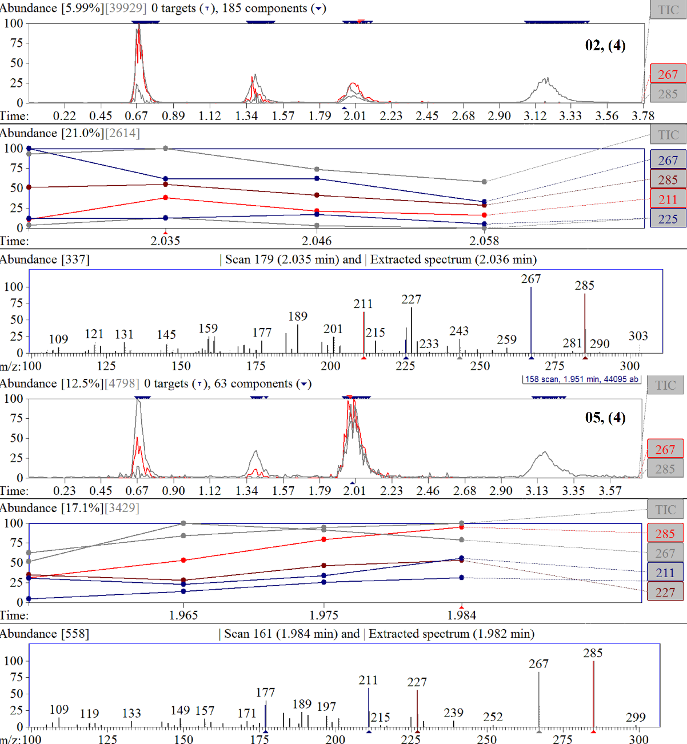
Figure 6. Absolute experimental intensity [arb. units] of analyte MS ions of (4) versus scan time [mins]; total ion current versus time [mins] of CID-MS spectra of (4) ate analyte concentration in solution 02 and 05.

Slide 24
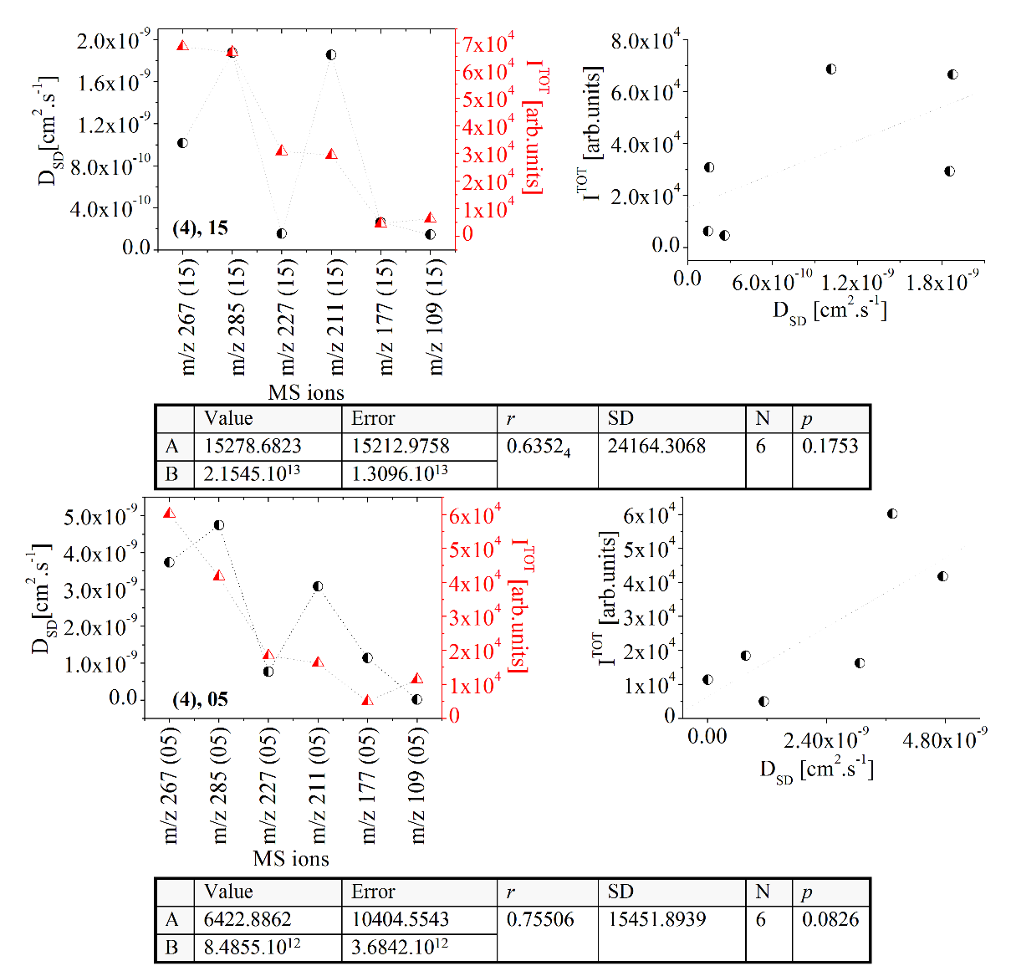
Figure 7. Relationships between the D_{SD} data [cm².s⁻¹] according to equation (1) and the total intensity of the MS ions (I^{TOT} {arb.units]) obtained over the whole time of the measurements of analyte (4) at concentrations in solution 05 and 15; chemometrics; I^{TOT} [arb.units]; experiment 15; steroid (4): 68605 (m/z 267), 66490 (m/z 285), 30682 (m/z 227), 29273 (m/z 211), 4624 (m/z 177) and 6304 (m/z 109); experiment 05; steroid (4): 60158 (m/z 267), 41726 (m/z 285), 18417 (m/z 227), 16229 (m/z 211), 4959 (m/z 177) and 11390 (m/z 109), respectively.

Slide 25
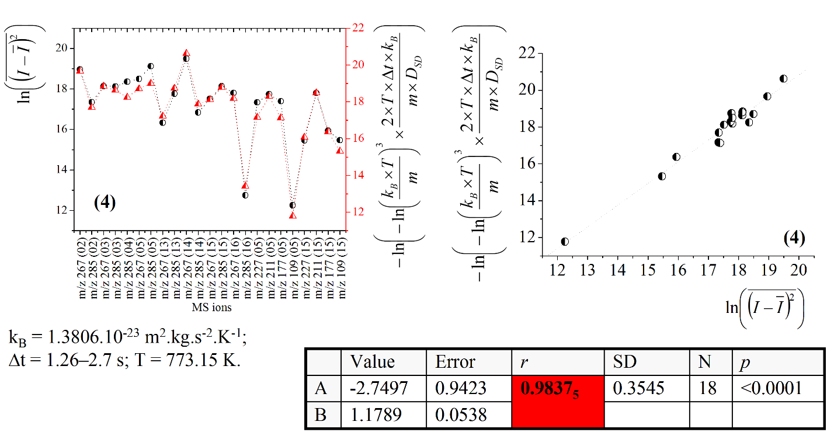
1.2.3. Correlations between the mass spectrometric diffusion data and the temperature
Hawing established the relationship between the measurable outcome intensity and the diffusion parameter D_{SD} via equation (1), in this subsection we announces its derivative equation (2) which accounts for the experimental parameter temperature. The correlative analysis between theory and experiment within the framework of the theoretical model presented in this subsection leads to excellent chemometrics showing |r| = 0.9837₅₂ (Figure 8.)
Figure 8. Quantitative correlations according to equation (3); chemometrics.

Slide 26
1.2.4. Correlative analysis between statistical and diffusion parameters according to the stochastic dynamic theory used to this work
We need to fill the gap of our knowledge whether the diffusion parameters (D’_{SD}) obtained within the framework of the simpler model equation (5) correlate with the analyte concentration in solution. However, it must be taken into account for that there are already obtained excellent chemometric correlation coefficients between D_{SD}-parameters according to equation (1) and the concentrations of steroids (1)–(3) in solution. The same is true for the correlation between the D_{SD}-data on steroid (4) and its chromatographic analysis with respect to the analyte concentration in solution shown in the next subsection. Because of, if the largest part of the chemometric correlation coefficients between the theory and experiment of a systematic quantitative analyses show that there is better chemometrics quantifying the concentration of the analytes according to equation (5) instead of equation (1), then we would revise the original assumption that only by means of equations (1) and (3) there can be gained excellent-to-exact quantification of the measurable variable intensity of ions of analytes, respectively, the analyte concentration in solution. The problem which currently prevents to determine unambiguously which of the model equations express the exact analyte concentration is the lack of enough data on quantitative relations. Our model equations are tested so far on a small-scale research on this issue. Despite this remark, however, Figure 9 shown that the correlative analysis between the parameters according equations (4) and (5), respectively, between equation (1) and (4) yield to |r|=0.9311–1, thus, indicating an excellent-to-exact relations studying steroid (4). The correlation between D_{SD} and D’_{SD} data on steroids (2) and (3) according to equations (1) and (5) show |r|=0.9982 and |r|=0.9986 (Figure 10.) At this point, it should be kept in mind that equation (5) has been designed to clarify the physical meaning of the statistical parameter “A_{i}” according to the SineSqr approximation to the experimental relation (I – <I>)² = f(t) expressing the temporal behavior of the MS intensity of the ions of the analytes. It is based on the approximation A^{i} » <(I–<I>)²>. In this context, one important feature is the chemometric parameters obtained on the base on the linear approximation of the relationship D_{SD} = f(D”_{SD}) depicted on the latter figure, where D”_{SD} parameters are obtained according to equation (6). As can be seen A » 0 and B » 1. Therefore, the D_{SD}-parameters according equation (1) can be approximated with the D”_{SD} parameters when A^{i} = 2.<(I–<I>)²>. We think that the obtained excellent chemometric data on STs (1)–(4) are suffice to judger adequately there liability of our scientific explanation of the physical meaning of the statistical parameter A’ according to our basic model formula (1). The correlative analyses between the parameters according to equations (1) and (5), respectively, (1) and (6) of analytes (1) and (2) also exhibiting excellent–to–exact chemometric data (|r|=0.9828 and |r|=0.9982 – 1.)

Slide 27
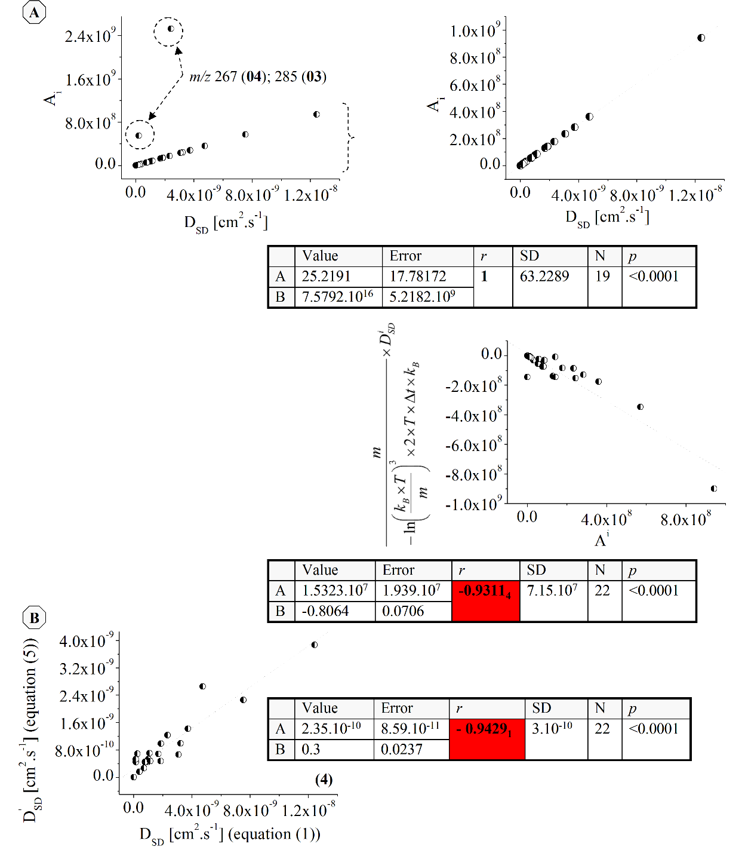
(6)
Figure 9. Quantitative correlations among diffusion parameters and statistical parameter A^{i} according to equations (4) and (5); chemometrics.

Slide 28
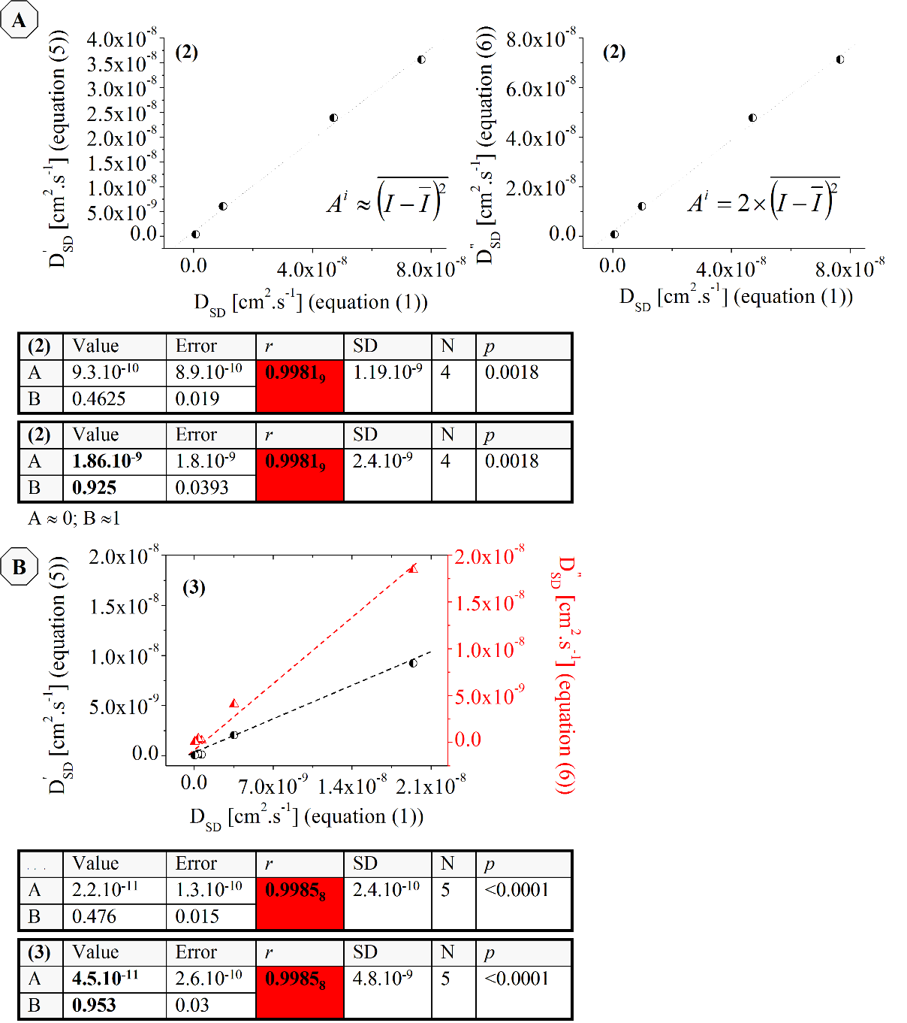
Figure 10. Quantitative relationships among diffusion parameters according to equations (1)–(6); A: Data on (2) in [40]; B: data on (3) in [40]; chemometrics.

Slide 29
1.2.5. Correlative analysis between diffusion parameters according to the simpler stochastic dynamic theory used to this work and the analyte concentration in solution
This subsection deals with our further attempt to elaborate our stochastic dynamic concept and model formulas and to defend our innovative view that these models provide exact determination of the concentration of the analyte in solution deriving equation (3) [40]. One very important effort in this direction is the results from the correlative analysis between mass spectrometric and chromatographic quantitative data on (4) with respect to the analyte concentration in solution presented, herein. A part of the results is depicted in Figure 11. As can be seen |r|=0.9758–0.9999₉. Therefore, the problem about the unambiguous mass spectrometric based quantification of analytes in solution is resolved successfully within the framework of our theory and model functional relationships. Moreover, there is obtained excellent correlation using independent correlative analysis between mass spectrometric and chromatographic methods, which not only proofs but also validate our protocol based on the model formulas written above.
The next persuasive example from the perspective of employment of equations (5) and (6) for the purposes of the analytical practice is the relation between the analyte concentration of (3) with respect to the observable MS intensity-values of the ion at m/z 297 quantified according to the latter model formulas (Figure 12.) There is obtained |r| = 0.9968. Again, the coefficient of correlation is improved comparing with the chemometric data on the correlation between the I^{TOT} values and the concentration of the analyte in solution shown [40]. The corresponding parameter reported there is |r| = 0.9896.

Slide 30
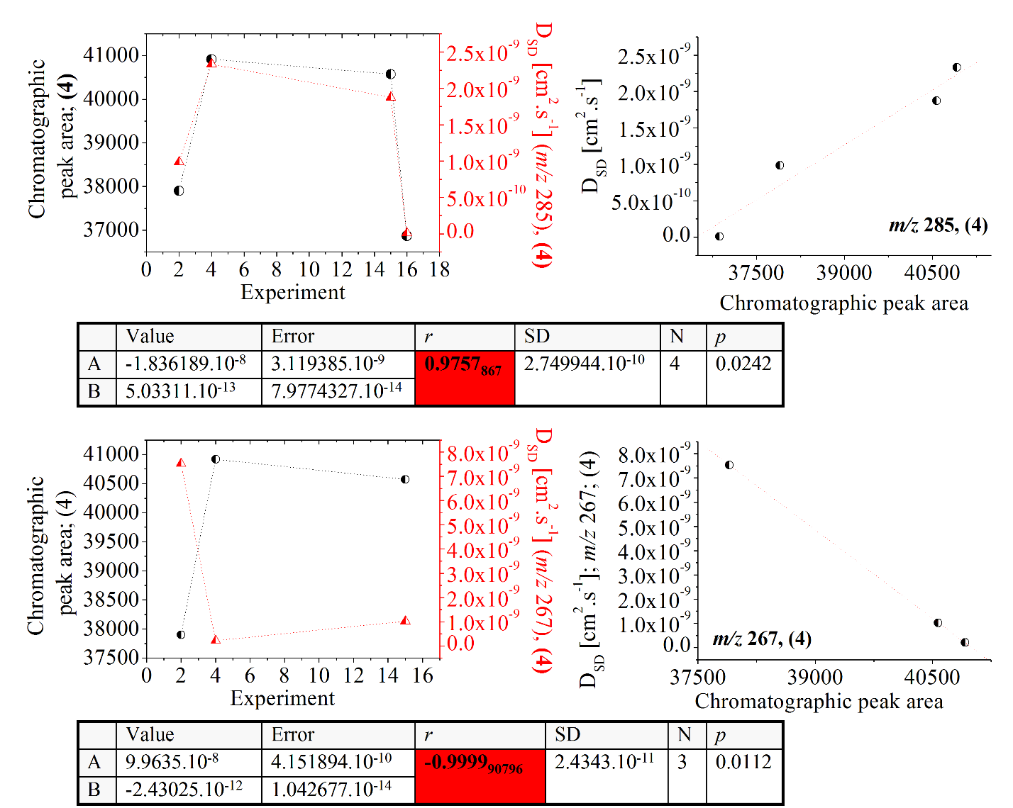
Figure 11. Functional relationships between the experimental chromatographic areas of the peak and the diffusion parameter according to equations (1)–(3) with respect to the analyte concentration in solution; chemometrics.

Slide 31
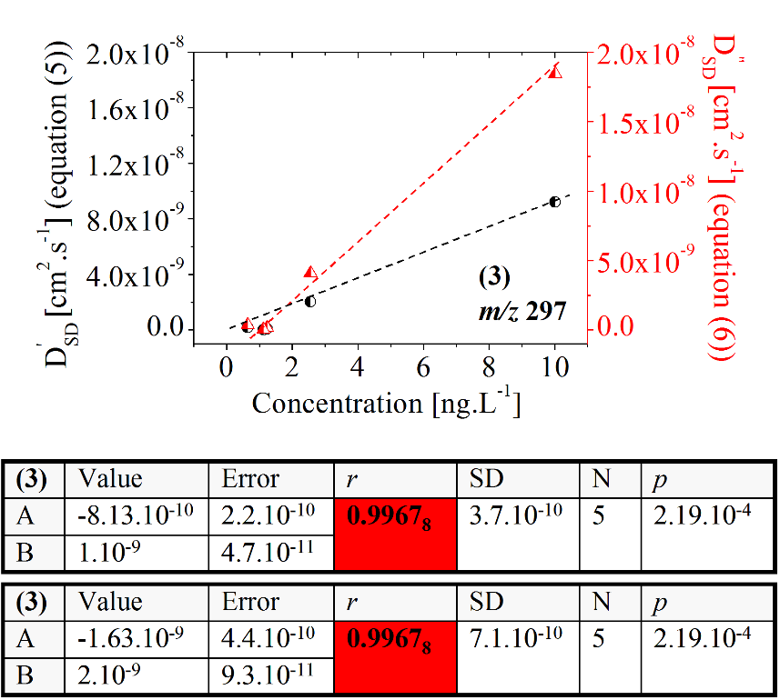
Figure 12. Relationship between the D’_{SD} and D’’_{SD} parameters according to equations (5) and (6); chemometrics.

Slide 32
Conclusions
Successful quantitative treatment of steroids in mixture mass spectrometrically requires monitoring of the temporal behavior of the experimentally observable outcome intensity. Therefore, compulsory there is needed an accurate, precise, selective and sensitive quantitative model equation connecting between the experimentally observed variables and the concentration of the analyte in solution. As presented throughout this paper as well as a more recent reference devoted to the same problem [40] our new formulas (5) and (6) provide adequate solution of this problem, showing a highly reliable quantification of four steroids in mixture at concentration level ng.(mL)⁻¹ yielding to coefficient of correlation between theory and experiment |r| = 0.9981_{9.}
The independent quantitative analysis between the mass spectrometric data according to our new equations and chromatographic data on the same mixtures of steroids has shown remarkable quantitative correlation |r| = 0.9999_{9.}
This result unambiguously proofs of not only the validity of our innovative quantitative relations between the experimental mass spectrometric variable intensity and the concentration of the analyte in solution, but also their direct applicability to the analytical practice to quantify complex mixtures of steroids.

Slide 33
Acknowledgments

