Slide 1

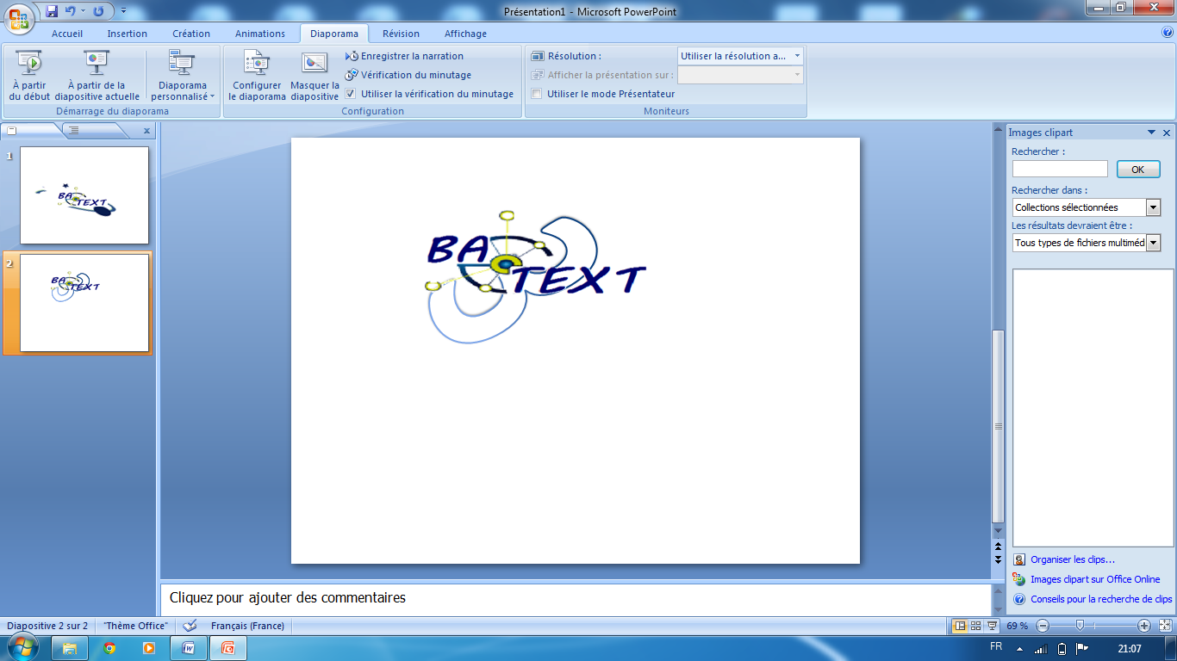
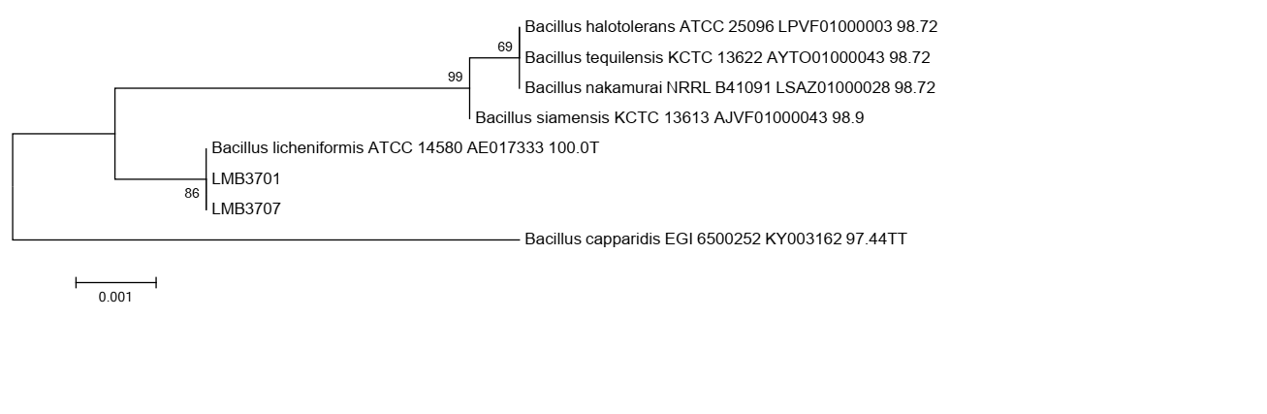
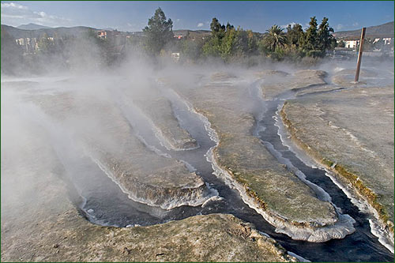
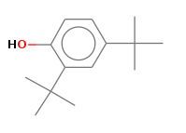
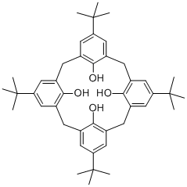
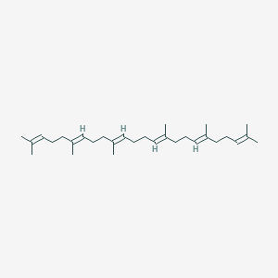
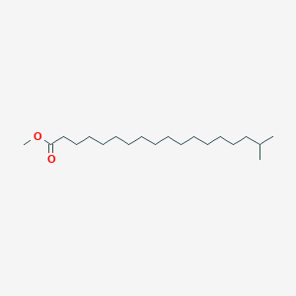
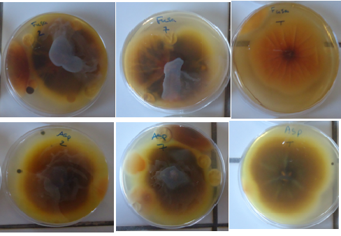
Production of 2,4 di-tert-butylphenol and fatty acid compounds by thermophilic
Bacillus licheniformis and evaluation as antifungal agents
Nadia Aissaoui ¹*, Nihel Klouche-Khelil^{1,2}, Fatima N¹.
¹LAMAABE Laboratory Tlemcen University, Algeria .
² Laboratory of Experimental Surgery, Dental Surgery Department, Faculty of Medecine, Tlemcen University, Algeria .
* Corresponding author e-mail: nada2389@gmail.com
INTRODUCTION
During studies aimed at discovering potent bioactives compounds, two bacterial strains, named LMB 3701 and LMB 3707 were isolated from Dbagh hot springs in Algeria and taxonomically identified as Bacillus licheniformis (Accession Numbers LMB3701 No.:KX100031, LMB707 No.:KX100032)( Aissaoui et al.,2018). These two isolates exhibited antimicrobial compounds against multidrug resistant bacteria. In this study, the same crude extracts were attempts at investigating the spectrum of antifungal proprieties.
A
B
Fig. 1. A: Phylogenetic tree of bacterial isolates basing on 16S rDNA partial sequences, B: Dbagh hot spring -Algeria ( sample site).
ANTIFUNGAL ASSAYS
The antifungal activity against A.flavus MNHN 994294 and C.herbarium MNHN 3369 was detected using the agar dilution method. In brief, 6 mm agar discs of each filamentous fungus were deposited in the centre of Petri plate containing 20 ml of Potato Dextrose Agar with various concentrations of each extract (10, 50, and 100µl). The plates were incubated at 28°C until the inhibition zone was formed. Isopropanol/water (50/50) was used as negative control (Hili et al., 1997). All tests were repeated in triplicate. GIR% was expressed using the following formula:
GIR%= [(C − T)/C] × 100.
T :the mycelial growth in treatment (mm).
C: the mycelial growth of the control (mm).
COMPOUNDS STRUCTURES
Bioactives compounds | Chemicals structure |  | Nature of the compounds |  |  | Biologicals actions
Communs bioactive compound
2,4-Di-tert-butylphenol |  |  | Phenol |  | Antibacterial potency (Aissaoui et al.,2018)
4-tert-Butylcalix[4]arene |  |  | Polyphenolic macrocycle |  | Antibacterial potency ( Aissaoui et al.,2018); application as prodrugs (Korchowiec et al., 2010)
Squalene |  |  | Triterpene |  | antibacterial, antioxidant activities
Specific compounds from crude extract of LMB3701
Octadecanoic acid, 17-methyl-, methyl ester |  |  |  | Stearic acid methyl ester (fatty acid) |  | antifungal activity (Silva-Hughes et al., 2015)
Tabb. 1.Bioactive compounds identified in the two ethyl acetate extracts from two thermophilic Bacillus licheniformis using GC-MS (Aissaoui et al.,2018).
Extract of LMB3701 has a better activity compared with extract of LMB3707(Fig.3);
Inhibitions were showed at 100µl;
Based on GC-MS analysis ; rude extract of LMB3701 contains fatty acids compound; Octadecanoic acid, 17-methyl-, methyl ester and display the supplementary antifungal activity in-vitro against Cladoporium compared with antifungal activity of crude extract of LMB3707 ( Tab.1).
C.herbarum MNHN3369
Control
A
B
C
D
A.flavus MNHN994294
Fig.2. Effect of cruds extracts on A.flavus and C.herbarum . a and c : effect of crud extract of LMB3701 isolate ; b and d: effect of crud extract of LMB3707 isolate .
Fig.3. Rath inhibition of cruds extracts on A.flavus and C.herbarum (100µl).
CONCLUSION
Taken collectively between the obtained results of the present study and GC-MS analysis in earlier report, we can imply that the phenolic exhibited antifungal potential. However, the presence of fatty acid displays an additive antifungal activity. It is fulfilled from the observed scale of activity that these molecules may serve as pattern for the development of news agents from natural source which could help to promote human health and preserve environment for pollution.
ACKNOWLEDGEMENT
Genotypic and GC-MS analysis were realized in Univ. Manouba, ISBST, BVBGR-LR11ES31, Biotechpole Sidi Thabet, 2020, Ariana (Tunisia).
References
Aissaoui et al.,2018. Geomicrobiol J.
Hili et al., 1997 . Lett Appl Microbiol.
Korchowiec et al., 2010. J Phys Chem B.
Silva-Hughes et al., 2015. Microbiol Res.

