Slide 1


Novel bridged heteronuclear Pt(II)-L-Zn(II) complexes with promising antitumor activity
Tanja Soldatović ^{1,}*, Enisa Selimović ¹, Nevena Milivojević ^{2,3}, Milena Jovanović ³, Biljana Šmit ², and Katarina Virijević ²
¹ Department of Chemical-Technological Science, State University of Novi Pazar, Vuka Karadžiča bb, 36300 Novi Pazar, Serbia;
² Institute for Information Technologies, Department of Science, University of Kragujevac, Jovana Cvijića bb, 34000 Kragujevac,
Serbia;
³ Faculty of Science, Department for Biology and Ecology, University of Kragujevac, Radoja Domanovića 12, 34000 Kragujevac,
Serbia.
* Corresponding author: tsoldatovic@np.ac.rs

Slide 2
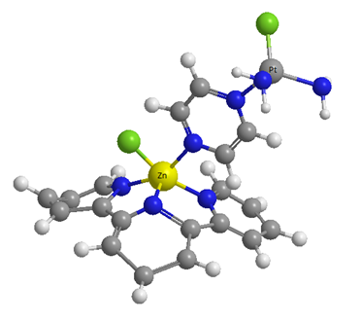

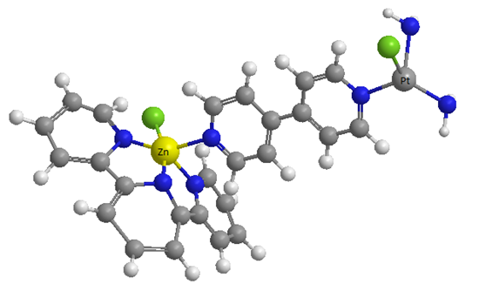

Novel bridged heteronuclear Pt(II)-L-Zn(II) complexes with promising antitumor activity

Slide 3
Abstract: Design of novel heteronuclear platinum(II)-zinc(II) complexes as potential DNA and protein targeting metal-based anticancer agents could be beneficial. The compounds of these two metal ions have different coordination geometry, kinetics properties, affinity, and reactivity towards biologically relevant nucleophiles. According to hard-soft acid base principle, different reactivities of metal centers will result in different coordination modes of biomolecules and in increment of cytotoxicity.
The novel heteronuclear complexes [{cis-PtCl(NH₃)(μ-pyrazine)ZnCl(terpy)}](ClO₄)₂ (Pt-L1-Zn) and [{cis-PtCl(NH₃)(μ-4,4′-bipyridyl)ZnCl(terpy)}](ClO₄)₂ (Pt-L2-Zn) (where terpy = 2,2′:6′,2′′-terpyridine, L1 = pyrazine, L2 = 4,4′-bipyridyl) were synthesized and characterized. The cytotoxic activity of heteronuclear Pt-L1-Zn and Pt-L2-Zn complexes was determined on human colorectal cancer cell line (HCT-116) and human breast cancer cell line (MDA-MB-231). Both complexes significantly reduced cell viability on tested cell lines and exerted significant cytotoxic effects, with better effect on HCT-116 cells than cisplatin, especially after 72 h (IC50 < 0.52 mM). The Pt-L2-Zn complex showed higher activity against human breast cancer cells (MDA-MB-231) than cisplatin after 72 h. The higher reactivity toward DNA constituent and significant cytotoxic activity may be attributed to the different geometries, Lewis acidity of different metal centers, as well as choice of bridging ligands.
Keywords: cytotoxic activity; heteronuclear complexes; platinum(II); structure-reactivity correlation; zinc(II)

Slide 4

Introduction
Design of novel heteronuclear platinum(II)-zinc(II) complexes as potential DNA and protein targeting metal-based anticancer agents could be beneficial. The compounds of these two metal ions have different coordination geometry, kinetics properties, affinity and reactivity towards biologically relevant nucleophiles. According to hard-soft acid base principle, dissimilar reactivity of metal centers will result in different coordination modes of biomolecules and in increment of cytotoxicity.^{[1]}
^{[1]} T.V. Soldatović, Application of the principle of hard and soft acids and bases to mechanisms of bioinorganic reaction, Livre de Lyon Publisher, Lyon, France, 2019

Slide 5


Results and discussion
Synthesis and characterisation of the heteronuclear complexes with general formula Pt(II)-L-Zn(II) starting from square-planar Pt(II) and square-pyramidal Zn(II) complexes using various types of bridging ligands
Investigation of interactions with biologically relevant molecules such as guanosine-5′-monophosphate (5′-GMP), inosine-5′-monophosphate (5′-IMP) and glutathione (GSH)
Evaluation of the cytotoxic effect of heteronuclear Pt-L-Zn complexes on human colorectal cancer cell line (HCT-116) and human breast cancer cell line (MDA-MB-231)
Soldatović, T., et al. Appl. Organomet. Chem. 2020, DOI: 10.1002/aoc.5864

Slide 6
Results and discussion
Synthesis of Pt-L-Zn complexes
Soldatović, T., et al. Appl. Organomet. Chem. 2020, DOI: 10.1002/aoc.5864

Slide 7
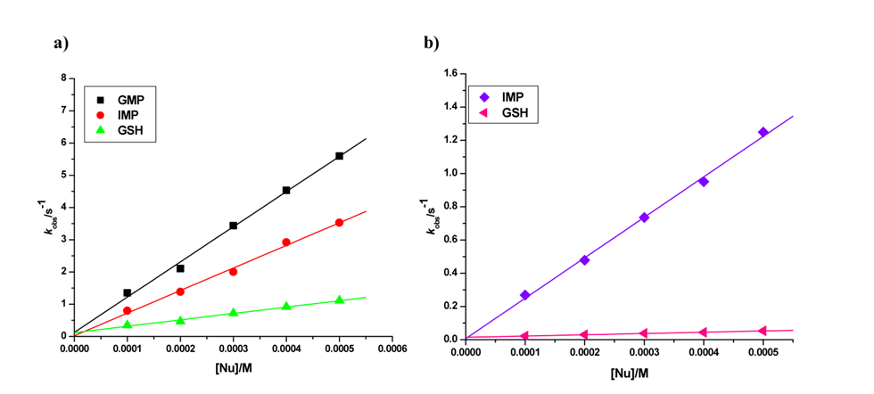
Pseudo-first-order rate constants plotted as a function of nucleophile concentration for the first (a) and second (b) substitution reactions of Pt-L1-Zn complex with 5’-GMP, 5’-IMP and GSH mixing at pH 7.4 (0.010 mol L⁻ ¹ Tris-HCl buffer) in addition of 0.005 mol L⁻¹ NaCl at 25 ºC
Proposed pathways for the reaction of the heteronuclear Pt-L-Zn complexes with biologically relevant nucleophiles
Soldatović, T., et al. Appl. Organomet. Chem. 2020, DOI: 10.1002/aoc.5864

Slide 8
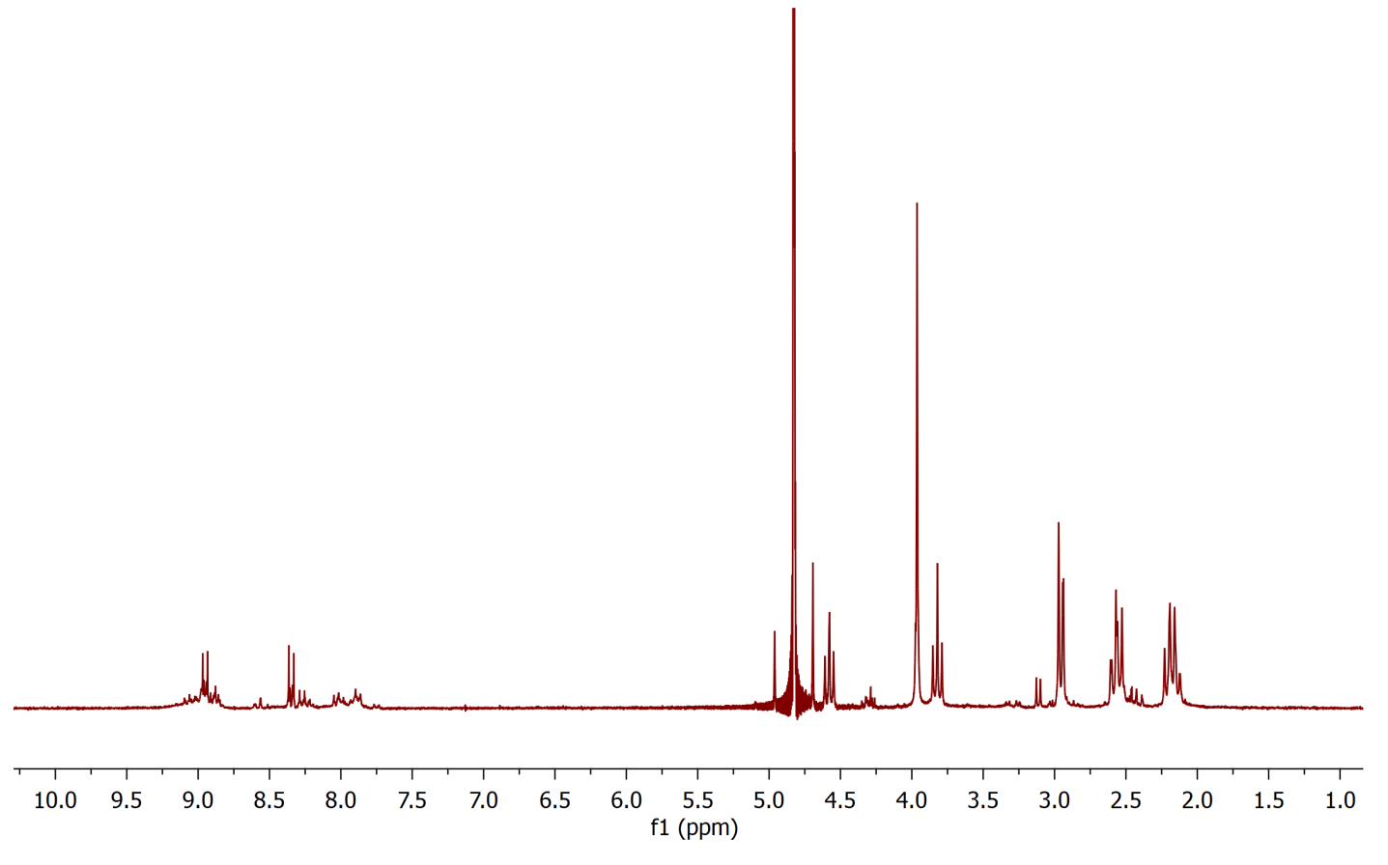
¹H NMR spectra of the reaction between Pt-L2-Zn complex with GSH in molar ratio 1:2 in D₂O
¹H NMR data of reaction between Pt-L2-Zn complexes and GSH exhibited upfiled shifts of all signals corresponding to the complex. At initial stage coordination of GSH to the zinc(II) metal center was observed, and was confirmed by the shift of signal originated from -CH₂(COO⁻) protons in glycine side chain. The signal of -CH₂(COO⁻) protons in free GSH was at 4.58 ppm while coordinated (via oxygen) at 4.30 ppm. After several minutes doublet of doublet at 3.11 ppm of -CH₂(S) protons of the second coordinated GSH appeared and was shifted relative to free GSH (2.97 ppm), which confirmed coorrdination via sulfur to the platinum(II) center. The results are significant, as it is known that glutathione deactivates platinum drugs.
Soldatović, T., et al. Appl. Organomet. Chem. 2020, DOI: 10.1002/aoc.5864

Slide 9
The effect of Pt-L1-Zn (a) and Pt-L2-Zn (b) complex on the HCT-116 and MDA-MB-231 cell viability. All values are mean, n=6; percentages of viable cells
Soldatović, T., et al. Appl. Organomet. Chem. 2020, DOI: 10.1002/aoc.5864

Slide 10

Conclusions
Two new heteronuclear complexes [{cis-PtCl(NH₃)(μ-pyrazine)ZnCl(terpy)}](ClO₄)₂ (Pt-L1-Zn) and [{cis-PtCl(NH₃)(μ-4,4′-bipyridyl)ZnCl(terpy)}](ClO₄)₂ (Pt-L2-Zn) were synthesized and characterized.
The kinetics of substitution reactions of the complexes with 5'-GMP, 5'-IMP and GSH were studied. The order of reactivity for the first substitution processes of both complexes is 5′-GMP > 5′-IMP > GSH, while for the second is 5′-IMP > GSH.
The short distance between the two metal centers involves electrostatic interaction between the metals that increased the electrophilicity of both Zn(II) and Pt(II) centers. The first reaction step is accounted to reactivity of Zn(II) center, while the second to Pt(II). The increasing in electrophilicity of centers leads to lower pK_{a} values in the case of the diaqua Pt-L1-Zn complex (pK_{a1}= 3.47; pK_{a2}= 5.19) and also in increasing in reactivity.
Two different metal centers, different in Lewis acidity and geometry in heteronuclear complexes, have great influence on the order of the reactivity and different coordination modes of biomolecules. The results gained a biological impact especially on the reactivity of 5′-GMP which is around 2-5.5 times higher than glutathione depending of the complex.
The heteronuclear Pt-L1-Zn and Pt-L2-Zn complexes reduced HCT-116 and MDA-MB-231 cell viabilities. Significant cytotoxic effects were noticed, with better activity exerted on HCT-116 cells than cisplatin especially after 72 h (IC₅₀ < 0.52 mM). Also, the Pt-L2-Zn complex has shown better cytotoxic effect against MDA-MB-231 cells after 72 h cisplatin.
Overall, we may conclude that heteronuclear complexes containing metals centers with different Lewis acidity, geometry and kinetic characteristics, connected with π-acceptor bridging ligands, could give promising antitumor activity.

Slide 11


Acknowledgments
The authors are grateful for the support to the Ministry of Education, Science and Technological Development of the Republic of Serbia. T. Soldatović and E. Selimović gratefully acknowledge financial support from State University of Novi Pazar, Novi Pazar, Republic of Serbia.

