Slide 1




Imidazole and Triazole-based Carbamates as Novel Aromatase Inhibitors: Synthesis and in vitro Evaluation on MCF7 Breast Cancer Cells
Alessandra Ammazzalorso
Department of Pharmacy, G. d’Annunzio University of Chieti-Pescara, Via dei Vestini, 66100 Chieti, ITALY
alessandra.ammazzalorso@unich.it

Slide 2
Imidazole and Triazole-based Carbamates as Novel Aromatase Inhibitors: Synthesis and in vitro Evaluation on MCF7 Breast Cancer Cells
13a
15c
IC₅₀ (aromatase) 0.82 μΜ
IC₅₀ (MCF7) 6.58 μM
IC₅₀ (aromatase) 0.86 μM
IC₅₀ (MCF7) 7.16 μM

Slide 3
Abstract
Aromatase (CYP19), a member of cytochrome P450 enzymes, is a monooxygenase responsible for the conversion of androgens (androstenedione and testosterone) to estrogens (estradiol and estrone). Estrogens play a central role in the development and progression of breast cancer: aromatase inhibitors and antiestrogens represent first line treatments in post-menopausal estrogen-dependent breast cancer. Extensive research over the last decades led to the identification of several aromatase inhibitors, classified as steroidal and non-steroidal, acting by a competitive or not competitive mechanism of action.
Our research group is involved in the discovery of novel non-steroidal aromatase inhibitors, based on azole scaffold. In the present study, novel compounds were designed by modification of BAS02077837, an imidazole-based aromatase inhibitor. Synthesized molecules were evaluated against aromatase, in a fluorimetric in vitro assay, and compared to letrozole. The most active derivatives were then submitted to cell viability and cytotoxicity evaluation on MCF7 breast cancer cells. Docking studies were also performed on most promising compounds to shed light on their binding mode in human aromatase binding pocket.
Keywords: aromatase inhibitors, breast cancer, carbamates, imidazole, triazole.

Slide 4
Introduction
Aromatase, a monooxygenase coded by the gene CYP19, is responsible for the conversion of androgens to estrogens by demethylation and aromatization of the steroidal A-ring.
Androstenedione is the endogenous substrate of aromatase.
androstenedione
aromatase
estrone
testosterone
estradiol

Slide 5
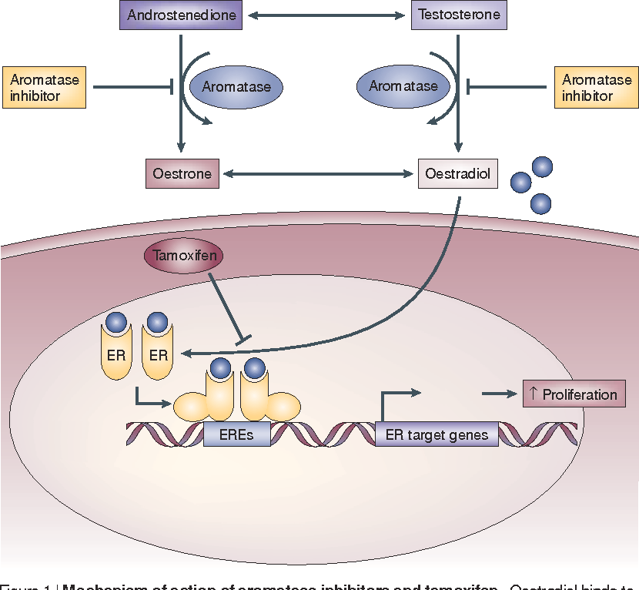
Nat Rev Cancer. 2003 Nov;3(11):821-31

Slide 6
Aromatase Inhibitors
Steroidal
Non Steroidal
First generation
Aminoglutetimide
Formestane
Second generation
Fadrazole
Exemestane
Third generation
Letrozole, Anastrozole
Vorozole

Slide 7
Aromatase Inhibitors
Two families of azole-based sulfonamides were developed by our research group as novel aromatase inhibitors.
In vitro enzymatic activity
IC₅₀ 6-339 nM
In vitro enzymatic activity
IC₅₀ 0.16-0.75 μM
Bioorg Med Chem Lett. 2016, 26, 3192-3194
Eur J Med Chem. 2020, 185, 111815

Slide 8
Aim of the Work
To identify novel azole-based aromatase inhibitors, starting from the structure of BAS02077837
aromatic
p-substitution

Slide 9
Designed Carbamates
Series I: Triazole Derivatives
Lenght of the linker
para substitution on aromatic rings
substitution on carbamic function

Slide 10
Designed Carbamates
Series II: Imidazole Derivatives
Lenght of the linker
substitution on carbamic function

Slide 11
Synthesis of Triazole Carbamates 2a-e and 11a-c
Reagents and conditions: a) 1,2-epoxy-3-phenoxypropane (for 1), styrene oxide (for 10) THF, 60°C, 24h; b) sodium hydride, R-NCO, dry ACN, N₂, r.t., 24h.
Ammazzalorso A. et al, under submission

Slide 12
Synthesis of Triazole Carbamates 6a-c and 9a-c
Reagents and conditions: a) p-chlorophenol (for 4) or p-methoxyphenol (for 7), potassium carbonate, refluxing ACN, 7h; b) triazole, THF, 60°C, 24h; c) sodium hydride, R-NCO, dry ACN, N₂, r.t., 24h.
Ammazzalorso A. et al, under submission

Slide 13
Synthesis of Imidazole Carbamates 13a-c and 15a-e
Reagents and conditions: a) styrene oxide (for 12) or 1,2-epoxy-3-phenoxypropane (for 14), THF, 60°C, 24h; b) sodium hydride, R-NCO, dry ACN, N₂, r.t., 24h.
Ammazzalorso A. et al, under submission

Slide 14
In vitro Aromatase Inhibition Assay
The human aromatase inhibitory activity of the 22 synthesized compounds was determined by using an in vitro fluorescence-based assay Aromatase (CYP19A) Inhibitor Screening Kit (Fluorimetric), BioVision.
This assay utilizes a fluorogenic substrate that is converted into a highly fluorescent metabolite detected in the visible range (Ex/Em = 488/527 nm).
The activity was measured dissolving target compounds in acetonitrile (1 μM), and the results were compared to letrozole at the same concentration, used as reference compound.

Slide 15
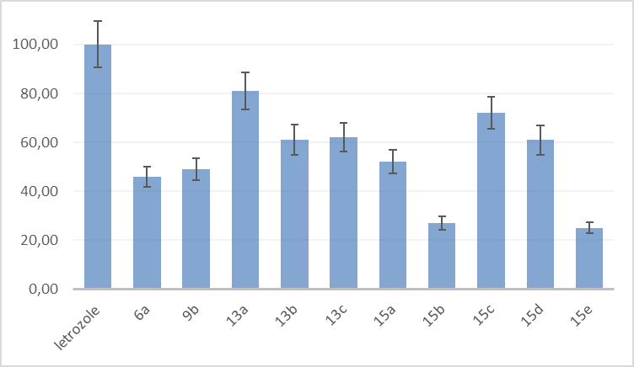
In vitro Aromatase Inhibition Assay: Results
Triazole derivatives
Imidazole derivatives
% of inhibition is shown only for values superior than 20%, compared to letrozole taken as 100%
Ammazzalorso A. et al, under submission

Slide 16
In vitro Aromatase Inhibition Assay: Results
Cpd | Aromatase inhibition %ª | IC₅₀ (μM)^{b,c}
13a | 81 | 0.82 ± 0.02
15c | 72 | 0.86 ± 0.05
13a
ª Inhibition percentage was calculated with respect to letrozole (1 μM), taken as 100%; ^{b}each compound was tested at concentration from 0.01 to 100 μM; ^{c} the values represent mean of triplicate determinations ± RSD
15c
Ammazzalorso A. et al, under submission

Slide 17
In vitro Aromatase Inhibition assay: Structure-Activity Relationships
Series I: Triazole Derivatives
Series II: Imidazole Derivatives
13
Benzyl >> Phenyl
15
6a R₁ = Cl, R₂ = H
9b R₁ = OCH₃, R₂ = Cl
p-Cl Ph > p-OMe Ph > Bn >> Ph, o,p-OMe Ph

Slide 18
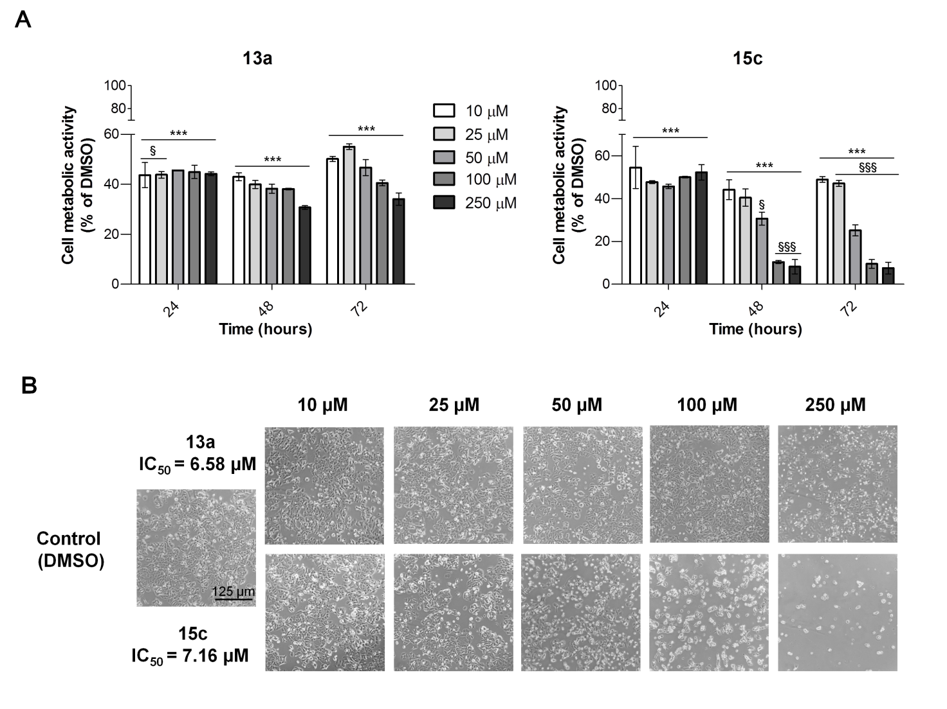
Cell Viability Evaluation on Human MCF7 Cells by MTT Assay
Most active compounds 13a and 15c were then submitted to an in vitro evaluation on breast cancer cell line MCF7 by MTT assay, cytotoxicity assay (LDH) and cell cycle analysis.
Ammazzalorso A. et al, under submission

Slide 19
Cell Viability Evaluation on Human MCF7 Cells by MTT Assay
Light microscopy images of MCF7 cells cultivated in 6 well plates (2.5 x10⁵/well) in the presence of DMSO (control) and loading concentrations of compounds 13a and 15c for 72 hours.
Ammazzalorso A. et al, under submission

Slide 20
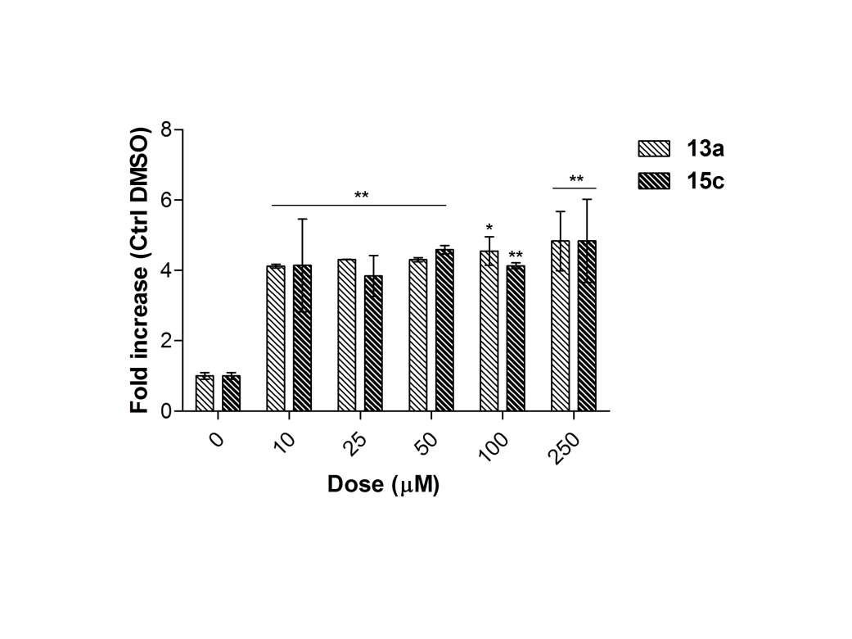
Cytotoxicity Evaluation on MCF7 Cells by LDH Assay
The cytotoxic effect of both compounds was measured by the lactate dehydrogenase assay of MCF7 cells in response to loading concentrations of 13a and 15c
Ammazzalorso A. et al, under submission

Slide 21
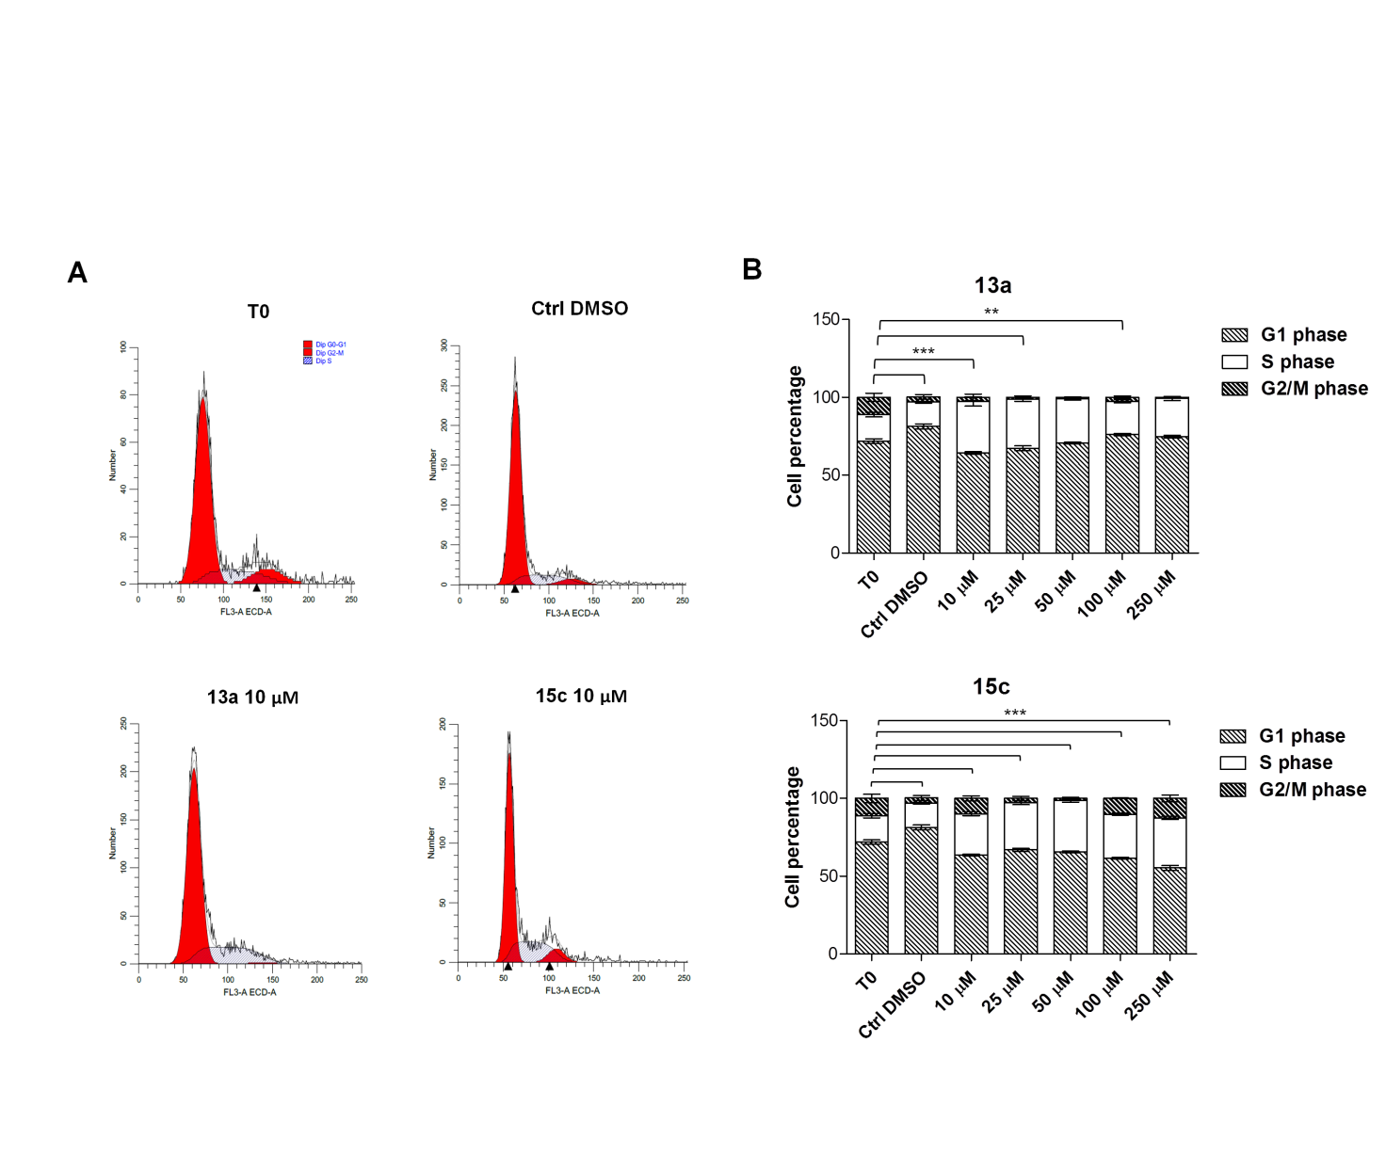
Cell Cycle Analysis of MCF7 Cells
Ammazzalorso A. et al, under submission

Slide 22
Docking Studies
13a
15c
Zoomed in view of the binding site of aromatase. 13a (Panel A) and 15c (Panel B) are rendered in green stick representation. The most relevant residues are rendered as white sticks.
Ammazzalorso A. et al, under submission

Slide 23
Conclusions
A novel family of 22 azole-based aromatase inhibitors has been synthesized.
Novel compounds were screened by an in vitro enzymatic assay against human aromatase, displaying submicromolar potency.
Most active imidazole-based compounds were tested in MCF7 cells, in which they induced a marked reduction of cell viability and cytotoxic effects, producing a cell cycle block.
Docking experiments confirmed for novel compounds a very similar binding mode with respect to letrozole.
13a
15c
IC₅₀ (aromatase) 0.82 μΜ
IC₅₀ (MCF7) 6.58 μM
IC₅₀ (aromatase) 0.86 μM
IC₅₀ (MCF7) 7.16 μM

Slide 24

Acknowledgments
Medicinal Chemistry Unit
Rosa Amoroso, Barbara De Filippis, Marialuigia Fantacuzzi, Letizia Giampietro, Cristina Maccallini
Anatomy Unit
G. d’Annunzio University
Chieti-Pescara
Amelia Cataldi, Marialucia Gallorini
Medicinal Chemistry Unit
Orazio Nicolotti, Nicola Gambacorta
Aldo Moro University
Bari

