Slide 1
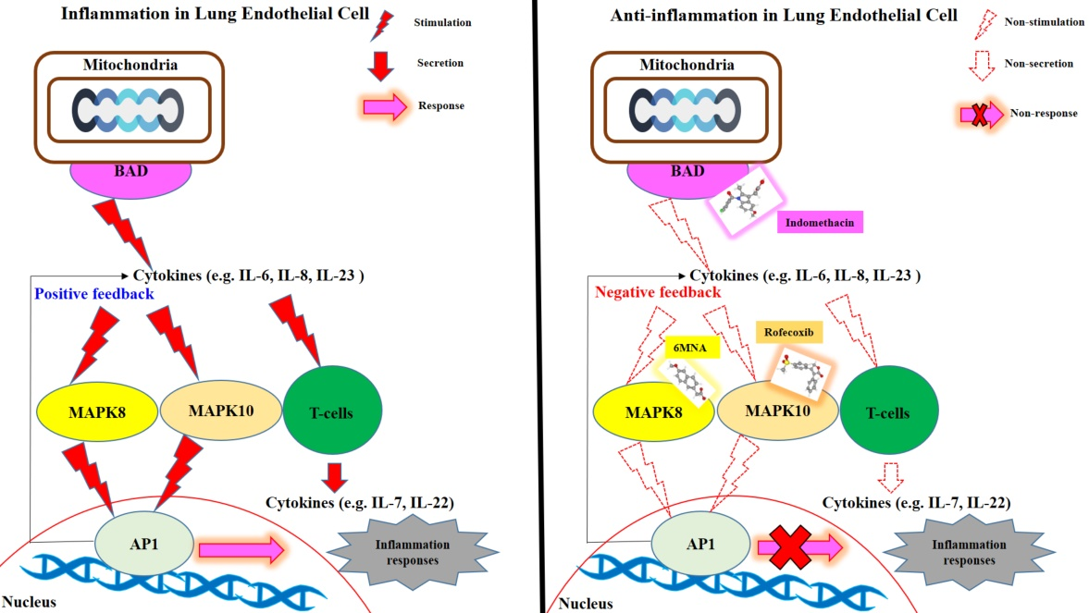
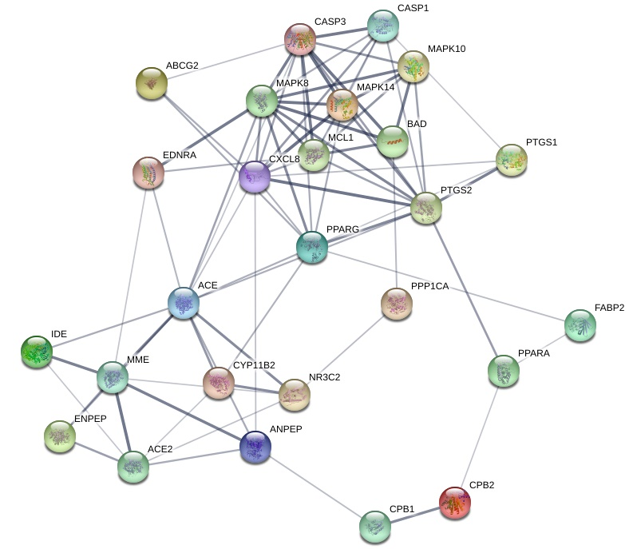
Potential Non-Steroidal Anti-Inflammatory Drugs (NSAIDs) and novel mechanism insights against COVID-19 through network pharmacology
Ki Kwang Oh¹, Md. Adnan¹, Dong Ha Cho^{1*}
¹Department of Bio-Health Technology, College of Biomedical Science, Kangwon National University, Chuncheon, 24341, Korea
Background: Non-Steroidal Anti-Inflammatory Drugs (NSAIDs) showed promising clinical efficacy toward COVID-19 patients as painkillers and anti-inflammatory agents,
however, the anti-COVID-19 mechanisms of NSAIDs are not exposed. Therefore, we evaluated the most potent NSAIDs candidate(s) and its novel mechanism(s) against
COVID-19 by network pharmacology.
Method: Genes related to selected NSAIDs and COVID-19 related genes were identified by Similarity Ensemble Approach, Swiss Target Prediction, and PubChem databases.
Venn diagram identified overlapping genes between NSAIDs and COVID-19 related genes. The interactive networking between NSAIDs and overlapping genes was analyzed by
STRING. RStudio plotted the bubble chart of KEGG pathway enrichment analysis of overlapping genes. Finally, binding affinity of NSAIDs against target genes was determined
through molecular docking analysis.
Results: Geneset enrichment analysis exhibited 26 signaling pathways against COVID-19, and inhibition of proinflammatory stimuli of tissues and/or cells by inactivating RAS
signaling pathway was identified as the key anti-COVID-19 mechanism of NSAIDs. MAPK8, MAPK10, and BAD genes were explored as the associated genes of RAS. 6MNA,
rofecoxib, and indomethacin revealed promising binding affinity with highest docking score against three genes, respectively.
Conclusions: Overall, our proposed three NSAIDs may possibly block RAS by inactivating its associated genes, thus may alleviate excessive inflammation induced by SARS-CoV-2.
Recently, clinicians recommended indomethacin as a drug of interest against COVID-19. Our study presents that indomethacin is a potent therapeutic candidate among all other
NSAIDs to treat COVID-19 symptoms. However, these results provide scientific evidence, plausible mechanism, target genes, and potential NSAIDs candidates against COVID-19.
Gene-gene interaction with 26 nodes and 78 edges in NSAIDs against COVID-19.
Introduction
Abstract
.
.
An initial outbreak of pneumonia caused by unknown etiology was first reported at Wuhan in Hubei Province, China, and alerted to the World Health Organization (WHO) by the Wuhan Municipal Health Commission on 31 December 2019. Later, the infectious disease experts detected severe acute respiratory syndrome coronavirus 2 (SARS-CoV-2), can rapidly transmit from person to person through interaction or respiratory droplets. As a consequence of its tremendous spread in the world, on March 11, 2020, WHO announced a changing level from epidemic to pandemic disease (COVID-19). Although the symptoms are alike to pneumonia, however, a considerable number of COVID-19 infected patients showed no physical sign, they can transmit the virus to others, as silent spread.
Due to the unavailability of a reliable vaccine, clinicians utilized anti-viral drugs and NSAIDs as a significant viable option for COVID-19 patients. A recent study has reported that use of NSAIDs is safe for COVID-19 treatment without exposing specific negative side effects. Though there is a lack of evidence whether combined NSAIDs treatment could worsen COVID-19 symptoms, but researchers suggested that anti-inflammatory therapies might suppress the fatal cytokine storm of COVID-19 patients. Additionally, WHO announced that no evidence of unwanted side effects was found, particularly the risk of death with the administration of NSAIDs in COVID-19 patients.
Commonly, NSAIDs are used to treat diverse anti-inflammatory symptoms due to its good therapeutic efficacy. However, one potential drug of interest is indomethacin which possesses both anti-inflammatory and antiviral properties. Its antiviral potentiality was first identified in 2006 during the outbreak of SARS-CoV and subsequent attribution was also observed against SARS-CoV-2. A study on canine coronavirus (in vitro) revealed that indomethacin could significantly suppress virus replication, thus protecting host cell from virus induce damage. Similar antiviral effect was also observed during in vivo assessment where normal anti-inflammatory dose was found very effective. Although there are many NSAIDs which may have possible therapeutic interventions against COVID-19, lack of scientific evidence has limited their broad application to COVID-19 patients. Hence, we aimed to identify the most potent NSAIDs and their mechanism(s) against COVID-19 through network pharmacology.
Network pharmacology can decode the mechanism(s) of drug action with an overall viewpoint, which focuses on pattern changing form “single protein target, single drug” to “multiple protein targets, multiple drugs”. Currently, network pharmacology has been extensively utilized to explore multiple targets and unknown additional mechanism(s) against diverse diseases. In this research, network pharmacology was applied to investigate the most potent NSAIDs and their novel mechanisms of action against COVID-19. Firstly, a total of 20 approved NSAIDs was identified via using public websites. The 20 NSAIDs and COVID-19 related genes were identified using public databases. Next, the selected overlapping genes are discovered target genes for analyzing anti-COVID-19.
Results
Graphical abstract
Materials and methods
NSAIDs linked to selected genes or COVID-19 related genes
Based on SMILES, targeted genes of the NSAIDs approved by FDA (U.S. Food & Drug Administration) were identified utilizing Similarity Ensemble Approach (SEA) (http://sea.bkslab.org/) and Swiss Target Prediction (STP) (http://www.swisstargetprediction.ch/) with the “Homo sapience” mode. COVID-19 related genes were identified by browsing PubChem (https://pubchem.ncbi.nlm.nih.gov/). The overlapping genes between NSAIDs targeted genes and COVID-19 related genes were identified and visualized by Venny 2.1 (https://bioinfogp.cnb.csic.es/tools/venny/)
Signaling pathway enrichment analysis of overlapping genes
Genes-genes interaction figure was visualized by STRING (https://string-db.org/). RStudio plotted the bubble chart of KEGG (Kyoto Encyclopedia of Genes and Genomes) pathway enrichment analysis of overlapping genes. Using RStudio, the most significant genes among signaling pathways, and correlation of NSAIDs on the most significant genes were analyzed. The results suggest a hint at the unknown molecular mechanism(s) of the most potent NSAIDs against COVID-19.
Signaling pathway enrichment analysis of overlapping genes
Genes-genes interaction figure was visualized by STRING (https://string-db.org/). RStudio plotted the bubble chart of KEGG (Kyoto Encyclopedia of Genes and Genomes) pathway enrichment analysis of overlapping genes. Using RStudio, the most significant genes among signaling pathways, and correlation of NSAIDs on the most significant genes were analyzed. The results suggest a hint at the unknown molecular mechanism(s) of the most potent NSAIDs against COVID-19.
Binding affinity energy value of the most potent NSAIDs on genes in silico
The binding affinity energy measurement of the uttermost NSAIDs on key genes was established by Autodock (http://autodock.scripps.edu/), Vina (http://vina.scripps.edu/), Pymol (https://pymol.org/2/).
.
Figure 1. Gene-gene interaction with 26 nodes and 78 edges
in NSAIDs against COVID-19.
Table 1. Target genes in 26 signaling pathways enrichment related to
COVID-19.
KEGG ID | Description | Target genes
hsa04921 | Oxytocin signaling pathway | PTGS2,PPP1CA
hsa04310 | Wnt signaling pathway | MAPK8,MAPK10
hsa04064 | NF-kappa B signaling pathway | CXCL8,PTGS2
hsa04014 | Ras signaling pathway | MAPK8,MAPK10,BAD
hsa04022 | cGMP -PKG signaling pathway | ENDRA,BAD,PPP1CA
hsa04926 | Relaxin signaling pathway | MAPK8,MAPK10,MAPK14
hsa04068 | FoxO signaling pathway | MAPK8,MAPK10,MAPK14
hsa04010 | MAPK signaling pathway | MAPK8,MAPK10,MAPK14,CASP3
hsa04071 | Sphingolipid signaling pathway | MAPK8,MAPK10,MAPK14
hsa04912 | GnRH signaling pathway | MAPK8,MAPK10,MAPK14
hsa04012 | ErbB signaling pathway | MAPK8,MAPK10,BAD
hsa03320 | PPAR signaling pathway | PPARA,PPARG,FABP2
hsa04920 | Adipocytokine signaling pathway | MAPK8,MAPK10,PPARA
hsa04917 | Prolactin signaling pathway | MAPK8,MAPK10,MAPK14
hsa04664 | Fc epsilon RI signaling pathway | MAPK8,MAPK10,MAPK14
hsa04370 | VEGF signaling pathway | MAPK8,MAPK10,BAD
hsa04910 | Insulin signaling pathway | MAPK8,MAPK10,BAD,PPP1CA
hsa04620 | Toll-like receptor signaling pathway | MAPK8,MAPK10,MAPK14,CXCL8
hsa04622 | RIG-I-like receptor signaling pathway | MAPK8,MAPK10,MAPK14,CXCL8
hsa04621 | NOD-like receptor signaling pathway | MAPK8,MAPK10,MAPK14,CXCL8,CASP1
hsa04722 | Neurotrophin signaling pathway | MAPK8,MAPK10,MAPK14,BAD
hsa04668 | TNF signaling pathway | MAPK8,MAPK10,MAPK14,CASP3,PTGS2
hsa04933 | AGE-RAGE signaling pathway in diabetic complications | MAPK8,MAPK10,MAPK14,CXCL8,CASP1
hsa04024 | cAMP signaling pathway | ENDRA,MAPK8,BAD,MAPK10,PPP1CA,PPARA
hsa05120 | Epithelial cell signaling in Helicobacter pylori infection | MAPK8,MAPK10,MAPK14,CXCL8,CASP3
hsa04657 | IL-17 signaling pathway | MAPK8,MAPK10,MAPK14,CXCL8,CASP3,PTGS2
In summary, NSAIDs-genes network suggested that the therapeutic effect of NSAIDs on COVID-19 was associated with 26 signaling pathways. This study suggests that 6MNA, rofecoxib, and indomethacin are the most potent NSAIDs against COVID-19. The basis is an understanding of which anti-inflammatory processes against COVID-19, how these NSAIDs work on COVID-19 patients. That scientific evidence informs the selection of NSAIDs, in turn, provides for clinical design against COVID-19. Our research suggests that the inhibition of BAD-Indomethacin with other two hub genes MAPK8-6MNA, MAPK10-Rofecoxib might play cumulative actions by inactivating RAS signaling pathway against COVID-19. Most recently, efficacy of indomethacin against COVID-19 has been approved clinically. Our study presents that indomethacin is a potent therapeutic candidate to treat COVID-19 symptoms, which is in line with the many previous studies. However, clinical trial of
indomethacin may warrant in COVID-19 patients for slowing progression of SARS-CoV-2 and mitigating the severity as well.
Conclusion
References
1. Amici C, Di Coro A, Ciucci A, et al (2006) Indomethacin has a potent antiviral activity against SARS coronavirus. Antivir Ther 11:1021
2. Astuti I, Ysrafil (2020) Severe Acute Respiratory Syndrome Coronavirus 2 (SARS-CoV-2): An overview of viral structure and host response. Diabetes Metab Syndr Clin Res Rev 14:407–412.
https://doi.org/10.1016/j.dsx.2020.04.020

