Slide 1
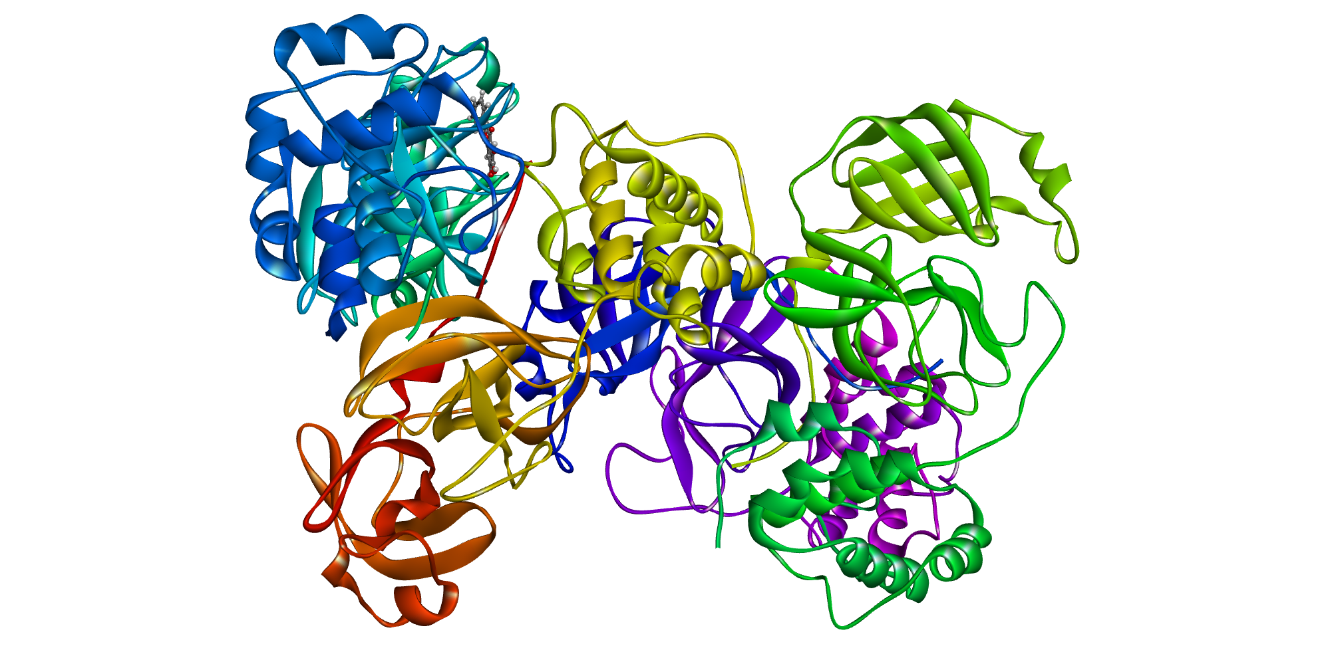
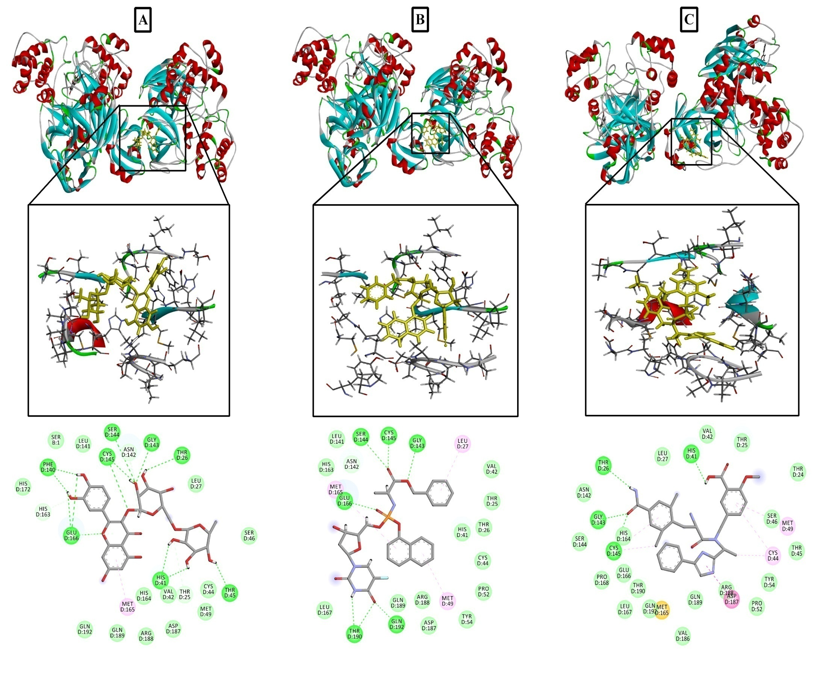
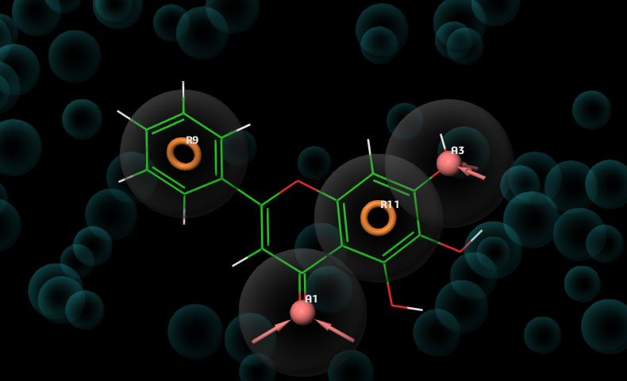
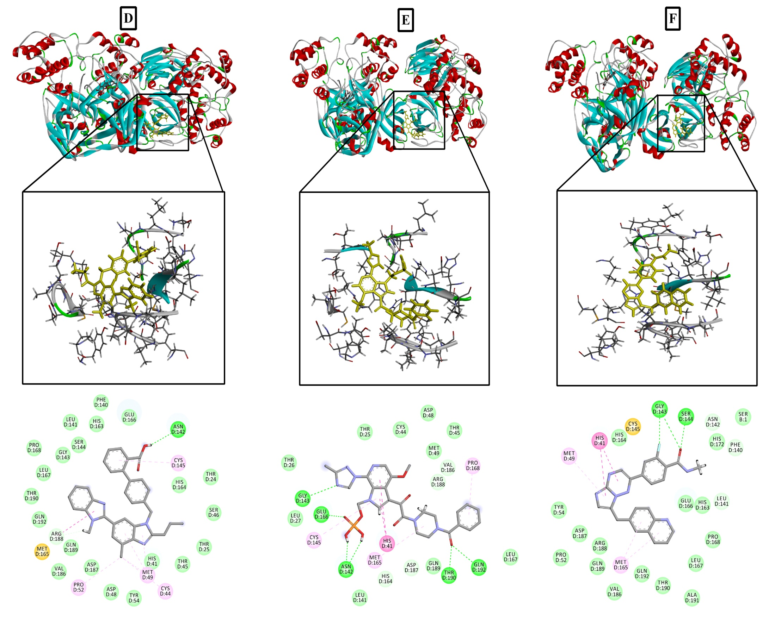
In silico virtual screening of known drugs against SARS-CoV-2 3CL protease: A drug repurposing approach for COVID-19
Md. Riad Chowdhury¹, Md. Adnan^{2,*}, Md. Nazim Uddin Chy^{1,*}, A.T.M. Mostafa Kamal¹
¹Department of Pharmacy, International Islamic University Chittagong, Kumira, Chittagong 4318, Bangladesh
²Department of Bio-Health Technology, Kangwon National University, Chuncheon, 24341, Republic of Korea
*Corresponding author: mdadnan1991.pharma@gmail.com; nazim107282@gmail.com
Since the outbreak of the novel coronavirus disease (COVID-19) in late December 2019, it rapidly spread throughout the world. Besides, no specific treatment has been reported so far against the disease. In such cases, the drug repurposing approach can be an effective way to determine potential candidates to treat COVID-19. Therefore, this study is focused on screening drugs that could inhibit the viral receptor. Structure of SARS-CoV-2 3CL protease with a complex (baicalein) was employed for the generation of pharmacophore hypothesis using Schrödinger Maestro. Initially, 8820 approved, investigational and experimental drugs from DrugBank database were screened on the basis of generated hypothesis features. Among those, 1000 drugs were subjected to molecular docking-based virtual screening to evaluate the glide score and glide energy. Moreover, receptor-ligand interactions of the best hits were analyzed using discovery studio software. The virtual screening revealed several drug classes including CYP3A4 inhibitor, anti-tumor, anti-platelet, antiviral, neurological, anticancer, Vit-B2 deficiency, anti-inflammatory, antidiabetic, and anti-asthmatic which are capable of inhibiting viral receptor. In particular, six drugs namely rutin, fosifloxuridine-nafalbenamide, eluxadoline, telmisartan, fostemsavir, and capmatinib demonstrated extra precision docking with promising binding affinities. Interaction analysis revealed several hydrogens and hydrophobic bonds with the amino acids of the active site. Additionally, 19 experimental drugs were found to possess higher docking scores than the bound complex with the receptor indicating a possibility of discovering novel drugs to treat COVID-19. However, further in vitro and in vivo studies are required for the evaluation of the antiviral activity of the mentioned drugs.
Abstract
Methodology
Results
Table-1: Top 30 potential drugs obtained virtual screening.
Drug Name | Group | Category | Glide Score (kcal/mol)
Olinciguat | Investigational | CYP3A4 Inhibitor | -7.981
Glumetinib | Investigational | Anti-tumor | -7.963
Prasugrel | Approved | Anti-platelet | -7.615
BMS-488043 | Investigational | Antiviral | -7.482
Darapladib | Investigational | Atherosclerosis | -7.473
Emapunil | Investigational | Anxiolytic | -7.447
Fulacimstat | Investigational | Antiinflammatory | -7.441
GSK-364735 | Investigational | Antiviral | -7.432
Lucitanib | Investigational | Anticancer | -7.363
Oxyphenisatin acetate | Approved, Investigational, Withdrawn | Anticancer | -7.355
Cianidanol | Approved, Withdrawn | Antiinflammatory | -7.340
Riboflavin | Approved, Investigational, Nutraceutical | Vit-B2 Deficiency | -7.306
Ivosidenib | Approved, Investigational | Anticancer | -7.256
Inarigivir | Investigational | Antiviral | -7.246
Tepoxalin | Vet approved | Antiinflammatory | -7.220
Iguratimod | Investigational | Antiinflammatory | -7.203
Cabotegravir | Investigational | Antiviral | -7.134
MK-0533 | Investigational | Antidiabetic | -7.025
Selurampanel | Investigational | Antiepileptic | -6.990
JNJ-39393406 | Investigational | Antidepressant | -6.986
Pagoclone | Investigational | Anxiolytic | -6.961
Aplindore | Investigational | Neurologic disorder | -6.936
Deracoxib | Investigational | Antiinflammatory | -6.927
Apararenone | Investigational | Antidiabetic | -6.922
Spebrutinib | Investigational | Anticancer | -6.902
Dolutegravir | Approved | Antiviral | -6.884
Indibulin | Investigational | Anti-tumor | -6.873
Cromoglicic acid | Approved | Anti-asthmatic | -6.871
Sonedenoson | Investigational | Antidiabetic | -6.829
Idelalisib | Approved | Anticancer | -6.8297
SARS-CoV-2 3CL protease (3CLpro) in complex with a novel inhibitor (Baicalein)
Figure-1: XP G-Score and glide energy of approved and investigational drugs from extra precision (XP) docking.
Schrödinger Maestro
1. Structure Refinement
2. Structure Optimization
3. Restrained Minimization
4. Hypothesis Generation
E-pharmacophore hypothesis of SARS-CoV-2 3CL protease in complex with Baicalein
DrugBank Database
(8820 Molecules)
Docking Based Virtual Screening
Pharmacophore Based Virtual Screening
(1000 Molecules)
Extra Precision Docking
Figure-2: 3D and 2D docking interactions of A) Rutin, B) Fosifloxuridine-nafalbenamide, C) Eluxadoline, D) Telmisartan, E) Fostemsavir and F) Capmatinib with SARS-CoV-2 3CL protease.
Conclusions
In this study, structure based virtual screening identified several categories of drugs against SARS-CoV-2 3CL protease. Among those, five antiviral drugs namely BMS-488043, GSK-364735, Inarigivir, Cabotegravir, and Dolutegravir interacted with the receptor through standard precision docking. However, six drugs specifically Rutin, Fosifloxuridine-nafalbenamide, Eluxadoline, Telmisartan, Fostemsavir and Capmatinib undergone extra precision docking with promising glide scores and interaction with the receptor active site. These drugs might be repurposed for the treatment of novel coronavirus disease.
References
H. Berman, J. Westbrook, … Z.F.-N. acids, undefined 2000, The protein data bank, Academic.Oup.Com. (n.d.). https://academic.oup.com/nar/article-abstract/28/1/235/2384399
H. Su, S. Yao, W. Zhao, M. Li, J. Liu, W. Shang, H. Xie, C. Ke, M. Gao, K. Yu, H. Liu, J. Shen, W. Tang, L. Zhang, J. Zuo, H. Jiang, F. Bai, Y. Wu, Y. Ye, Y. Xu, Discovery of baicalin and baicalein as novel, natural product inhibitors of SARS-CoV-2 3CL protease in vitro, BioRxiv. (2020) 2020.04.13.038687. https://doi.org/10.1101/2020.04.13.038687.
S.L. Dixon, A.M. Smondyrev, E.H. Knoll, S.N. Rao, D.E. Shaw, R.A. Friesner, PHASE: A new engine for pharmacophore perception, 3D QSAR model development, and 3D database screening: 1. Methodology and preliminary results, J. Comput. Aided. Mol. Des. 20 (2006) 647–671. https://doi.org/10.1007/s10822-006-9087-6.

