Slide 1
Selective DNA Intercalation of Massive Molecules as a New Method of Highly Specific Inhibition of Transcription
Andrii Zaremba *, Polina Zaremba and Svetlana Zagorodnya
Zabolotny Institute of Microbiology and Virology of NASU, 154 Acad. Zabolotny Str., Kyiv, 03143, Ukraine;
* Corresponding author: vstyp17@gmail.com

Slide 2
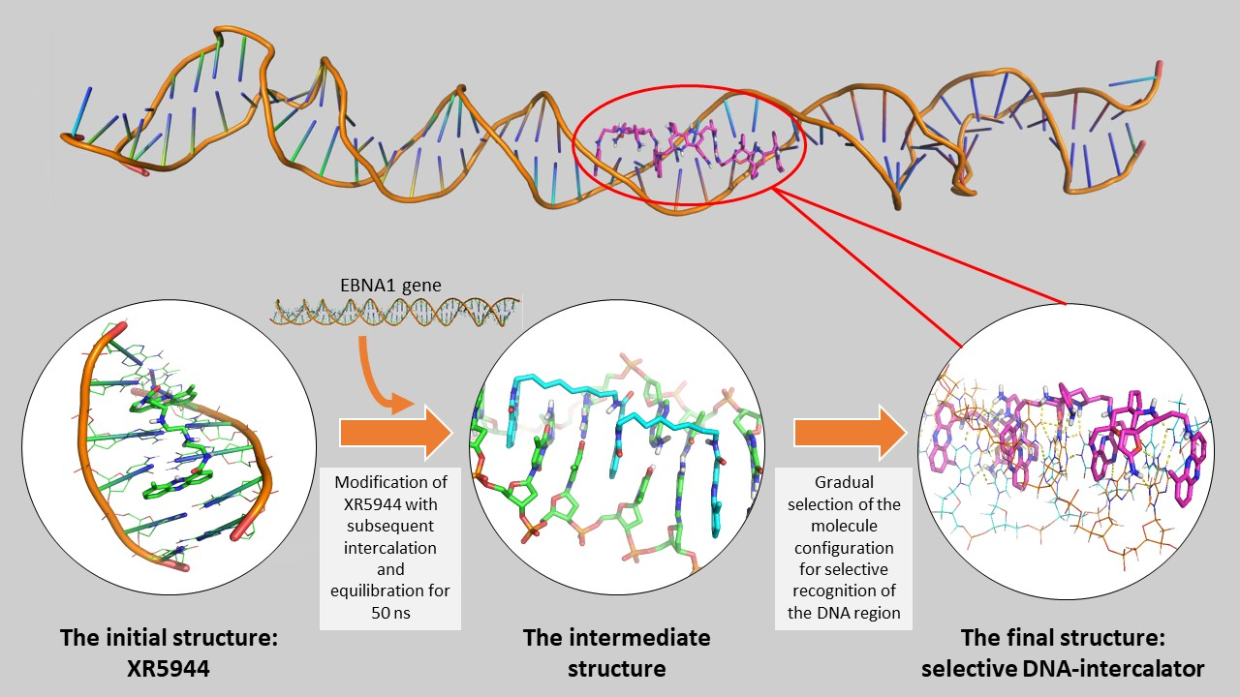
Selective DNA Intercalation of Massive Molecules as a New Method of Highly Specific Inhibition of Transcription

Slide 3
Abstract:
The possibility of precise external control of transcription opens up many prospects. One of them is dealing with disorders based on enhanced transcription of a certain part of the genome or its mutant fragment. Therefore, the aim of our study is to prove the fundamental possibility of developing DNA-intercalators capable of highly specific binding to certain pre-selected areas of DNA by using a number of in silico methods.
A positively charged bis-intercalator - XR5944 (PDB ID: 2MG8) was chosen as the basis. The target 50-nucleotide DNA duplex (a part of the viral protein EBNA1 gene) was generated along with preliminary intercalation of XR5944 in Avogadro program. Then by manual modification and data analysis, structure of the DNA-intercalator was created.
Thus, we developed a structural model of the DNA-intercalator which during a molecular dynamic experiment, along with constant intercalation, selectively recognized the nucleotide sequence of the DNA duplex. This process is based on the specific placement of the hydrogen bond donors and acceptors directed to each pair of nitrogenous bases in the direction of the large DNA furrow. So, we have proved the possibility of developing substances – DNA-intercalators – that can bind highly specifically to certain pre-selected areas of DNA.
Keywords: DNA-intercalation; transcription inhibitor; drug development; Gromacs; molecular simulation.

Slide 4
Introduction
DNA is the basic molecule of "life". The realization of the information encoded in it is the first stage in the transition of inanimate matter to a new level of organization, which we call "life". Thus, having a tool that will allow you to manipulate DNA, human, as a species, will be able to move to a new level of development. A level at which there are no incurable genetic diseases, cancer and many other disorders of our body.
In these disorders hyperactivation of the transcription of certain genes or even parts of the genome plays an important part. The reasons for this are extremely diverse: from point mutations to global chromosomal recombination. Therefore, an important task of modern science is to develop a universal tool that can highly selectively affect the transcription of a particular DNA fragment.
In this study we take the first steps in this direction. Here we want to present the process of development and analysis of a model of low-molecular high-selective DNA-intercalator, on the basis of which in the future we plan to develop a tool capable of selective inhibition of transcription.

Slide 5
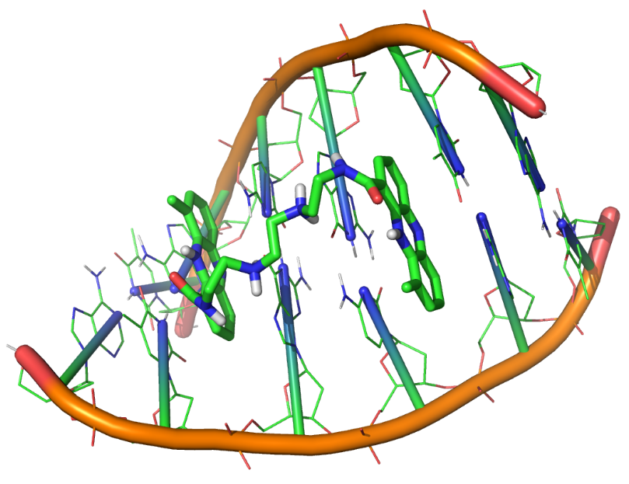
Step 1: Selection and preparation of source structures
The XR5944 DNA-intercalator meets all requirements.
PDB ID: 2MG8
DNA-intercalator was selected according to the following criteria:
Availability of convincing evidence of effectiveness.
The presence of more than one site of intercalation per molecule, which must be identical molecular fragments.

Slide 6
The selection of the DNA fragment for further research was limited to the identification of a convenient object and the identification of a vital product whose change in expression could be easily identified.
Epstein-Barr virus, with which our laboratory works, meets the above requirements. Inhibition of transcription of its factor EBNA1 can be further easily identified by determining the total amount of viral DNA by PCR.
We used Avogadro program to create a Watson-Crick duplex.
Sequence: TGGAGGTAGTAAGACCTCCCTTTACAACCTCAGGCGAGGAATTGCCCTTG

Slide 7
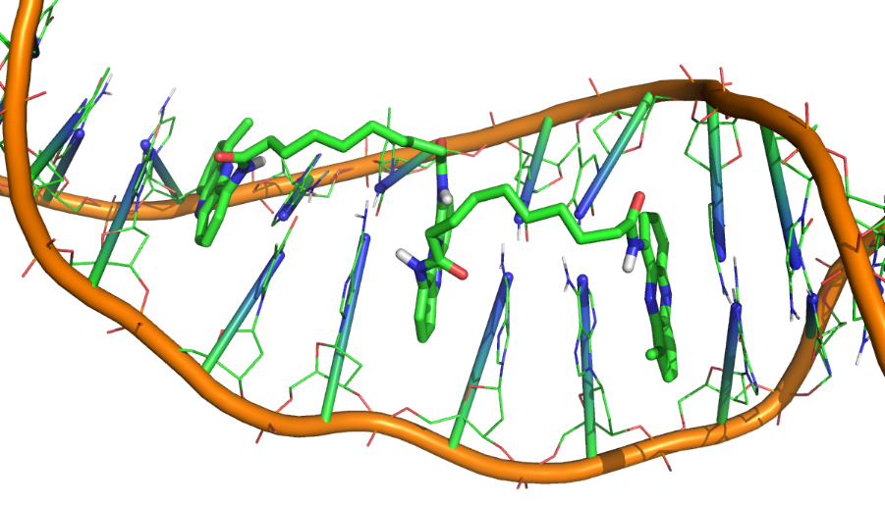
Step 2: Initial intercalator modification and intercalation
Prior to the initial intercalation, the original structure of XR5944 was somewhat elongated: another phenazine fragment was added, and jumpers between these fragments were presented as simple aliphatic chains to simplify parameterization.
The formation of gaps between the base residues and subsequent manual placement of phenazine residues in them took place in Avogadro program.
The complex was also equilibrated by molecular dynamics using Gromacs.
Simulation parameters:
50 ns, AMBER, TIP3P, physiological ionic strength

Slide 8
Step 3: Selection of the optimal configuration of the intercalator model
The nucleic bases in the DNA duplex contain hydrogen bond donors and acceptors directed toward the large furrow. They are vacant and form a sequence-specific topology of the large furrow.
Thus, the main task for us was to choose the configuration of the part of the intercalator that lies in a large furrow, which would allow:
a) selectively recognize pairs of bases over which it is located;
b) be able to scale with minimal modification.
General view of the model

Slide 9
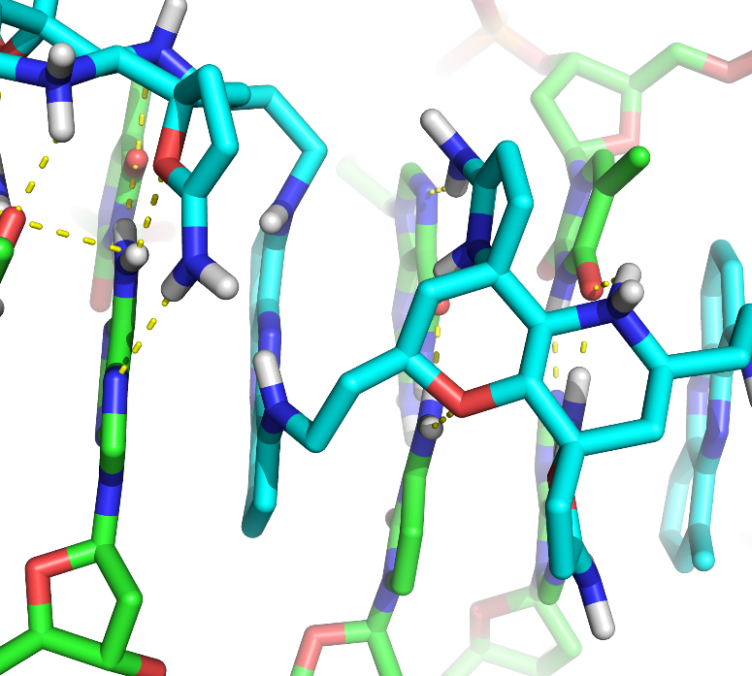
Results and discussion
Decalin was chosen as the basis for the selective part of the intercalator. It binds to phenazine via ethylamine.
Due to the rightness of the spiral 1.4 and 6.9 atoms of decalin lie perpendicular to the planes of the base pairs. Modification of decalin at these positions as shown in the figure made it possible to identify two base pairs by recognizing the sequence-specific placement of hydrogen bond donors and acceptors in the large DNA furrow.

Slide 10
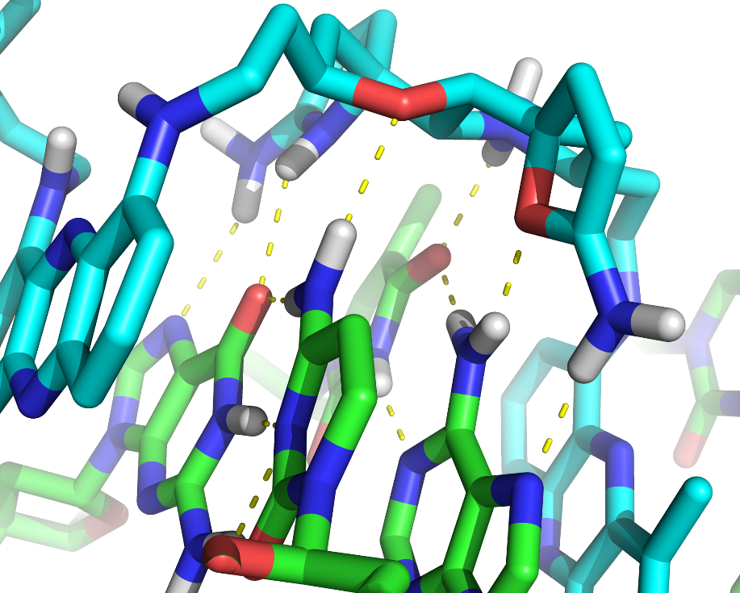
As you can see in the figure above to recognize the two pairs of bases (A-T, C-G) our model interacts with DNA at six points. Which strongly discriminates all other parts of DNA with a different sequence from the one presented. However, it is obvious that two pairs of bases will not be enough for qualitative recognition of any gene. Statistically, it is enough to selectively recognize 16 bp which, with proper site selection for intercalation, provides 48 touchpoints uniquely located in space. In this study, we have limited the recognition to only 6 bp to facilitate calculations.

Slide 11
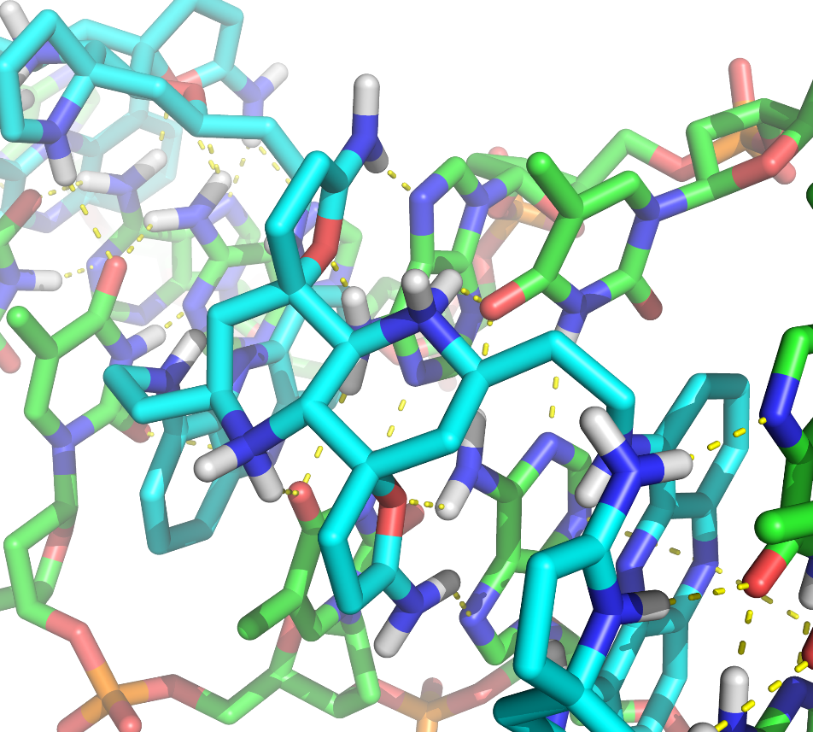
The figure on the right shows the central part of our model molecule. There is also a six-point interaction with two pairs of nucleic bases from the side of the large furrow. The base pairs themselves are not identical to those shown on the previous slide. Proving the potential versatility of decalin as a basis for developing a library of molecular fragments, the inclusion of which in a molecule similar to the presented topology, will lead to the development of a universal comprehensive methodological tool aimed at inhibiting transcription of individual regions of the genome.

Slide 12
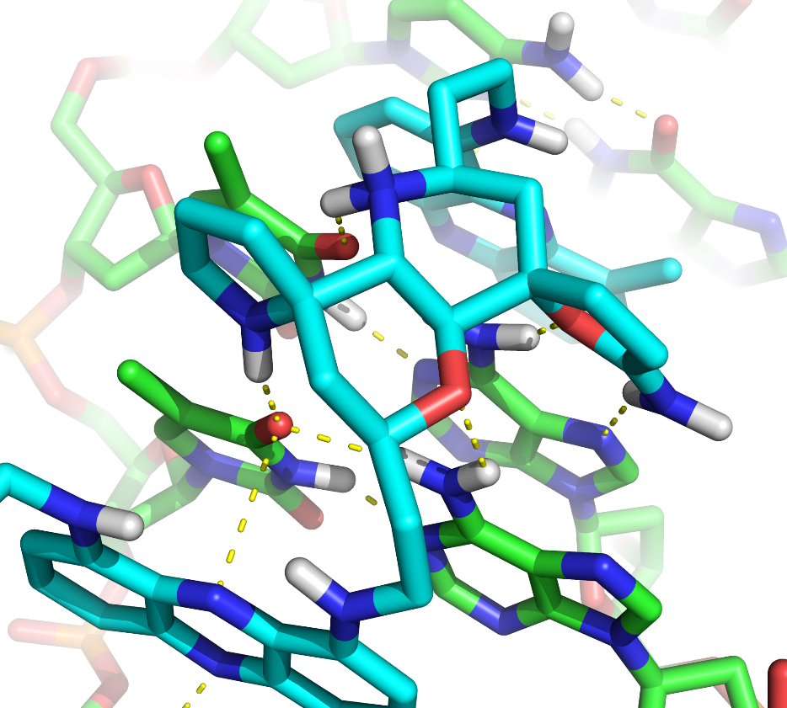
The figure on the right shows the final region of our molecular model, which also recognizes two pairs of bases. However, it differs from the areas described above. Here, only the second pair of T-A is recognized at three points, while the first only at two. Five points of interaction are still sufficient for almost error-free recognition of this part of the genome, especially given the complete recognition of the previous two regions.
However, there is a difference in the substituent that recognizes thymidine. This difference is due to the three-dimensional arrangement of nitrogenous bases relative to each other. Here the first thymidine is located slightly lower than the second, so it needs another substitute in position 6 of decalin. The change of the substituent in position 9 of decalin is caused by a slightly closer placement of the first adenosine relative to the second.

Slide 13
Conclusions
Thus, our developed model of the DNA-intercalator during molecular dynamics, in addition to constant intercalation, shows the ability to selectively recognize a DNA fragment with a size of 6 bp. Given current knowledge of molecular translation machinery, the incorporation of such a massive low-molecular molecule into a DNA duplex will slow or completely stop RNA polymerase during the construction of the primary RNA transcript and, consequently, inhibit the transcription of the target gene.
Also, based on our results, we can talk about the fundamental possibility of developing a universal tool for controlling the level of transcription of a wide range of genes. This assumption is based mainly on the high periodicity of the secondary structure of DNA and as a consequence the high periodicity of our model.
We plan to further develop this idea. Carry out already closer to reality calculations aimed at developing a molecule based on our model. Which would have the ability to selectively intercalate and scale. However, would be much easier to synthesize.

