Slide 1



Conjugation with Angiopep2 as a strategy for the brain delivery of a mitochondriotropic inhibitor of the potassium channel Kv1.3
Sofia Parrasia¹, Andrea Rossa², Tatiana Varanita³, Riccardo De Lorenzi^{2,4}, Mario Zoratti^{1,5}, Cristina Paradisi², Paolo Ruzza^{2,4}, Andrea Mattarei⁶, Ildikò Szabò³, Lucia Biasutto^{1,5,*}
¹ Dept. Biomedical Sciences, University of Padova
² Dept. Chemical Sciences, University of Padova
³ Dept. Biology, University of Padova
⁴ CNR Institute of Biomolecular Chemistry, Padova
⁵ CNR Neuroscience Institute, Padova
⁶ Dept. Pharmaceutical and Pharmacological Sciences, University of Padova
*corresponding author: lucia.biasutto@cnr.it; sofia.parrasia@gmail.com
Notes:
I am Sofia Parrasia, last year PhD student in Biomedical Sciences at the University of Padova. I am presenting a part of my PhD project

Slide 2
Conjugation with Angiopep2 (An2) as a strategy for the brain delivery of a mitochondriotropic inhibitor of the potassium channel Kv1.3
PAPTP
NO BRAIN DELIVERY
An2-PAPTP
Notes:
which is focused on the brain delivery of PAPTP, a promising inhibitor of the voltage dependent potassium channel 1.3.

Slide 3
Abstract: The voltage-gated potassium channels Kv1.3, expressed by the cells at the plasma membrane and mitochondria level, is highly expressed in several cancers such as melanoma, pancreatic cancer (PDAC), glioblastoma and neuroblastoma, thus turning out an interesting pharmacological target against cancer. Inhibition of the mitochondrial population of the channel leads to pro-apoptotic processes. PAPTP, one of the novel inhibitors of the mitoKv1.3, turned out to be highly effective against melanoma and PDAC in vivo and against glioblastoma cell lines in vitro. It cannot be exploited in orthotopic models of glioma because it is completely unable to cross the blood brain barrier (BBB). A possible approach to enhance the BBB permeability of drugs relies on the use of brain penetrating peptides. The aim of this study is to synthesize angiopep2-PAPTP and to evaluate its absorption into the brain in vivo. To design the conjugate as a pro-drug, the triphenylphosphonium (TPP+) moiety of PAPTP was modified adding a linker to one of the phenyl groups (PAPTPL), conjugated to angiopep2 through a bio-reversible carbamate bond. Angiopep2-PAPTP was administered to C57CL/6 mice (5 µmol/kg b.w.), which were sacrificed after 15 (n=5), 30 (n=4) and 60 (n=6) minutes. The results show that angiopep2-PAPTP is present in the brain at 15 and 30 minutes after the injection. The analysis of the liver showed that Angiopep2-PAPTP is mainly metabolized through the cleavage of the peptide chain. Summarizing, conjugation of PAPTP to angiopep2 represents a promising strategy to deliver PAPTP to the brain.
Keywords: Angiopep2; blood brain barrier; brain delivery; cancer

Slide 4
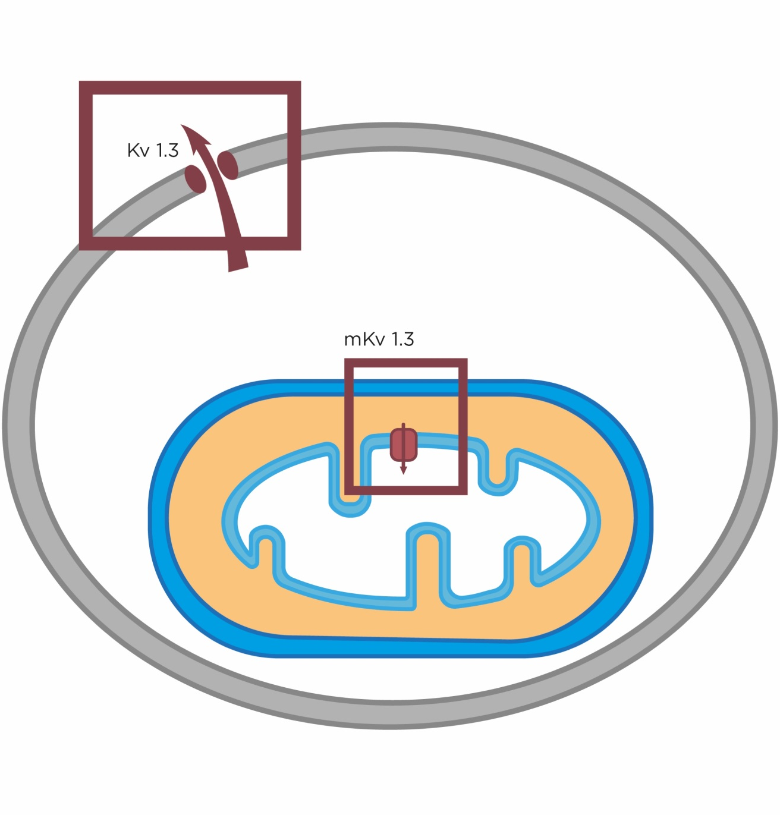
Kv1.3 CHANNEL
Plasma membrane Kv1.3: cell proliferation, migration and metastasis
Mitochondrial Kv1.3: apoptosis
Notes:
Kv1.3 is a voltage gated potassium channel, expressed by many cell types, mainly in the plasma membrane and mitochondria. The two populations of the channel impact on different pathways. Inhibition of the PM channel population leads to a reduction in cell proliferation while inhibition of the mitochondrial population leads to apoptosis.

Slide 5
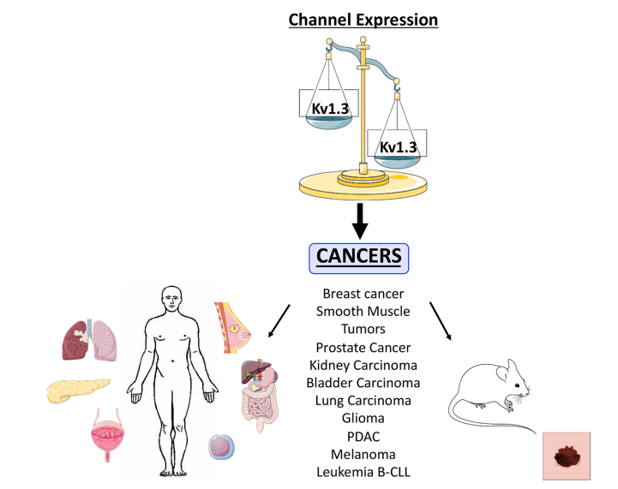
Kv1.3 CHANNEL
TARGET FOR CANCER THERAPY?
Prosdocimi et al., 2019, Cell Physiol Biochem
Notes:
It has been demonstrated that Kv1.3 is over-expressed in several cancers, What is of particular interest is that some o these cancers such as glioma, PDAC and melanoma are currently very difficult to treat with standard approved therapies. thus kv1.3s have been explored as an interesting target for anti-cancer drugs.

Slide 6
PAPTP
TPP⁺
Vennekamp et al., 2004 Mol Pharmacol
PAP-1
PMK_{V}1.3 channel inhibition
REDUCTION OF PROLIFERATION
mitoK_{V}1.3 channel inhibition
APOPTOSIS
Notes:
Given the relevance of mitoKv1.3 inhibition for apoptosis induction and the relevance of this target for anti-cancer applications, we designed a mitochondriotropic derivative of PAP-1, a known membrane permeant Kv1.3 inhibitor, characterized by a psoralenic group and of a phenoxybuthoxy arm. Accumulation of this derivative in mito was allowed by the addition of a TPP moiety to the phenoxybuthoxy branch

Slide 7

PAPTP
Δψ_{m} = 150-180 mV
MITOK_{V}1.3 CHANNEL INHIBITION
100-500X
Δψ_{p} = 30-60 mV
3-10X
APOPTOSIS
PAPTP
Notes:
The derivatization of drugs with the lipophilic cation TPP is a strategy to obtain mito-targeting derivatives which accumulate into mitochondria according to Nernst’s law. In our case this strategy allows us to concentrate, in a sense, the inhibitor on the mitochondrial population of the channel.

Slide 8
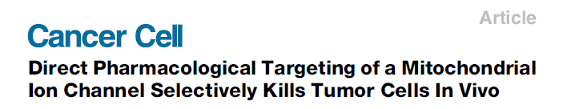

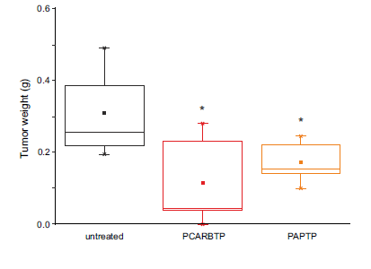
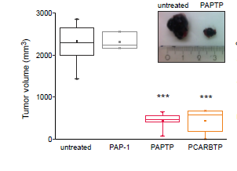
PDAC in vivo model
PAPTP 5 µmol/kg, i.p.
Melanoma in vivo model
PAPTP 5 µmol/kg, i.p.
Notes:
PAPTP was successfully tested in vivo in eterothopic PDAC and melanoma models, turning out to be highly effective and well tolerated.

Slide 9
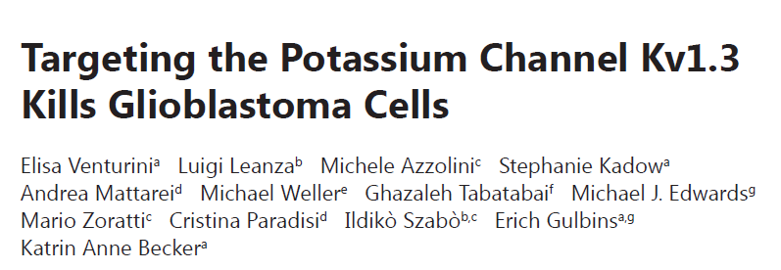
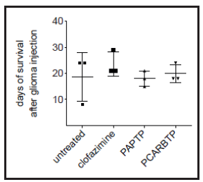
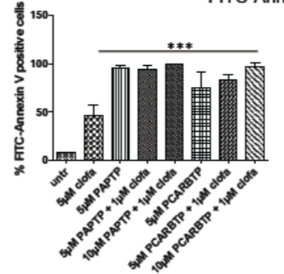
2017
NO ACTIVITY IN AN ORTHOTOPIC ANIMAL MODEL OF GLIOBLASTOMA
A172 cell line
PHARMACOKINETICS: NO BRAIN UPTAKE
Venturini et al., 2017, Neurosignals
Notes:
It was also active in vitro on glioma cell lines but when administered in vivo it turned out to be ineffective because it is completely unable to permeate the blood brain barrier, even upon i.v. injection.

Slide 10
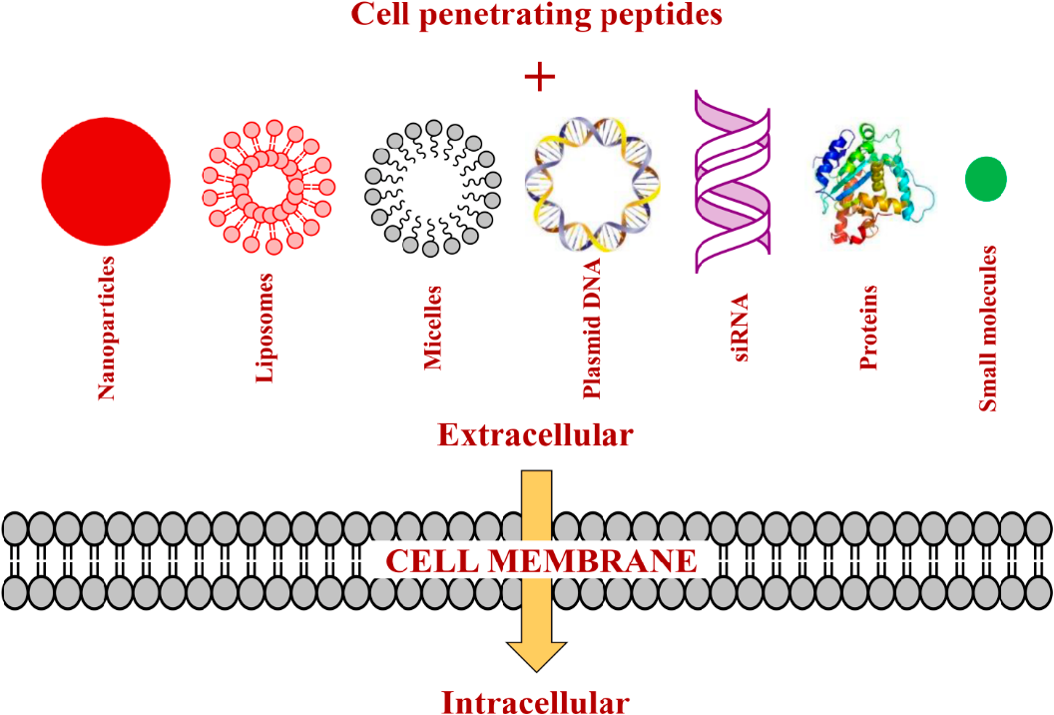
PEPTIDES AS A STRATEGY FOR BRAIN DELIVERY
Buddhadev et al., 2015,
Int J Mol Sci
TRANSPORTER
RECEPTOR MEDIATED
ABSORPTIVE
DIFFUSION
Notes:
A strategy adopted to carry drugs through the BBB is the derivatization with peptides able to cross this barrier. These peptides are able to cross the BBB through different mechanisms such as transporter or receptor mediated transcytosis, absorption or diffusion

Slide 11
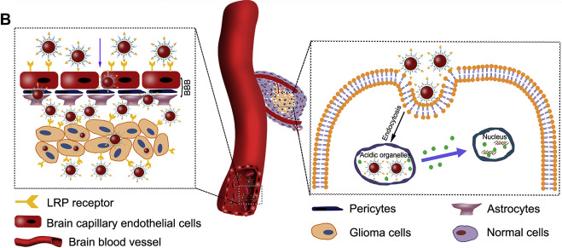
Angiopep2 (An2)
Ruan et al., 2015, Biomaterials
Notes:
An2 is one of the most promising among the various peptides studied and reported in the literature. It exploits its affinity for the LRP1 receptor expressed at the level of the BBB and of glioma cells.

Slide 12
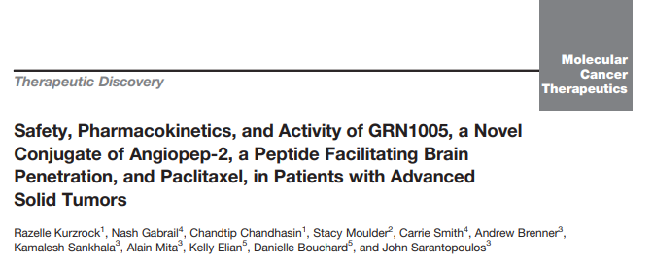
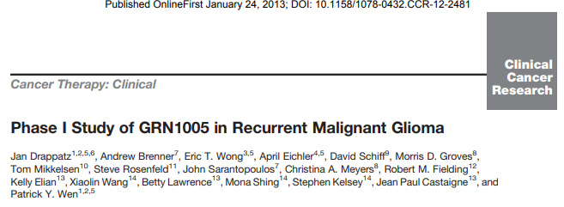
Angiopep2 (An2) AS A BBB PENETRATING PEPTIDE
Notes:
Of note, it reached the clinical trial phase I for the delivery of paclitaxel.

Slide 13
An2-PAPTP MODEL
PAPTP
An2-PAPTP
BIO-REVERSIBLE
CARBAMATE BOND
ISOLEUCINE
LINKER
ANGIOPEP2
PAPTP
Notes:
Thus, the aim of our study is to achieve the brain delivery of PAPTP through its conjugation with Angiopep2.
To obtain a derivative with the appropriate stability we modified the TPP moiety of PAPTP with a linker. The resulting molecule called PAPTPL was then conjugated with Angiopep2 through a bio-reversible carbamate bond. Isoleucin was used an intermediate aminoacid to allow the coupling to An2, while the peptide was still bound to the resin used for its synthesis as I will show you in the next slides.

Slide 14
PAPTPL-I SYNTHESIS
Notes:
The synthesis of PAPTPL-Ile was carried out in 9 steps, illustrated in the slide

Slide 15
Angiopep2 SYNTHESIS
Gly-Fmoc
Piperidine 20% in DMF, R.T. 20 min
Piperidine 20% in DMF, R.T. 10 min
MDF, HBTU, HOBt, DIPEA, Protected-AA, R.t., 1 h
Gly—Gln(Trt)-Pro-Pro-Arg(Pbf)-Arg(Pbf)-Arg(Pbf)-Gln(Trt)-Arg(Pbf)-Arg(Pbf)-Lys(Boc)-Lys(Boc)-Arg(Pbf)-Gly-Fmoc
Piperidine 20% in DMF, R.T. 20 min
Piperidine 20% in DMF, R.T. 10 min
Gly—Gln(Trt)-Pro-Pro-Arg(Pbf)-Arg(Pbf)-Arg(Pbf)-Gln(Trt)-Arg(Pbf)-Arg(Pbf)-Lys(Boc)-Lys(Boc)-Arg(Pbf)-Gly-NH₂
COUPLING WITH PAPTPL-I
DEPROTECTION AND SOLID PHASE UNBLOCK
Notes:
Angiopep2 was synthesized by solid-phase peptide synthesis, growing the chain toward the N-terminus. When the desired sequence was obtained, the N-terminus was deprotected and conjugated with PAPTPL. After the coupling, the construct was detached from the solid phase under acidic conditions, along with the deprotection of the aminoacids. The resulting conjugates were then purified by reverse-phase HPLC and characterized by HPLC-MS.

Slide 16
PAPTPL vs PAPTP
Notes:
Since PAPTPL is supposed to be the active moiety of the conjugate, we evaluated whether the addition of the linker could alter the cytotoxicity profile of PAPTP, performing an MTS assay.

Slide 17
VIABILITY ASSAY
Cell viability of SHSY-5Y cells following treatment for 24 hr with the indicated compounds (MTS assay, 540 nm). Values are reported as mean percentage of viable cells normalized with respect to untreated cells (n = 3); each condition was significantly different from control: *p < 0.05, ***p < 0.001, One-way ANOVA.
Notes:
The results clearly showed that PAPTPL is as active as PAPTP.

Slide 18
An2-PAPTP BLOOD STABILITY
Kinetics of An2-PAPTP hydrolysis in fresh mouse blood. Data refer to the percentage of PAPTPL released and are expressed as mean ± SEM. N = 5.
Notes:
Before proceeding with intravenous administration we evaluated the blood stability of the conjugate. The kinetics of carbamate hydrolysis turned out to be adequate.

Slide 19



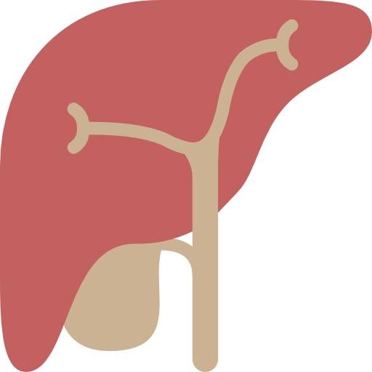
An2-PAPTP DISTRIBUTION
Angiopep2-PAPTP
5 µmol/kg bw; i.v.
15 min (n = 5)
30 min (n = 4)
60 min (n = 6)
Notes:
So we could move to the evaluation of the distribution of An2-PAPTP. We administered the conjugate at 5 umol/kg i.v. and we evaluated its distribution in brain and its liver metabolism after 15, 30 and 60 minutes.

Slide 20
An2-PAPTP DISTRIBUTION
BRAIN
TIME OF TREATMENT (min) | Psoralenic species (nmol/g tissue) | Psoralenic species (% of injected dose)
15 | 0.3 ± 0.1 | 0.1 ± 0.04
30 | 0.4 ± 0.6 | 0.2 ± 0.2
60 | traces | traces
Quantification by HPLC-UV (312 nm). Data in the table are expressed as mean ± SEM (N = 5, 4 and 6 respectively).
Notes:
The results showed that An2-PAPTP was present the brain 15 and 30 minutes after administration. After 1 hour it was only present as traces.
Even though the brain levels reached are still presumably too low for therapeutic applications, they are in good agreement with data from the literature, concerning the utilization of An2 for the brain delivery of other drugs

Slide 21
An2-PAPTP METABOLISM
LIVER
A = PAPTPL-I-T
B = PAPTPL
D
A
C
B
A
D
C = PAPTPL-I
D = PAPTPL-I-TF
C
B
Representative HPLC/MS analysis of a liver extract, 60 minutes after treatment.
Notes:
Using HPLC/MS we identified the metabolites extracted from the liver, finding that the main ones are PAPTPL, PAPTPL-I, PAPTPL-IT, PAPTPL-ITF, in other words the active principle plus the initial portion of the peptide chain. This is coherent with the expected proteolytic degradation of the aminoacid chain by liver peptidases.

Slide 22
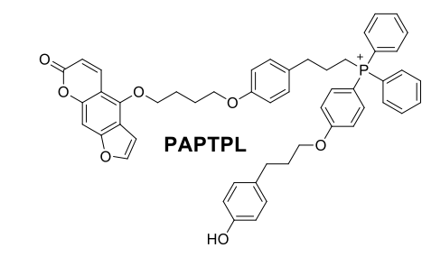
An2-PAPTP METABOLISM
LIVER
PAPTPL
PAPTPL
PAPTPL was quantified by HPLC-UV (312 nm). Data are expressed as mean ± SEM (N = 5, 4 and 6 respectively).
Notes:
We quantified the metabolites and we found no significant trend for PAPTPL

Slide 23
An2-PAPTP METABOLISM
LIVER
PAPTPL-I
PAPTPL-IT
PAPTPL-ITF
Quantifications by HPLC-UV (312 nm). Data are expressed as mean ± SEM (N = 5, 4 and 6 respectively).
Notes:
On the other hand, the amount of PAPTPL-I found at 1 h after treatment was significantly higher than at earlier time points. The increase of PAPTP-IT and PAPTPL-ITF just failed to reach the statistical significance probably because of the high dispersion of the data

Slide 24
CONCLUSIONS
First evidence of PAPTP brain delivery
Angiopep2 is successful for PAPTP brain delivery
Brain concentrations are still low but may be improved
Glioma mouse model
Enhanced permeability and retention effect
LRP1 expression by glioma cells
Notes:
To conclude, this work represents the first evidence of PAPTP delivery to the brain and showed that the coupling with An2 is a successful strategy to achieve this goal. As future perspectives, we are planning to evaluate the brain uptake in a murine model of orthotopic glioma, in which access to the tumor is expected to be selectively increased due to the EPR effect and the high expression of LRP1 receptors that mediate the uptake of An2.

Slide 25



ACKNOWLEDGMENTS
Mario Zoratti
Lucia Biasutto
Cristina Paradisi
Andrea Mattarei
Andrea Rossa
Paolo Ruzza
Riccardo De Lorenzi
Ildikò Szabò
Tatiana Varanita
Daniele Bonesso
Notes:
In the final slide I would like to show again the names of the other persons who took part in this research. They work in the departments of Medical Sciences, of Chemistry and of Biology of the University of Padova. I would like to thank in particular for their help my supervisor Dr. Lucia Biasutto, Andrea Rossa among the chemists (cerca di far stare Riccardo De Lorenzi su una riga sola), and Tatiana Varanita for her help with the in vivo experiments.

