Slide 1




A robust bioassay of the human bradykinin B₂ receptor that extends molecular/cellular studies:
the isolated umbilical vein
François Marceau
Professeur associé

Slide 2
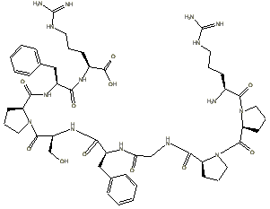
Importance of bradykinin (BK)
Derived from kininogens via the action of kallikreins
A small and unstable peptide
Target cell types:
  Endothelial cells: edema, hyperemia
  Sensory nerve terminals: pain, etc.
  Epithelial cells: various inflammatory consequences
  Smooth muscle cells

Slide 3
plasminogen
tPA, uPA
C1-INH
plasmin
FXII
prekallikrein
contact system
C1-INH
C1-INH
FXIIa
plasma-kallikrein
abnormal surfaces
N
C
HK
N
LK
C
tissue kallikrein =
KLK-1
Lys-BK
inactive
fragments
BK
N
Lys-des-Arg⁹-BK
N
N
ACE inhibitors
B₁R
B₂R
ACE
C
C
C

Slide 4
Signaling in endothelial cells
BK
Lys-BK
Lys-des-Arg⁹-BK
PLC-β
B₁R ↑
B₂R
G_{q}
DAG
PKC
G_{q}
cPLA₂
IP₃
PGI₂
Ca²⁺
calmodulin
MEK/ERK
c-Fos
cytosol
vasodilation
nucleus
NO
ER
eNOS
MLCK
myosin
actin
BDKRB2→
BDKRB1→
leaky microvessels

Slide 5
Need for a human bioassay
In vitro screening of new ligands based on radioligand binding competition, simple signaling (e.g., intracellular calcium)
BK B2R has a notoriously species-specific pharmacological profile
Naturally expressed BK B2R in the umbilical vein (not overexpressed)

Slide 6
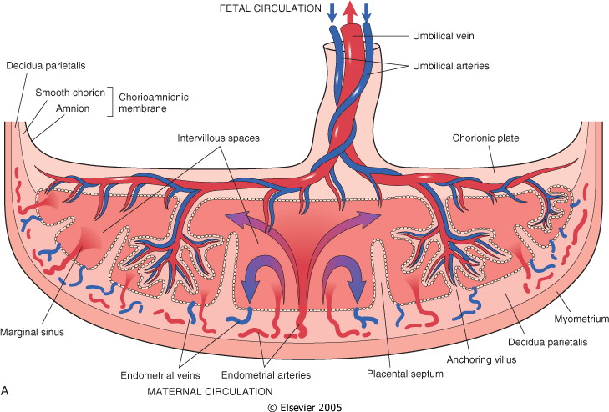
B2R antagonists exert species-specific effect: need for a bioassay based on human tissues
Stable in a time scale of hours
vein
Notes:
Issue with B2R antagonists: species-specific pharmacology. Preclinical pharmacology based on a human tissue: hUV.
In the umbilical cord, there are 3 macroscopic fetal blood vessels, one vein and 2 arteries.

Slide 7
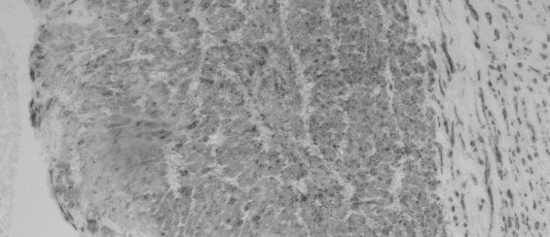
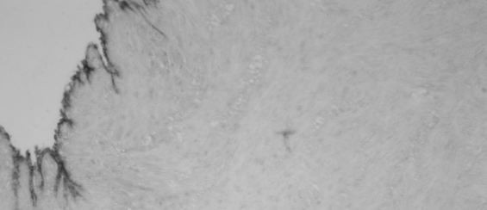
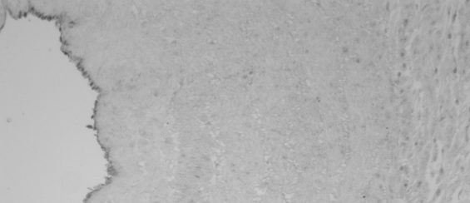
vein
Obtained after uncomplicated elective caesarean sections (with informed consent)
SMCs dominate → contractile response mediated by BK B₂Rs
HUVECs: this is where they reside
α-actin
monoclonal
vWF
polyclonal
ACE (C28)
polyclonal
Koumbadinga et al. Peptides 2010; 31: 1546
Notes:
-obtained after uncomplicated cesarean sections
-There are about 20 layers of vasc smooth muscle cells in the wall, so the dominant response will be contractile
-the endothelial surface expresses ACE

Slide 8

Force transducer
Krebs solution reservoir
95% O₂ + 5% CO₂
drain
Notes:
In the 1990’s, we have introduced the isolated umbilical vein as a bioassay for bradykinin receptor ligands.
Krebs = protein free physiological buffer

Slide 9
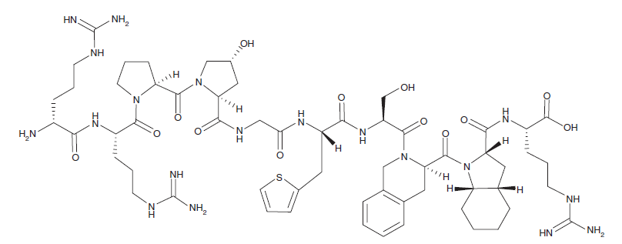
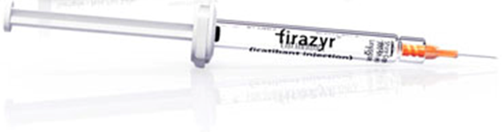
1304.5 g/mol
icatibant (Hoe 140; Firazyr; D-Arg[Hyp³, Thi⁵, D-Tic⁷, Oic⁸]-bradykinin)
reported by Hock et al., Br J Pharmacol 1991; 102, 769
clinical use: auto-injected s.c., hereditary angioedema
Notes:
But potential for a wider use as anti-inflammatory drugs

Slide 10
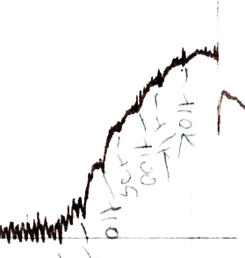
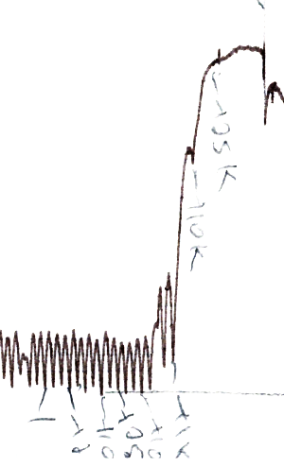
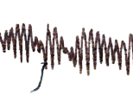
icatibant
1 μM
1 g
34093
10508
1074
10508
131
36.3
10 min
12.7
3.3
1074
0.94 nM
12.7
131
3.3
36.3
0.94 nM
Lesage et al., Front. Pharmacol. 2020; 11: 916

Slide 11
pA₂ = 8.06 ± 0.37
Lesage et al., Front. Pharmacol. 2020; 11: 916

Slide 12

Small molecule antagonists of the BK B2R

Slide 13
WIN 64338
47a
anatibant = LF16-0687
Pharvaris
Compound 3
bradyzide
19c

Slide 14
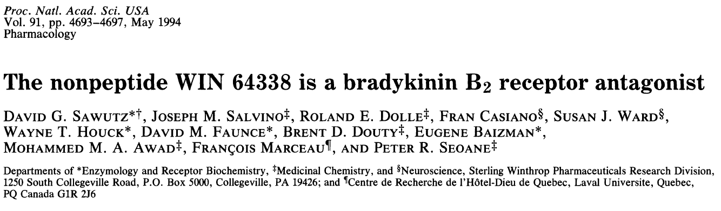
WIN 64338
First non-peptide BK B2R antagonist

Slide 15
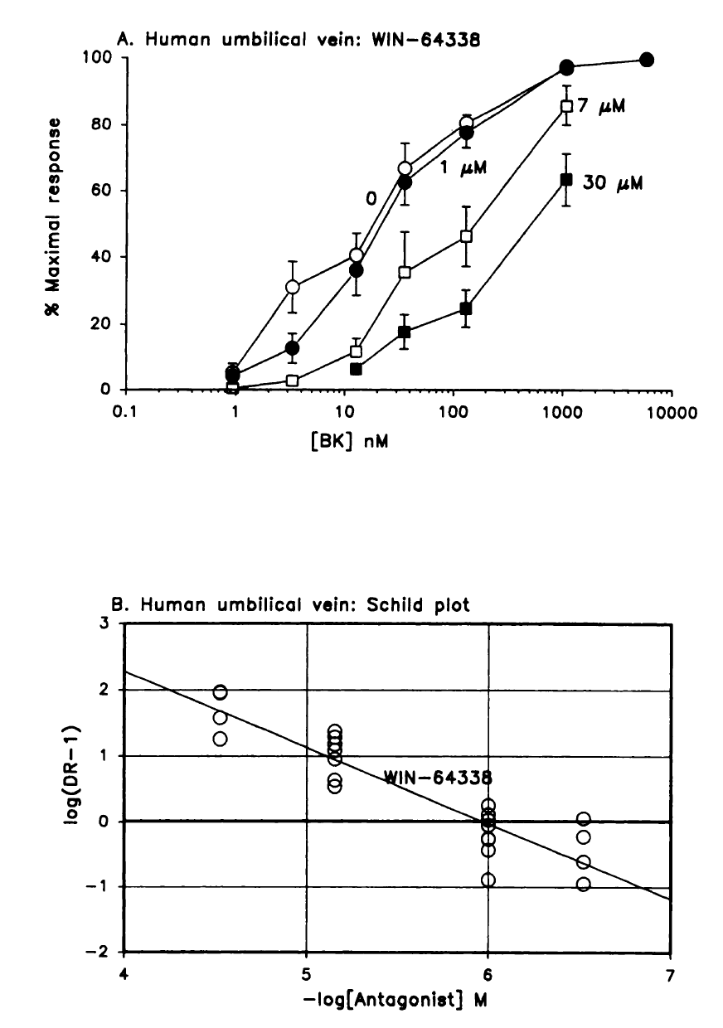
pA₂ = 5.99
Marceau et al. J Pharmacol Exp Ther 1994; 269: 1136

Slide 16
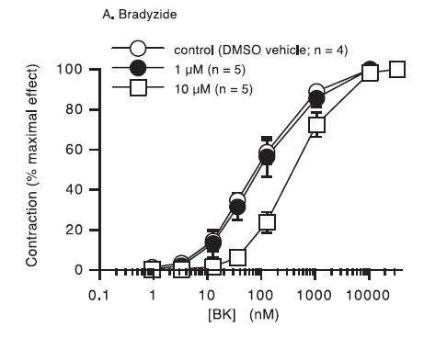
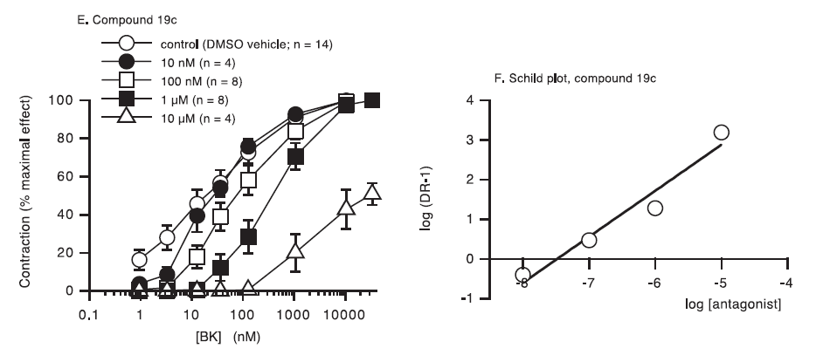
The rodent-specific antagonist bradyzide is modified to improve potency at human B2R
bradyzide
19c
pA₂ = 7.53
Marceau et al., Int. Immunopharmacol. 2003; 3: 1529
Notes:
Novartis, bradyzide reported in 2000

Slide 17
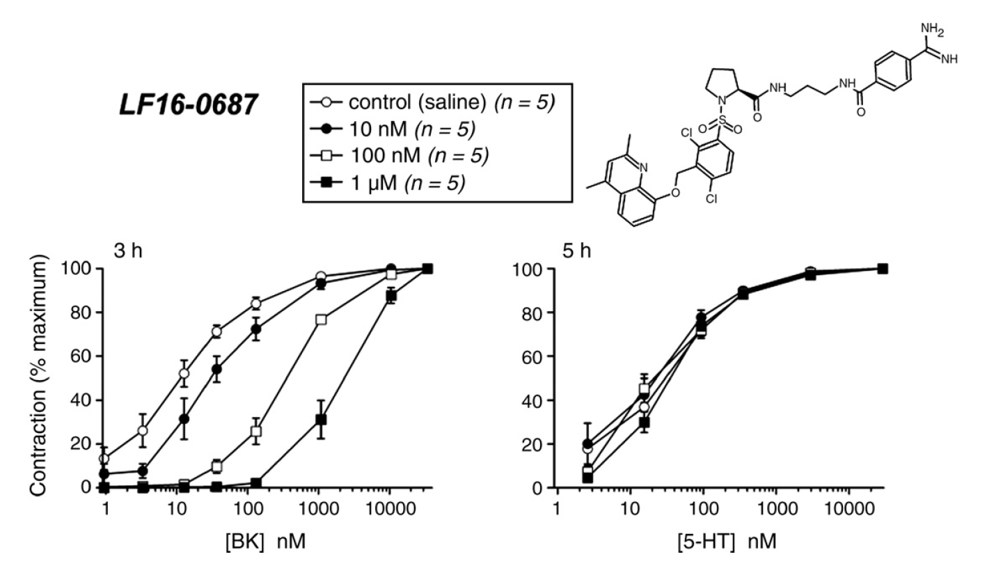
Anatibant (LF 16-0687)
pA₂ = 8.3
Bawolak et al., Regul.Peptides 2007; 140: 125

Slide 18
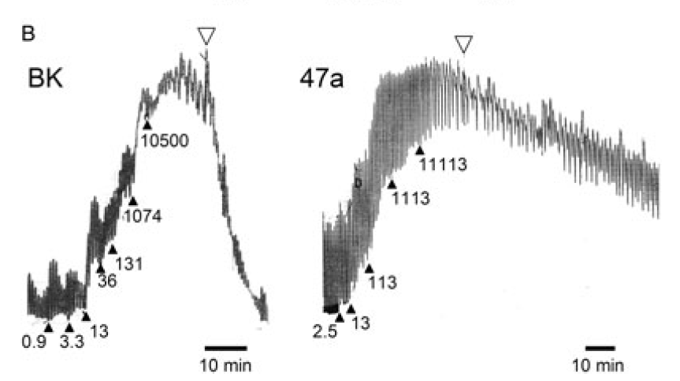

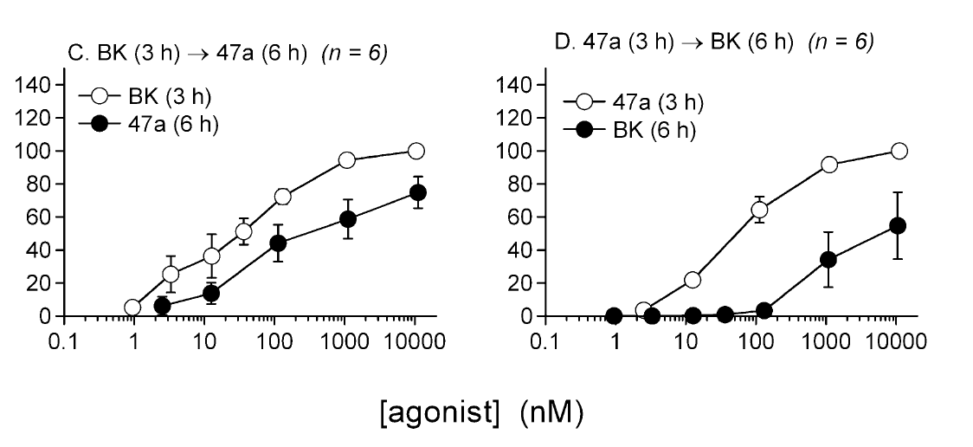
Compound 47a, a partial agonist identified by Fujisawa scientists
Bawolak et al., Br. J. Pharmacol. 2009; 158: 1375

Slide 19
Pharvaris Compound 3
pA₂ = 9.67 ± 0.42
Lesage et al., Front. Pharmacol. 2020; 11: 916

Slide 20
Lesage et al., Front. Pharmacol. 2020; 11: 916

Slide 21
Lesage et al., Front. Pharmacol. 2020; 11: 916

Slide 22
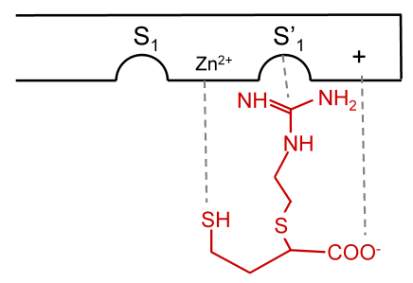
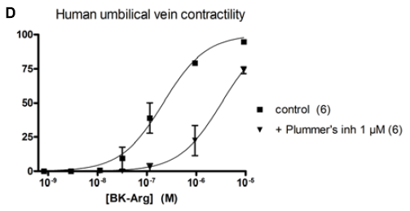
Verifying the properties of special peptide ligands, such as
latent agonists activated by peptidases
Arg-carboxypeptidases
Plummer’s inh.
H-Arg-Pro-Pro-Gly-Phe-Ser-Pro-Phe-Arg-Arg-OH BK-Arg
H-Arg-Pro-Pro-Gly-Phe-Ser-Pro-Phe-Arg-OH bradykinin (BK)
B₂R
Charest-Morin et al., Front. Pharmacol. 2014; 5: 32

Slide 23
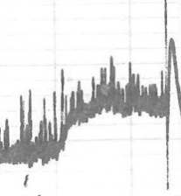
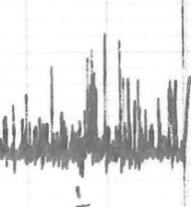
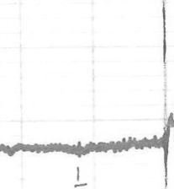
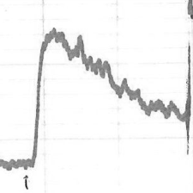
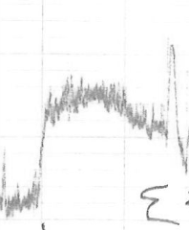
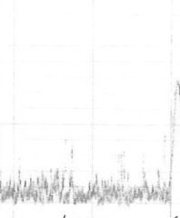
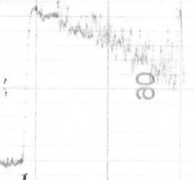
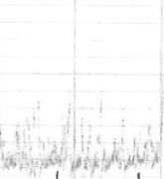
Verifying the claim that tissue kallikrein (KLK-1) is a direct BK B2R agonist
Tachyphylaxis, as well as the inhibitory effect of aprotinin or icatibant, indicated that KLK-1 releases a kinin from residual kininogen(s) adherent to the freshly isolated vein
KLK-1 1 nM at 1-hr intervals
BK 10 nM
KLK-1 10 nM at 1-hr intervals
1 g
10 min
BK 10 nM
Jean et al., Life Sci. 2016; 155: 180

Slide 24
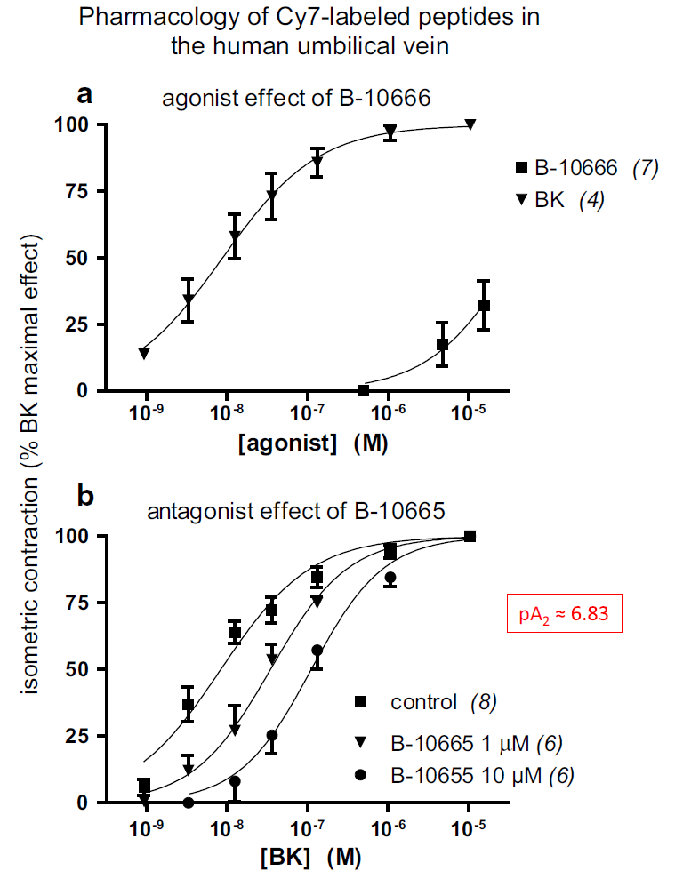
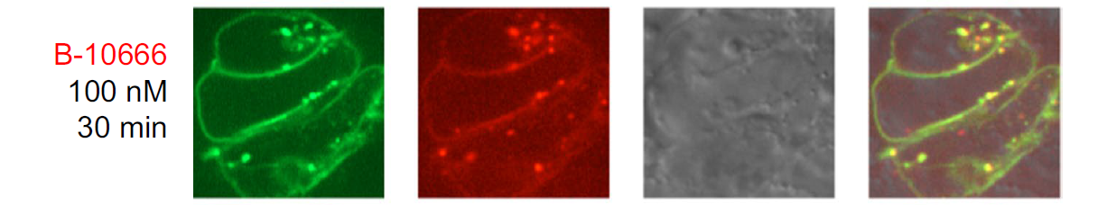
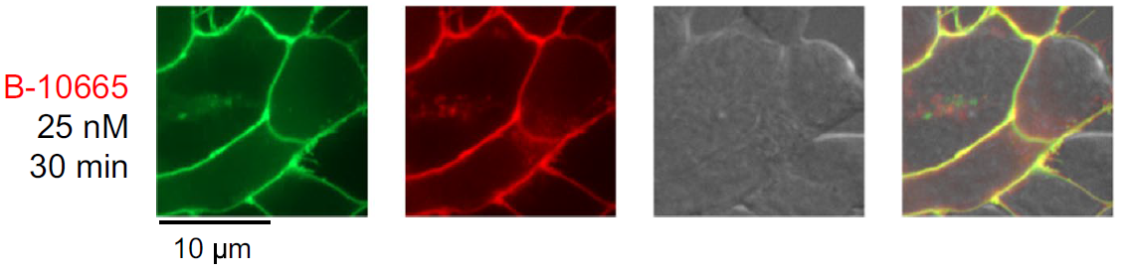
Verifying the properties of special peptide ligands, such as fluorescent probes
HEK 293 cells expressing B2R-GFP
GFP
Cy7
Gera et al., BMC Res. Notes 2016; 9: 452

Slide 25
conclusions
Antagonists have variable affinities for B2Rs from various mammalian species; the human umbilical vein smooth muscle naturally expresses the BK B2R
Not a “low tech” approach: remarkably quantitative and complementary to molecular/cellular pharmacology. In a time scale of several hours, this assay allows determining potency, surmountability, residual agonist activity, specificity and reversibility
This assay has an intermediate level of complexity between cellular and molecular pharmacology on one hand, and in vivo studies in subhuman primates on the other

Slide 26




funding
acknowledgements
Ms. Johanne Bouthillier
Dr. Xavier Charest-Morin
pharvaris.com

