Slide 1

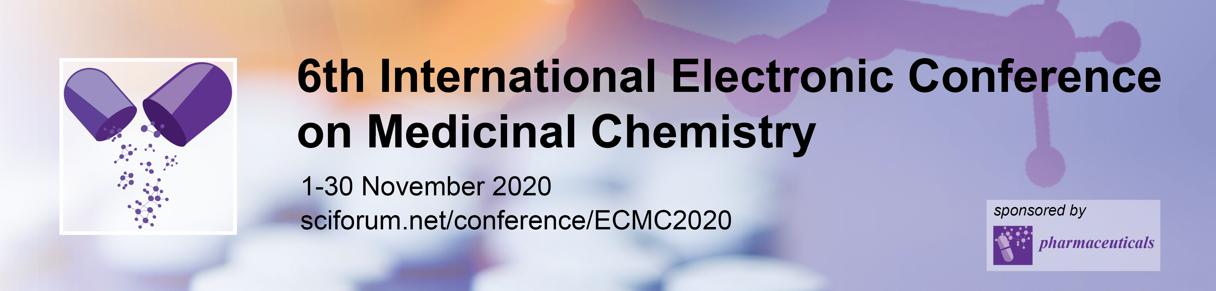


Synthesis and biological evaluation of inducible Nitric Oxide Synthase inhibitors as anticancer agents
Cristina Maccallini
Department of Pharmacy, University “G. d’Annunzio” of Chieti-Pescara, Via dei Vestini,31-66100 Chieti, Italy
cristina.maccallini@unich.it

Slide 2
Synthesis and biological evaluation of inducible Nitric Oxide Synthase inhibitors as anticancer agents
Graphical Abstract
Aromatase
iNOS
Breast cancer

Slide 3
Abstract:
Nitric Oxide (NO) is a free radical signalling molecule, involved in different biological processes and produced by nitric oxide synthases (NOS). There are two constitutive NOS (the endothelial and neuronal ones) and an inducible NOS (iNOS).
In tumour biology, NO has a controversial role, since there is evidence that NO can both inhibit and stimulate tumour cell growth. This response depends on tumour type, genetic background, NO levels and sensibility in the target cells. Correlation between iNOS expression and clinical outcome associated to worse prognosis, was evaluated in different types of tumours. Therefore, inhibition of iNOS has been proposed as a targeted therapy in several cancers, including breast cancer and gliomas.
Our research group is involved in the research of new potent and selective iNOS inhibitors, and we have recently collected evidences of their usefulness as antiglioma agents, compromising in vitro proliferation of cancer cells with selectivity with respect to astrocytes, and ameliorating the effects of the standard therapeutic agent Temozolomide. Moreover, a set of azole-based compounds showed interesting activity both as iNOS and aromatase inhibitors, compromising the MCF-7 breast cell line proliferation, and thereby suggesting their potential application in a polypharmacological approach. In this presentation results obtained from these studies will be shared.
Keywords: Cancer; Inhibition; Nitric Oxide; synthesis

Slide 4
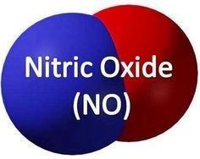
Nitric Oxide
Endogenous gaseous free radical
Lipophilic
Reactive
Second messanger
L-Arginine, NADPH, O₂
Nitric Oxide Synthase
L-Citrulline
+
NO
nNOS/NOS1
eNOS/NOS3
iNOS/NOS2

Slide 5
iNOS: a valuable target for the cancer therapy

Slide 6

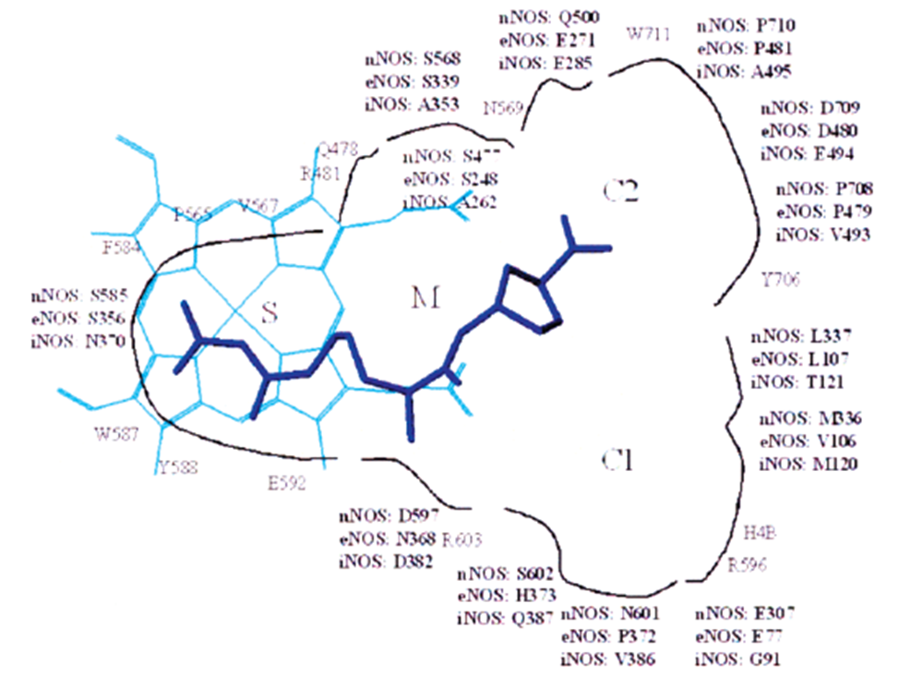
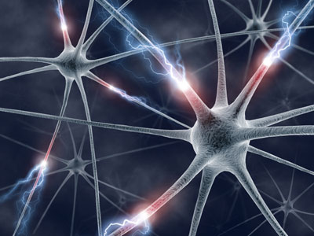
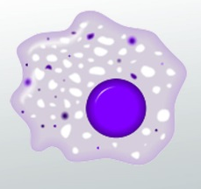
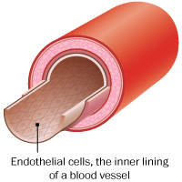
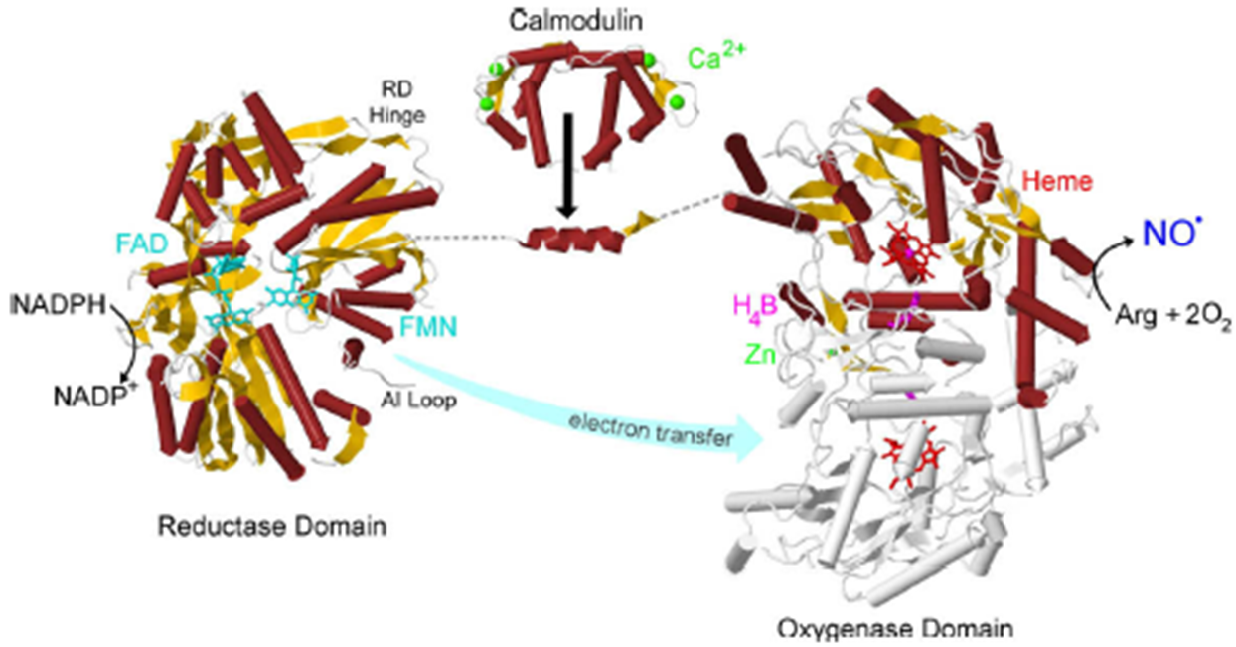
The NOS isoforms: where are the differences?
nNOS (NOS-1)
iNOS (NOS-2)
eNOS (NOS-3)
CNS; PNS
MΦ
Endothelium
Synaptic plasticity;
atypical neurotransmission;
Blood pressure control; etc
Immune defense;
inflammation
Vasodilation
vasoprotection
Forstermann, U. et al; European Heart Journal, 2012, 33, 829–837
Ji, H. et al; J. Med. Chem. 2003, 46, 5700-5711

Slide 7
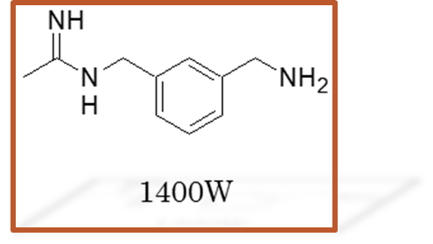
Acetamidines as iNOS inhibitors: a quick view of our background
Fantacuzzi, M. et al. J. Pharm. Biomed. Analysis, 2016, 120, 419–424
Maccallini , C. et al. Med. Chem., 2012, 8, 991-995
Maccallini, C. et al. ChemMedChem 2016, 1695-1699
Maccallini, C. et al. ACS Med. Chem. Lett. 2015, 6, 635−640
Maccallini, C. et al. E. J. Med. Chem. 2018, 152, 53−64
Maccallini, C et al. J. Med. Chem. 2009, 52, 1481–1485
Maccallini, C et al. Bioorg. Med. Chem. Lett., 2010, 20, 6495–6499
Fantacuzzi, M. et al.ChemMedChem 2011, 6, 1203 – 1206
Maccallini, C. et al. ACS Med. Chem. Lett. 2020, 11, 1470−1475

Slide 8
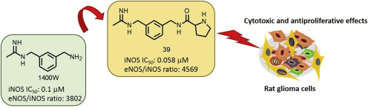
CM544: a new acetamidine blocking glioma cells
CM544

Slide 9
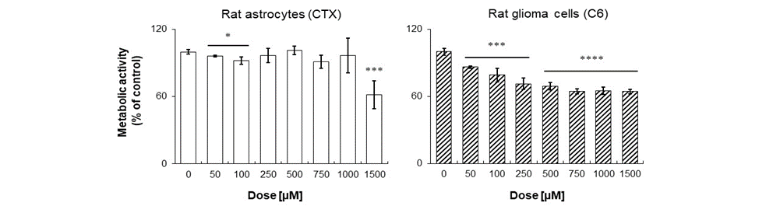
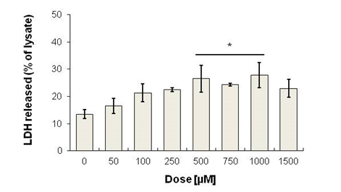
Developing new iNOS inhibitors blocking glioma cells
Cpd | IC₅₀(μM)ª |  |  | Selectivity ratio
 | hiNOS | hnNOS | heNOS | nNOS/iNOS | eNOS/iNOS
17 | 0.011±0.02 | 6.2±0.08 | >10 | 563 | >900
1400W | 0.080±0.002 | 7.8±0.04 | 304±2 | 72 | 3800

Slide 10
Aim of the work: developing new iNOS and aromatase inhibitors as dual agents targeting breast cancer

Slide 11
Synthesis of 2-5 and 6-8
Scheme 1. Reagents and conditions: a. 60°C, 12h; b. aryl-carboxylic acid, DMAP, EDC, CH₃CN dry, N₂, from 0°C to r.t., 18-22h; c. Et₃N, CH₃CN_{dry}, N_{2,} r.t., 18h or NaH 60%, DMF_{dry}, N₂, from 0°C to r.t., 20h

Slide 12
Synthesis of 13-20
Scheme 2. Reagents and conditions. a) NEt₃, DCM, from 0°C to r.t., 24h. b) Mesylchloride, NEt₃, DCM, r.t., 1h.
c) Triazole, NaH 60% mineral oil, DMF dry, N₂, 100°C, 8h. d) H₂, Pd/C, CH₃OH dry, N₂, r.t., 6h.
e) ArSO₂Cl, NEt₃, DCM dry, N₂, 2h at 0°C and 2h at r.t.

Slide 13


Results: Biological evaluation of 2-5 and 6-8
*@ 1μM compound.Data are mean of duplicate experiments. S.D. was within 10%
*@ 1μM compound.Data are mean of duplicate experiments. S.D. was within 10%
MCF-7 viability assay
2
5
6
2
5
6
2
5
6

Slide 14
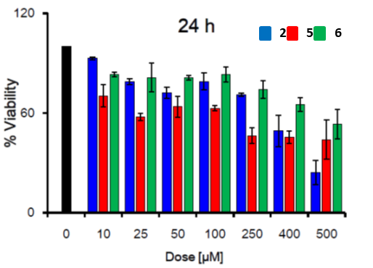
Results: Biological evaluation of 2-5 and 6
Cytotoxicity (MFC-7)
Selectivity vs human gingival fibroblasts

Slide 15

Results: Biological evaluation of 13-20
*Data are mean of duplicate experiments. S.D. was within 10%

Slide 16
Conclusions
iNOS is a potential biological target for the treatment of cancer.
Different iNOS inhibitors were disclosed showing antiproliferative effects on rat glioma cells, without affecting control astrocytes.
New iNOS inhibitors were synthesized with dual activity also against aromatase.
Among the most potent compounds of the series, molecules 2, 5, and 6 demonstrated antiproliferative and cytotoxic effects on MCF-7 breast cancer cell line, although cell selectivity was preliminarly observed only for molecules 2 and 6.
Effects on further human breast cancer cell lines will be evaluated in the next future to confirm the therapeutic potential of these azole-based dual agents.

Slide 17


Acknowledgments
Medicinal Chemistry Group
Prof. Rosa Amoroso
Dr. Alessandra Ammazzalorso
Dr. Barbara De Filippis
Dr. Marialuigia Fantacuzzi
Dr. Letizia Giampietro
Biology Group
Prof. Amelia Cataldi
Dr. Marialucia Gallorini
Medicinal Chemistry group
Prof. M. Encarnacion Camacho
Dr. Fabio Arias Bordajandi

