Slide 1
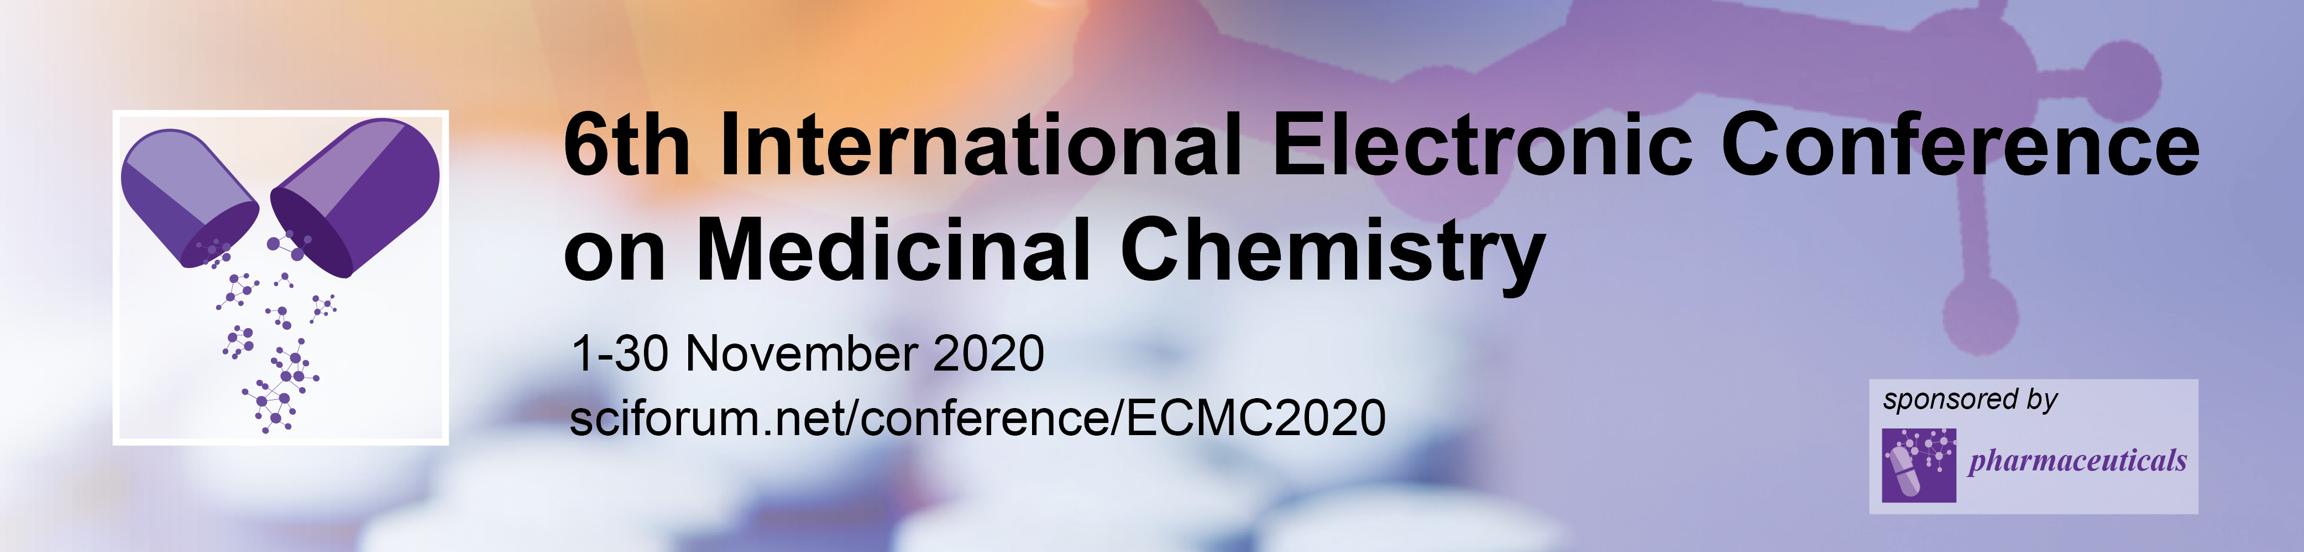




DNA/BSA binding affinities and in vivo toxicity of
dinuclear silver(I) complexes with phthalazine
Tina P. Andrejević^{1,}*, Dusan Milivojevic², Darko P. Ašanin³, Nevena Lj. Stevanović¹,
Jasmina Nikodinovic-Runic², Miloš I. Djuran⁴ and Biljana Đ. Glišić¹
¹University of Kragujevac, Faculty of Science, Department of Chemistry, R. Domanovića 12, 34000 Kragujevac, Serbia
²Institute of Molecular Genetics and Genetic Engineering, University of Belgrade, Vojvode Stepe 444a, 11042 Belgrade, Serbia
³University of Kragujevac, Institute for Information Technologies Kragujevac, Department of Science, Jovana Cvijića bb, 34000 Kragujevac, Serbia
⁴Serbian Academy of Sciences and Arts, Knez Mihailova 35, 11000 Belgrade, Serbia
*Corresponding author: tina.andrejevic@pmf.kg.ac.rs

Slide 2
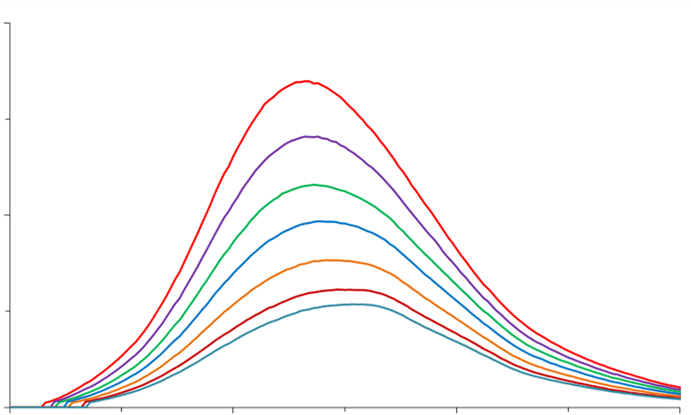
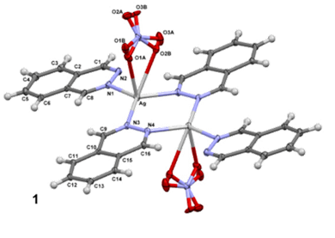
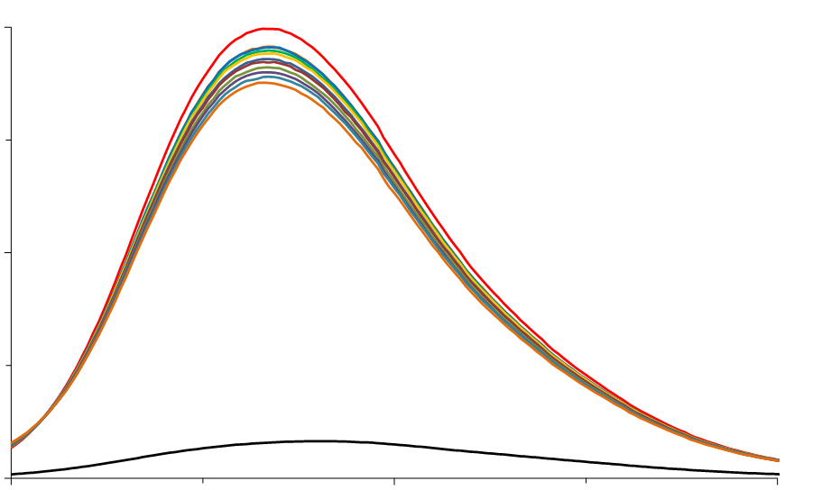
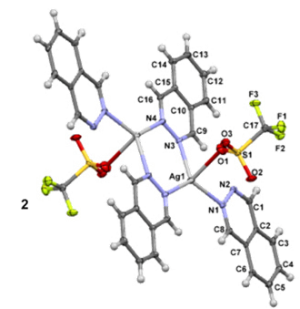
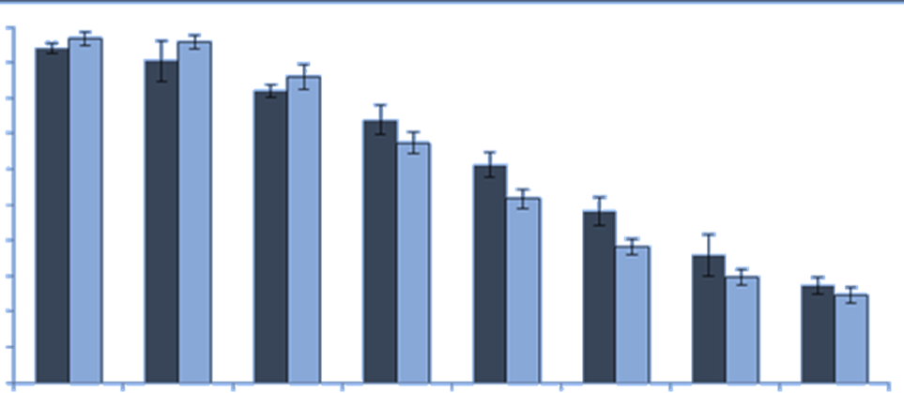
DNA/BSA binding affinities and in vivo toxicity of
dinuclear silver(I) complexes with phthalazine
Silver(I) complexes
BSA
DNA
Caenorhabditis elegans

Slide 3
Abstract
Silver(I) complexes with aromatic nitrogen-containing heterocycles have shown an effective and wide-spectrum antimicrobial activity. The possible mechanism of their antimicrobial activity can be attributed to interactions of these complexes with biomolecules, including DNA and proteins. Herein, we investigated the interactions of two antimicrobial active dinuclear phthalazine-silver(I) complexes, [{Ag(NO₃)(phtz)}₂(μ-phtz)₂] (Ag1) and [{Ag(CF₃SO₃)(phtz)}₂(μ-phtz)₂] (Ag2) (phtz is phthalazine), with calf thymus DNA (ctDNA) and bovine serum albumin (BSA) to evaluate their binding affinities towards these biomolecules for possible insights on their mode of antimicrobial activity. The value of binding constants (K_{A}) of Ag1 and Ag2 to BSA is higher than that for DNA, indicating greater affinity of the complexes toward this model protein. The partition coefﬁcient (logP) values for Ag1 and Ag2 are 0.0035 and -0.0063, respectively, what is in accordance with higher cellular uptake efficiency and better antibacterial activity of Ag1 in respect to Ag2. In order to determine the therapeutic potential of Ag1 and Ag2 complexes, their toxicity in vivo against nematode, Caenorhabditis elegans, was investigated.
Keywords: Silver(I) complexes; Phthalazine; DNA/BSA interaction; Lipophilicity; Caenorhabditis elegans.

Slide 4

Introduction
Silver(I) complexes showed significant antimicrobial activity against the strains which are resistant to the currently used antimicrobial drugs, while their toxicity to the normal human cells was not pronounced
One of the mechanism of antimicrobial activity of silver(I) complexes is their interactions with biological targets including DNA and proteins

Slide 5
Results and discussion
Molecular structures of Ag1 and Ag2 complexes
Ag2
Ag1
B.Đ. Glišić et al., J. Inorg. Biochem. 155 (2016) 115.

Slide 6
Interaction of Ag1 and Ag2 complexes with ct-DNA
Interaction between synthesized complexes and ct-DNA was studied using fluorescence spectroscopy and cyclic voltammetry
The K_{A} values for both silver(I) complexes are similar, but much lower than that for EthBr itself
Complex | K_{sv} (M⁻¹) | Hypochromism (%) | K_{q} (M⁻¹s⁻¹) | K_{A} (M⁻¹) | n
Ag1 | (8.50 ± 0.19).10² | 12.24 | 8.51.10¹⁰ | 9.30.10² | 1.01
Ag2 | (1.71 ± 0.01).10³ | 12.99 | 1.71.10¹¹ | 4.91.10³ | 1.12

Slide 7
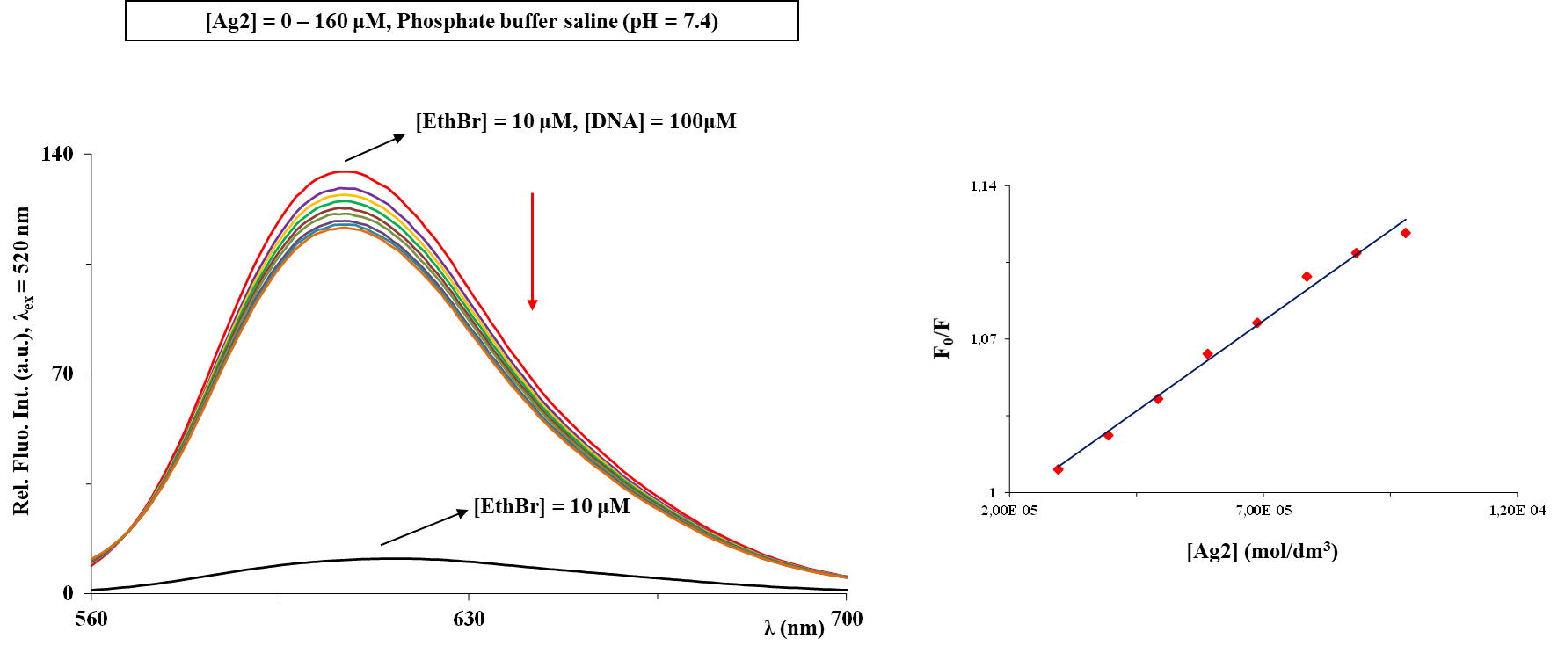
The results of fluorescence spectroscopy suggest the electrostatic mode of binding of Ag1 and Ag2 complexes to ctDNA
Fluorescence emission spectra of DNA-EthBr system in the presence of an increasing concentration of Ag2 complex. Arrow shows the intensity changes upon increased amount of the complex. Inserted graph: Stern-Volmer plots of F₀/F vs [complex]

Slide 8
Non-intercalative mode of binding was confirmed for Ag1 and Ag2 by cyclic voltammometry

Slide 9
Interaction of Ag1 and Ag2 complexes with BSA
The protein binding study of Ag1 and Ag2 was performed by tryptophan fluorescence quenching experiments using BSA in phosphate buffer solution (pH = 7.4)
The addition of increasing amounts of the complexes to the BSA solution resulted in a remarkable quenching of BSA fluorescence, as a consequence of the complexes binding to BSA
Complex | K_{sv} (M⁻¹) | Hypochromism (%) | K_{q} (M⁻¹s⁻¹) | K_{A} (M⁻¹) | n
Ag1 | (6.23 ± 0.19).10⁴ | 70.19 | 6.23.10¹² | 1.05.10⁶ | 1.34
Ag2 | (2.99 ± 0.15).10⁴ | 83.69 | 3.00.10¹² | 4.81.10⁵ | 1.30

Slide 10
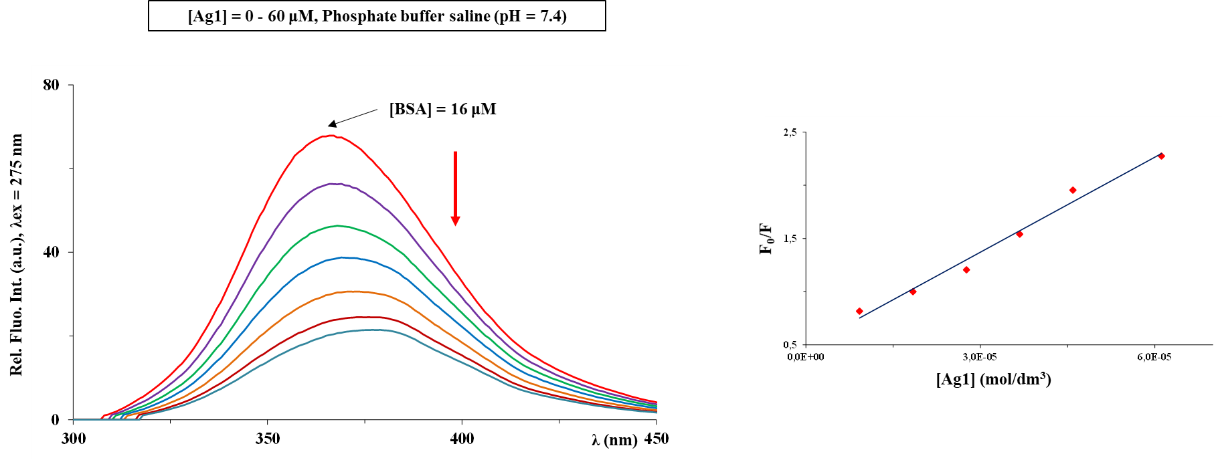
Fluorescence emission spectra of BSA in the presence of an increasing concentration of Ag1 complex alongside. Arrow shows the intensity changes upon increased amount of the complex. Inserted graph: Stern-Volmer plots of F₀/F vs [complex]

Slide 11
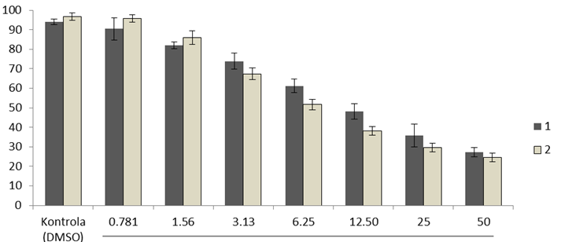
In vivo cytotoxicity of Ag1 and Ag2
C.elegans model
survived C. elegans, %
Ag1
Ag2
DMSO
concentration of silver(I) complex, μg/mL
IC₅₀ values of Ag1 and Ag2 are 12.5 and 6.25 µg/mL, respectively

Slide 12
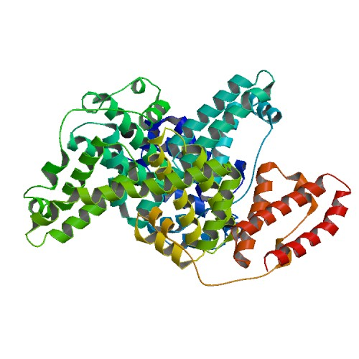
Conclusions
[{Ag(NO₃)(phtz)}₂(μ-phtz)₂] (Ag1) and [{Ag(CF₃SO₃)(phtz)}₂(μ-phtz)₂] (Ag2) complexes interact with ctDNA through electrostatic mode
Complexes Ag1 and Ag2 have greater affinity toward BSA with respect to DNA
The partition coefﬁcient values for Ag1 are in accordance with higher cellular uptake efficiency and better antibacterial activity of Ag1 in respect to Ag2
The presently investigated complexes Ag1 and Ag2 are moderatly cytotoxic in vivo in C. elegans model

Slide 13


Acknowledgments
This research has been financially supported by the Ministry of Education, Science and Technological Development of the Republic of Serbia (Agreements No. 451-03-68/2020-14/200042, 451-03-68/2020-14/200122 and 451-03-68/2020-14/200378). This research has also received funding from the Serbian Academy of Sciences and Arts under strategic projects programme - grant agreement No. 01-2019-F65 and project of this institution No. F128.

