Slide 1
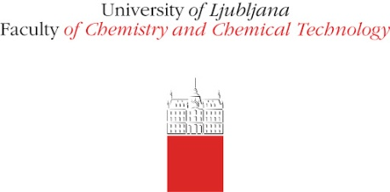
Antimicrobial activity and DNA/BSA binding study of new silver(I) complexes
with 1,8-naphthyridine
Darko P. Ašanin^{1,}*, Tina P. Andrejević², Sanja Skaro-Bogojevic³, Franc Perdih⁴, Iztok Turel⁴, Jasmina Nikodinovic-Runic³, Miloš I. Djuran⁵ and Biljana Đ. Glišić²
¹University of Kragujevac, Institute for Information Technologies Kragujevac, Department of Science, Jovana Cvijića bb, 34000 Kragujevac, Serbia
²University of Kragujevac, Faculty of Science, Department of Chemistry, R. Domanovića 12, 34000 Kragujevac, Serbia
³Institute of Molecular Genetics and Genetic Engineering, University of Belgrade, Vojvode Stepe 444a, 11042 Belgrade, Serbia
⁴University of Ljubljana, Faculty of Chemistry and Chemical Technology, Večna pot 113, SI-1000, Ljubljana, Slovenia
⁵Serbian Academy of Sciences and Arts, Knez Mihailova 35, 11000 Belgrade, Serbia
*Corresponding author: darko.asanin@uni.kg.ac.rs

Slide 2
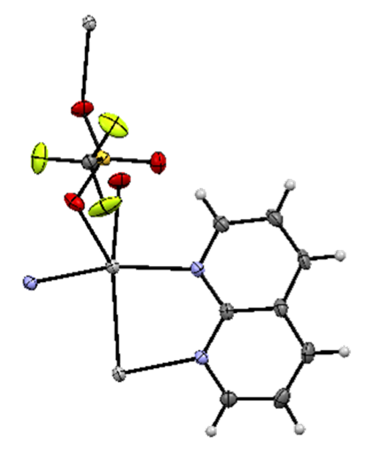
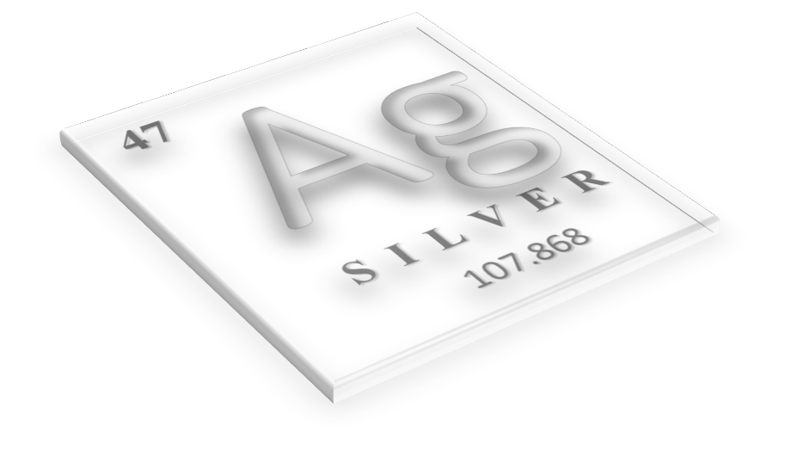
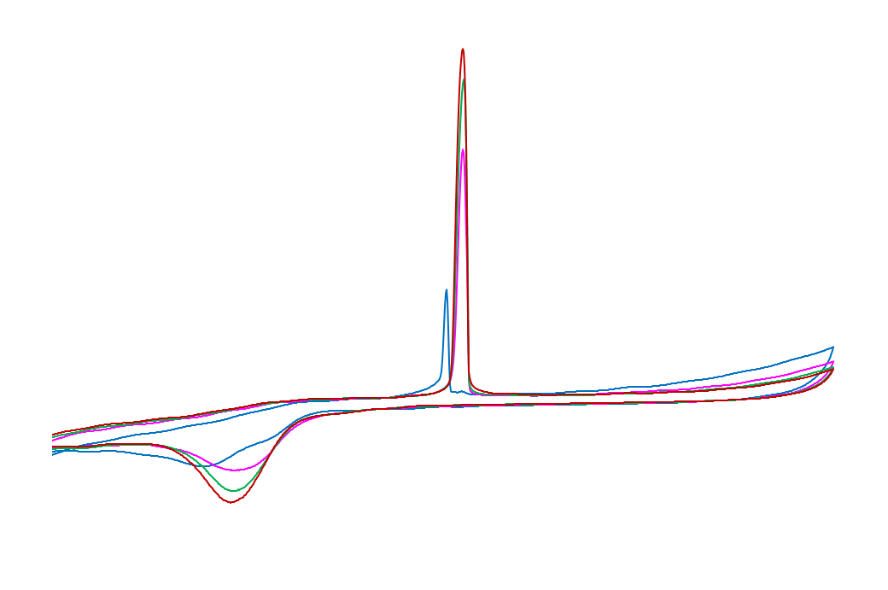
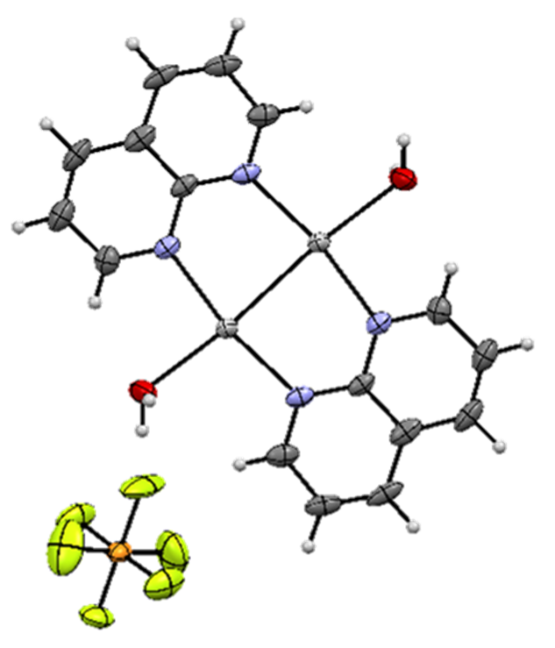
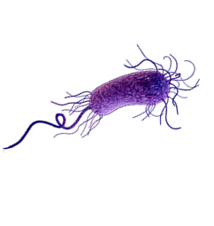
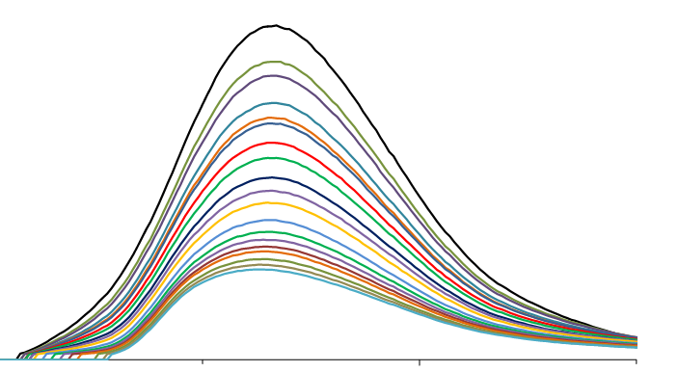
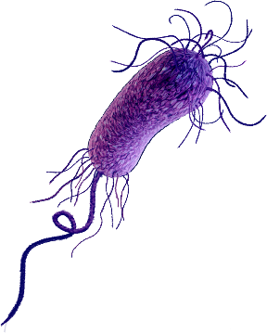
Antimicrobial activity and DNA/BSA binding study of new silver(I) complexes with 1,8-naphthyridine
Synthesis
Structural characterization
DNA binding study
Antimicrobial susceptibility testing
Protein binding studies

Slide 3
Abstract
Among different classes of ligands used for the synthesis of biologically active silver(I) complexes, a special attention was devoted to the aromatic nitrogen-containing heterocycles. Considering this, in the present study, we have synthesized two new silver(I) complexes with 1,8-naphthyridine (1,8-naph), polynuclear [Ag(CF₃SO₃)(1,8-naph)]_{n} (Ag1) and dinuclear [Ag(1,8-naph)(H₂O)]₂(PF₆)₂ (Ag2), and evaluated their antimicrobial activity against Gram-positive and Gram-negative bacteria, as well as Candida spp. The obtained results revealed that these silver(I) complexes showed significant activity toward the Gram-positive Staphylococcus aureus and Candida spp. The values of binding constants of Ag1 and Ag2 to BSA are high enough to indicate their interaction to this biomolecule, but not so strong to prevent their release upon arrival to the target site. The partition coefﬁcient (logP) values for Ag1 and Ag2 are -0.14 and 0.37, respectively, what is in accordance with those for pharmacophores in the Comprehensive Medicinal Chemistry database. Тhe investigated silver(I) complexes inside the cell could interact with DNA through the non-intercalative (electrostatic) mode.
Keywords: Silver(I) complexes; 1,8-Naphthyridine; Antimicrobial activity; DNA/BSA interaction.

Slide 4
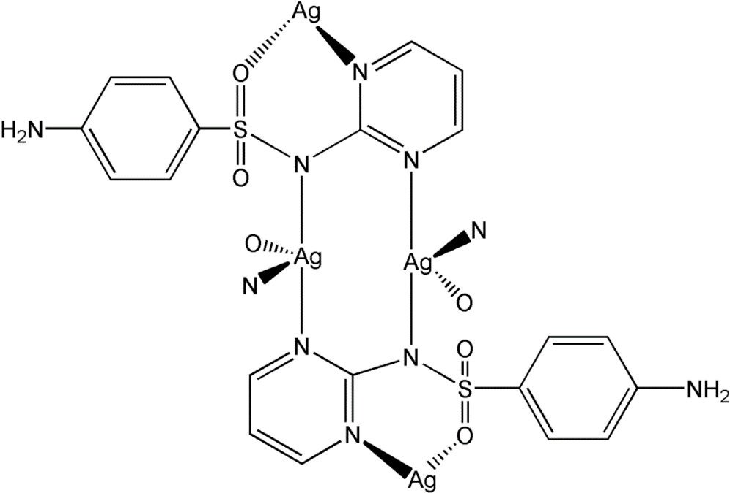
Introduction
Silver(I) compounds are well known for their pharmacological applications as antibiotics and have been also evaluated as potential anticancer agents
The use of simple silver(I) salts, such as AgNO₃, as an antimicrobial agent, has been limited due to the formation of AgCl precipitate under the physiological conditions, preventing a major part of Ag(I) ions to reach the infected site
On the other hand, a slow and maintainable release of Ag(I) ion into the infected cell or tissue could be achieved by its administration in the form of complexes (such as silver(I) sulfadiazine)

Slide 5
Results and discussion
Silver(I) complexes were synthesized according to the presented procedure

Slide 6
Structural characterization
The synthesized complexes were characterized by elemental analysis, UV-Vis, IR, ¹H and ¹³C NMR spectroscopy, mass spectrometry and cyclic voltammetry, while their structure was determined by a single-crystal X-ray diffraction analysis
Ag1
Ag2

Slide 7
Antimicrobial susceptibility testing
Antimicrobial activity of silver(I) complexes and the corresponding 1,8-naphthyridine ligand expressed as MIC (µg/mL) in comparison to their cytotoxicity against healthy human fibroblasts MRC-5 (IC₅₀, µg/mL)
Test organism | Candida albicans ATCC 10231 | Candida parapsilosis ATCC 22019 | Staphylococcus aureus ATCC 25923 | Listeria monocytogenes NCTC 11994 | Escherichia coli NCTC 9001 | MRC-5
Compounds
Ag1 | 3.91 | 3.91 | 7.81 | 15.62 | 31.25 | 3.65
Ag2 | 3.91 | 7.81 | 7.81 | 125 | 15.62 | 3.75
1,8-naph | > 200 | > 200 | > 250 | > 250 | > 250 | > 100

Slide 8
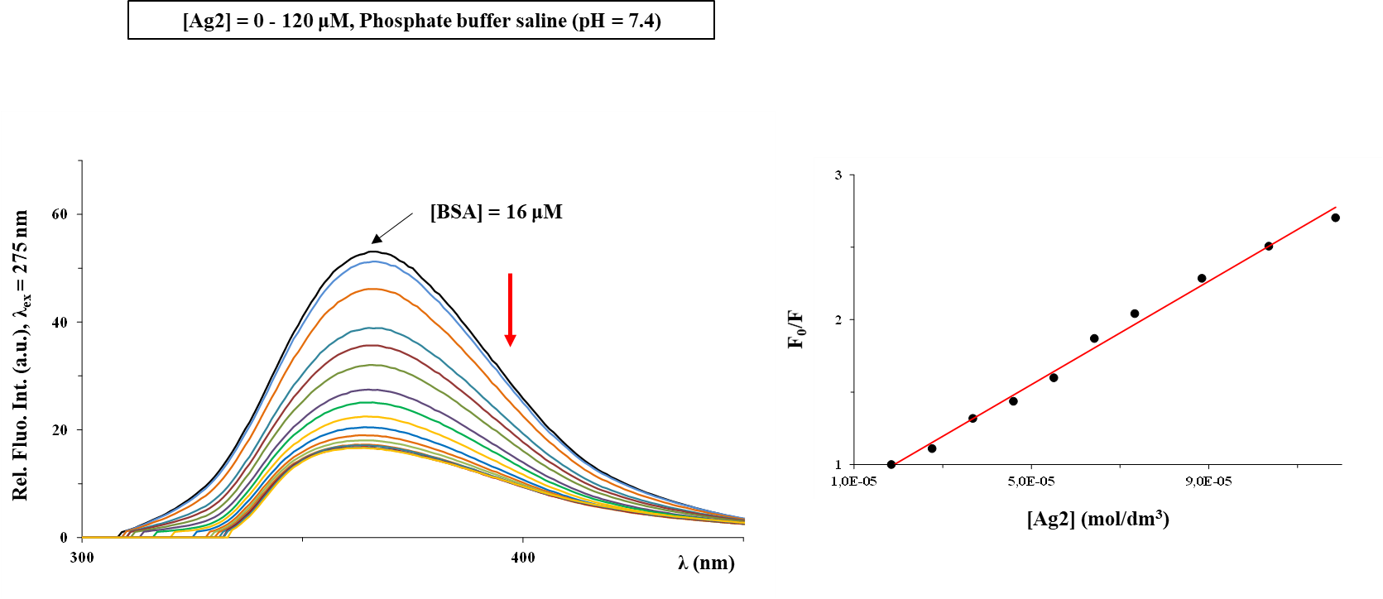
Protein binding studies
The affinity of silver(I) complexes to BSA was studied using florescence spectroscopy
Complex | K_{sv} (M⁻¹) | Hypochromism (%) | K_{q} (M⁻¹s⁻¹) | K_{A} (M⁻¹) | n
Ag1 | (1.21 ± 0.02).10⁴ | 71.92 | 1.21.10¹² | 7.42.10⁴ | 1.22
Ag2 | (2.70 ±­ 0.05).10⁴ | 68.70 | 2.70.10¹² | 6.08.10⁵ | 1.37
Fluorescence emission spectra of BSA in the presence of an increasing concentration of Ag2 complex alongside with the values of the binding constants for both complexes. Arrow shows the intensity changes upon increased amount of the complex. Inserted graph: Stern-Volmer plots of F₀/F vs [complex]

Slide 9
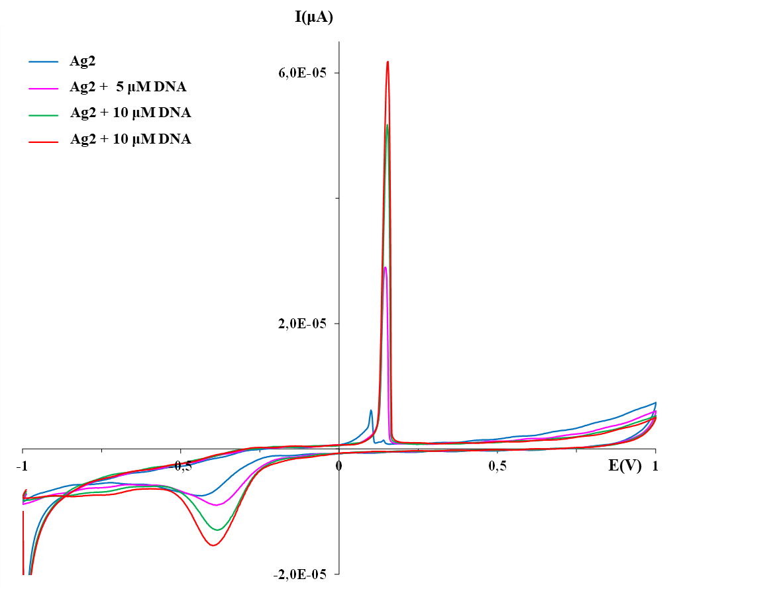
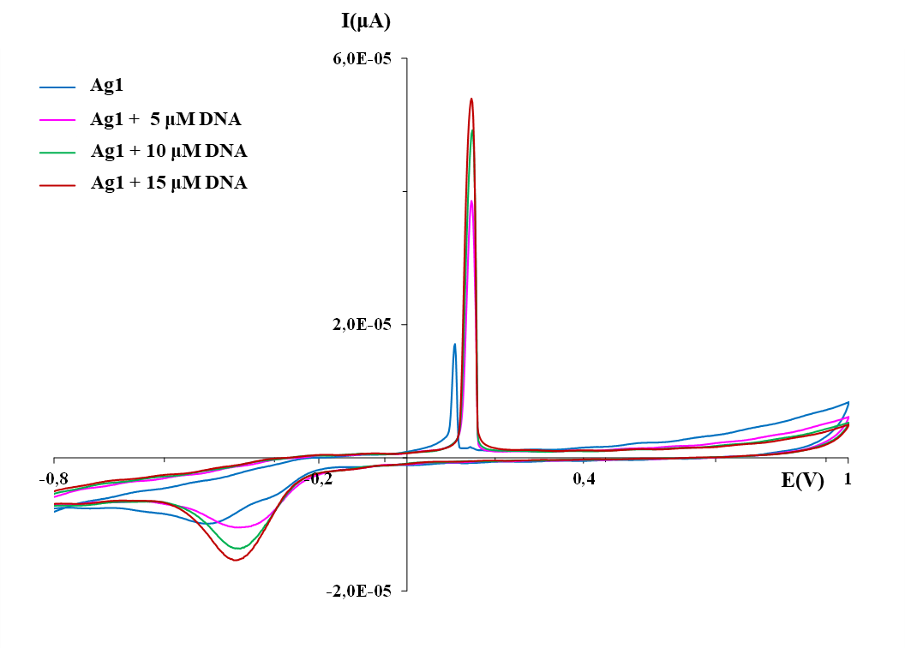
DNA binding study
DNA interaction of Ag1 and Ag2 was studied by cyclic voltammetry and florescence spectroscopy
Cyclic voltammograms of the silver(I) complexes Ag1 and Ag2 in the absence and presence of DNA at GC electrode in DMSO/PBS with a scan rate of 50 mV/s

Slide 10
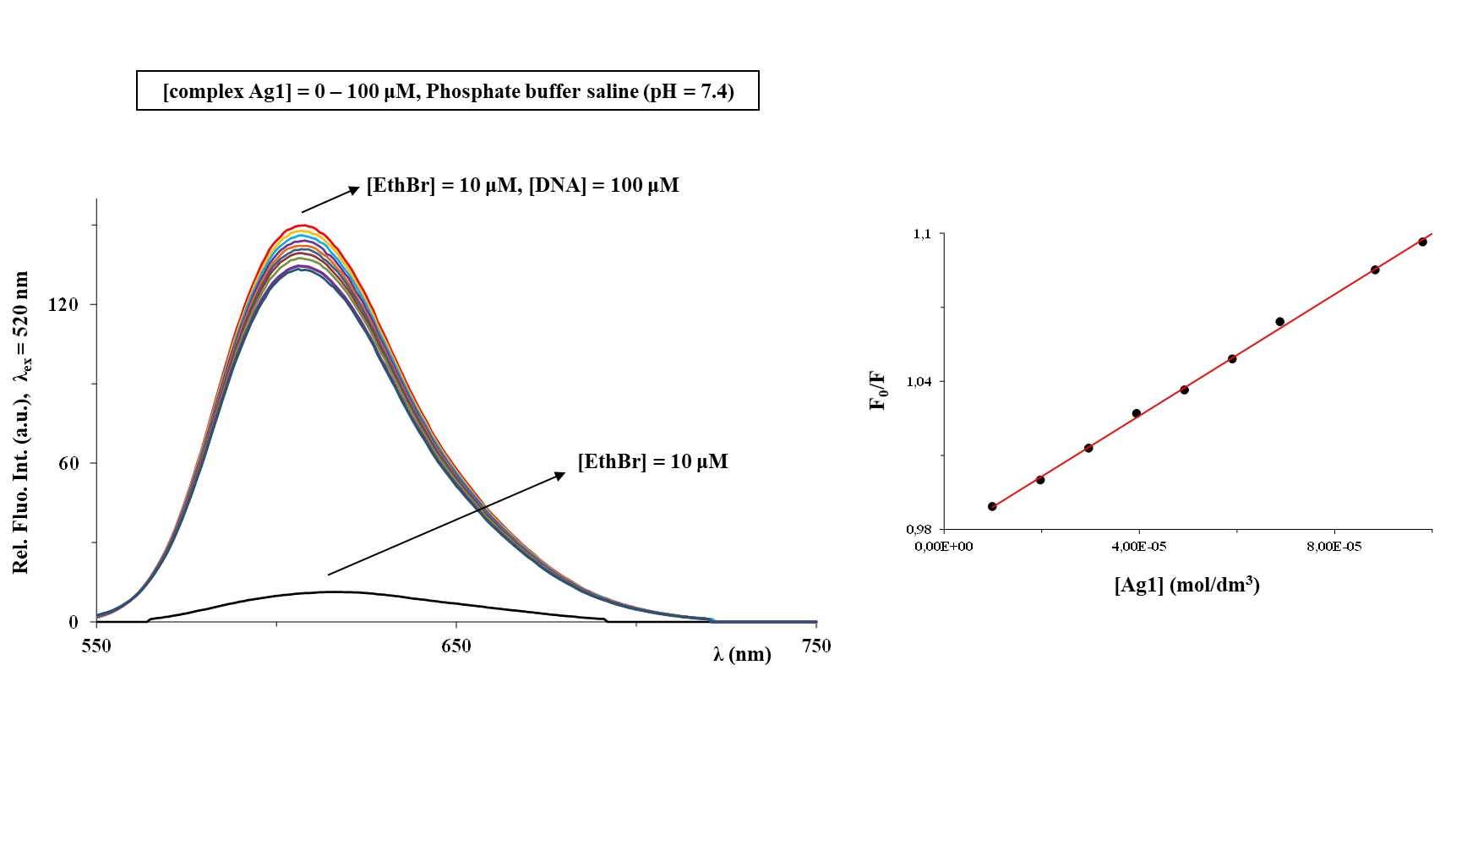
DNA binding study
Fluorescence emission spectra of DNA-EthBr system in the presence of an increasing concentration of Ag1 complex. Inserted graph: Stern-Volmer plots of F₀/F vs [complex]

Slide 11
Conclusions
Two silver(I) complexes with 1,8-naphthyridine (1,8-naph), [Ag(CF₃SO₃)(1,8-naph)]_{n} (Ag1) and [Ag(1,8-naph)(H₂O)]₂(PF₆)₂ (Ag2) were synthesized, structurally characterized and biologically evaluated
Silver(I) complexes showed significant activity toward the Gram-positive Staphylococcus aureus and Candida spp.
The values of binding constants of Ag1 and Ag2 to BSA are high enough to indicate their interaction to this biomolecule, but not so strong to prevent their release upon arrival to the target site
Silver(I) complexes interact with DNA through the non-intercalative (electrostatic) mode

Slide 12
Acknowledgments
This research has been financially supported by the Ministry of Education, Science and Technological Development of the Republic of Serbia (Agreements No. 451-03-68/2020-14/200042, 451-03-68/2020-14/200122 and 451-03-68/2020-14/200378) and by the Slovenian Research Agency (grant P1-0175). The EN→FIST Centre of Excellence, Trg OF 13, SI-1000 Ljubljana, Slovenia, is acknowledged for the use of the SuperNova diffractometer. This research has also received funding from the Serbian Academy of Sciences and Arts under strategic projects programme - grant agreement No. 01-2019-F65 and project of this institution No. F128.

