Slide 1






Improvement of antifungal activity and therapeutic profile of fluconazole by its complexation with copper(II) and zinc(II) ions. Complex characterization and antimicrobial activity studies
Nevena Lj. Stevanović^{1,*}, Ivana Aleksic², Jakob Kljun³, Darko P. Ašanin⁴, Tina P. Andrejević¹, Jasmina Nikodinovic-Runic², Iztok Turel³, Miloš I. Djuran⁵ and Biljana Đ. Glišić¹
¹ University of Kragujevac, Faculty of Science, Department of Chemistry, R. Domanovića 12, 34000 Kragujevac, Serbia;
² University of Belgrade, Institute of Molecular Genetics and Genetic Engineering, Vojvode Stepe 444a, 11042 Belgrade, Serbia;
³ University of Ljubljana, Faculty of Chemistry and Chemical Technology, Department of Chemistry and Biochemistry, Večna pot 113,
SI-1000, Ljubljana, Slovenia;
⁴ University of Kragujevac, Institute for Information Technologies Kragujevac, Department of Science, Jovana Cvijića bb, 34000 Kragujevac, Serbia;
⁵ Serbian Academy of Sciences and Arts, Knez Mihailova 35, 11000 Belgrade, Serbia.
Corresponding author: nevena.stevanovic@pmf.kg.ac.rs

Slide 2
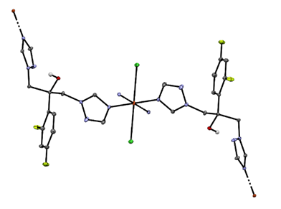
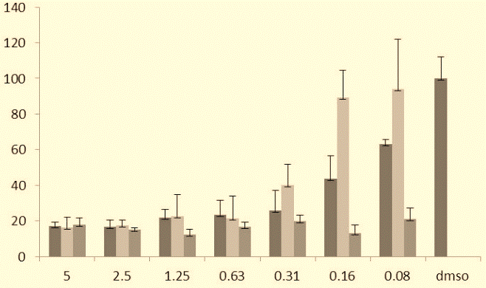
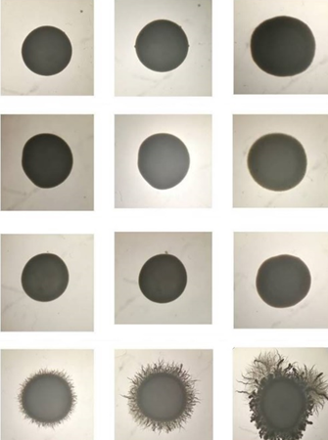
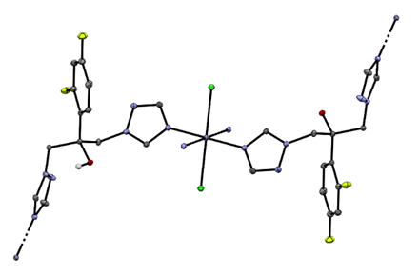
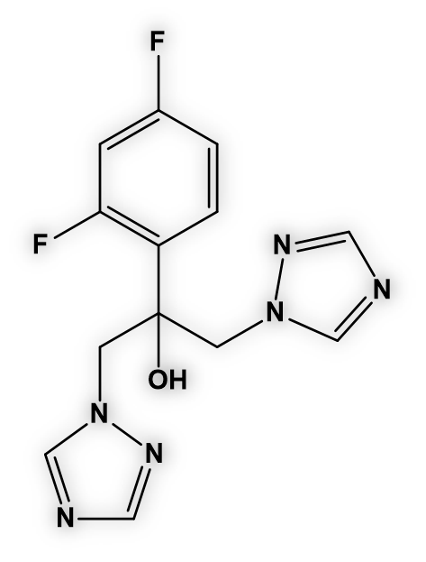
Improvement of antifungal activity and therapeutic profile of fluconazole by its complexation with copper(II) and zinc(II) ions. Complex characterization and antimicrobial activity studies
Fungal anti-biofilm activity
Antifungal activity
Structural characterization
Synthesis of Cu(II)/Zn(II) complexes
Fluconazole

Slide 3
Abstract: In order to overcome resistance of the clinically used antifungal triazole agents, we synthesized copper(II) and zinc(II) complexes with fluconazole (flz), {[CuCl₂(flz)₂].5H₂O}_{n} (1) and {[ZnCl₂(flz)₂]·2C₂H₅OH}_{n} (2). These complexes were obtained from the reactions between CuCl₂·2H₂O or ZnCl₂ with this antifungal agent in 1 : 2 molar ratio in ethanol at room temperature. The compounds were characterized by elemental analysis, NMR, IR and UV-Vis spectroscopy and mass spectrometry. The crystal structure of complexes was determined by a single-crystal X-ray diffraction analysis. The antimicrobial effect of both complexes and fluconazole was evaluated against different Candida species, as well as Gram-positive and Gram-negative bacteria by means of minimal inhibitory concentrations (MICs). The obtained results have shown that, in most cases, the coordination of fluconazole to Zn(II) and Cu(II) ions leads to the enhancement of its antifungal activity. Both complexes showed strong inhibitory activity against C. albicans biofilm formation at concentrations lower than MIC values, as well as strong inhibition of C. albicans filamentation.
Keywords: Zinc(II) complex; Copper(II) complex; Fluconazole; Antifungal agents; Biofilms

Slide 4
Introduction
Invasive fungal infections represent a serious problem for modern-day healthcare
Therapeutic options for the treatment of fungal infections are presently limited to only four classes of compounds
Each of these drug classes has significant therapeutic limitations, including serious toxic-side effects, resistance development and limited routes of administration
Fluconazole (flz) belongs to the first-generation azoles and is developed for the treatment of Candida infections
fluconazole (flz)
M.K. Kathiravan et al., Bioorg. Med. Chem. 20 (2012) 5678.

Slide 5
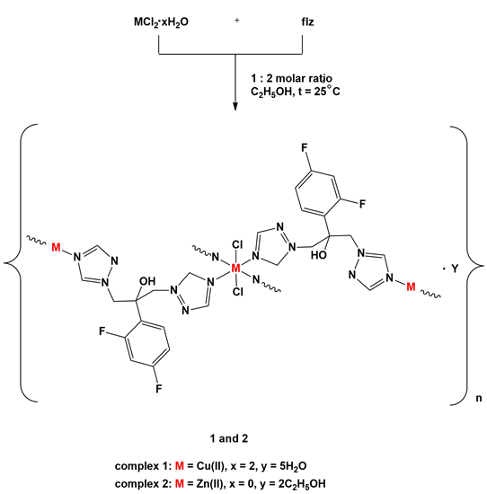
Results and discussion
Synthesis of metal complexes
Reaction between CuCl₂.2H₂O or ZnCl₂ with flz was perfomed in 1 : 2 molar ratio, respectively, in ethanol at room temperature

Slide 6
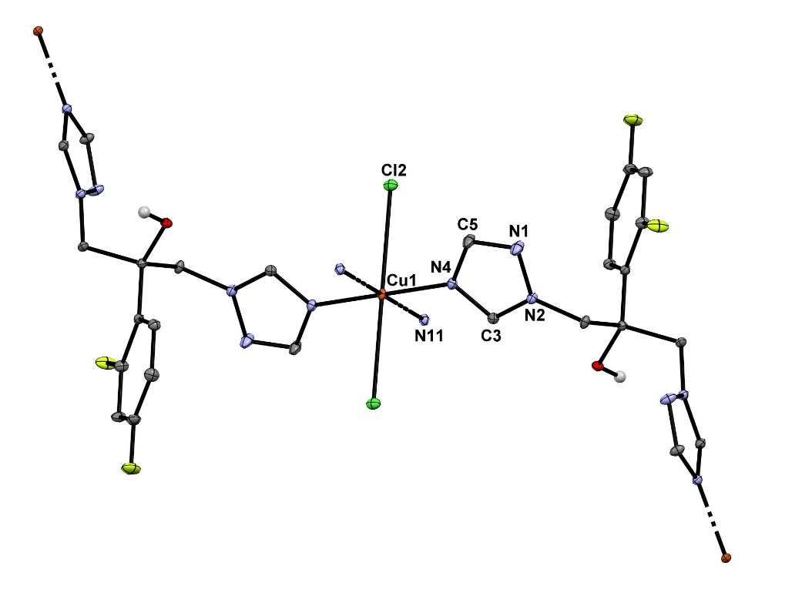
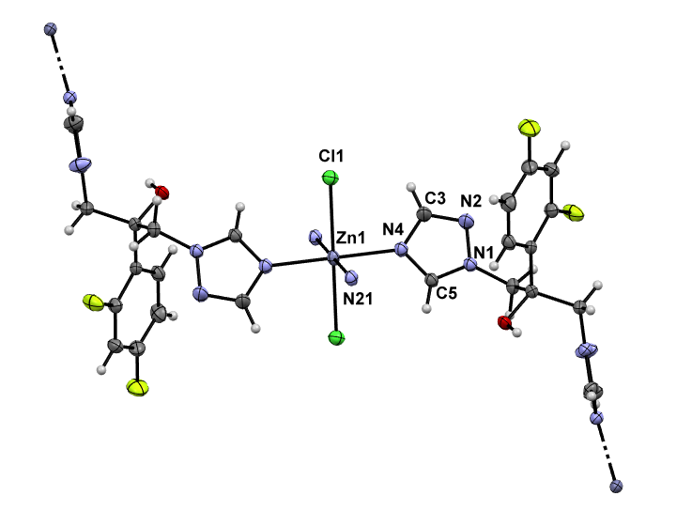
The crystals of the complex 1 were obtained after the blue precipitate from the reaction was recrystallized in the mixture of acetonitrile/water, while those of 2 were obtained after evaporation of the mother solution
The structure of the complexes was confirmed by mass spectrometry, IR and UV-Vis spectroscopy and single-crystal X-ray diffraction analysis, while the complex 2 was additionally characterized by ¹H and ¹⁹F NMR spectroscopy
{[CuCl₂(flz)₂].5H₂O}_{n} (1)
{[ZnCl₂(flz)₂]·2C₂H₅OH}_{n} (2)

Slide 7
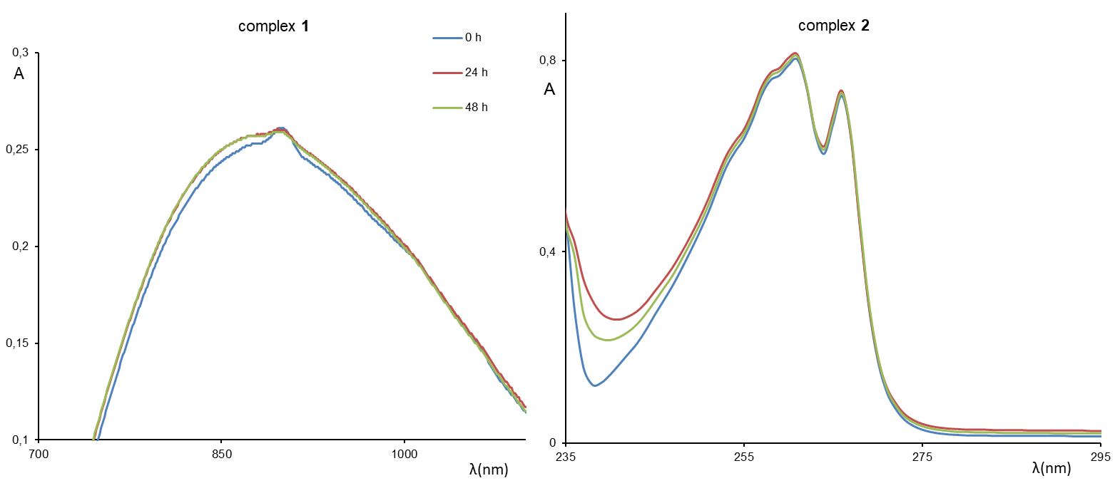
The intensity and the position of the absorption maxima of 1 and 2 and the shape of spectra remained unmodified during the investigated time, being in accordance with the stability of these complexes in solution

Slide 8
Stability of complex 2 in DMSO-d₆/D₂O (v/v 3:1) over a period of 48 h followed by
¹H NMR spectroscopy

Slide 9
Antifungal (MIC, µg/mL) vs cytotoxicity (LC₅₀ values, µg/mL)
Test organism: | C. albicansATCC 10231 | C. parapsilosisATCC 22019 | C. kruseiATCC 6258 | C. albicansRFP | C. albicansGFP | C. albicans1C | C. albicans1F | C. albicans11 | C. albicans 13 | MRC-5
Complex ligand
Fluconazole (flz) | 2.87 | 5.72 | 40.1 | 0.25 | 0.25 | 6.53 | 6.53 | 6.53 | 6.53 | 980
Cu(II) complex (1) | 3.71 | 1.05 | 3.72 | 0.19 | 0.19 | 2.38 | 2.38 | 2.38 | 2.38 | 77.3
Zn(II) complex (2) | 66.9 | 2.34 | 66.9 | 0.21 | 0.21 | 2.68 | 2.68 | 2.68 | 2.68 | 96.4
The coordination of fluconazole to Zn(II) and Cu(II) ions leads to the enhancement of its antifungal activity
Selectivity indices > 400 in the case of C. albicans RFP and GFP

Slide 10
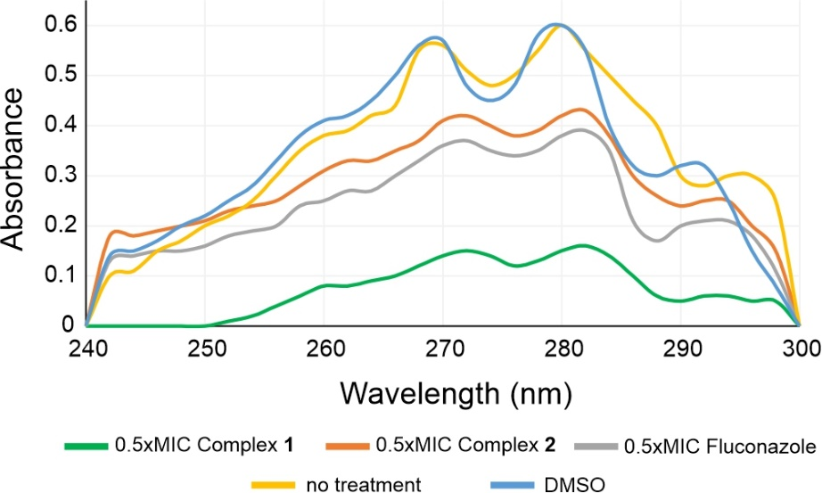
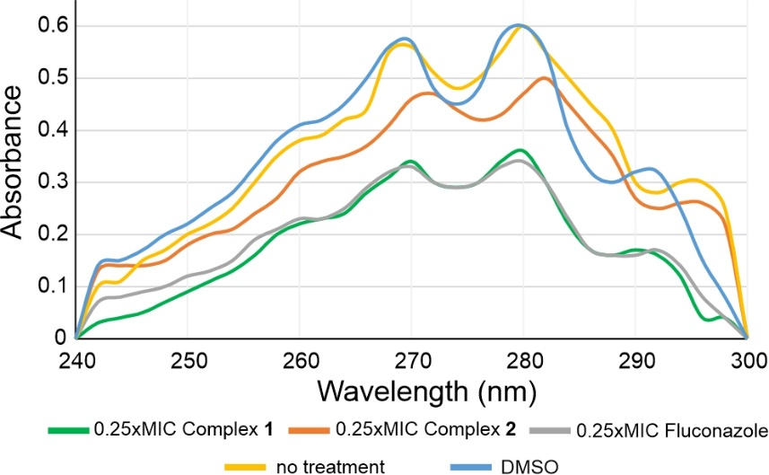
UV spectrophotometric ergosterol profiles of C. albicans treated with subinhibitory concentrations of fluconazole and complexes 1 and 2
Fluconazole and the corresponding complexes 1 and 2 reduced the total amount of ergosterol at subinhibitory concentrations, with copper(II) complex 1 being the most potent
The general mode of the activity of fluconazole has been retained within the complexes, while the presence of Cu(II) ion might add some additional inhibitory activity
B.A. Arthington-Skaggs et al., J. Clin. Microbiol. 37 (1999) 3332.

Slide 11
Inhibition of C. albicans filamentation (Spider solid and RPMI medium)
DMSO flz
Strong inhibition of filamentation of C. albicans ATCC 10231 was observed in the presence of subinhibitory (0.5 x MIC value) concentrations of fluconazole and complexes 1 and 2
A) on the Spider medium and
B) in RPMI broth

Slide 12
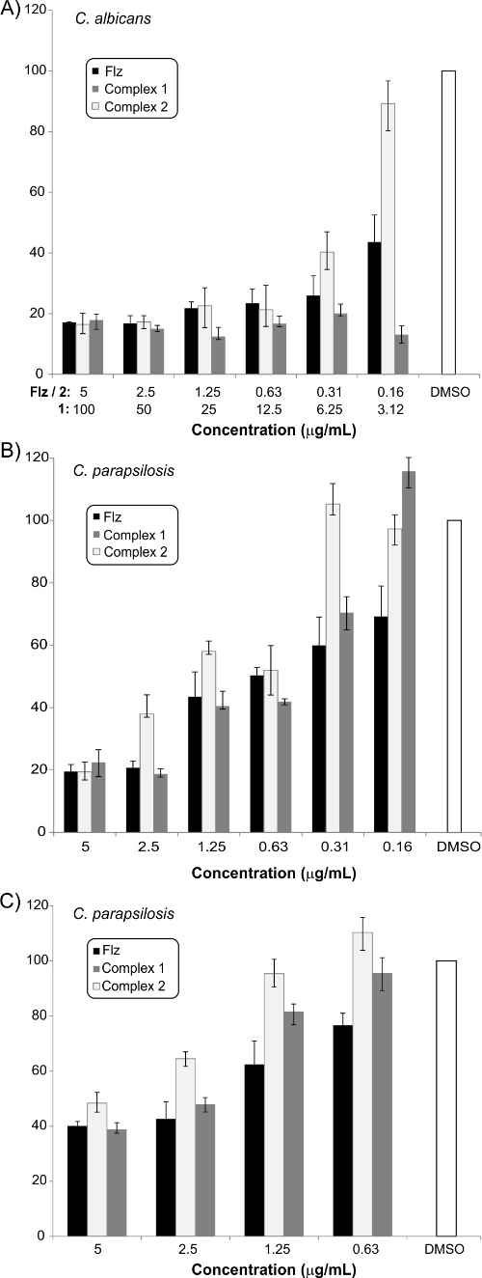
Effect of tested compounds on destruction of pre-formed biofilms
Effect of fluconazole and complexes 1 and 2 on Candida biofilms.
A) C. albicans biofilm formation;
B) C. parapsilosis biofilm formation and
C) C. parapsilosis biofilm destruction
Activity is detected against pre-formed
C. parapsilosis biofilms

Slide 13
Conclusions
Copper(II) and zinc(II) complexes with fluconazole (flz), {[CuCl₂(flz)₂].5H₂O}_{n} (1) and {[ZnCl₂(flz)₂]·2C₂H₅OH}_{n} (2) were synthesized and structurally characterized
Both complexes have polymeric structure in the solid state, with four flz molecules monodentately coordinated to the metal center via the triazole nitrogen atom and two chlorido ligands
In most cases, complexes 1 and 2 possessed higher antifungal activity than fluconazole itself, being 3-fold more active against the clinical isolates of Candida albicans
The general mode of the activity of fluconazole has been retained within the complexes, while the presence of Cu(II) ion might add some additional inhibitory activity
Both complexes showed strong inhibition of C. albicans biofilms formation and filamentation of this fungi at subinhibitory concentrations, what is highly desirable property of a novel antifungal agent

Slide 14



Acknowledgments
This research has been financially supported by the Ministry of Education, Science and Technological Development of the Republic of Serbia (Agreements No. 451-03-68/2020-14/200042, 451-03-68/2020-14/200122 and 451-03-68/2020-14/200378) and by the Slovenian Research Agency (grant P1-0175). The EN→FIST Centre of Excellence, Trg OF 13, SI-1000 Ljubljana, Slovenia, is acknowledged for the use of the SuperNova diffractometer. This research has also received funding from the Serbian Academy of Sciences and Arts under strategic projects programme - grant agreement No. 01-2019-F65 and project of this institution No. F128.

