Slide 1
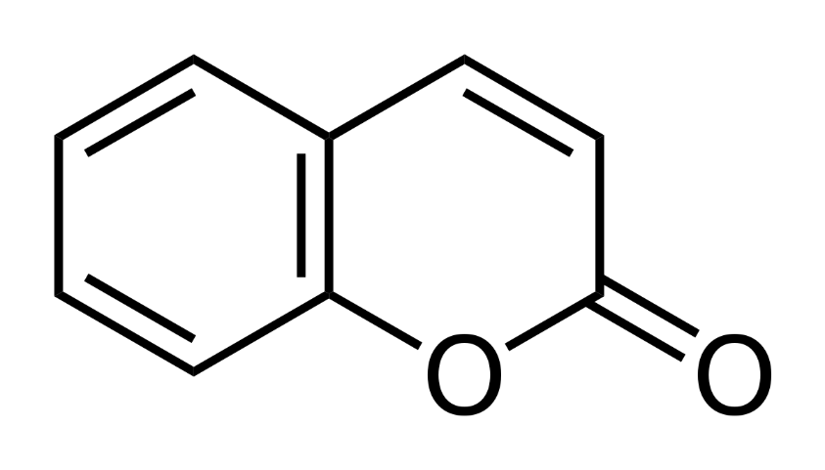
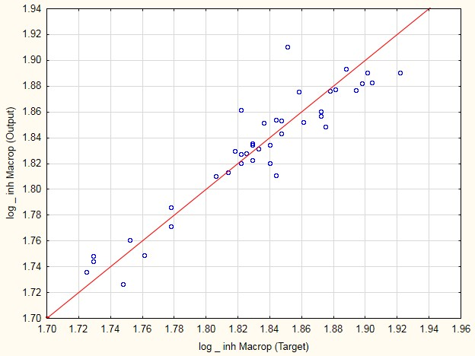
QSAR study for antifungal activity of coumarin derivatives
Vesna Rastijaª, Melita Lončarić^{b}, Maja Karnašª, Karolina Vrandečićª, Jasenka Čosićª, Maja Molnar^{b}
ª Faculty of Agrobiotechnical Sciences Osijek, Josip Juraj Strossmayer University of Osijek, 31000 Osijek, Croatia
^{b} Faculty of Food Faculty Osijek, Josip Juraj Strossmayer University, 31000 Osijek, Croatia
sijek, Croatia
computer-aided molecular design
Coumarins
screening
optimization
biological activities
design
new potent agents in plant protection
antifungal
antioxidant
antibacterial
nematocidal
antiviral
Synthesized of Coumarin Derivatives
antifungal evaluation
(Macropomina phaseolina, Sclerotinia sclerotiorum)
S. sclerotiorum
Used molecular descriptors:
3D-MoRSE (Mor19v); Moran autocorrelation (MATS7v); relative negative charge (RNCG AM1); and E-States, the sum of (- CH2 -) (SssCH2),
Quantitative Structure Activity Relationship) QSAR
The artificial neural networks (ANN) analysis
M. phaseolina
Used molecular descriptors:
geometrical symmetry (SYMM2); MATS4m; MATS5m; and sum of (= C<) (SdssC)
Results of ANN analysis
Graphs of observed against calculated values using ANN models for:
Sclerotinia sclerotiorum;
Macropomina phaseolina .
a)
b)
Conclusions:
relationship between the structures of coumarine and antifungal activity is not linear
ANN could be performed for further research of more effective coumarin agents against the pathogen fungi.
Literature:
Melita Lončarić, Martina Sušjenka, Maja Molnar, Current Organic Synthesis, 2020, 17, 98-108
FUNDING
This work has been supported in part by Croatian Science Foundation under the project “Green Technologies in Synthesis of Heterocyclic Compounds” (UIP-2017-05-6593).

