Slide 1
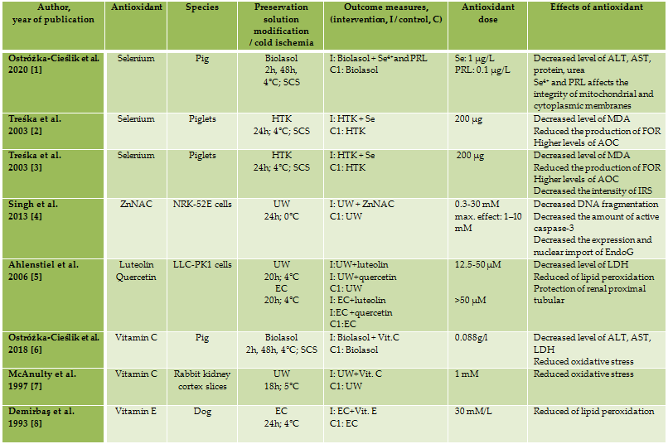
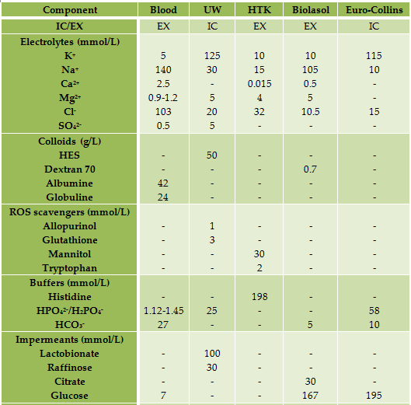
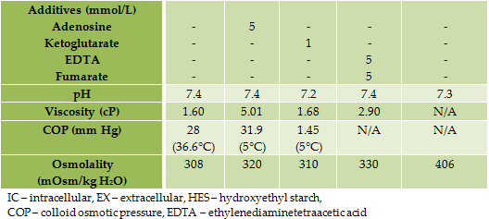
The effect of antioxidants added to preservation solution on the protection of kidneys before transplantation
Aneta Ostróżka-Cieślik, Barbara Dolińska
Department of Pharmaceutical Technology, Faculty of Pharmaceutical Sciences in Sosnowiec, Medical University of Silesia in Katowice, Kasztanowa 3, 41-200 Sosnowiec, Poland
Background: The maximum storage time for the kidneys prior to transplantation using the static cold storage method is 30 hours. During this period, damage to the renal tubules may occur as a consequence of cold ischemia and reperfusion. In the cells, biochemical changes and microcirculation disorders are observed, which can lead to delay graft function. The purpose of the organ perfusion and preservation solutions is to minimize these processes. The development of a fluid composition that would ensure high protection of grafts during ischemia-reperfusion is the current direction of research and a challenge. The aim of the analysis was to evaluate the effectiveness of antioxidants as components of preservation solution in kidney protection based on a literature review.
Method: Two independent analysts searched the medical databases of Medline/PubMed, Embase, and Cochrane Library between October 5 and October 10, 2020. The following keywords were used: transplantation, kidney, cold storage, solution preservation, ischemia-reperfusion injury, additives, antioxidants, trace metals, bioflavonoids. There was no time limit for publication date.
Results: The analysis of the literature showed a significant correlation between the use of the preservation solution that composition was modified by the addition of an antioxidant (vitamin C/E, selenium, zinc, bioflavonoids) and their effectiveness in kidney protection. It is suggested that antioxidants counteract free radical damage. They protect nephrons against oxidative stress and protect cell membranes against peroxidative damage.
Conclusion: The antioxidants added to the preservation solution counteract damage to the nephrons that result from the excessive generation of oxygen free radicals during ischemia-reperfusion.
Ostróżka-Cieślik, A.; Dolińska, B.; Ryszka, F. Therapeutic Potential of Selenium as a Component of Preservation Solutions for Kidney Transplantation. Molecules 2020, 25, 3592.
Třeška, V.; Kuntscher, V.; Molacek, J.; Kobr, J.; Racek, J.; Trefil, L. Can the ischemia-reperfusion syndrome in transplanted kidneys procured from non-heart-beating donors be influenced by adding selenium into the reperfusion solution? An experimental study. Transplant. Proc. 2003, 35, 1584–1586.
Třeška, V.; Kuntscher, V.; Molacek, J.; Kobr, J.; Racek, J.; Trefil, L. Can ischemia-reperfusion syndrome in transplanted kidneys procured from non-heart-beating donors be influenced by adding selenium into the reperfusion solution? An experimental study. Transplant. Proc. 2003, 35, 3125–3127.
Singh, M.; Odeniyi, D.T.; Apostolov, E.O.; Savenka, A.; Fite, T.; Wangila, G.W.; Walker, R.B.; Basnakian, A.G. Protective effect of zinc-N-acetylcysteine on the rat kidney during cold storage. American journal of physiology. Renal Physiol. 2013, 305(7), F1022–F1030.
Ahlenstiel, T.; Burkhardt, G.; Köhler, H.; Kuhlmann, M.K. Improved cold preservation of kidney tubular cells by mensa of adding bioflavonoids to organ preservation solutions. Transplantation. 2006, 81(2), 231-239.
Ostróżka-Cieślik, A.; Dolińska, B.; Ryszka, F. The effect of modified biolasol solution on the efficacy of storing isolated porcine kidneys. BioMed Res. Int. 2018, 2018, 1–7.
McAnulty, J.F.; Huang, X.Q. The efficacy of antioxidants administered during low temperature storage of warm ischemic kidney tissue slices. Cryobiology. 1997, 34, 406-415.
Demirbaş, A.; Bozoklu, S.; Ozdemir, A.; Bilgin, N.; Haberal, M. Effect of alpha-tocopherol on the prevention of reperfusion injury caused by free oxygen radicals in the canine kidney autotransplantation model. Transplant Proc. 1993, 25(3), 2274.

