Slide 1
Dual- and multi-action Pt(IV) antitumor prodrugs or how to kill two birds with one stone
Mauro Ravera*, Elisabetta Gabano, and Domenico Osella
Dipartimento di Scienze e Innovazione Tecnologica, Università del Piemonte Orientale, Viale Michel 11, 15121 Alessandria Italy
Corresponding author: mauro.ravera@uniupo.it
Notes:
Prova

Slide 2
Dual- and multi-action Pt(IV) antitumor prodrugs or how to kill two birds with one stone

Slide 3
Abstract:
Although targeted- and immuno- therapies are nowadays considered among the most promising tools in fighting cancer, combination protocols including new biologically-smart agents and old cytotoxic drugs (the Pt(II)-based ones, in particular) result to be useful, especially against very aggressive tumors.
Octahedral Pt(IV) derivatives are intensively studied as prodrugs, being deprived of most of the heavy side effects of cisplatin and suitable to be administered orally. These complexes reach tumor cells in their intact form and then are reduced (ideally only) in the hypoxic intracellular milieu to cytotoxic cisplatin, with the simultaneous loss of the two remaining ligands from the axial position (activation by reduction). The well-established Pt(IV) chemistry permits to design dual-action drug candidates that can act as single-molecule combination-therapy, often called combo. Indeed, two adjuvant/synergistic drugs (generally in form of carboxylates) are conjugated to the Pt(IV) core (frequently obtained by cisplatin oxidation) in axial positions. These Pt(IV) derivatives are much more lipophilic than their progenitors (i.e., the hydrophilic cisplatin and the amphiphilic carboxylate anions). Their assembly permits a more efficient cellular uptake (via passive diffusion) than that of the separate components (synergistic cellular accumulation), increasing the intracellular concentration of the two drugs.
Nowadays, dozens of dual- or even multi-action antitumor Pt(IV) prodrugs (mitochondria-targeted complexes, glutathione-S-transferase-targeted complexes, cyclooxygenases inhibitors, histone deacetylase inhibitors, etc.) have been designed, synthesized and tested in vitro and in vivo, and a number of them moved into clinical trials. In this presentation some prototypal Pt(IV) prodrugs will be shown as case studies.
Keywords: anticancer activity; cisplatin; metal-based drugs; prodrugs; Pt complexes.

Slide 4
Introduction
cis-diamminedichloridoplatinum(II), cisplatin, CDDP
FDA Approval: Dec 19, 1978.
Awards: WHO Model List of Essential Medicines since 1991.^{1,2}
Indications: cervical, head and neck, nasopharyngeal, non-small cell lung cancers, osteosarcoma, ovarian and testicular germ cells tumors. ²
(Main) Final target: DNA
Possible side effects: nausea, vomiting, diarrhea, hair loss, hiccups, nephrotoxicity, ototoxicity, neuropathy and myelosuppression, etc.
Resistance: reduced drug uptake and/or increased drug efflux; improved repair or tolerance of DNA–cisplatin adducts.
Alternative metal-based compounds: different DNA-binding modes or different cellular targets, complexes accumulated or activated only in the tumor tissue, etc.
¹K. Sikora et al., Ann. Oncol., 1999, 10, 385 (doi); ²WHO Model List of Essential Medicines, 21st ed., June 2019. http://www.who.int/medicines/publications/essentialmedicines/; ³T.C. Johnstone et al., Chem. Rev., 2016, 116, 3436 (doi).

Slide 5
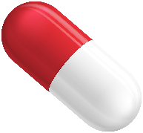
Introduction
Why Pt(IV) complexes?
kinetic inertness: limited ligand substitution, fewer side effects, administration per os.
redox properties: in vivo reduction under the hypoxic conditions of the tumor site.⁴
⁴D. Gibson, Dalton Trans., 2016, 45, 12983 (doi).
administration
blood
cytosol
nucleus

Slide 6
Introduction
Why Pt(IV) complexes?
kinetic inertness: limited ligand substitution, fewer side effects, administration per os.
redox properties: in vivo reduction under the hypoxic conditions of the tumor site.⁴
modular platform:
Leaving ligands:
Activation kinetics
Systemic toxicity (off-target reactions)
Carrier ligands:
Nature of Pt-DNA adduct
Selectivity
Resistance profile
Axial ligands:
Lipophilicity / solubility
Reduction (thermodynamic / kinetics)
Vectors for drug targeting and delivery
Second drug
Am = am(m)ine/s; X = carboxylatos, halidos, etc.⁵
⁴D. Gibson, Dalton Trans., 2016, 45, 12983 (doi); ⁵Figure adapted from: J.J. Wilson, S.J. Lippard, Chem. Rev., 2014, 114, 4470 (doi).

Slide 7
Introduction
Why bifunctional or dual-action compound?
Treatment of cancer by attacking one pathway at a time and disregarding its complexity and redundancy is destined to fail (combination therapy).
A drug with a complementary mode of action can be coordinated to the Pt(IV) core, so that the final conjugate can operate on multiple targets with greater potency than a single-target drug (a sort of intramolecular combination therapy).^{6,7}
⁶E. Gabano et al., Dalton Trans., 2014, 43, 9813 (doi); ⁷R.G. Kenny et al., Eur. J. Inorg. Chem., 2017, 1596 (doi)

Slide 8
Introduction
Which bifunctional or dual-action compound?
Pt(IV)
core
Valproic
acid
Suberoylanilide Hydroxamic Acid (SAHA)
p53
activators
NSAIDs
α-tocopherol
succinate
Dichloro-
acetate
Bis-
phosphonates
Ethacrinic
acid
Retinoic acid
Nitrogen mustard
Paclitaxel
…and many others…
⁶E. Gabano et al., Dalton Trans., 2014, 43, 9813 (doi); ⁷R.G. Kenny et al., Eur. J. Inorg. Chem., 2017, 1596 (doi)

Slide 9
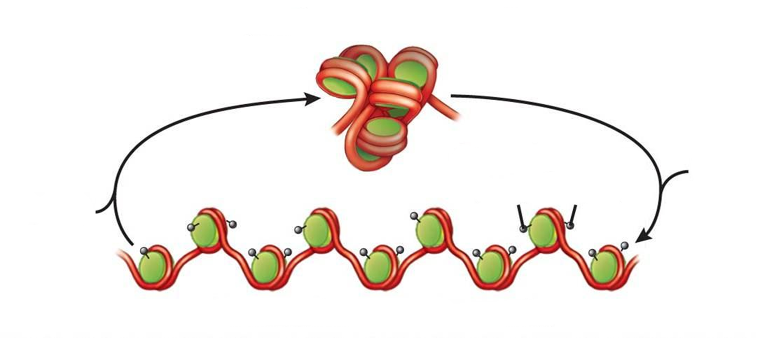
Results and discussion
Inhibition of histone deacetylase
Histones are a family of positively charged proteins that are bound to the negatively charged DNA. The N-ε-Lys acetylation and deacetylation of histone are controlled by two groups of enzymes: HAT and HDAC.
Condensed chromatin
histone acetyltransferase (HAT)
histone deacetylase (HDAC)
acetyl groups on histone
Decondensed chromatin
Inhibitors of HDAC (HDACi) decrease expression of chromatin maintenance proteins. The chromatin’s morphology transforms into a more chemo-sensitive conformation.

Slide 10
Results and discussion
The target
J. Yang et al., Mol. Pharm., 2012, 9, 2793; M. Ravera et al., J. Inorg. Biochem., 2013, 129, 52; V. Novohradsky et al., J. Inorg. Biochem., 2014, 140, 72 and Biochem. Pharmacol., 2015, 95, 133; R. Raveendran et al., Chem. Sci., 2016, 7, 2381; M. Ravera et al., Dalton Trans., 2017, 46, 1559; V. Novohradsky et al., Sci. Rep., 2017, 7, 3751.
HDAC
The conjugate
The "bullet"
Medium chain fatty acids are a class of HDAC inhibitors.
Pt-(VPA)₂
Valproic acid,
VPA

Slide 11
Results and discussion
The results
Pt-(VPA)₂ shows a much higher antiproliferative activity than CDDP and VPA in a variety of cancer cell lines.
Cell lines | Pt-(VPA)₂ IC₅₀ [nM] | CDDP IC₅₀ [μM] | VPA IC₅₀ [mM]
A2780 | 11.1±0.3 | 0.5±0.1 | 1.8±0.7
HCT116 | 77.1±1.3 | 2.3±0.3 | 1.3±0.2
A549 | 158±35 | 3.8±0.7 | 0.8±0.5
MCF-7 | 155±49 | 6.5±0.9 | 4.8±1.1
MM98 | 273±42 | 3.2±1.0 | 3.9±0.9
MM98R | 245±53 | 19.4±2.8 | 3.5±0.7
Comparison of IC₅₀ values. Key: ovarian A2780, colon HCT116, lung A549, breast MCF7 carcinomas, malignant pleural mesothelioma MM98 and CDDP-resistant subline MM98R.
M. Ravera et al., J. Inorg. Biochem., 2013, 129, 52 (doi)

Slide 12
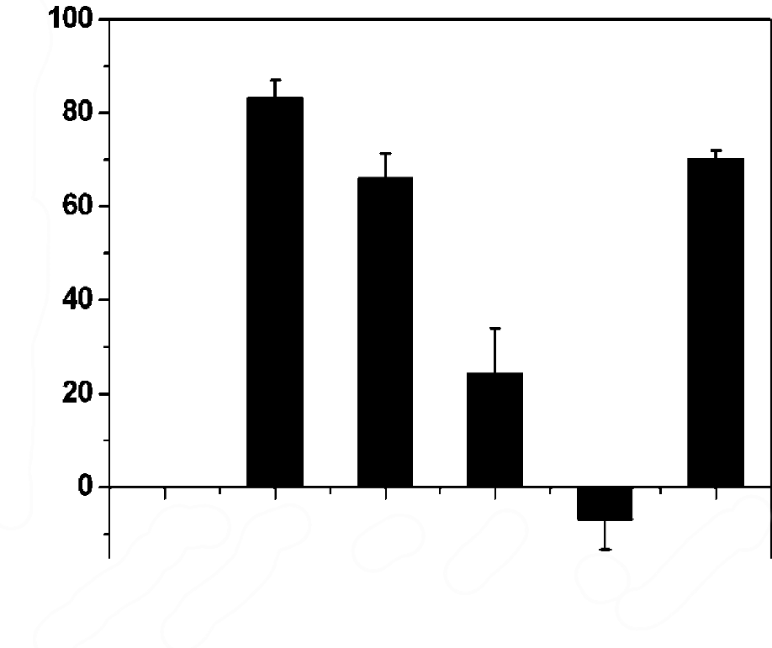
Results and discussion
The results
Two explanations have been proposed
1. synergism between CDDP and VPA metabolites
HDAC inhibitory efficiency (%)
HDAC inhibitory activities of the nuclear extract of HeLa cells treated with 5 mM VPA-equivalent dose of VPA, Pt-(VPA)₂, or Pt-(VPA)₂ pretreated with 5 mM ascorbic acid, AA, at 37 °C for 10 h. In the case of Pt-(VPA)₂, 5 mM is ∼25,000×IC₅₀, for VPA is ∼IC₅₀.
(- ) CTRL
(+) CTRL
VPA
Pt-(VPA)₂
AA +
Pt-(VPA)₂
AA
J. Yang et al., Mol. Pharm., 2012, 9, 2793 (doi)

Slide 13
Results and discussion
The results
Two explanations have been proposed
2. high lipophilicity
LIPOPHILICITY ↑
CELL UPTAKE ↑
POTENCY ↑
Cell lines | VPA IC₅₀ [mM] | CDDP IC₅₀ [μM] | Pt-(VPA)₂ IC₅₀ [nM] | CDDP AR | Pt-(VPA)₂ AR
A2780 | 1.8±0.7 | 0.5±0.1 | 11.1±0.3 | 1.5±0.5 | 18.6±5.4
HCT116 | 1.3±0.2 | 2.3±0.3 | 77.1±1.3 | 2.0±1.2 | 15.4±2.3
Accumulation Ratio, AR, is the ratio between intra- and extra-cellular [Pt] after 4 h treatment with 10 μM Pt complexes.
M. Ravera et al., J. Inorg. Biochem., 2013, 129, 52 (doi)

Slide 14
Results and discussion
The results
It has been demonstrated that free VPA hardly enter cells, but, as a result of the high lipophilicity of Pt-(VPA)₂, there was an enhanced uptake of Pt that obviously parallels the enhanced uptake of VPA (synergistic accumulation).
Compounds | moles Pt per 10⁶ cells | moles VPA per 10⁶ cells
Pt-(VPA)₂ | 2.2×10⁻¹¹ | 4.4×10⁻¹¹
VPA | - | 6.2×10⁻¹⁵
Uptake of the compounds (0.35 μM) into ovarian A2780 cells after 24 h of exposure.
V. Novohradsky et al., Biochem. Pharmacol., 2015, 95, 133 (doi)

Slide 15
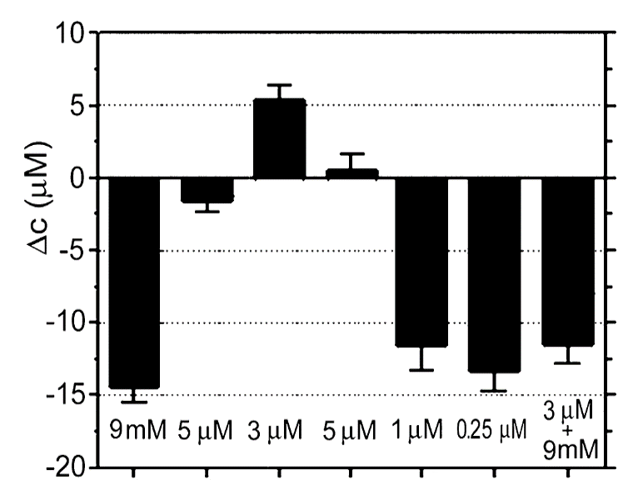
Results and discussion
The results
What about HDAC inhibition?
Effect of several compounds on HDAC activity in A2780 cells. The cells were treated for 24 h with the equitoxic concentrations of the agents corresponding to their IC₅₀ values (with VPA also at the 5 μM concentration). The Δc values were computed by subtracting the concentration of deacetylated product in the control (untreated) cells, from the concentration of deacetylated product in the treated cells.
VPA
VPA
Pt-(Ac)₂
CDDP
Pt-(Ac)VPA
Pt-(VPA)₂
CDDP
+VPA
V. Novohradsky et al., Biochem. Pharmacol., 2015, 95, 133 (doi)

Slide 16
Results and discussion
The target
The conjugate
HDAC
Pt-POA
L = rac-POA⁻
Pt-R-POA
L = R-POA⁻
Pt-S-POA
L = S-POA⁻
The "bullet"
2-(2-propynyl)octanoic acid, POA.
rac-POA; R-POA; S-POA
E. Gabano et al., Dalton Trans., 2017, 46, 14174 (doi)

Slide 17
Results and discussion
E. Gabano et al., Dalton Trans., 2017, 46, 14174 (doi)
The results (in vitro)
Also in this case the conjugates are better than the “fragments” CDDP and POA.
Cmpd | Unit | IC₅₀ (mean±standard deviation, sd)
 |  | A2780 | NT2/D1 | A549 | HCT 116 | MCF-7
POA | μM | 237±65 | 94±18 | 521±288 | 439±279 | 319±119
CDDP | μM | 0.5±0.1 | 0.10±0.04 | 3.6±0.9 | 2.3±0.3 | 3.3±0.2
Pt-POA | nM | 8±1 | 4±1 | 129±44 | 29±11 | 474±56
Pt-R-POA | nM | 13±4 | 5±2 | 115±27 | 50±24 | 215±119
Pt-S-POA | nM | 14±5 | 4±2 | 84±40 | 37±2 | 301±68
Antiproliferative activity (IC₅₀) obtained after 72 h of treatment of ovarian carcinoma A2780, testicular cancer NT2-D1, colorectal cancer HCT 116, lung carcinoma A549, and breast adenocarcinoma MCF-7 cell lines.

Slide 18
Results and discussion
E. Gabano et al., Dalton Trans., 2017, 46, 14174 (doi)
The results (in vitro)
A robust inhibition of HDAC activity was observed for POAs, whereas the Pt-POA series caused a less important decrease.
HDAC activity after 24 h of treatment of A2780 cells with IC₅₀ concentrations of the complexes (1 μM) and POAs (5 mM).
Data are means ± sd of three experiments performed in triplicate and were compared by means of a two-tailed t-test (* p<0.05; ** p<0.01).

Slide 19
Results and discussion
E. Gabano et al., Dalton Trans., 2017, 46, 14174 (doi)
The results (in vivo)
Pt-POA induced an impressive reduction of the tumor mass of 94%, whereas CDDP induced a tumor regression of 75%.
Cmpd | Daily dose [mg kg⁻¹] | Average tumor weight [g] | Inhibition of tumor growth [%]
control | 0 | 0.542±0.16 | 0
CDDP | 1.5 | 0.135±0.09 | 75
Pt-POA | 20 | 0.037±0.02 | 94
In vivo antitumor activity of Pt-POA and CDDP. Lewis lung carcinoma (LLC) was implanted intramuscularly in C57BL mice and from day 7 to 14 animals received daily Pt-POA (per os) or CDDP (ip). At day 15 animals were sacrificed and the inhibition of tumor growth was determined.

Slide 20
Results and discussion
E. Gabano et al., Dalton Trans., 2017, 46, 14174 (doi)
The results (in vivo)
Total platinum levels determined in organs of mice treated with Pt-POA after a single dose oral application (20 mg kg⁻¹).
Body weight changes of LLC-bearing C57BL mice treated with vehicle or Pt compounds.
A significant Pt content was present into the tumor mass.
Pt-POA did not induce body weight loss.

Slide 21
Conclusions
Dual-action Pt(IV) complexes
Active bioligands can be coordinated to the Pt(IV) core. The coordination should not affect its biological activity.
Activation by reduction will (should) release the two metabolites (Pt(II) and bioligand).
A strong rationale should support the synergism. The synergism should occur for co-treatment of the components at the same or similar concentrations. Some effect may be enhanced by synergistic accumulation.
If these constrains are satisfied, dual-action Pt(IV) antitumor prodrugs may represent an alternative worthy to be further explored in clinical practice.

Slide 22
Acknowledgments
Elisabetta Gabano
Domenico Osella
Elena Perin
Beatrice Rangone
Maurizio Sabbatini
Ilaria Zanellato
Valentina Astesana
Maria Grazia Bottone
Serena Camuso
Beatrice Ferrari
Martina Gilodi
Irene Masiello
Erica Cecilia Priori
Elisa Roda
Francesca Urselli
Paola Veneroni
Cristina Marzano
Valentina Gandin
HERMES project
Project funded by offer of compensation to the residents of Casale Monferrato (Italy) died or suffering from mesothelioma

