Slide 1
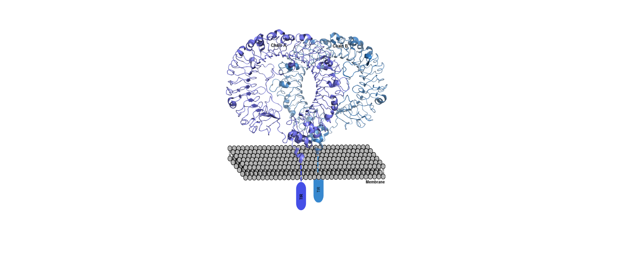
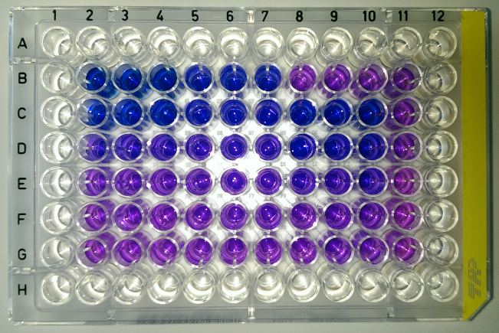
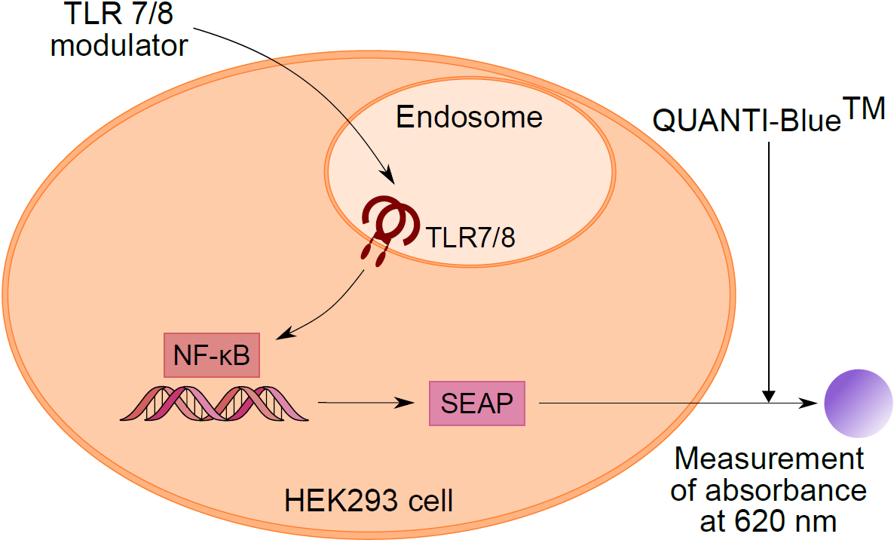
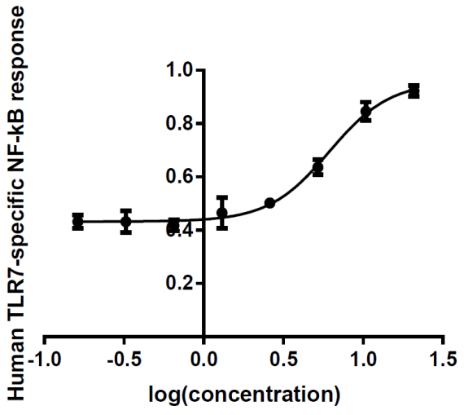
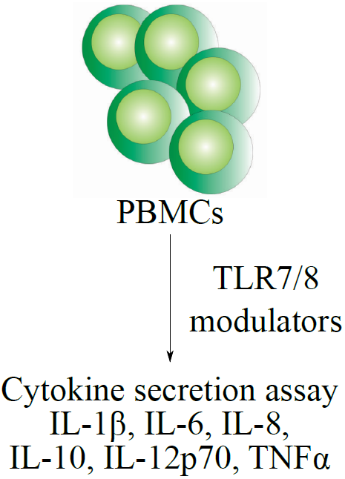
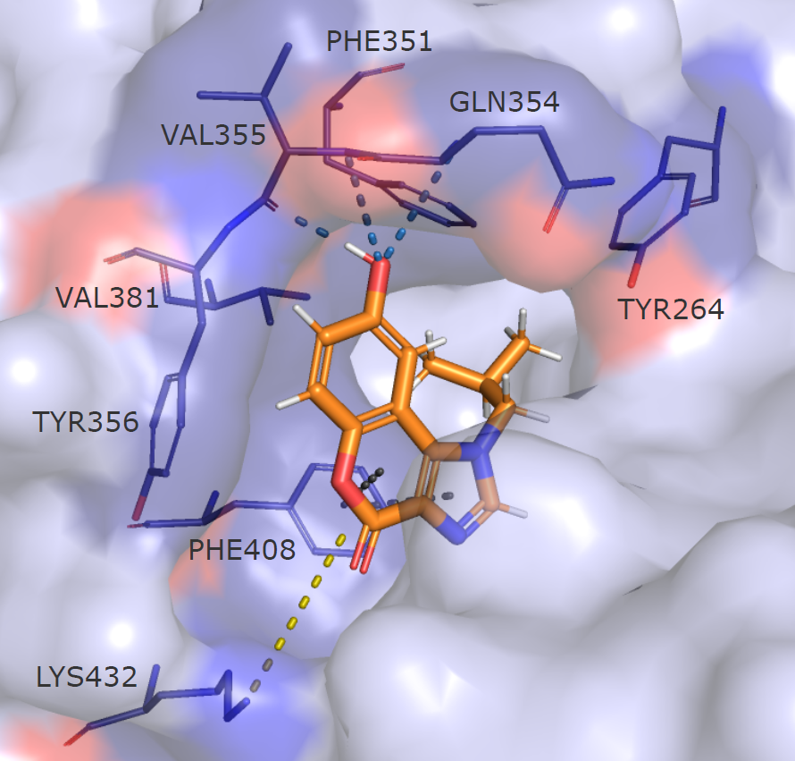
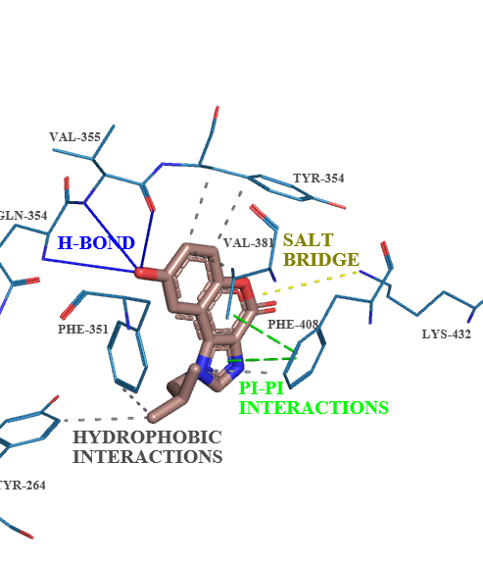
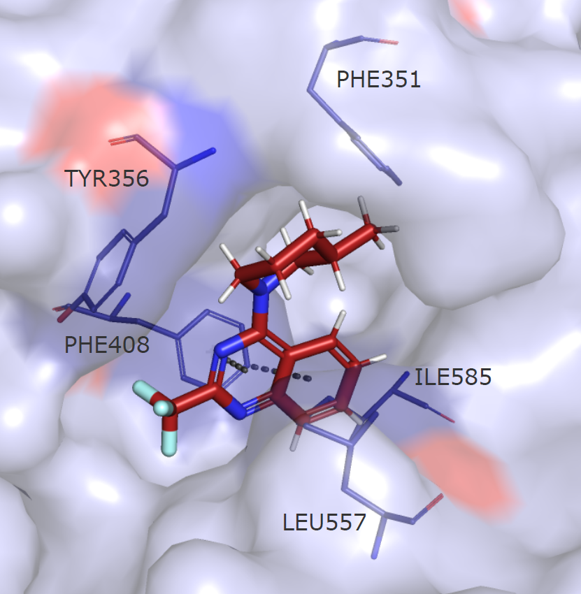
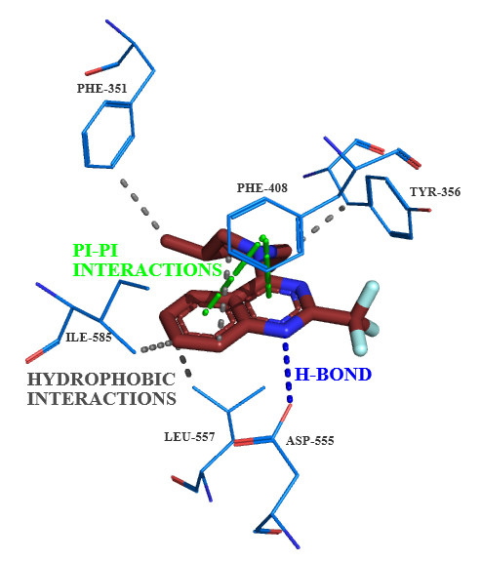
Discovery of novel selective TLR7 agonists based on chromeno[3,4-d]imidazol-4(1H)-one and 2-(trifluoromethyl)quinoline/ quinazoline-4-amine scaffold
Ana Dolšak,¹ Urban Švajger,² Samo Lešnik,³ Janez Konc,³ Stanislav Gobec,¹ Matej Sova¹
¹ University of Ljubljana, Faculty of Pharmacy, Aškerčeva 7, SI-1000 Ljubljana, Slovenia
² Blood Transfusion Centre of Slovenia, Šlajmerjeva 6, SI-1000 Ljubljana, Slovenia
³ National Institute of Chemistry, Hajdrihova 19, SI-1001 Ljubljana, Slovenia
bbbb
TOLL-LIKE RECEPTORS (TLRs) AS TARGETS
13 types
Intracellular on endosome:
TLR3, TLR7, TLR8, TLR9
Drug on the market - TLR7 agonist IMIQUIMOD
- used only locally on the skin
- unfavorable pharmacokinetic properties
(induce strong local and systemic inflammatory reactions)
the need for novel small molecule TLR modulators!
IN SILICO DESIGN
Ligand-based virtual screening (ROCS, LiSiCA)
SYNTHESIS
Three scaffolds – development and optimization of synthetic procedures
RESULTS
CHROMENOIMIDAZOLONE series
RES
QUINOLINES
RESULTS
QUINAZOLINE series
BIOLOGICAL EVALUATION
- TLR7 and TLR8 agonist activity evaluation
- HEK293 cell line, co-transfected with hTLR7 or hTLR8 gene and an inducible
SEAP reporter gene
- EC₅₀ determination
RESULTS: selective agonist activity on TLR7
CYTOKINE SECRETION ASSAY
MOLECULAR DOCKING STUDY
.
Compound 5
Compound 4
Reference: Dolšak, A. et al., Eur J Med Chem, 2019, 18; 179: 109-122
Acknowledgements: Slovenian Research Agency (research core funding No. P1-0208, project grant
BI-US/18-20-087 and junior researcher's programme for Ana Dolšak)

