Slide 1
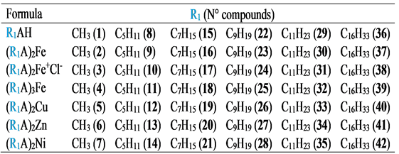
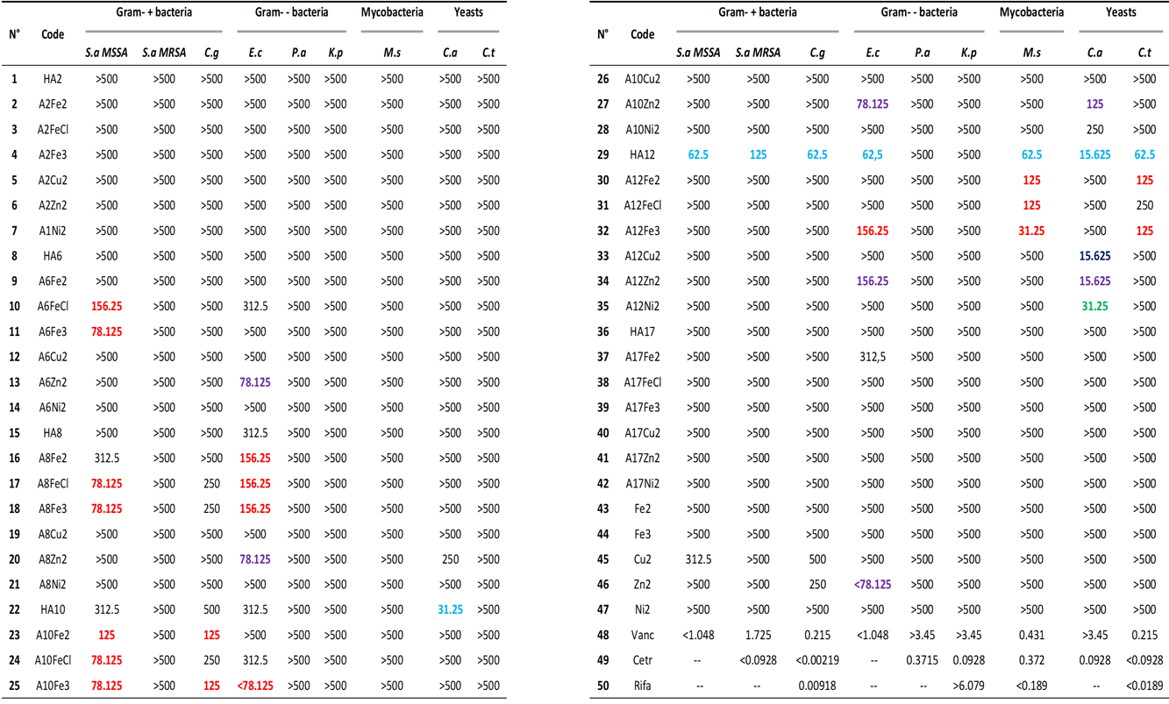
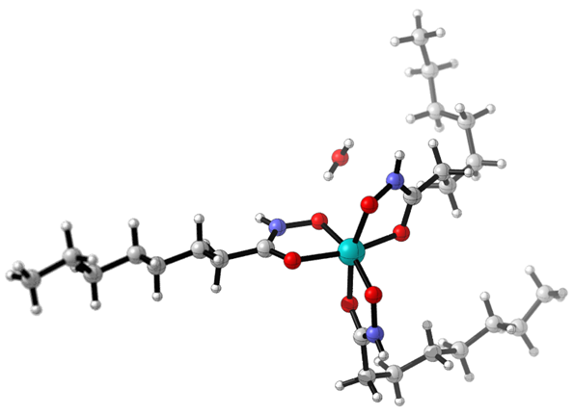
Synthesis and antibacterial, antimycobacterial and antifungal activities of Fe(II), Fe(III), Cu(II), Zn(II) and Ni(II) complexes of aliphatic hydroxamic acids
Ibrahima Sory Sow¹, Michel Gelbcke¹, Franck Meyer¹, Dong Yang¹, Koen Robeyns² , Véronique Fontaine¹ and François Dufrasne¹
¹ Microbiology, Bio-Organic and Macromolecular Chemistry, Université Libre de Bruxelles, Belgique; ² Institute of Condensed Matter and Nanosciences, Molecular Structural Analysis, Université catholique de Louvain, Belgique
1. Introduction: Hydroxamic acids show interesting biological properties described in the literature [1], particularly against bacteria, tumoral cells, fungi [2,3,4] and mycobacteria [5,6]. In the present project we aim at more deeply and systematically exploring the biological properties of Fe(II), Fe(III), Cu(II), Zn(II) and Ni(II) complexes of aliphatic hydroxamic acids with variable chain lengths [7]. We investigate the effect of lipophilicity on the biological activity. The synthesis of Fe(II), Fe(III), Cu(II), Zn(II), Ni(II) complexes with C₂, C₆, C₈, C₁₀, C₁₂ and C₁₇ hydroxamic acids and their effects on bacteria, mycobacteria and yeasts are described.
2. Synthesis:
Table 1: Formula of R₁
Scheme 1: Synthetic routes for preparation of hydroxamic acids and complexes 1—42.
Reagents and conditions: a = Et₂O, b = ClCOOEt, c = O(CH₂CH₂)NCH₃, d = NH₂OH, e = FeCl₂ (43),
f = FeCl₃ (44), g = CuCl_{2·}2H₂O (45), h = ZnCl₂ (46), i = NiCl_{2·}6H₂O (47), j = MeOH, k = NaOH (1 M),
0°C and room temperature (r.t).
3. Results. Table 2: Minimum inhibitory concentration (µM) values biological assays against: Gram-positive/-negative bacteria, mycobacteria and yeasts of hydroxamic acids and their complexes (1–42) (see Table 1).
Figure 1: Crystal structure obtained by X-ray diffraction of A8Fe3 (18).
S.a MSSA: methicillin-sensitive Staphylococcus aureus,
S.a MRSA: methicillin-resistant Staphylococcus aureus,
C.g: Corynebacterium glutamicum,
E.c: Escherichia coli,
P.a: Pseudomonas aeruginosa,
K.p: Klebsiella pneumoniae,
M.s: Mycobacterium smegmatis,
C.a: Candida albicans
C.t: Candida tropicalis,
Van: Vancomycin (48),
Cetr: Cetrimide (49)
Rifa: Rifampicin (50).
4. Conclusion and perspective : The results of the in vitro test carried out support the hypothesis that the length of the R₁ group chain and the type of coordination metal have an effect on antimicrobial activity. The toxicity of compounds with significant antibacterial and antifungal activity will be investigated on cervical cancer cells and the cell penetration of the most promising compounds will be determined.
[1] Alam et al. Cur. Org. Chem. 2019, [2] Karger, Horst Kehl N.Y 1982.; [3] Maehr et al. Pure Appl. Chem. 1971; [4] Hase et al. Chem. Pharm. Bull. 1971; [5] Urbanski, Nature, 1950; [6] Urbanski et al. Nature, 1952; [7] O’Brien et al. J. of Inorg. Biochem. 2000; [8] Brown et al. Inorg. Chem. 1983; [9] Aliyu et al. Asian J. of Chem. 2011; [10] Bayer et al. from Patentschrift, 1967; [11] Zhu et al. N.P.C, 2011; [12] Darren et al. J. of Inorg. Biochem., 2011; [13] Reddy et al. Tetrahedron letters, 2000; [14] Cerniauskaite et al. Eur. J. Org. Chem. 2011; [15] Brown et al. M.R. In Chemi. 1988; [16] Devlin et al. J. Chem. Soc. 1975.

