Slide 1
Synthesis of potential bioactive benzo-, pyrido- or pyrazinothieno[3,2-d]pyrimidin-4-amine analogs of MPC-6827
Yvonnick Loidreau ¹, Marie-Renée Nourrisson ², Corinne Fruit ¹, Cécile Corbière ³, Pascal Marchand ²,* and Thierry Besson ^{1,*}
¹ Normandie Univ, UNIROUEN, INSA Rouen, CNRS, COBRA UMR 6014, 76000 Rouen, France.
² Université de Nantes, Cibles et médicaments des infections et du cancer, IICiMed, EA 1155, F-44000 Nantes, France.
³ Normandie Univ, UNIROUEN, ABTE, 76000 Rouen, France.
* Corresponding authors: pascal.marchand@univ-nantes.fr; thierry.besson@univ-rouen.fr

Slide 2
Synthesis of potential bioactive benzo-, pyrido- or pyrazinothieno[3,2-d]pyrimidin-4-amine Analogs of MPC-6827
Graphical Abstract

Slide 3
Abstract: Efficient microwave-assisted chemical processes were applied to the synthesis of an array of novel N-(4-methoxyphenylamino)-2-methyl benzo-, pyrido- or pyrazino-thieno[3,2-d]pyrimidin-4-amine derivatives. These heteroaromatic systems were envisioned as potent bioisosteric analogues of MPC-6827, an anticancer agent previously developed until phase II clinical studies. A brief evaluation and comparison of their antiproliferative activity on HT-29 and Caco-2, two human colorectal cancer cell lines, were also reported. At the tested concentrations (5 and 10 µM), thieno[3,2-d]pyrimidin-4-amines 4a and 4c exhibited an inhibitory effect similar to MPC-6827 on human colorectal cancer cell proliferation.
Keywords: Microwave-assisted chemistry; thieno[3,2-d]pyrimidines; colorectal cancer; HT-29 cells; caco-2 cells; antiproliferative activity

Slide 4
Introduction
MPC-6827 (N-(4-methoxyphenylamino)-N,2-dimethylquinazoline) has been extensively studied for its therapeutic use against cancer.
Also named Azixa or Verubulin, MPC-6827 is a microtubule destabilizing agent with a dual mode of action :
It leads to apoptosis by blocking cell cycle
and to growth inhibition on several types
of cancer such as breast, colon or ovarian.
It reduces blood supply to the tumors.
Cancer Res. 2007, 67, 5865–5871, doi:10.1158/0008-5472.CAN-07-0127.
J. Med. Chem. 2008, 51, 4771–4779, doi:10.1021/jm8003653.
Bioorg. Med. Chem. Lett. 2009, 19, 3536–3540, doi:10.1016/j.bmcl.2009.04.145.
J. Med. Chem. 2009, 52, 2341–2351, doi:10.1021/jm801315b.
Bioorg. Med. Chem. Lett. 2010, 20, 2330–2334, doi:10.1016/j.bmcl.2010.01.155.
ChemMedChem 2014, 9, 847–854, doi:10.1002/cmdc.201300531.

Slide 5
MPC 6827 was as a good candidate for phase I and phase II clinical trials in patients with metastatic melanoma and multiform glioblastoma. These investigations revealed some cardiotoxicity, leading to suspend its clinical development in Phase II.
MPC 6727 remains an excellent model for the design of potential cytotoxic agents.
Bioisosteric analogs of MPC-6827 were envisioned by extending and replacing the benzene part of this small molecule into an arylthiophene ring.
N-(4-methoxyphenylamino)-2-methyl benzo- pyrido- or pyrazino- thieno[3,2-d]pyrimidine derivatives envisioned in this work.
Mol. Cancer Ther. 2010, 9, 3410–3419, doi:10.1158/1535-7163.MCT-10-0516.
J. Neurooncol. 2012, 110, 257–264, doi:10.1007/s11060-012-0964-7.
J. Neurooncol. 2014, 118, 335–343, doi:10.1007/s11060-014-1437-y.
Oncologist 2011, 16, 1120–1130, doi:10.1634/theoncologist.2010-0432.
Bioorg. Chem. 2019, 83, 380–390, doi:10.1016/j.bioorg.2018.10.027.

Slide 6
Results and discussion: chemistry
Initial work of Sirisoma et al. described synthetic route of MPC-6827, from anthranilic acid methyl ester.
In the last step, 4-chloro-2-methylquinazoline was reacted with N-methyl-4-methoxyaniline in anhydrous propanol to give the target product in an overall yield of 55%.
Sirisoma, N. et al. J. Med. Chem. 2009, 52, 2341–2351, doi:10.1021/jm801315b.

Slide 7
Developing sustainable and convenient multicomponent processes our group investigated a novel and efficient two-step synthesis of MPC-6827: reaction of anthranilonitrile with N,N-dimethylacetamide dimethylacetal (DMA-DMA) at 115°C for 2 min and intense heating (200°C for 2 h) with N-methyl-p-anisidine, in N-methylpyrrolidone (NMP), in the presence of aluminum chloride (AlCl₃).
MPC-6827 was obtained in 71% yield, i.e. 64% over the two steps.
Foucourt, A. et al. Tetrahedron 2010, 66, 4495–4502, doi:10.1016/j.tet.2010.04.066.

Slide 8
The retrosynthetic route to the novel heteroarenes was envisioned via intramolecular cyclization of the key N,N-dimethylacetamidamidines (2), itselves obtained by formylation of the corresponding cyanoenamines (1).

Slide 9
First approach: via previous « MPC-6827 route »
According preceding works on MPC-6827, compound 2 was heated at 200°C for 2 h under microwave irradiation in the presence of N-methyl-p-anisidine and AlCl₃ in N-methylpyrrolidone (NMP). These operating conditions were unable to generate the target compounds.
Foucourt, A. et al. Tetrahedron 2010, 66, 4495–4502, doi:10.1016/j.tet.2010.04.066. Loidreau, Y. et al. Tetrahedron 2011, 67, 4852–4857, doi:10.1016/j.tet.2011.05.010.

Slide 10
Second approach: alternative two-step procedure from acetimidamides 2
For all series:
a : X = CH, Y = CH
b : X = CH, Y = N
c : X = N, Y = CH
d : X = N, Y = N
Compound 2 | Temp.¹ (°C) | Time² (min) | Yield³ (%) | Compound 3 | Temp.¹ (°C) | Yield³ (%) | Compound 4 | Yield³ (%)
a | 115 | 5 | 72 | a | 160 | 78 | a | 86
b | 115 | 5 | 74 | b | 160 | 37 | b | 90
c | 115 | 5 | 83 | c | 160 | 27 | c | 83
d | 100 | 2 | 61 | d | 140 | 59 | d | 74
¹ Temperature; ² Reaction time; ³ Isolated yields
For experimental details see: Loidreau, Y. et al. Pharmaceuticals 2020, 13, 89, doi : https://doi.org/10.3390/ph13050089.

Slide 11
Comments on chemistry part:
Microwave-assisted heating is still an efficient technology allowing reproducible and safe operating conditions when traditional multistep processes would need long reaction times and unstable and toxic reagents.
The innovative conditions previously described for the synthesis of MPC-6827 failed and a more traditional approach was investigate to provide compounds 4a-d.
The crucial part of our synthetic pathway is the cyclization step in which cyanoenamines 2 were converted into tricyclic compounds 3. Suggested mechanism is described below.

Slide 12
Results and discussion:
Antiproliferative activity on colorectal cancer cell lines (Caco-2 and HT29)
Preliminary results:
Anti-proliferative effects of compounds (3b-d) and (4a-d) was evaluated on Caco-2 cells and compared to MPC-6827. Each molecule was tested at two concentrations (5 and 10 µM), for 1, 24, 48 and 72 h. The benzo[4,5]thieno[3,2-d] pyrimidine 3a was not tested because of its insolubility in the conditions used. Proliferation of Caco-2 cells was not altered with molecules 3b, 3c, 3d, 4b and 4d (data not shown).
The two most interesting compounds (4a and 4c) were also tested on HT29 cells.

Slide 13
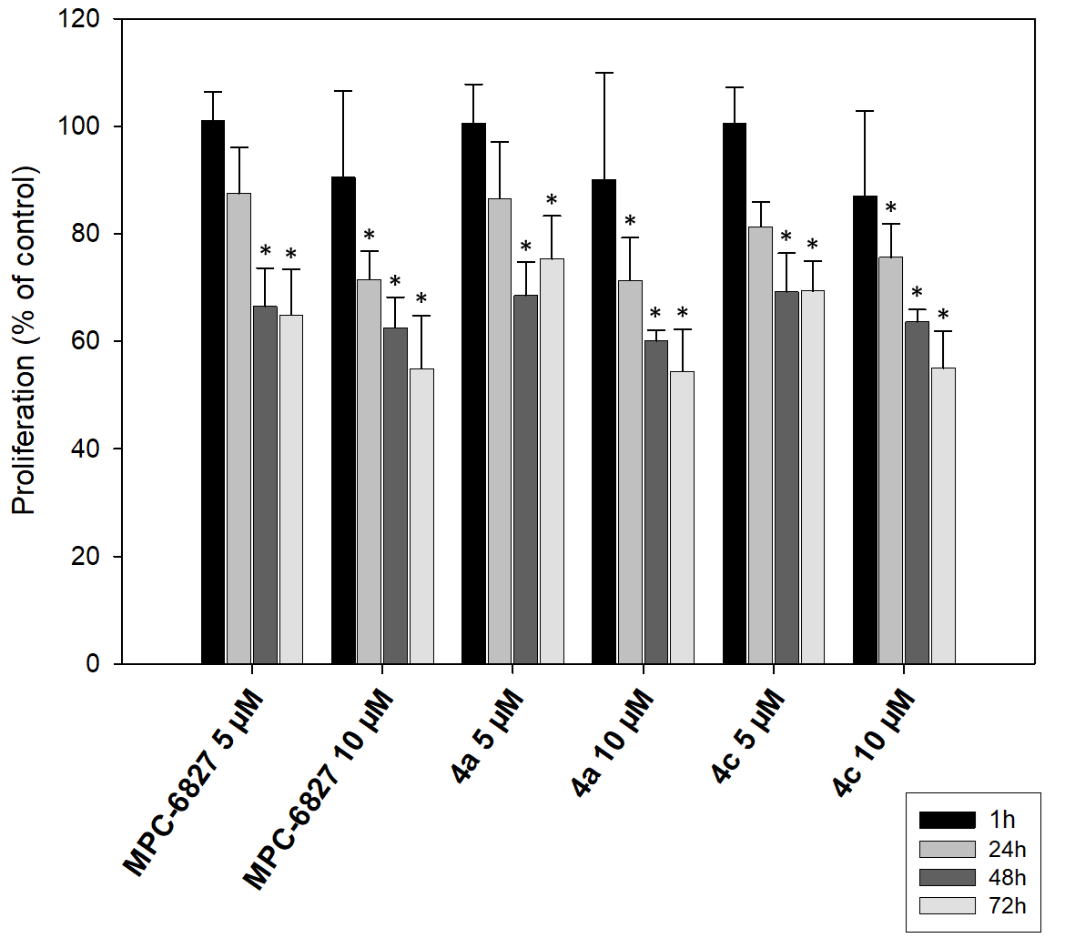
1) Results obtained on Caco-2 cells for 4a, 4c and MPC-6827.
Proliferation of Caco-2 cells treated with MPC-6827 (5 and 10 µM), 4a (5 and 10 µM) and 4c (5 and 10 µM) after 1, 24, 48 and 72 h of treatment. Proliferation was evaluated with MTT assay. Data are reported as the mean ± SD in percentage from three independent experiments. *P < 0.05 vs control that represented 100% of proliferation.

Slide 14
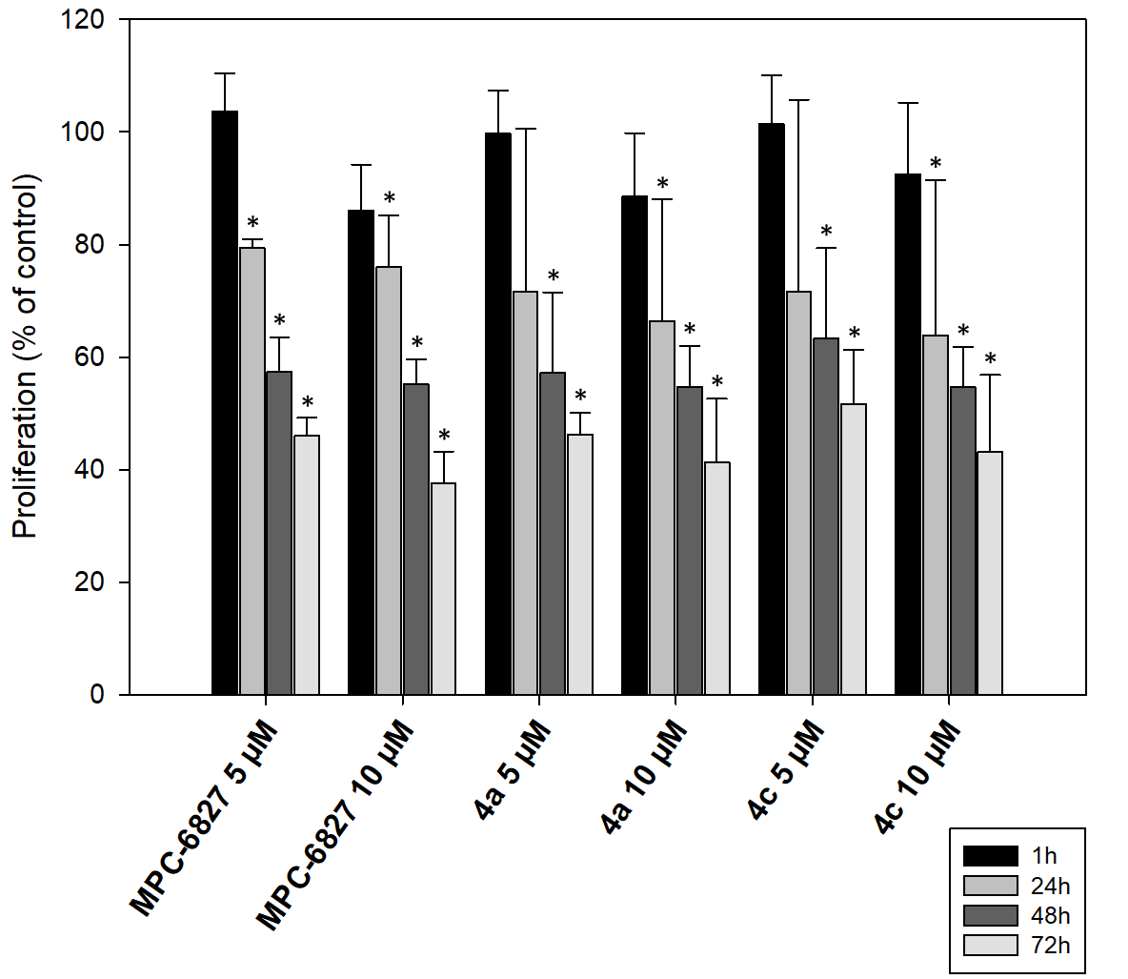
2) Results obtained on HT-29 cells for 4a, 4c and MPC-6827.
Proliferation of HT-29 cells treated with MPC-6827 (5 and 10 µM), 4a (5 and 10 µM) and 4c (5 and 10 µM) after 1, 24, 48 and 72 h of treatment. Proliferation was evaluated with MTT assay. Data are reported as the mean ± SD in percentage from three independent experiments. *P < 0.05 vs control that represented 100% of proliferation.

Slide 15
Comments on biological part
The results of the biological evaluation highlighted the interest of two compounds (4a and 4c) that possess antiproliferative properties on Caco-2 and HT-29 as interesting as MPC-6827 (Azixa or Verubulin).
Overall, the number of surviving Caco-2 cancer cells decreased in a time-dependent manner. More precisely, inhibition of the proliferation of Caco-2 colon cancer cells was 25% after 24 h of treatment with 10 µM concentration of 4c. Higher inhibitory effects measured after 48 h incubation are close to the final results observed after 72 h of experiment. In this case, proliferation of Caco-2 cells was significantly inhibited in the presence of 4a and 4c, in a manner equivalent to MPC-6827, with inhibitory effects of 30% and 45% at 5 µM and 10 µM, respectively.
As Caco-2 cells, HT-29 cancer cell proliferation was significantly inhibited in the presence of MPC-6827 and compounds 4a and 4c, after 72 hours of treatment. The growth inhibition of this HT-29 colorectal cancer cell line appeared also time-dependent. In addition, more important effects were observed compared to those described for Caco-2 cells (around 50% and 60% inhibition at 5 µM and 10 µM concentration, respectively).
For experimental details see : Loidreau, Y.; et al. Pharmaceuticals 2020, 13, 89, doi : https://doi.org/10.3390/ph13050089.

Slide 16
Conclusion
This work described the convenient microwave-assisted synthesis of novel thieno[3,2-d]pyrimidin-4-amines (4a-d). It demonstrates that 4a and 4c exhibit a similar inhibitory effect on colon cancer cells proliferation as MPC-6827. Preliminary SAR results are summarized below:
The development of such compounds is in course in the hope of identifying new leads.

Slide 17
Acknowledgments
Financial support from the MESR (French: Ministère de l’Enseignement Supérieur & de la Recherche) is gratefully acknowledged for the doctoral fellowships to Y.L. T.B. and his co-workers thank the LABEX SynOrg (ANR-11-LABX-0029) and the University of Rouen-Normandie for financial support. The authors thank Carole Dubouilh-Benard and Catherine Buquet for technical support on chemistry and biological experiments, respectively.

