Slide 1
Steroid derivatives: a promising class of bacterial efflux pump inhibitors?
Fernando Durães ^{1, 2}, Ana Rita Neves ^{1, 2}, Joana Freitas-da-Silva ^{2, 3}, Annamária Kincses ⁴, Eugénia Pinto ^{2, 5}, Paulo Costa ^{2, 3}, Madalena Pinto ^{1, 2}, Marta Correia-da-Silva ^{1, 2}, Gabriella Spengler ⁴, Emília Sousa ^{1, 2*}
¹ Laboratory of Organic and Pharmaceutical Chemistry, Faculty of Pharmacy, University of Porto, Portugal
² Interdisciplinary Centre of Marine and Environmental Research (CIIMAR), University of Porto, Portugal
³ ICBAS – Institute of Biomedical Sciences Abel Salazar, University of Porto, Portugal
⁴ Department of Medical Microbiology and Immunobiology, Faculty of Medicine, University of Szeged, Hungary
⁵ Laboratory of Microbiology, Department of Biological Sciences, Faculty of Pharmacy, University of Porto, Portugal
* Corresponding author: esousa@ff.up.pt

Slide 2
Steroid derivatives: a promising class of bacterial efflux pump inhibitors?
Antibacterial activity
Natural Products
Antifungal activity
Natural Product derivatives
Screening
Synergy with antimicrobials
Bacterial efflux pump inhibition
Synthetic compounds

Slide 3
Abstract:
The quest for compounds capable of circumventing antimicrobial resistance is important and urgent. Current research has been focusing not only in the search for new antibiotics, but also for “helper” compounds, capable of blocking resistance mechanisms and, therefore, regaining the activity of currently used antibacterial drugs. In this scope, bacterial efflux pump inhibitors arise as interesting compounds, as they can block this resistance mechanism and lead to increased efficacy of antibiotics.
Our group has been studying the potential of steroid derivatives. One amide derivative was found to display promising activity in antibacterial and in synergy assays, as well as in the efflux pump inhibition assays.
A screening for antimicrobial activity has been performed in Gram-positive and Gram-negative bacteria. Then, they were tested for their capability to modulate pump-mediated efflux. The derivatives tested were able to increase the accumulation of ethidium bromide, which translates into efflux pump inhibition.
Keywords: amides, antimicrobial, bacterial efflux pumps, steroid derivatives

Slide 4
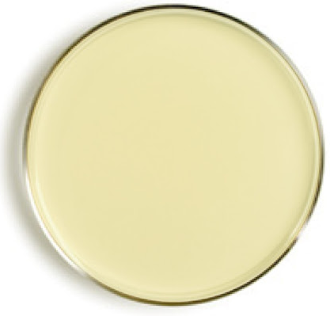
Introduction
A screening of an in-house library of structurally diverse compounds was performed
Four steroid derivatives emerged as promising
Antimicrobial activity
Compounds 1-4
Can they also influence resistance mechanisms?
Antifungal activity
Synergy with antimicrobial drugs

Slide 5
Chemistry
The amide steroid derivatives were obtained through a coupling reaction with the desired amine

Slide 6
Antibacterial activity
Compounds 1-4 were tested against ATCC susceptible strains (Escherichia coli ATCC 25922, Staphylococcus aureus ATCC 29213, Pseudomonas aeruginosa ATCC 27853 and Enterococcus faecalis ATCC 29212)
 | E. coli ATCC 25922 |  | S. aureus ATCC 29213 |  | P. aeruginosa ATCC 27853 |  | E. faecalis ATCC 29212
 | MIC ¹ | MBC ² | MIC | MBC | MIC | MBC | MIC | MBC
1 | 73-147 | 147 | 37 | 37 | 147 | 147 | 37 | 73
2 | >139 | ND ³ | >139 | ND | >139 | ND | >139 | ND
3 | >139 | ND | >139 | ND | >139 | ND | >139 | ND
4 | >139 | ND | >139 | ND | >139 | ND | 70 | ND
¹ Minimum Inhibitory Concentration (µM)
² Minimum Bactericidal Concentration (µM)
³ Not determined

Slide 7
Antibacterial activity
Compounds 1-4 were tested against resistant (S. aureus MRSA 272123) and a mutant strain with the acrA gene deleted (Salmonella enterica serovar Typhimurium SL1344), in order to access their capability of inhibiting bacterial efflux pumps
 | S. aureus MRSA 272123 | S. Typhimurium SL1344
 | MIC ¹ | MIC
1 | 12.5 | 6.25
2 | >100 | >100
3 | >100 | >100
4 | >100 | >100
¹ Minimum inhibitory concentration (µM)

Slide 8
Bacterial Efflux Pump Inhibition
Compounds 1-4 were assayed for their capability of inhibiting bacterial efflux pumps in S. aureus MRSA 272123 and S. enterica Typhimurium SL1344 through the accumulation of ethidium bromide, an efflux pump substrate, capable of increasing fluorescence
No efflux pump inhibition
Efflux pump inhibition
Ethidium Bromide
Efflux Pump Inhibitor

Slide 9
Bacterial Efflux Pump Inhibition
All the derivatives showed a higher relative fluorescence index (RFI) than reserpine (positive control) after 60 minutes of incubation for S. Typhimurium, and three derivatives led to a higher RFI than reserpine in S. aureus
 | S. aureus MRSA 272123 | S. Typhimurium SL1344
Compound | RFI
1 | 0.14 | 1.07
2 | 2.33 | 2.27
3 | 1.77 | 1.08
4 | 0.80 | 5.15
Reserpine | 0.70 | 0.51
$$RFI=\frac{{RF}_{treated }− {RF}_{untreated}}{{RF}_{untreated}}$$

Slide 10
Antifungal activity
Compound 1 was also tested for its antifungal activity in strains susceptible (Candida albicans ATCC 10231, Aspergillus fumigatus ATCC 46645 and Tricophyton rubrum FF5) and resistant to azoles (Candida krusei ATCC 6258, C. albicans D5 and A. fumigatus C111)
 | C. albicans ATCC 10231 |  | C. albicans D5 |  | C. krusei ATCC 6258 |  | A. fumigatus ATCC 46645 |  | A. fumigatus C111 |  | T. rubrum FF5
 | MIC | MFC ¹ | MIC | MFC | MIC | MFC | MIC | MFC | MIC | MFC | MIC | MFC
1 | 147 | 147 | 147 | 147 | 147 | 147 | 294 | >294 | 294 | >294 | 147 | 147
¹ Minimum Fungicidal Concentration (µM)
Compound 1 was also able to inhibit the filamentation of C. albicans:
147 µM: 100%; 74 µM: 96.72%; 37 µM: 41.22%; 18 µM: 0%

Slide 11
A steroid derivative emerged as a hit compound against bacteria and fungi
Conclusions
Three amide derivatives were synthesized
Future work:
Synthesis of derivatives
for SAR studies
The four derivatives inhibit bacterial efflux pumps
Studies on other antimicrobial and resistance mechanisms

Slide 12
A steroid derivative emerged as a hit compound against bacteria and fungi
Conclusions
Three amide derivatives were synthesized
Future work:
Synthesis of derivatives
for SAR studies
The four derivatives inhibit bacterial efflux pumps
Studies on other antimicrobial and resistance mechanisms

Slide 13
A steroid derivative emerged as a hit compound against bacteria and fungi
Conclusions
Three amide derivatives were synthesized
Future work:
Synthesis of derivatives
for SAR studies
The four derivatives inhibit bacterial efflux pumps
Studies on other antimicrobial and resistance mechanisms

Slide 14
A steroid derivative emerged as a hit compound against bacteria and fungi
Conclusions
Future work:
Synthesis of derivatives
for SAR studies
Three amide derivatives were synthesized
The four derivatives inhibit bacterial efflux pumps
Studies on other antimicrobial and resistance mechanisms

Slide 15
A steroid derivative emerged as a hit compound against bacteria and fungi
Conclusions
Three amide derivatives were synthesized
Future work:
Synthesis of derivatives
for SAR studies
The four derivatives inhibit bacterial efflux pumps
Studies on other antimicrobial and resistance mechanisms

Slide 16
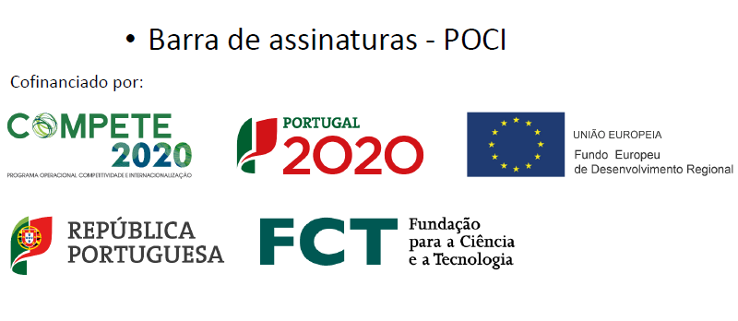
Acknowledgments
This research was supported by national funds through FCT—Foundation for Science and Technology within the scope of UIDB/04423/2020, UIDP/04423/2020 (Group of Natural Products and Medicinal Chemistry_CIIMAR), and under the project PTDC/SAU-PUB/28736/2017 (reference POCI-01-0145-FEDER-028736), co-financed by COMPETE 2020, Portugal 2020 and the European Union through the ERDF and by FCT through national funds.
Fernando Durães and Ana Rita Neves acknowledge their PhD grants SFRH/BD/144681/2019 and SFRH/BD/114856/2016.
The authors thank Dr. Jessica Blair (Institute of Microbiology and Infection, College of Medical and Dental Sciences, University of Birmingham, Birmingham B15 2TT, UK) for providing the Salmonella strain.

Slide 17
Steroid derivatives: a promising class of bacterial efflux pump inhibitors?
Fernando Durães ^{1, 2}, Ana Rita Neves ^{1, 2}, Joana Freitas-da-Silva ^{2, 3}, Annamária Kincses ⁴, Eugénia Pinto ^{2, 5}, Paulo Costa ^{2, 3}, Madalena Pinto ^{1, 2}, Marta Correia-da-Silva ^{1, 2}, Gabriella Spengler ⁴, Emília Sousa ^{1, 2*}
¹ Laboratory of Organic and Pharmaceutical Chemistry, Faculty of Pharmacy, University of Porto, Portugal
² Interdisciplinary Centre of Marine and Environmental Research (CIIMAR), University of Porto, Portugal
³ ICBAS – Institute of Biomedical Sciences Abel Salazar, University of Porto, Portugal
⁴ Department of Medical Microbiology and Immunobiology, Faculty of Medicine, University of Szeged, Hungary
⁵ Laboratory of Microbiology, Department of Biological Sciences, Faculty of Pharmacy, University of Porto, Portugal
* Corresponding author: esousa@ff.up.pt

