Slide 1



In vitro antioxidant, DNA-protective and cytotoxic effects of 2,3-substituted quinazolinone-derived Schiff bases
Jana Hricovíniová ¹*, Katarína Kozics ¹, and Zuzana Hricovíniová ²
¹ Cancer Research Institute BMC, Slovak Academy of Sciences, Dúbravská cesta 9,
845 05 Bratislava, Slovak Republic;
² Institute of Chemistry, Slovak Academy of Sciences, Dúbravská cesta 9, 845 38
Bratislava, Slovak Republic
*Corresponding author: exonhric@savba.sk

Slide 2
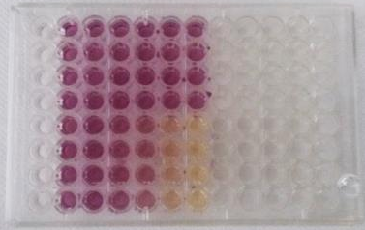
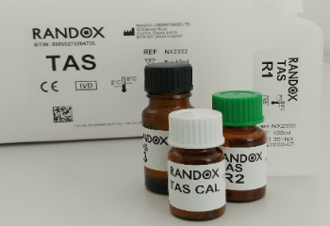
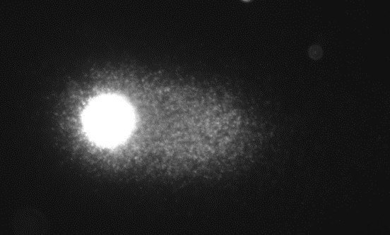
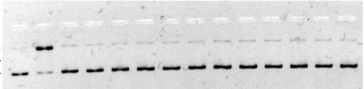
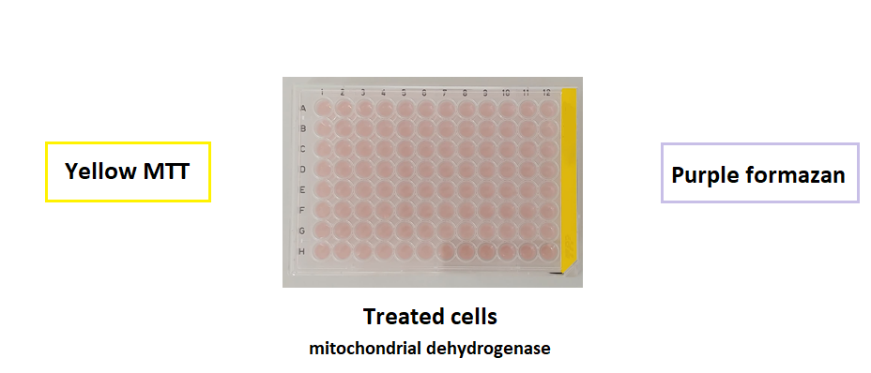
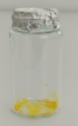
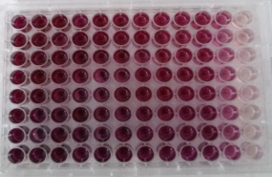
In vitro antioxidant, DNA-protective and cytotoxic effects of 2,3-substituted quinazolinone-derived Schiff bases
Graphical Abstract
Antioxidant activity
Genotoxicity/protectivity
Cytotoxicity

Slide 3
Abstract: Group of 2,3-ring-substituted quinazolinone-derived Schiff bases (Q1-Q4) were prepared and tested for cytotoxicity and DNA-protective potential against free radical-induced oxidative damage. The in vitro cytotoxic effect of compounds was assessed in human renal proximal tubular epithelial (TH-1) and hepatocellular carcinoma (HepG2) cells by MTT assay. The radical-scavenging and reducing potency was determined by DPPH and reducing power assay. The DNA-protective potential against oxidants (Fe²⁺, H₂O₂) was screened by DNA topology and Comet assay. Antioxidant mode of action - total antioxidant cell status (TAS) and activity of individual antioxidant enzymes (SOD, CAT, GPx) were screened on TH-1 cells. The results suggest that Q1-Q4 affected TH-1 and HepG2 cell viability in a dose-dependent manner. Treatment of cells with Q1-Q4 increases TAS, GPx, SOD, and CAT levels. Compounds exhibit significant antioxidant properties, and high DNA-protective ability. The structure-biological activity relationships revealed the relation between structure and efficacy of studied compounds. The modification of the C-2/N-3 positions of the quinazolinone nucleus, by differently substituted phenyl moieties seems to be crucial for the DNA-protective potential of these compounds. Quinazolinones Q1-Q4 can be considered as an effective antioxidants, non-genotoxic and DNA-protective agents with potential medicinal applications.
Keywords: Quinazolinones; Antioxidant effect; DNA protectivity; Cytotoxicity

Slide 4
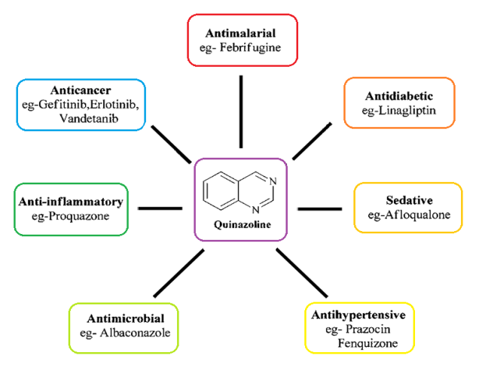
Introduction
Quinazolinones
applications in medicinal chemistry
quinazoline-based alkaloids (vasicine, febrifugine) and synthetic analogues
wide range of biological activities: antibacterial, antimalarial, antioxidant, anti-
depressant, anti-inflammatory, vasodilating, anticancer agents [1-3].
[1] Hameed A., Al-Rashida M., Uroos M., Ali S.A. (2018) Expert Opin Ther Pat. 28, 281
[2] Gupta T., Rohilla A., Pathak A., et al. (2018). Synth Commun. 48, 1099
[3] Rakesh K.P., Manukumar H., Gowda D.C. (2015) Bioorg Med Chem Lett. 25, 107

Slide 5
new C–2, N–3 di-substituted quinazolinone derivatives were designed and
synthesized as novel antioxidants and potential DNA-protective agents
Quinazolinone-derived Schiff bases (Q1-Q4) were synthesized by microwave-
assisted, phosphomolybdic acid catalysed condensation reaction of 2-amino
benzhydrazide with differently substituted aromatic aldehydes (R). The
molecular structures of Q1-Q4 were characterized by analytical, and
spectroscopic methods (NMR, FT IR, UV-Vis, EPR, HRMS) [4].
[4] Hricovíniová Z., Hricovíni M., Kozics K. (2018) Chem Pap. 72, 104

Slide 6
Material and methods
Compounds: C-2,N-3-ring-substituted quinazolinone derived Schiff bases (Q1-Q4)
Cell lines: Human renal proximal tubular epithelial cells (TH-1)
Human hepatocellular carcinoma (HepG2) cells
Antioxidant activity:
1,1-diphenyl-2-picrylhydrazyl (DPPH) assay
Reducing power (RPA) assay
    Antioxidant enzymes activity assays (SOD, CAT, GPx)
    Total antioxidant status (TAS)
    DNA genotoxicity/protectivity:
    DNA topology assay
    Single cell gel electrophoresis (Comet assay)
    Cytotoxic activity:
    MTT assay

Slide 7
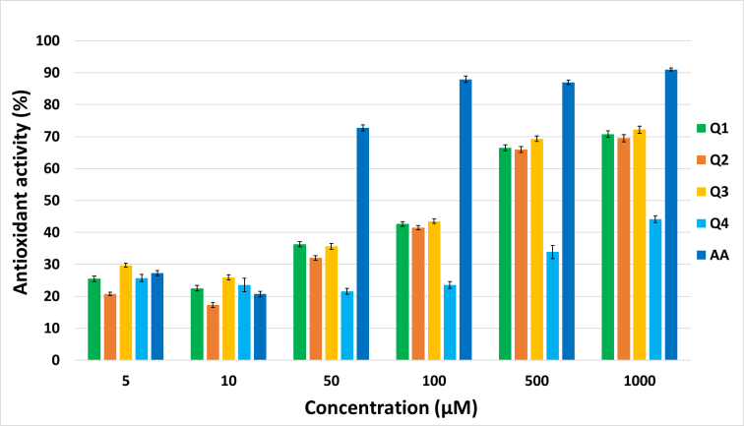
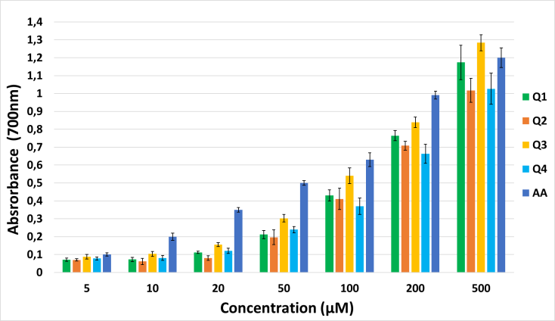
Results and discussion
Studied compounds Q1-Q4 showed promising antioxidant effect (DPPH assay, Fig.1.) and reducing power (RPA test, Fig.2.) in comparison with ascorbic acid (AA). The relative DPPH radical-scavenging activity of tested compounds increased in the following order: Q4 < Q2 ~ Q1~ Q3 < AA.
Derivative Q3 bearing four OH groups showed the highest Fe²⁺ reducing activity: Q4 < Q2 < Q1 < AA < Q3.
Fig.1. DPPH assay – Evaluation of radical scavenging activity of compounds Q1–Q4.
Fig. 2. Reducing power assay – Evaluation of antioxidant activity of compounds Q1–Q4.

Slide 8
Total antioxidant status (TAS) of Q1–Q4 and the activity of individual enzymes – superoxide dismutase (SOD), glutathione peroxidase (GPx), and catalase (CAT) in TH-1 cells after 24 h treatment (Table 1.).
Tab.1. Control (−) untreated TH-1 cells; control (+) ascorbic acid. The levels of CAT and GPx and TAS, in TH-1 cells treated with Q1–Q4, were significantly higher in comparison with the negative control. Data represent the mean ± SD of three independent experiments. *P < 0.05; **P < 0.01; ***P < 0.001 indicate significant differences compared to the untreated control cells.
 | TAS | SOD (U/mg prot) | GPx (U/mg prot) | CAT (U/mg prot)
Control (−) | 0.795±0.120 | 0.957±0.070 | 0.0104±0.0008 | 142.109±2.290
Control (+) | 3.320±0.080 | 2.520±0.520 | 0.039±0.002 | 585±54
Q1
10µM | 0.828±0.040 | 1.471±0.130 | 0.0187±0.0028* | 237.274±1.948***
20 µM | 0.992±0.025 | 0.804±0.210 | 0.0161±0.0008** | 217.756±16.280*
50 µM | 1.016±0.060 | 1.537±0.290 | 0.0229±0.0023** | 285.640±0.956***
Q2
10 µM | 0.755±0.090 | 1.041±0.180 | 0.0158±0.0015** | 232.940±7.437**
20 µM | 1.091±0.240 | 1.415±0.440 | 0.0312±0.0029** | 489.357±27.782**
50 µM | 2.678±0.110** | 2.084±0.001* | 0.0349±0.0006** | 544.981±29.630**
Q3
10 µM | 1.033±0.410 | 0.980±0.070 | 0.0140±0.0007* | 243.603±16.312**
20 µM | 1.247±0.420 | 1.023±0.180 | 0.0121±0.0007 | 240.114±3.354***
50 µM | 1.615±0.110* | 1.031±0.150 | 0.0197±0.0018** | 261.402±2.166***
Q4
10 µM | 0.841±0.350 | 0.792±0.140 | 0.0162±0.0012** | 232.392±6.750***
20 µM | 1.040±0.040 | 0.869±0.010 | 0.0149±0.0007* | 244.104±1.994***
50 µM | 1.636±0.110* | 1.077±0.030 | 0.0202±0.0021** | 323.904±8.911***

Slide 9
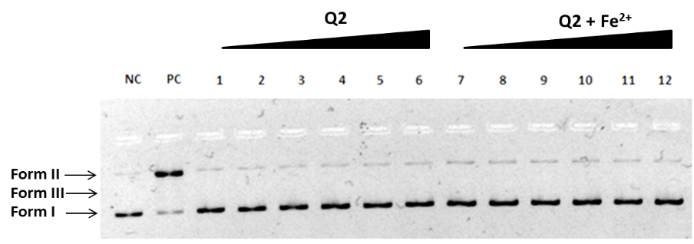
DNA-protective/damaging effect of Q1-Q4, was assessed by DNA topology assay (Fig.3) and Comet assay (Fig.4). All studied compounds were able to protect pBR322 plasmid DNA as well as the DNA of TH-1 cells against oxidative DNA damage induced by oxidants (Fe²⁺ions, H₂O₂).
DNA topology assay. Treatment of pBR322 plasmid DNA with Q1–Q4 in selected concentration range (5-500 µM) did not change the mobility of the supercoiled pDNA, indicating the non-genotoxic effect of tested compounds.
Fig. 3. Electrophoretic monitoring of topological changes induced in the structure of plasmid DNA with compound Q2. Plasmid DNA treated only with Q2 in selected concentrations (5, 10, 20, 50, 100, 500 µM) (lanes 1–6); treatment with increasing concentrations (5–500 µM) of Q2 in the presence of Fe²⁺ ions (lanes 7–12); negative control (NC): intact pBR322; positive control (PC): pBR322 treated with Fe²⁺ ions. Treatment of pBR322 with Fe²⁺ ions induce DNA breaks resulting in the conversion of plasmid topology from supercoiled (form I) to single-strand breaks (form II) or double-strand breaks (form III).

Slide 10
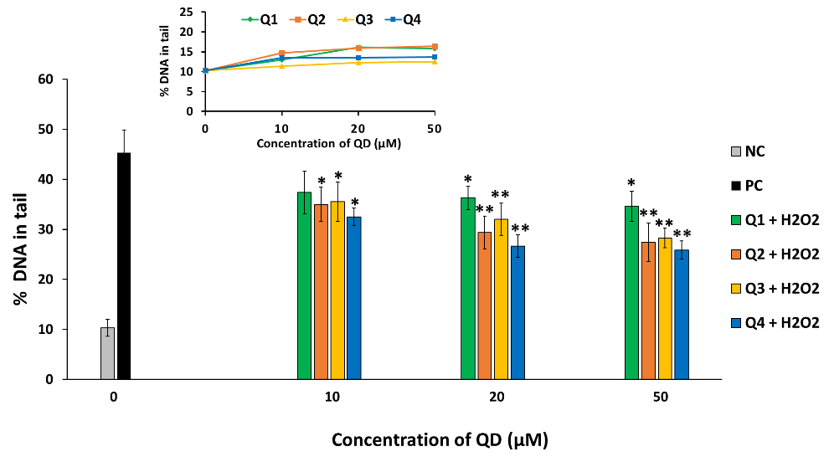
Comet assay. For the induction of DNA single strand breaks in TH-1 cells, H₂O₂ (500 µM) was used (Fig.4). Three non-genotoxic concentrations (10, 20 and 50 µM) were selected from standard comet assay (Fig.4, inserted panel). The H₂O₂-induced DNA damage (% of DNA in the tail) was about 45%. Pre-treatment of TH-1 cells with derivatives Q1-Q4 showed promising DNA-protective activity against H₂O₂, as they significantly decreased the levels of DNA lesions in comparison with the positive control.
Fig. 4. Comet assay. DNA-protective effect of derivatives Q1–Q4 against H₂O₂. TH-1 cells were pre-treated with Q1–Q4 for 24 h and then treated with 500 µM H₂O₂. TH-1 cells only with PBS were used as negative control (NC); cells incubated only with 500 µM H₂O₂ correspond to a positive control (PC). *P < 0.05; **P < 0.01; ***P < 0.001 indicate significant differences compared to the positive control.

Slide 11
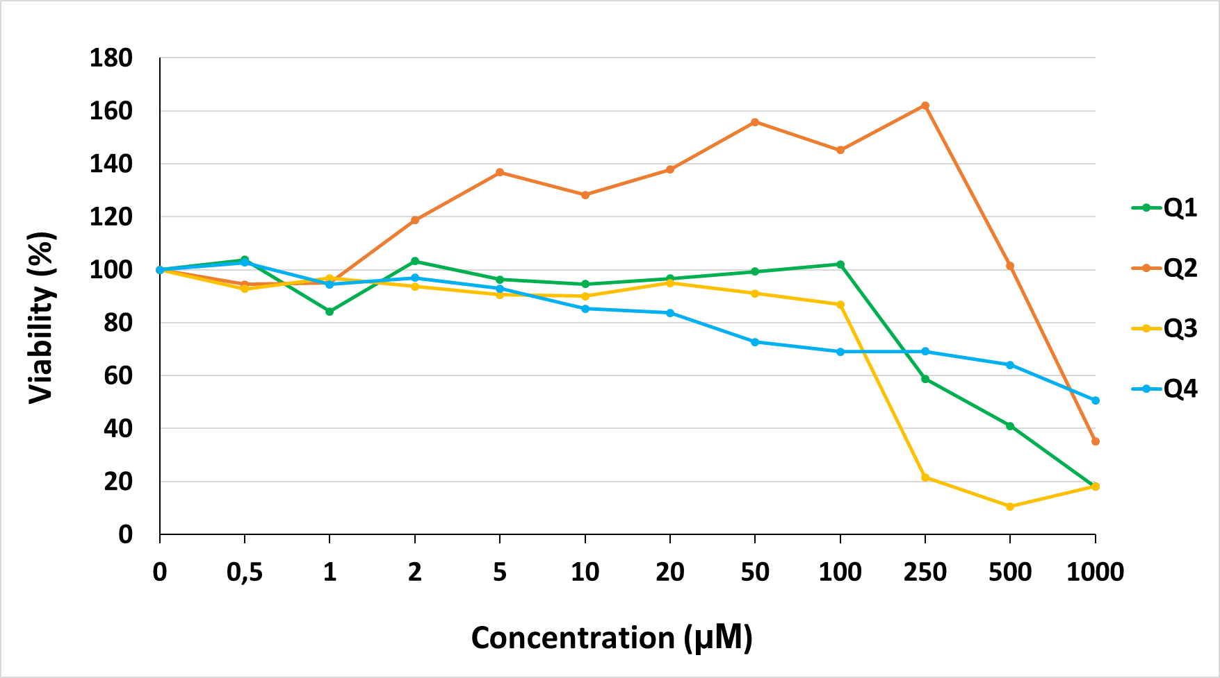
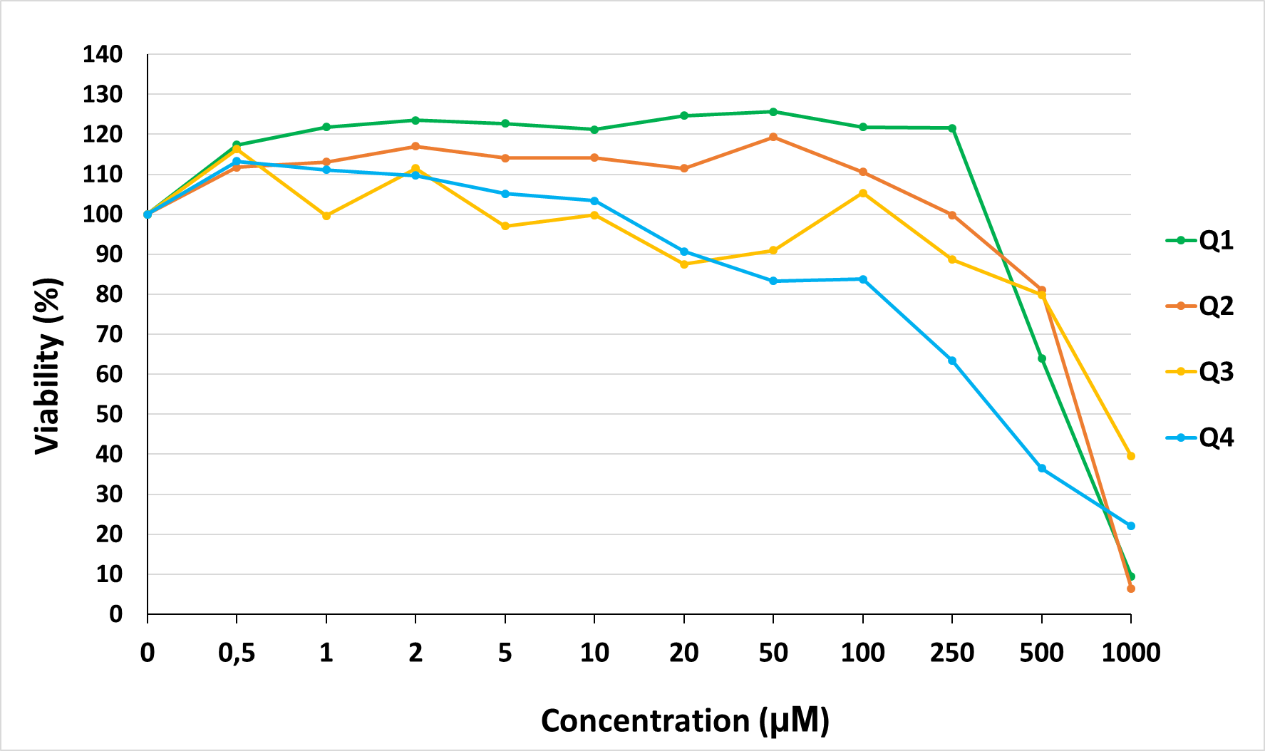
MTT assay. The cytotoxic effect of Q1–Q4 was investigated in vitro in the human TH-1 and HepG2 cell lines. The results of the MTT assay showed that the 24 h treatment of cells with Q1–Q4 affected cell viability in a dose-dependent manner. Derivatives exhibited variable potencies (IC₅₀).
Studied compounds exhibited different cytotoxic activity against tested cell lines (TH-1 Fig.5) and (HepG2 Fig.6).
Fig.5 MTT assay – Evaluation of cytotoxic effects of compounds Q1–Q4 on TH-1 cells.
Fig.6 MTT assay – Evaluation of cytotoxic effects of compounds Q1–Q4 on HepG2 cells.

Slide 12
Conclusions
C-2,N-3 substituted quinazolinone-derived Schiff bases (Q1-Q4) were
characterized by chemical and biological assays
High radical-scavenging, antioxidant and DNA-protective effects were
observed
Efficient DNA-protection correlates with enzymatic (SOD, CAT, GPx, TAS)
and non-enzymatic (DPPH, RPA assay) antioxidant defence
Studied compounds were able to protect the DNA of TH-1 cells as well as
pBR322 plasmid DNA against oxidative DNA damage induced by oxidants
SAR analysis revealed the relation between molecular structure and
efficiency of studied derivatives
Their potential applications in pharmacology will require additional
validation using further in vitro and in vivo studies

Slide 13

Acknowledgments
The authors would like to acknowledge financial support from the Slovak Grant Agency, VEGA grants No. 2/0022/18 and 2/0055/20.

