Slide 1



Design, synthesis, and biological evaluation of 1,2,3-triazole-linked triazino[5,6-b]indole-benzene sulfonamide conjugates as potent carbonic anhydrase I, II, IX , and XIII inhibitors
Ch.Krishnakartheek ^{1,}*, Dr. Mohammud Ariuddin ², and Prof. Claudiu T. Supuran ²
¹ Department of Medicinal Chemistry, National Institute of Pharmaceutical Education and Research (NIPER), Balanagar, Hyderabad 500037;
² Neurofarba Department, Sezione di Scienze Farmaceutiche e Nutraceutiche, Università degli Studi di Firenze,Via Ugo Schi 6, Sesto Fiorentino, 50019 Florence, Italy;
* Corresponding author: arifabib@gmail.com, claudiu.supuran@unifi.it

Slide 2
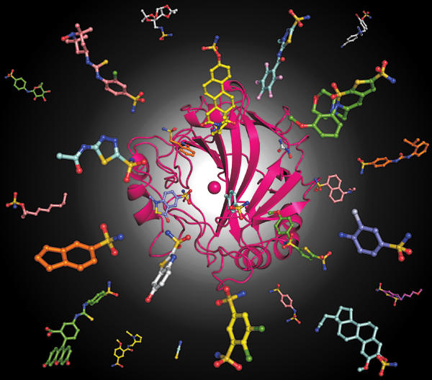
Design, synthesis, and biological evaluation of 1,2,3-triazole-linked triazino[5,6-b]indole-benzene sulfonamide conjugates as potent carbonic anhydrase I, II, IX , and XIII inhibitors

Slide 3
Abstract:
A series of 1,2,3-triazole-linked triazino[5,6-b]indole-benzene sulfonamide hybrids (6a–6o) was synthesized and evaluated for carbonic anhydrase (CA, EC 4.2.1.1) inhibitory activity against the human (h) isoforms hCA I, II, XIII (cytosolic isoforms), and hCA IX (transmembrane tumor-associated isoform) The results revealed that the compounds 6a–6o exhibited Ki values in the low to medium nanomolar range against hCA II and hCA IX (Kis ranging from 7.7nM to 41.3 nM) and higher Ki values against hCA I and hCA XIII. Compound 6i showed potent inhibition of hCA II (Ki = 7.7 nM), being more effective compared to the standard inhibitor acetazolamide (AAZ) (Ki = 12.1 nM). Compounds, 6b and 6d showed moderate activity against hCA XIII (Ki = 69.8 and 65.8 nM). Hence, compound 6i could be consider as potential lead candidate for the design of potent and selective hCA II inhibitors.
Keywords: 1,2,3-triazole; triazino[5,6-b]indole-benzene sulfonamide; carbonic anhydrase inhibitors

Slide 4
Introduction
Respiration is one of the key physiological processes across all phyla, ranging from prokaryotes to eukaryotes.
Several cellular metabolic reactions utilize carbon dioxide (CO₂) as their substrate and produce its hydrated form, bicarbonate (HCO₃⁻), as the product.
This bicarbonate plays a pivotal role physiologically by acting as a substrate for various carboxylating enzymes, which are involved in the biosynthesis of fatty acids, amino acids and nucleotides.
The interconversion between CO₂ and HCO₃⁻ can be shown by the following two-step reaction:-

Slide 5
The uncatalyzed reaction is slow at physiological pH.
Hence in order to accelerate this reaction, a class of enzymes called carbonic anhydrases come into picture.
Carbonic anhydrases (CAs, EC 4.2.1.1) are a superfamily of ubiquitous metalloenzymes, which facilitate the above said reaction across all phyla.
Till date, seven genetically distinct families of CAs have evolved across all phyla, ranging from bacteria and archaea to eukarya.
These seven families are the α-, β-, γ-, δ-, ζ-, η- and θ.
These carbonic anhydrases cater a role in various biosynthetic processes and pH regulation.
α- CA | Vertebrates, Algae, Gram – ve bacteria
β- CA | Gram +ve bacteria, monocots & dicots
γ- CA | Archaea, Cyanobacteria
δ- CA | Marine diatoms
ζ- CA | Marine diatoms
η- CA | Protozoa
θ- CA | Phaeodactylum tricornutum

Slide 6
Humans and Carbonic anhydrases
Humans primarily contain the α- class of carbonic anhydrases.
Sixteen isozymes of this class have been identified in total and they differ in a variety of attributes like molecular features, oligomeric arrangement, cellular localization, distribution in organs and tissues, expression levels, kinetic properties and response to different inhibitor classes.
Among all isozymes, CA I, CA II, CA III, CA VII, CA VIII, CA X, CA XI and CA XIII are cytosolic, CA IV, CA IX, CA XII and CA XIV are membrane-bound, CA VA and VB are mitochondrial and CA VI is secreted in saliva and mammary glands.
CAs VIII, X and XI are devoid of any enzymatic activity and are designated as CA-related proteins (CARPs).

Slide 7
Enzyme | Organ/tissue distribution | Disease in which enzyme is involved
CA I | Erythrocytes, gastrointestinal tract, eye | Retinal/cerebral edema
CA II | Erythrocytes, eye, gastrointestinal tract, bone osteoclasts, kidney, lung, testis, brain | Glaucoma, edema, epilepsy, altitude sickness
CA III | Skeletal muscle, adipocytes Skeletal muscle, adipocytes | Oxidative stress
CA IV | Kidney, lung, pancreas, brain capillaries, colon, heart muscle, eye | Glaucoma, retinitis pigmentosa, stroke
CA VA | Liver | Obesity
CA VB | Heart and skeletal muscle, pancreas, kidney, spinal cord, gastrointestinal Tract | Obesity
CA VI | Salivary and mammary glands | Cariogenesis
CA VII | Central nervous system | Epilepsy Oxidative stress
CA IX | Tumors, gastrointestinal mucosa | Cancer
CA XII | Renal, intestinal, reproductive epithelia, eye, tumors | Cancer Glaucoma
CA XIII | Kidney, brain, lung, gut, reproductive tract | Sterility
CA XIV | Brain, liver, eye, skeletal muscle | Epilepsy, retinopathies

Slide 8
Classical carbonic anhydrase inhibitors
Benzene sulphonamide based compounds are most potent and most utilized among carbonic anhydrase inhibitor classes
These compounds bind to zinc ion via sulphonamide as Zinc binding group (ZBG) in deprotonated form displacing zinc bound water/hydroxide molecule.
For all catalytic isoforms, three histidine residues coordinating the zinc, Thr199 and Glu106 are conserved. Both T199 and E106 play a crucial role in catalysis
Small molecular weight carbonic anhydrase inhibitors utilize ZBG tend to bind deep inside the active site cavity make extensive interactions with amino acid residues thus contributing indiscriminate inhibition profiles. Therefore alternative approaches have been developed for better isoform specific carbonic anhydrase inhibitors

Slide 9
“Tail approach” in designing isoform specific carbonic anhydrase inhibitors
It is one of the most successful approach in designing isoform specific CAIs. In this approach a chemical moiety known as tail appended on to a organic scaffold (usually aromatic/Heterocyclic) of a ZBG
This tail elongates the inhibitor allowing it to make extensive interactions with amino acids towards outside of the active site, mainly at hydrophobic and hydrophilic halves.
Structural superposition of Tails of different compounds towards hydrophobic(red) and hydrophilic(blue) halves.
Expert Opin. Drug Discov. (2013) 8(7)

Slide 10
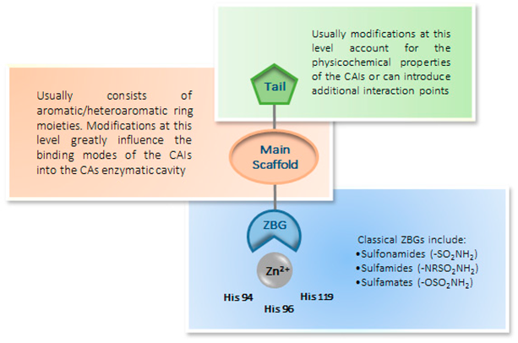
Bioorganic & Medicinal Chemistry 22 (2014) 334-340.

Slide 11
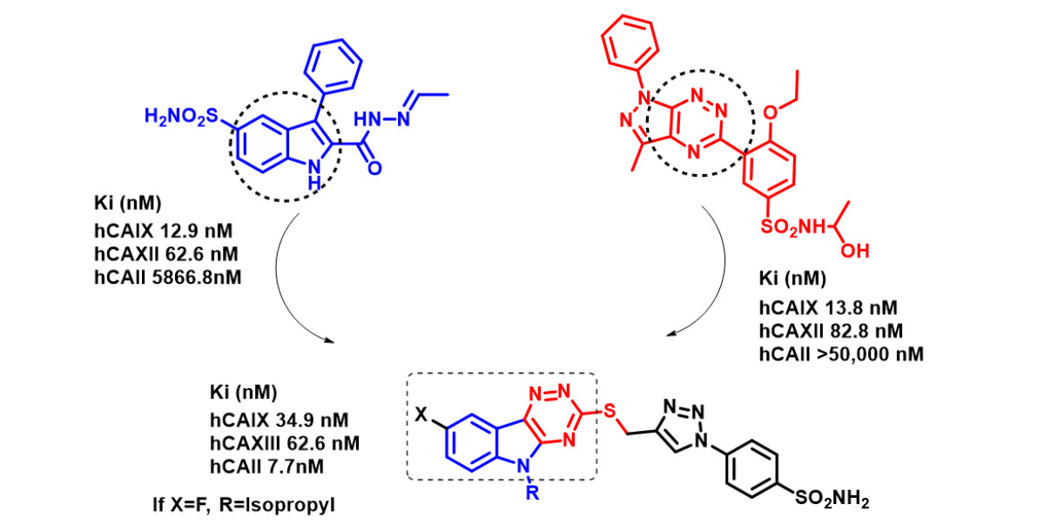
In the present work, new series of compounds were designed based on Tail approach via the
fusion of indole scaffold with 1,2,4-triazine which were reported as potent scaffolds for carbonic
anhydrase activity.
The present design of compounds based on two strategies, The first one was fusion of two potent
Scaffolds i.e. Indole & 1,2,4-triazine in order to develop a flexible tail with better interactions in the
Enzymatic active site and the second one was to incorporate different N-alkyl substituents in the
Indole tail in systematic fashion to enhance hydrophobic interactions.

Slide 12
Results and Discussion
The current Design of experiment (DOE) based on molecular hybridization approach
We synthesized molecular hybrids of bulky triazno[5,6-b] indole, used as a tail, conjugated to
Benzene sulfonamide through a flexible 1,2,3-triazole as al inker.

Slide 13
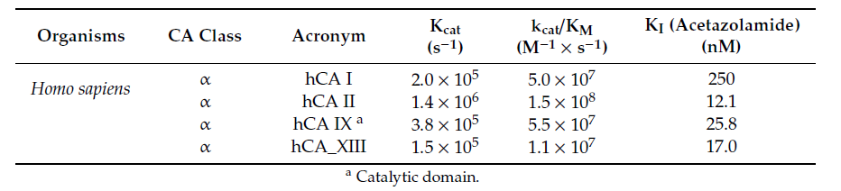
Carbonic anhydrase Inhibition
The newly synthesized 1,2,3-triazole linked triazino[5,6-b]indole-benzene sulfonamide hybrids (6a–6o) were evaluated for their carbonic anhydrase inhibitory activity against a panel of carbonic anhydrases, i.e., hCA I, hCA II, hCA IX, and hCA XIII, by the stopped-flow CO₂ hydrase assay method.
Highly purified CA isoforms were employed, for which the kinetic parameters for the physiologic reaction (CO₂ hydration) were measured , monitoring the color change produced by the formation of H⁺ ions (and bicarbonate).
For all the pure enzymes, the kinetic parameters (k_{cat} and k_{cat}/K_{M}) are measured and these values are given in the below table. These activities were highly inhibited by the clinically used sulfonamide inhibitor acetazolamide (AAZ), as shown in table below. It was observe that all these enzymes are highly efficient catalysts with k_{cat}/K_{M} > 10⁷ M⁻¹x s⁻¹.

Slide 14
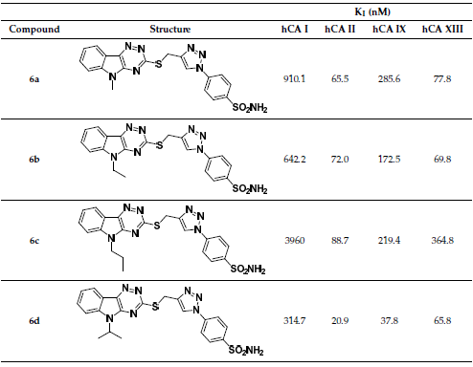
Inhibition of hCA isoforms I, II, IX & XIII by the compounds 6a to 6o

Slide 15
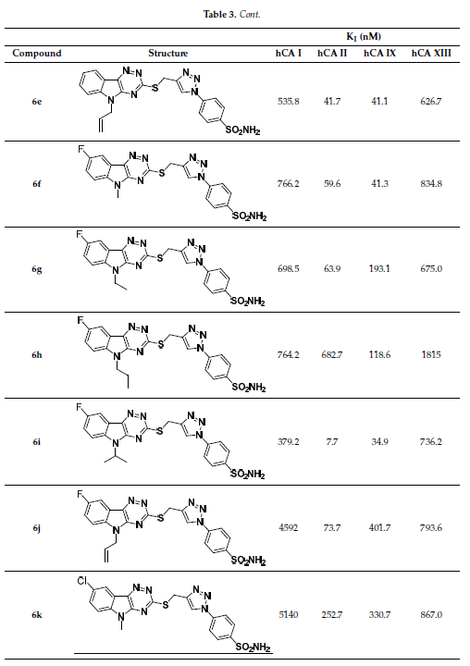

Slide 16
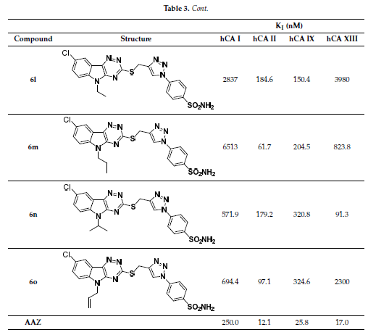

Slide 17
Structural activity relationships
The cytosolic hCA II isoform was strongly inhibited by all the synthesized compounds 6a–o, in a low to medium nanomolar range (K_{i}s = 7.7 nM to 0.2527 µM).
The best activity against hCA II was shown by compound 6i (K_{i} = 7.7 nM), possessing a fluoro group attached at the 5th position of the indole ring and an isopropyl group anchored to the nitrogen of indole. It was almost twofold more active than the standard AAZ (K_{i} = 12.1 nM).
Compounds 6d–6g, were found to have potent activity at the nanomolar concentration against hCA II, with K_{i} ranging from 20.9 to 63.9 nM.
Compounds 6k–6o, containing a chloro group at the 5th position of indole, showed lower activity in the range of 61.7 to 252.7 nM, compared to compounds containing a fluoro group and unsubstituted indole.
Continue….

Slide 18
The transmembrane hCA IX isoform, which is expressed exclusively in tumors, was also strongly inhibited by the synthesized compounds in the medium nanomolar range (K_{i}s = 34.9 nM to 0.3246 µM).
Compounds 6d, 6e, 6f, and 6i showed equipotent nanomolar activity with AAZ, with K_{i}s ranging from 34.9 nM to 41.3 nM. Among these compounds, 6i showed the best activity (K_{i} = 34.9 nM) against hCA IX isoform.
The cytosolic hCA I and hCA XIII isoforms were inhibited by all synthesized compounds in the high nanomolar range (K_{i}s > 500 nM). However, compounds 6b and 6d showed moderate activity with K_{i}s of 69.8 nM and 65.8 nM respectively against hCA XIII isoform.
From the above structure–activity relationship, it was found that compound 6i was the most potent compound with a K_{i} values of 7.7 nM against hCAII and 34.9 nM against hCA IX.

Slide 19
Conclusions
In conclusion, we report here the synthesis of a series of 1,2,3-triazole-linked triazino[5,6-b]indole-benzene sulfonamide hybrids (6a–6o).
The structures of these compounds where confirmed by different spectral and elemental analyses methods .
The Biological evaluation of sulfonamides was performed against hCA I, hCA II, hCA IX, and hCA XIII. All compounds showed low to moderate inhibitory activity against hCA II and hCA IX isoforms, at concentrations in the range between 7.7 nM and 0.3246 µM.
Compound 6i emerged as a potent hCA II and hCA IX inhibitor (K_{i} = 7.7 nM against hCA II and 34.9 nM against hCA IX).
The compounds 6b and 6d was showed activity at medium nanomolar concentrations, with K_{i} of 69.8 nM and 65.8 nM, respectively, against hCA XIII isoform. Thus, the compound 6i can be emerged as a novel potential lead compound to develop selective carbonic anhydrase inhibitors against the hCA II isoform.

Slide 20
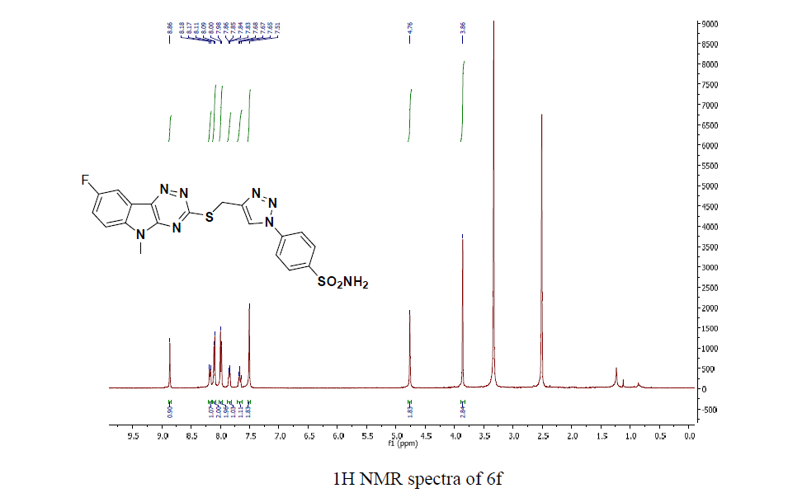
H1 NMR & C13 Spectra of some compounds

Slide 21
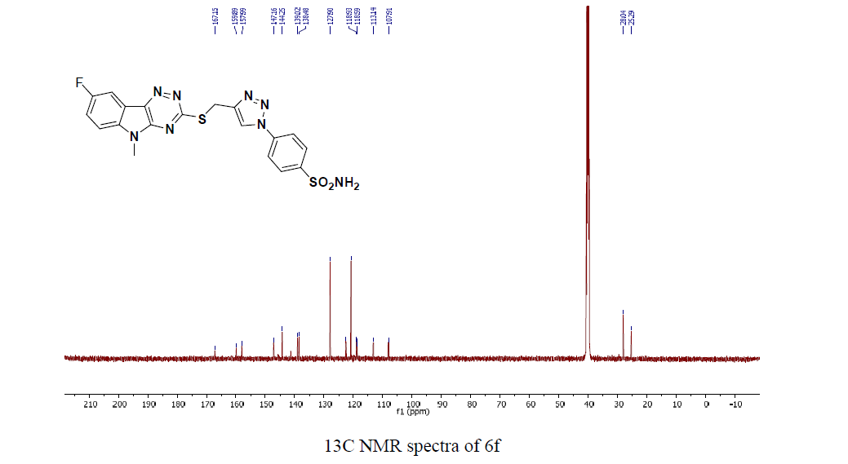

Slide 22
Mass spectra of compound 6g

Slide 23
Acknowledgments
I thankful to the Department of Pharmaceuticals, Ministry of Chemicals and fertilizers, Govt. of India, New Delhi, for awarding NIPER Fellowship.
The Italian Ministry for University and Research, MIUR is also thanked for a grant to CTS (PRIN: rot. 2017XYBP2R).

Slide 24


