Slide 1
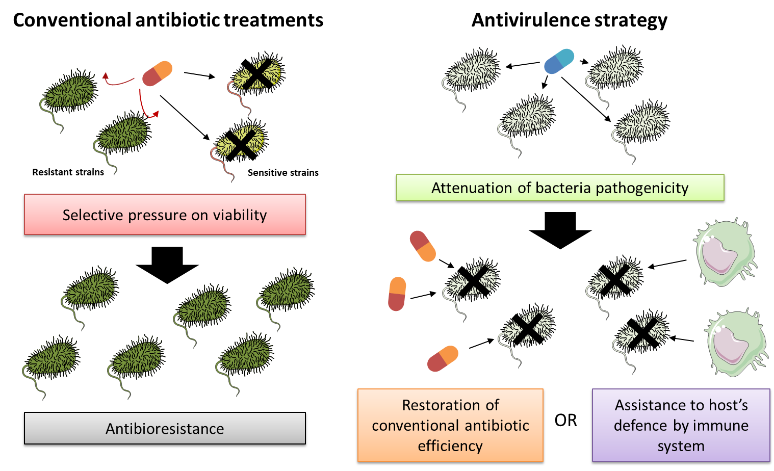
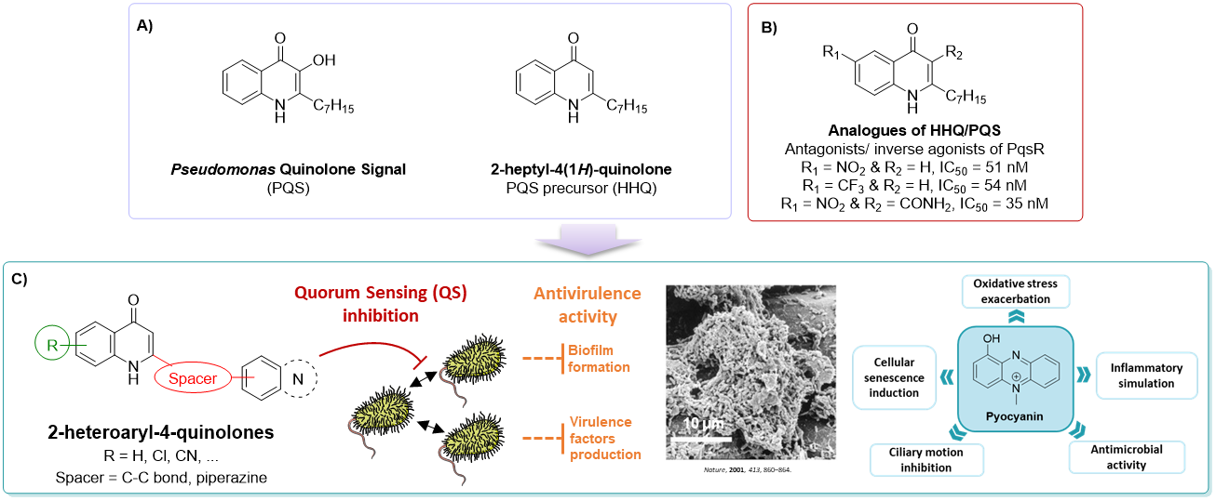
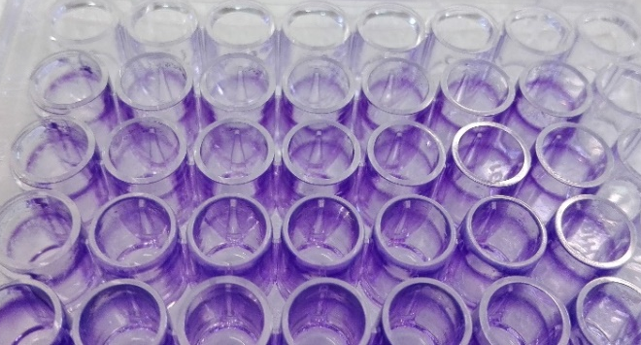
Development of new 2-heteroaryl-4-quinolones as potential antivirulence agents targeting multi-drug resistant ESKAPEE pathogens
Marine Duplantier ⁽¹⁾, Elodie Lohou ⁽¹⁾, Pascal Sonnet ⁽¹⁾
AGIR, UR 4294, UFR of Pharmacy, Jules Verne University of Picardie, 80037 Amiens, France.
Introduction
Over the last decades, massive misuse of antibiotics prompted the apparition of resistances in many microorganisms such as ESKAPEE pathogens responsible for various nosocomial infections.¹ Indeed, the selective pressure put on sensitive bacteria by conventional antimicrobial molecules that cause their death promotes resistant strain survival. The development of antivirulence agents that could attenuate bacteria pathogenicity without affecting their growth, seems to be a new promising therapeutic strategy. This could facilitate the host’s defence by immune system and restore the associated efficiency of conventional treatments (Fig. 1).² The inhibition of quorum sensing (QS) that refers to bacterial communication systems, could disrupt, especially in P. aeruginosa, virulence pathways (pyocyanin or rhamnolipid production) and intra/inter-species protective interactions (biofilm formation). Among a pool of promising pharmacological targets provided by QS, the interest of Pseudomonas Quinolone Signal receptor (PqsR) that regulates virulence gene expression in response to environmental factors and population density once activated by its natural ligand (PQS), has emerged for the development of inhibitors.³
Figure 1: Interest of new antivirulence strategy vs conventional antibiotic treatments.
Aims and Strategy
Different 2-heptyl-4-quinolone analogues of PQS revealed efficient as PqsR antagonists (Fig. 2A-B).⁴⁻⁶ Taking these studies into account, we aim to develop a 2‑heteroaryl‑4‑quinolone family potentially active against ESKAPEE pathogens as QS inhibitors. The building block coupled in position 2 of the quinolone pharmacophore via different spacers was chosen for i) its similar lipophilic properties with alkyl chain of PQS and ii) its bioisoterism with several heteroaryl cores of various PqsR antagonists described in the literature.
Herein, we reported the synthesis of two series of 2-heteroaryl-4-quinolones i) derivatives possessing a direct C-C bond between the two aromatic fragments and ii) analogues bearing a piperazine spacer (Fig. 2C). Minimal inhibitory concentrations of these compounds on different ESKAPEE strains and their biofilm formation inhibitory properties have been evaluated, as well as their cytotoxicity in human hepatoma cell line.
Figure 2: A) Natural ligands of PqsR produced by P. aeruginosa; B) Quorum sensing inhibitors described in literature and C) Development of 2-heteroaryl-4-quinolones as potential QS inhibitors.
Synthesis
The design of new 2-heteroaryl-4-quinolones relies on pallado-catalyzed cross-coupling reactions between different 2-bromo-4-chloroquinoline precursors 1 and various second heteroaryl derivatives (Fig. 3) such as:
4, 5 or 6-heteroarylboronic esters 2a-c in the series I (Suzuki C-C couplings, Table 1),
or N-heteroarylpiperazine derivatives 5 in the series II (Buchwald-Hartwig C-N couplings).
In vitro biological evaluation
Minimal inhibition concentrations (MIC) of synthetised 2-heteroaryl-4-quinolones have been evaluated on various ESKAPEE strains (Table 2). All compounds have no effect on bacterial growth that is a favorable result in the case of antivirulence strategy.
Compounds |  | S. aureus CIP 103.429 MIC (µg/ml) | A. baumannii 15 clinical strains MIC (µg/ml) | P. aeruginosa DSM 1117 MIC (µg/ml) | E. coli DSM 1103 MIC (µg/ml)
Ciprofloxacin |  | 0.06 | Resistance by efflux | 0.06 | 0.06
 | 4c, R = H | >128 | >128 | >128 | >128
 | 4d, R = 6-CN | >128 | X | >128 | >128
 | 4e, R = 7-Cl | >128 | X | >128 | >128
 |  | >128 | X | >128 | >128
Table 2: Evaluation of MIC of 2-heteroaryl-4-quinolones on ESKAPEE bacterial strains.
Inhibitory properties of these new compounds on biofilm formation have been evaluated on P. aeruginosa PAO1 strain using purple crystal dyeing (Fig. 4A). Compounds 4d and 4e showed
a potent anti-biofilm activity with inhibition ratio of 12% and 24% at 100 µM respectively, whereas the derivative 4c was inactive (Fig. 4C-D). The presence of an electron-withdrawing substituent in position 6 or 7 of the quinolone core seems to be promising for the development of antivirulence agents. In contrast, compound 7b appeared able to stimulate biofilm formation with overproduction ratio of 33% at 100 µM (Fig. 4B). The nature of the spacer between the two fragments could thus orientate the activity towards a biofilm overproduction or inhibition.
No cytotoxicity of the compounds 4c-e was observed in a human hepatoma cell line (HepG2 from ECACC) after 48 hours of treatments at 100 µM.
A)
B)
*
*
C)
*
D)
7b
Figure 3: Synthesis of 2-heteroaryl-4-quinolones.
*
*
*
Quinolone core (R) | Second building block | 3a-h Yields (%) |  | 4a-h Yields (%)
H | 4’-HetAr | 3a | 78 | 4a | 81
7-Cl |  | 3b | 63 | 4b | 98
H | 5’-HetAr | 3c | 90 | 4c | 77
6-CN |  | 3d | 83 | 4d | 31
7-Cl |  | 3e | 82 | 4e | 81
H | 6’-HetAr | 3f | 62 | 4f | 53
6-CN |  | 3g | 32 | 4g | Quantitative
7-Cl |  | 3h | 58 | 4h | 68
4d
4e
Figure 4: A) Biofilm dyeing with purple crystal and B), C) and D) Evaluation of biofilm formation/inhibition properties of compounds 7b, 4d and 4e, respectively (*p < 0.05 indicate statistically significant differences from the untreated control group).
Table 1: Coupling and final products in the series I.
Conclusion
Eleven 2-heteroaryl-4-quinolones have been synthesized in 4-5 steps with global yields of 8 to 50% for the series I and of 1 to 3% for the series II. The 6-cyano and 7-chloro derivatives 4d and 4e showed a promising anti-biofilm efficiency without affecting the bacterial growth. Taking this into account, extended pharmacomodulations in positions 4 to 8 of the quinolone core are currently in progress to develop antivirulence agents, as well as the evaluation of their pyocyanin production inhibitory properties.
References: ¹ Pharm. Ther., 2015, 40 (4), 277-283; ² RSC Med. Chem. 2020, 10.103; ³ Chem. Sci., 2017, 8, 7403-7411; ⁴ Org. Biomol. Chem., 2017, 15 (21), 4620–4630 ; ⁵ Chem. Biol., 2012, 19 (3), 381–390 ; ⁶ Angew. Chem. Int. Ed., 2014, 53 (4), 1109–1112.

