Slide 1


The analysis of photochemical anti-syn isomerization process across the –N–N= bond in heterocyclic imines
Michal Hricovíni^{1,*}, James Asher², and Miloš Hricovíni¹
¹ Institute of Chemistry, Slovak Academy of Sciences, Dúbravská cesta 9, 845 38 Bratislava, Slovak Republic;
² Institute of Inorganic Chemistry, Slovak Academy of Sciences, Dúbravská cesta 9, 845 36 Bratislava, Slovak Republic.
* Corresponding author: chemmike@savba.sk

Slide 2
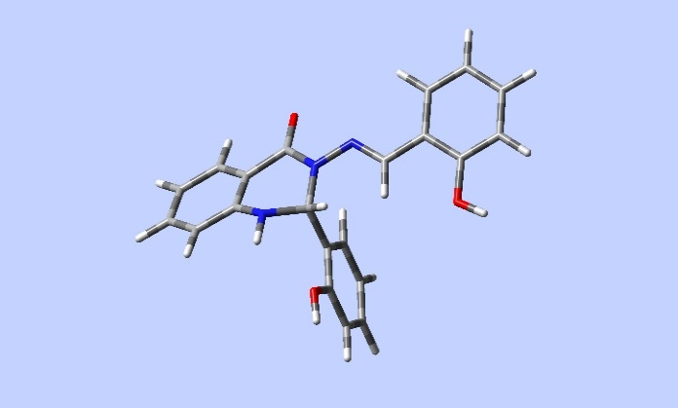
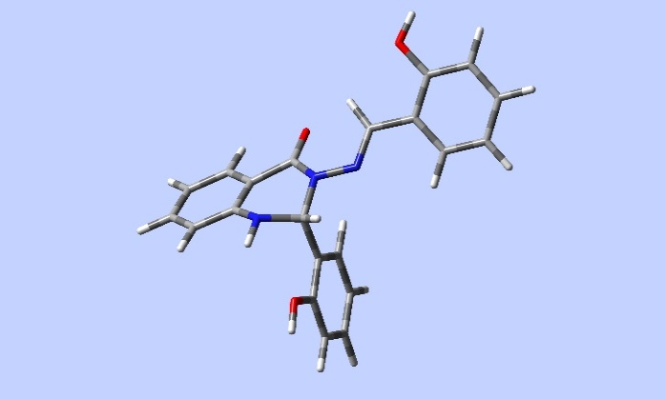

The analysis of photochemical anti-syn isomerization process across the –N–N= bond in heterocyclic imines

Slide 3
Abstract: Many biologically active molecules experience photoisomerization processes after light-induced excitation (e.g. rhodopsin). Important photochemical properties showed particularly compounds possessing aromatic systems in the presence of conjugated heteroatoms. Such systems often constitute a part of natural biomolecules and play a crucial role in essential biochemical and biological processes. Due to photochemical nature of these aromatic compounds, such as Schiff bases, they are often studied for pharmacological applications and used in biochemistry and medicine. For this reason, we focused our study on photochemical processes of quinazolinone-based Schiff bases. The isomerization from the energetically more favourable anti-isomer to the syn-isomer by UV/vis excitation has been found namely in the systems possessing a double bond systems. Presented analysis deals with NMR spectroscopy and theoretical DFT analysis of photochemical processes of the Schiff base possessing a quinazolinone moiety with a series of model compounds to investigate the photochemical behaviour of the –N–N= linkage. The NMR experiments in solution showed that irradiation at 365 nm leads to photochemically-induced isomerization from the anti- to the higher-energy syn-form around the –N–N= linkage.
Keywords: NMR; Photoactive biomolecules; Photoisomerization; Schiff-bases

Slide 4
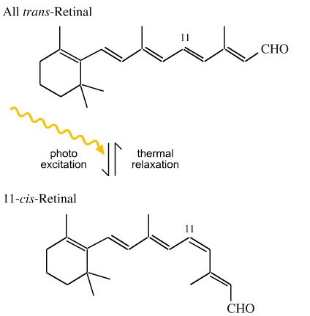
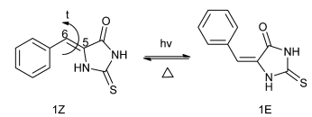
Introduction
some chemical substances are photoactive when subjected to UV radiation
can form many reactive species
play a crucial role in essential biochemical processes
exhibit structural changes and biological activities upon radiation
act as the first step in a number of light-induced biological processes
photochemical nature makes them applicable in many fields
Pepino, A. J. et al. Phys. Chem. Chem. Phys., 2015, 17, 12927.
Yin, T.-T. et al. Org. Electron., 2018, 52, 61.
Rashid, Md Al M. et al. Nanomaterials, 2019, 9, 119.

Slide 5
Compounds
Schiff-base possessing a quinazolinone moiety (S1)
model compounds (M1-M4) possessing N–N=CH moiety
significance of Schiff bases can be attributed to the presence of the N=C or N=N double bond
the –N–N=CH– array of atoms has different photochemical properties compared to the N=N double bond
S1
Hricovíni, M.; Asher, J.; Hricovíni, M. RSC Adv. 2020, 10, 5540.

Slide 6
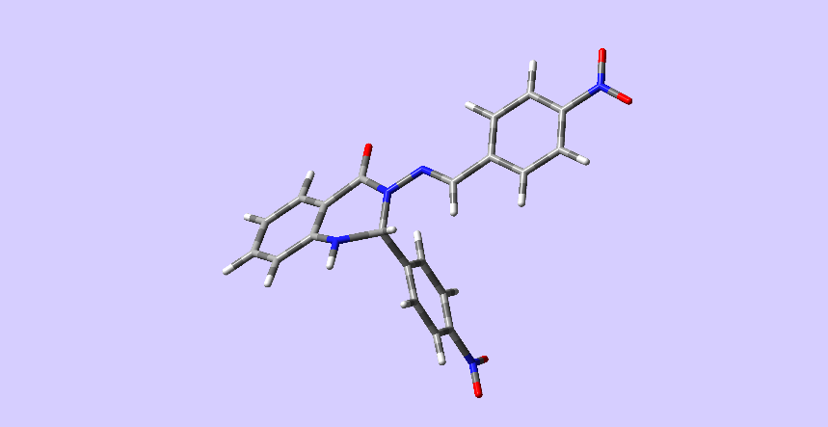
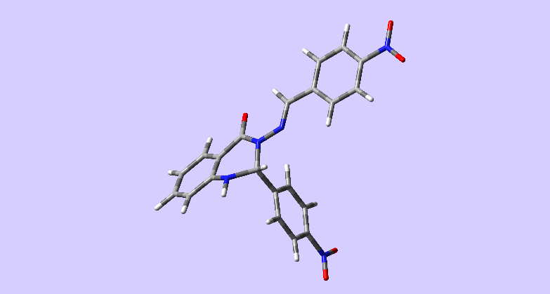

Outline
study of photochemical behaviour
  generation of ROS via photosystem I/II mechanism
  structural changes upon irradiation
spectroscopic characterisation
  EPR (X-band)
  NMR (1D and 2D)
DFT calculations
  geometry optimisation
  excited states study
P = photosensitizer, S = substrate, ⁰ = ground state, ¹ = singlet, ³ = triplet, * = activated state, ISC = intersystem crossing

Slide 7
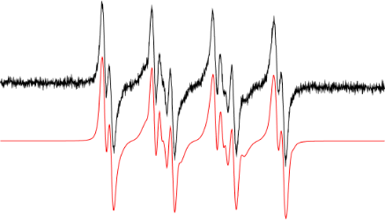
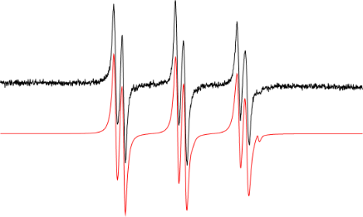
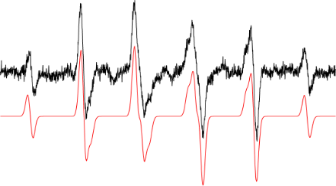
Results and discussion
(a)
DMSO solvent, RT, continuous irradiation at 365 nm
spin-trapping technique, spin traps used
detected oxygen centred adducts, namely •DMPO-O₂– (a-c) and carbon centred adduct •ND-CH₃ (d)
reactive species are formed via consecutive reactions in DMSO under atmospheric conditions
•DMPO-O₂– (60%)
•DMPO-OCH₃ (37%)
•DMPO-OR’ (3%)
(b)
•POBN-OCH₃ (98%)
•POBN-O₂– (2%)
(c)
•ND-CH₃ (100%)
Hricovíni, M.; Asher, J.; Hricovíni, M. RSC Adv. 2020, 10, 5540.

Slide 8
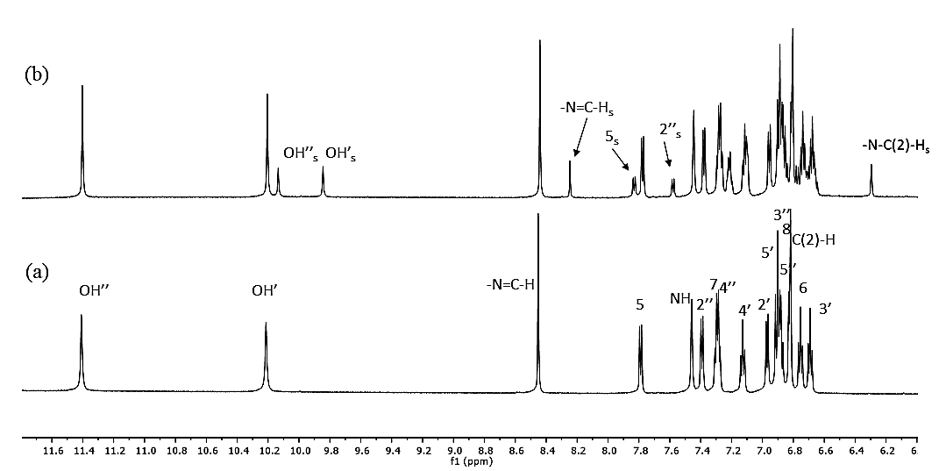
Results and discussion
600 MHz, RT, DMSO, before irradiation (a)
new resonances originating from the syn-isomer after 10 min irradiation at 365 nm (b)
intensities had been increasing
with irradiation
isomerization varied in a manner
correlated to the structure
stabilisation of syn-isomer
via H-bonds
High-resolution 600 MHz ¹H NMR spectrum of S1 in DMSO at 25°C before irradiation (a) and after 10 minutes of UV irradiation (λ_{max} = 365 nm) (b). Smaller signals (marked with subscript s) belong to the syn-isomer, which formed upon irradiation; assignments without indices belong to the main form (anti-isomer).
Hricovíni, M.; Asher, J.; Hricovíni, M. RSC Adv. 2020, 10, 5540.

Slide 9
Results and discussion
temperature coefficients of the –N₃–N=C(H) protons and OH protons (Table 1)
coefficients for the OH protons for 1 – 7 varied between -5.36 and -6.11 ppb/K
OH groups are involved in intramolecular H-bonds with different strengths depending upon the structure and conformation
the same behaviour also for the NH protons
stability of syn-isomers due to the formation of intramolecular hydrogen bonds
Table 1. Temperature dependence of the chemical shifts of –N=C(H) and –OH protons in S1.
 |  |  | (20°C) | (25°C) | (35°C) | (45°C) | (55°C) | (65°C) | ppb/K
S1 | anti- | ‒OH’ | 10.233 | 10.203 | 10.142 | 10.080 | 10.020 | 9.958 | −6.11
 |  | ‒OH’’ | 11.434 | 11.409 | 11.353 | 11.299 | 11.246 | 11.193 | −5.36
 |  | N₃-N=CH | 8.441 | 8.454 | 8.477 | 8.499 | 8.522 | 8.542 | −2.24
 |  | ‒NH | 7.484 | 7.460 | 7.408 | 7.357 | 7.305 | 7.254 | −5.11
Hricovíni, M.; Asher, J.; Hricovíni, M. RSC Adv. 2020, 10, 5540.

Slide 10
Results and discussion
The relative energies between the anti- and syn-forms for M1-M4 and S1 are listed in Table 2 and the selected geometry parameters are in Table 3 (next slide).
the N₃–N₉ bond has partial double-bond character (around 1.37 Å, see Table 3, row 3)
incorporation of the heterocyclic moiety (M2) to the structure of M1 caused the bond elongation of the bond (1.380 vs. 1.356 Å).
A significant effect is also seen after addition of the aromatic ring C to the carbon atom C₁₀; there is a visible zigzag double-bond formation in the C₄‒N₃‒N₉‒C₁₀ linkage, where the N₃‒N₉ bond was shortened and the N₉‒C₁₀ bond was prolonged (Table 3, rows 3 and 4)
Ring C
Ring C
Ring A
Ring A
Ring B
Ring B
DFT-optimised geometries of compound S1: anti-isomer (left) , syn-isomer (right)
Table 2. DFT-computed energy differences (kJ/mol) between the anti and syn-forms for all compounds using ωB97XD functional, 6-311++G(2d,2p) basis set and SMD solvent model (DMSO)
Compound | M1 | M2 | M3 | M4 | S1
ΔE_{syn} – ΔE_{anti} | 7.88 | 6.09 | 4.99 | 2.39 | 7.56
Hricovíni, M.; Asher, J.; Hricovíni, M. RSC Adv. 2020, 10, 5540.

Slide 11
Results and discussion
Table 3. Selected optimised bond lengths (Å), bond angles (degrees) and torsion angles (degrees) for M1‒M4 and S1 obtained by DFT calculations at the ωB97XD/6-311++G(2d,2p) using SMD solvent model (DMSO)
 |  | M1 |  | M2 |  | M3 |  | M4 |  | S1
 |  | anti- | syn- | anti- | syn- | anti- | syn- | anti- | syn- | anti- | syn-
Bond length | C_{1”}–C_{6”} | ‒ | ‒ | ‒ | ‒ | 1.410 | 1.409 | ‒ | ‒ | 1.410 | 1.410
 | C₁₀–C_{1”} | ‒ | ‒ | ‒ | ‒ | 1.458 | 1.453 | ‒ | ‒ | 1.457 | 1.453
 | N₃–N₉ | 1.365 | 1.371 | 1.365 | 1.375 | 1.357 | 1.387 | 1.374 | 1.402 | 1.360 | 1.386
 | C₁₀‒N₉ | 1.267 | 1.272 | 1.270 | 1.272 | 1.278 | 1.280 | 1.265 | 1.268 | 1.278 | 1.279
 | C₄–N₃ | 1.356 | 1.356 | 1.380 | 1.368 | 1.385 | 1.385 | 1.358 | 1.349 | 1.388 | 1.384
 | C₂–N₃ | ‒ | ‒ | 1.463 | 1.471 | 1.459 | 1.462 | 1.449 | 1.447 | 1.458 | 1.459
Bond angle | N₃‒N₉–C₁₀ | 120.7 | 116.5 | 120.1 | 123.1 | 122.7 | 117.5 | 118.6 | 113.4 | 122.5 | 117.9
 | N₉–C₁₀‒C_{1”} | ‒ | ‒ | ‒ | ‒ | 119.4 | 120.7 | ‒ | ‒ | 119.4 | 120.3
 | C₄‒N₃‒C₂ | ‒ | ‒ | 123.8 | 122.3 | 121.3 | 118.2 | 121.2 | 122.5 | 122.5 | 120.8
 | C_{8a}‒N₁‒C₂ | ‒ | ‒ | 110.4 | 109.8 | 116.7 | 115.2 | ‒ | ‒ | 116.8 | 116.3
 | N₁‒C₂‒N₃ | ‒ | ‒ | 110.4 | 110.2 | 109.0 | 108.0 | ‒ | ‒ | 108.2 | 107.4
 | C₄‒N₃‒N₉ | 121.6 | 130.8 | 115.8 | 126.5 | 114.9 | 119.8 | 117.1 | 120.8 | 115.0 | 120.6
 | C_{1’}‒C₂‒N₃ | ‒ | ‒ | ‒ | ‒ | ‒ | ‒ | ‒ | ‒ | 112.4 | 113.4
Torsion angle | C₄‒N₃‒N₉–C₁₀ | −180 | 0 | −170.9 | 14.8 | −165.7 | 58.9 | −180 | −67.1 | −167.3 | 57.4
 | C₂‒N₃‒N₉–C₁₀ | ‒ | ‒ | 3.4 | −177.7 | −1.5 | −156.8 | 0 | 131.1 | 1.3 | −151.9
 | N₃‒N₉–C₁₀‒C_{1’’} | ‒ | ‒ | ‒ | ‒ | −179.5 | −178.0 | ‒ | ‒ | 179.9 | −178.1
 | N₉–C₁₀‒C_{1”}‒C_{6”} | ‒ | ‒ | ‒ | ‒ | −2.2 | 1.0 | ‒ | ‒ | −2.3 | 2.0
 | N₃‒C₂‒C_{1’}‒C_{2’} | ‒ | ‒ | ‒ | ‒ | ‒ | ‒ | ‒ | ‒ | −9.3 | −11.7
 | N₁‒C₂‒N₃‒C₄ | ‒ | ‒ | −21.8 | −31.1 | −41.8 | −53.6 | ‒ | ‒ | −38.7 | −48.1
Hricovíni, M.; Asher, J.; Hricovíni, M. RSC Adv. 2020, 10, 5540.

Slide 12
Results and discussion
For M1, both the molecule and its energy profile with respect to D(C‒N−N‒C) are symmetric
energy profiles of S1 and M1, M2 and M3 are compared
The C₄N₂ ring present in M2 introduces a major part of the asymmetry - steric repulsion between the Schiff’s base CH₂ group and the ring CH₂ group
The difference between S1 and M3 is the aromatic Ring B, which does not participate in the large π-system
Ground state energy curves (kJ/mol) against C₄‒N₃‒N₉‒C₁₀ dihedral angle for S1 and model systems. Top: energy profiles for S1 and M1, M2, and M3 (zeroed to lowest energy point on curve). Calculated at the ωB97XD/6-311++G(2d,2p) level. Bottom: S1 and M3 (zeroed to syn minimum).
Hricovíni, M.; Asher, J.; Hricovíni, M. RSC Adv. 2020, 10, 5540.

Slide 13
Results and discussion
small shoulder around 0° in S1, M2, and M3 is visible as a peak in the case of M4, less pronounced in case of M2
steric repulsion between the C=O group and the electron pairs (two lone pairs, one N‒C bond) on sp³-hybridised N‒
This suggests that the peak (or shoulder) at 0° arises from resonance structures with negative charge at the Schiff’s base nitrogen
nearby electron-donating OH group shows such effects most strongly
Top: ground-state energy curves (in kJ/mol) for S1, M3, M4, and M3_{pcm} against D(C‒N‒N‒C). Bottom: resonance structure with negative charge on Schiff’s-base nitrogen.
Hricovíni, M.; Asher, J.; Hricovíni, M. RSC Adv. 2020, 10, 5540.

Slide 14
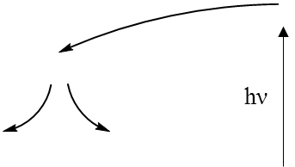
Results and discussion
potential energy curves for ground and excited states against the dihedral angle D(C‒N−N‒C); studied for all model compounds and S1
first excited state has its highest energy at 180° and its lowest energy at 0°
The first state arises from an n‒π* excitation
the dominant excitation is HOMO → LUMO
Top: Energy curves for the ground state (GS) and first three excited states (ES1-ES3) of M1. Relative energies (kJ/mol) of the states have been heavily adjusted for clarity.
Bottom: Ground state (GS) and first two excited states (ES1, ES2) energy curves for M2. Relative energies (kJ/mol) of the curves have been adjusted for clarity. .
Hricovíni, M.; Asher, J.; Hricovíni, M. RSC Adv. 2020, 10, 5540.

Slide 15
Results and discussion
M3 and S1 – the situation is a little different
the first two have similar energy profiles to the ground state; third is inverted
the conical intersection between 2nd and 3rd excited state
deexcitation mechanism is similar for both systems
S1
Energy curves for ground state (GS) and excited states (ES1-ES4) of M3 (left) and S1 (right) with proposed mechanisms of excitation and deexcitation processes (E – excitation, 1 – structural relaxation, 2 – internal conversion, 3 – emission). Relative energies (kJ/mol) of the curves have been adjusted for clarity.
Hricovíni, M.; Asher, J.; Hricovíni, M. RSC Adv. 2020, 10, 5540.

Slide 16
Conclusions
EPR measurements evidenced the generation of ROS using spin-trapping technique
  the presence of oxygen- and carbon-centred adducts
NMR spectra proved the photoisomerization process around the N‒N bond within the –N–N=CH– array
  two isomers, syn-isomer formed, 25% of conversion
  presence of hydrogen bonds
DFT calculations
  the anti-form to be lower in energy than the syn-form, in accordance with experiment
  excited state energy curves; photoisomerization involves n‒π* excitations or proceeds purely via π‒π* states; the mechanism is determined by the π-system size
  M3 and S1, the 3rd singlet-singlet excitation (π‒π*) results in an excited state with an appropriate energy profile for isomerisation; lower excitations are unlikely to be involved

Slide 17



Acknowledgments
Grant agencies:
VEGA 1/0041/15
VEGA 2/0100/14
APVV-15-0053
SP Grant 2003SP200280203
Institute of Chemistry
Slovak Academy of Sciences
Computing Centre of the SAS using the supercomputing infrastructure acquired in projects ITMS 26230120002 and 26210120002
Department of Physical Chemistry and Chemical Physics
Faculty of Chemical and Food Technology, Slovak University of Technology

