Slide 1
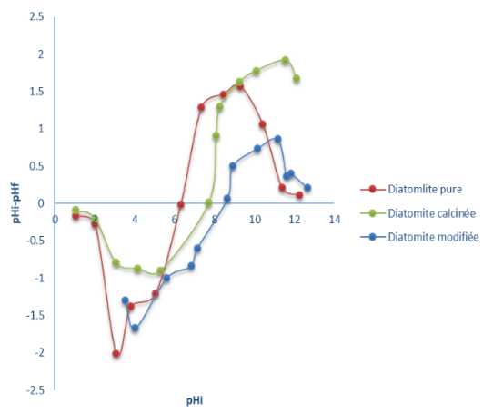
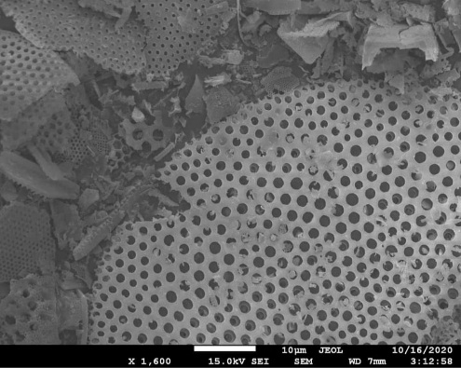
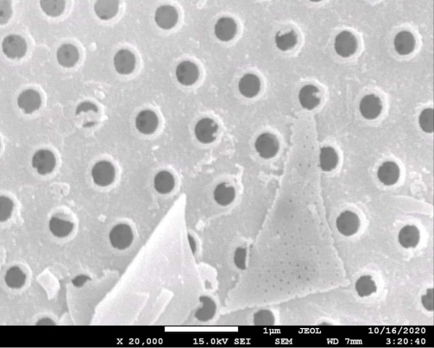
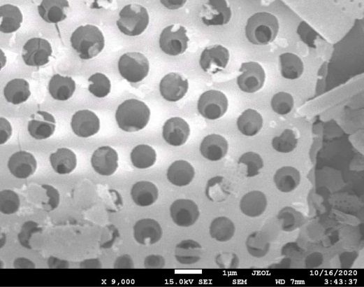
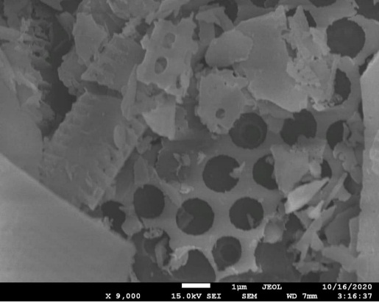
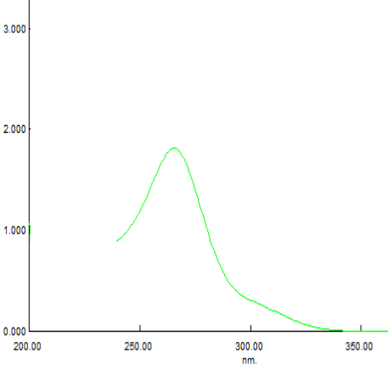
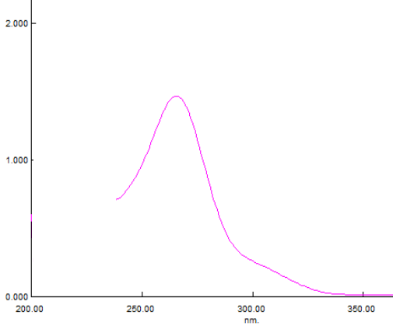
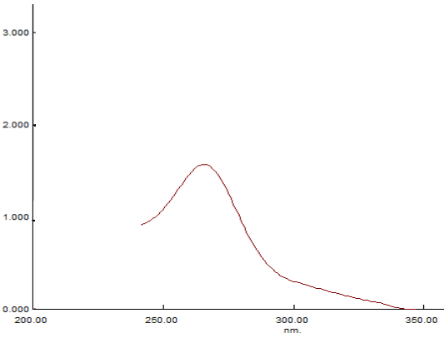
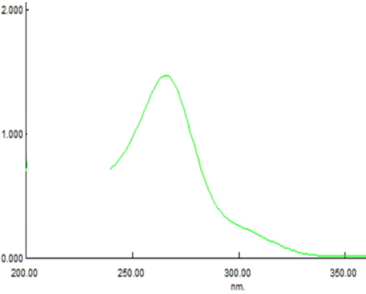
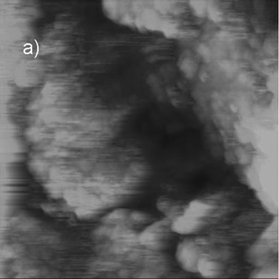
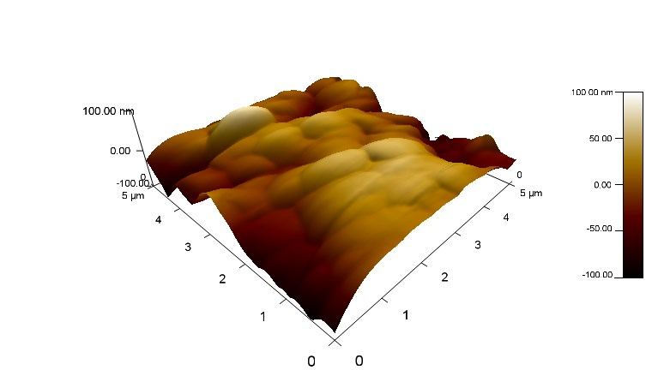
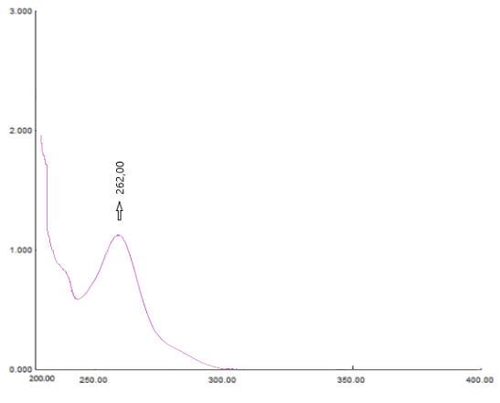
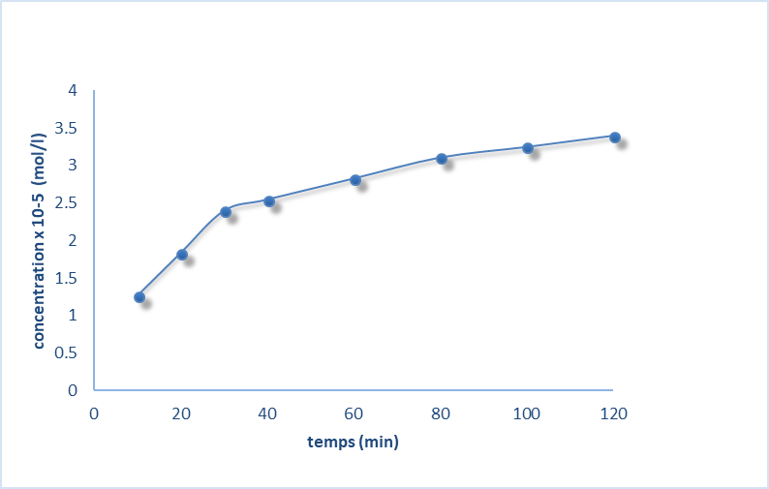
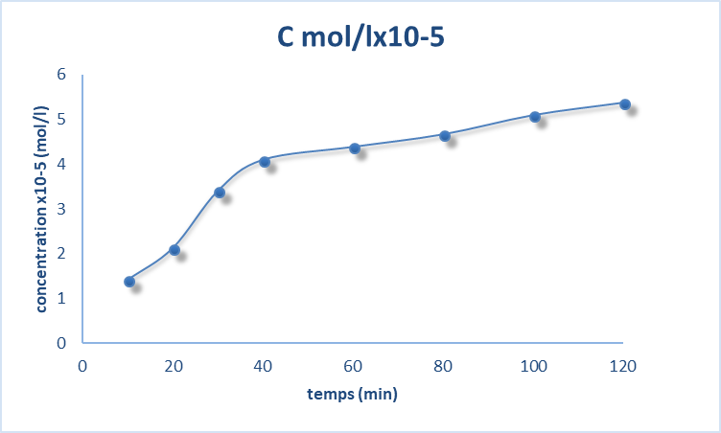
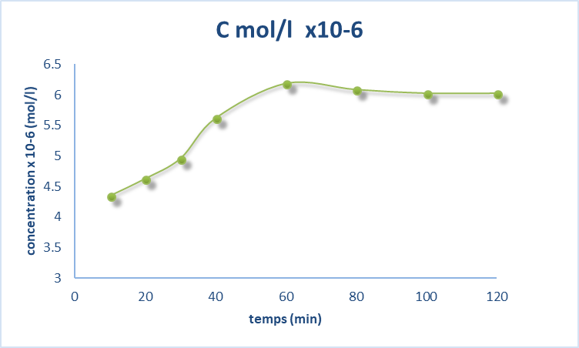
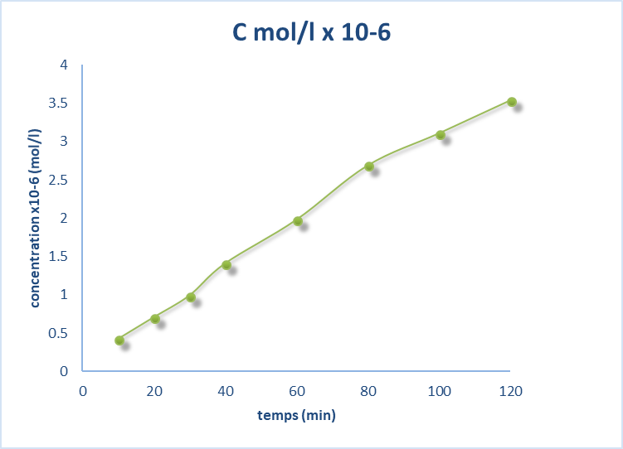
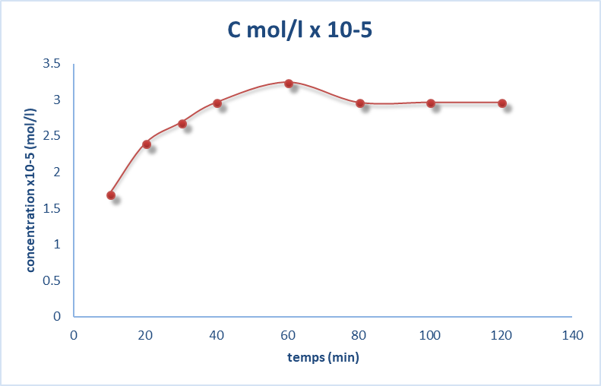
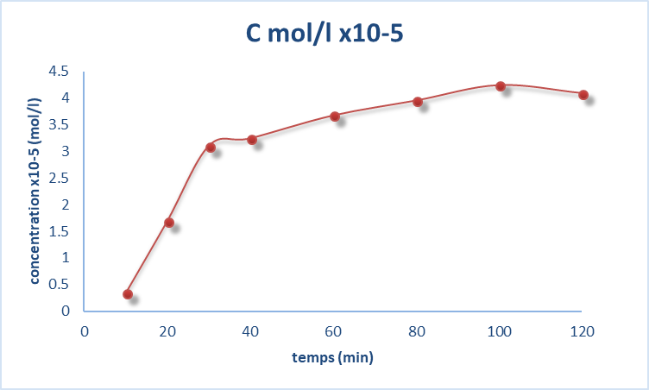
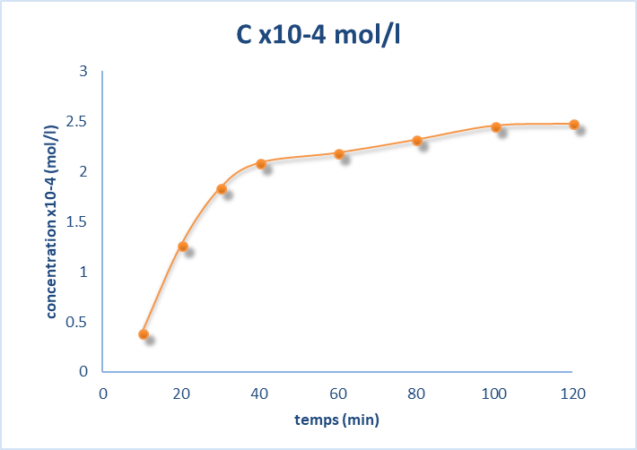
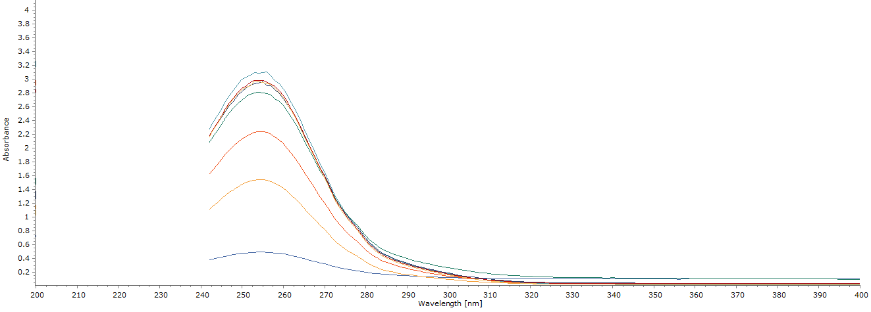
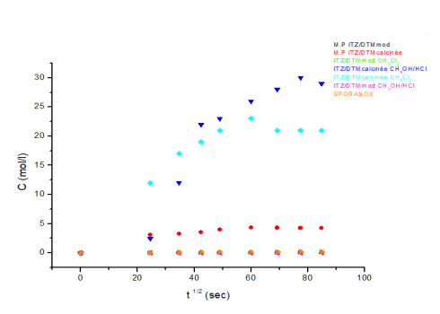
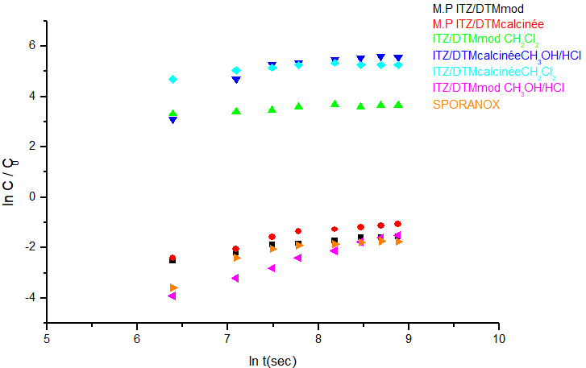
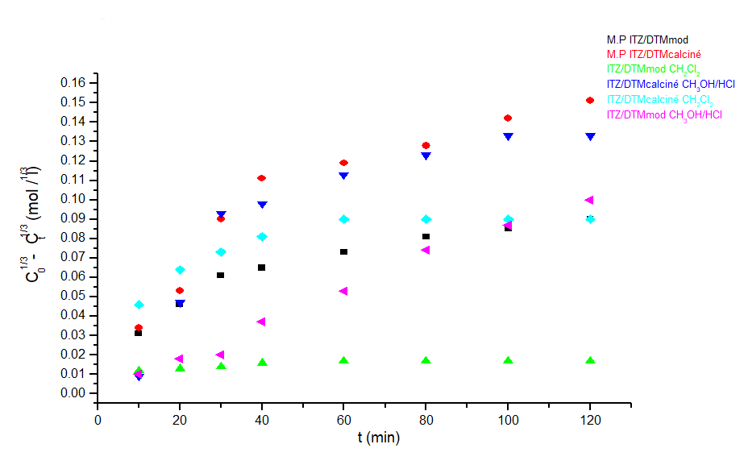
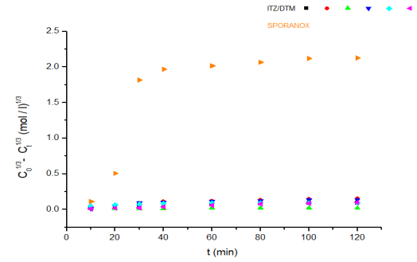
Diatomite as a potential drug carrier for Itraconazole and improvement in release control
Roufaida Merir^{1,}*, Milad Baitiche¹, Ferhat Djerboua¹, Mokhtar Boutahala²
¹Laboratoire de Préparation, Modification et Applications des Matériaux Polymériques Multiphasiques, Département de génie des procédés, Faculté de technologie,Université Ferhat Abbas Sétif1
²Laboratoire de Génie des Procédés Chimiques, Département de génie des procédés,Faculté de technologie, Université Ferhat Abbas Sétif1
Abstract:
Many obstacles associated with the use of conventional drug delivery systems have led to the development of new various micro/nano sized drug carriers. These carriers are designed with the aim to improve therapeutic outcomes and/or reduce drug’s adverse effects, by providing protection of the entrapped drug against in vivo degradation, releasing drug in desired man­ner, improving drug solubility and/or reducing its immunogenicity. Additionally, their small sizes make these carriers when loaded with the bioactive molecules suitable and allowing their vectorization to the target site. In this work, Diatomite (DTM) was used as a support material for Itraconazole (ITZ) which is known for its fairly low side effects. The major drawback in the therapeutic application and efficacy of ITZ as oral dosage forms is its very low aqueous solubility. Three Binary systems were prepared using different proportions of the two components and where tested for the ability of DTM to improve the solubility of ITZ in aqueous and in organic media. The efficacy of encapsulation was demonstrated by UV analysis. The prepared systems were characterized using UV-Vis, FTIR, MEB, AFM and Optical microscopy. Moreover, the study of kinetics and mechanism of drug release in the gastric medium exhibit a sustained profile during 02 hours.
Introduction Today smart technologies are used in several domains. Most of them are related with pharmaceutical industry and biomedical applications. The most recent are poorly soluble drug in aqueous solvents, that's why the modern medicine address a formidable challenge to resolve this hurdle by developing a new drug delivery systems. The main objective is to enhance the solubility, the drug efficiency and minimized the side effects. Itraconazole is hydrophobic agent having low side effects and widely prescribed for normal and immunocompromised hosts with serious fungal infections.[1]
Therefore, in the last years, emerging natural porous materials for biomedical applications have also been suggested to overcome the shortcomings of the synthetic porous materials like Diatomite. This magic bullet are characterized by excellent biocompatibility, non-toxicity and thermal stability[2]. The aim of this research was to enhance the solubility capacity of itraconazole using pure Diatomite silica and the modified one with several techniques(calcination and chemical methods) as encapsulation system. The efficacy of encapsulation was demonstrated by standard methods such as extraction and UV analysis. The prepared systems were characterized using UV-Vis, FTIR, MEB, AFM and Optical microscopy. Moreover, the study of kinetics and mechanism of drug release in the gastric medium exhibit a sustained profile during a time of two hours.
Isoelectric point of all DTMs
types
Optical microscopy analysis
By comparing the pur DTM (a) with the chemically modified DTM (b) and calcined (c)
The appearance of the identical particle
DTM types | Pure | Mod by AL₂(SO₄)₃ | Cal
IZ. P | 6.3 | 8.6 | 7.7
Scanning electron microscope analysis
Table 3 : DTM isoelectric point (pure, modified,
calcined)
It can be seen that DTM mod and DTM cal encapsulate ITZ present a higher porosity than DTM pur.
This confirms that pur DTM has a low absorbing capacity due to the reduced diameter of the pores.
Results and discussion
DTM
UV-vis analysis
FTIR analysis
ITZ/DTM pur CH₂Cl₂
AFM images
ITZ/DTM mod CH₂Cl₂
ITZ/DTM cal CH₂Cl₂
Fig 1: UV spectrum of ITZ/DMT pure (CH₂Cl₂)
Fig 2: UV spectrum of ITZ/DMT mod (CH₂Cl₂)
Fig 11:FTIR spectrum of DTMs (pure, calcined and modified)
Fig 12: FTIR spectrum of :
-DTM mod by AL2(SO₄)₃
-AL2(SO₄)₃
DTM
ITZ/DTM mod CH₂Cl₂
Fig 3: UV spectrum of ITZ/DMT cal (CH₂Cl₂)
Fig 4: UV spectrum of ITZ/DMT cal (CH₃OH/HCl)
The absence of the characteristic peaks of ITZ was noted. This confirms that pure DTM has a low absorbing capacité due to the reduced diameter of the pores (very low % encapsulation of ITZ just 2%).
Fig 16: AFM image (5x5 μm) of DTM: a) topography [1]
Fig 17: AFM image (5x5 μm) of ITZ/DTM mod CH₂Cl₂ a) topography.
Fig 18: AFM 3D surface topography (500x500nm) of ITZ/DTM mod CH₂Cl₂
Fig 13: FTIR spectrum of : - DTM pur
- ITZ/DTM pur CH₂Cl₂
The appearance of the characteristic bands of ITZ at 1510, 1700, 3068 cm-¹ in the FTIR spectrum ITZ/DTM mod CH3OH/HCl and also in ITZ/DTM mod CH₂Cl₂ at 1609 and 1697 cm-¹(Fig 14).
It can be seen from the fig 16 where the AFM micrographs of the diatomite are presented that small diatomite particles are compacted into the pellet. A sponge like structure with small pore sizes that can be noticed from topography picture [1]
We can notice a surface with a higher rugosity in AFM picture of Diatomite /ITZ system fig 17. RMS = 28.053 nm
Fig 5:UV spectrum of ITZ/DMT mod(CH₃OH/HCl)
Fig 6: UV spectrum of pure ITZ
Fig 14: FTIR spectrum of :
-DTM mod - Al2(SO4)3
-ITZ/DTM mod CH2Cl2 -ITZ/DTM mod
Release kinetics in the gastric meduim
DTM | Pure | Mod by AL₂(SO₄)₃ | Cal
% included | 0,2% | 100% | 100%
Physical mixture ITZ/DTM
ITZ/DTM mod complex
The FTIR spectra of ITZ / DTM calcinated CH₃OH / HCl show a peaks at 1510, 1700 and 3130 cm-¹ and broad band between 1000 cm-¹ and 1200 cm-¹ of ITZ / DTM calcinated CH₂Cl₂ these observations validate and justify the result of the calcinated DTM encapsulation.
Fig 7: ITZ calibration curve in CH₂Cl₂
Table 1:% included of ITZ/DTM in CH₂Cl₂
Releae profile
ITZ/DTM mod
DTM | Mod by AL₂(SO₄)₃ | Cal
% included | 93,16% | 83,44%
Fig 15: FTIR spectrum of : -DTM cal
-ITZ/DTM cal CH₂Cl₂
-ITZ/DTM cal CH₃OH/HCl
Releae profile
ITZ/DTM cal
Releae profile
ITZ/DTM mod (CH₂Cl₂)
Releae profile
ITZ/DTM mod (CH₃OH/HCl)
ITZ/DTM cal complex
SPORANOX 50mg Tablet
Fig 8: ITZ calibration curve in CH₃OH/HCl
Table 2:% included of ITZ/DTM in CH₃OH/HCl
Conclusion
Release results of SPORANOX 50mg tablets:
This study demonstrates the feasibility of naturally and modified DTM microparticles to be used as drug carrier for drug delivery of ITZ. Versatile and successful modifications of DTM surface by calcination and chemical modifications were successfully demonstrated. The loading capacity and in vitro drug release properties of DTM microparticles were successfully obtained by enhancing the solubility of ITZ and by sustaining its release[3].
Releae profile
ITZ/DTM cal (CH₂Cl₂)
Releae profile
ITZ/DTM cal (CH₃OH/HCl)
SPORANOX Releae profile
Mathematical modeling of release profiles in the gastric meduim
Fig 9: UV Spectrum of SPORANOX® 50mg tablet during 120min.
Reference
Higuchi model
Korsmeyer-Peppas
model
Hixson-Crowel model
Hixson-Crowel model for ITZ/DTM and SPORANOX ®
[1]S. S. Nenadović et al., « Influence of Diatomite Microstructure on its Adsorption Capacity for Pb(II) », Sci. Sinter., vol. 41, nº 3, p. 309‑317, 2009, doi: 10.2298/SOS0903309N.
[2]M. J. Grau, O. Kayser, et R. H. Müller, « Nanosuspensions of poorly soluble drugs — reproducibility of small scale production », Int. J. Pharm., vol. 196, nº 2, p. 155‑159, mars 2000, doi: 10.1016/S0378-5173(99)00411-1.
[3]M. Bariana, M. S. Aw, M. Kurkuri, et D. Losic, « Tuning drug loading and release properties of diatom silica microparticles by surface modifications », Int. J. Pharm., vol. 443, nº 1‑2, p. 230‑241, févr. 2013, doi: 10.1016/j.ijpharm.2012.12.012.
the optimal model for the liberation kinetics
the one that has an R² closer to1.
DTM mod and the DTM cal liberate ITZ by a diffusion mechanism more than by erosion.

