Slide 1
SLMP53-1 inhibits tumor cell growth through regulation of glucose metabolism and angiogenesis in a P53-dependent manner
Juliana Calheiros¹, Helena Ramos¹, Carla Carvalho¹, Valentina Barcherini², Maria M. M. Santos², Lucília Saraiva^{1,*}
¹LAQV/REQUIMTE, Laboratório de Microbiologia, Departamento de Ciências Biológicas, Faculdade de Farmácia, Universidade do Porto, Portugal
²Research Institute for Medicines (iMed.ULisboa), Faculty of Pharmacy, Universidade de Lisboa, Portugal
* Corresponding author: lucilia.saraiva@ff.up.pt

Slide 2
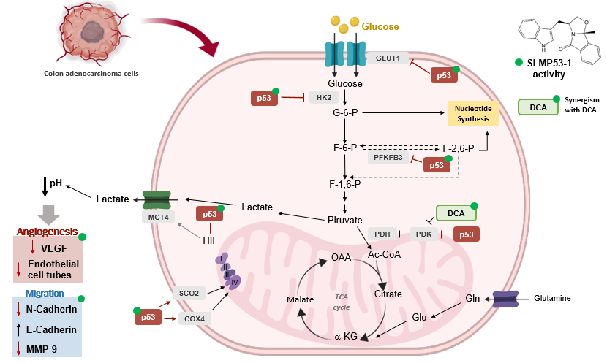
SLMP53-1 inhibits tumor cell growth through regulation of glucose metabolism and angiogenesis in a P53-dependent manner
[3] Ramos et al. International Journal of Molecular Sciences.2020;21(2):596.

Slide 3
Abstract: The Warburg effect is an emerging hallmark of cancer, which has p53 as its major regulator. Recently, we have reported the (S)-tryptophanol-derived oxazoloisoindolinone (SLMP53-1) as a new p53-activating agent with in vitro and in vivo antitumor activity. Herein, we investigated the molecular events underlying the antitumor activity of SLMP53-1 in colon cancer by analyzing its effect on glucose metabolism, angiogenesis and migration.
In colon HCT116 cancer cells, SLMP53-1 inhibited glycolysis through reduction of GLUT1, hexokinase-2, and phosphofructokinase-2 isoform 6-phosphofructo-2-kinase/fructose-2,6-biphosphatase-3 protein levels, also depleting the lactate export in colon cancer cells. Conversely, it enhanced mitochondrial oxidative phosphorylation (OXPHOS), upregulating the synthesis of cytochrome-c oxidase 2 and cytochrome-c oxidase subunit 4. SLMP53-1 further increased E-cadherin and reduced metalloproteinase-9 levels, which corroborated an inhibition of extracellular matrix (ECM) remodeling and epithelial-to-mesenchymal transition (EMT). Consistently, SLMP53-1 depleted angiogenesis, decreasing endothelial cell tube formation and vascular endothelial growth factor protein levels. In tumor tissues of xenograft mouse models carrying p53^{+/+}- and p53^{-/-}-HCT116 cells treated with SLMP53-1 or vehicle obtained in our previous work, the levels of molecular markers of glycolysis, OXPHOS, angiogenesis and migration were evaluated, confirming the in vitro results and unveiling that SLMP53-1 effect is p53-dependent in tumor tissues of colon cancer xenografts. SLMP53-1 exhibited synergistic cytotoxicity with the metabolic regulator dichloroacetic acid.
These data reinforce the promising application of SLMP53-1 in cancer therapy by targeting p53-mediated pathways of growth and dissemination.
Keywords: anticancer drug, anti-angiogenic, anti-migratory, glycolysis and OXPHOS, p53
Soares et al. Oncotarget. 2016;7(4):4326-4343;
Saraiva et al. European patent application nºEP3013833-A1, US-patent nº20160347765;
Ramos et al. International Journal of Molecular Sciences. 2020;21(2):596.

Slide 4
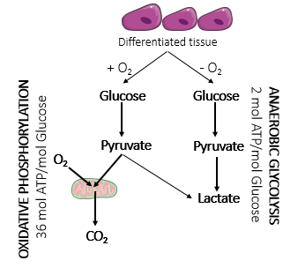
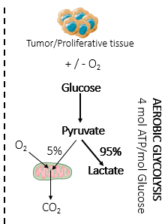
Warburg effect in tumor cells
Warburg effect
Even in the presence of sufficient oxygen, most cancer cells increased glucose consumption and converted it to lactate, instead of relying on mitochondrial oxidative phosphorylation (OXPHOS)
A.S. Gomes et al. p53 and glucose metabolism: an orchestra to be directed in cancer therapy, Pharmacological Research. 131 (2018) 75–86.

Slide 5
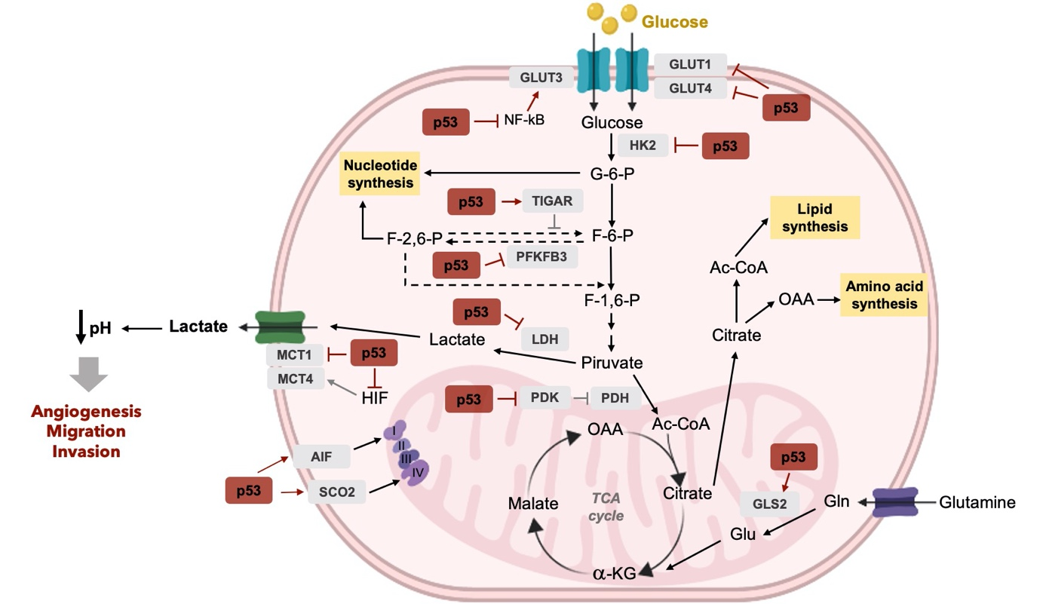
p53 as a regulator of metabolic reprogramming in tumor cells
p53 regulates important glucose metabolism mediators, with impact in maintaining mitochondrial health, increasing mitochondrial respiration and lowering glycolysis
A.S. Gomes et al. p53 and glucose metabolism: an orchestra to be directed in cancer therapy, Pharmacological Research. 131 (2018) 75–86.

Slide 6
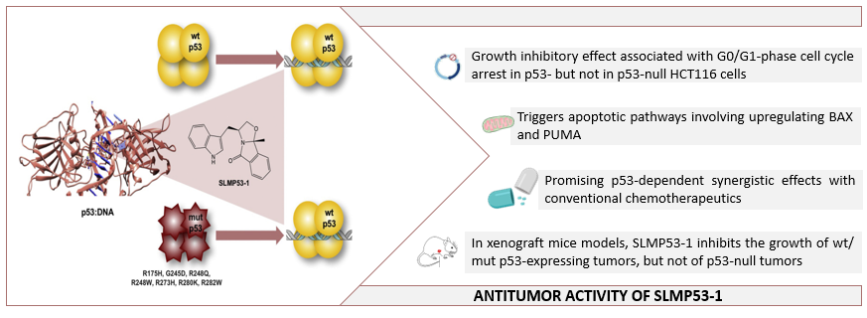
(S)-tryptophanol-derived oxazoloisoindolinone (SLMP53-1) as a new activator of wt- and mutp53 with in vitro and in vivo antitumor activity
AIM
To investigate the molecular events underlying the antitumor activity of SLMP53-1 in colon cancer by analyzing its effect on glucose metabolism, angiogenesis and migration
Soares et al. Oncotarget. 2016; 7(4):4326-4343.
Saraiva et al. European patent application nºEP3013833-A1, US-patent nº20160347765

Slide 7
SLMP53-1 regulates the Warburg effect and angiogenesis in cancer cells, with interference in ECM remodeling and EMT events
Mitochondrial complexes expression by immunoblotting. HCT116 cells treated with 16µM SLMP53-1 for 24h (n=3).
Immunoblotting. HCT116 cells treated with for 24h (n=3).
Immunoblotting. HCT116 cells treated for 24h (n=3).
Immunoblotting. HMVEC-D endothelial cells treated with 42µM SLMP53-1 for 48h (n=3).
Immunoblotting. HCT116 cancer cells treated for 24h (n=3).
Lactate secretion assay. HCT116 cells treated with 16µM SLMP53-1 or DMSO for 24h; Relative luminescence corresponds to mean ± SEM (n=3). Values significantly different from DMSO: * p < 0.05, unpaired Student’s t-test).
Endothelial cell tube formation assay. Tube-like structures of HMVEC-D cells treated for 12h; (5 randomly selected microscopic fields); quantification represented by mean ± SEM (n=3). * p < 0.05; one-way ANOVA with Dunnett’s multiple comparison test.
7

Slide 8
SLMP53-1 regulates the Warburg effect and angiogenesis, interfering with ECM remodeling and EMT events in a p53-dependent manner, in tumor tissue of xenograft mouse models
Balb/c nude mice
GLUT1 ↓
HK2 ↓
PFKFB3 ↓
MCT4 ↓
in p53 ^{+/+}, but not in p53 ^{-/-} HCT116 tumors
GLUT1
HK2
PFKFB3
MCT4
Imunohistochemistry. Tumor tissues xenografts treated with 50 mg/kg SLMP53-1 or vehicle (IP injection 2x/week, 5 administrations obtained from Soares et al, Oncotarget (2016); Scale bar = 20 μm; magnification = x200. Quantification of IHC staining in tumor tissues treated with SLMP53-1 (+) or vehicle (-). Data are mean ± SEM (n=3); * p < 0.05, unpaired Student’s t-test.
8

Slide 9
SLMP53-1 regulates the Warburg effect and angiogenesis, interfering with ECM remodeling and EMT events in tumor tissue of xenograft mouse models
Balb/c nude mice
SCO2
COX4
SCO2 ↑
COX4 ↑
E-CAD ↑
MMP-9 ↓
VEGF1 ↓
in p53 ^{+/+}, but not in p53 ^{-/-} HCT116 tumors
E-CAD
MMP-9
VEGF1
Imunohistochemistry. Tumor tissues xenografts treated with 50 mg/kg SLMP53-1 or vehicle (IP injection 2x/week, 5 administrations obtained from Soares et al, Oncotarget (2016); Scale bar = 20 μm; magnification = x200. Quantification of IHC staining in tumor tissues treated with SLMP53-1 (+) or vehicle (-). Data are mean ± SEM (n=3); * p < 0.05, unpaired Student’s t-test.
9

Slide 10
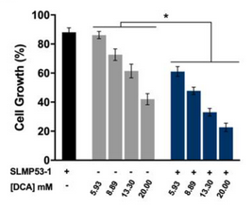
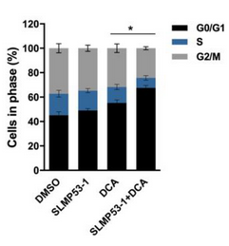
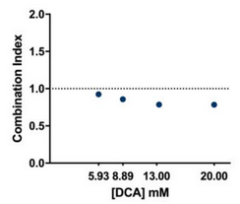
SLMP53-1 synergizes with dichloroacetic acid (DCA), enhancing its antitumor efficacy in cancer cells
Sulforhodamine B assay. HCT116 cells treated with DCA alone and in combination with SLMP53-1 for 48h; growth obtained with solvent (DMSO) was set as 100%. Data are mean ± SEM (n=6); values different from DCA alone: * p < 0.05, two-way ANOVA followed by Sidak’s test.
Combination therapy assay. CI values were calculated by using a mean value effect. CI < 1: synergy (n=6); CompuSyn software.
Cell Cycle analysis. HCT116 cells treated with DCA alone and in combination with SLMP53-1 for 48h; Data are mean ± SEM (n=3); Values significantly different from DCA alone: * p < 0.05, two-way ANOVA followed by Dunnett’s test).
Synergistic effect of SLMP53-1 with the metabolic regulator DCA, with increase of G0/G1-phase cell cycle arrest
10

Slide 11
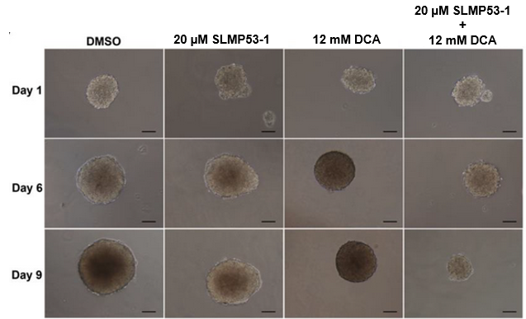
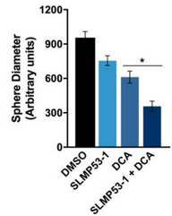
SLMP53-1 synergizes with dichloroacetic acid (DCA), enhancing its antitumor efficacy in cancer cells
HCT116 colonospheres. Cells were treated with 20 μM SLMP53-1 alone and in combination with 12 mM DCA, for up to nine days of treatment (n=3); scale bar = 50 μm; magnification = ×100. Spheroid diameter data are mean ± SEM (n=3); values significantly different from DCA alone: * p < 0.05, one-way ANOVA followed by Dunnett’s test.
SLMP53-1 was shown to synergize with DCA both in 2D and 3D cancer cell models
11

Slide 12
Conclusions
Potential promising antitumor activity of SLMP53-1, as single or combined anticancer drug, by targeting major pathways of cancer metabolism and dissemination
12

Slide 13
Acknowledgments
This work received financial support from PT national funds (FCT/MCTES, Fundação para a Ciência e Tecnologia and Ministério da Ciência, Tecnologia e Ensino Superior) through grants UID/QUI/50006/2020, UID/DTP/04138/2019, PTDC/QUI-QOR/29664/2017; PhD grants of PD/BD/143126/2019 (V. Barcherini), and 2020.04613.BD (J. Calheiros).
The authors declare the following competing financial interest: one patent application protecting the compound disclosed in this manuscript has been filed by the authors M.M.M Santos and L. Saraiva
113

