Slide 1
Antistaphylococcal Activity of Polychlorinated N-Arylcinnamamides
Hana Michnova^{1*}, Tomas Strharsky¹, Jiri Kos¹, Alois Cizek², Josef Jampilek¹
¹ Regional Centre of Advanced Technologies and Materials, Faculty of Science, Palacky University, Slechtitelu 27, 78371 Olomouc, Czech Republic
² Department of Infectious Diseases and Microbiology, Faculty of Veterinary Medicine, University of Veterinary and Pharmaceutical Sciences, Palackeho 1946/1, 61242 Brno, Czech Republic
* Corresponding author: michnova.hana@gmail.com

Slide 2
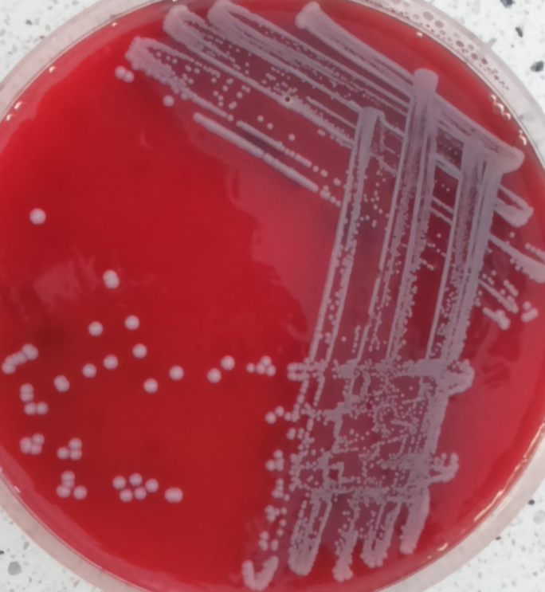
Antistaphylococcal Activity of Polychlorinated N-Arylcinnamamides
Graphical Abstract

Slide 3
Abstract:
Mutant strains of Staphylococcus aureus resistant to methicillin (MRSA) became widespread throughout the world at the end of the 20th century. Unfortunately, in recent years, individual cases of vancomycin-resistant S. aureus (VRSA) have also begun to appear. For that reason, the research and development of new active compounds is still needed.
A series of newly synthesized ring-substituted (2E)-3-(3,4-dichlorophenyl)- N-arylprop-2-enamides was tested for their antimicrobial effect against control strain S. aureus ATCC 29213 and three isolates of MRSA. The microdilution method was used to determine minimum inhibitory concentration (MIC). Three derivatives substituted by a trifluoromethyl moiety on the anilide ring were chosen and are demonstrated in this contribution. This electron-withdrawing substituent has been shown several times to carry an antibacterial effect against MRSA. Two of the tested compounds have comparable or higher activity than that of the standard antibiotic ciprofloxacin.
Keywords: cinnamides; antistaphylococcal activity; MRSA; microdilution method

Slide 4
Introduction
Research and development of new agents with antimicrobial activity against resistant pathogens is urgently needed.
Derivatives of cinnamic acid have previously proven their potential in this area.
A series of new ring-substituted (2E)-3-(3,4-dichlorophenyl)-N-arylprop- 2-enamides was prepared and tested for their antimicrobial activity against S. aureus and its methicillin-resistant mutants.
A microdilution method on a microtiter plate was used to determine MIC. Ciprofloxacin was used as the reference chemotherapeutic.
Three compounds of this new group were chosen for this contribution. All of them were substituted by a trifluoromethyl moiety on the anilide ring. They differ only in the position of this substituent.
The relationship between structure and activity is discussed.

Slide 5
Method
Microdilution method using microtitration plate allows to test multiple samples at once.
Tested compounds are diluted in a suitable medium, in this case Müller-Hinton broth. This creates concentration series from 256 to 2 µg/mL, if necessary to 0.008 µg/mL.
The inoculum is prepared by transferring a few colonies from a bacterial culture on blood agar to sterile deionized water. This solution is then diluted to form an inoculum with a cell count of 5×10⁷ CFU/mL.
Inoculated plates are incubated in a thermostat at 37 °C for 24 hours.
The MIC value is read visually as the lowest concentration with no bacterial growth.
All compounds were tested in three independent measurements.

Slide 6
Results
Table 1: Minimum inhibitory concentration (MIC) in µg/mL and µM; S. aureus – Staphylococcus aureus, MW – molecular weight, CIP - ciprofloxacin
Comp. | MW | R | S. aureus ATCC 29213 |  | MRSA 63718 |  | MRSA SA 630 |  | MRSA SA 3202
 |  |  | MIC
 |  |  | µg/mL | µM | µg/mL | µM | µg/mL | µM | µg/mL | µM
1 | 360.16 | 2-CF₃ | >256 | >711 | >256 | >711 | >256 | >711 | >256 | >711
2 | 360.16 | 3-CF₃ | 0.50 | 1.39 | 0.25 | 0.69 | 0.50 | 1.39 | 0.50 | 1.39
3 | 360.16 | 4-CF₃ | 0.25 | 0.69 | 0.13 | 0.35 | 0.13 | 0.35 | 0.25 | 0.69
CIP | 331.35 | – | 0.25 | 0.75 | 8 | 24 | 128 | 386 | 16 | 48

Slide 7
Discussion
Trifluoromethyl is a promising substituent that often carries activity against S. aureus including MRSA. It is a sterically bulky, electron-withdrawing, lipophilic group. In addition, thanks to fluorine atoms, it is able to form hydrogen and other non-bonding interactions with biomolecules.
(2E)-3-(3,4-dichlorophenyl)-N-[4-(trifluoromethyl)phenyl]prop-2-enamide (3) with the substitution in the para-position is the most active structure from this contribution.
The change to the meta-position (compound 2) led to only a slight decrease in activity.
Compounds 2 and 3 are more active than ciprofloxacin against all three MRSA isolates, and their activity against S. aureus ATCC 29213 is comparable with that of ciprofloxacin.
The change of the substitution to the ortho-position (compound 1) led to loss of activity.

Slide 8
Conclusions
New active compounds need to be developed to combat the increasing resistance.
(2E)-3-(3,4-Dichlorophenyl)-N-[3-(trifluoromethyl)phenyl]prop-2-enamide (2) and (2E)-3-(3,4-dichlorophenyl)-N-[4-(trifluoromethyl)phenyl]prop-2-enamide (3) were really active against S. aureus and MRSA. Their MIC values were comparable with or lower than the MICs of the reference ciprofloxacin.
The substitution by the trifluoromethyl moiety on the anilide ring seems really promising. The position of this moiety is very important. Para- and meta-positions bring a high antistaphylococcal effect. The ortho-position completely loses activity.

Slide 9
Acknowledgments
This study was supported by Palacky University Olomouc (IGA_PrF_2020_023).

